Slide 1
Portfolio - a means of developing the child's personality, assessment and self-assessment
Brno PdF MU
Jana Kratochvílová

Slide 2
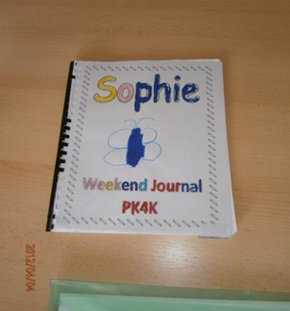
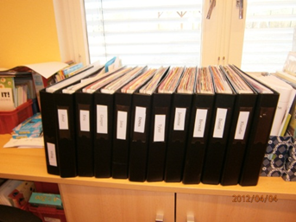
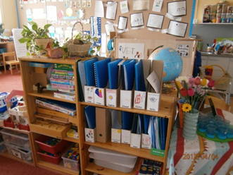
Basic questions
What do you understand by the term portfolio?
What are your experiences with portfolios?
Why should students create a portfolio?
Notes:
What do you understand by portfolio?
What are your experiences with portfolios?
Why should students create a portfolio?
2

Slide 3
A portfolio is a structured set of a student's work during a certain period, which provides information on the pupil’s school results, his/her learning and development.
1995 – it appeared for the first time in a pedagogical thesaurus: A collection of records about a person (his/her characteristics and performance), which is based on an evaluation he or she performs.
It is intended for: students, teachers and parents
Notes:
3

Slide 4
What is the purpose of it?
A pupil’s results
The learning process
A pupil’s progress
personality development in the cognitive, social, emotional, biological, spiritual areas as well as the self
Notes:
4

Slide 5
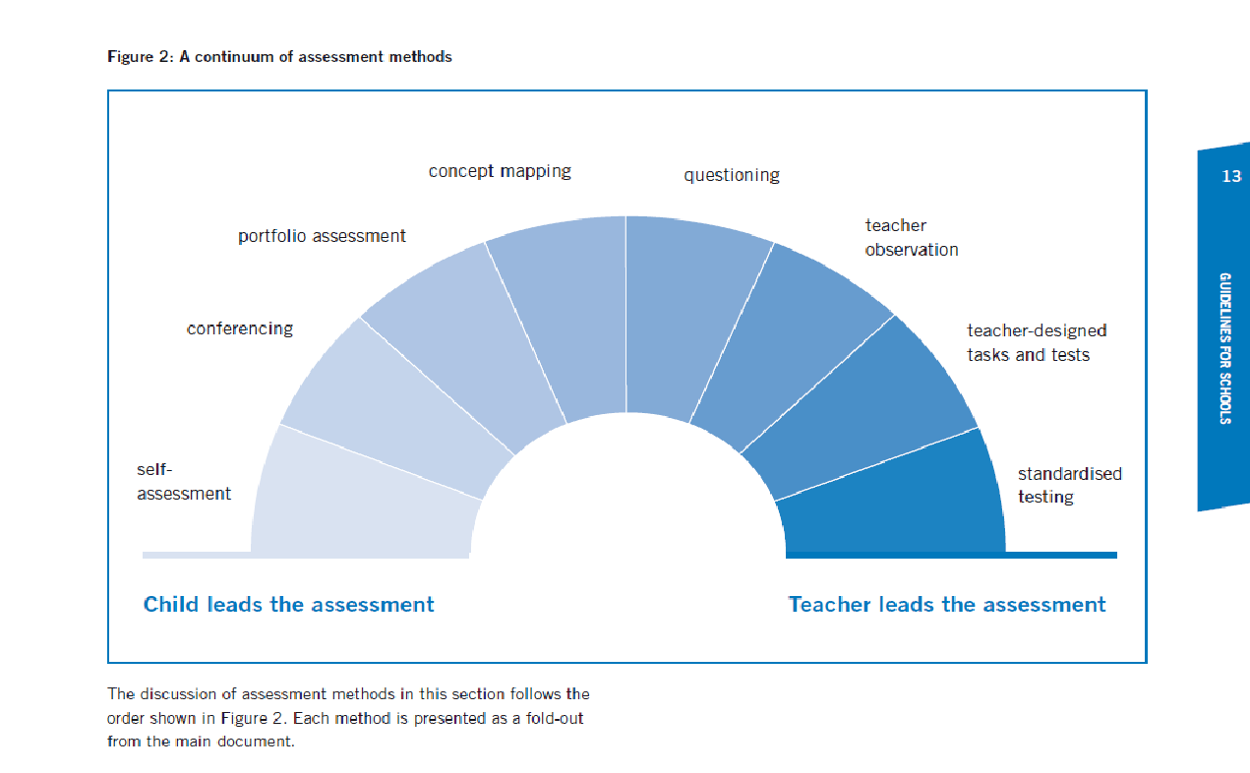
One of the tools of pedagogical diagnosis
Notes:
5

Slide 6
Functions Types
Collection (Documentational) – a collection of all a student’s work
Selection, representative the best work, a presentation of the child
Evaluative, diagnostic documents the child’s progress, teacher’s records of observations, regular comments from the teacher records the child's self-esteem, reports from parents ...
informative
motivational
communicative
Self-regulative
diagnostic
Jihlava 5.6.2012

Slide 7
Persons influencing the form of portfolio
The pupil: creation is entirely in the hands of the pupil,
The teacher
The pupil and teacher: They both work together on the form of the portfolio
The pupil, teacher and pupil: They all work together on the form of the portfolio

Slide 8
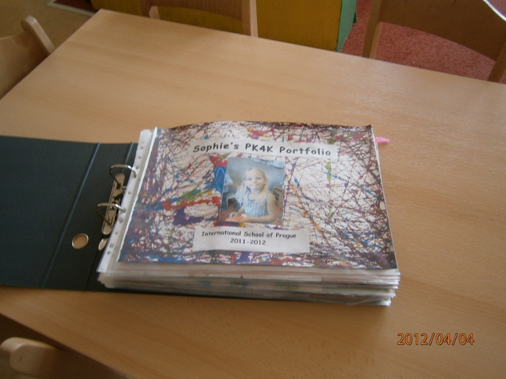
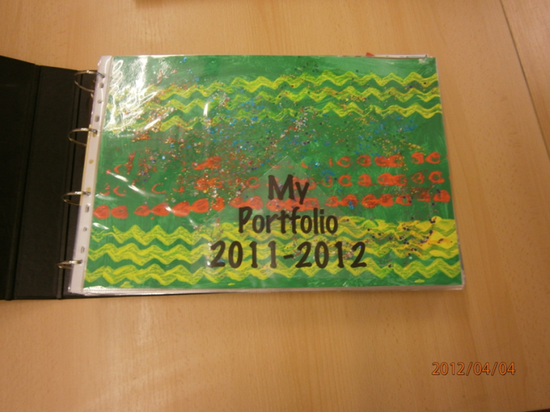
Front page
Method of storing records
Based on aims (skills) which are being observed
Based on themes, subjects
Chronologically
Repeating? Development (with dates)
Non-repeating?
Notes:
According objectives (competencies) that tracks
According themes, objects
After a time line
repeating? progress (dating)
non-recurring?
8

Slide 9
Basis for the structure of the portfolio
Knowledge of skills, aims and outcomes
Content of the portfolio
Expected outcomes | Parts of the portfolio
The pupil: Understands how language is used in everyday situations in the class Experiments with spoken language in groups, in the class, individually, acts out a role Communicates with the teacher, with classmates and with familiar adults Listens to stories read aloud and individually reads various types of texts, e.g. stories, picture books, poems, song lyrics and other texts Works with rhyme and rhythm, repeats them Develops their own reading habits Creates their own texts using their own experience, texts they have read and heard and visual perceptions Understands the structure of texts (including notes, lists and symbols) Uses written text in order to share information | The teacher’s non-official notes on the behaviour of the pupil in the class in various situations Audio/video recordings documenting how the pupil copes in situations requiring him/her to listen and answer Records about the pupil’s reading Audio/video recordings from discussions about reading Pupil’s written work Regular notes about the errors made by pupils, including photocopies of texts which serve to look at their reading strategies
Jihlava 5.6.2012

Slide 10
Possible content
Life story – who am I?
weekly plans, agreements, class rules
written assignments and tests
evaluative and self-assessment questionnaires (for individual and group evaluation)
School report
materials showing the process of learning (concepts, sketches, comments, etc..)
reflective journals describing the conditions and feelings in learning
extracurricular activities
evaluation of student performance by the teacher
teacher records from regular observation of the pupil
records of classmates from observation of and co-operation with the pupil
Parents’ records
homework

Slide 11
Working with a portfolio:
The pupil
Regularly planned reflection
When choosing which work to put into the portfolio and conversations
When self-evaluating,
  for experiencing and remembering life at primary school.
  2) Unintentional reflection at a particular time.
Working with a portfolio:
The teacher
Evaluation of results, progress, how the learning is going.
Time for a "private" conversation with the student, uncovering implicit phenomena.
Lesson planning
Individualisation and differentiation.
Notes:
11

Slide 12
Jihlava 5.6.2012
Working with a portfolio:
The parent
evaluation of the work of the child – verbally and in writing
shares in the selection of work to go into the portfolio
communication with the teacher on the child’s results
communication with the child about his/her results: unofficial, official – consultation days.
Its importance for parents
monitor the development of the child and his/her progress,
To understand the organization in primary schools,
To understand a teacher’s teaching style
It is an opportunity for communication between parents, teachers and pupils
Notes:
12

Slide 13
Benefits of introducing portfolios
Advantages :
Lays the foundation for self-evaluation and self-reflection
Supports the involvement of children in planning other activities
Allows for a comprehensive and long-term assessment of children’s results, and to follow their progress.
It combines formative and summative aspects of evaluation
It helps teachers, children and parents to get a picture of the child's self-efficacy
It increases the involvement of all participants in the educational process
Notes:
13

Slide 14
Disadvantages of introducing a portfolio
Disadvantages
It requires some time to create the intended content, selection of work, continuous and summarizing reflection
It consists mainly of worksheets, in which the pivotal domain of the cognitive development of the student is documented
Too wide or overly narrow range of material – core skills, objectives and outcomes not covered - unsystematic, underdeveloped system of evaluation
Parents are sometimes not interested.
Managing portfolios requires funding
Notes:
Portfolio management requires funding.
14

Slide 15
Sources:
Butler, S. M., Mcmunn, N. D. (2006) Understanding and Using Assesment to Improve Student Learning. San Francisco : WILEY.
Kratochvílová, J. (2011) Systém hodnocení a sebehodnocení žáků - Zkušenosti z České republiky i Evropských škol. Brno : MSD.
Slavík, J. (1999) Hodnocení v současné škole. Praha : Portál.
Rámcový vzdělávací program pro předškolní vzdělávání. 1. vydání. [online]. Praha: Výzkumný ústav pedagogický, 2006. 48 s. [cit. 2012-06-04]. ISBN 80-87000-00-5. Available at WWW: <http://www.vuppraha.cz/wp-content/uploads/2009/12/RVP_PV-2004.pdf>.
http://www.esf-kvalita1.cz/portfolio/oprojektu.php
http://www.eursc.eu/index.php?id=88
Photos: International School of Prague
Selection from the translation by Jana Strakova - Foster, M, Masters, G.: Assessment Resource Kit, Portfolios, ACER, 1996, published in Moderním vyučování listopad – únor 2005/06
Kritické listy 1, 2: Experiment with portfolios
Teachers’ newspaper 19/2006: Portfolio učí poznat sebe sama

