Slide 1
Online seminar

Slide 2
Soil analysis
Physical properties
pH
Nutrient content,…
Helps determine: nutrient availability
determine the values of the following fertilization
economic decision making
- sampling after harvesting or before fertilizing (in several places depending on the plot – slope, sampling depth,…)

Slide 3
- soil texture refers to the proportion of sand, loess and clay particles
- the soil triangle is used in soil texture analysis
- different textures affect the physical processes in the soil:
- eg: sandy soils drain quickly but have limited water holding capacity and low nutrient content
loess soils are more fertile than sandy soils and retain water better
clay soils hold water well, but drain poorly
loamy soils (also called agricultural soils) are generally preferred because they retain moisture, nutrients and humus well

Slide 4
Soil properties:
Specific gravity
Density
Porosity
pH
- see exercise no. 3 and no. 4

Slide 5
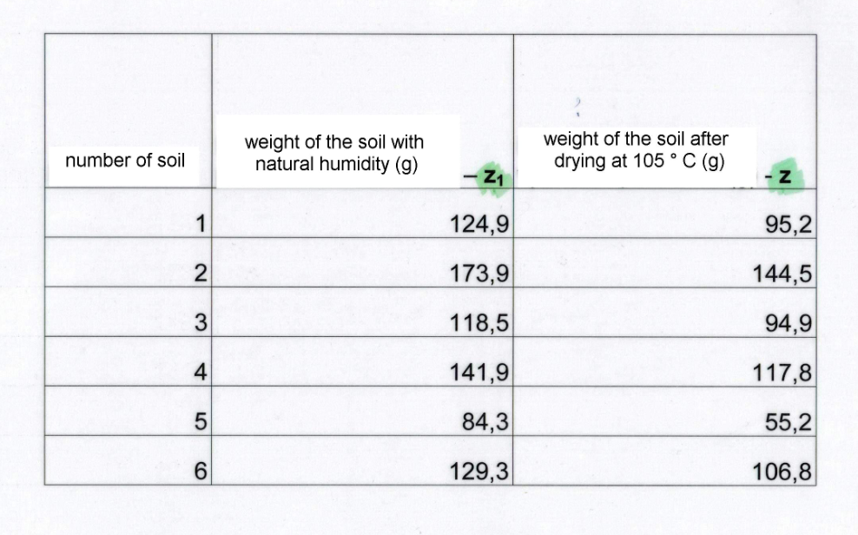
il no. | Specific gravity
1 | 2,5
2 | 2,7
3 | 2,4
4 | 2,5
5 | 2,2
6 | 2,5

Slide 6
Density
bulk density is an indicator of soil compaction
a high level of compaction is undesirable
compaction reduces pore size, inhibits root growth, water storage and oxygen availability
the necessity of prevention - possible adjustment of compaction by adding sand or mechanical crushing of topsoil

Slide 7
Evaluation of the experiment - influence of factors on the quality of MP
determination of N
HPLC analysis
calculation of values per unit of dry matter (tenth of a gram)
graphic output

Slide 8
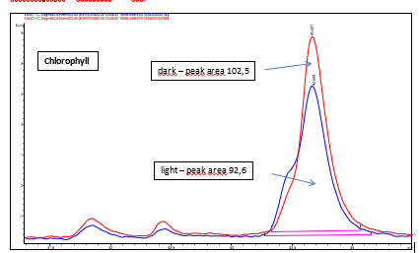
Plant species | Cultivation | weight of test tube + weight of fresh material | weight of test tube | weight of test tube + weight of dry material | weight of fresh material | weight of dry material
Iresine herbstii | light | 17,011 | 13,963 | 14,275 | 3,048 | 0,312
Iresine herbstii | dark | 15,867 | 13,967 | 14,15 | 1,9 | 0,183
Tradescantia pallida | light | 19,898 | 14,041 | 14,315 | 5,857 | 0,274
Tradescantia pallida | dark | 17,632 | 13,903 | 14,387 | 3,729 | 0,484
Browalia | Eriksson medium | 15,147 | 13,813 | 14,022 | 1,334 | 0,209
Browalia | Heller medium | 15,444 | 13,859 | 14,112 | 1,585 | 0,253
Browalia | water | 15,356 | 13,999 | 14,247 | 1,357 | 0,248
Plectranthus forsteri | soil no.1 | 17,161 | 13,975 | 14,124 | 3,186 | 0,149
Plectranthus forsteri | soil no.2 | 16,49 | 13,192 | 14,062 | 3,298 | 0,87
Plectranthus forsteri | soil no.3 | 17,116 | 13,837 | 14,007 | 3,279 | 0,17
Plectranthus forsteri | soil no.4 | 17,284 | 14,022 | 14,229 | 3,262 | 0,207
Plectranthus forsteri | soil no.5 | 17,59 | 13,973 | 14,123 | 3,617 | 0,15
Plectranthus forsteri | soil no.6 | 17,104 | 13,837 | 13,995 | 3,267 | 0,158
plant | cultivation | weight of fresh material | weight of dry material | % of Water content | anthocyanin | anthocyanin (0.1 g) | chlorophyll | chlorophyll (0.1 g)
Tradescantia pallida | Light | 5,857 | 0,274 | 95,3 | 44,7 | 16,31 | 92,60 | 33,80
Tradescantia pallida | Dark | 3,729 | 0,484 | 87 | 9,9 | 2,05 | 102,5 | 21,18
cultivation | Anthocyanine - peak areas – fresh material
light | 44.7
dark | 9.9

Slide 9
Odkazy:
https://www.sciencedirect.com/topics/earth-and-planetary-sciences/soil-porosity
https://www.youtube.com/watch?v=Rt1qD7Ldhng
https://www.youtube.com/watch?v=moexid5puSI
https://www.youtube.com/watch?v=zQowljL8e5E
https://www.youtube.com/watch?v=i0ymSP_e2-w
(12) Nitrogen Cycle | #aumsum #kids #science #education #children - YouTube
Cation Exchange (youtube.com)
Půdy – Procvičování online – Umíme fakta (umimefakta.cz)

