Slide 1
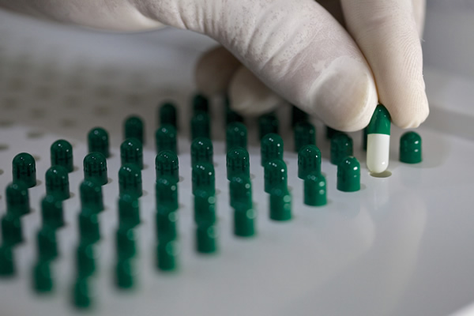
Orphan Medicines
Vasiliki Nicolaou

Slide 2


About EURORDIS
EURORDIS is a non-governmental patient-driven alliance of patient organisations representing 826 rare diseases patient organisations in 70 countries.
They are the voice of 30 million people affected by rare diseases throughout Europe.
EURORDIS represent in the various activities linked to the orphan drug development process.
What they do
EURORDIS' mission is to build a strong European community of patient organisations and people living with rare diseases, to be their voice at the European level. The role played by EURORDIS is financially independent from the pharmaceutical industry. All orphan drug activities are made possible through the work of EURORDIS volunteers and the financial support from its members.
International activities
Their vision is to unite, expand and reinforce the rare disease movement of patient organisations and patient advocates around the world.

Slide 3

What is Orphanet ?
Orphanet is a unique resource, gathering and improving knowledge on rare diseases so as to improve the diagnosis, care and treatment of patients with rare diseases.
Orphanet aims to provide high-quality information on rare diseases, and ensure equal access to knowledge for all stakeholders.
Orphanet was established in France by the INSERM (French National Institute for Health and Medical Research) in 1997.This initiative became a European endeavour from 2000, supported by grants from the European Commission: Orphanet has gradually grown to a Consortium of 40 countries, within Europe and across the globe.

Slide 4
REGULATION (EC) NO 141/2000 OF THE EUROPEAN PARLIAMENT AND OF THE COUNCIL
On 16 December 1999, the European Parliament adopted Regulation (EC) No 141/2000 (the Orphan Regulation).
This Regulation:
The main objective of this Regulation is to create a Community for medicinal products as orphan medicinal products and to provide motivation for the research, development and placing them on the market as orphan medicinal products.
Establishes the Committee for Orphan Medicinal Products (COMP).
Sponsors of orphan medicinal products designated under this Regulation should be entitled to the full benefit of any incentives granted by the Community or by the Member States to support the research and development of medicinal products for the diagnosis, prevention or treatment of such conditions, including rare diseases
The Agency (European Agency) sends the COMP(Committee for Orphan Medicinal Products ) opinion to the European Commission, which is responsible for granting the orphan designation.

Slide 5
Why it was created?
About 30 million people living in the European Union (EU) suffer from a rare disease.
Patients suffering from rare conditions should be entitled to the same quality of treatment as other patients and deserve the same quality, safety and efficacy in medicinal products. Its necessary to stimulate the research, development and bringing to the market by the pharmaceutical industry.
Rare diseases have a priority for the Community action in the field of public health.

Slide 6
Medicinal Product designated as orphan
Orphan drug status :
For diagnosis, prevention or treatment of a life-threatening or chronically condition affecting small number of people in the European Community (EC).

Slide 7
Marketing Authorization
Authorisation to place the medicinal product on the market be granted by the Community .
The marketing authorisation shall cover only those therapeutic indications which fulfil the criteria set of orphan medicinal products and cover the conditions which are rare and to give the opportunity in patients with such conditions to feel safe and to have the same quality of life as other patients.

Slide 8
Market exclusivity
The holder of the marketing authorisation for the original
orphan medicinal product :
has given his consent to the second applicant.
is unable to supply sufficient quantities of the medicinal product.
the second applicant can prove in the application that the second medicinal product, similar also to the orphan medicinal product already authorised, is safer and more effective.

Slide 9
References
https://www.eurordis.org/orphan-drug-designations-marketing-authorisations
https://www.orpha.net/consor/cgi-bin/OC_Exp.php?lng=EN&Expert=25017
https://www.eurordis.org/sites/default/files/publications/Fact_sheet_OD-Eurordis.pdf
https://www.orpha.net/consor/cgi-bin/index.php
https://rarediseases.info.nih.gov/diseases/fda-orphan-drugs
https://www.fda.gov/drugs/resourcesforyou/consumers/ucm143563.htm

