Slide 1
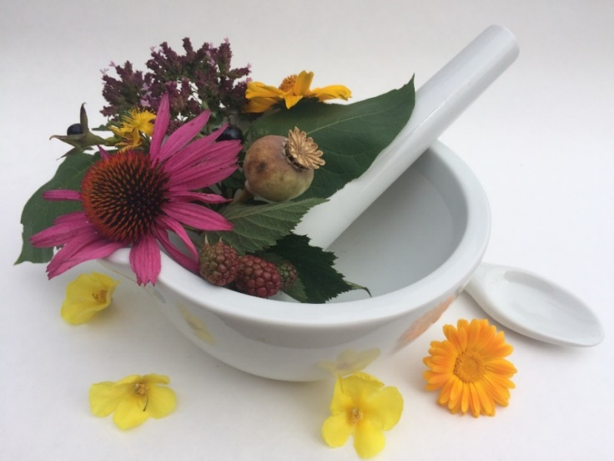
Pharmacognosy lab exercise 2
Amorphous drugs
Natural fibers
Natural antidiabetics

Slide 2
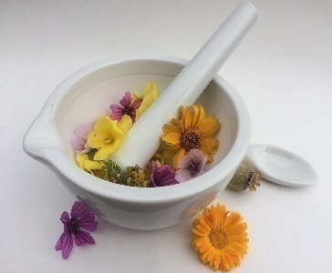
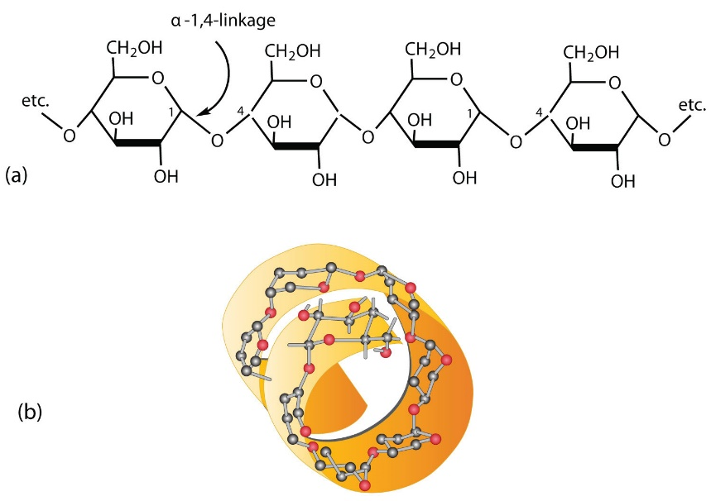
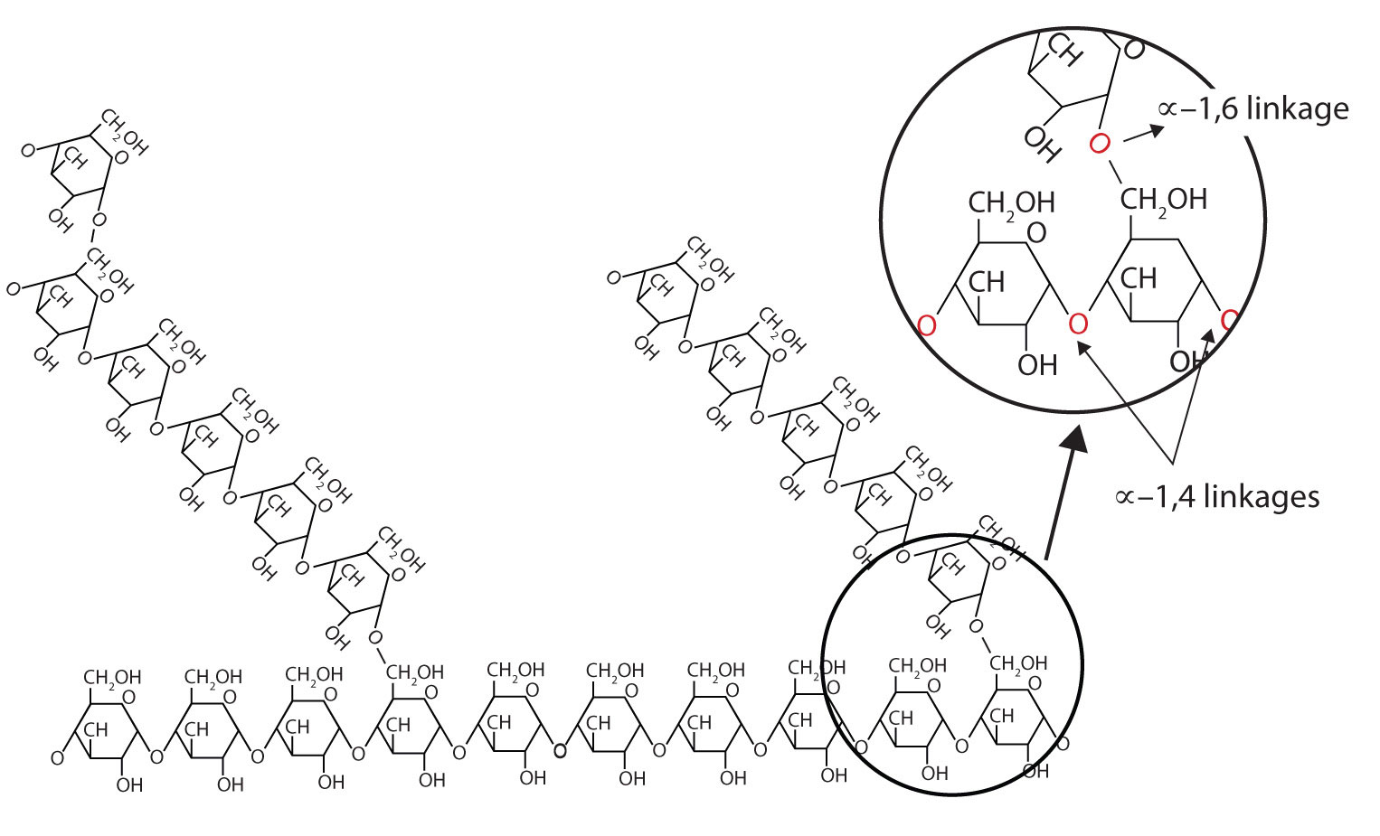
Starches - Amyla
Macromolecules composed from glucose units, consist of water-soluble amylose and water-swelling amylopectine
Obtained from crushed plant material by washing with water and consequent chemical adjustment
https://chem.libretexts.org/Courses/Remixer_University/Username%3A_Kasey.J.Clear.3@nd.edu/Organic_Chemistry/2%3A_Organic_Chemistry_(Smith)/05%3A_Stereochemistry/5.01%3A_Starch_and_Cellulose
Notes:
Polysaccharides.
Starches contain also small amounts of lipids and proteins, 10-20% water.
Amylose – linear chains of alpha (1-4) glycosidically bonded glc units. Has a structure of a helix (1 helix=6 glc). Amylose content in starch varies between 15-25%. Amylose in water changes to a colloid solution. Amylose reacts with Lugol reagent, it bonds iodine which creates blue color.
Amylopectin - alpha (1-4) bonds, but for every 20-25 units there is also alpha (1-6) bonding, thus it creates a widely branching molecule. Amylopectin is not soluble in cold water, it only swells.However, in higher temp. It creates a colloid solution.

Slide 3
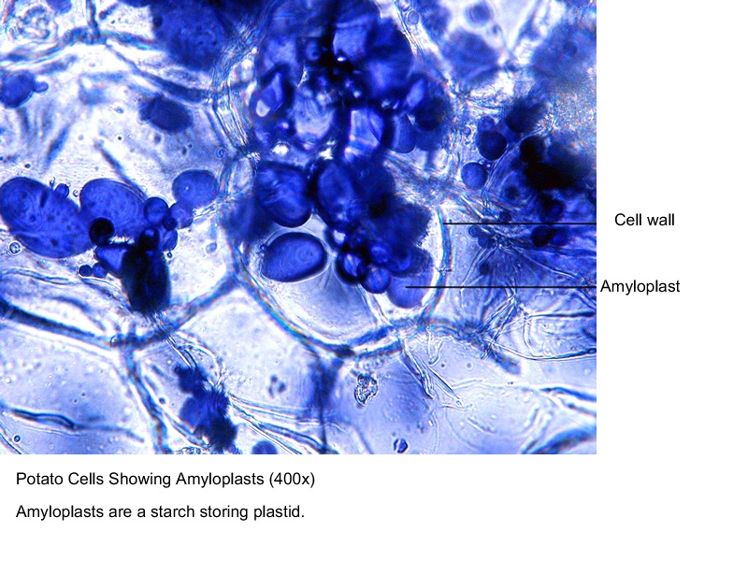
Starches - Amyla
Used as additive compounds to manufacture powders, tablets, suppositories and unguents; dietetics;
Pharmacopoeial starches:
Solani amylum,
Oryzae amylum,
Tritici amylum,
Maydis amylum
Important starches: Marantae amylum
Notes:
Starches are also chemically modified to gain better qualities such as endurance against temperatures. These chemical modifications include partial hydrolysation, esterification and crosslinking. Partial hydrolysis of starches leads to dextrines, which should not be interchanged with dextran.

Slide 4
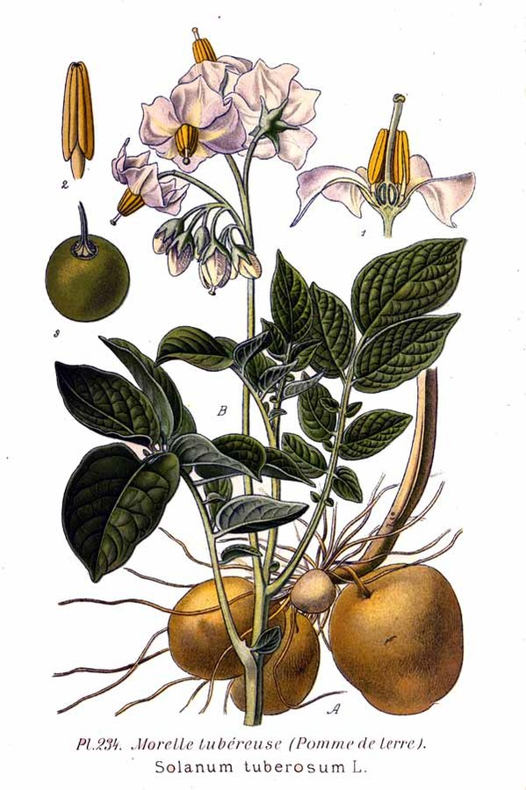
Solani amylum CzPh 2017
Mother plant: Solanum tuberosum
Solanaceae (potato)
Macroscopy: very smooth white powder, squeaking when pressed, without taste and smell
Usage: additive substance for dosage forms, food industry, chemistry, dietetics
Notes:
Solani amylum is gained from the pulverized tubers by repeated washing with water.
Also used for glucose preparation, productionof dextrines and glues.

Slide 5
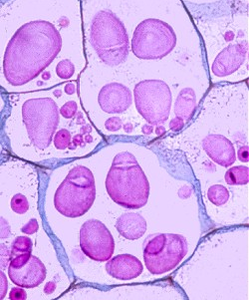
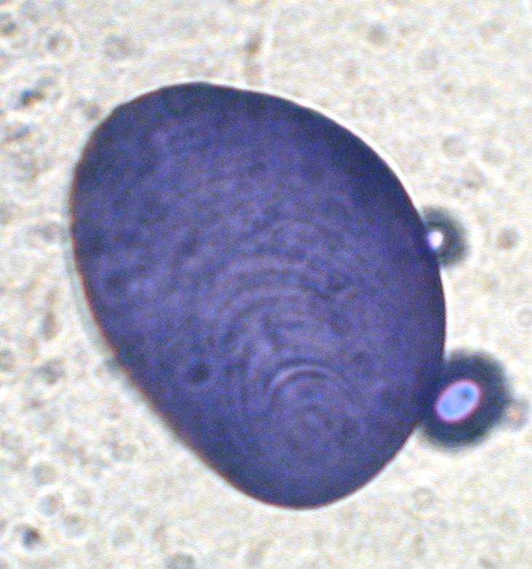
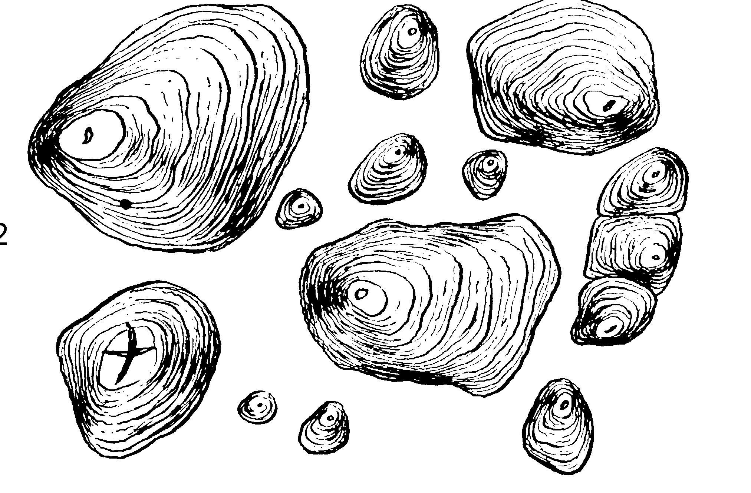
Solani amylum CzPh 2017
Microscopy: big grains egg or pear shaped with eccentric hilum, eccentric embedded, size 30-100 mm

Slide 6
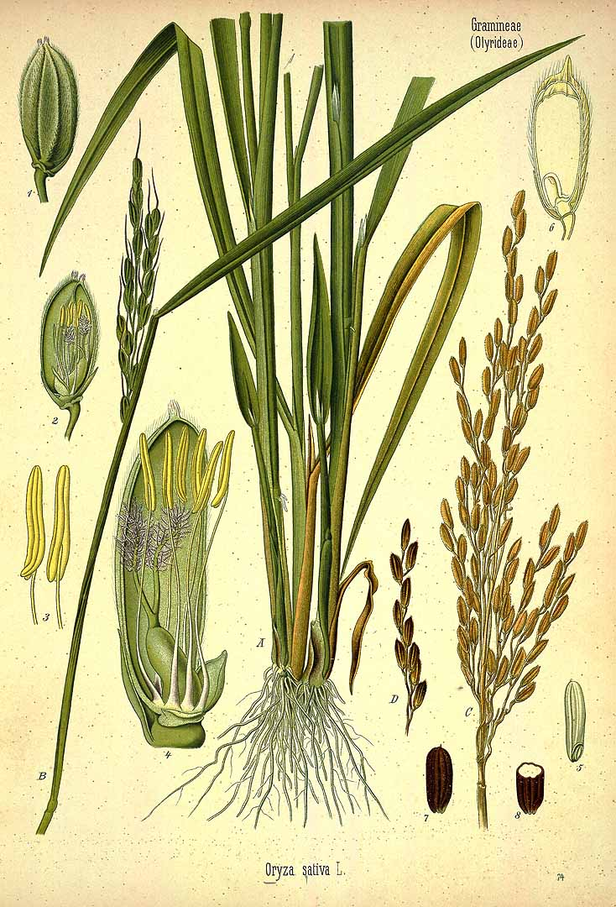
Oryzae amylum CzPh 2017
Mother plant: Oryza sativa,
Poaceae (rice)
Macroscopy: very smooth white powder, squeaking when pressed
without taste and smell
Usage: adjuvant in pharmacy, talcum powders
Notes:
IS located in the endosperm of grains. Starch is isolatd from waste that is generated in the process of sorting and polishing of the grains. First the waste is let to swell and is alkalized to disrupt the protein layer surrounding the starch grains. Isolation is then done by washing with water

Slide 7
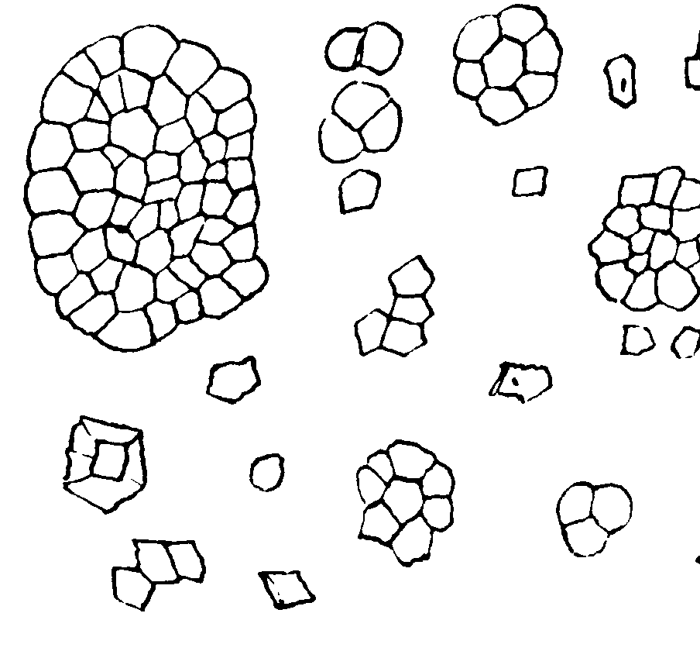
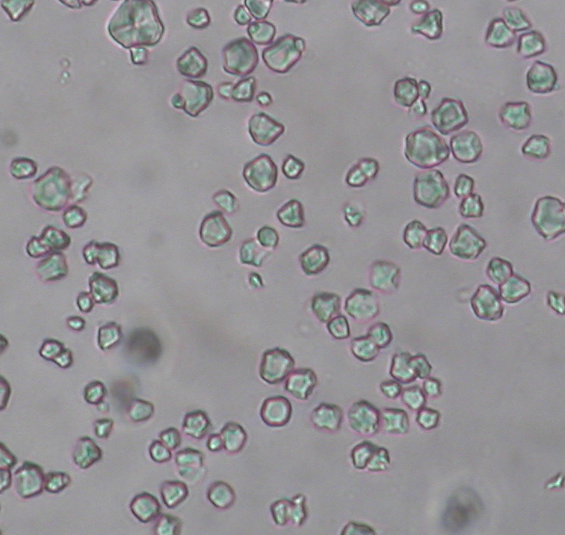
Oryzae amylum CzPh 2017
Microscopy: multi-angular grains without concentric stratification, with vague central disruption, diameter 2-5 mm, usually aggregated into egg-shaped formations

Slide 8
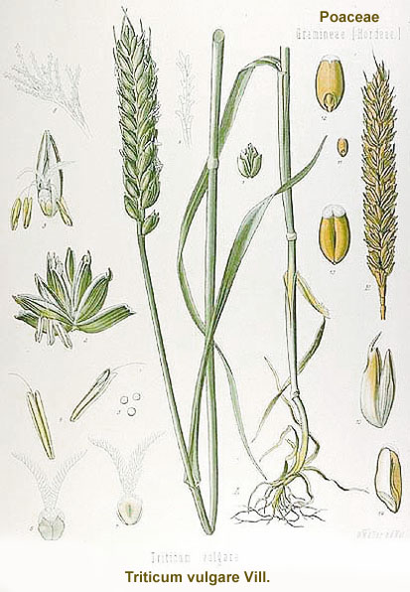
Tritici amylum CzPh 2017
Mother plant: Triticum aestivum
Poaceae (wheat)
Macroscopy: very soft smooth white powder, squeaking between fingers, without taste and odour
Usage: adjuvants in pharmacy
Notes:
A dough is prepared from wheat flour, and from this dough starch is washed by water.

Slide 9
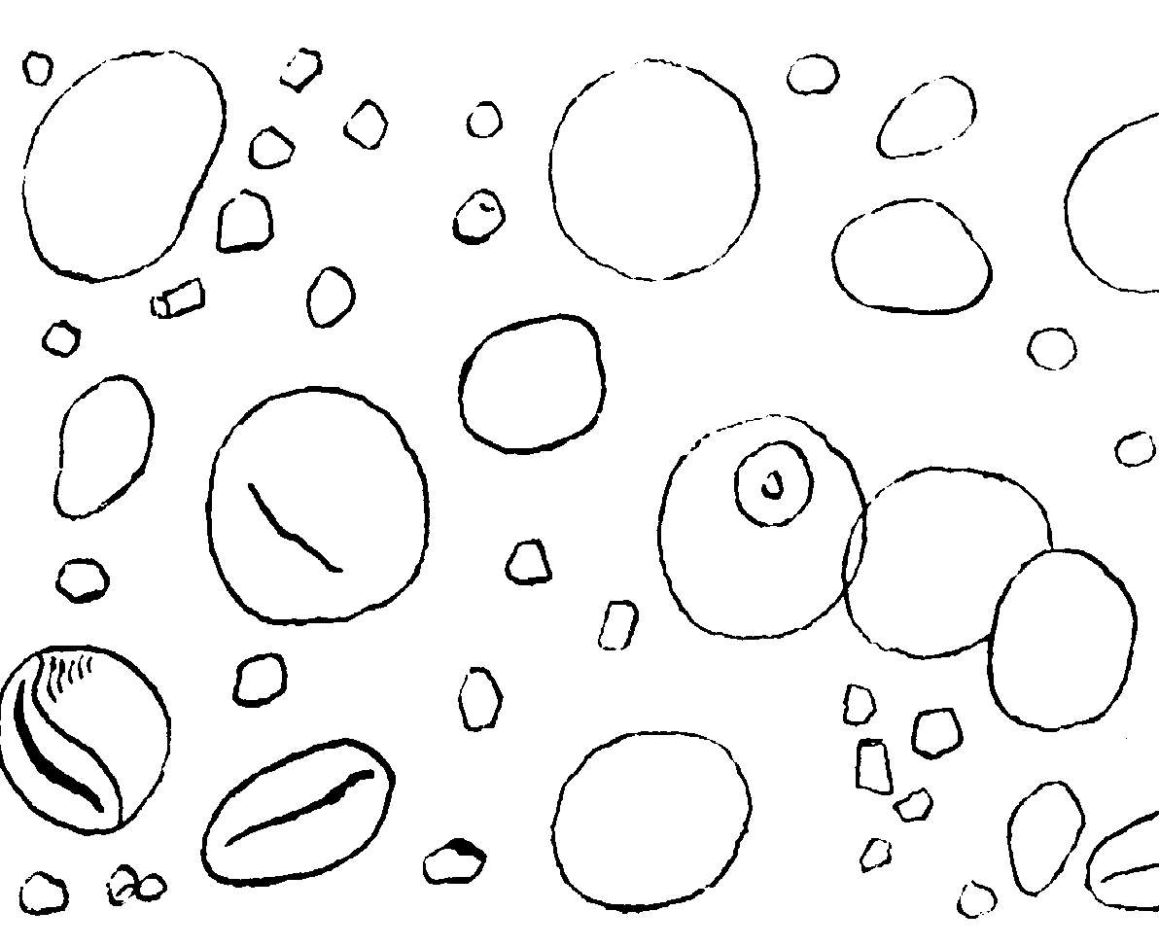
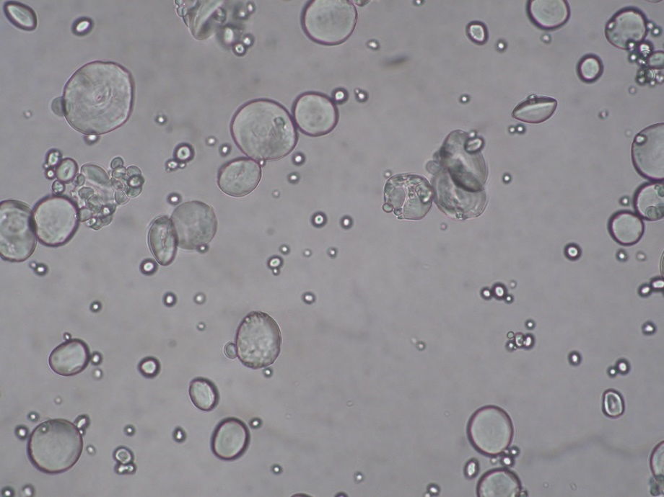
Tritici amylum CzPh 2017
Microscopy: big grains of lentiform shape, without stratification, size 10-45 mm; or small round grains, size 2-10 mm

Slide 10

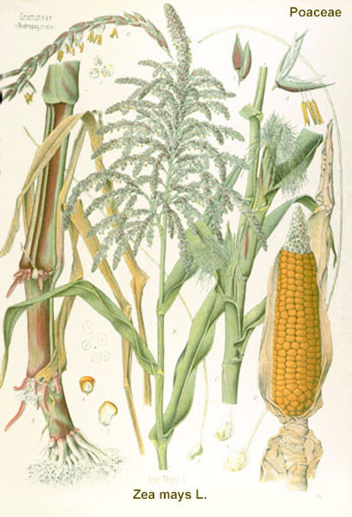
Maydis amylum CzPh 2017
Mother plant: Zea mays
Poaceae (corn)
Macroscopy: very smooth white to yellowish powder, squeaking when pressed, without taste and smell
Usage: adjuvant in pharmacy
Notes:
Starch is located in the endosperm of grains.

Slide 11
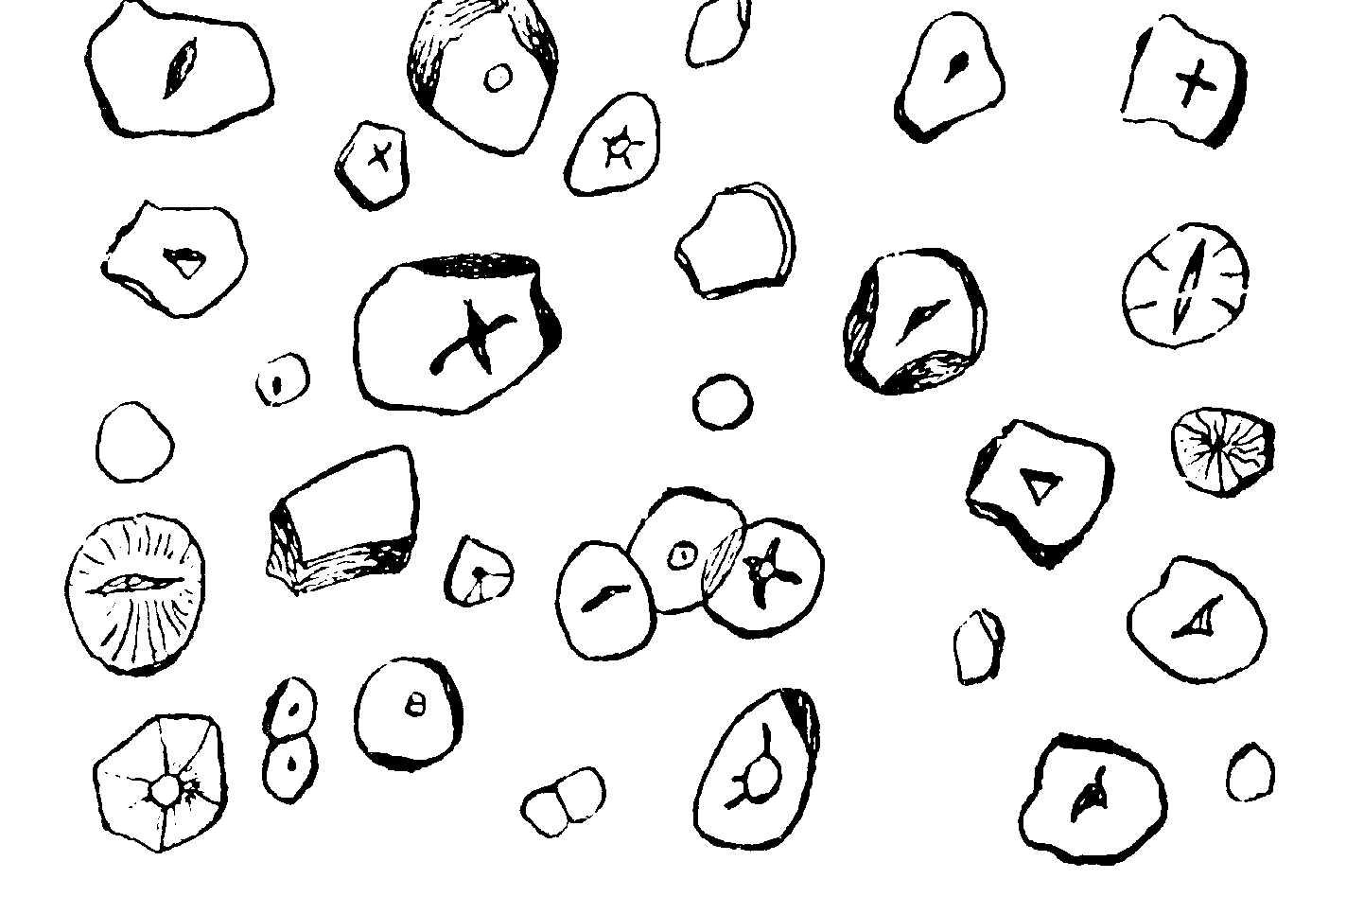
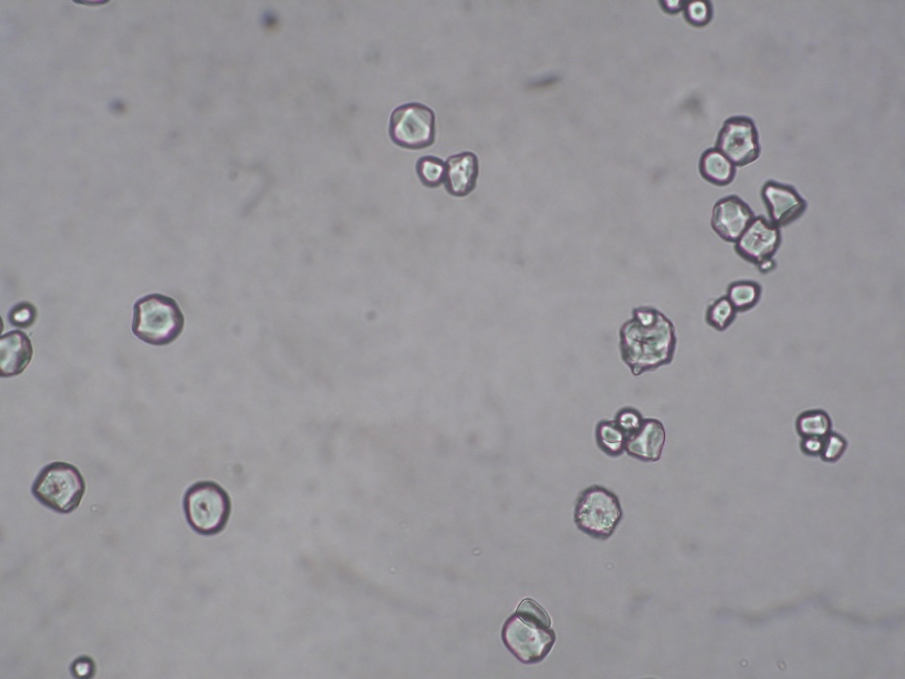
Maydis amylum CzPh 2017
Microscopy: multi-angular cornered grains with diameter 2-23 mm, or rounded grains with size 25-32 mm, with distinct central two to five star shaped disruptions

Slide 12
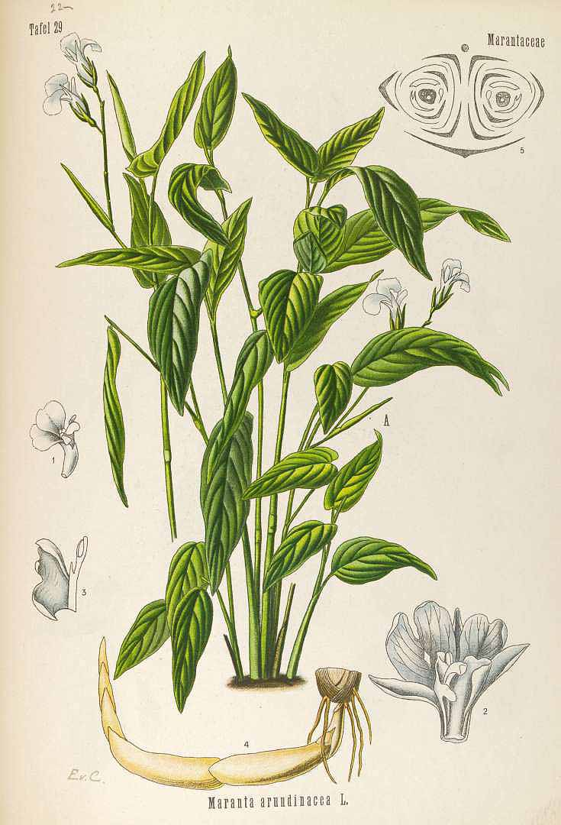
Marantae amylum
Mother plant: Maranta arundinacea
Marantaceae (arrowroot)
Macroscopy: very smooth soft white powder, squeaking when pressed, without taste and smell
Usage: starch, dietetics

Slide 13
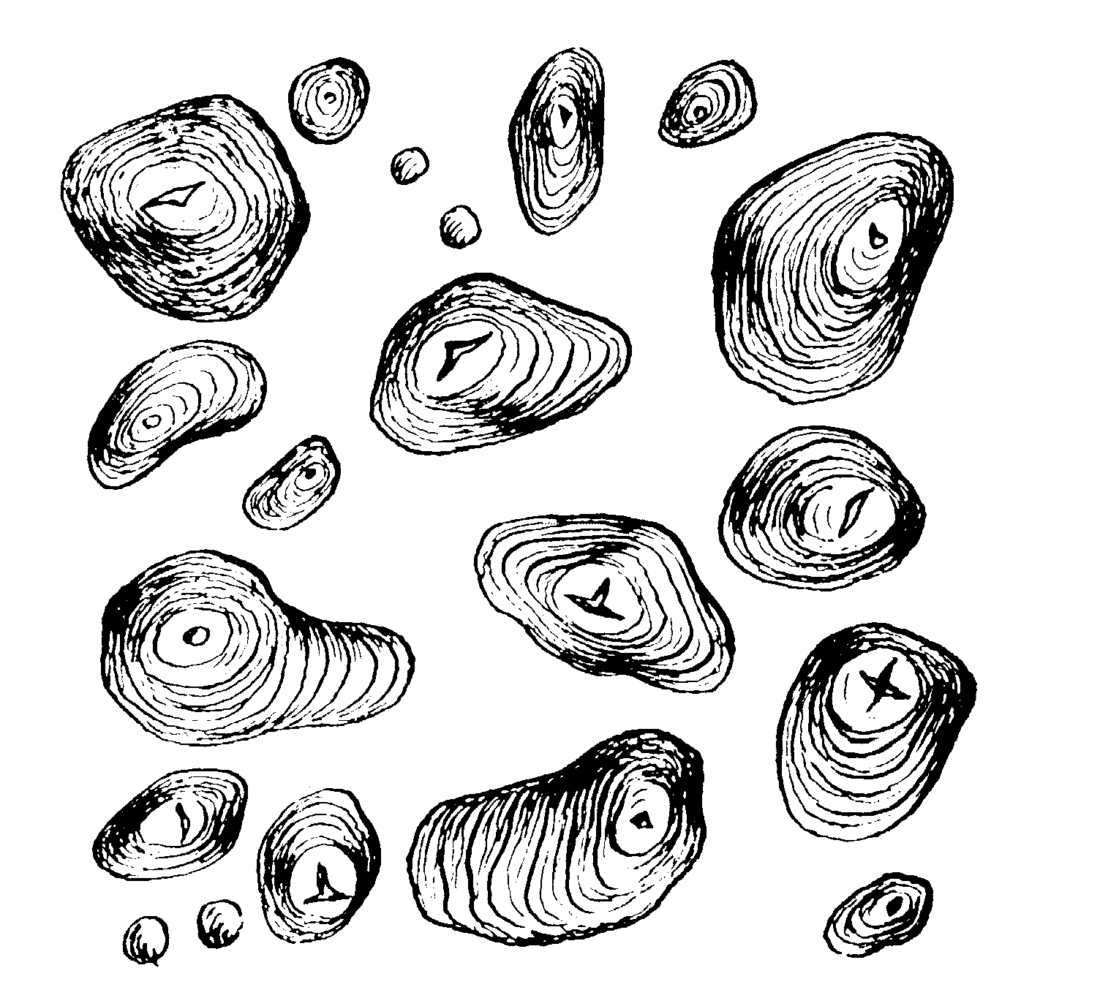
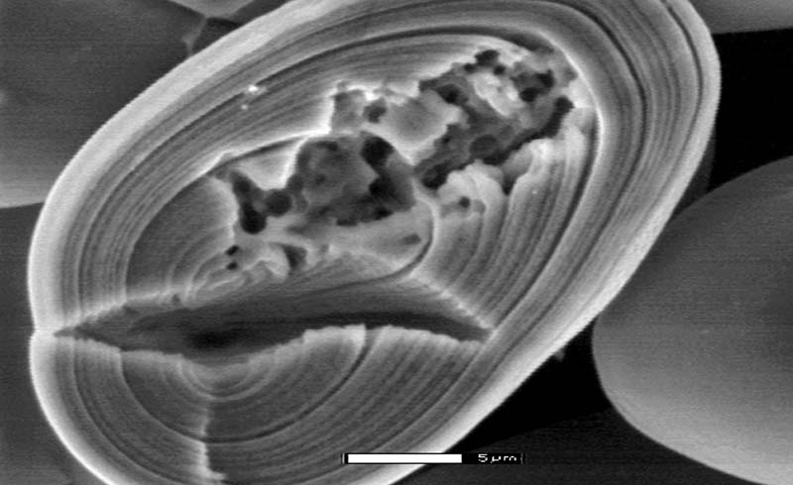
Marantae amylum
Microscopy: starch grains egg-shaped, ellipsoid, pear-shaped, or spindle-like with a central disruptions with a shape of flying bird , concentric or eccentric, size 10 - 60 μm

Slide 14
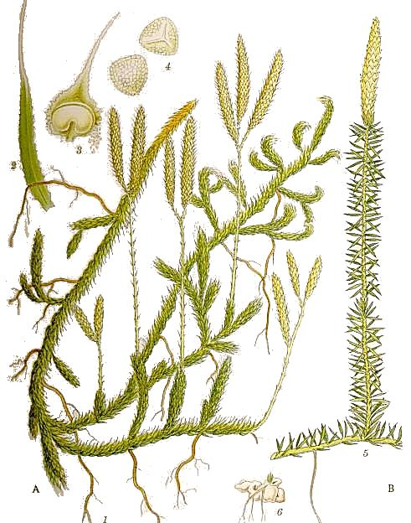

Lycopodium
Mother plant: Lycopodium clavatum
Lycopodiaceae
(common club moss)
Macroscopy: smooth soft yellow powder floating on the water, adhesive, without taste and smell
Usage: component of wound powders,
adjuvant for pills manufacturing,
special effects, fireworks

Slide 15
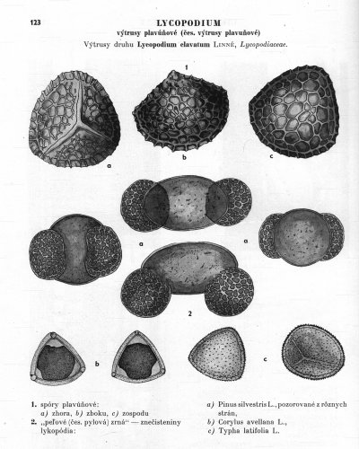
Lycopodium
Constituents: fatty oils, resin, malic acid, citric acid
Microscopy: quadrilateral spores – three flat sides, one strongly concave, with a reticular surface structure and dentated margins, size 30 mm
Notes:
Fatty oils comprise acylglycerols from oleic and linolic acid. Terpene sporopolenin on the surface.

Slide 16
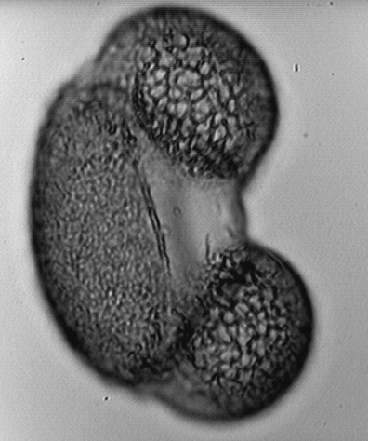
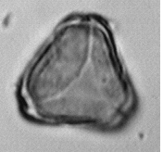
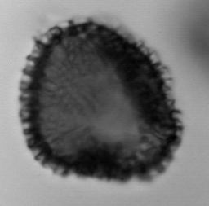
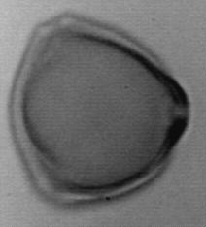
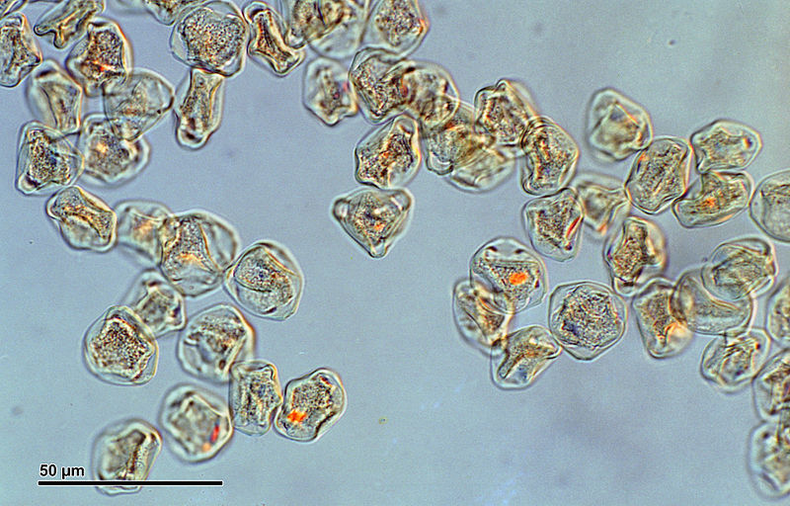
Lycopodium
Attention do not confuse with pollen

Slide 17
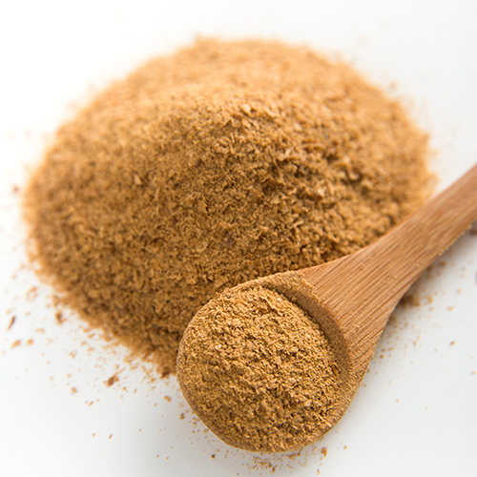
Faex medicinalis
Washed, devoid of bitter substances beer yeast Saccharomyces cerevisiae
Saccharomycetaceae
Macroscopy: bright yellow powder of characteristic taste and odour
Content compounds: polysaccharides, fats, proteins, NK, vitamins
Usage: source of vitamin B, dietetic, tonic, roborant, dried yeast as filling agent for pills
Notes:
By heating the yeast at 120 C for two hours we gain dried yeast – Faex siccata.
Polysaccharides 6-17%, cell wall is composed of glycanes (1-3 and 1-6 bonds). Cell wall lacks cellulose, lignin and pectins.
Cells contains yeast glycogen, mananes, proteins, fats, nucleic acids, enzymes and vitamins – mainly vitamin B group.
Vit. B – to treat acne, eczema, neuritis

Slide 18
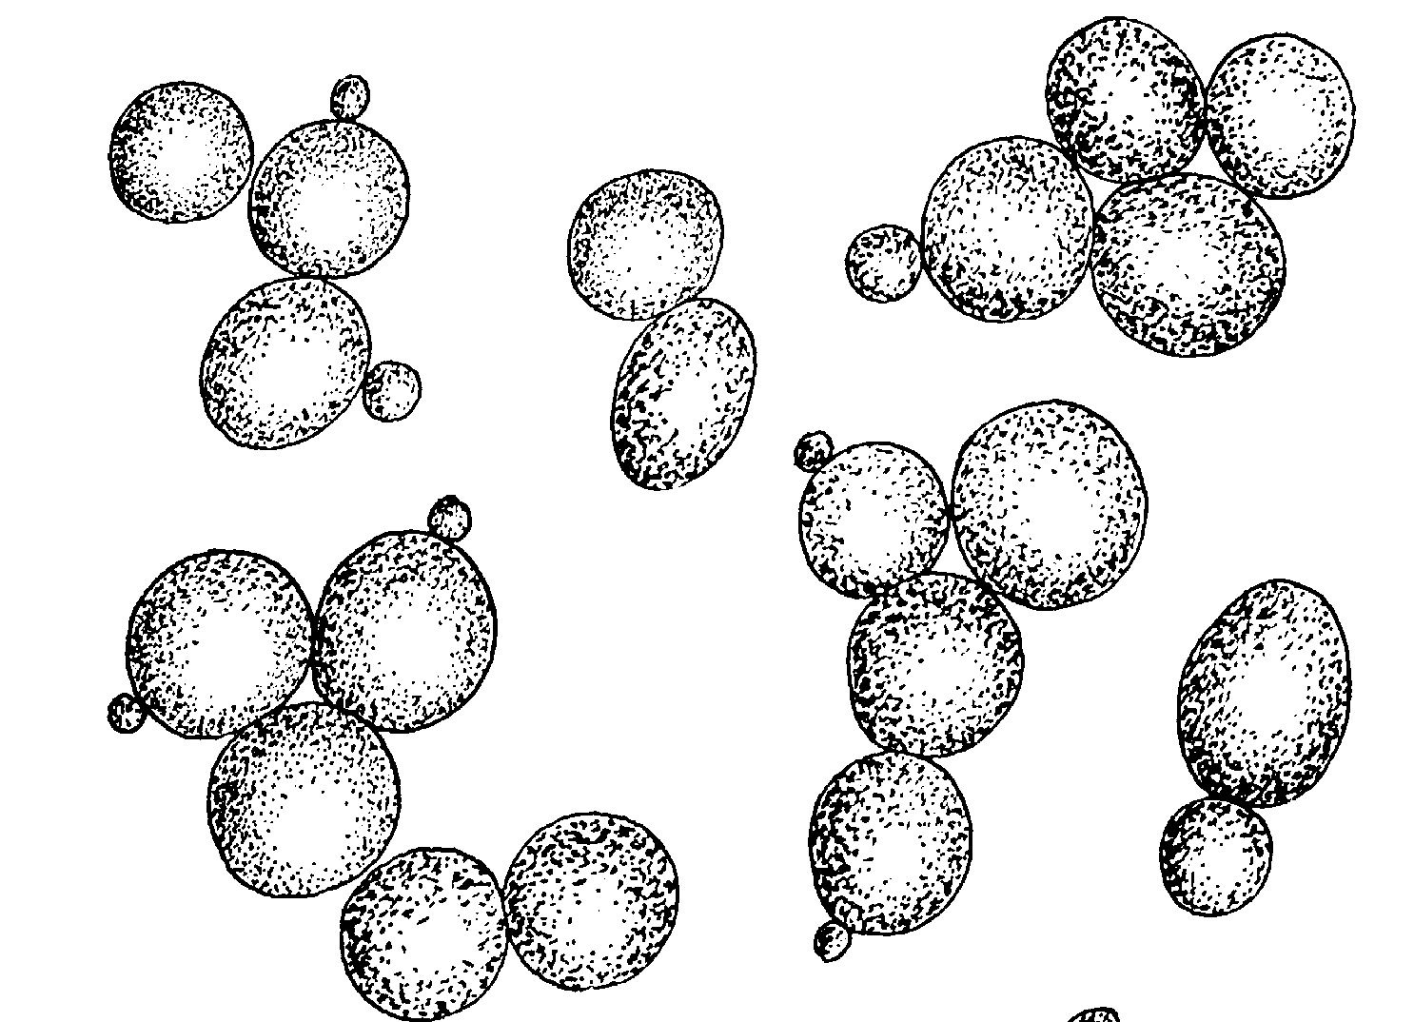
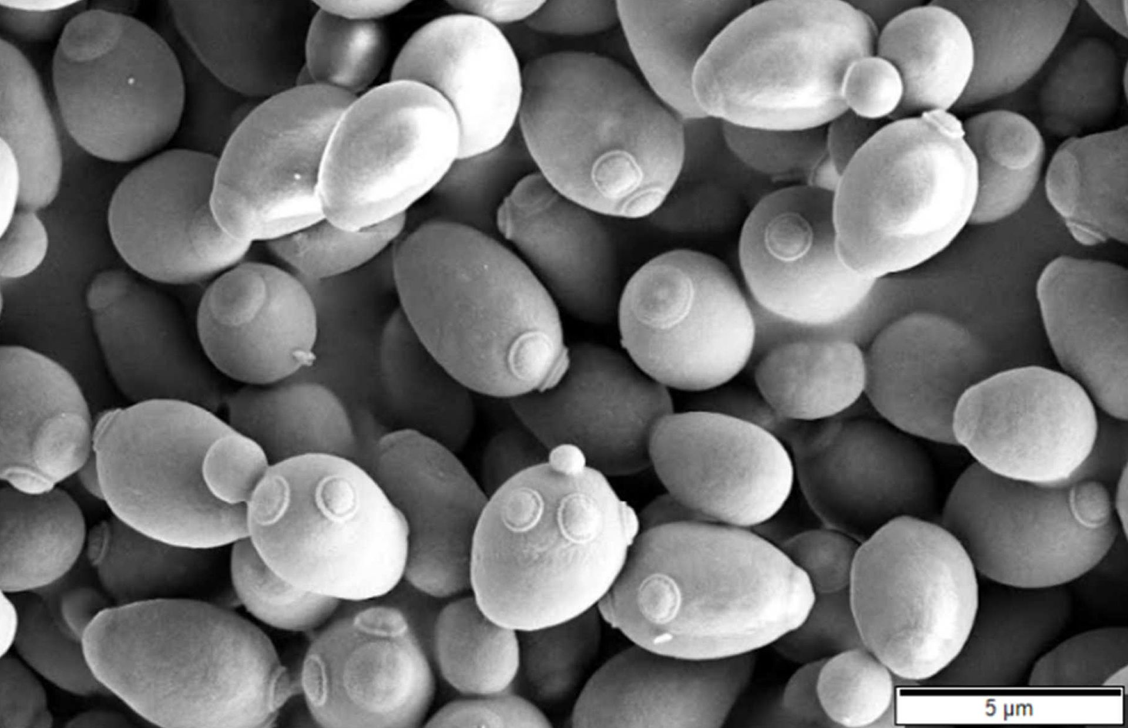
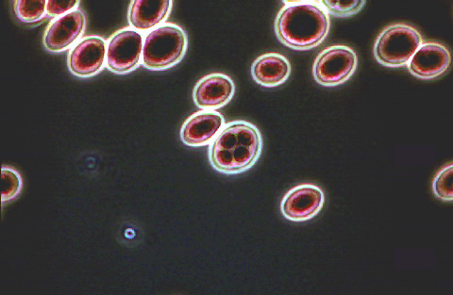
Faex medicinalis
Microscopy: round to oval cells with diameter 8-10 mm, sometimes it is possible to see cell division, cytoplasm is granulated
https://www.intechopen.com/books/modern-electron-microscopy-in-physical-and-life-sciences/sample-preparations-for-scanning-electron-microscopy-life-sciences

Slide 19
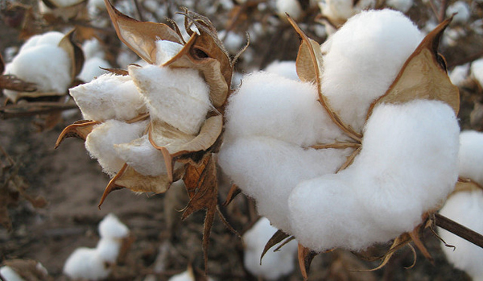
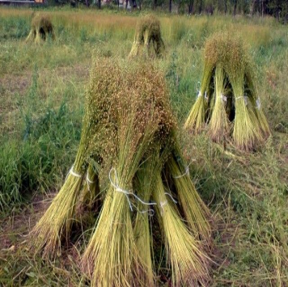
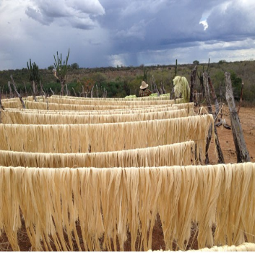
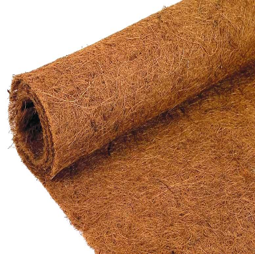
Natural fibers
Fibers from seed (cotton wool)
Fibers from stem (tow - flix, hemp, jute)
Fibers from leaves (sisal)
Fibers from fruits (cocos)

Slide 20
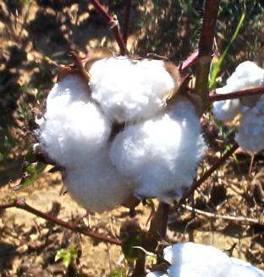
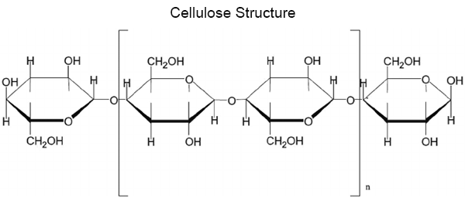
Lana gosypii depurata CzPh 2017
Mother plant: Gossypium spp.
Malvaceae
(cotton plant)
Macroscopy: purified (pinned), defatted and bleached fibrous trichomes from seed
Content compounds: pure cellulose
Usage: high suction ability – dressing material
http://botanystudies.com/the-cell-wall-and-its-structure/cellulose-structure/
Notes:
Conyains also small amount of water, fats and waxes. Length of fibers 5-25 mm.

Slide 21
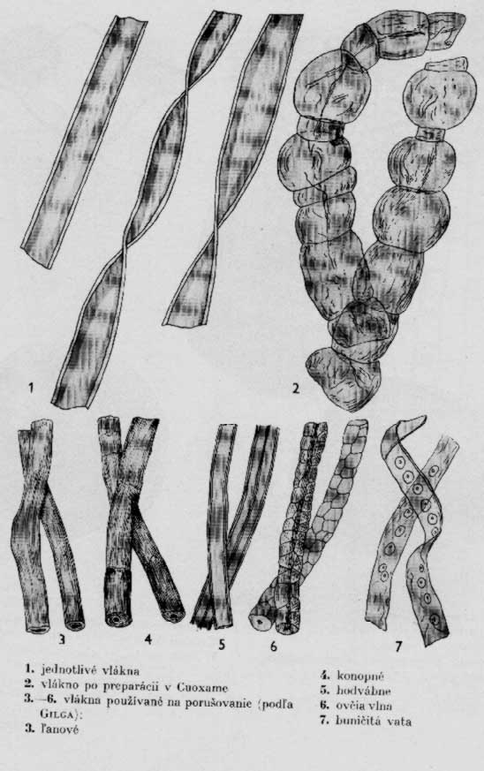
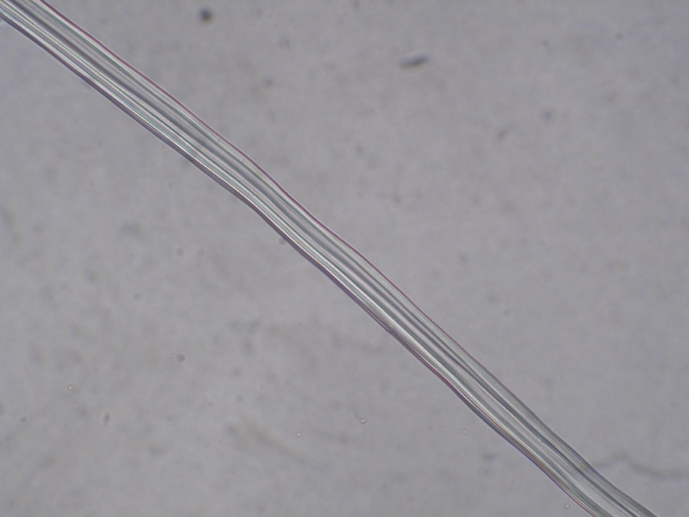
Lana gosypii depurata CzPh 2017
Microscopy: unicellular trichomes covered with cuticula

Slide 22
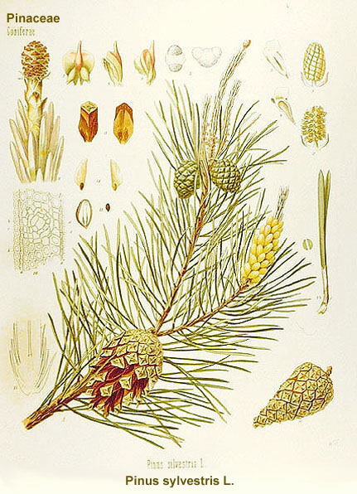
Cellulosum ligni CzPh 2017
Mother plant: coniferous species e.g. Pinus
Pinaceae (pine)
Macroscopy: very short fibers obtained from wood-pulp
Content compounds: cellulose
Usage: dressing material
Notes:
Cellulose fibers are very short. Can contain up to 20% cellulose from deciduous trees.

Slide 23
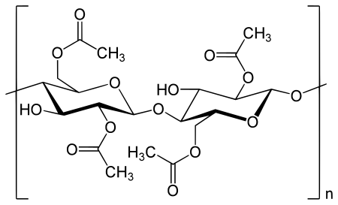
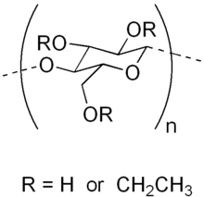
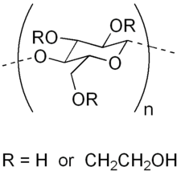
Examples of cellulose in CzPh 2009
  Cellulosi pulvis
  Cellulosum microcrystallinum
  Cellulosi acetas
  Ethylcellulosum
  Hydroxyethylcellulosum
Cellulose acetate
Ethyl cellulose
Hydroxyethyl cellulose
Notes:
Microcrystalline cellulose is partially depolymerized cellulose, used as a bulking agent and emulsifier.
Ethylcellulose – OH groups modified to ethyleter. Used as thin-film coating material, emulsifier.

Slide 24
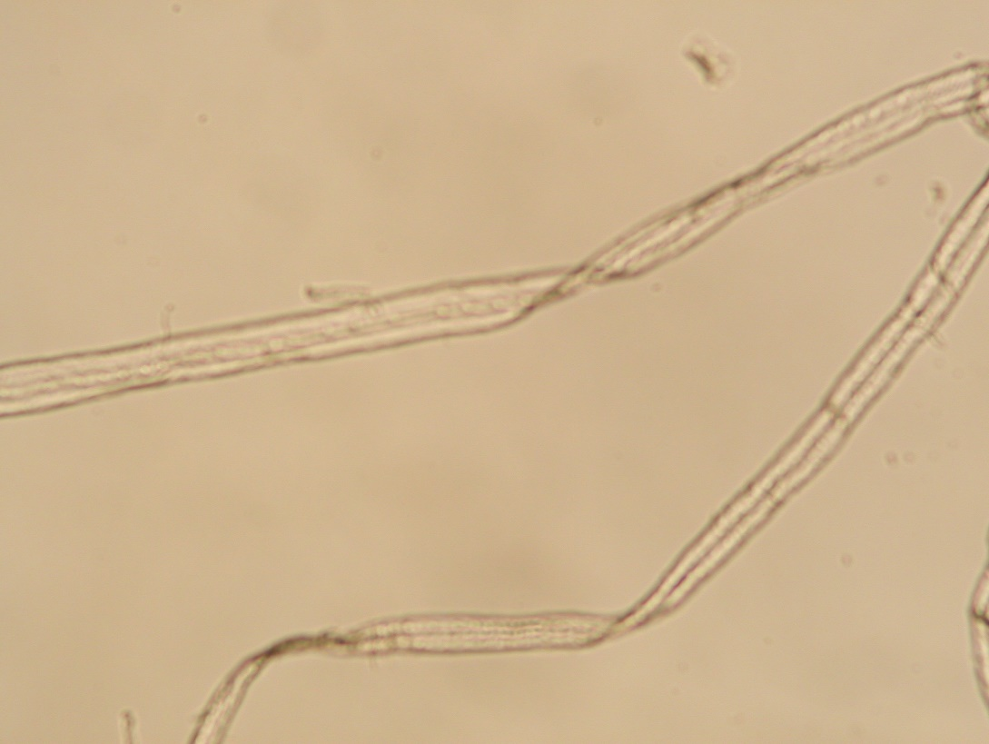
Cellulosum ligni CzPh 2017
Microscopy: short fibers of cellulose with fascicular formations

Slide 25
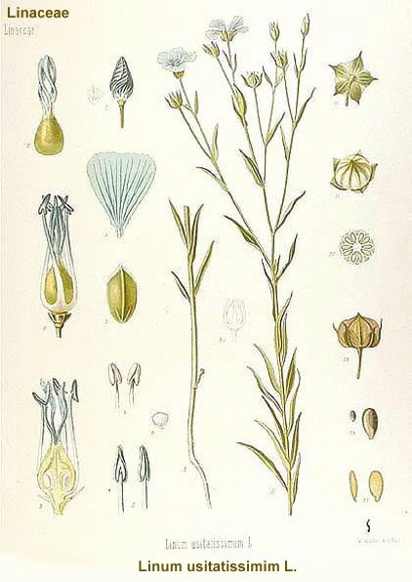
Other natural fibers
Flax fibers Linum ussitatissimum
Linaceae (flax, linseed)
obtained from seed-removed, grassed or steeped stems of flax
Sclerenchyma fibres from wedge-shaped cells
markedly solid, heat-stable, weak acid resistant, rottenness resistant
CzPh 2017 Fila non resorbilia sterilia
Notes:
Stitching material

Slide 26
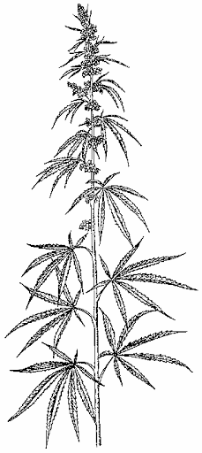
Other natural fibers
Hemp fibers Cannabis sativa
Cannabaceae
Sclerogenic stem fiber spindle-shaped, at the end sharpened
Usage: manufacturing of durable textiles (working cloths)

Slide 27
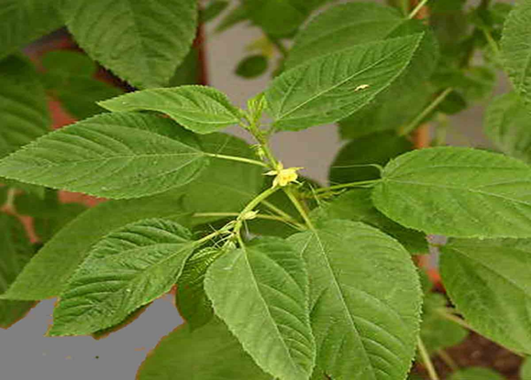
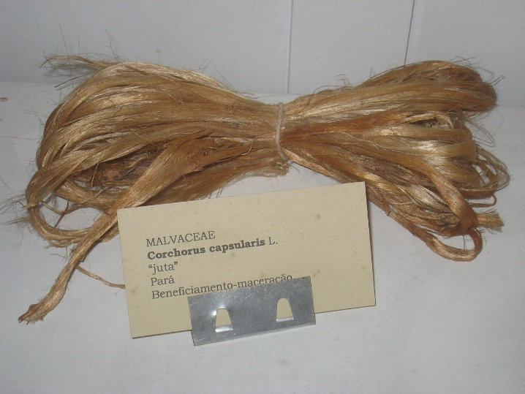
Other natural fibers
Jute fibre Corchorus capsularis
Malvaceae
very solid phloemic fibers
Usage: manufacturing of jute bags, sails, or carpets of durable textiles (working clothes)

Slide 28
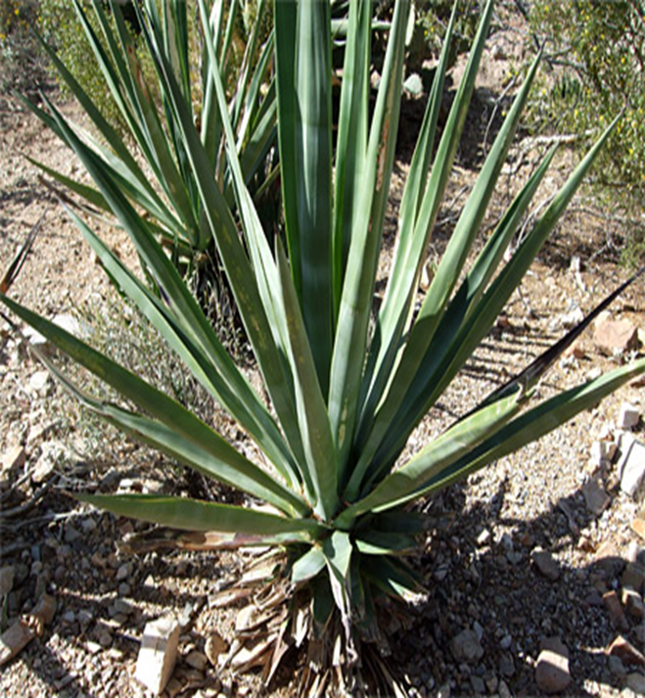
Other natural fibers
Sisal Agave sisalana
Asparagaceae
Sclerenchyma stem fiber spindle-shaped, at the end sharpened
Usage: ropes, twines, cat scratching posts
Fun fact: can be distilled to make a tequilla-like liquor

Slide 29

Other natural fibers
Coconut fibers, Coir
Cocos nucifera (coconut tree)
Arecaceae
cavernous, very light fibers, resistant to sea water
Usage: floormats, ropes, fishing nets

Slide 30


Agar CzPh 2017
Source: Dried mucilage obtained from red algae Gelidium spp., Gelidiaceae (class Rhodophycaeae)
Macroscopy: transparent cca 30 cm long strips, or flakes or white powder, without odour, slimy taxture
Content compounds: agarose, agaropectin
Usage: mild laxative, dietetics, adjuvant
Notes:
Thallus is dried in the sun which also bleaches it. Agar is then extracted with boiling water. As the temperature drops down the extract changes to gel. The gel is then shaped into strips.
Agaropectin contains beta-D-galactose units connected with (1-3) bonds and partially esterified with sulfuric acid at the 6th carbon.
Agar speeds up the disintegration of tablets.

Slide 31


Agar CzPh 2017
Agarose
Agaropectin
Notes:
Agarose is the main compound, linaer polymer consists of beta-D-galactoses bonded with 3,6-anhydro-alfa-L-galactoses, bonds are (1-4). Disaccharides from these monoS are called agarobiose and neoagarobiose.

Slide 32

Gelatina CzPh 2017, Gelatin
Denatured, partially hydrolyzed collagen from cartilages, bones and skin of cattle
Macroscopy: flakes or powder of bright yellow colour, without odour and taste
Content compounds: AMA: glycine, proline, alanine
Usage: gelatine capsules, base of suppositories, resorbable sponges, substitute of blood plasma
Notes:
Molecular mass 60 000 - 90 000.
In natural collagen the AMA chains are formed as a levorotary spiral = helix, these helixes are then grouped by three and they form dextrorotary fibrils = superhelix

Slide 33

Gelatina CzPh 2017, Gelatin
Notes:
Molecular mass 60 000 - 90 000.
In natural collagen the AMA chains are formed as a levorotary spiral = helix, these helixes are then grouped by three and they form dextrorotary fibrils = superhelix
A single collagen molecule, tropocollagen, is used to make up larger collagen aggregates, such as fibrils. It is approximately 300 nm long and 1.5 nm in diameter, and it is made up of three polypeptide strands (called alpha peptides, see step 2), each of which has the conformation of a left-handed helix – this should not be confused with the right-handed alpha helix. These three left-handed helices are twisted together into a right-handed triple helix or "super helix", a cooperative quaternary structure stabilized by many hydrogen bonds. With type I collagen and possibly all fibrillar collagens, if not all collagens, each triple-helix associates into a right-handed super-super-coil referred to as the collagen microfibril.

Slide 34


Cera flava CzPh 2017, Bee Wax
Beeswax made by bee workers (Apis mellifera syn. mellifica, Apidae) when building honeycombs
Macroscopy: pieces of waxy yellowish mass, without taste and odor
Content compounds: esters of higher fatty acids and higher aliphatic alcohols
Usage: ointment base
Cera alba CzPh 2017
Notes:
Honeycombs are melted, the melted product is filtrated, purified by hot water or steam and bleachd chemically or in the sun to gain white wax Cera alba.
Contains also free acids and alcohols, aliphatic hydrocarbons, pigments and fragrant substances.
YEllow wax is used for prepartion of white wax, ointment base, plasters, productionof waxed paper (Charta cerata), candles.
White wax is used as oitment base, plasters, cosmetics, Charta cerata

Slide 35


Adeps lanae CzPh 2017
Obtained by isolation from sheep wool (Ovis aries, Bovidae)
Macroscopy: substance of unguent consistence, very viscous, yellow to brown-yellow, weak characteristic odour
Usage: emulgator
A. lanae cum aqua (Lanolin) CzPh 2017(75:25)
A. lanae hydrogenatus CzPh 2017 (hydrogenation)
Notes:
Waterless and purified fatty wax-like substance.
Adeps lanae is able to bind 200-300% of water without loosing unguent consistence, therefore it is used as an ointment base for emulsion of water-oil type in cosmetics, in pharmacy as an ointment base for creams and ointments, these emulsion are very stable. By adding other stabilizing agents such as tocopherol it is possible to reduce the decomposition by light, oxygen or heat.
Can be sterilized, so is used for eye ointments.

Slide 36


Cetaceum (Spermaceti)
Purified solid portion of fatty-waxy mixture found in cranial cavities of Sperm whale (Physester macrocephalus, Physeteridae)
Macroscopy: white substance, pearly glossy, on touch oily, weak characteristic odour and pale taste
Usage: cosmetics, isolation of cetylalcohol
Notes:
Contents: complex of esters of alcohols such as cetyl/, stearyl/, myricylalkohols and acids as palmitic, myristic,, lauric, stearic.
Obsolete in pharmacy.

Slide 37



Cera carnauba CzPh 2017
(Carnauba)
Mother plant: Copernicia cerifera, Arecaceae (Palmae)
Macroscopy: bright brown or bright yellow powder or flakes of characteristic odour
Content compounds: esters of fatty acids, higher alcohols
Usage: cosmetics
Notes:
Obtained mechanically from young leaves.
Ointment base

Slide 38


Guttapercha (gutta-percha)
Mother plant: different species of genus Palaquium, Sapotaceae
Macroscopy: yellow-brown mass, soft in warm water, solid at room temperature

Slide 39
Guttapercha (gutta-percha)
Content compounds: up to 75 % of polyterpenic hydrocarbon (gutta), resin, salts, nitrogen compounds
Usage: in stomatology as a dental cement, manufacturing of plasters, dressing material

Slide 40


Gummi elasticum (rubber, caoutchouc)
Mother plant: Mother plant: different species of Euphorbiaceae, genus Hevea

Slide 41

Gummi elasticum (rubber, caoutchouc)
Macroscopy: thin elastic slides or mass
Content compounds: up to 60 % of water, emulsified rubber, proteins, saccharides
Usage: rubber industry

Slide 42

Propolis
Propolis is obtained by bees during harvest of resinous substances from different deciduous and coniferous trees
Macroscopy: resinous mass, green-brown to dark brown color, characteristic pleasant odor, bitter taste
Content compounds: resins, waxes, volatiles, flavonoids, alcohols, aromatic aldehydes
Usage: bactericidal, fungicidal, antivirotic, local anesthetic, stomatologic, antiphlogistic, dermatic

Slide 43

Mel CzPh 2017 (honey)
Obtained by bees when processing and transformation of sweet juice (nectar) from different plants in the honey stomach
Macroscopy: mass of soft consistance, colour, odour and taste depend on honey type
Content compounds: glucose, fructose, saccharose, nitrogen compounds, vitamines, mineral compounds
Usage: dietetic, energetic, local antiseptic effect

Slide 44


Natural antidiabetics
Stevia rebaudiana, Asteraceae

Slide 45


Natural antidiabetics
Stevia rebaudiana, Asteraceae
Content compounds: diterpenic glycoside stevioside, rebaudiosides A-E (20-120x higher sweeter than saccharose)
Usage: sweetener (diet foods), additive to toothpaste (steviosid – destroys pathogenic bacterial of oral micro flora)
Stevioside
Rebaudioside A

Slide 46




Natural antidiabetics
Polymnia sonchifolia, Asteraceae (yacon)
Content compounds: monosaccharides and disaccharides, inuline
Usage: vegetables, juice from tubers as a sweetener
Inulin

