Slide 1
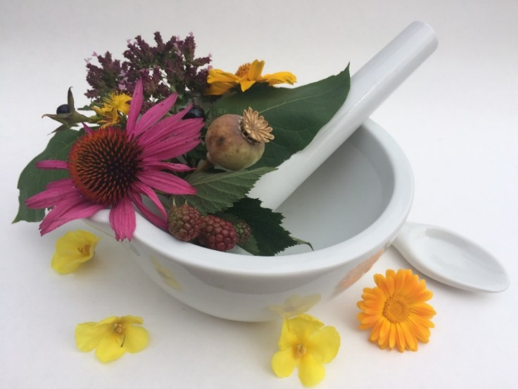
Pharmacognosy lab exercise 8
Leaves, herbs

Slide 2
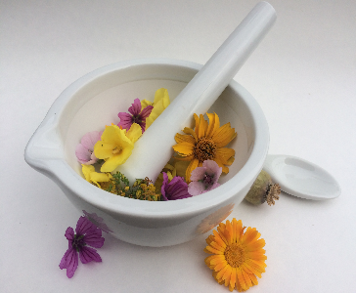

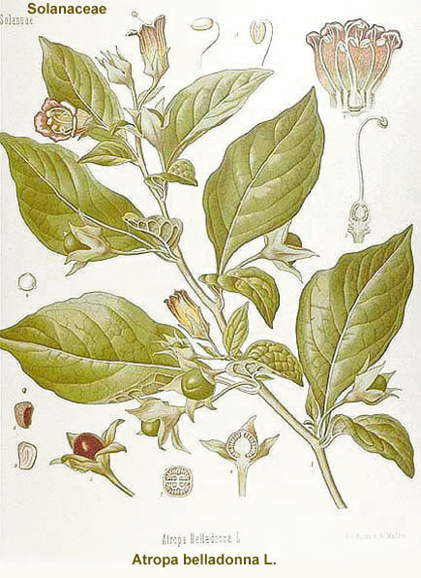
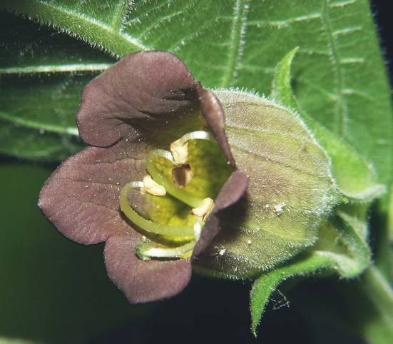
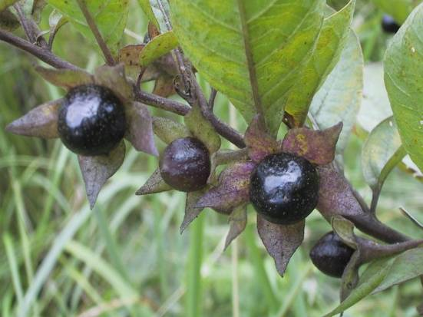
Belladonnae folium
CzPh 2017
Mother plant: Atropa belladonna, Solanaceae(Deadly Nightshade)
    Belladonnae folii exctractum siccum normatum CzPh 2017
    Belladonnae folii tinctura normata CzPh 2017
    Belladonnae pulvis normatus CzPh 2017

Slide 3
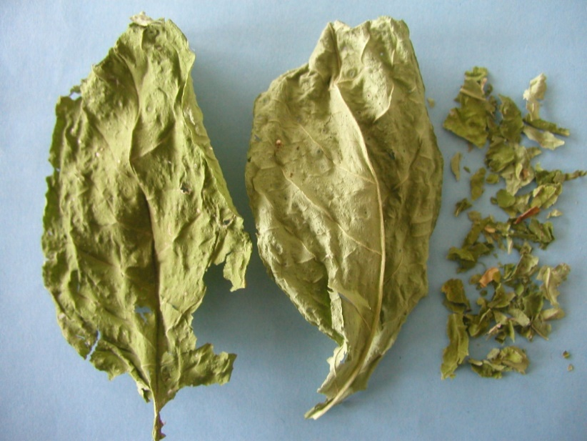
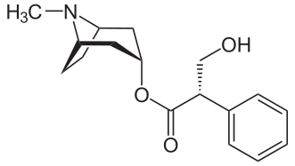
Belladonnae folium
CzPh 2017
Macroscopy: oval leaves, sharpened, integerrimum, on the face brown-green, reversed side grey-green, infrequently and smoothly hairy, numerous grey dots, narcotic odour, sharp bitter taste
Content compounds: tropane alkaloids (L-hyoscyamine – racemization to atropine), coumarins
Usage: isolation of alkaloids: neurotropic parasympatolytic, spasmolytic, antiasthmatic
L-hyoscyamine

Slide 4
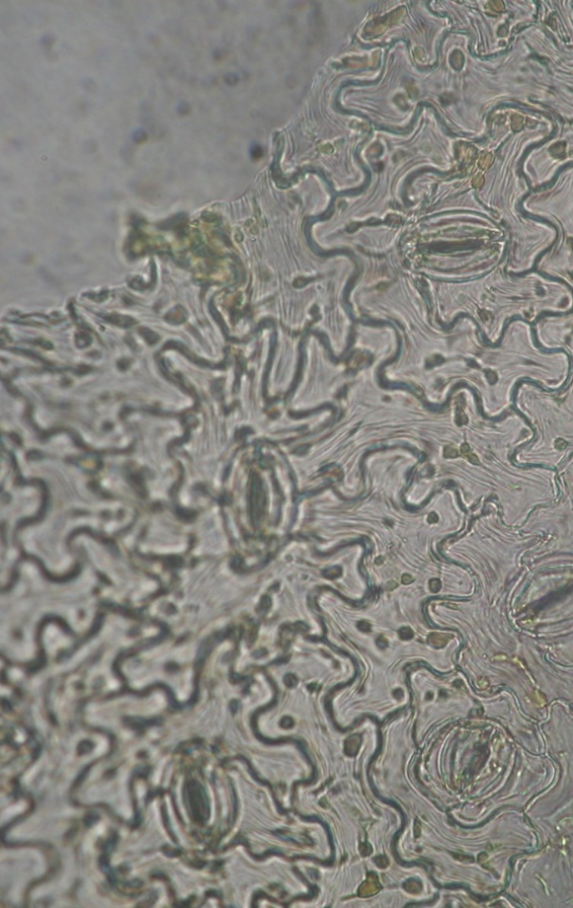
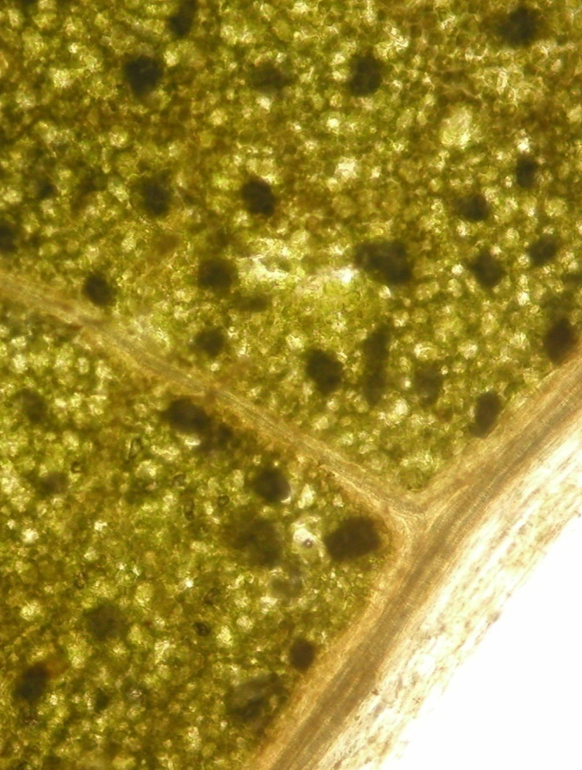
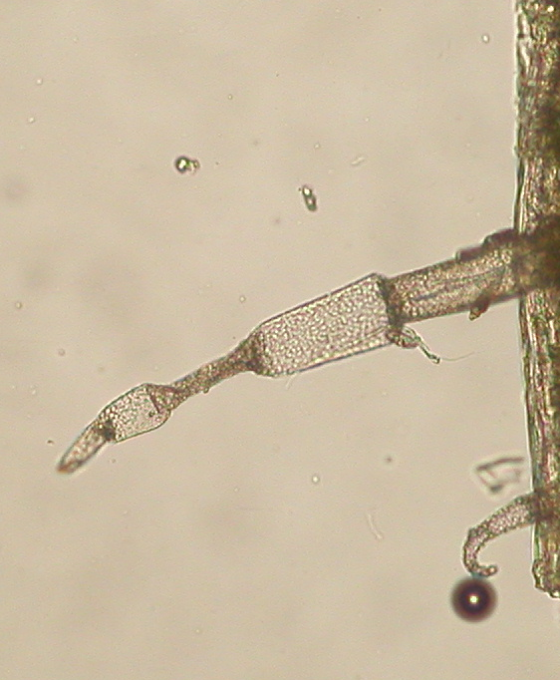
Belladonnae folium
CzPh 2017
Microscopy: upper epidermis with covering trichomes (polycellular, spiky) and glandular trichomes with uni-cellular pod and uni- or poly-cellular head, sand cells, stomata of Brasiccaceae type

Slide 5
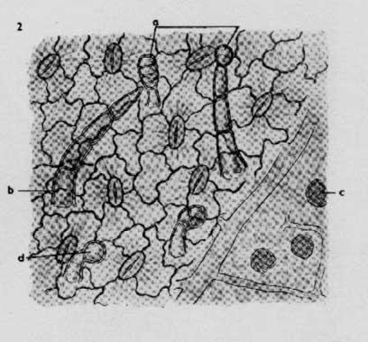
Belladonnae folium
CzPh 2017
Microscopy:
glandular trichome
covering trichome
sand cells

Slide 6
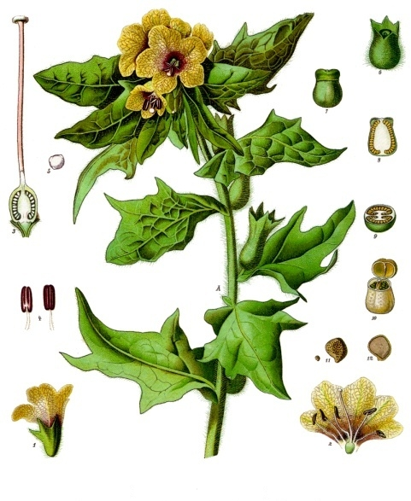
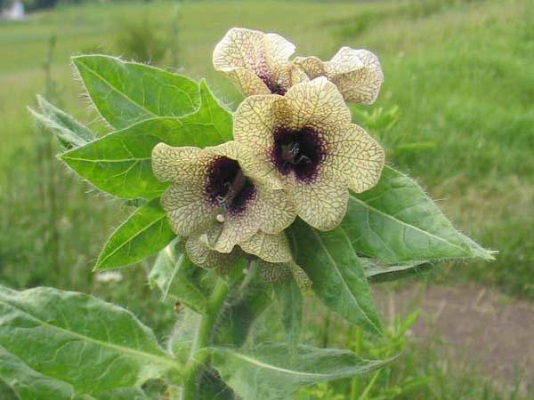
Hyoscyami folium
Mother plant: Hyoscyamus niger, Solanaceae (Black Henbane )

Slide 7
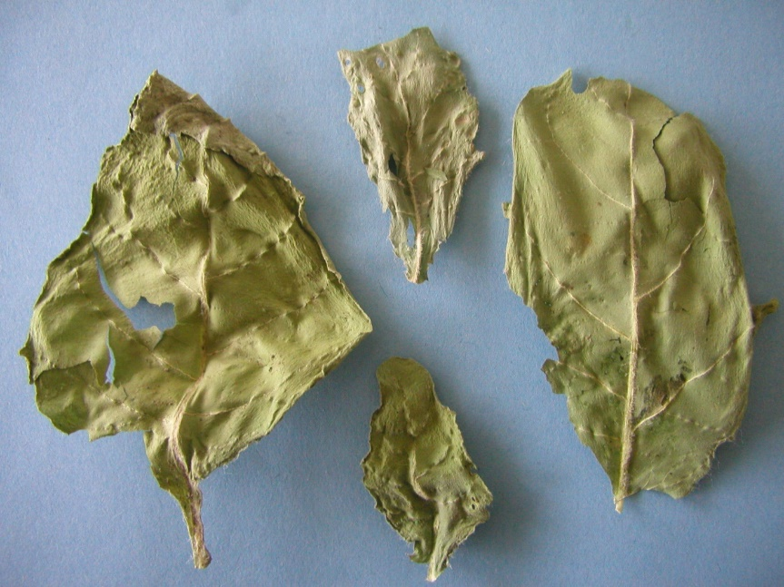
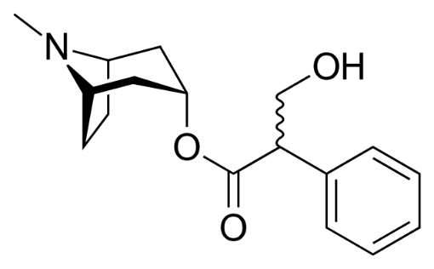
Hyoscyami folium
Macroscopy: long leaf, matt grey-green, both sides hairy, distinct central vein with higher number of trichomes, narcotic odour, sharp bitter-sweet taste
Content compounds: tropane alkaloids (hyoscyamine, scopolamine)
Usage: isolation of alkaloids: parasympatolytic
atropine

Slide 8
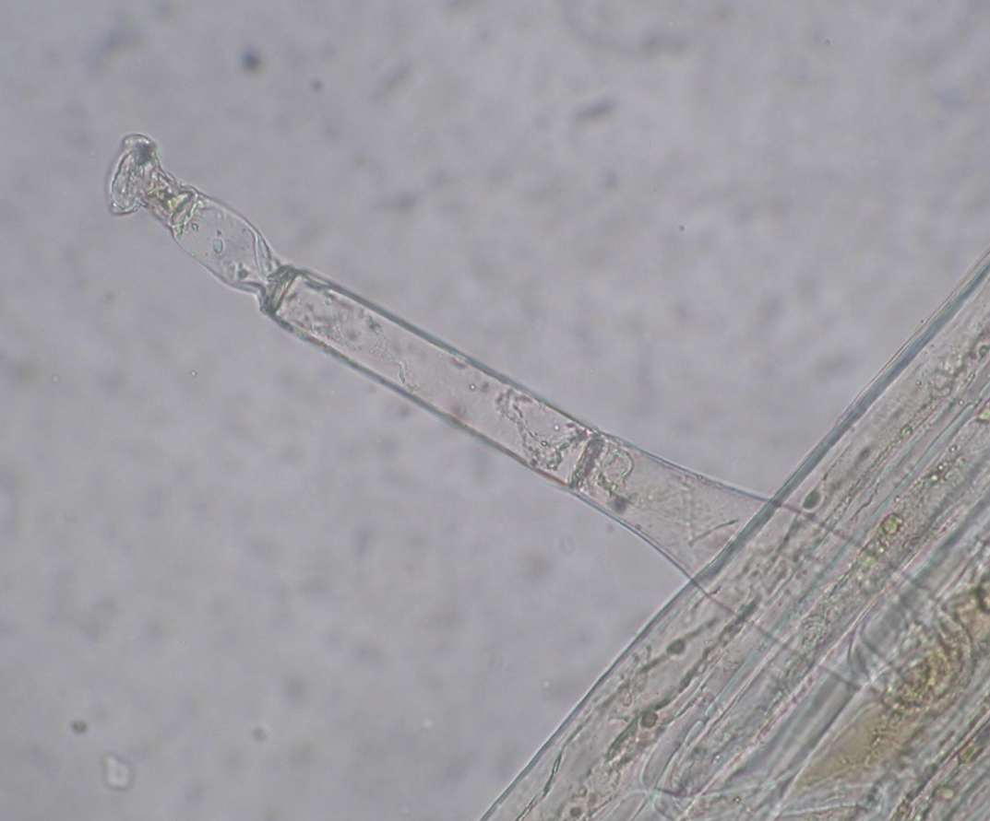
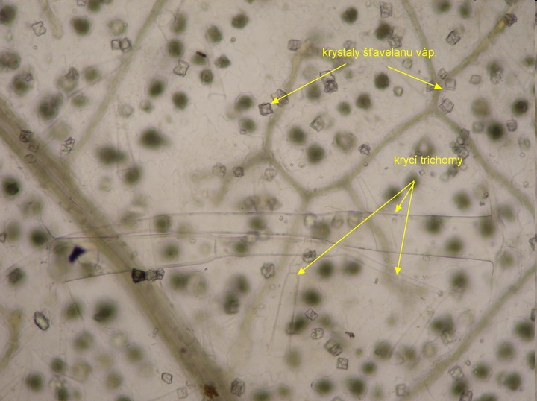
Hyoscyami folium
Microscopy: stomata of Brasiccaceae type, covering trichomes poly-cellular, glandular trichomes with poly-cellular pod and uni- or poly-cellular head, crystals of calcium oxalate in leaf mesophyl
Calcium oxalate crystals
covering trichomes

Slide 9
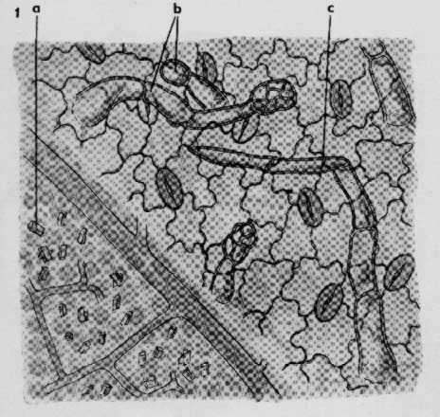
Hyoscyami folium
Microscopy:
glandular trichome
covering trichome
crystals
Notes:
Mucilage cells can be in the epidermis too.

Slide 10
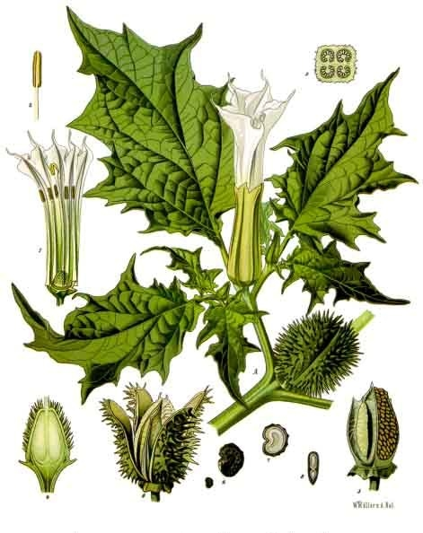
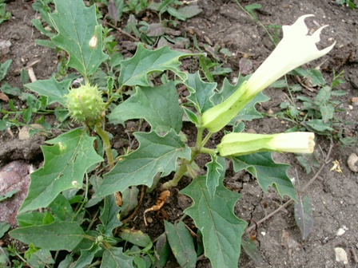
Stramonii folium
CzPh 2017
Mother plant: Datura stramonium, Solanaceae (Thorn Apple, Devil´s Weed)
Stramonii folii pulvis normatus CzPh 2017

Slide 11
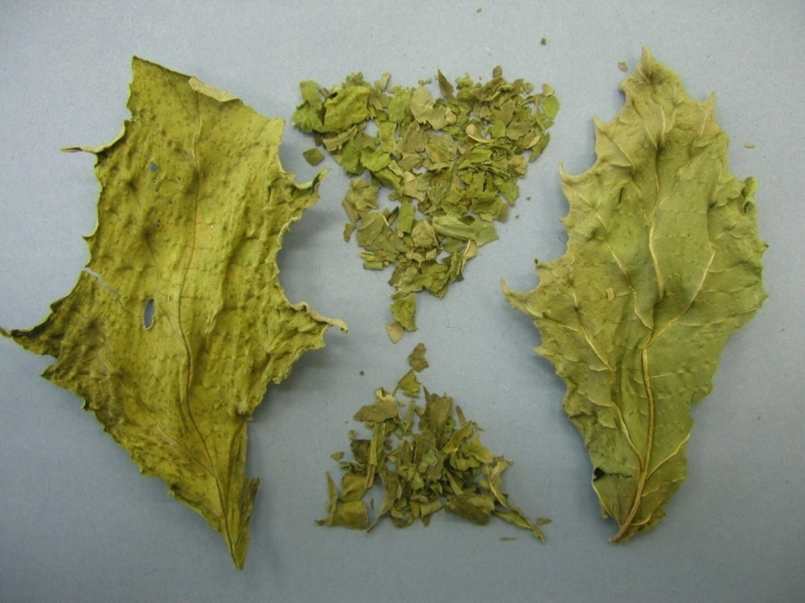
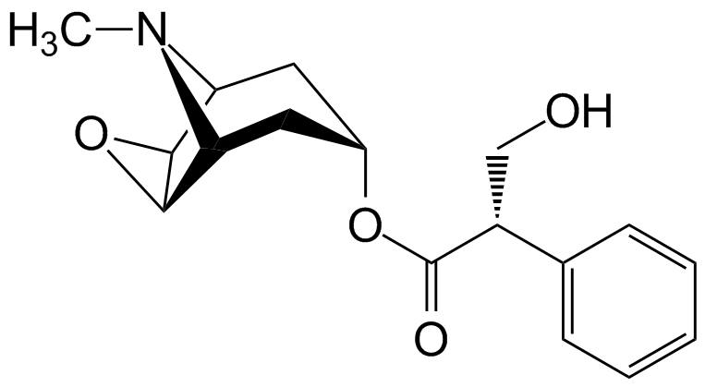
Stramonii folium
CzPh 2017
Macroscopy: fragile leaf, thin, almost bald, stalked, strogly lobular, serrated, on the face richly green, on the reversed side brighter, weak narcotic odour, taste sharp bitter
Content compounds: tropane alkaloids (up to 0.25%), higher scopolamine content
Usage: isolation of alkaloids (sedative effect of scopolamine), production of semisynthetic derivatives
scopolamine

Slide 12
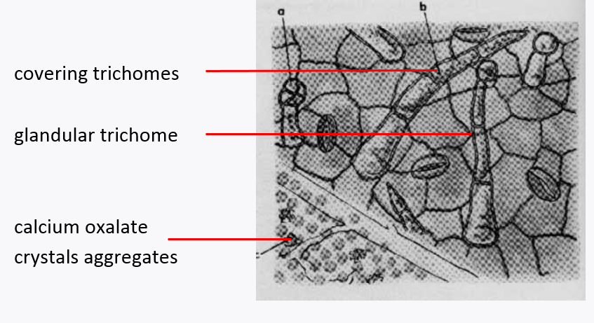
Stramonii folium
CzPh 2017
Microscopy: stomata of Brasiccaceae type, covering trichomes 2 - 5 cellular with grainy cuticle, shortly stalked glandular trichomes with poly-cellular head, aggregates of calcium oxalate in leaf mesophyl, multi-edged cells of epidermis

Slide 13
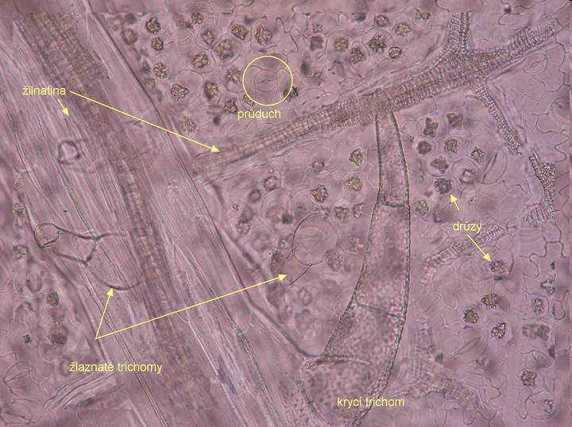
Stramonii folium
CzPh 2017
Microscopy:
stoma
vein
druses of calcium oxalate
glandular trichomes
covering trichome

Slide 14
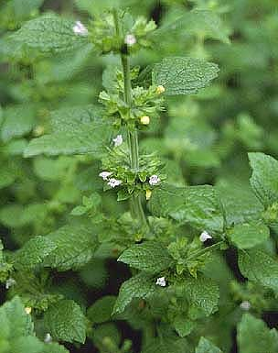
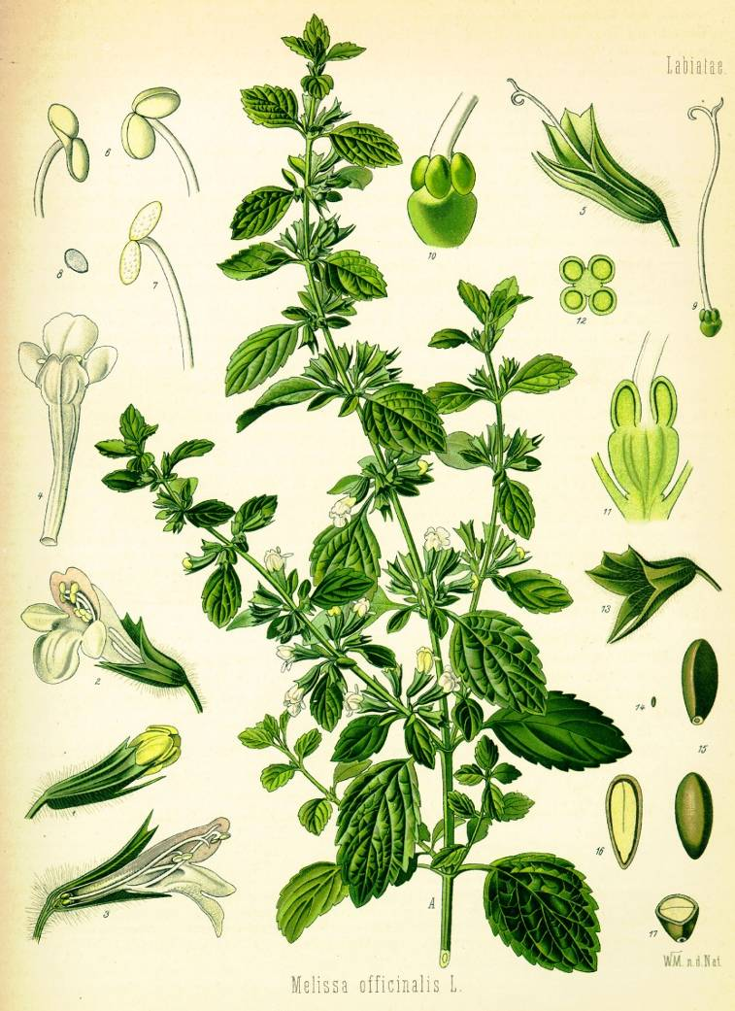
Melissae folium CzPh 2017
Melissae herba CzPh 2017^{National part}
Mother plant: Melissa officinalis, Lamiaceae Lemon Balm
  Melissae folii extractum siccum CzPh 2017

Slide 15
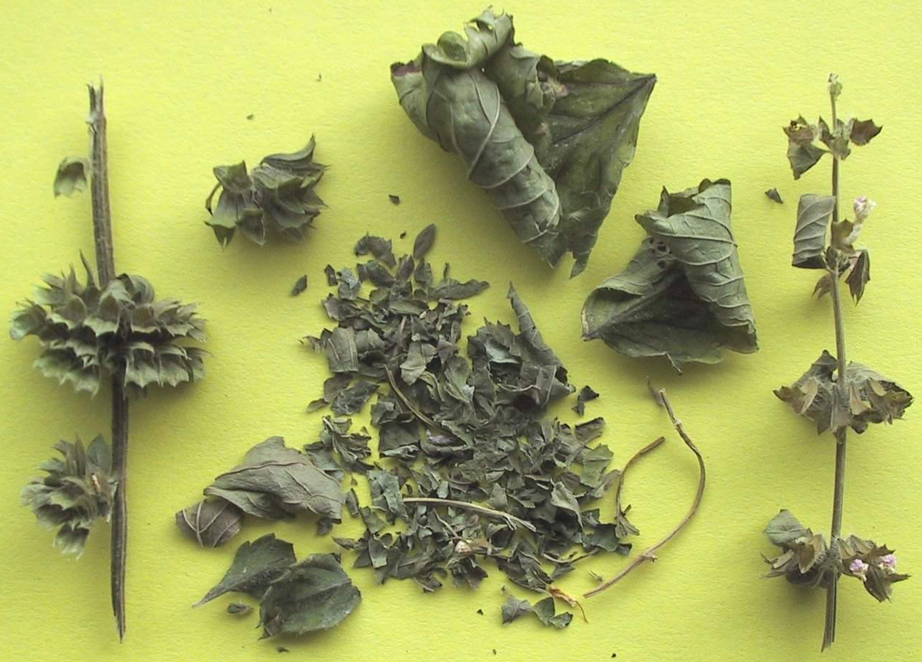
Melissae folium CzPh 2017
Melissae herba CzPh 2017^{National part}
Macroscopy: 4-edged stem, opposite
leaves stalked broadly oval, serrate margins,
on the face richly green, wrinkled, softly hairy,
reversed side of leaves brighter, almost bald,
white flowers in pseudo-verticiles, pleasant
citrus odour, pleasant aromatic taste
Content compounds: essential oil – monoterpenes (citronellal, citral, nerole, geraniol, linalool), sesquiterpens (caryophylen); rosmarinic acid, tannins, flavonoids
Usage: sedative, nervinum; carminative, spasmolytic; antibacterial and antiviral effect
Notes:
Drying at low temperature, store for short time – essential oils are volatile
Perfumery, cosmetics, food industry – food conservation
Essential oils irritate the kidney parenchyma and respiratory tract epitel – they increase production of urine and mucus – expectorant effect.
Tea from lemon balm for calming

Slide 16

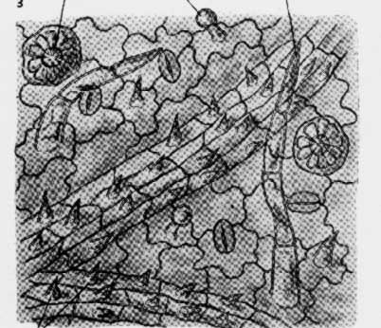
Melissae folium CzPh 2017
Melissae herba CzPh 2017^{National part}
  Microscopy:
  surface - stomata (Caryophylaceae type),
  covering and glandular trichomes,
  glandules of Lamiaceae type
  glandule
  covering trichome
  glandular trichome

Slide 17
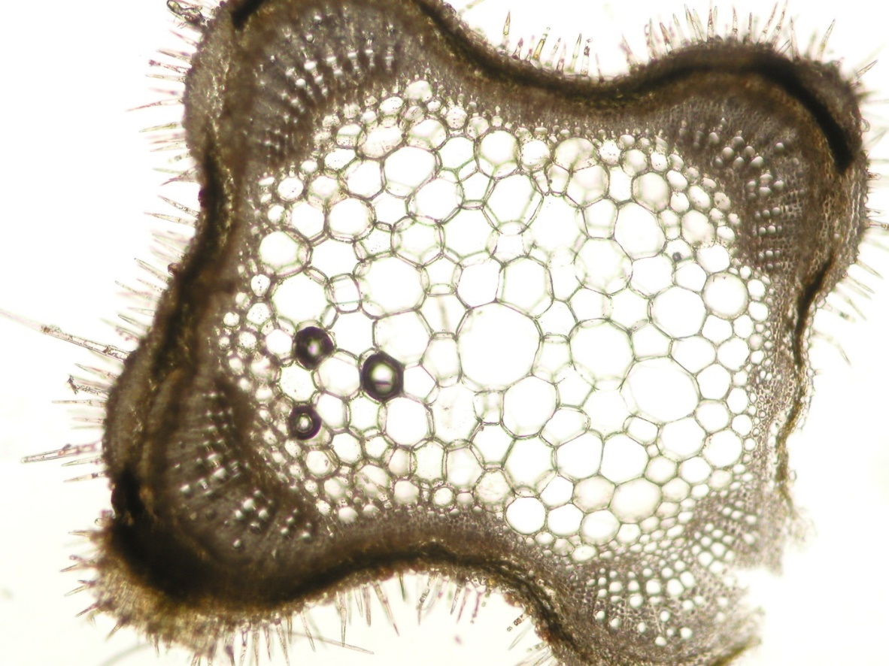
Melissae folium CzPh 2017
Melissae herba CzPh 2017^{National part}
Microscopy: stem – transversal section – covering and glandular trichomes, epidermis, reinforcing collenchyma, cortex parenchyma, thickened phloem fibers, collateral vascular bundle with sclerenchymatic sheath
epidermis with trichomes
collenchyma
phloem fibers
kambium
medullar parenchyma
xylem
Notes:
Mucilage cells can be in the epidermis too.

Slide 18
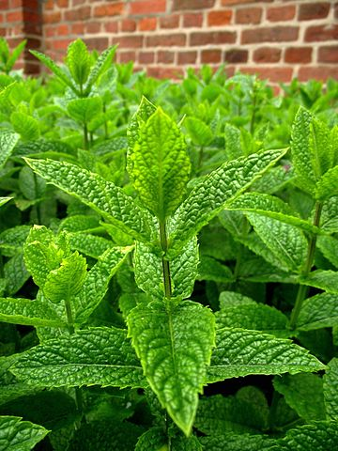
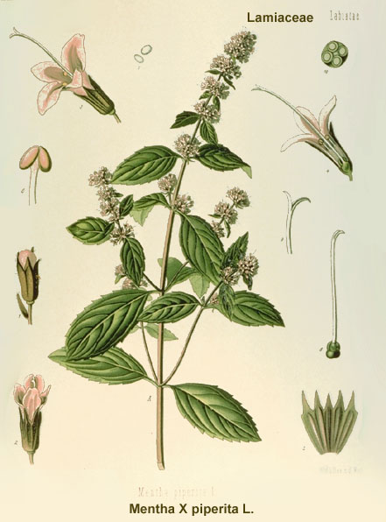
Menthae piperitae folium CzPh 2017
Menthae piperitae herba CzPh 2017
Mother plant: Mentha x piperita, Lamiaceae (Peppermint)
Menthae piperitae folii extractum siccum CzPh 2017
Menthae piperitae etheroleum CzPh 2017

Slide 19
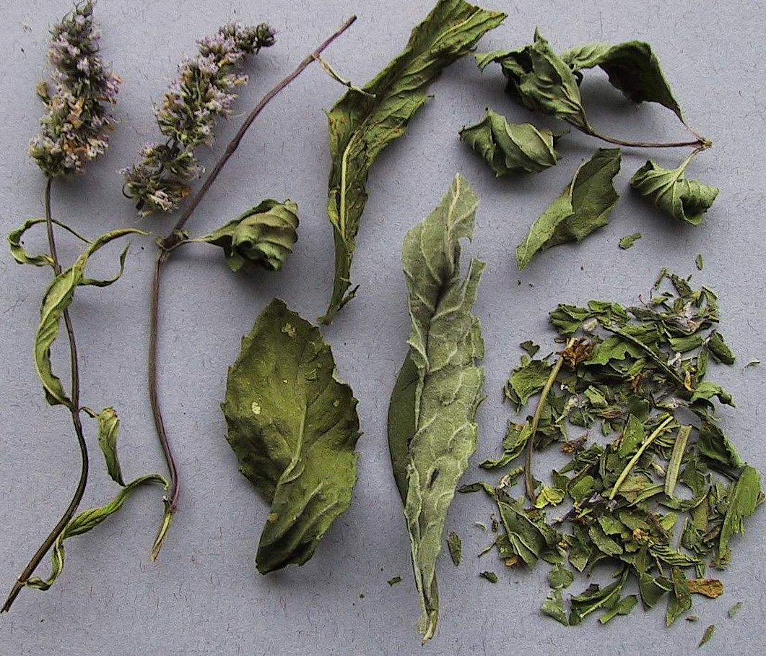
Menthae piperitae folium CzPh 2017
Macroscopy: 4-edged green-brown stems, opposite leaves stalked, oval, sharply serrated margins, slightly hairy, purple vains on the reversed side, purple flowers in pseudo-verticiles creating spikes, menthol odour, taste spicy hot taste, later cooling

Slide 20
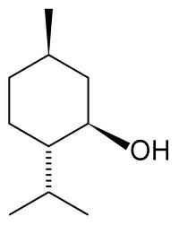
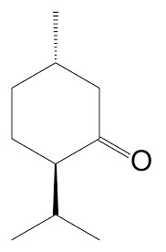
Menthae piperitae folium CzPh 2017
Content compounds: essential oil - monoterpens (menthol, menthone), menthofurane, felandrene, piperidone; tannins, flavonoids
Usage: stomachic, carminative, antiseptic, spasmolytic, choleretic; taste and smell corigens in tea mixtures; pure menthol: derivans, antiseptic, local anaesthetic
menthol
menthone

Slide 21
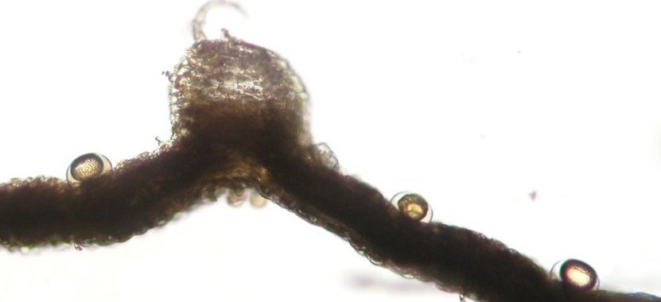
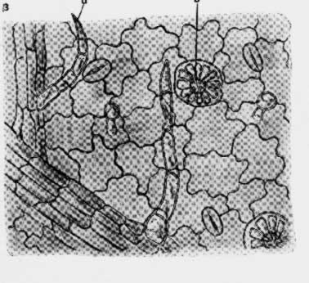
Menthae piperitae folium CzPh 2017
Microscopy: surface – lobular cells, stomata (Caryophylaceae type), on the reversed side covering and glandular trichomes, glandules of Lamiaceae type
  glandule
  glandular trichome
  covering trichome

Slide 22
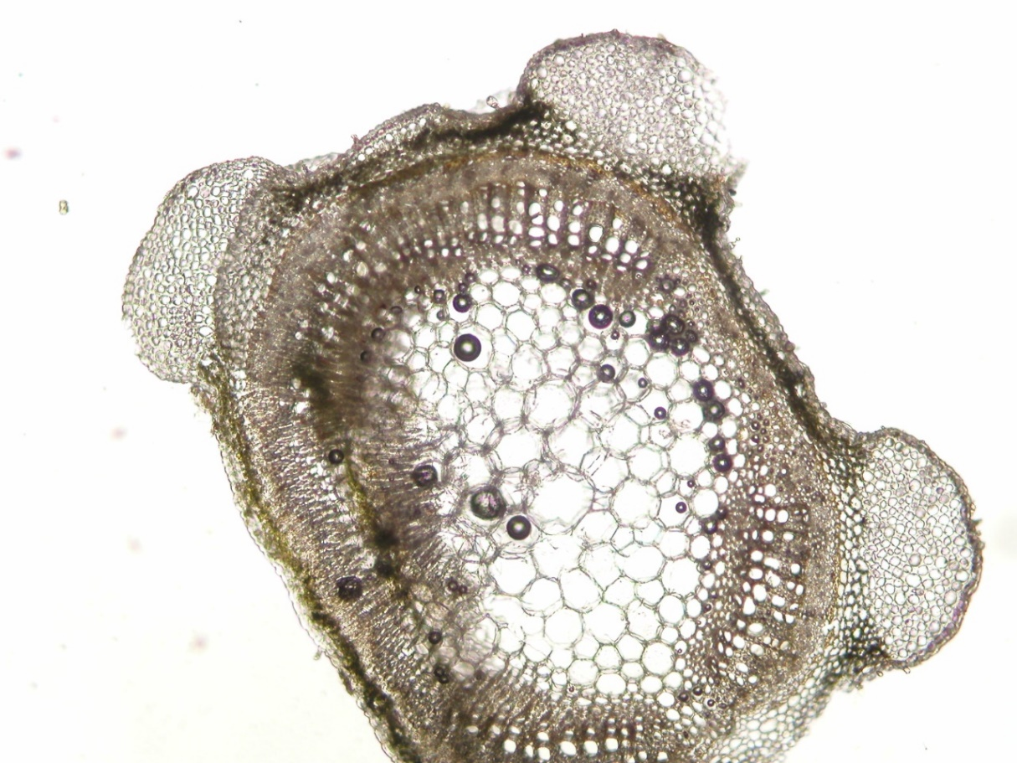
Menthae piperitae folium CzPh 2017
Microscopy: stem – transversal section: nippled cuticle with trichomes, epidermis, collenchymatic cells, narrow cortex, collateral vascular bundles, in wood parenchyma cells with crystals of calcium oxalate
epidermis
collenchyma in hypodermis
phloem
medullar parenchyma
xylem

Slide 23
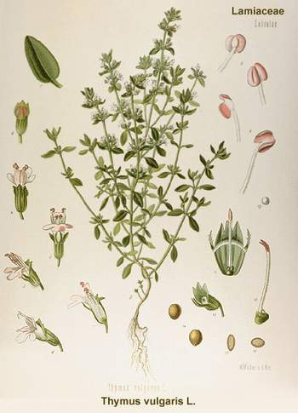
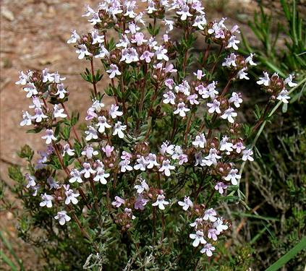
Thymi herba CzPh 2017
Mother plant: Thymus vulgaris, Thymus zygis Lamiaceae (Thyme)
Thymi typo thymolo etheroleum CzPh 2017

Slide 24
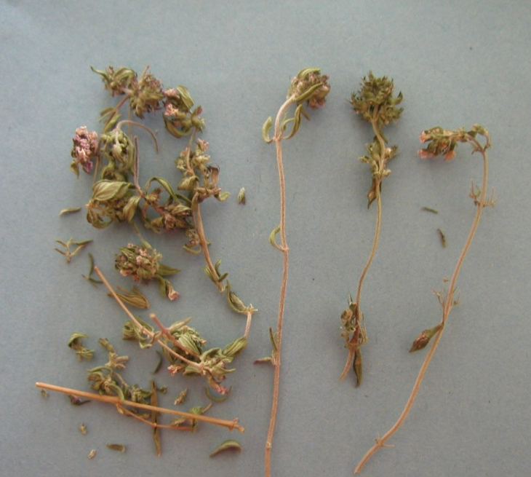
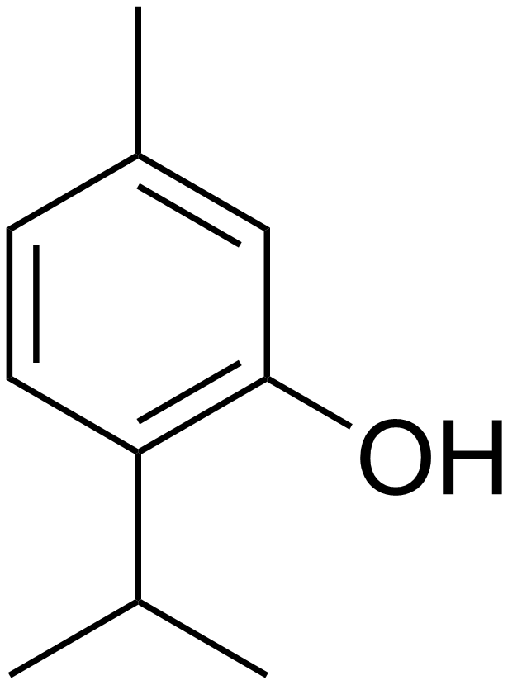
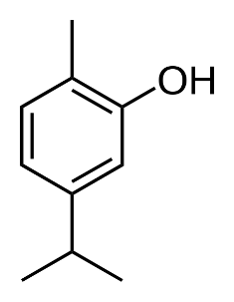
Thymi herba CzPh 2017
Macroscopy: 4-edged stems, hairy sessile short line-like leaves with underwinded margin, on the face green and bald, on the reversed side glandulary pointed, flowers white or purplish in verticiles, pleasant aromatic odour and taste
Content compounds: essential oil – monoterpens (thymol, carvacrol); tannins, flavonoids
Usage: expectorans, stomachic, antiseptic, astringent, antiphlogistic
thymol
carvacrol

Slide 25
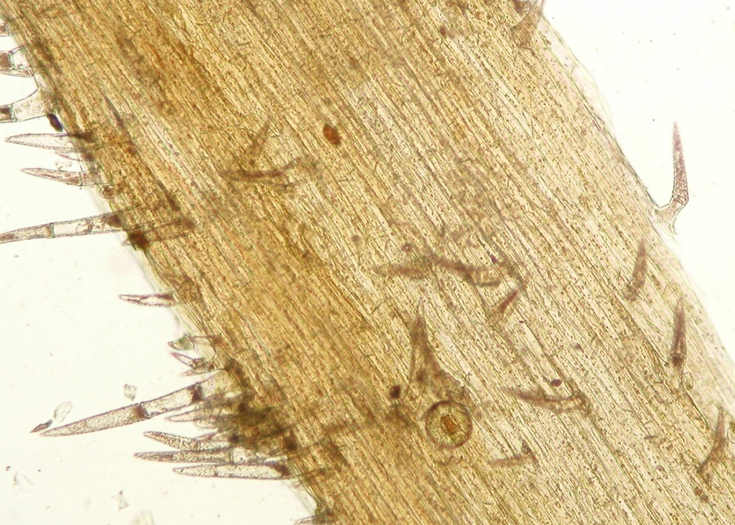
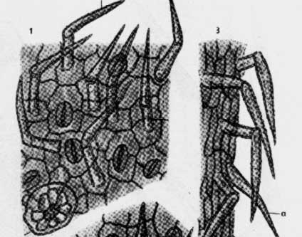
Thymi herba CzPh 2017
  Microscopy: surface – wavy epidermal cells, nodular covering trichomes, glandular trichomes, glandules of Lamiaceae type
  covering trichome
  glandule
Notes:
Mucilage cells can be in the epidermis too.

Slide 26
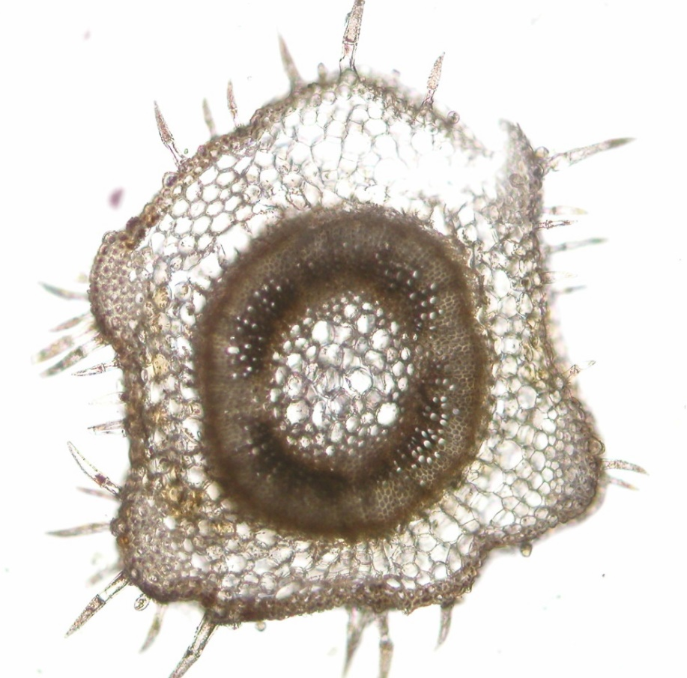
Thymi herba CzPh 2017
  Microscopy: Stem – transversal section – epidermis with plate-shaped cells with nippled cuticle, trichomes, reinforcing collenchyma, collateral vascular bundle, vessels with libriform, medullar rays uni-linear, in medulla chain parenchyma
epidermis with cuticle
hypodermis with collenchyma
medullar parenchyma
veins with libriform

Slide 27
MACROSCOPY

Slide 28
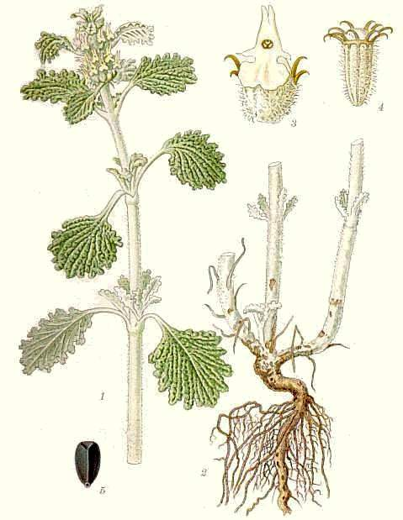
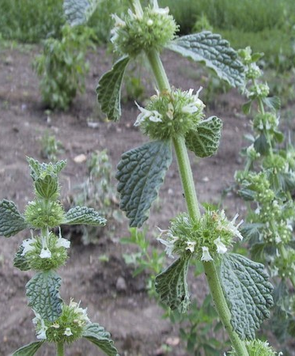
Marrubii herba CzPh 2017
Mother plant: Marrubium vulgare, Lamiaceae (White Horehound or Common Horehound )

Slide 29
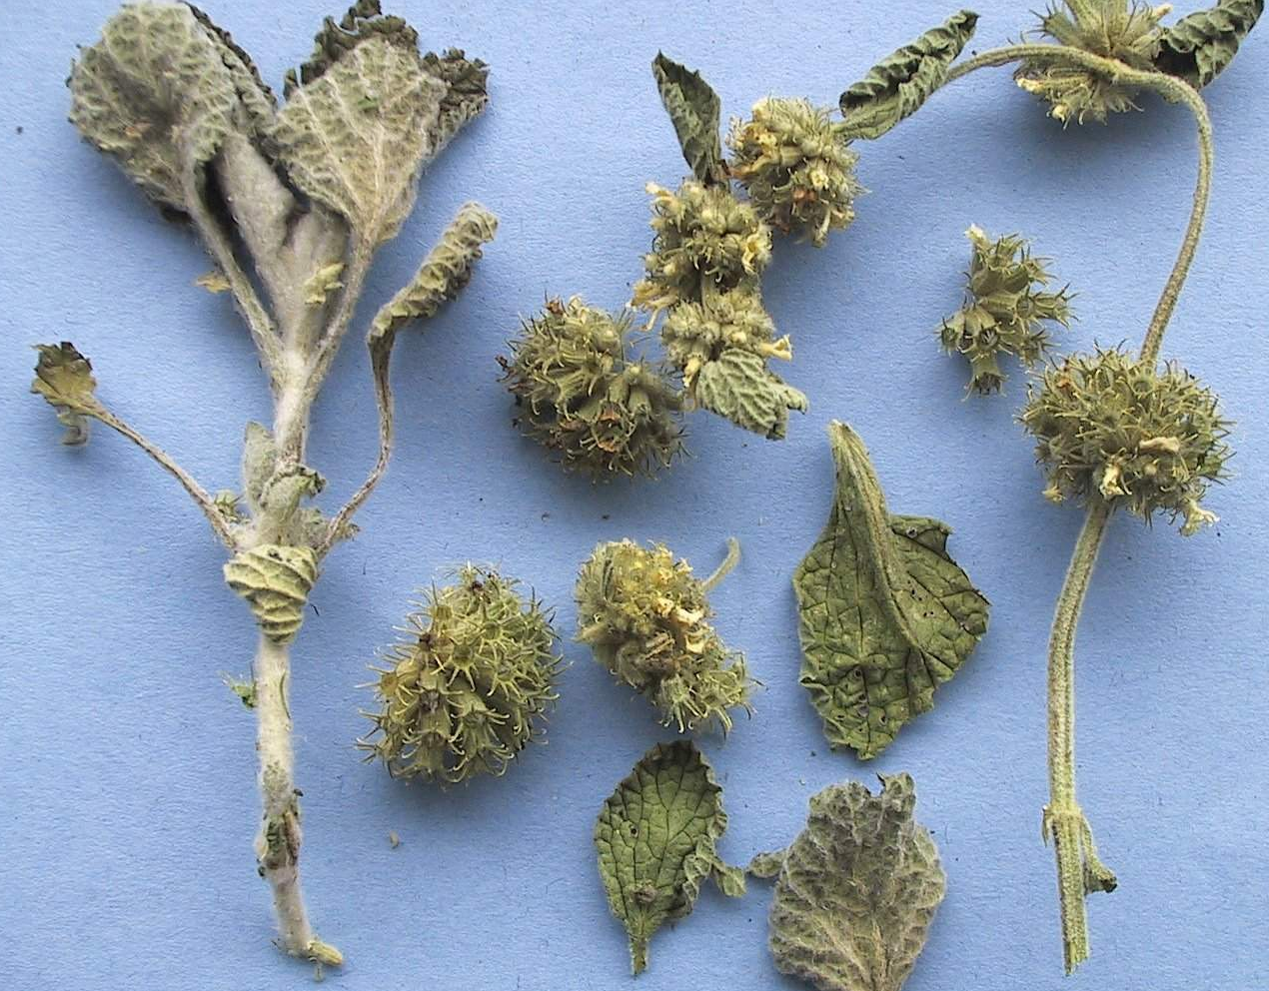
Marrubii herba CzPh 2017
Macroscopy: 4-edged white felt-like stems, opposite leaves, wrinkled, oval, on the margin serrated, on the face almost bald, on the reversed face hairy, small white flowers in pseudo-verticiles, apple odour, very bitter taste
Content compounds: bitter substances (diterpenic lactone marrubiin), essential oils, tannins, saponins
Usage: amare, choleretic, carminative; secretolytic expectorant, mild anti-inflammatory effect

Slide 30
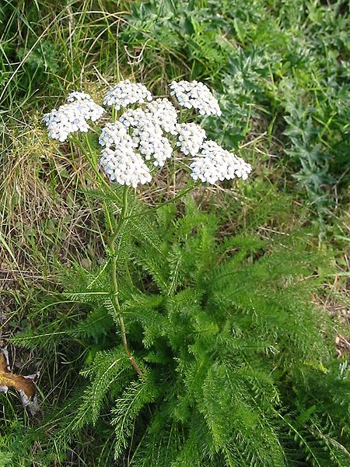
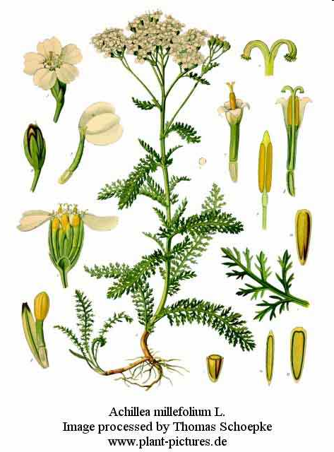
Millefolii herba CzPh 2017
Mother plant: Achillea millefolium,Asteraceae (Yarrow)

Slide 31

Millefolii herba CzPh 2017
Macroscopy: whole stems with flower head of yellow-white flowers, leaves narrow cutted, divided to segments, aromatic odour, bitter taste
Content compounds: essential oil (sesquiterpens – proazulens), bitter substances, flavonoids, tannins, manganese salts
Usage: amare, stomachic, spasmolytic, choleretic, expectorant, mild antiseptic, diuretic

Slide 32



Origani herba CzPh 2017
Mother plant: Origanum vulgare, O. onites, Lamiaceae, (Oregano, Wild Marjoram)

Slide 33

Origani herba CzPh 2017
Macroscopy: weakly edged reddish stems, opposite leaves, purple flowers in terminal erect spikes, pleasant aromatic odour, spicy bitter taste
Content compounds: essential oil ( thymol, carvacrol); tannins, bitter substances
Usage: stomachic - amare, expectorant, spasmolytic, carminative

Slide 34


Polygoni avicularis herba
CzPh 2017
Mother plant: Polygonum aviculare, Polygonaceae (Common Kntograss, Birdweed)

Slide 35

Polygoni avicularis herba CzPh 2017
Macroscopy: green stems, leaves almost sessile, elipsoid, integerrimum, small flowers in underarm of leaves, without odour, bitter astringent taste
Content compounds: flavonoids, mucilage, higher amount of soluble silica acid, tannins, phenolic glycosides, vitamin C
Usage: expectorant, diuretic, astringent, antiphlogistic, haemostyptic

Slide 36


Salviae officinalis folium CzPh 2017
Salviae herba CzPh 2017
Mother plant: Salvia officinalis, Lamiaceae (Sage)
Salviae tinctura CzPh 2017
Salviae sclareae etheroleum CzPh 2017
Salviae trilobae folium CzPh 2017
Salviae lavandulifoliae etheroleum CzPh 2017

Slide 37

Salviae officinalis folium CzPh 2017
Salviae herba CzPh 2017
Macroscopy:
rounded grey felt-like stems, strong
leaves, stalked, green-grey, prolonged
oval, flowers in poor verticiles with
two-labiate corolla, aromatic odour,
bitter astringent taste
Content compounds: essential oil (monoterpens – thujon, cineole, camphora, pinen); bitter substances (pikrosalvine); tannins, saponins, flavonoids
Usage: antiphlogistic, spasmolytic, antihydrotic;
externally - astringent, dermatologic, antilactagogue

Slide 38


Serpylli herba CzPh 2017
Mother plant: Thymus serpyllum, Lamiaceae (Wild Thyme)

Slide 39

Serpylli herba CzPh 2017
Macroscopy: rounded stems, oval,
integerrimum leaves, almost sessile
with mild underwinded margin, on the
reversed side glandulary pointed,
purple-black and white flowers in
pseudo-verticiles, aromatic odour, spicy
bitter taste
Content compounds: essential oil (thymol, carvacrol), tannins, bitter compounds, flavonoids, minerals
Usage: expectorans, bronchospasmolytic, stomachic, antiseptic, antiphlogistic

Slide 40


Urticae herba
Urticae folium CzPh 2017
Mother plant: Urtica dioica, Urticaceae (Stinkink Nettle)
Urticae radix CzPh 2017

Slide 41

Urticae herba
Macroscopy: stem direct 4-edged, stalked leaves, oval, spiked, coarse serrated, flowers in leaves underarms, greenish, drug smells like spinach, bitter and acrid taste
Content compounds: chlorophyll, flavonoids, carotenoids, triterpens, sterols, minerals, vitamins K and C
Usage: metabolic, diuretic, antiseptic, antirheumatic; astringens, hemostyptic

Slide 42



Visci albi herba
Mother plant: Viscum album, Santalaceae (Mistletoe )

Slide 43


Visci albi herba
Macroscopy: rounded, furcated branched stems, slightly fragile, prolonged oval leaves with compact margin, tough, leatherlike, uni-seminal fruits, weak odour, bitter taste
Content compounds: cardiotoxic proteins viscotoxins, lectins (=glycoproteins) amines, flavonoids, polysaccharides, lignans
Usage: hypotonic, antisclerotic (flavonoids), cytotoxic (lectins)
Intradermally – treatment of degenerative inflammatory diseases of joints, treatment of cancer

