Slide 1
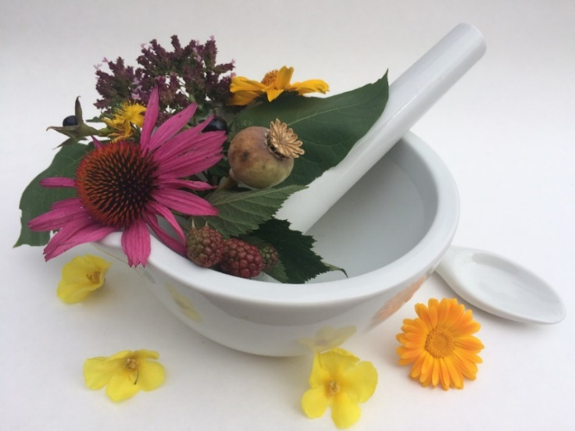
Pharmacognosy lab exercise 10
Drugs - fruits

Slide 2
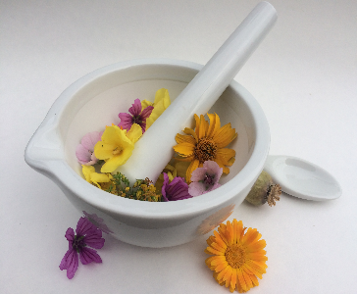
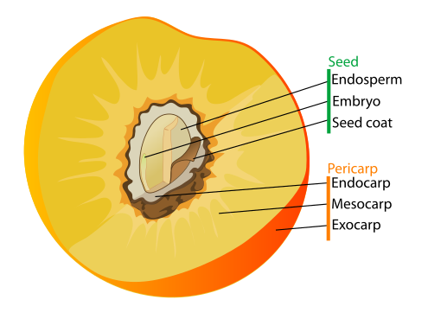
Fructus - fruit
Generative organ of flowering plants, contains one or several seeds. Its function is to disperse seeds.
Fruit is composed of outer layer (pericarp, pericarpium) and seed (semen)
Pericarpium is further divided into:
  exocarp (epicarp), mesocarp, endocarp
Seed consists of:
  Seed coat (testa), endosperm, embryo

Slide 3
Apiaceae fruits
Diachenium
Anatomy of diachenium:
  Exocarp with prominent ribs (ridges), vascular bundles in ridges
  Mesocarp contains essential oil channels
  Endocarp intergrown with testa
  Endosperm composed of parenchyma, contains oil drops, starch, aleurone grain

Slide 4
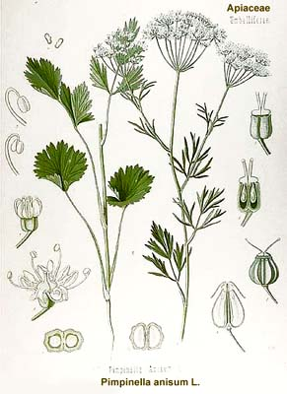
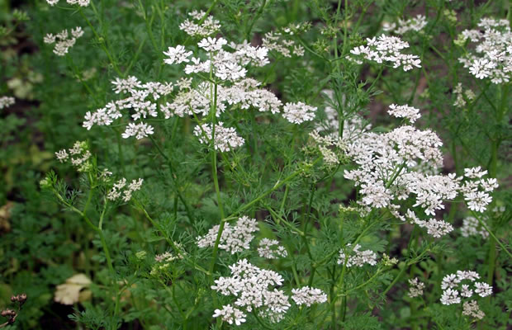
Anisi fructus CzPh 2017
Mother plant: Pimpinella anisum, Apiaceae, anise
  Anisi etheroleum CzPh 2017

Slide 5
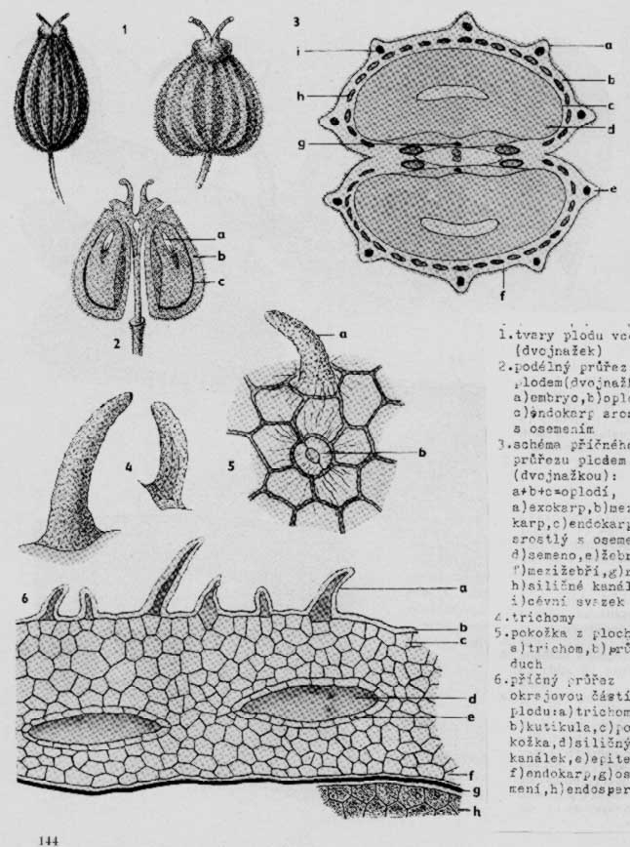
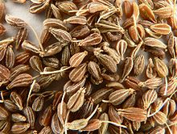
Anisi fructus CzPh 2017
Macroscopy: diachenium of obovate shape, grey-brown, softly hairy, fruit connected by short stalk, each achene has 5 bright ribs, strong spicy odour, sweet aromatic taste

Slide 6
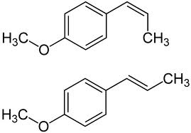
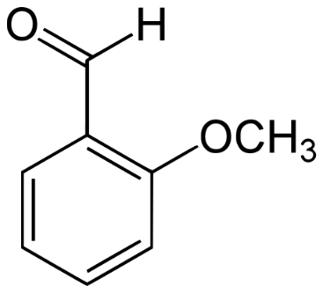
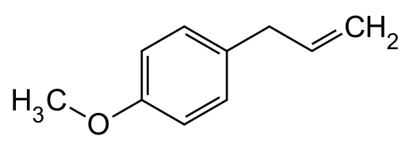

Anisi fructus CzPh 2017
Content compounds: essential oil (trans-anethol, methylchavikol, anisaldehyd), oil, proteins, sugars
Usage: expectorant, carminative, stomachic, spasmolytic, spice, flavoring for ouzo, rakı, Czech candy called Hašlerky
cis, trans-anethol
methylchavikol
anisaldehyd

Slide 7
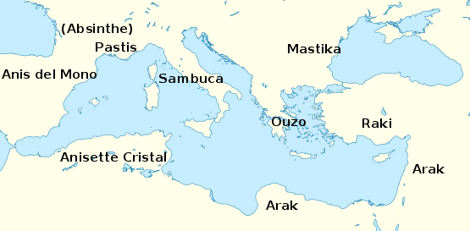
Anisi fructus CzPh 2017
Different names of anise alcohols across the Mediterranean region

Slide 8
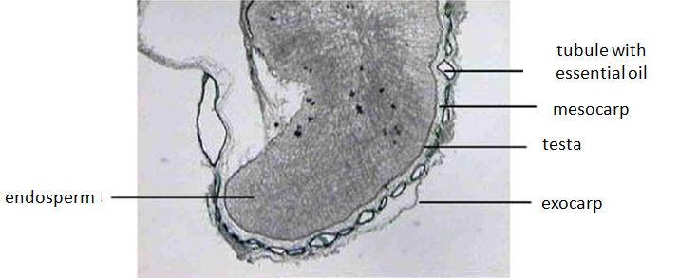
Anisi fructus CzPh 2017
Microscopy: exocarp, on epidermis located small, soft fine papilla-like trichomes with grainy cuticle, mesocarp – numerous tubules with essential oil, endocarp (fused with testa), in ribs located collateral vascular bundles, endosperm

Slide 9
Anisi fructus CzPh 2017
Microscopy:
vascular bundle
tubule with essential oil
rafe
endosperm
trichomes
exocarp
mesocarp
tubule with essential oil
endocarp
testa
endosperm

Slide 10
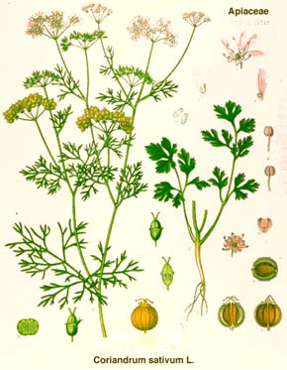
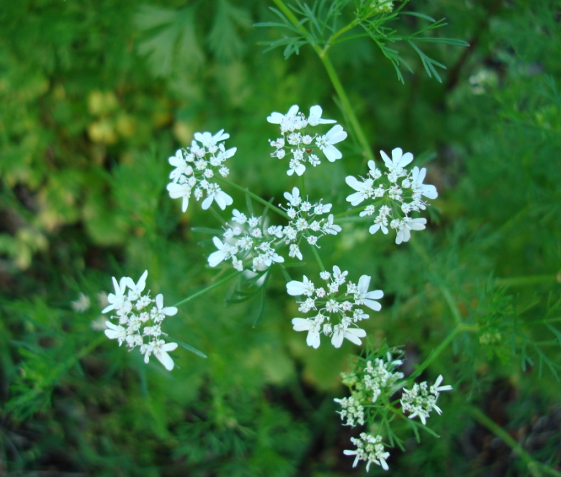
Coriandri fructus CzPh 2017
Mother plant: Coriandrum sativum, Apiaceae, Coriander, kορίαννον
  Coriandri etheroleum CzPh 2017

Slide 11
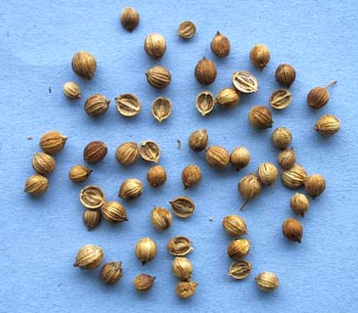
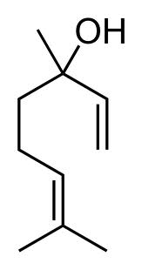
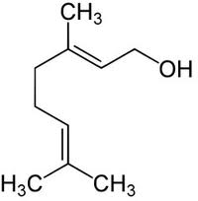
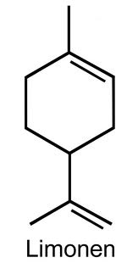
Coriandri fructus CzPh 2017
Macroscopy: spherical diachenium yellow-brown, 12 main and 10 side ribs, pleasant aromatic taste and odour
Content compounds: essential oil (linalol, geraniole, limonene, camphora), oil, tannins
Usage: stomachic, carminative, mild spasmolytic; externally to treat neuralgia. Corigens of taste and smell, ingredient of curry powder
linalol geraniole limonene

Slide 12
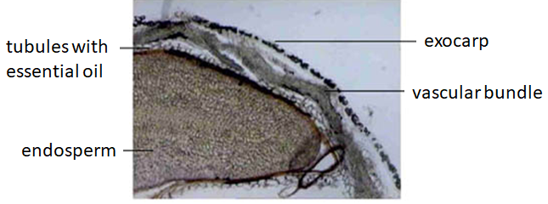
Coriandri fructus CzPh 2017
Microscopy: exocarp, mesokarp, endocarp fused with testa, in main ribs located tubules with essential oil and small vascular bundles, strip of sclerenchyma - stereome layer, at carpophore two big tubules with essential oil with epithelial lining, endosperm

Slide 13

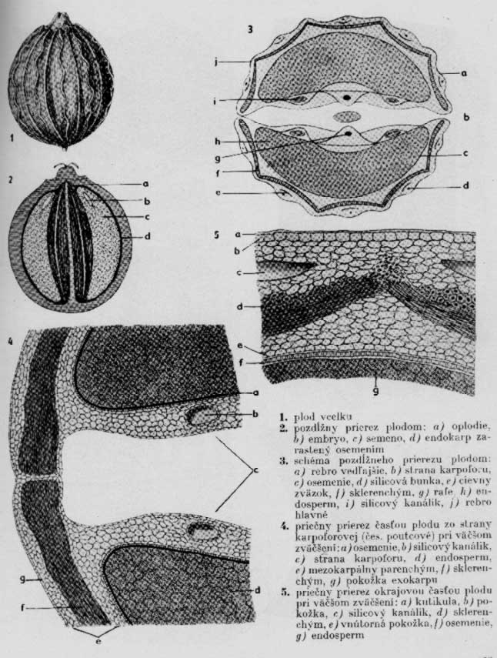
Coriandri fructus CzPh 2017
Microscopy:
vascular bundle
cell with essential oil
rafe
strip of stereom
endosperm

Slide 14
Coriandri fructus CzPh 2017
Microscopy:
exocarp
mesocarp
endocarp
tubule with
essential oil
strip of stereom

Slide 15
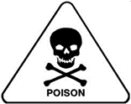
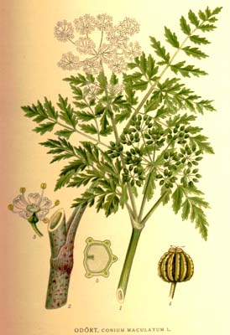
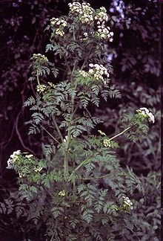
Conii fructus
Mother plant: Conium maculatum, Apiaceae, Poison Hemlock

Slide 16
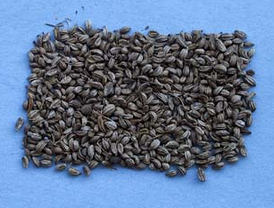
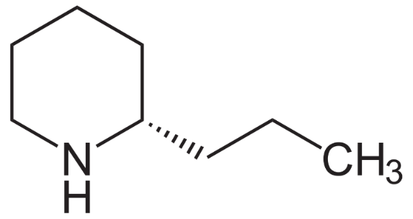
Conii fructus
Macroscopy: bald, oval-spherical, grey-green diachenium, strongly rib-like, ribs deformed, smells after mice, acrid oily taste. Do not confuse with anise/coriander.
Content compounds: piperidine alkaloid coniine, oil, proteins
Usage: poisonous, obsolete analgesic (neuralgia)
Coniin inhibits nicotinic acetylcholine receptors – paralysis of muscles
koniin
Notes:
The onset of symptoms is similar to that caused by curare. Peripheral paralysis, loss of sensation, paresthesias, profuse salivation. Death occurs after paralysis of respiratory muscles, with full consciousness. Fatal dose for human less than 5 mg/kg of body weight.
Socrates was killed by hemlock.

Slide 17
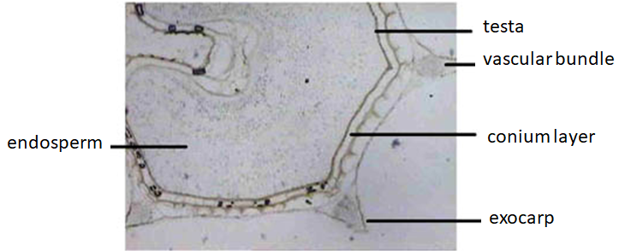
Conii fructus
Microscopy: exocarp, mesocarp, endocarp fused with testa creating conium layer, 5 pronounced ribs with vascular bundles and small cells with essential oil, endosperm, aleuronic grains and droplets of oil

Slide 18
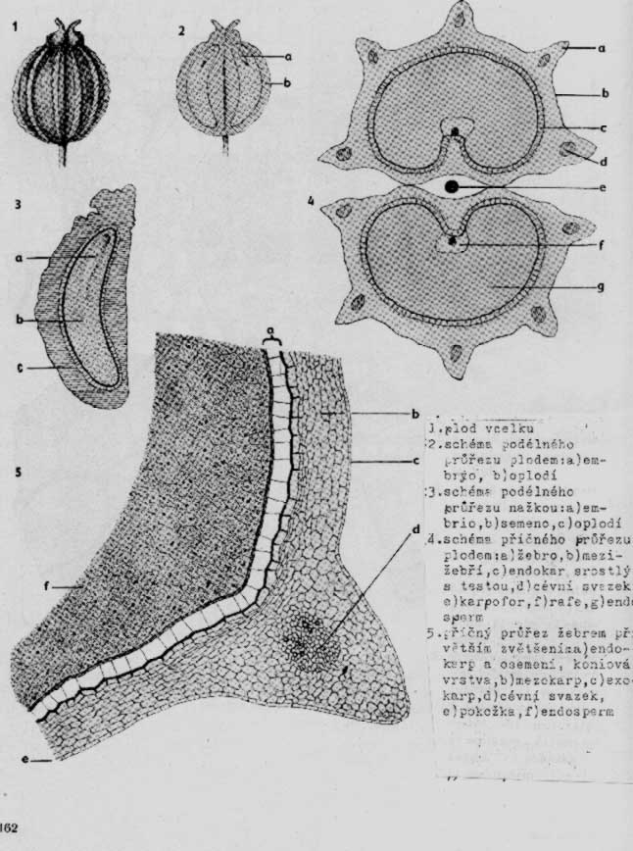
Conii fructus
Microscopy:
rib with vascular bundle
and cell with essential oil
endosperm
rafe
conium layer

Slide 19
Conii fructus
Microscopy:
endosperm
conium layer
collateral vascular bundle

Slide 20
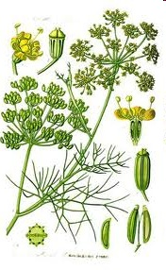
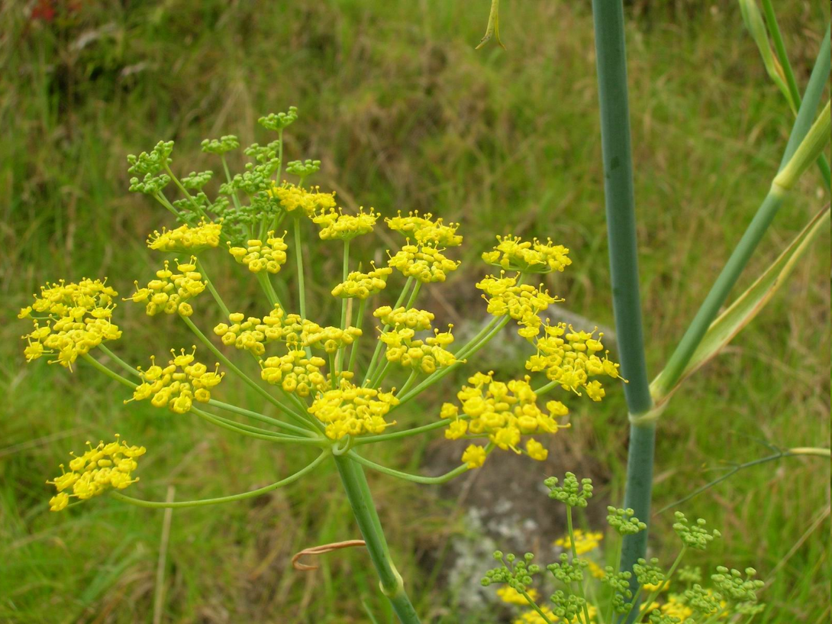
Foeniculi amari fructus CzPh 2017
Foeniculi dulci fructus CzPh 2017
Mother plant: Foeniculum vulgare subsp. vulgare var. vulgare,
or var. dulce, Apiaceae, Fennel
  Foeniculi amari fructus etheroleum CzPh 2017
  Foeniculi amari herbae etheroleum CzPh 2017

Slide 21
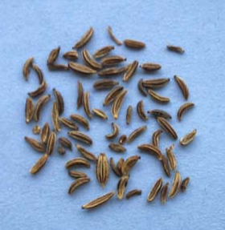
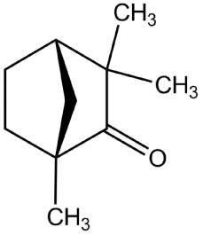
Foeniculi amari fructus CzPh 2017
Foeniculi dulci fructus CzPh 2017
Macroscopy: diachenium of cylindric shape, flattened, smooth, bald, brown-green to yellow, 5 ribs of straw-like yellow colour, aromatic odour, F. amari of sharp taste, F. dulci of sweet taste
Content compounds: essential oil (trans-anethol, methylchavikol, fenchone), sugars, oil, proteins
Usage: expectorant, spasmolytic, carminative, taste and smell corigens
fenchone
Notes:
Teas for children from 1 week of age – for digestion. Essential oils pass into mother´s milk and ease the flatulence of the child. Also ointments are available for this purpose. Gentle massage of the baby´s belly further promotes the anti-flatulence effects of fennel.

Slide 22
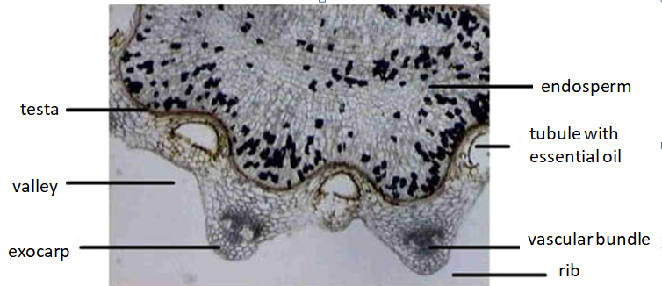
Foeniculi amari fructus CzPh 2017
Foeniculi dulci fructus CzPh 2017
Microscopy: exocarp, mesocarp, endocarp, 5 ribs, in carpophore area two bigger tubules with essential oil, in ribs located vascular bundles, in their surrounding septular cells, in valley tubules with essential oil, tubules with essential oil, endosperm (droplets of oil, and aggregates of calcium oxalate crystals), endocarp fused with testa (parquetry block cells)

Slide 23
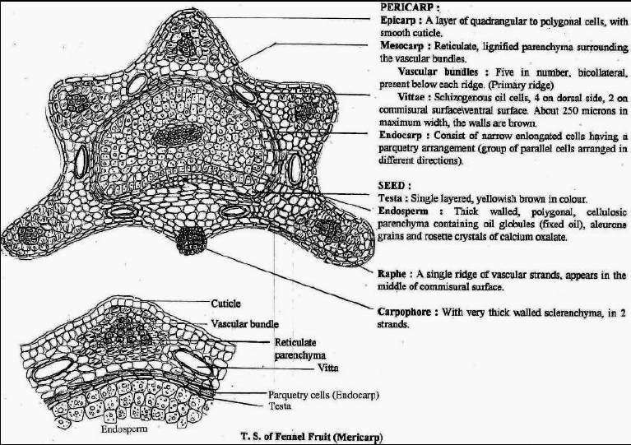
Foeniculi amari fructus CzPh 2017
Foeniculi dulci fructus CzPh 2017
http://awmkhan.blogspot.com/p/some-t_7151.html

Slide 24
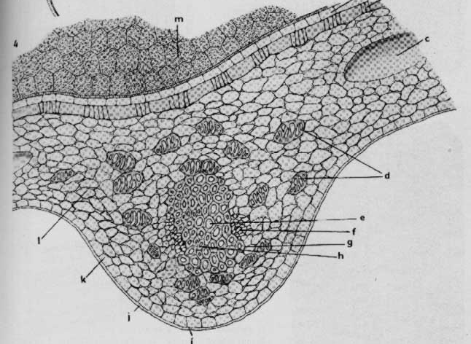
Foeniculi amari fructus CzPh 2017
Foeniculi dulci fructus CzPh 2017
Microscopy:
endosperm
cell with essential oil
parquetry block
cells of testa
septular cells
vascular bundle collateral
exocarp

Slide 25
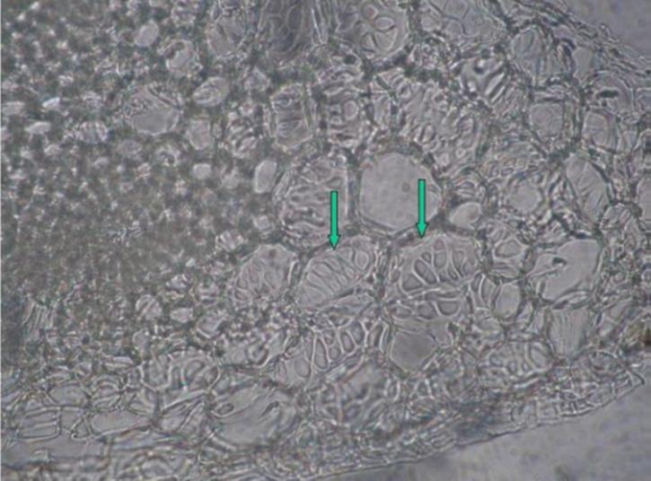
Foeniculi amari fructus CzPh 2017
Foeniculi dulci fructus CzPh 2017
septular cells

Slide 26
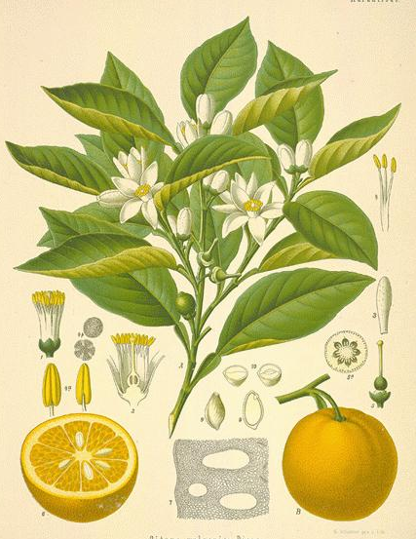
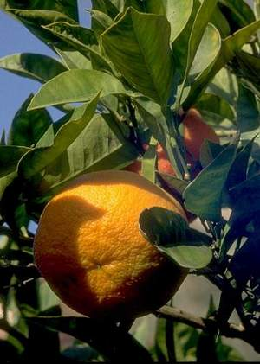
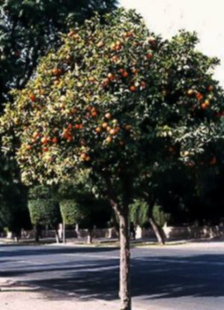
Aurantii dulce pericarpium CzPh 2017
Aurantii amari pericarpium CzPh 2017
Mother plant: Citrus aurantium subsp. aurantium, or var. dulcis, Rutaceae, Orange
  Aurantii amari pericarpii tinctura CzPh 2017
  Aurantii dulcis pericarpii etheroleum CzPh 2017

Slide 27
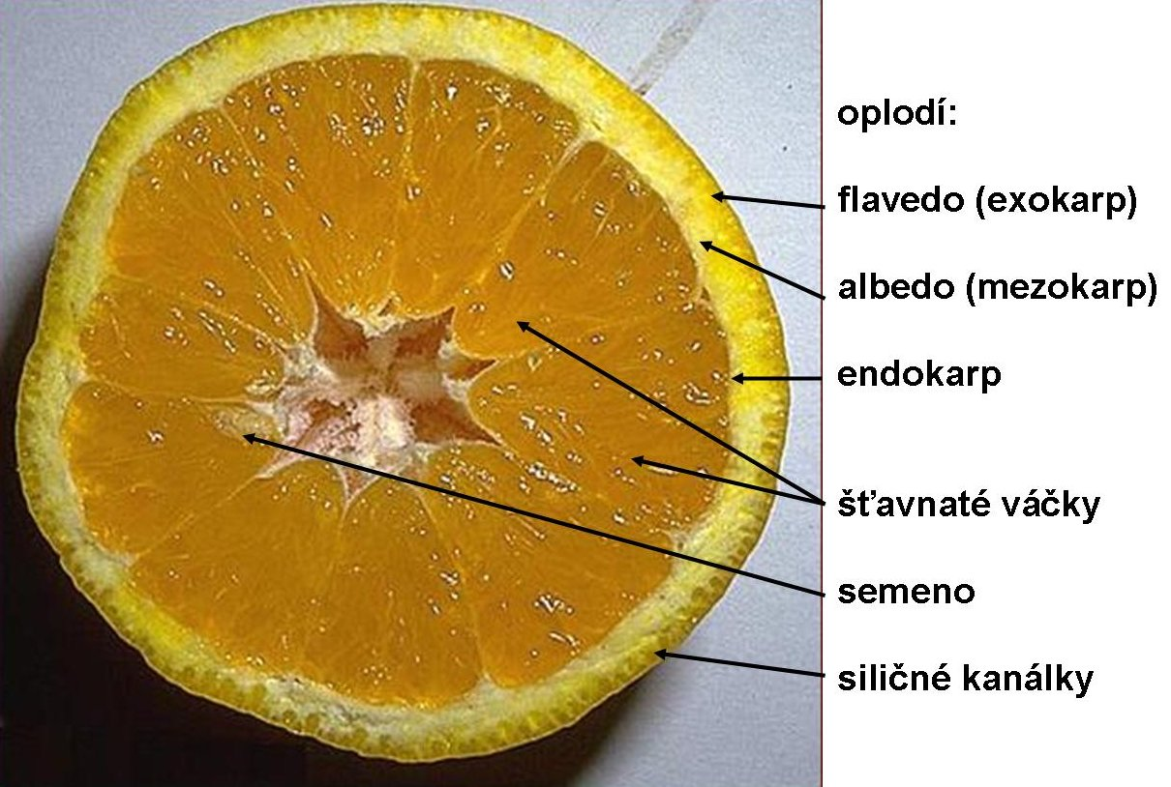
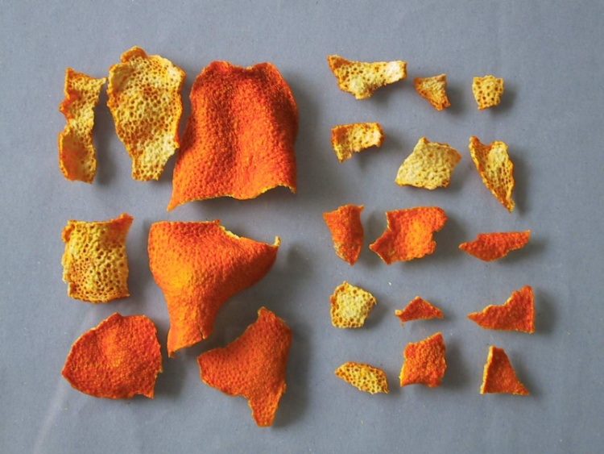
Aurantii dulce pericarpium CzPh 2017
Aurantii amari pericarpium CzPh 2017
Macroscopy: irregular circular pieces, at the end sharpened, externally orange, glandularly pointed from tubules with essential oil, internal side yellowish
juicy vesicles
juicy vesicles
seed
essential oil channels

Slide 28
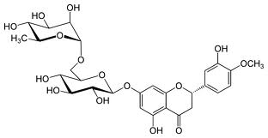
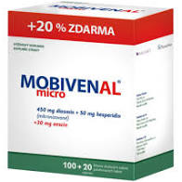
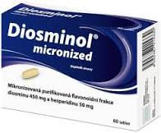
Aurantii dulce pericarpium CzPh 2017
Aurantii amari pericarpium CzPh 2017
Content compounds: essential oil, (limonen, linalol), flavonoids (rutin, hesperidin, naringin) carotenoids, xantophylls, bitter substances
Usage: amare, cholagogue, taste corrigent
limonen
hesperidin
Notes:
Hesperidin is part of several venoprotective drugs such as Detralex, Mobivenal, Diosminol.

Slide 29
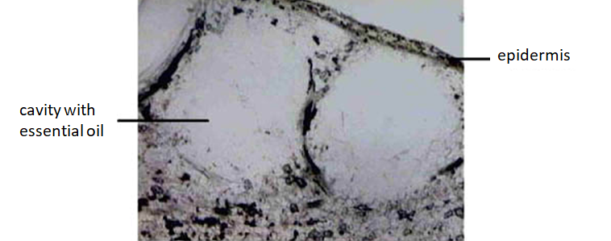
Aurantii dulce pericarpium CzPh 2017
Aurantii amari pericarpium CzPh 2017
Microscopy: epidermis with stomata, in parenchyma crystals of calcium oxalate and hesperidin, 1-2 lines of schiso-lyzigennic tubules with essential oil, rarely vascular bundles

Slide 30
MACROSCOPY

Slide 31
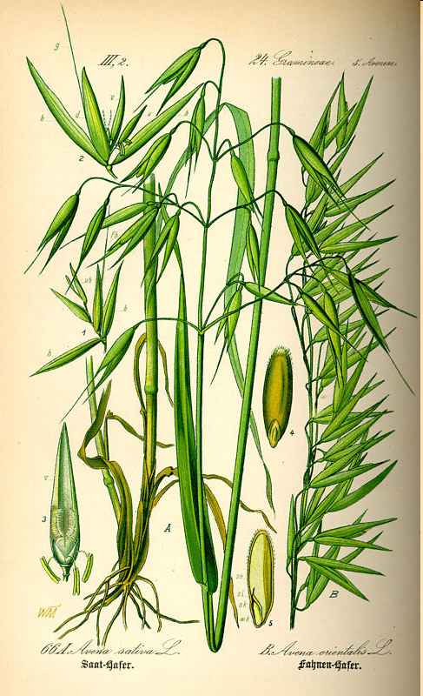
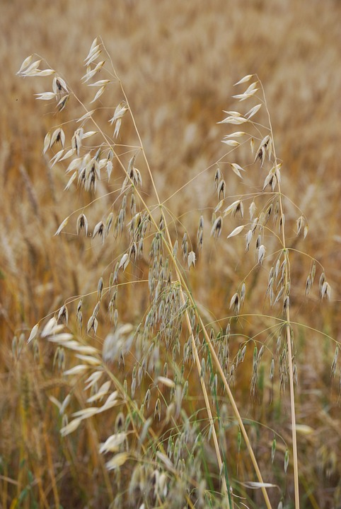
Avenae fructus
Mother plant: Avena sativa, Poaceae, Oat

Slide 32
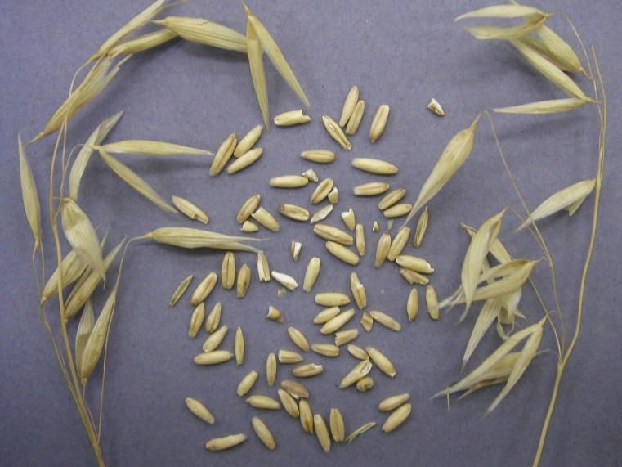
Avenae fructus
Macroscopy: longer and slimmer caryopsis of yellowish colour, without odour, taste mucilaginous floury
Content compounds: proteins, oils, mineral compounds, vitamins, amino acids, saponins, sugars, glucokinins
Usage: dietetic, metabolic, sedative, hypotensive, antidiabetic

Slide 33
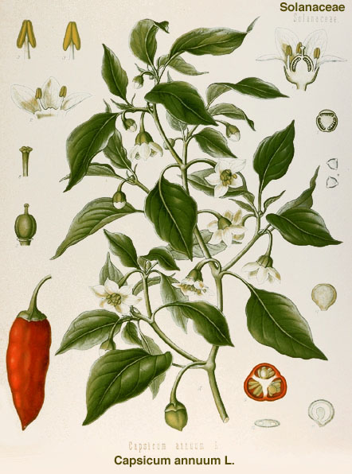
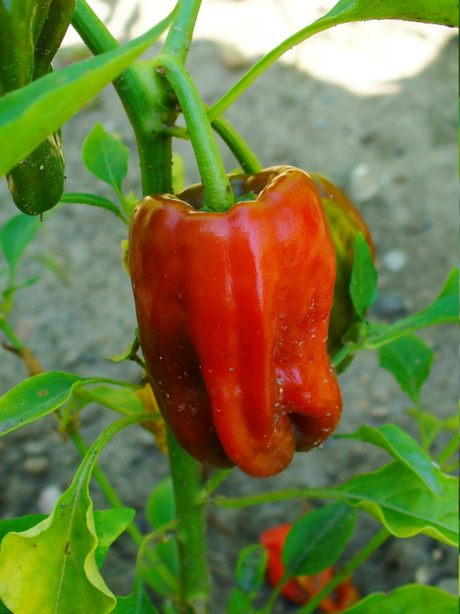
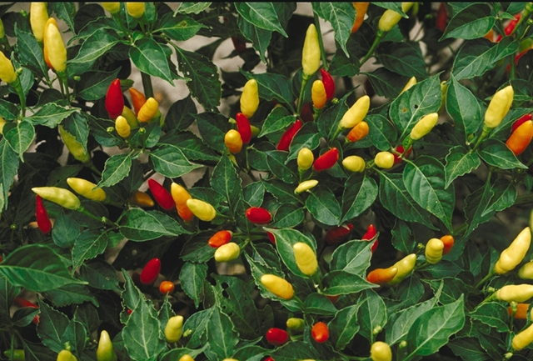
Capsici fructus CzPh 2017
Mother plant: Capsicum anuum var. minimum, C. frutescens Solanaceae Pepper
  Capsici oleoresina raffinata et quantificata CzPh 2017
  Capsici tinctura normata CzPh 2017
  Capsici acris extractum spissum normatum CzPh 2017

Slide 34



Capsici fructus CzPh 2017
Macroscopy: spindle like berry, hollow, numerous yellow kidney-shaped seeds, leatherlike pericarp is externally shiny, smoothly stripped, internally wrinkled, weak spicy odour, spicy later hot taste

Slide 35

Capsici fructus CzPh 2017
Content compounds: alkaloid capsaicin, carotenoids (capsanthin), vitamins B₂, C, flavonoids, essential oil, sugars
Usage: stomachic, external derivans, rubefacient for rheumatism treatment
Spiciness is measured in Scoville Heat Units
kapsaicin
Notes:
Capsaicin activates sensory neurons for heat therefore it creates a burning sensation whereever it is applied. It inhibits pain transmission from nociceptive nerve fibers to spinal cord, it is used in topical creams or topical patches to treat muscle or joint pain associated backache, bruises, strains and arthritis; also neuropathic pain.

Slide 36
Capsici fructus CzPh 2017
Scoville heat units | Example peppers
800,000 to 3,200,000 | Pepper X, Carolina Reaper, Dragon's Breath
350,000 to 800,000 | Red savina,Chocolate habanero
100,000 to 350,000 | Habanero, Scotch Bonnet
10,000 to 100,000 | Malagueta pepper, Cayenne pepper, Tabasco pepper
1,000 to 10,000 | Guajillo pepper, Jalapeño
100 to 1,000 | Banana pepper, Cubanelle
0 to 100 | Bell pepper, Pimento
Pungency | SHU
Very highly pungent | Above 80,000
Highly pungent | 25,000 to 70,000
Moderately pungent | 3,000 to 25,000
Pungency | SHU
Mildly pungent | 700 to 3,000
Non pungent | 0 to 700

Slide 37


Carvi fructus CzPh 2017
Mother plant: Carum carvi, Apiaceae, Caraway, Persian cumin
  Carvi etheroleum ČL 2009

Slide 38


Carvi fructus CzPh 2017
Macroscopy: diachenium flattened from sides, brown, 5 ribs, bald rough surface, odour and taste typical aromatic
Content compounds: essential oil (carvone, limonene), oil, proteins, sugars, flavonoids
Usage: carminative, spasmolytic, stomachic, digestive, bacteriostatic
karvon

Slide 39


Crataegi fructus CzPh 2017
Mother plant: Crataegus laevigata syn. C. oxyacantha, Crataegus monogyna, Rosaceae, Hawthorn

Slide 40


Crataegi fructus CzPh 2017
Macroscopy: without odour, acidic taste
  C. oxyacantha- fruits oval to spherical shape, calyx has got the scarification after stalk, 2-3 seedless
  C. monogyna- fruits barrel-like shape, one seedless
Content compounds: flavonoids (hyperoside, rutin), aminopurines, saponins, catechine tannins, vitamins, triterpenic acids (ursolic acid, crataegic acid)
Usage: antisclerotic, hypotensive, sedative, venoprotective effect
hyperoside
Notes:
Flavonoids are present as either O-glycosides (quercetin, rutin) or C-glycosides (vitexine, isovitexine).
Antisclerotic – lowers the deposition of cholesterols into vessels.

Slide 41


Cynosbati fructus CzPh 2017
Mother plant: Rosa canina, Rosa pendulina Rosaceae, Dog Rose

Slide 42


Cynosbati fructus
Macroscopy: hypanthium oval, fleshy, shiny, dark red, inside hard achenes placed in small sharply hispid trichomes, honey-like odour, taste sweet-acid, mild astringent
Content compounds: vitamins C, B, K, sugars, pectins, carotenoids, tannins
Usage: vitaminiferic, diuretic, mild laxative, tonic
ascorbic acid
Notes:
Used fort treating colds. High content of sugar makes it ideal for marmelades.

Slide 43



Juniperi fructus
Mother plant: Juniperus communis, Cupressaceae Juniper
  Juniperi etheroleum ČL 2009

Slide 44


Juniperi fructus
Macroscopy: spherical fruit, bald, shiny, frosted-like, on the top three-rayed joint, brown-green pulp with three hard 3-edged seeds, resinous odour, taste sweet than aromatic
Content compounds: essential oil (terpinen-4-ol, pinens, sabinene), sugars, bitter substances, ascorbic acid, tannins, leucoanthocyanins
Usage: diuretic, stomachic, urinary desinficient, cholagogue, spices, liqueurs
terpinen-4-ol
Notes:
Leucoanthocyanins help to regenerate pigments in eye.

Slide 45


Myrtilli fructus recens CzPh 2017
Myrtilli fructus siccus CzPh 2017
Mother plant: Vaccinium myrtillus, Ericaceae, Blueberry
  Myrtilli fructus recentis extractum siccum raffinatum et normatum CzPh 2017

Slide 46

Myrtilli fructus recens CzPh 2017
Myrtilli fructus siccus CzPh 2017
Macroscopy: shrivelled berries with small stalk, on the top residues of calyx with deeper place, blue-purple pulp with numerous seeds, without odour, sweet-acid acrid taste
Content compounds: catechine tannins, anthocyanins, organic acids (caffeic, cinnamic acid), pectine, sugars
Usage: antidiarrhoic, desinficient, dietetic, astringent

Slide 47


Papaveris fructus
Mother plant: Papaverum somniferum, Papaveraceae, Poppy

Slide 48


Papaveris fructus CzPh 2017
Macroscopy: capsules, perfectly ripen poppy heads of spherical shape, matte bright brown, ovary terminated by imperfect segmented radial stigma, narcotic odour, bitter taste

Slide 49





Papaveris fructus CzPh 2017
Content compounds: opium alkaloids (15-25% of latex) - morphine, codeine, thebaine, noscapine, papaverine, in form of different salts, meconic acid
Usage: isolation of alkaloids.
morfin
papaverin
noscapin
Notes:
Opium alkaloids are divided into three groups based on their structure: morphinane (morphine, codein, thebain), benzylisoquionoline (papaverine), phtalideisoquinoline (noscapin).
Opium is white latex obtained by cutting into green unripe poppy heads. It is collected after drying as a brown substance.
Opium alkaloids create strong addiction. They bond to opioid receptors.
Morphin – strong analgesic effect. Papaverin is a spasmolytic. Codein is a derivative of morphine with antitussic properties and less addiction chance. But it metabolises into morphine – and this morphine is responsible for euphoria and addiction.
Opoids have analgesic, antitussic effects, they cause euphoria and they also suppress diarrhea . In chronic users a tolerance develops but is different for different effects: it easily develops for analgesic, antitussic and euphoric effects – so users need larger dose for the same effect. However, tolerance does not develop for constipation.
Derivatives of opoid alkaloids include tramadol, which was considered to be non-addcitive. Tramadol is used as a strong analgesic, but it also induces euphoria and for this is abused by many people.

Slide 50


Phaseoli fructus sine semine CzPh 2017
Mother plant: Phaseolus vulgaris, Fabaceae, Common Bean

Slide 51

Phaseoli fructus sine semine CzPh 2017
Macroscopy: legumes, on the surface matte yellowish, without seeds, at the end sharpened, screwed, without odour, mucilaginous taste
Content compounds: amino acids (arginine), triterpens, organic acids, allantoin, choline, mineral compounds (chromium salts), hemicelluloses, glucokinins
Usage: antidiabetic, metabolic, dermatologic

Slide 52


Sennae acutifoliae fructus CzPh 2017
Sennae angustifoliae fructus CzPh 2017
Mother plant: Cassia senna (acutifolia), Cassia angustifolia, Fabaceae

Slide 53



Sennae acutifoliae fructus CzPh 2017
Sennae angustifoliae fructus CzPh 2017
Macroscopy: without odour, bitter mucilaginous taste
  C. senna – flat kidney-shaped legumes up to 3.5 cm long, with brown spots corresponding to seeds positions, translucent, markedly sharpened, shortly stalked, 6-7 seeds
  C. angustifolia – legumes insignificantly kidney-shaped, yellow-brown to yellow with brown spots, 5-8 seeds

Slide 54

Sennae acutifoliae fructus CzPh 2017
Sennae angustifoliae fructus CzPh 2017
Content compounds: dianthrone derivatives – sennosides A, B, C, D, mucilage, flavone glucosides, bitter substances, tannins
Usage: irritant laxative
sennoside A
Notes:
Sennae fructus contains less sennosides than sennae folium, so it has less potent lôaxative effect.
Sennosides increase secretion of water into bowels and irritate it. Senna should not be used frequently, because frequent use can cause lazy bowel syndrome. The bowels can loose their defecating reflex and for their proper function it is necessary to take senna or other laxative.
Tea from senna should be prepared with lukewarm water, not boiling water. Too hot water extracts also other irritative compounds such as resin substances. Use of such extract can cause bloody diarrhea with very painful cramps.
Laxatives usually work 8-12 hours after consuming them. It is best to consume laxative in the evening and and the effect takes place in the morning.
For people with chronic constipation – better to use laxatives that are not addictive (lactulose) or adhjusting their diet to contain more fruit, vegetables.

Slide 55
Some interesting tips
List of crude drugs assorted according to their main effect and usage:
http://awmkhan.blogspot.com/p/blog-page.html
Portal about medicines for patients and healthcare professionals:
https://www.drugs.com/
Bioinformatics and cheminformatics portal with detailed drug data:
https://www.drugbank.ca/

