Slide 1
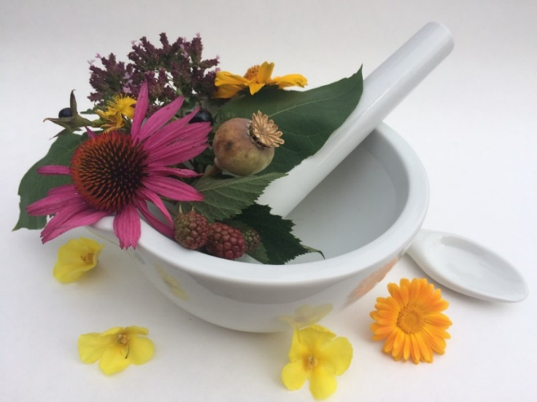
Pharmacognosy lab exercise 11
Drugs - seeds

Slide 2
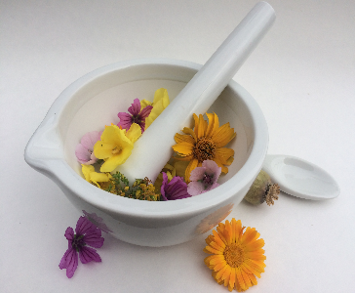

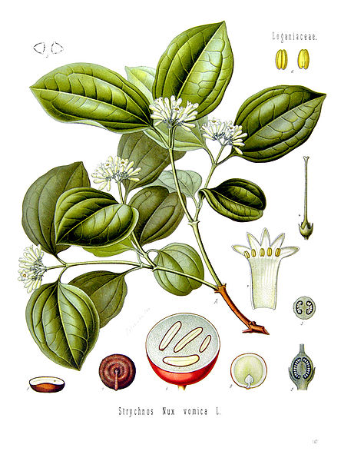
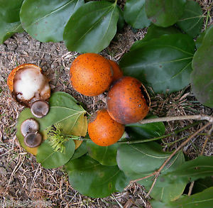
Strychni semen
Mother plant: Strychnos nux-vomica, Loganiaceae (Strychnaceae), Nux vomica, Poison Nut, Semen strychnos, Quaker Buttons

Slide 3
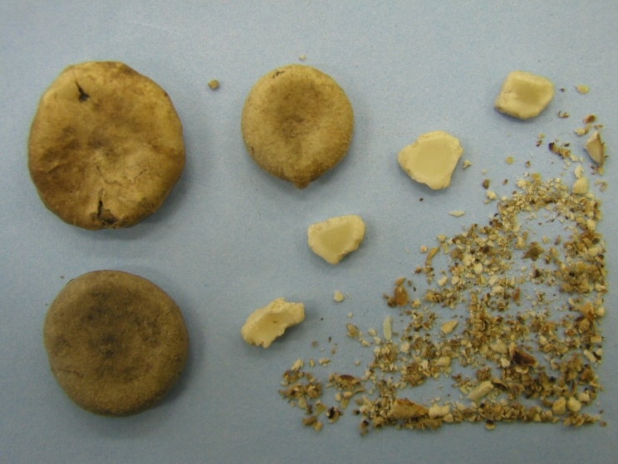
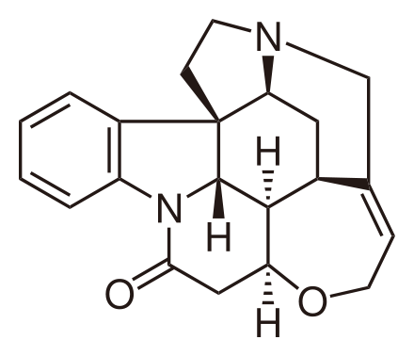
Strychni semen
Macroscopy: discoid seed, on the margin thicken, size 2,5 cm, greenish to grey-yellow colour, silky shiny, densely felt-like, without odour, very bitter taste
Content compounds: indole alkaloids - strychnin, brucin, bitter substances, choline, sugars, oil
Usage: analeptic
strychnin

Slide 4
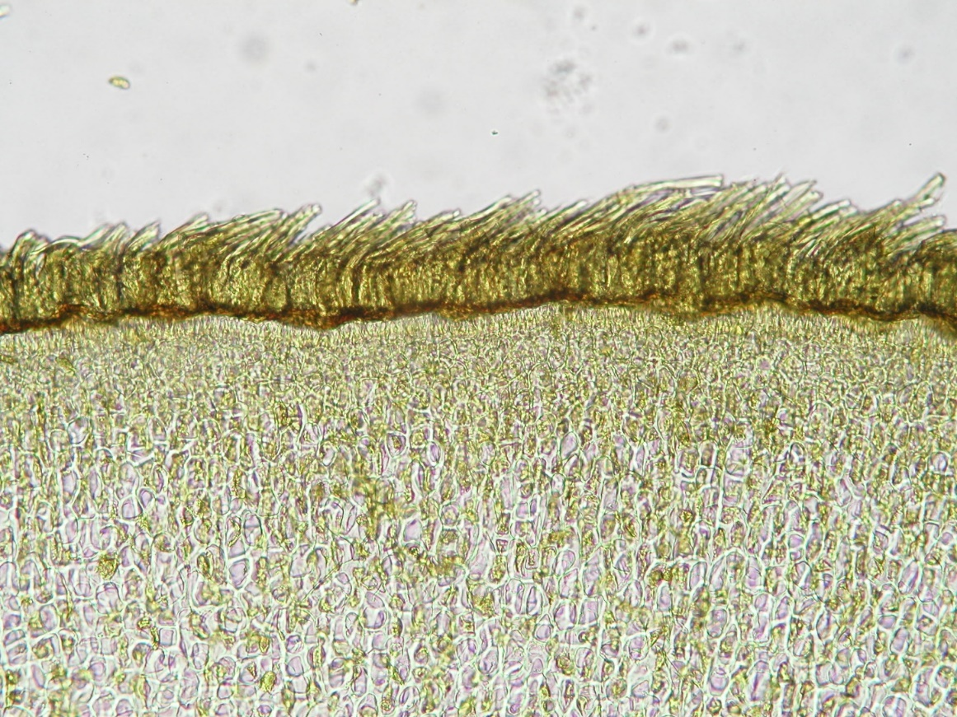
Strychni semen
Microscopy: epidermal cells pass to thick-walled trichomes nodular curved with club-like pointed base, nutritious layer with hardly pressed cells, endosperm with plasmodesma, with aleuronic grains and fat droplets

Slide 5
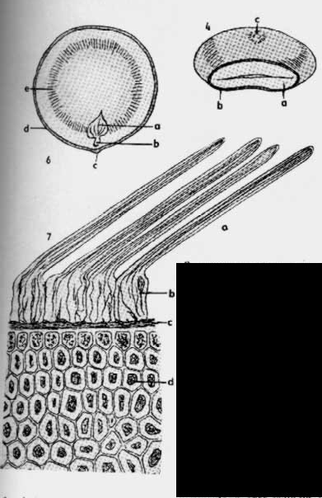
Strychni semen
Microscopy:
trichomes
nutritious layer
endosperm

Slide 6
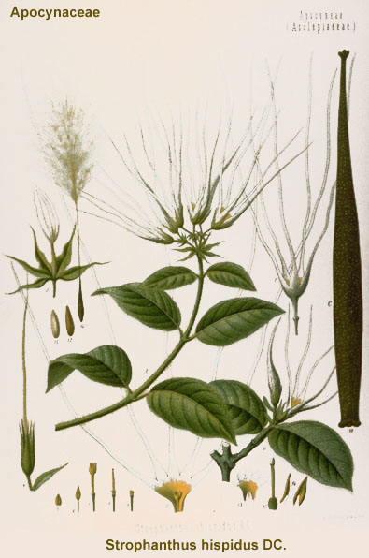
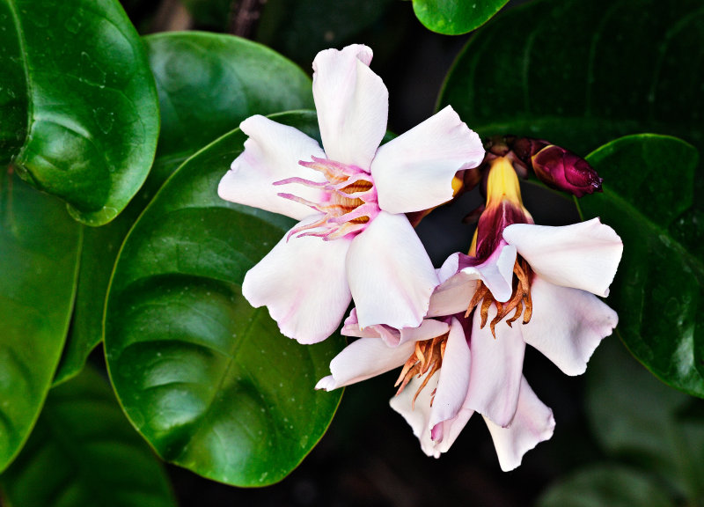
Strophanti semen
Mother plant: Strophantus gratus, Strophantus combé, Apocynaceae

Slide 7
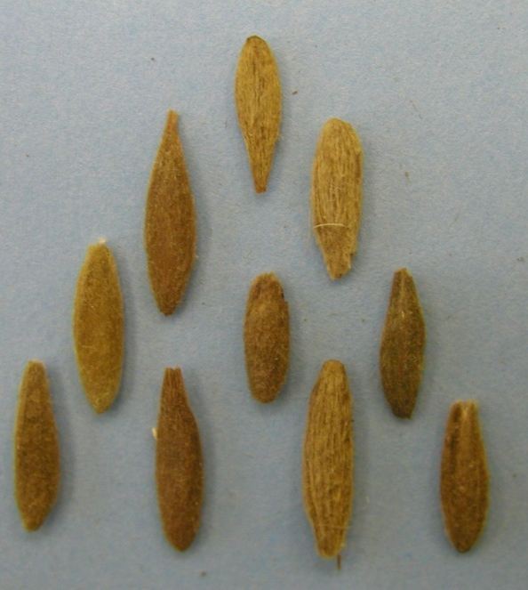
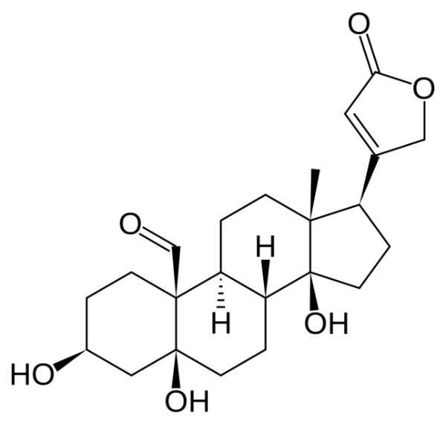
Strophanti semen
Macroscopy: seeds of spindle-like shape, pressed, sharpened, sharp-edged, without residue of awn, 2 cm length, yellow to brown-yellow, characteristic odour, persistent bitter taste
Content compounds: cardioglycosides, saponins, proteases, choline, oil
Usage: for isolation of cardioglycosides, cardiotonic
k-strofantidin

Slide 8
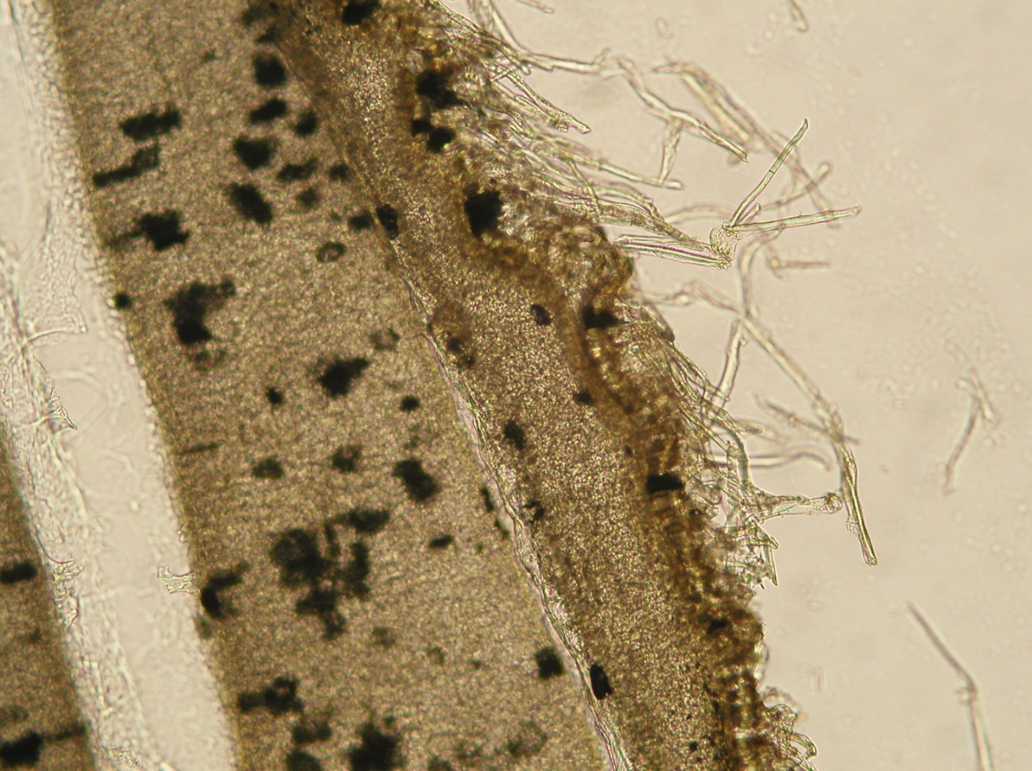
Strophanti semen
Microscopy: grainy cuticle, tangential prolonged epidermal cells, papilla-like trichomes, layer of pressed nutritious cells, endosperm, embryo

Slide 9
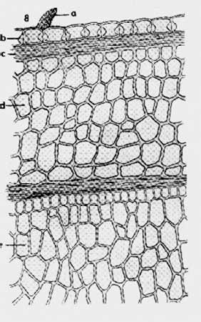
Strophanti semen
Microscopy:
trichome
nutritious layer
endosperm
embryo

Slide 10
MACROSCOPY

Slide 11
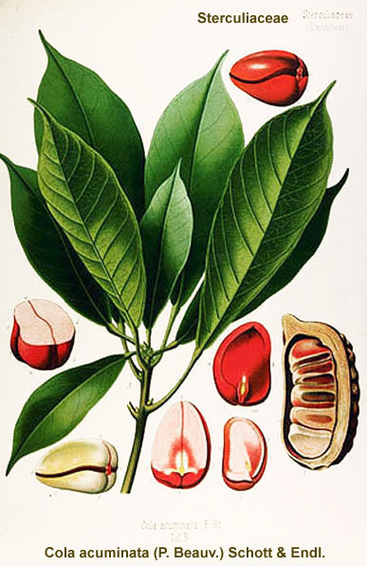
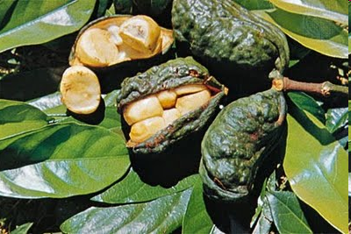
Colae semen CzPh 2017
Mother plant: Cola nitida, Cola acuminata, Cola vera, Malvaceae (Sterculioideae) Cola nut

Slide 12
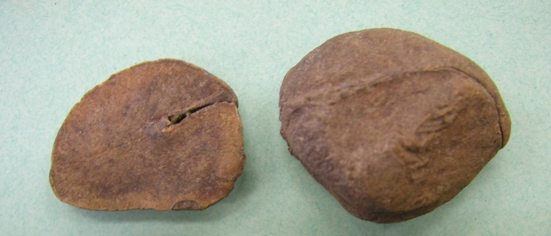
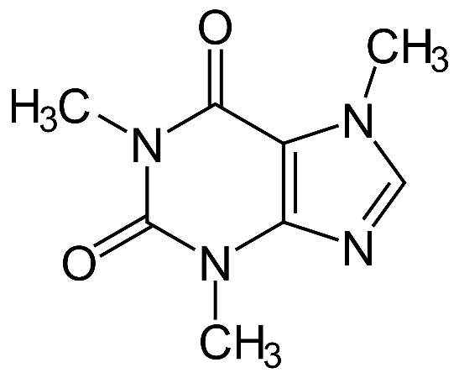
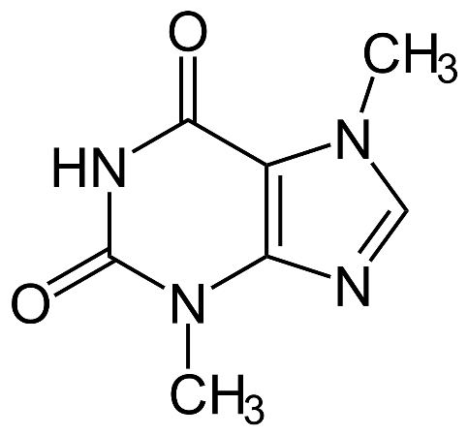
Colae semen CzPh 2017
Macroscopy: seeds - embryo, testa is removed, posses 2 (C. vera) or 3-6 (C.acuminata) cotyledons, cola cotyledons are hard, externally smooth to roughly wrinkled, on the section grainy, externally dark brown, inside brighter, aromatic odour, nut-like bitterish taste
Content compounds: purine alkaloids- caffein, theobromin, fixed on tannins
Usage: roborant, stimulant, refreshing beverages
caffein
theobromin

Slide 13
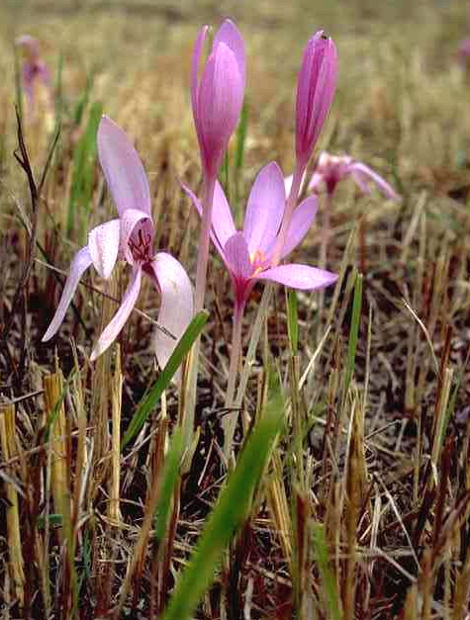
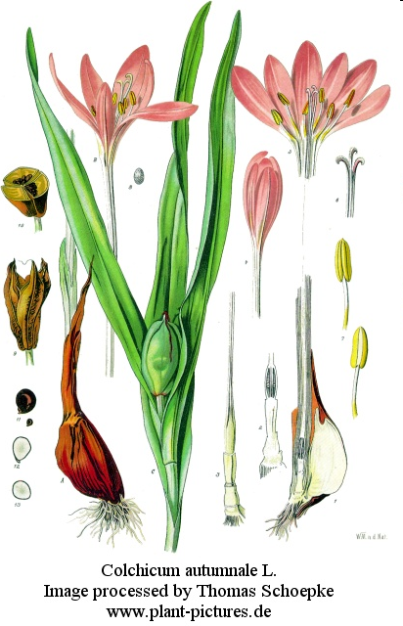
Colchici semen
Mother plant: Colchicum autumnale, Colchicaeae, autumn crocus, meadow saffron, naked lady

Slide 14
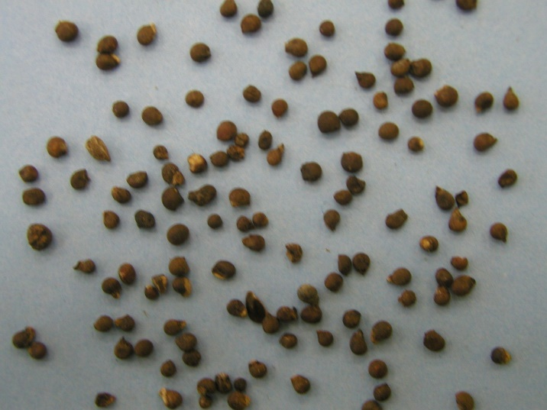
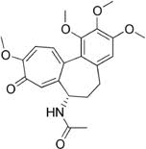
Colchici semen
Macroscopy: spherical, hard, in diameter cca 3 mm big, matte red to dark brown, fresh little bit sticky, wrinkled rough surface, without odour, sharp very bitter taste
Content compounds: alkaloids - colchicine, demecolcine; oil, tannins, proteins
Usage: antineoplastic, antiuratic
colchicine

Slide 15
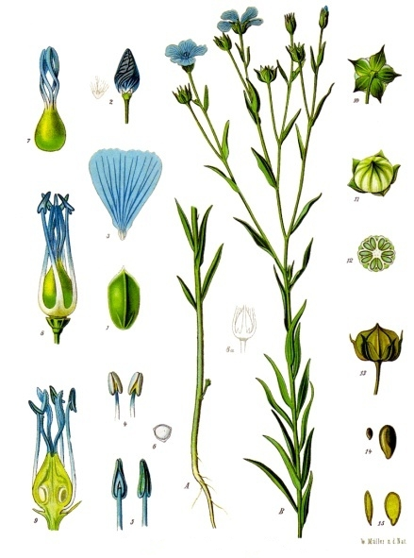
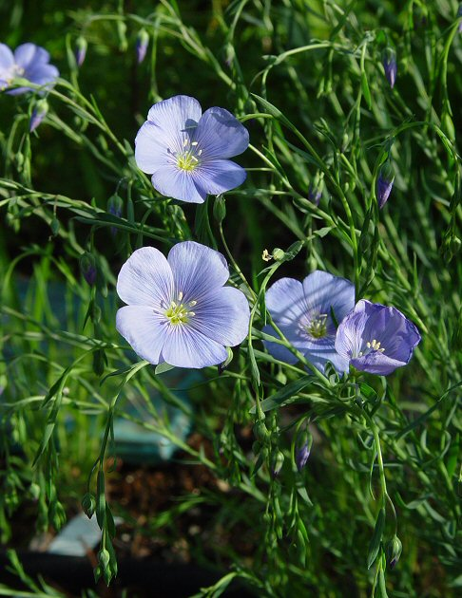
Lini semen CzPh 2017
Mother plant: Linum usitatissimum, Linaceae, Flax

Slide 16
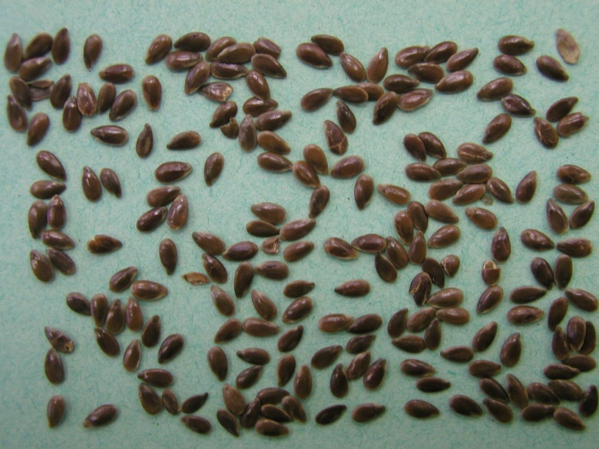
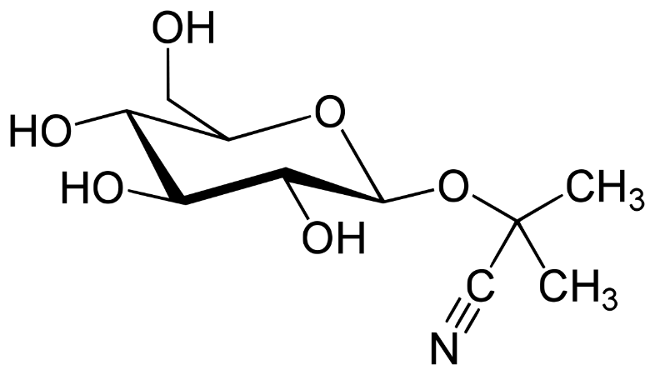
Lini semen CzPh 2017
Macroscopy: seeds oval, concave sharpened, flattened, on the margin thin with concave edge, to 6 mm long, yellow-brown to brown-red, shiny, without odour, taste mucilaginous, oily
Content compounds: mucilage, drying oil, proteins, cyanogenic glycosides (linamarin)
Usage: emolient, mucilaginous, laxative, protective of mucous layers
linamarin

Slide 17
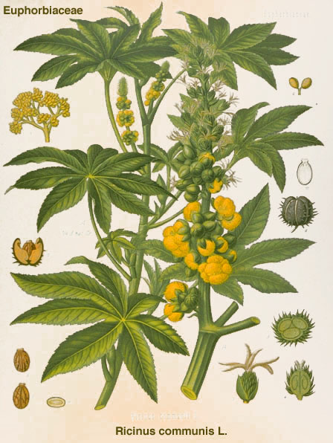
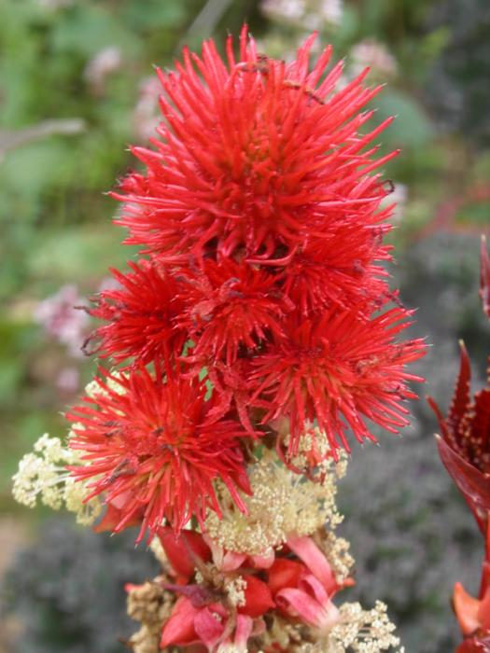
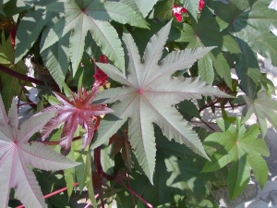
Ricini semen
Mother plant: Ricinus communis, Euphorbiaceae, Castor oil plant
  Ricini oleum hydrogenatum CzPh 2017
  Ricini oleum raffinatum CzPh 2017
  Ricini oleum virginale CzPh 2017

Slide 18
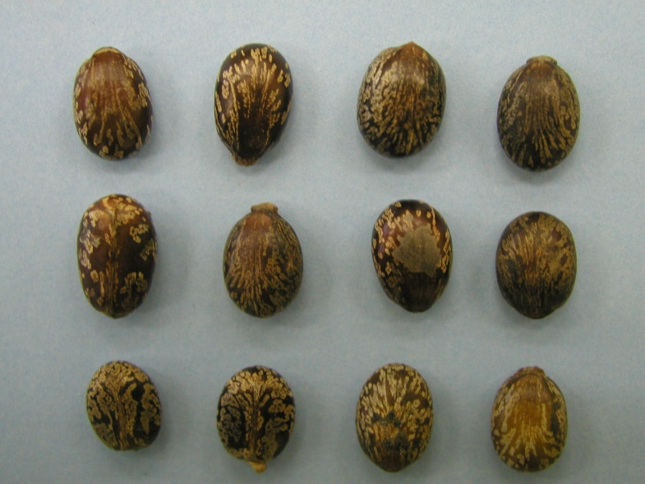
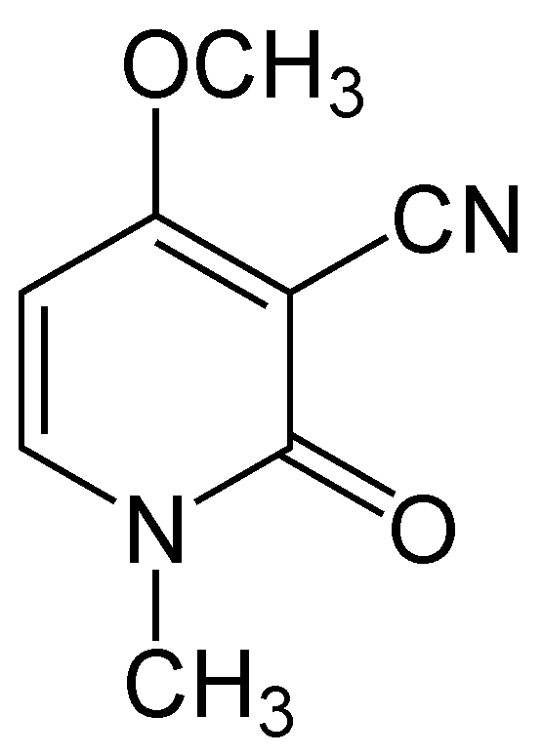
Ricini semen
Macroscopy: shiny seeds, grey-brown to red-brown stripped, oval, without odour, oily bitter taste
Content compounds: non-drying oil, lectines (ricin), alkaloid ricinine, lipases, mucilage-like compounds
Usage: laxative, dermatic and cosmetic
ricinine

Slide 19
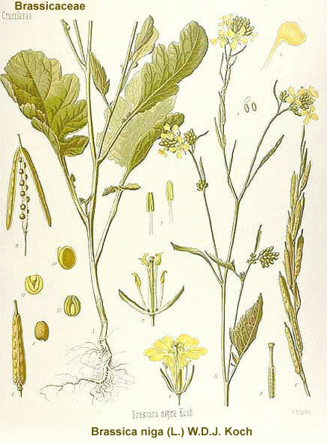
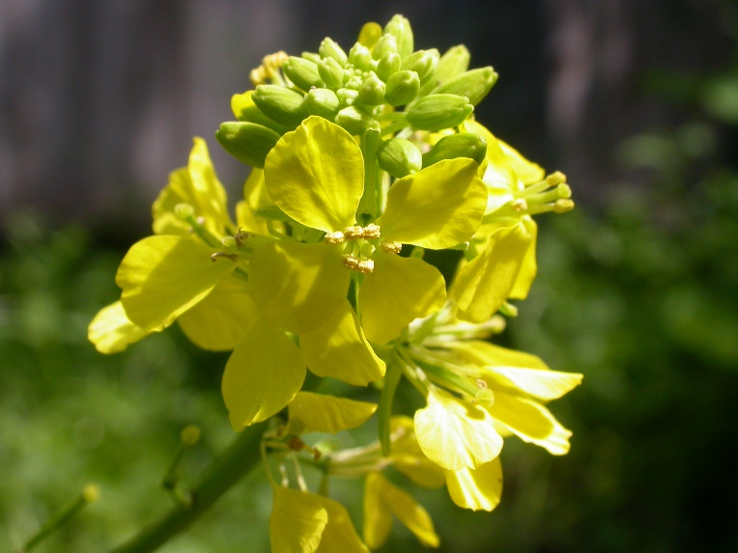
Sinapis semen
Mother plant: Brassica nigra, Brassicaceae, Black Mustard

Slide 20
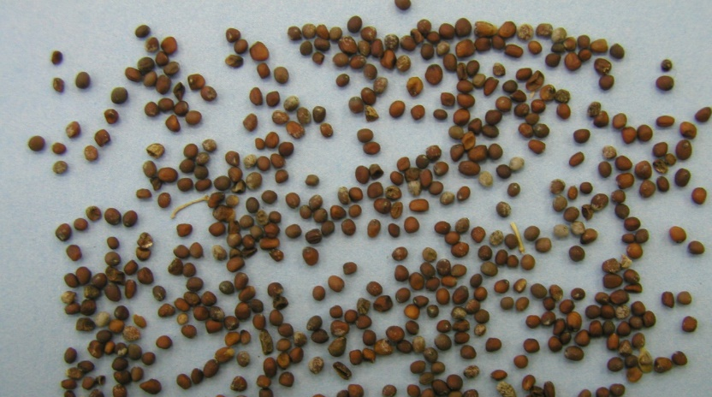
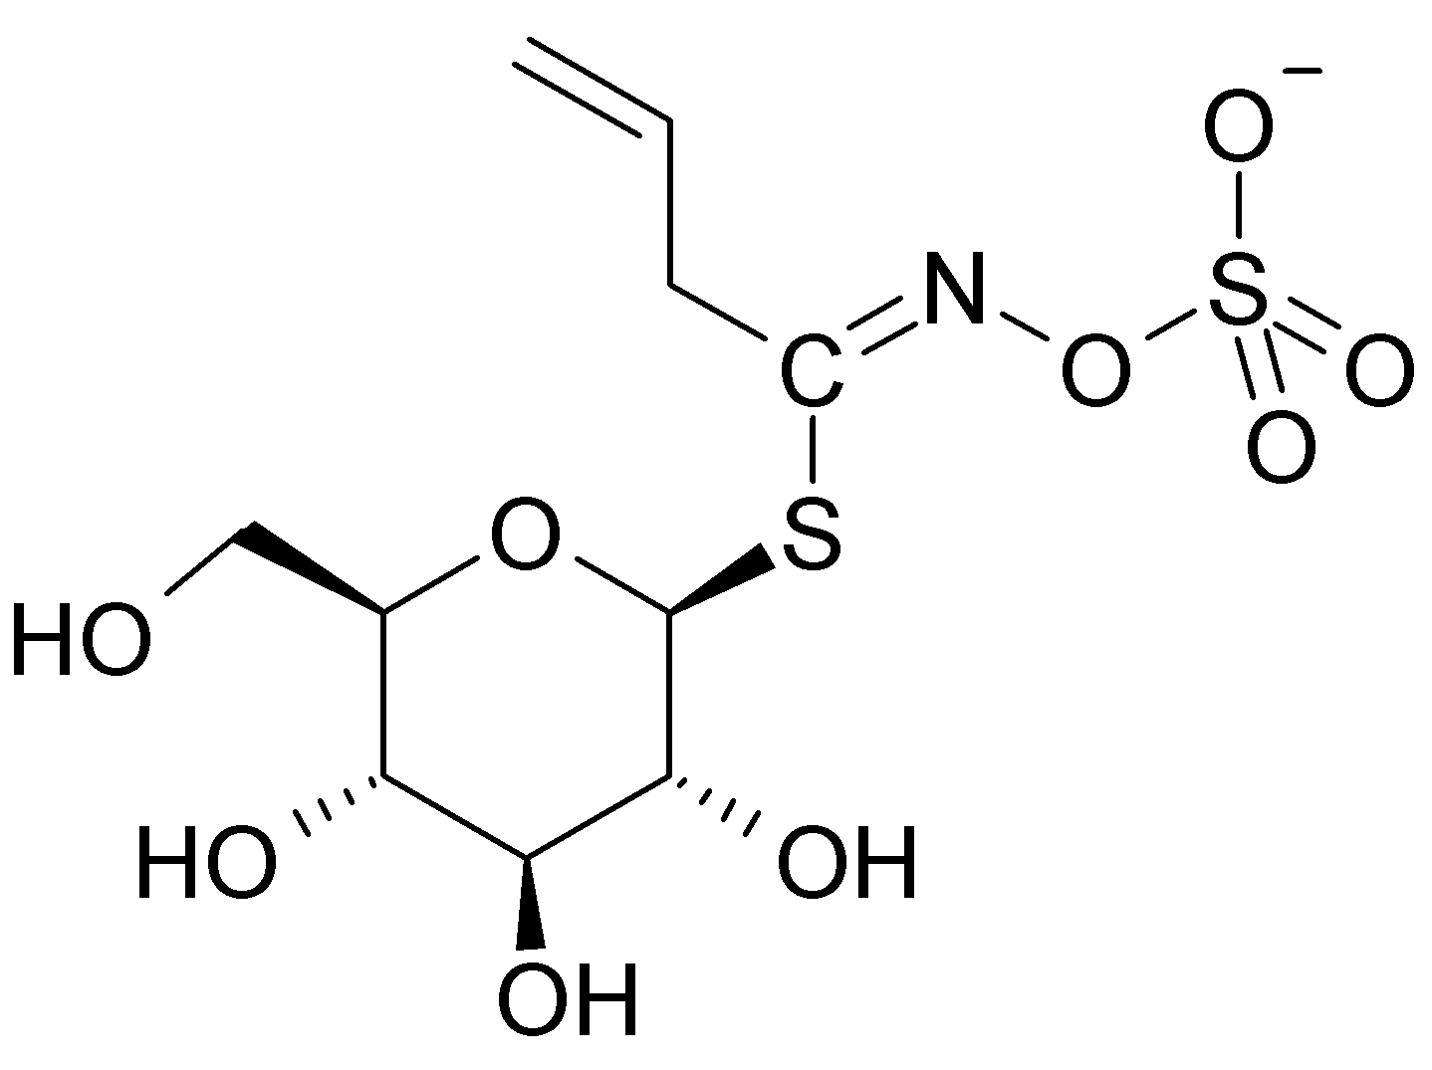
Sinapis semen
Macroscopy: almost spherical seeds, pale to red-brown, when dry – fragile, without odour, oily taste – later acidish and spicy hot
Content compounds: up to 35 % of oil, glucosinolate sinigrin, proteins, mucilage
Usage: derivant
sinigrin

