Slide 1
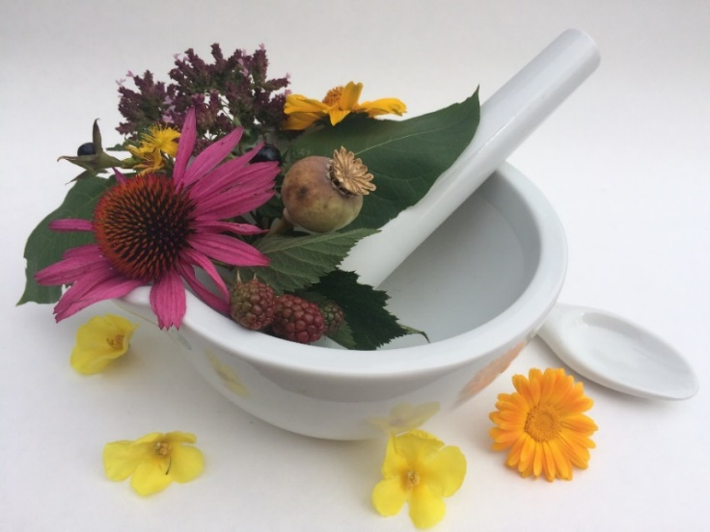
Pharmacognosy lab exercise 12
Macroscopy of miscellaneous drugs

Slide 2
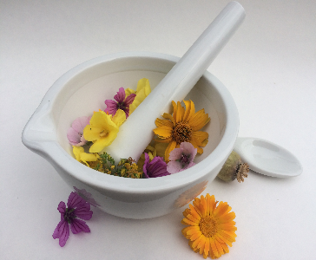
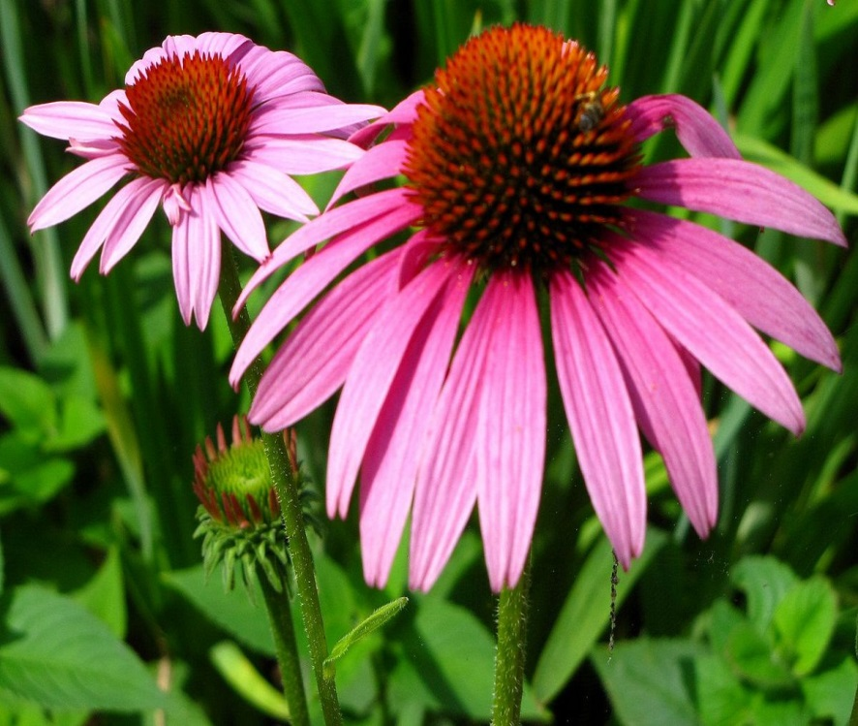
Echinaceae radix
CzPh 2017
Echinaceae angustifoliae radix
  - root of narrow-leaved coneflower
Echinaceae pallidae radix
  - root of pale purple coneflower
Echinaceae purpureae radix
  - root of purple coneflower

Slide 3
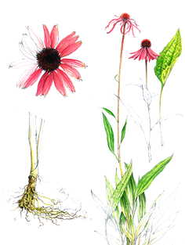
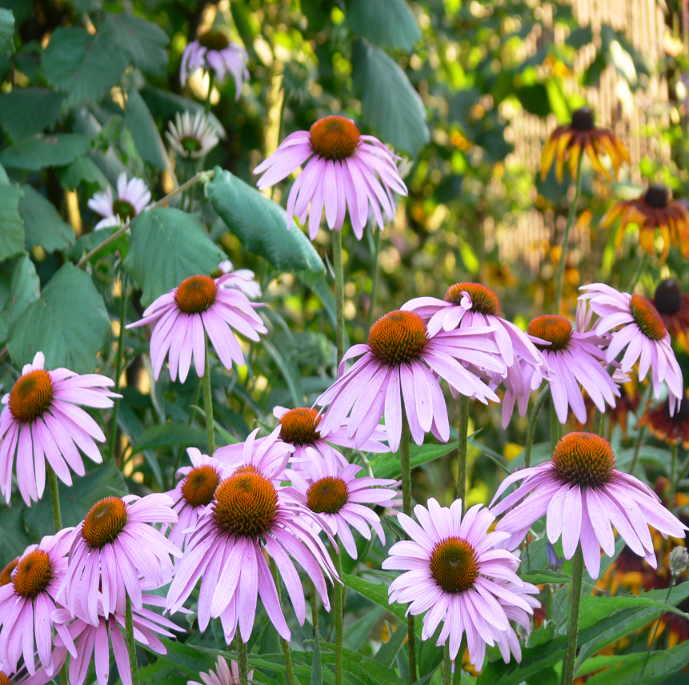
Echinaceae angustifoliae radix CzPh 2017
Mother plant: Echinacea angustifolia, Asteraceae, narrow-leaved coneflower root

Slide 4
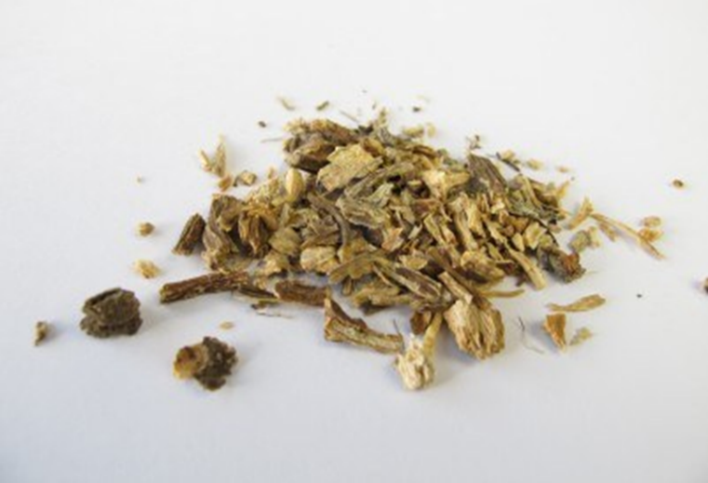
Echinaceae angustifoliae radix CzPh 2017
Macroscopy: tubular roots 15 mm in diameter, sometimes helically twisted, upper side is light brown to yellow-brown. The root fracture is short, dark brown with a radiant structure.
Notes:
MÚ: podpora funkce makrofágů, stimulace produkce cytokinů (IL, TNF-α), stimulace funkce NK buněk
KI: pacienti s progredujícími systémovými onemocněními (AIDS, TBC, roztroušená skleróza, alergie, astma,…), alergie na rostliny čeledi Asteraceae
NÚ: alergická dermatitida, kopřivka, GIT obtíže, suprese imunitního systému a leukopenie při dlouhodobém užívání (> 8 týdnů)
! Imunostimulační účinek způsoben převážně endofytními bakteriemi, ostatní látky se podílí svou protizánětlivou aktivitou (alkylamidy).

Slide 5
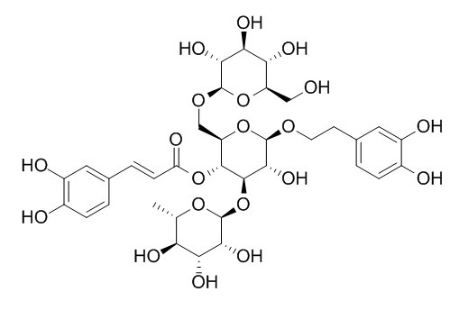
Echinaceae angustifoliae radix CzPh 2017
Content compounds: caffeic acid derivatives (echinacosid), polysaccharides, alkylamides, glycoproteins, traces of pyrolizidine alkaloids
Usage: immunostimulant (extracts of root and flower as dietary supplements), antivirotic, antimycotic, antirheumatic; externally for poorly healing wounds, inflammation
echinacosid

Slide 6
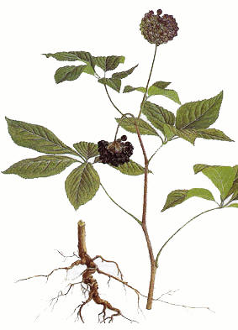
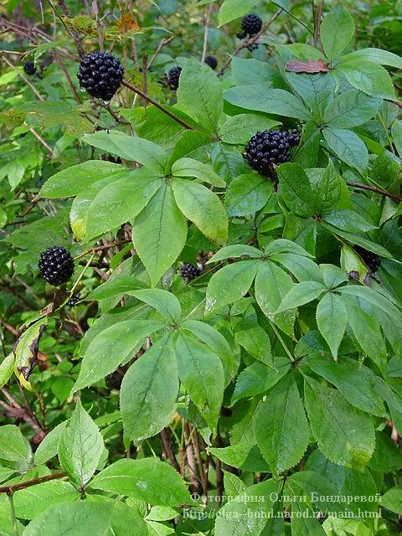
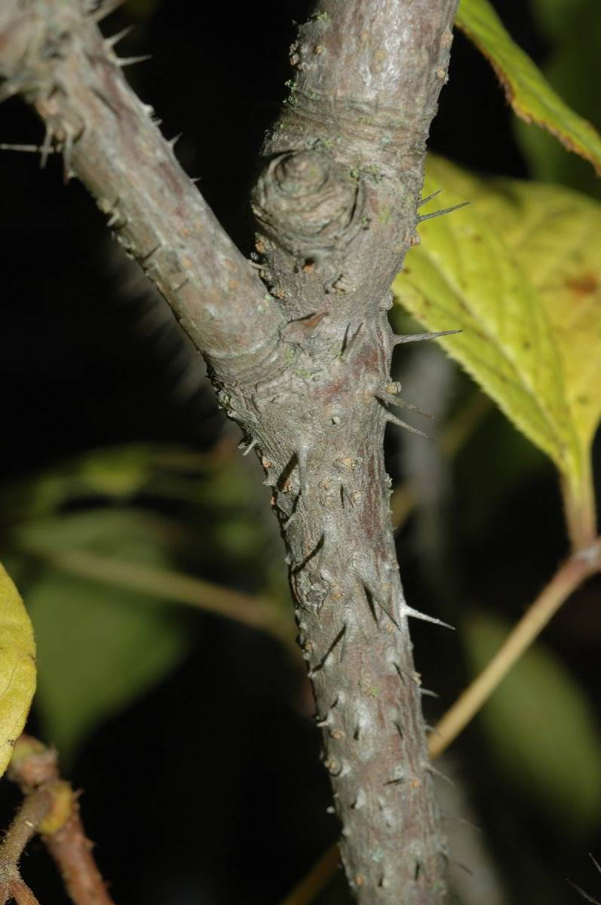
Eleutherococci radix CzPh 2017
Mother plant: Eleutherococcus senticosus (syn. Acanthopanax senticosus), Araliaceae (devil’s bush, siberian ginseng)

Slide 7
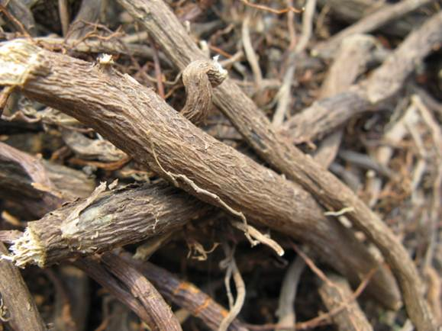
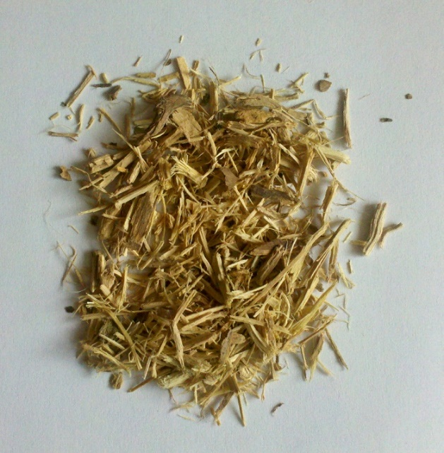
Eleutherococci radix CzPh 2017
Macroscopy: cylindrical rhizome with numerous nodular roots. The surface of the rhizome is bumpy, longitudinally grooved, gray-brown to red-brown. The roots are 3.5 -15 cm long, 0.3 -1.5 cm in diameter; on the surface smooth, gray-brown to black-brown. The bark is about 0.5 mm thick, close to the light yellow wood. After removing the bark, the root is yellow-brown.

Slide 8
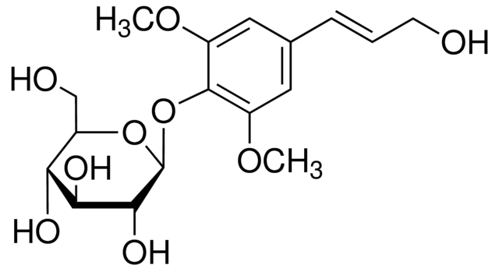
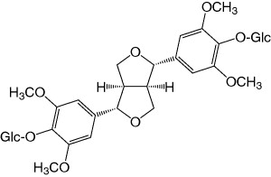
Eleutherococci radix CzPh 2017
Content compounds: saponins (eleutherosid A), phenylpropanoid glycosides (eleutherosid B) and lignans (eleutherosid E), coumarins (isofraxidin), polysaccharides, mineral compounds
Usage: adaptogen, tonic, immunostimulant; ethanolic root extract available as drops
eleutherosid B (= syringin)
- glycoside of sinapylalcohol
eleutherosid E = syringaresinol-diglucoside

Slide 9
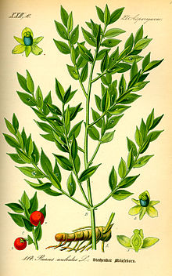
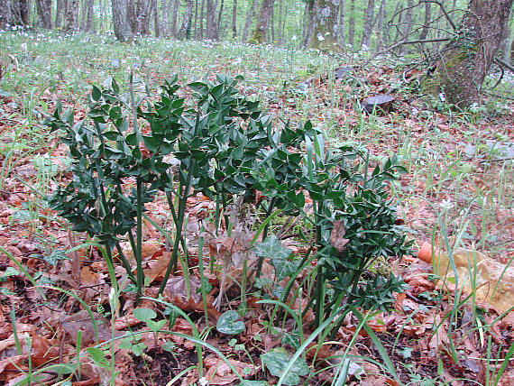
Rusci radix CzPh 2017
Mother plant: Ruscus aculeatus, Asparagaceae (butcher’s broom)

Slide 10
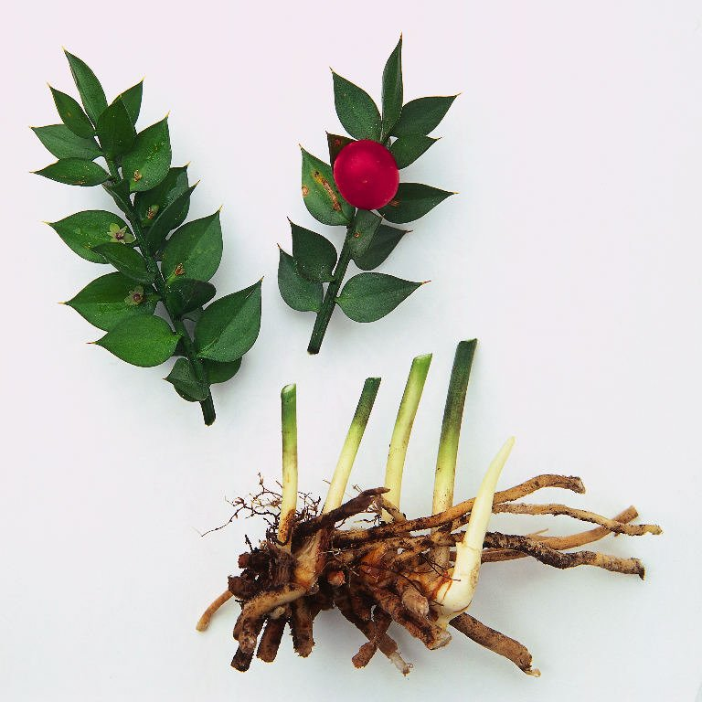
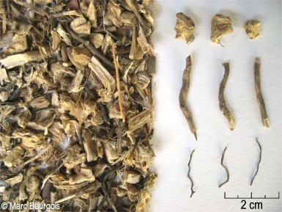
Rusci radix CzPh 2017
Macroscopy: The drug consists of a rhizome with roots. The rhizome consists of yellowish, branched, cylindrical pieces, on the surface with thin annular grooves. The underside of a rhizome with numerous roots or scars after them; roots about 2 mm in diameter have a similar color to the rhizome. The outer layer can be easily peeled off, the middle part under it is hard, yellowish white.

Slide 11
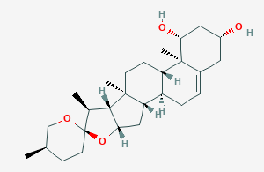
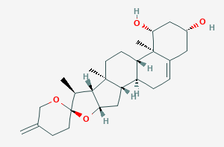
Rusci radix CzPh 2017
Content compounds: steroidal saponins (at least 1%) – ruscogenins, neoruscogenins; sterols, triterpenes, flavonoids, coumarins
Usage: vasoprotective, venoprotective
ruscogenin
neoruscogenin

Slide 12
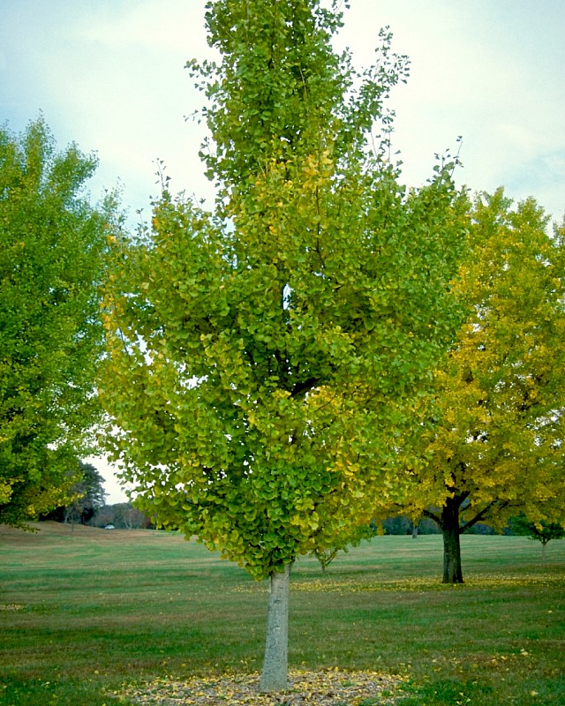
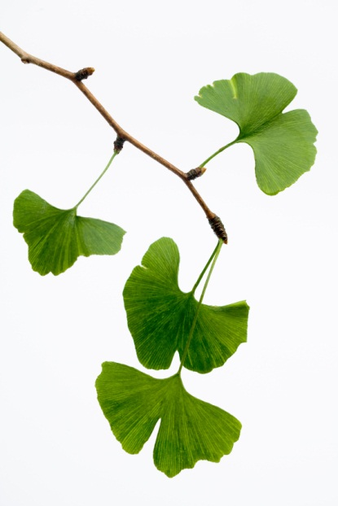
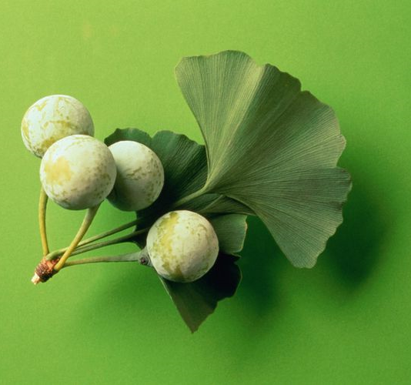
Ginkgo folium CzPH 2017
Mother plant: Ginkgo biloba, Ginkgoaceae (maidenhair tree)
Ginkgo extractum siccum raffinatum et quantificatum CzPh 2017
Notes:
Je to nahosemenná rostlina, nemá květy ani plody, vajíčka nejsou chráněna v květech a vyvíjející se semena v plodech.

Slide 13
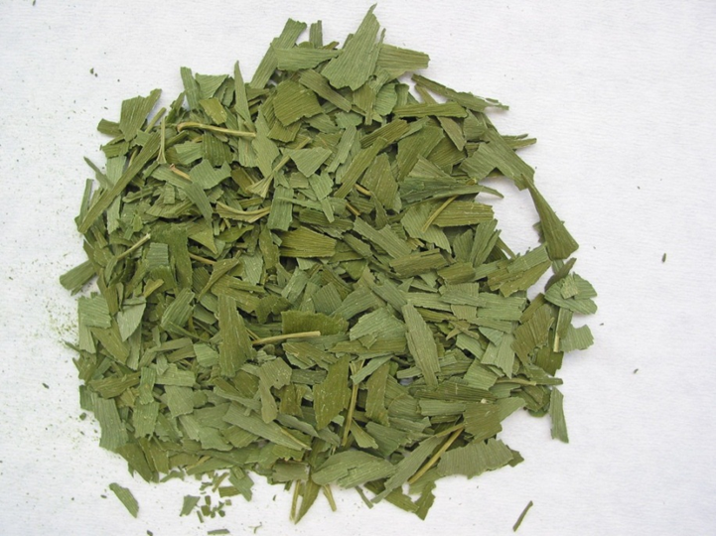
Ginkgo folium CzPH 2017
Macroscopy: The leaf is slightly darker on the upper side than on the lower side. The blade of the leaf is fan-shaped, usually bilobed or sometimes without lobes. The leaf is glabrous on both sides, the veins are dichotomous. The blade is wide at the upper edge with an irregular notch of various sizes

Slide 14
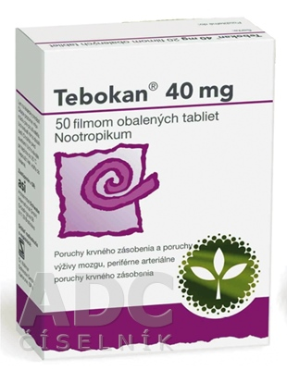
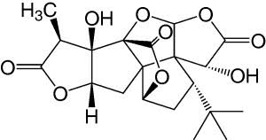
Ginkgo folium CzPH 2017
Content compounds: flavonoids, terpenic lactones, organic acids, carotenoids, saccharides
Usage: dementia treatment, nootropic, adjuvant vasodilatans; Ginkgo extractum siccum raffinatum et quantificatum - Gingio, Tanakan, Tebokan; dietary supplements (pills)
ginkgolid A

Slide 15
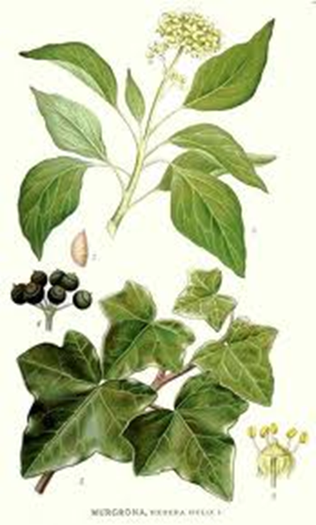
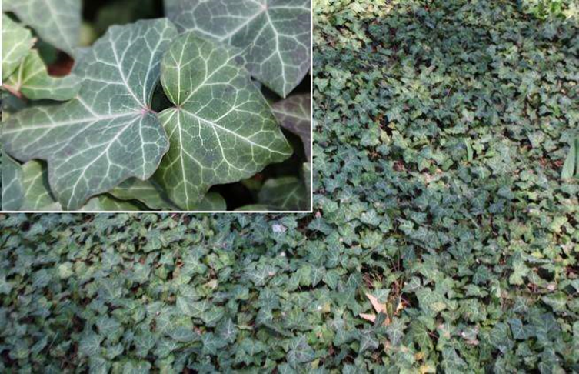
Hederae folium CzPh 2017
Mother plant: Hedera helix L., Araliaceae (common ivy, European ivy)
Notes:
heterofylie

Slide 16
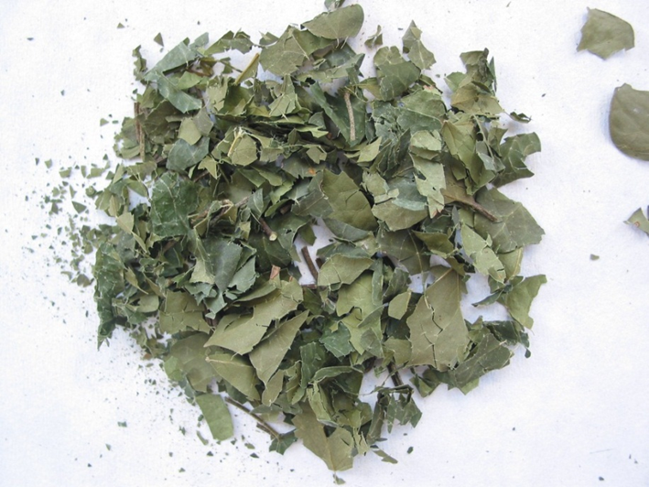
Hederae folium CzPh 2017
Macroscopy: leathery leaves, cordate at the base. Smooth edged, palmately trilobal to five lobed, with more or less triangular lobes. The upper side of the leaf is dark green with palmate veins; the lower side is more gray-green, with clearly prominent veins. Petioles and blades of younger leaves are scattered with white hairs, older leaves are glabrous.

Slide 17
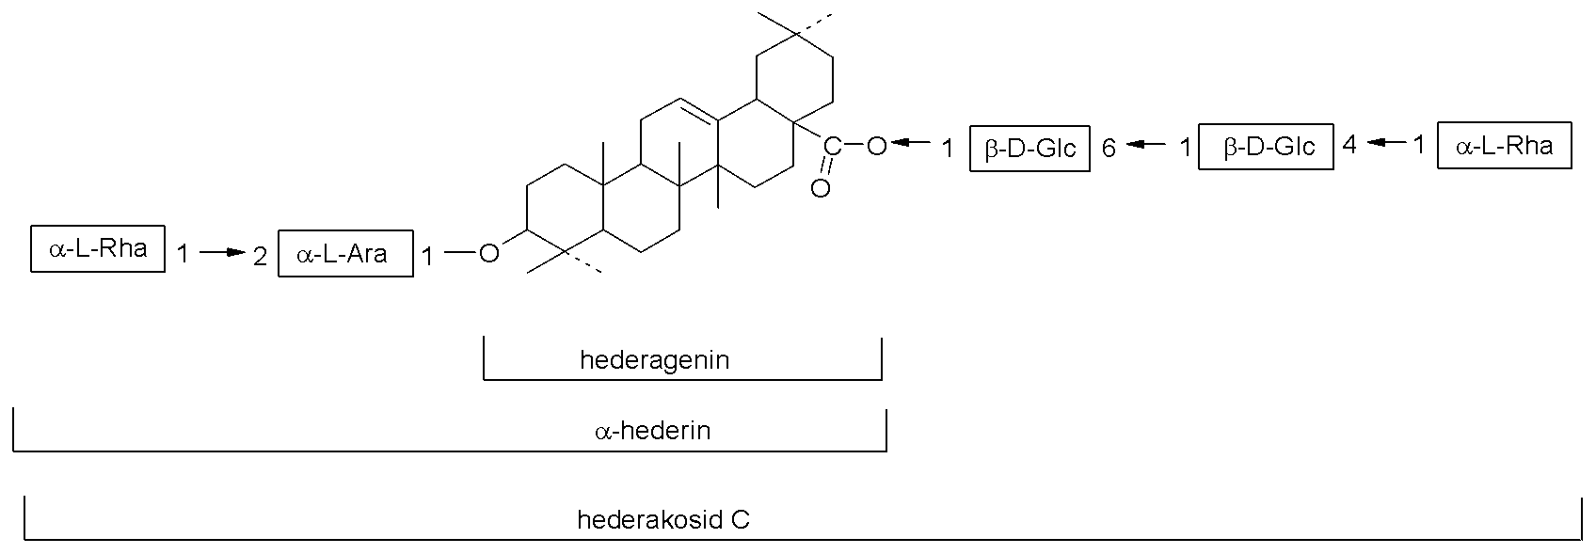
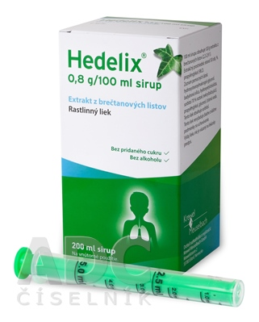
Hederae folium CzPh 2017
Content compounds: triterpenoid saponins - hederacosid C, which by drying breaks down to α-hederin
Usage: expectorans, coughing syrups (Hederae folii exctractum spissum -Hedelix in Czech Republic)

Slide 18
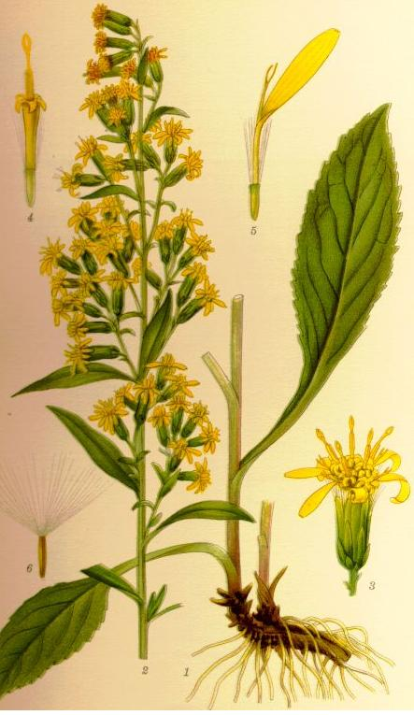
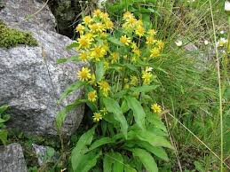
Solidaginis virgaureae herba CzPh 2017
Mother plant: Solidago virgaurea, Asteraceae (European goldenrod)

Slide 19
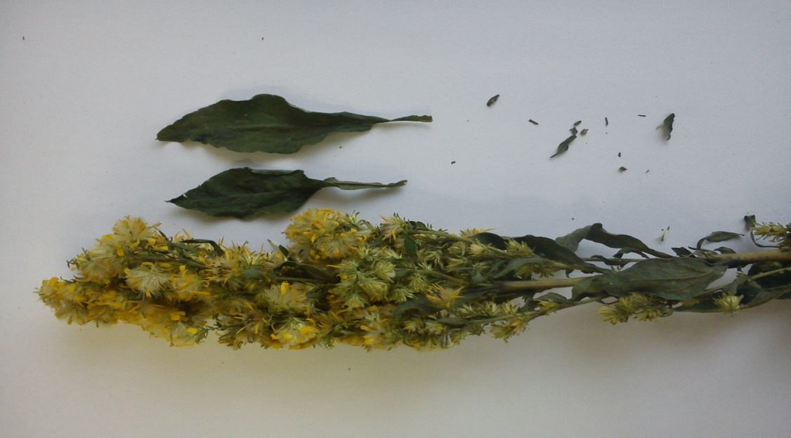
Solidaginis virgaureae herba CzPh 2017
Macroscopy: stem cylindrical, longitudinally grooved, glabrous or pubescent. Leaves ovate to oval, entire, glabrous on both sides n. Scattered hairy. The capes are arranged in a narrow lath of female lingual flowers and bisexual tubular flowers. All flowers are yellow. The drug is odorless, the taste is bitter.

Slide 20
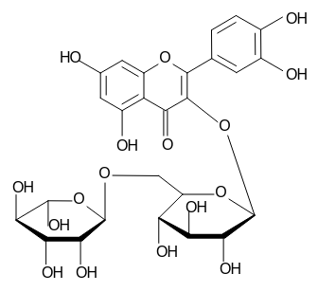
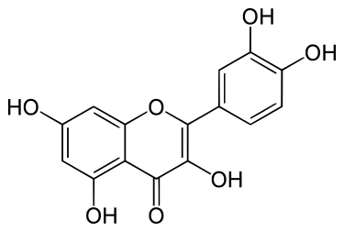
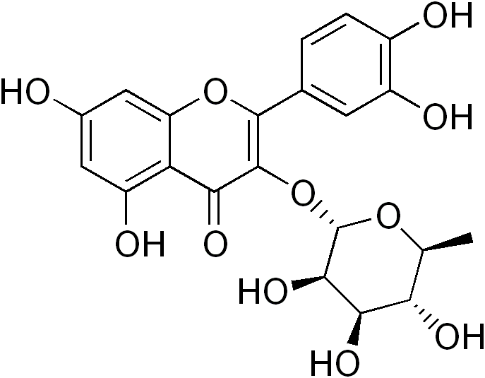
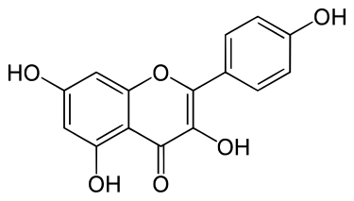
Solidaginis virgaureae herba CzPh 2017
Content compounds: flavonoids (0.5-1.5 %; rutin, quercitrin, hyperoside, aglycones quercetin, kaempferol), saponins, tannins
Usage: diuretic, antiphlogistic; externally for purulent wounds
rutin
quercitrin
quercetin
kaempferol

Slide 21
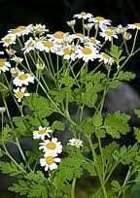
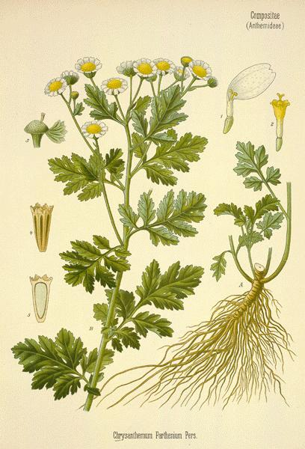
Tanaceti parthenii herba CzPh 2017
Mother plant: Tanacetum parthenium, Asteraceae (feverfew)

Slide 22
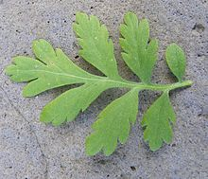
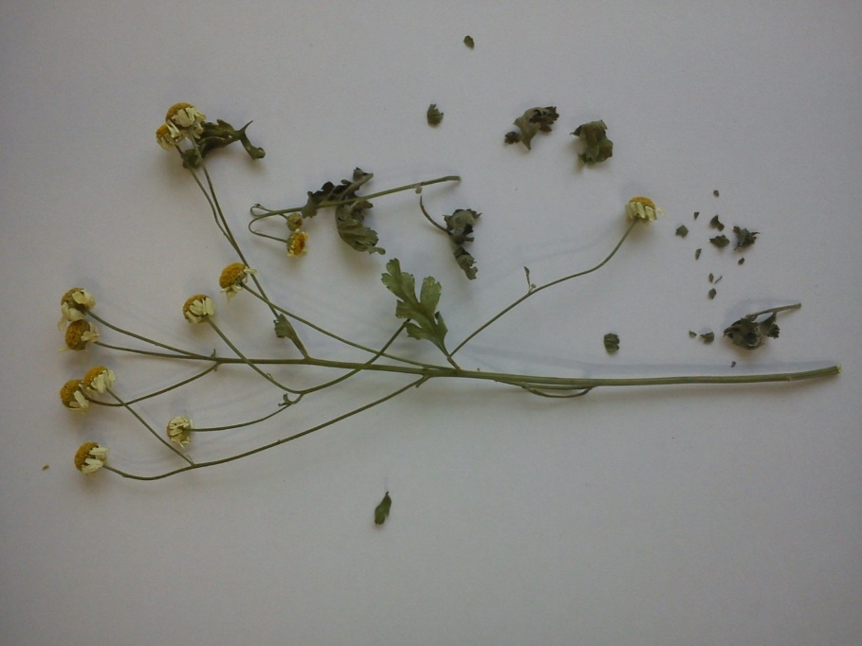
Tanaceti parthenii herba CzPh 2017
Makroskopie: stem branched, almost square, longitudinally grooved. Leaves ovate, pinnate, with 5-9 segments with jagged edge and blunt tip, slightly pubescent. Hemispherical intervention from overlapping leaves. Perimeter flowers are white, female; target tubular flowers are yellow, bisexual. The drug has an aromatic aroma and a sharp, bitter taste.

Slide 23
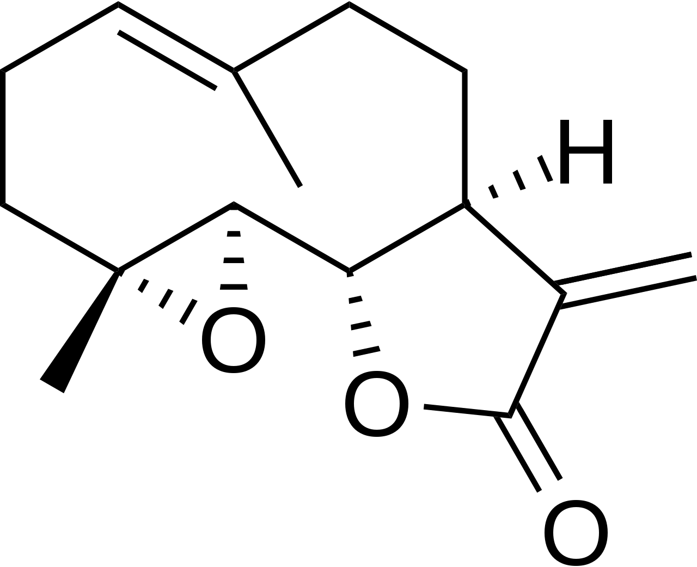
Tanaceti parthenii herba CzPh 2017
Content compounds: essential oils (sesquiterpene lactone parthenolid), bitter substances, tannins, mucilage
Usage: analgetic (migraines, menstrual pain), antipyretic; historically was used to reduce fever - hence the name feverfew
parthenolid

Slide 24
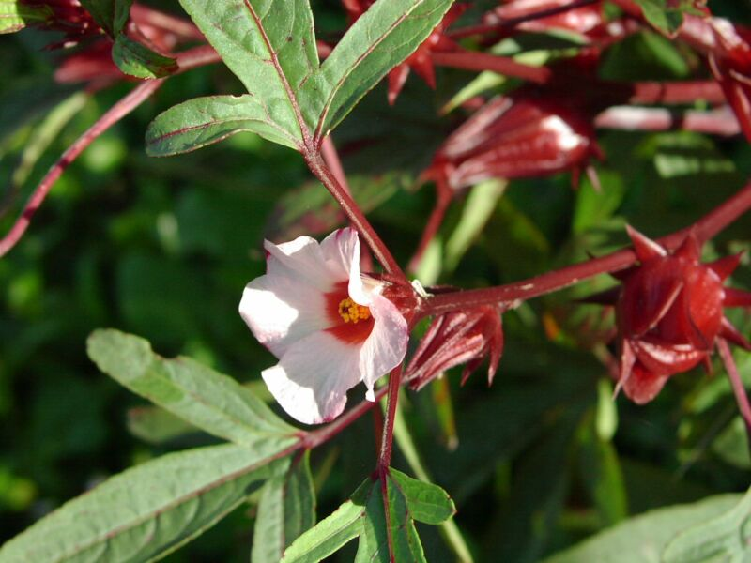
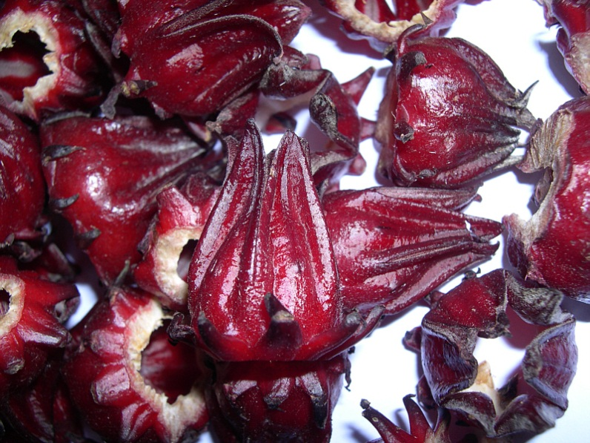
Hibisci sabdariffae flos CzPh 2017
Mother plant: Hibiscus sabdariffa, Malvaceae (roselle)
Notes:
ibištek krvavý

Slide 25
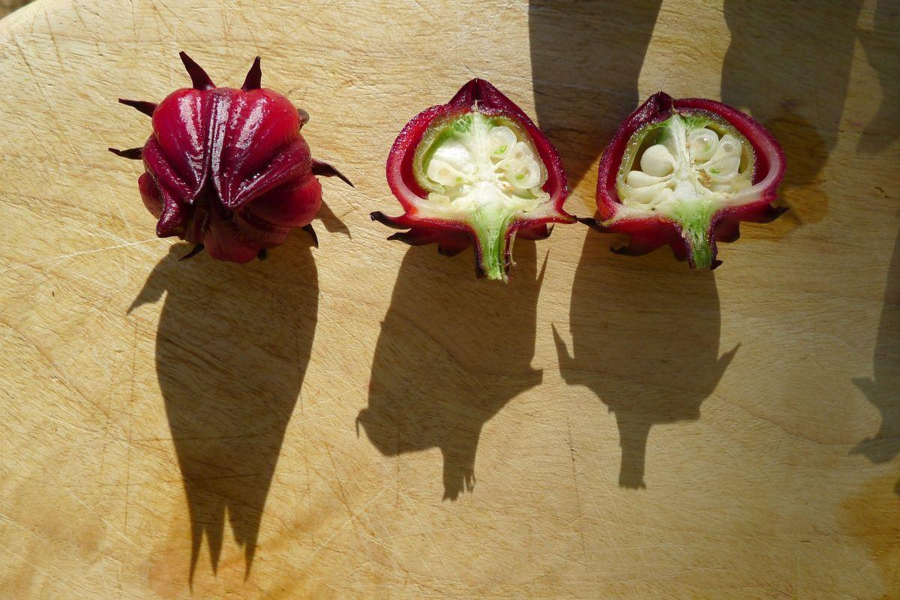
Hibisci sabdariffae flos CzPh 2017
Macroscopy: dried flower is light to dark violet-red and fleshy, after drying calyx and goblet are brittle. The chalice is jug-shaped in the lower half, in the upper half with five long pointed points bent backwards. The cup consists of 8-12 leaves grown to the base of the chalice
Notes:
Pre kyslú chuť kvetov ako korigens chuti v čajovinových zmesiach

Slide 26
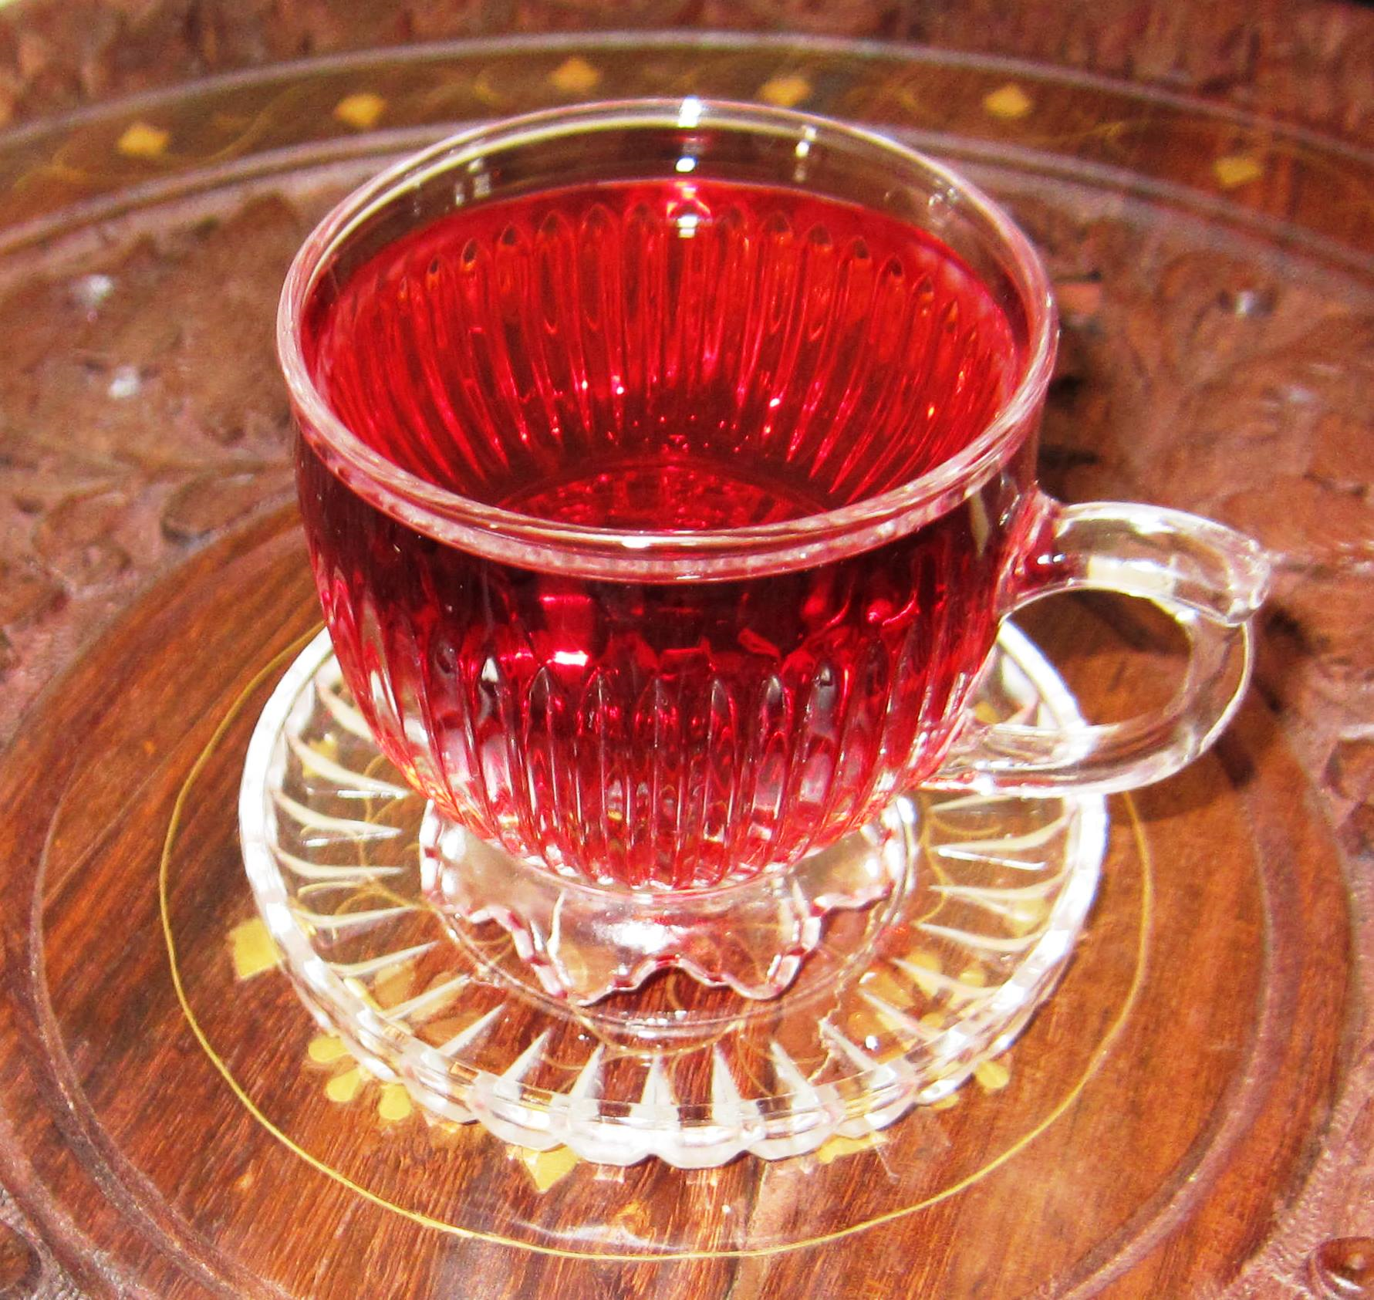
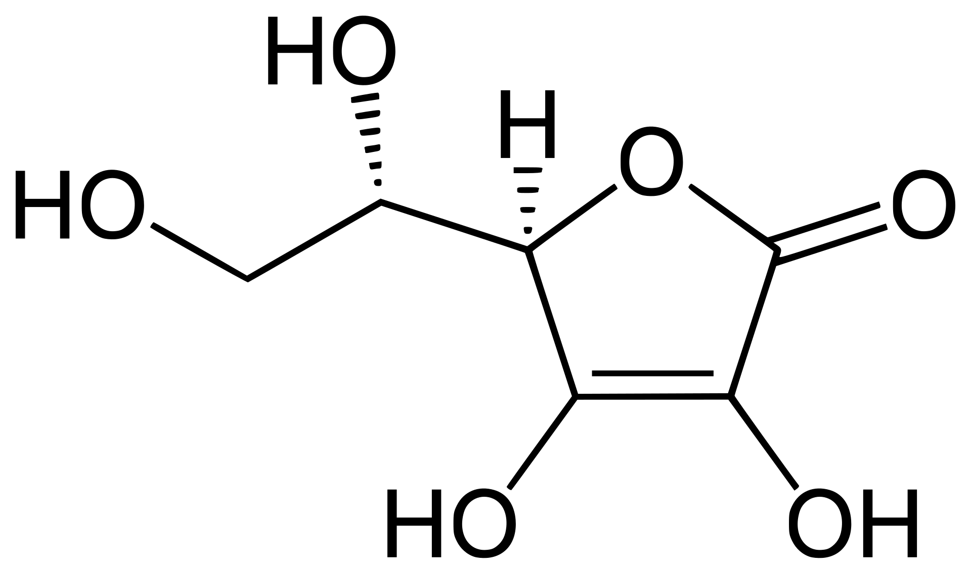
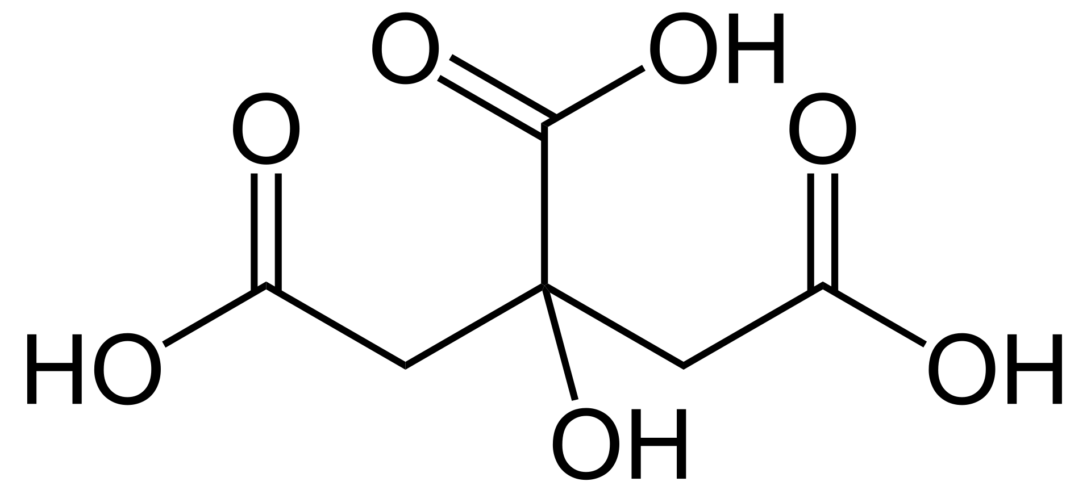
Hibisci sabdariffae flos CzPh 2017
Content compounds: at least 13.5 % organic acids (ascorbic, citric, malic, tartaric), anthocyans, flavonoids, fytosterols, pectin
Usage: delicacy (tea, wine), source of vitamin C, antioxidant, (antiphlogistic, hypotonic, antisclerotic)
  In Carribean, fruit is boiled for 8-10 minutes, in Jamaica the drink is seasoned with rum, seasonal Christmas drink in Trinidad
  Europe - in many herbal teas as a coloring agent
ascorbic acid
citric acid
Notes:
Pre kyslú chuť kvetov ako korigens chuti v čajovinových zmesiach

Slide 27
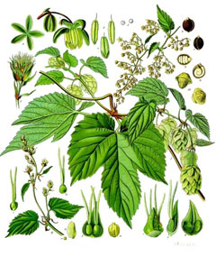

Lupuli flos CzPh 2017
Mother plant: Humulus lupulus, Cannabidaceae (common hop)

Slide 28


Lupuli flos CzPh 2017
Macroscopy: dried, usually whole female inflorescences. Hop cones are usually individual, 2-5 cm long, ovoid in shape, composed of numerous oval green-yellow, overlapping leaves. The outer bracts are flat, regular, the inner bracts are longer, irregular at the base, completely enclosing the fetus (achene = achenium). The testicles, base of the leaves and leaflets are covered with small orange-yellow glands

Slide 29



Lupuli flos CzPh 2017
Content compounds: bitter substances (bitter resin acids, 15-30 %) = prenylated acylphloroglucinols (humulon, lupulon); flavonoids, prenylated chalkons (xanthohumol), essential oils (0,3-1%, monoterpenes, sesquiterpenes: myrcen, humulen, farnesen, karyofylen)
Usage: amare, stomachic (bitter acids), sedative (Novo-Passit - Humuli lupuli extractum + other plant extracts + guaifenesine), anafrodisiac (antigonadotropic glucoprotein); female fruits in brewing industry
humulon
xanthohumol
Notes:
ve stadiu výzkumu: antidiabetikum (použitelné v počátečních stádiích diabetu),
anafrodiziakálny účinok pozorovaný v experimente u samcov potkanov

Slide 30
Thank you for your attention!
Notes:
ve stadiu výzkumu: antidiabetikum (použitelné v počátečních stádiích diabetu),
anafrodiziakálny účinok pozorovaný v experimente u samcov potkanov

