Slide 1
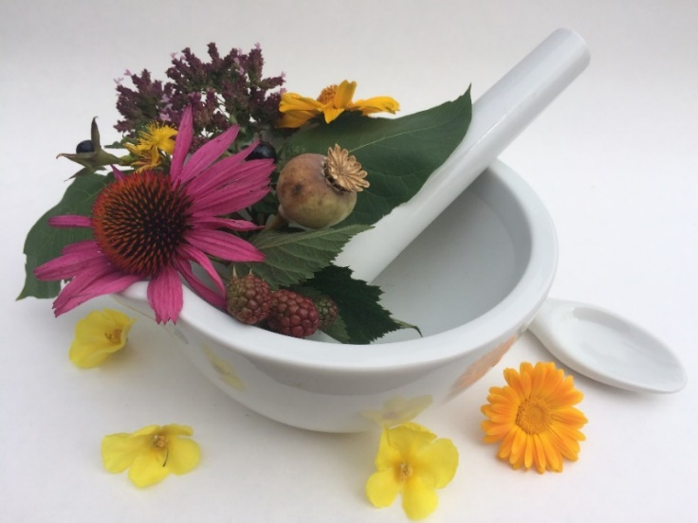
Pharmacognosy lab exercise 3
Root drugs
Balsams, Tars
Gumms
Tubers

Slide 2
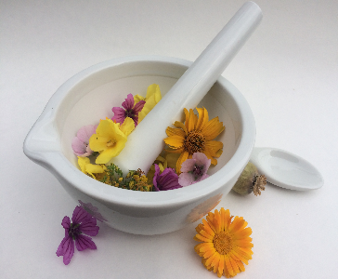
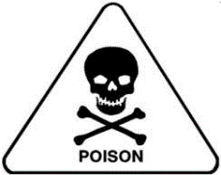
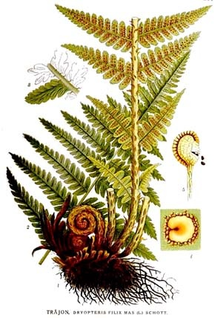
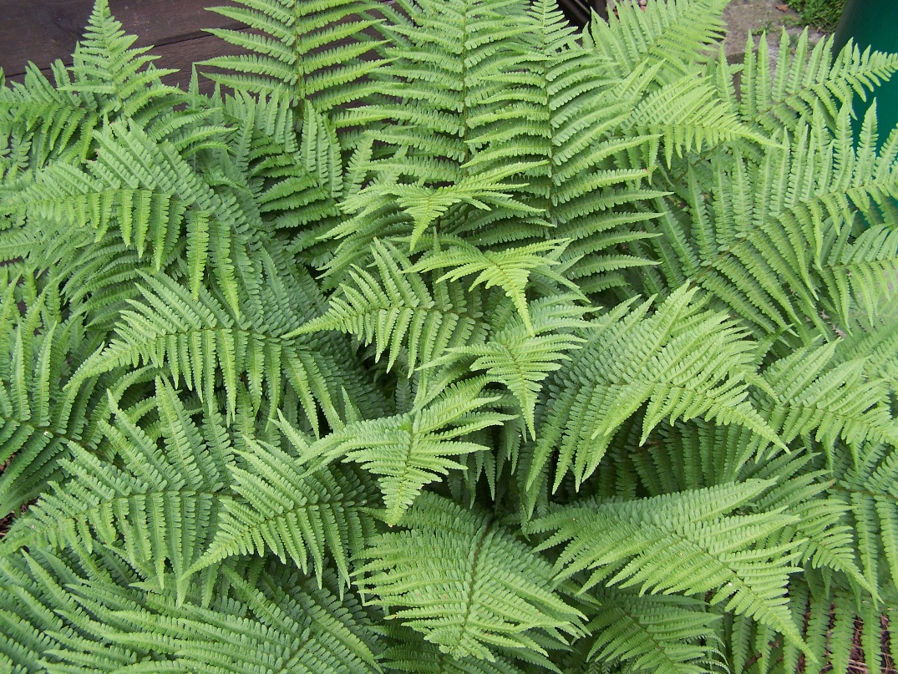
Filicis maris radix
(rhizoma)
Mother plant: Dryopteris filix-mas, Dryopteridaceae
(male fern)

Slide 3
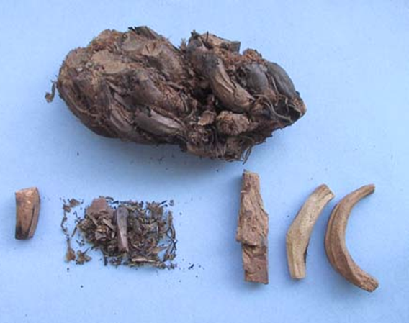
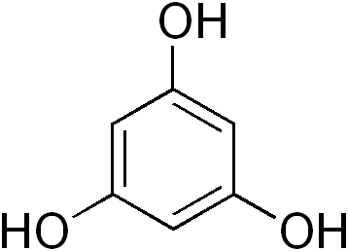
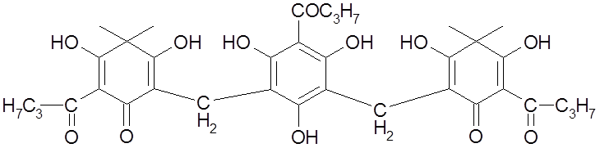
Filicis maris radix
(rhizoma)
Macroscopy: unstripped, uncut brown rhizomes, on fractures greenish, without odour, disgusting bitter taste
Content compounds: phloroglucinol derivatives (mixture is called filicin) in form of oleoresin
Usage: veterinary antihelmintic (obsolete)
filixic acid
Notes:
Filicin is toxic for tapeworms, it paralyzes their muscles. The bigger the molecule of filicine, the more potent it is.

Slide 4
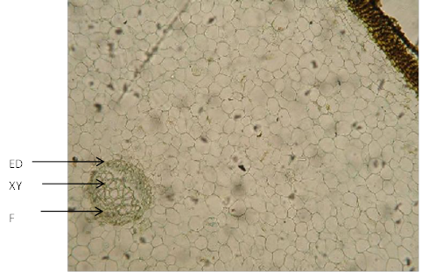
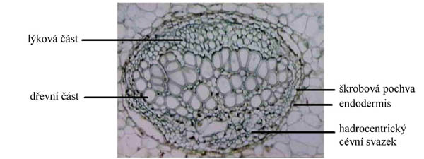
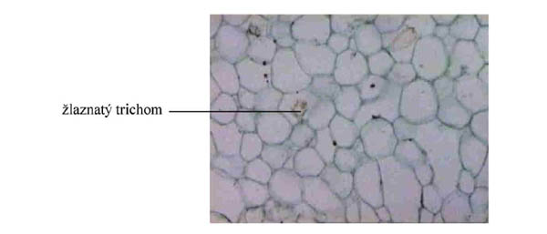
Filicis maris radix
(rhizoma)
Microscopy: monocotyledonous plant, hadrocentric vascular bundles with endodermis and starchy sheath, glandular trichomes in basic parenchym
epidermis
phloem
sklerenchym
xylem
starchy sheath
endodermis
basic parenchym
hadrocentric vascular bundle
glandular trichome
Notes:
hadrocentric vascular bundle has xylem in the middle

Slide 5
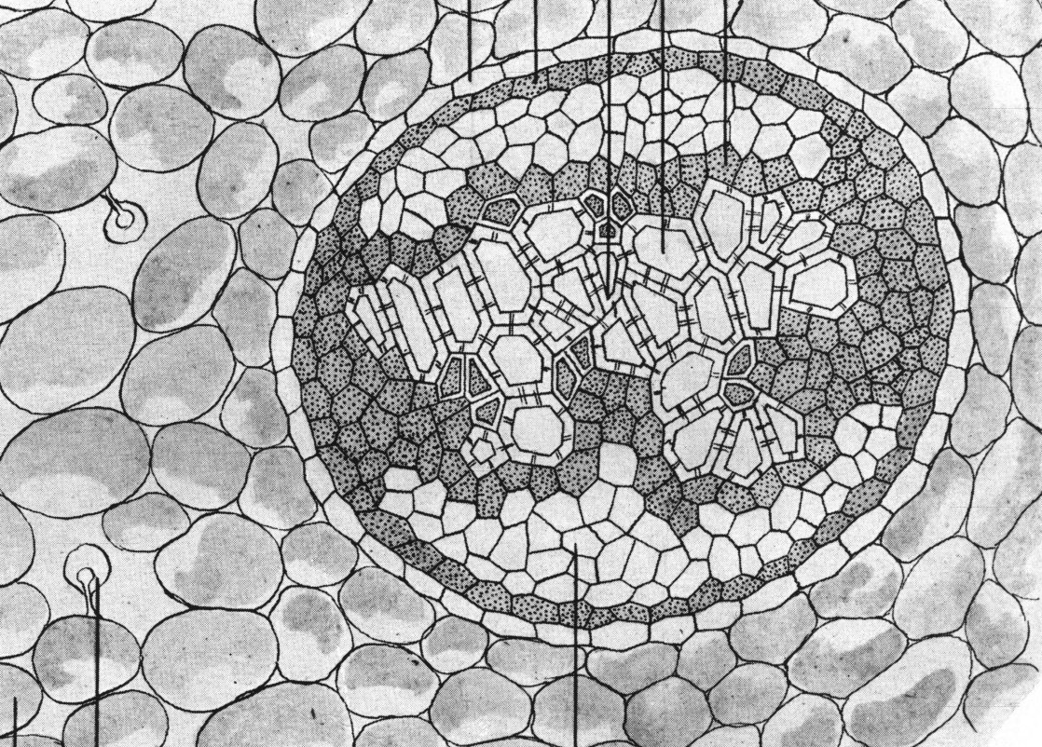
Filicis maris radix
(rhizoma)
Microscopy:hadrocentric vascular bundle
endodermis
phloem
xylem
internal glandular trichome

Slide 6
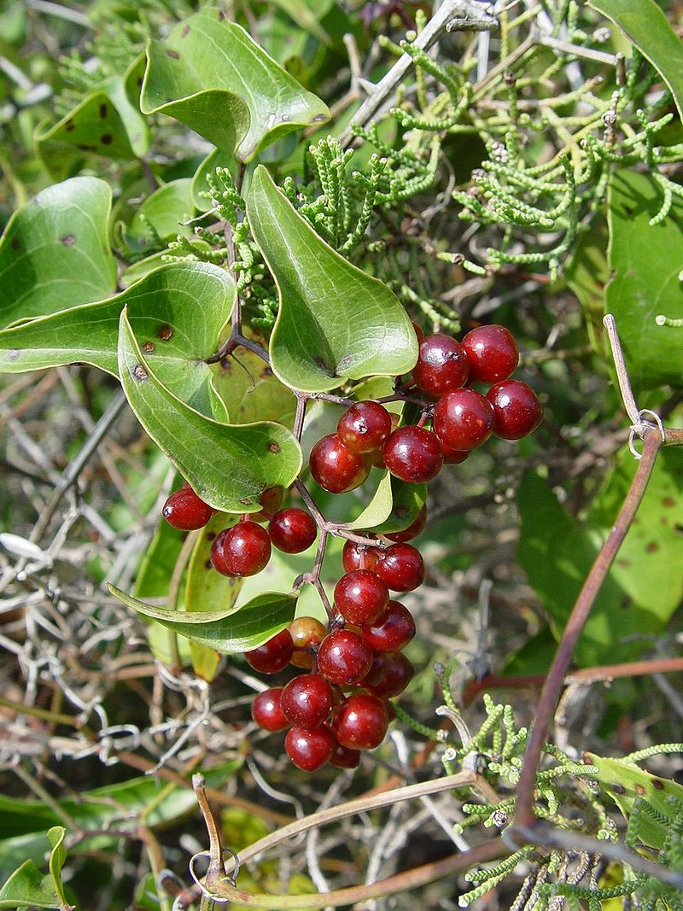
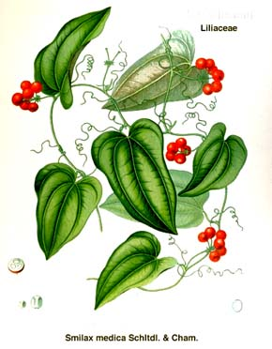
Sarsaparillae radix (sarsaparilla)
Mother plant: Smilax sp., Smilacaceae (catbrier, prickly-ivy)

Slide 7
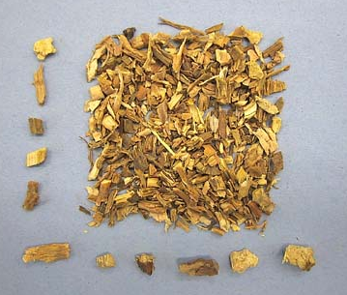
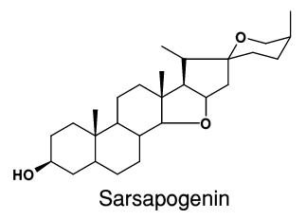
Sarsaparillae radix (sarsaparilla)
Macroscopy: long, without branches, cylindrical, brown, without odor, slimy taste
Content compounds: steroidal saponins
Usage: metabolic, therapy of syphilis
Notes:
Basic structure for steroidal compounds.
Suffix genin means it is that part of a molecule of glycoside, which is not sugar. Glycosides consist of non-sugar molecules and sugar moleculs, which are bound together with glycosidic bond.

Slide 8
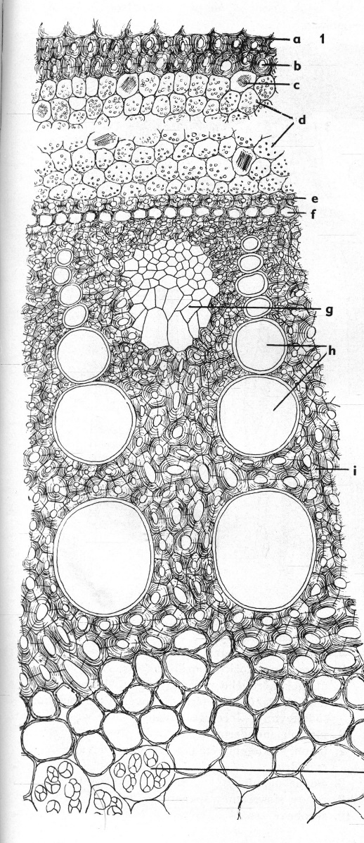
Sarsaparillae radix (sarsaparilla)
Microscopy:
rhizodermis
primary cortex with raphides and starch
endodermis
sieve-tubes
vessel
Vascular bundle: radial polyarch
starch
Notes:
Raphides are needle-shaped crystals of calcium oxalate, they tend to be blunt at one end and sharp at the other.

Slide 9
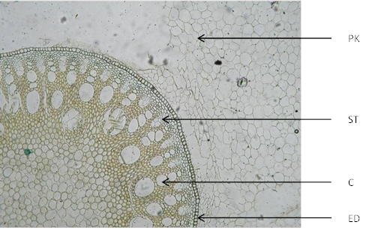
Sarsaparillae radix (sarsaparilla)
Microscopy:
primary cortex
primary floem
primary xylem
endodermis

Slide 10
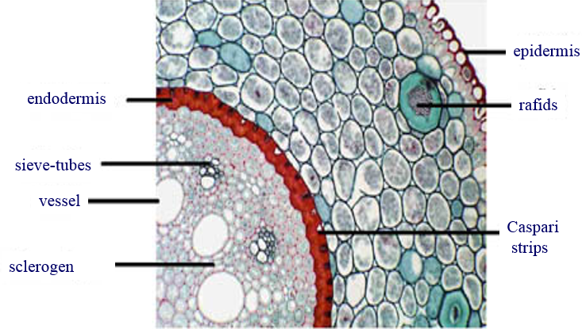
Sarsaparillae radix (sarsaparilla)
Microscopy:

Slide 11
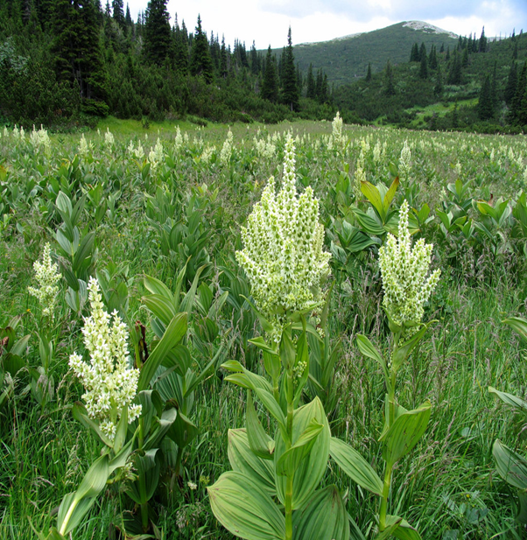
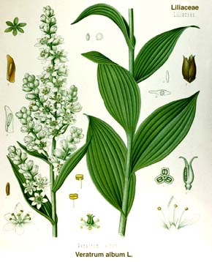
Veratri albi radix CzPh 2017
Mother plant: Veratrum album, Melanthiaceae (white hellebore)

Slide 12
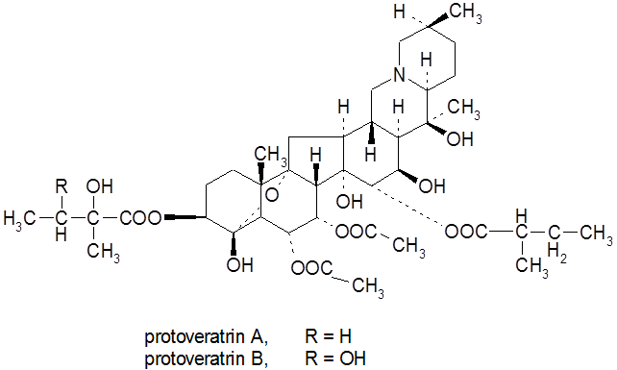
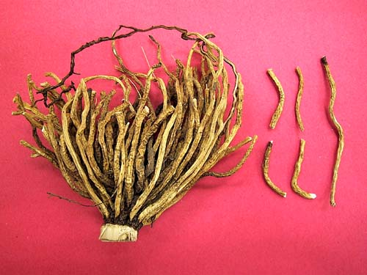
Veratri albi radix CzPh 2017
Macroscopy: black-brown rhizome obovate shape, with roots surrounding or with scars after roots, fracture is white-grey, without odour, bitter taste
Content compounds: steroidal alkaloids protoveratrine A, B
Usage: hypotensive, ectoparasitic, isolation of alkaloids
Notes:
Protoveratrine A, B are esterified alkaloids

Slide 13
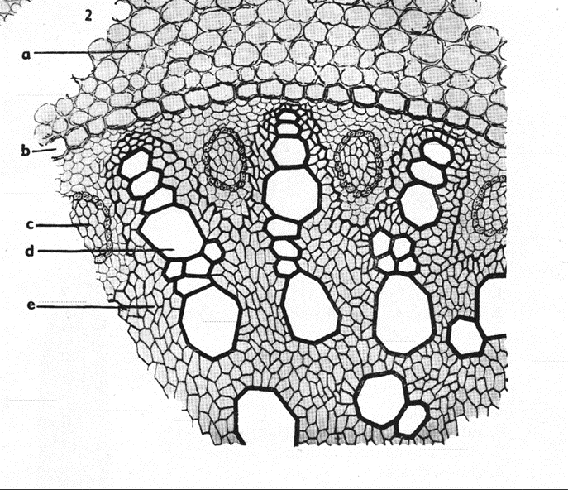
Veratri albi radix CzPh 2017
Microscopy:
primary cortex
endodermis
(Caspari strips)
sieve-tubes
ducts
Vascular bundle: radial polyarch

Slide 14
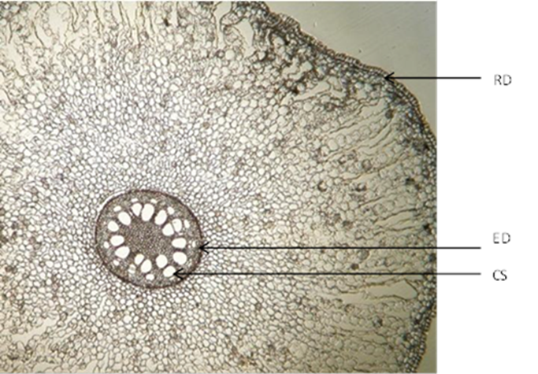
Veratri albi radix CzPh 2017
Mikroskopie:
rhizodermis
parenchym
medulla
endodermis
Vascular bundle: radial polyarch

Slide 15
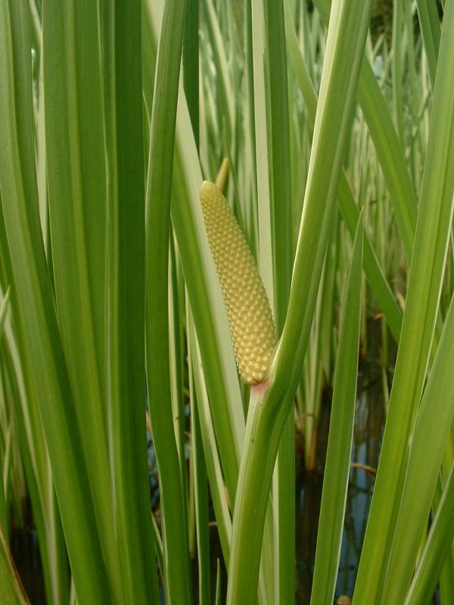
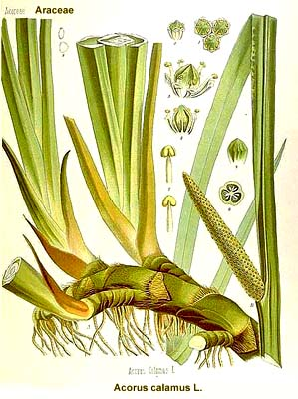
Calami aromatici radix
Mother plant: Acorus calamus, Acoraceae (sweet flag)

Slide 16
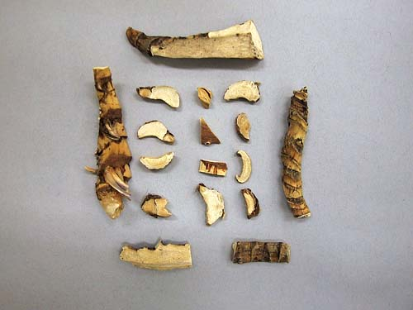
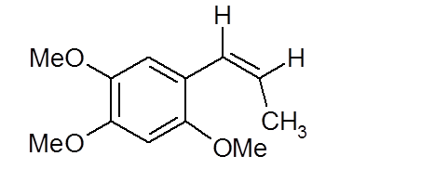
Calami aromatici radix
Macroscopy: grey-brown wrinkled rhizomes without roots (visible scars), aromatic odor, strong spicy taste
Content compounds: volatiles (β-asaron), bitter substances, tannins, cholin, starch and mucilages
Usage: aromatic amarum, stomachic, spasmolytic
β-asaron
Notes:
Spazmolytický účinek se připisuje cholinu

Slide 17
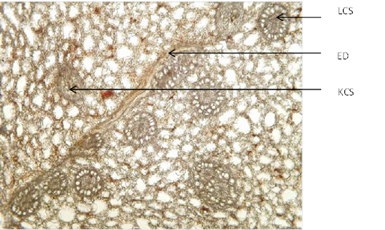
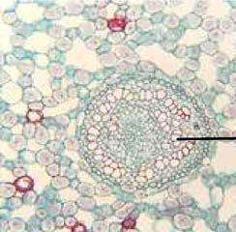
Calami aromatici radix
Microscopy: rhizodermis, primary cortex with vascular bundles collateral in sclerogen sheath, endodermis, central cylinder with leptocentric vascular bundles, often volatiles-containing cells, characteristic chain parenchyma - aerenchyma
endodermis
vascular bundle collateral
vascular bundle leptocentric
aerenchyma
Notes:
Aerenchyma is a spongy tissue that forms spaces or air channels in the leaves, stems and roots of some plants
Leptocentric vascular bundle has phloem in the middle

Slide 18
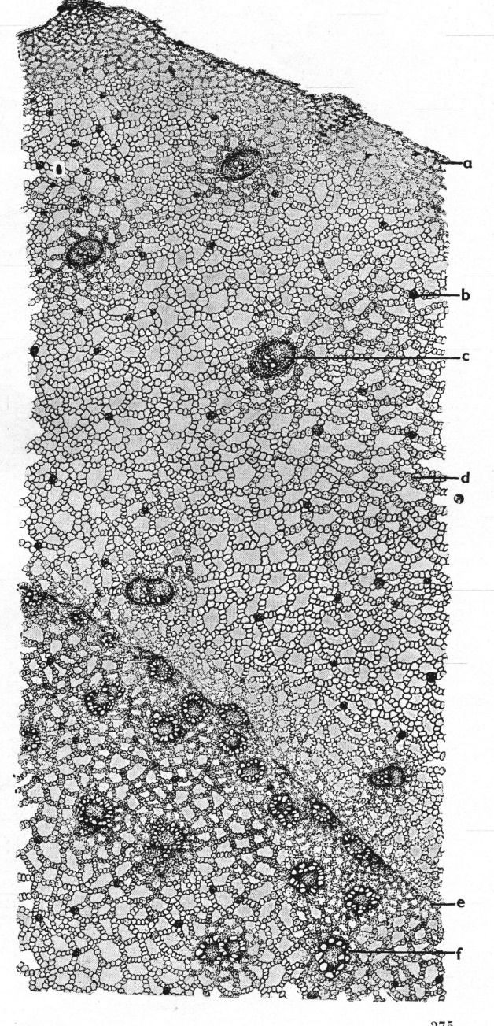
Calami aromatici radix
Microscopy:
rhizodermis
collateral vascular bundle
endodermis
leptocentric vascular bundle

Slide 19
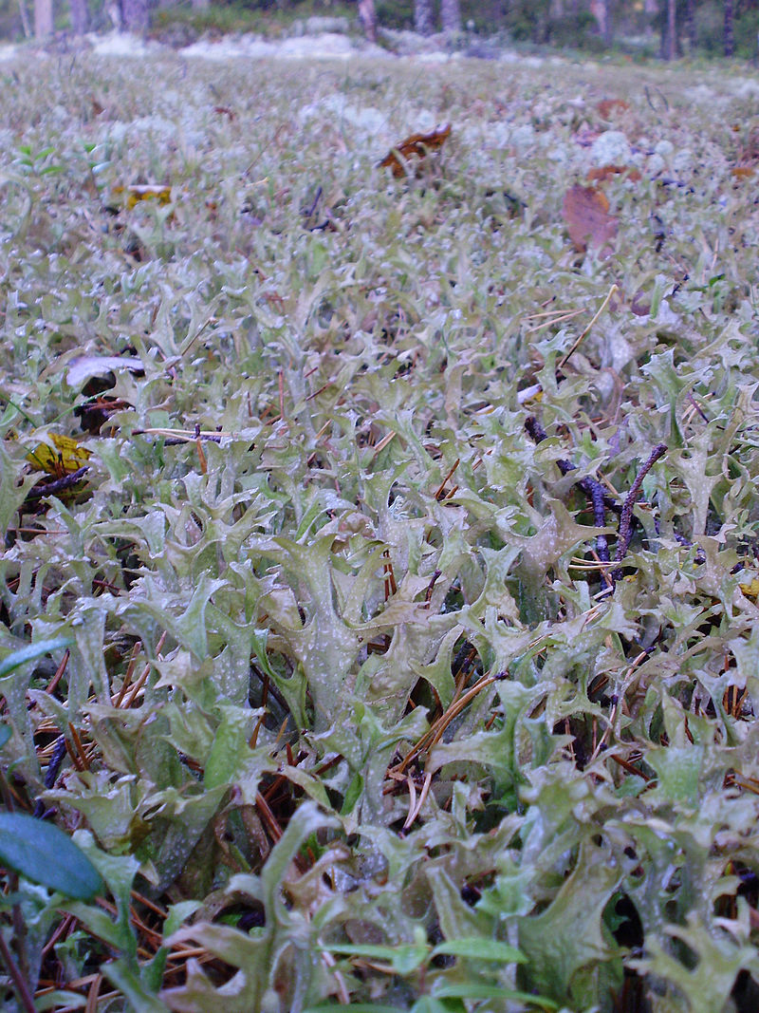
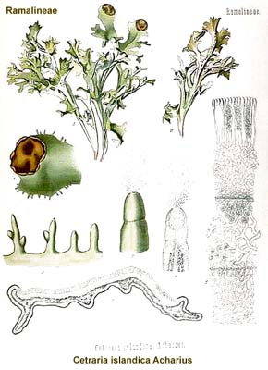
Lichen islandicus CzPh 2017 (iceland moss)
Mother plant: Cetraria islandica, Parmeliaceae

Slide 20
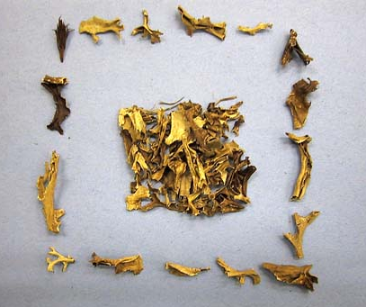
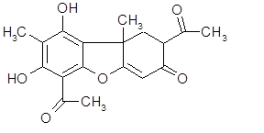
Lichen islandicus CzPh 2017 (iceland moss)
Macroscopy: thin, branched, fragile thallus, upper side green-brown, under side grey-white with bright spots, weak odour, slimy taste
Content compounds: lichenin, isolichenin, lichen acids (usnic acid, fumarprotocetraric acid), iodine, flavonoids, vitamins A and B₁
Usage: mucilage, antitussive, amare
Usnic acid
Notes:
Lichenin is like cellulose in structure (β-D-glucose units). Lichenin is soluble in hot water, and as it cools down, it turns into a gel, which cannot be stained by iodine.
Isolichenine is like amylose in structure (α-D-glucose units), is soluble in cold water and iodine stains it blue.

Slide 21
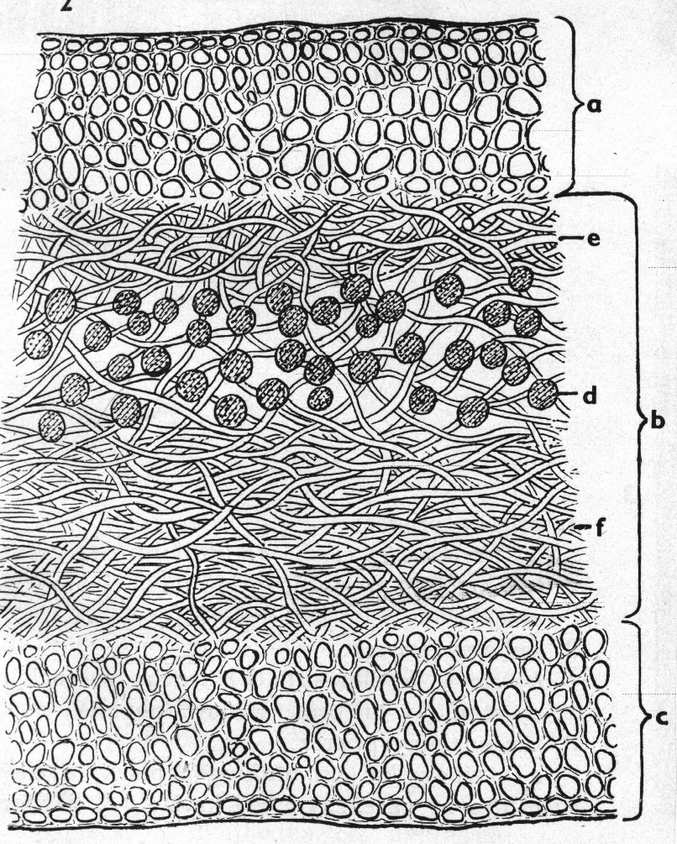
Lichen islandicus CzPh 2017 (iceland moss)
Microscopy: transversal section
  upper cortical part
  (stratum corticale superior)
  hyphae
  medullar part
  (stratum medulare)
  gonidia
  hyphae
  lower cortical part
  (stratum corticale inferior)
Notes:
Hyphae: filamentous structure of a fungus
Gonidiae: algae or bacteria, they often contain chlorophyll and thus are green

Slide 22
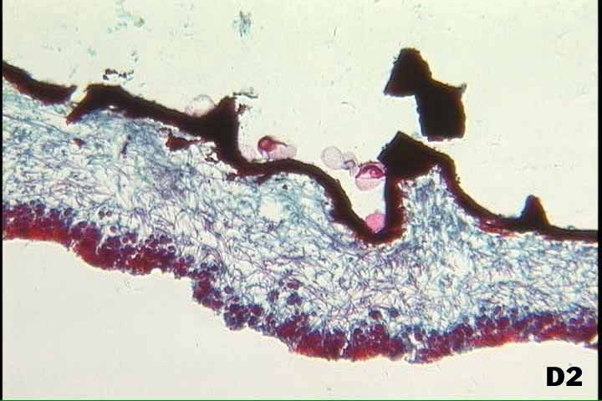
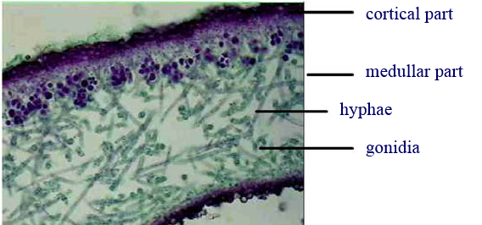
Lichen islandicus CzPh 2017 (iceland moss)
Microscopy:

Slide 23
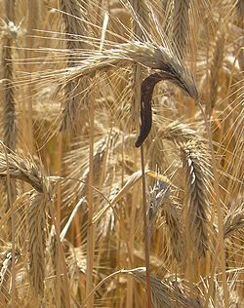
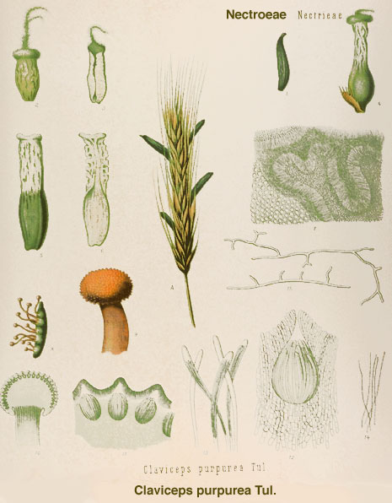
Secale cornutum (rye ergot)
Mother plant: Claviceps purpurea, Clavicipitaceae
(ergot fungus)

Slide 24
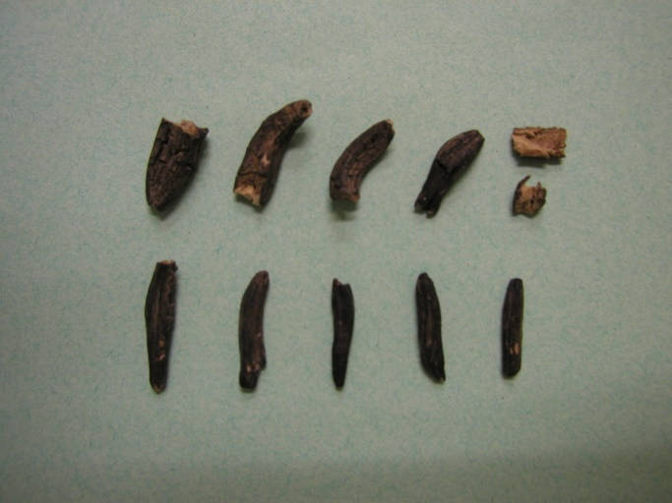
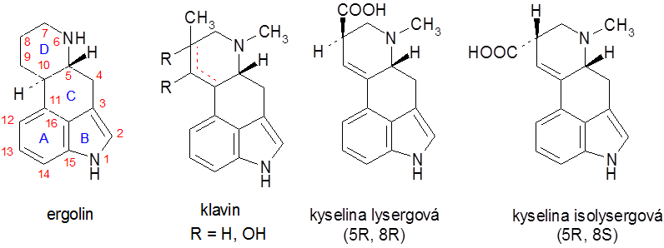
Secale cornutum (rye ergot)
Macroscopy: drug is a sclerotium of roll-shape, dark purple at the surface, characteristic odour, bitter-sweet taste
Content compounds: ergoline alkaloids: derivatives of lysergic acid
  Amino alcohol derivatives: ergometrine
  Peptide derivatives: ergotamine group (ergotamine)
  ergoxine group (ergostine)
  ergotoxine group (ergocristine, ergocornine, ergocryptine)
ergoline
(+)-lysergic acid
(+)-isolysergic acid
Notes:
Clavine alkaloids – upon hydrolysis do not yield lysergic acid, are not pharmacologically important.
Pharmacologicalically effective alkaloids are based on the structure of lysergic acid. Alkaloids derived from isolysergic acid are inactive.

Slide 25
Secale cornutum (rye ergot)
Usage: uterotonic (ergometrin), antimigrenic (ergotamine), spasmolytic, hypotensive, sedative
Infamous cousin: LSD – lysergide (lysergic acid diethylamide)
  Psychotomimetic, hallucinogen
Ergotism: ergot poisoning
  Gangrenous ergotism (vasoconstrictor effect in extremities – tissue death – gangrene – shedding of fingers, hands, limbs) known as St. Anthony´s fire
  Convulsive ergotism (painful convulsions, psychotic disturbances, hallucinations)
Notes:
LSD intensifies perceptions and distorts them.
An effective oral dose is from 30 to 50 μg
The Order of St Anthony cared for sufferers in the Middle Ages.

Slide 26
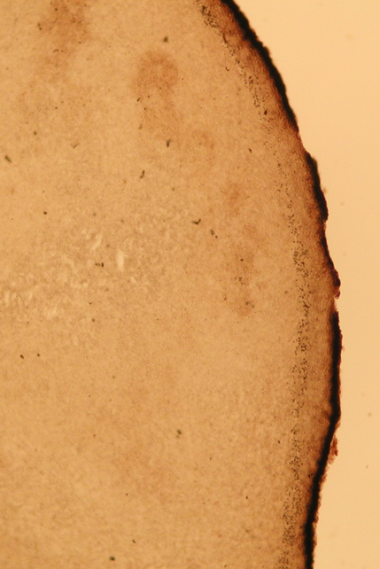
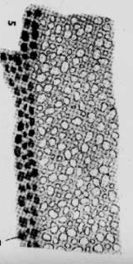
Secale cornutum (rye ergot)
Microscopy:
Transversal section: surface layer (3-8 layers), containing the purple pigment, plectenchyma with air ruptures
plectenchyma
        surface layer

Slide 27
MACROSCOPY

Slide 28
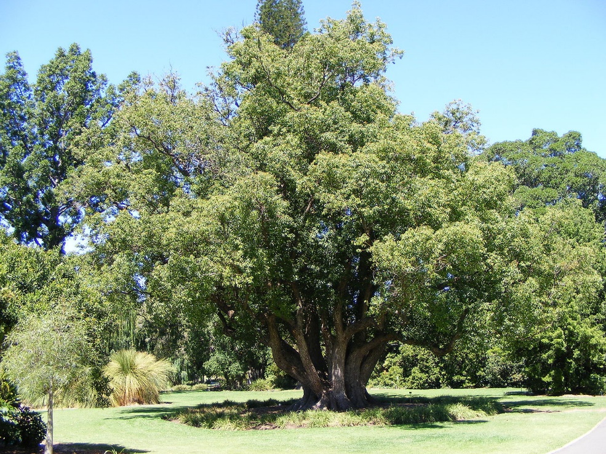
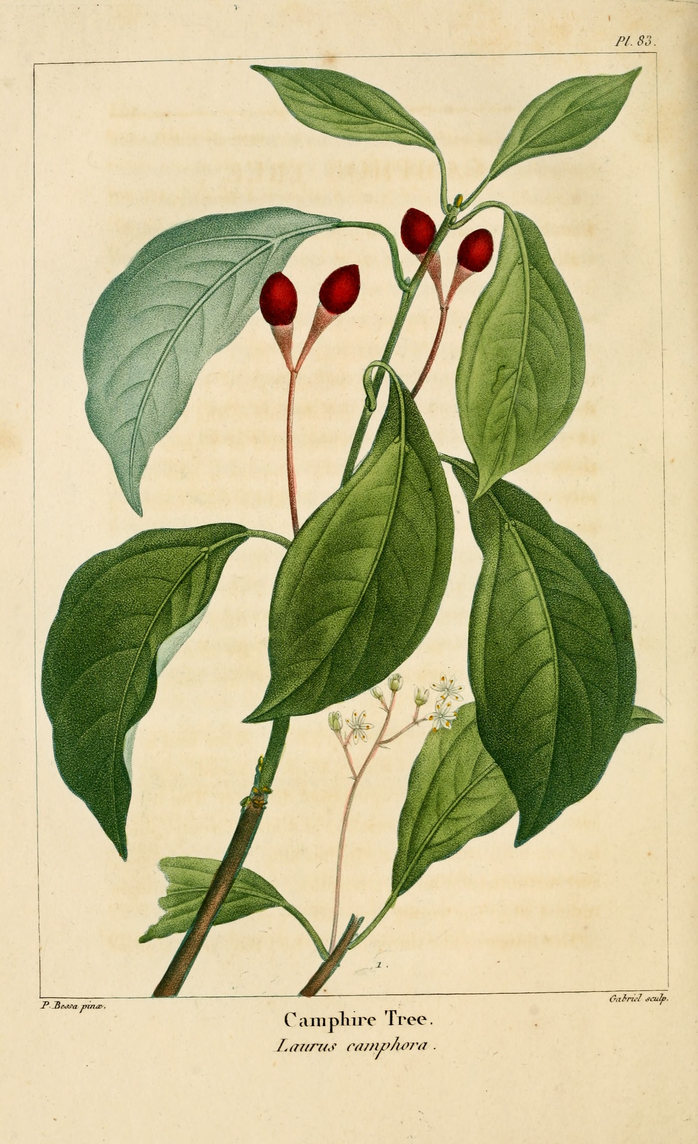
Camphora racemica CzPh 2017
Camphora D CzPh 2017
Mother plant: Camphora officinarum (Cinnamomum camphora)
Lauraceae (camphor tree)
Natural camphor is dextro-rotary and is obtained by steam distillation from the wood of camphor tree
By Peripitus - Own work, CC BY-SA 3.0, https://commons.wikimedia.org/w/index.php?curid=3288580

Slide 29
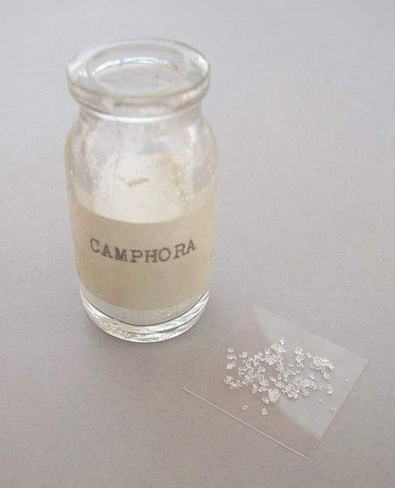

Camphora racemica CzPh 2017
Camphora D CzPh 2017
Macroscopy: drug consist of white crystalline powder of characteristic odour, hot, later cool taste
Content compounds: 2-bornanone
Usage: antiseptic, derivans (neuralgia, gout pain, rheumatic pain), central analeptic
Notes:
Camphor stimulates nerve cells sensitive to cold, thus it creates the cold sensation on the skin (also it is highly volatile, which contributes to this a lot, since the process of changing from solid to gas takes out the heat from the skin). It also has a mild local anaesthetic effect.

Slide 30
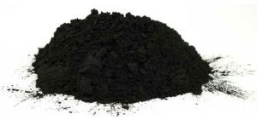
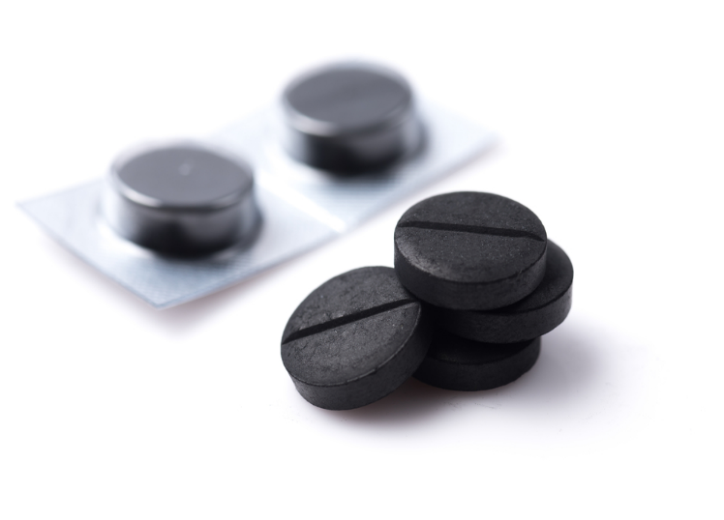
Carbo activatus CzPh 2017
Macroscopy: black light powder without lumps, highly adsorbent, without taste and odour
Content: 80 - 95% carbon
Usage: poisonings, gastrointestinal dysfunctions, water purifying, solution bleaching
Notes:
Activated carbon is carbon produced from carbonaceous source materials such as bamboo, coconut husk, willow peat, wood, coir, lignite, coal, and petroleum pitch

Slide 31



Chrysarobinum
Mother plant: Andira araroba, Fabaceae
Macroscopy: light, microcrystalline, yellow powder, without odour, strong irritant
Content: derivatives of anthracene
Usage: cytostatic effects, dermatology (keratolytic for therapy of psoriasis and mycosis)

Slide 32

Balsams (oleoresins)
Complex mixtures of carbohydrates and resins dissolved in them
Produced by plants under normal conditions or pathologically after wounding
Balsamum peruvianum CzPh 2017
Balsamum tolutanum CzPh 2017
Balsamum canadense
Balsamum copaivae

Slide 33


Balsamum peruvianum
CzPh 2017, Balsam of Peru
Mother plant: Myroxylon balsamum var. pereirae, Fabaceae
Macroscopy: transparent syrup-like liquid of dark-red colour, vanilla odour, bitterish taste

Slide 34


Balsamum peruvianum
CzPh 2017, Balsam of Peru
Content compounds: cinnamein (mixture of cinnamate and benzoate ester of benzyl alcohol), resinous compounds, free aromatic acids, vanillin
Usage: desinficiens, slight derivans, support of tissue granulation and healing
benzoate ester of benzyl alcohol
cinnamate ester of benzyl alcohol

Slide 35

Balsamum tolutanum
CzPh 2017, Tolu Balsam
Mother plant: Myroxylon balsamum var. balsamum, Fabaceae
Macroscopy: soft material with dispersed microscopic crystals of yellow-brown colour, vanilla odour, aromatic taste, slight acid
Content compounds: cinnamein, 80 % of resin, vannilin and eugenol
Usage: expectorans, healing preparation for wounds treatment, cosmetics

Slide 36




Balsamum canadense,
Canada balsam
Mother plant: Abies balsamea, Pinaceae (balsam fir)
Macroscopy: syrup-like liquid of light to green-yellow colour, weak fluorescence, balsamic odour and taste
Content compounds: volatiles with pinene and bornyl acetate
Usage: closure of microscopic slides, cement for optics, rarely for therapy of bronchial diseases
bornyl acetate
pinen

Slide 37


Balsamum copaivae
Mother plant: tree Copaifera, Fabaceae
Macroscopy: syrup-like yellow liquid, aromatic odour, spicy bitter taste
Content compounds: volatiles
Usage: desinficiens in veterinary medicine

Slide 38

Pixes (tars)
Variable mixtures of aromatic hydrocarbons and other compounds, produced by dry distillation of coal, woods, and slates
Content compounds: polycyclic aromatic hydrocarbons, heterocycles, aliphatic hydrocarbons
Lithantracis pix CzPh 2009
Fagi pix CzPh 2009
Betulae pix

Slide 39


Lithantracis pix CzPh 2009
Obtained by dry distillation of black coal
Macroscopy: black shiny viscous liquid of characteristic odour, soluble only in organic solvents
Usage: dermatologic

Slide 40


Fagi pix CzPh 2009
Mother plant: tree Fagus sylvatica, Fagaceae (European beech)
Macroscopy: black-brown viscous liquid of characteristic odour
Content compounds: creosot
Usage: dermatologic

Slide 41

Betulae pix
Mother plant: Betula pendula, Betulaceae (silver birch)
Macroscopy: yellowish liquid of pleasant odour
Usage: rarely used in cosmetics or dermatology

Slide 42

Gumms and mucilages
Amorphous substances, optically active, they form colloidal solutions in water
Content compounds: strings of pentoses and hexoses (arabinose, rhamnose, galactose)
Acaciae gummi CzPh 2017
Gummiresina myrha CzPh 2017
Tragacantha CzPh 2017

Slide 43


Acaciae gummi CzPh 2017
Mother plant: Acacia senegal, Fabaceae (gum acacia)
Alternatively other species of African Acacia species or A. seyal
Macroscopy: irregular round-shaped peaces, white to yellow, transparent, fragile with ruptures and breaks, without odour, mucous taste, adhesive
Content compounds: polysaccharides
Usage: mucilaginosum, more often as excipient in pharmacy

Slide 44


Gummiresina myrrha CzPh 2017
Mother plant: Commiphora myrrha, Burseraceae (African myrrh)
Macroscopy: yellow-brown mass, which solidifies on air, characteristic odour and taste
Content compounds: 50-60 % slimy compounds, resins, volatiles oils, bitter compounds
Usage: deodorant of oral cavity, desinficiens, astringents

Slide 45


Tragacantha = Traganth CzPh 2009
Mother plant: Astragallus gummifer or other species from West Asia, Fabaceae
Macroscopy: foliate, white to yellow flat peaces of hornlike consitence, translucent, without odour, slimy taste
Content compounds: polysaccharides, 3 % of starch
Usage: mucilaginose, mild laxative, excipient - binder, emulsifier, ointment base, cement, lubrificant
http://www.biolib.cz/cz/taxonimage/id76775/?taxonid=196259

Slide 46
Tubers
Underground formations, they do not replace roots
Aconiti radix
Colchici radix

Slide 47


Aconiti radix (tuber)
Mother plant: Aconitum napellus, Ranunculaceae
(monk’s-hood, wolfsbane)

Slide 48


Aconiti radix (tuber)
Macroscopy: heavy hard turnip-shaped tubers, winkled, dark brown, with residues of side roots, without odour, bitter taste, irritant to vomit
Content compounds: : diterpenic alkaloids - aconitine, napelline, atisine; tannins, starch
Usage: formerly as analgesic and antipyretic for gout, neuralgia and migraine
Danger - aconitine belongs to very poisonous compounds!
aconitine

Slide 49


Colchici radix
Mother plant: Colchicum autumnale, Colchicaceae (autumn crocus)

Slide 50



Colchici radix
Macroscopy: subsidiary full tubers of brown colour, without odour, sharp bitter taste
Content compounds: highly toxic alkaloids colchicine and demecolcine
Usage: cytostatic, antimitotic, antiuratic
colchicine
demecolcine

