Slide 1
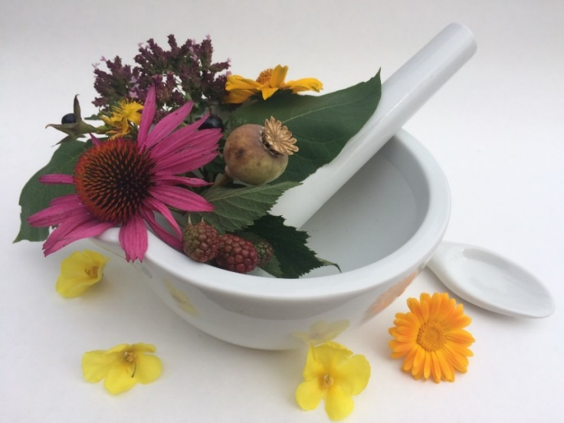
Pharmacognosy lab exercise 9
Herbs, flowers

Slide 2
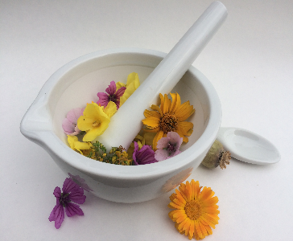
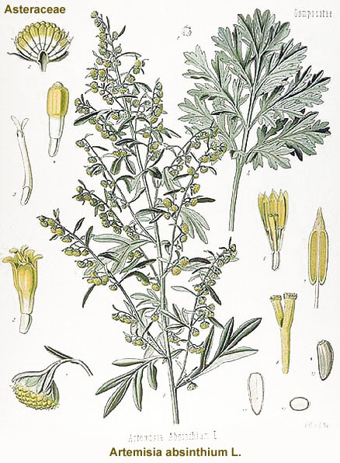
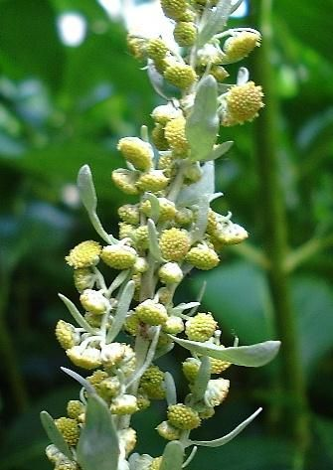
Absinthii herba CzPh 2017
Mother plant: Artemisia absinthium, Asteraceae (Common wormwood)

Slide 3
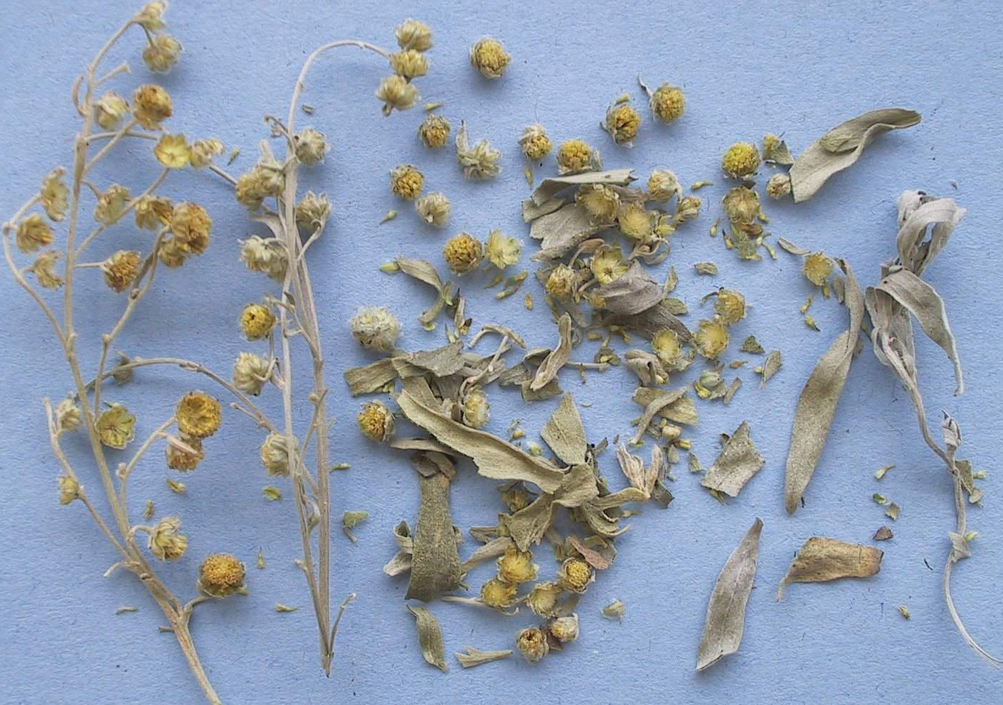
Absinthii herba CzPh 2017
Macroscopy: ground leaves from greyish to greenish, silver-grey felt-like, leaf-stalked, leaf segments from rounded to lanceolate, stem green-grey, felt-like, usually with 5 wrinkles, flowers yellow, target-like, involucrum grey felt-like, aromatic odour and very bitter spicy taste.

Slide 4
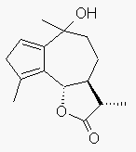
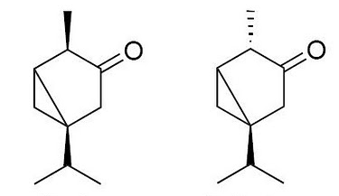
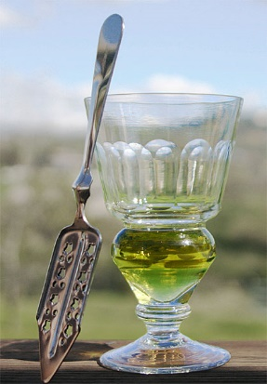
Absinthii herba CzPh 2017
Content compounds: essential oil (thujone, thujole), bitter substances – sesquiterpenic lactones (artemisin, artabsin, absinthin), flavonoids, polyalkyns
Thujon - neurotoxic (GABA receptors inhibitor)
Usage: amare, digestive, choleretic, spasmolytic
α-thujone β-thujone
(Thuja, Artemisia, Salvia, Tanacetum )
artabsin
Notes:
Ingredient for absinth. In the Middle Ages, wormwood was used to spice mead, and in Morocco it is used with tea, called sheeba.^{[16]} In 18th century England, wormwood was sometimes used instead of hops in beer.
Absinthe has often been portrayed as a dangerously addictive psychoactive drug and hallucinogen.^{[9]} Thujone was blamed for its alleged harmful effects. By 1915, absinthe had been banned in the United States and in much of Europe, including France, the Netherlands, Belgium, Switzerland, and Austria–Hungary, yet it has not been demonstrated to be any more dangerous than ordinary spirits. Recent studies have shown that absinthe's psychoactive properties have been exaggerated, apart from that of the alcohol.

Slide 5
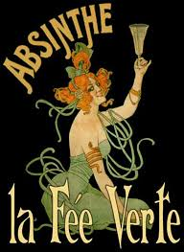
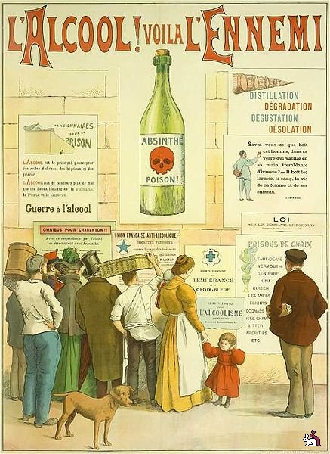
Absinthii herba CzPh 2017
Absinthism – syndrome connected to absinth drinking (thujon)
    Hallucinations, insomnia, convulsions
    Van Gogh, E. A. Poe, Ch. Baudelaire
Rise and fall of absinth: 20. century – increasing popularity (consumption increased 15-fold only in France between 1875 - 1913)
1915 – banned without any scientific proof of thujon content
    “the trouble with alcohol lies not in the consumed amount but in
the quality of consumed alcohol”
Thujon content: pre-ban absinth 25,4 mg/l (samples from 1895-1910)
post-ban absinth 7,6 mg/l (samples from 1915-1988)
modern absinth 26,9 mg/l (samples from 2003-2006)
  Padosch SA, Lachenmeier DW, Kröner LU. Absinthism: a fictitious 19th century syndrome with present impact. Substance Abuse Treatment, Prevention, and Policy 2006 1:14, https://www.alandia.de/absinthe-blog/absinthe-prohibition/
Notes:
Wine production was decreased due to infestations in that time and this helped to increase the popularity of absinth. However, mass consumption of alcohol took its toll and an antialcohol movement developed. Wine producers joined forces with church and together they demanded prohibition of absinthe. Absinthe was blamed for many health issues including mind health issues.
A common belief was that the trouble with alcohol lies not in the consumed amount but in the quality of consumed alcohol.
Wine producers supported antialcohol movement (haha) and thus helped to ban absinth

Slide 6
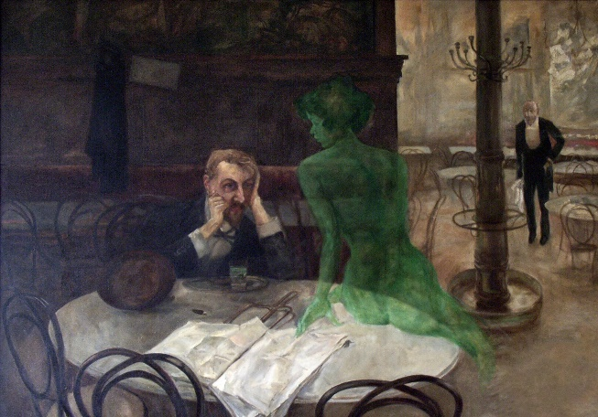
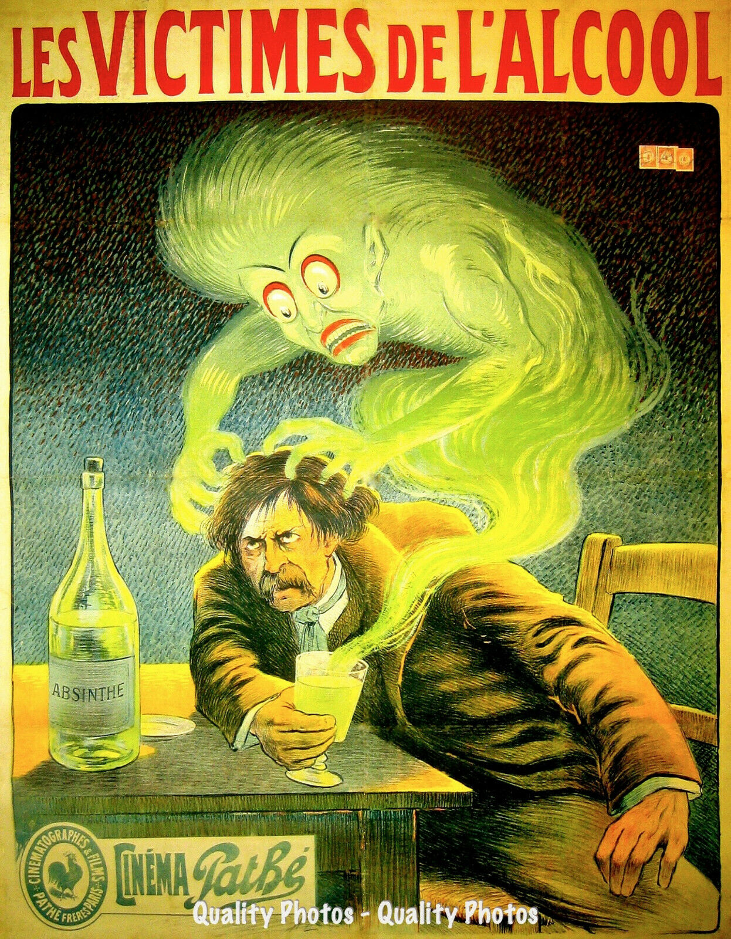
Absinthii herba CzPh 2017
ADI (acceptable daily intake) for thujon based on scientific data :
0.11 mg/kg of body weight per day = 2-20 cups of wormwood tea
Where do the roots of absinthism lie?
  Drinking of poor-quality absinth (samples from 19. century are from high-quality production)
  Addition of wormwood essential oil or other additives just before consumption (copper salts, antimony chloride)
  Combination with other psychotropic substances
  Drinking of such high amounts of absinth and other alcoholic beverages that ethanol was responsible for the symptoms of absinthism
https://www.ebay.com/itm/Green-Fairy-Causes-Madness-8-5x11-Photo-Print-Anti-Absinthe-Propaganda-Poster-/254472052339

Slide 7
Absinthii herba CzPh 2017
  1988 EU regulation of thujone content in food and beverages:
0.5 mg/kg in food prepared with Artemisia species, excluding those prepared with sage and non alcoholic beverages
10 mg/kg in alcoholic beverages not prepared with Artemisia species
25 mg/kg in food prepared with sage
35 mg/kg in alcoholic beverages prepared with Artemisia species
More about absinth and Absinthii herba:
10.1136/bmj.319.7225.1590
https://www.absinthes.com/absinthe-encyclopedia/thujone/thujone-and-absinthe-scientific-research/poison-on-line/
https://www.ema.europa.eu/en/medicines/herbal/absinthii-herba
(https://en.wikipedia.org/wiki/Thujone#cite_note-EU2008-29)

Slide 8
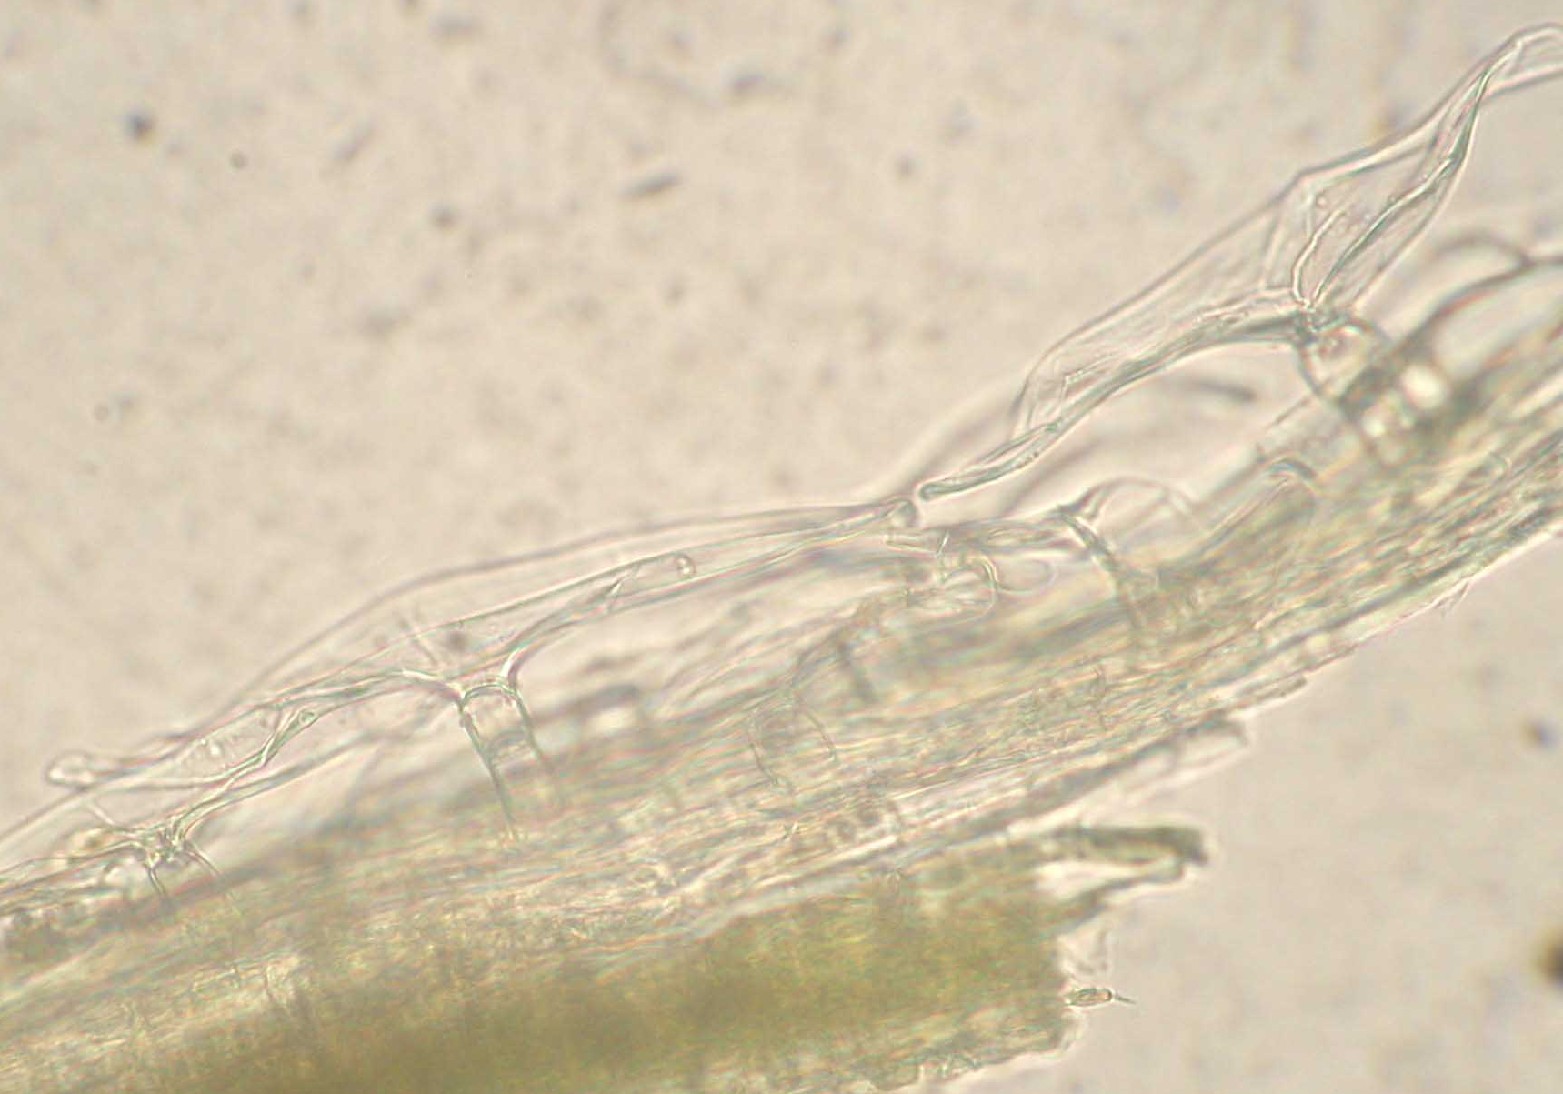
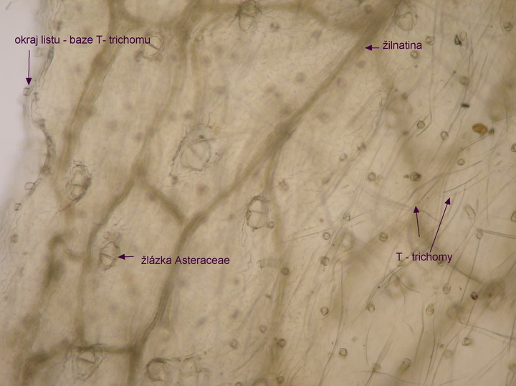
Absinthii herba CzPh 2017
Microscopy: leaf – upper and lower skin layer with characteristic T - trichomes, glandules of Asteraceae type (squamous division), cells of lower skin layer wavy trunk-like
  trichomes
T-trichomes

Slide 9
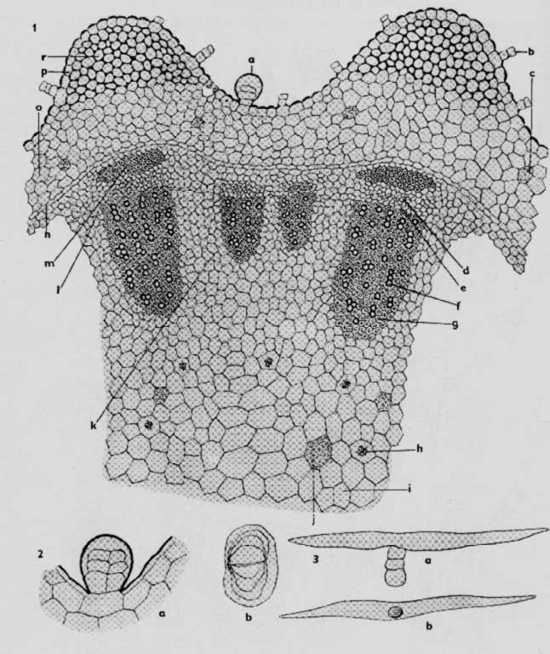
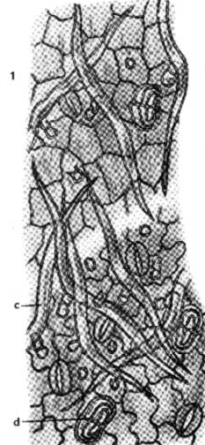
Absinthii herba CzPh 2017
Asteraceae glandulae
T-trichomes
  glandules
Notes:
Ribs - ridges

Slide 10
Absinthii herba CzPh 2017
Microscopy: Stem transversal section – surface glandules, schisogennic channel with essential oil in parenchyma, collenchyma in ribs (ridges), endodermis, aggregates of sclerenchyma, sieve-tubes, cambium, vessels with libriform, medullar rays, aggregates of calcium oxalate, collateral vascular bundle
skin layer
collenchyma
endodermis
phloem
xylem
crystal aggregate
channel with
essential oil
Notes:
Ribs - ridges

Slide 11
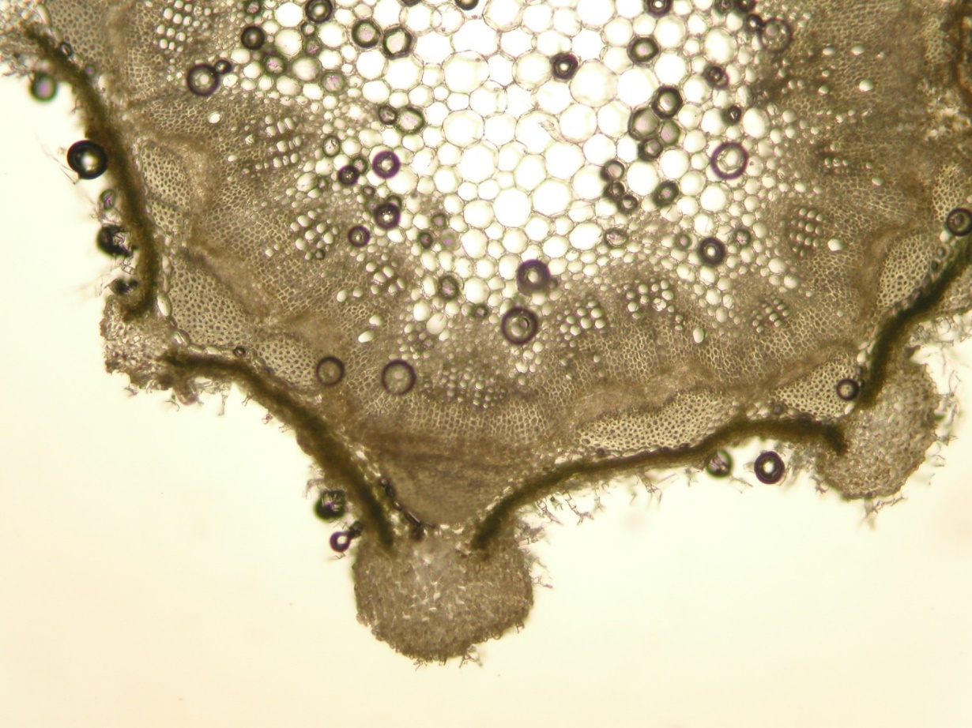
Absinthii herba CzPh 2017
xylem with libriform
phloem
sclerenchyma
essential oils channels
colenchymatic hypodermis
Notes:
Ribs - ridges

Slide 12
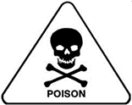
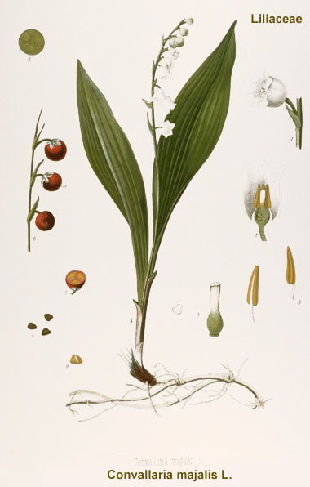
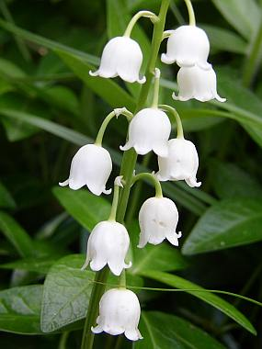
Convallariae herba
Mother plant: Convallaria majalis, Ruscaceae (Liliaceae)
Lily Of The Valley

Slide 13
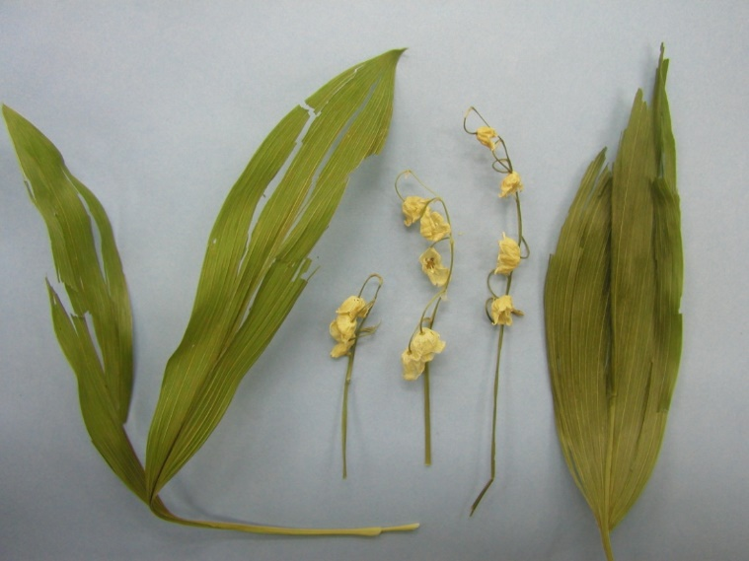
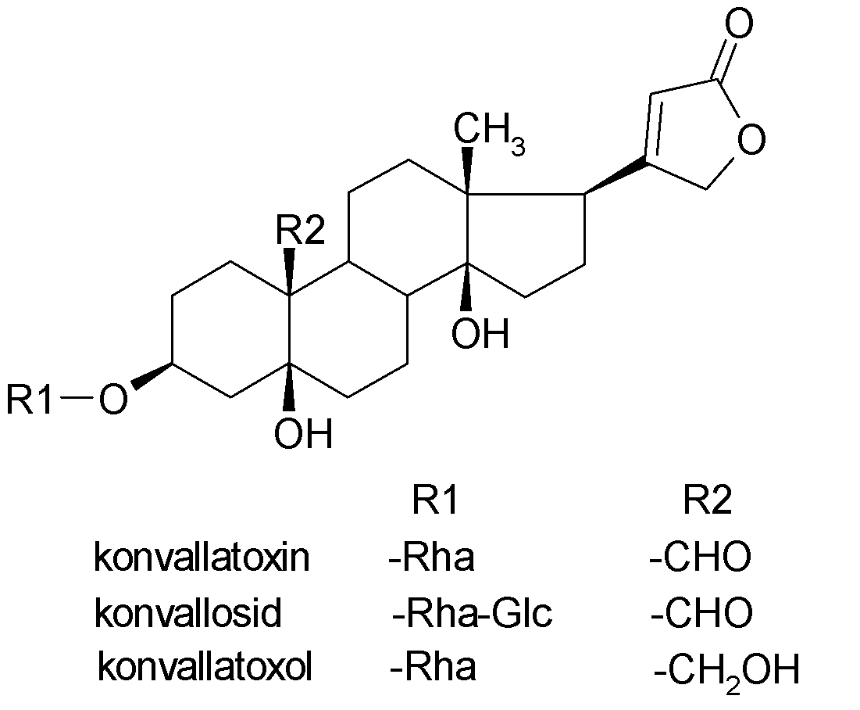
Convallariae herba
Macroscopy: leaves entire, elliptic, parallel veined; flowering stem bearing a one-sided raceme (to 4-9” long) of nodding, bell-shaped, sweetly fragrant, white flowers without odour, taste firstly sweet then sharp bitter
Content compounds: cardioglycosides – cardenolides (0.2 - 0.3% - convallatoxin, convallatoxol), saponins, flavonoids
Usage: cardiotonic
Notes:
North European plants – high content of convallatoxin, convallatoxol
East European plants – rich in convalloside
Not used in therapy, whole plant is poisonous

Slide 14
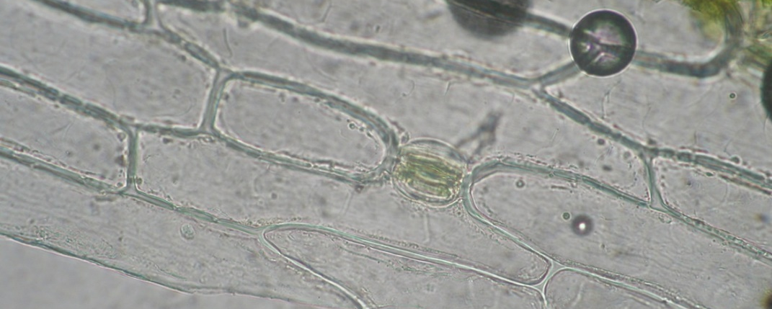
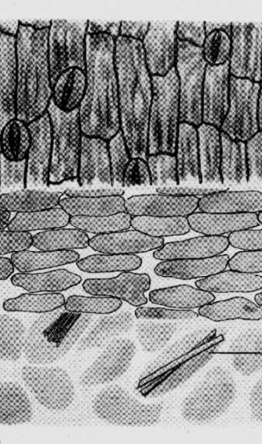
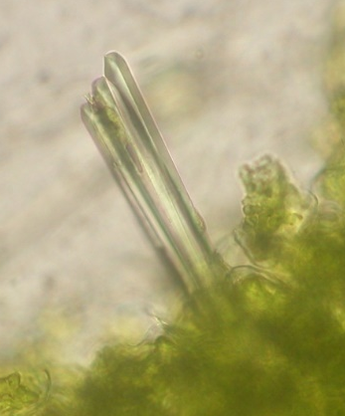
Convallariae herba
Microscopy: epidermal cells of leaves rod-like elongated, parallel with venatio, sporadic stomata without accompanying cells, non-differentiated palisade and spongeous parenchyma, raphides of calcium oxalate
palisades
raphides

Slide 15
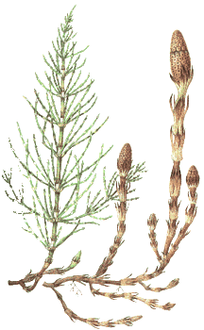
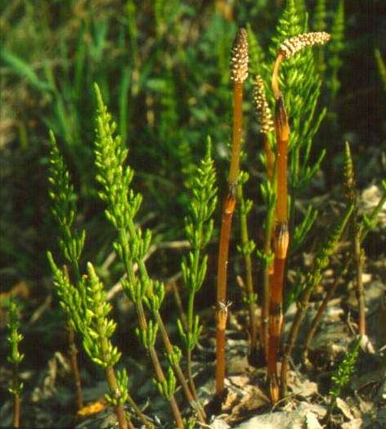
Equiseti herba CzPh 2017
Mother plant: Equisetum arvense, Equisetaceae (Horsetail)

Slide 16
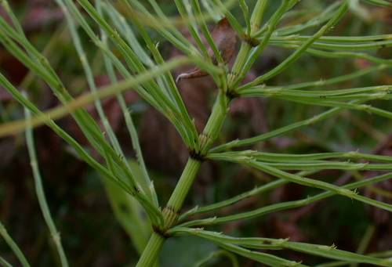
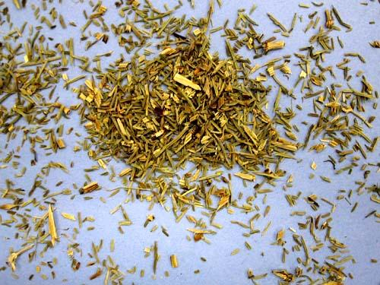
Equiseti herba CzPh 2017
Macroscopy: tough, fragile stems, articular, poly-costate, branched to simpler verticillate branches, without taste and odour
Content compounds: flavonoids, silicic acid (or soluble silicates), organic acids, traces of alkaloids (nicotine)
Usage: diuretic, skin disorders
Notes:
Flavonoids: glycosides of luteolin, kempferol, kvercetin, apigenin
Phenolic acids: caffeic, chlorogenic, ferulic
Only a small portion of silicates passes into water infusion

Slide 17
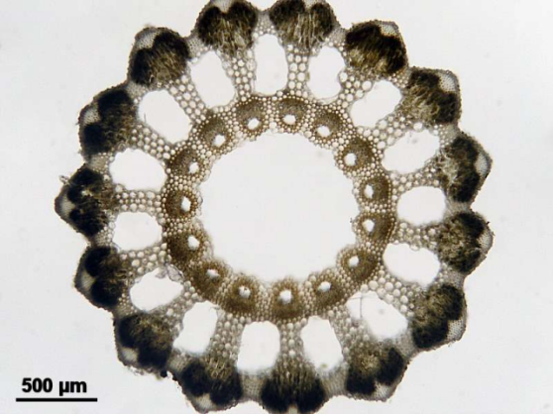
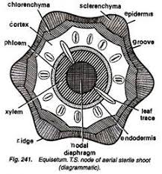
Equiseti herba CzPh 2017
Microscopy: transversal section: characteristic ribs/ridges reinforced by sclerenchyma and incrusted with silicic acid, between ribs located valleys/grooves, valecular cavities between ribs, under endodermis in ribs located carinal cavities, upon them collateral vascular bundles

Slide 18
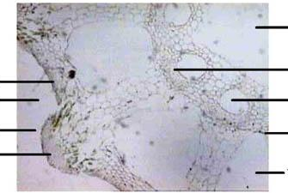
Equiseti herba CzPh 2017
Microscopy: transversal section: characteristic ribs/ridges reinforced by sclerenchyma and incrusted with silicic acid, between ribs located valleys/grooves, valecular cavities between ribs, under endodermis in ribs located carinal cavities, upon them collateral vascular bundles
central cavity
vascular bundle
collenchyma
valley/groove
carinal cavity
rib/ridge
endodermis
sclerenchyma
valecular cavity

Slide 19
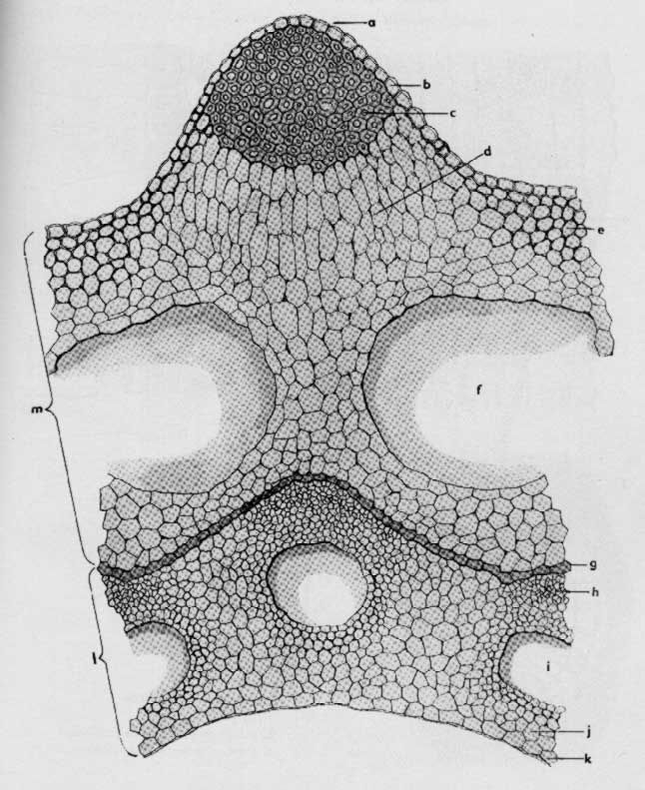
Equiseti herba CzPh 2017
Microscopy:
sclerenchyma
epidermis
rib
collenchyma
valecular cavity
endodermis
vascular bundle
collateral
carinal cavity
central cavity

Slide 20
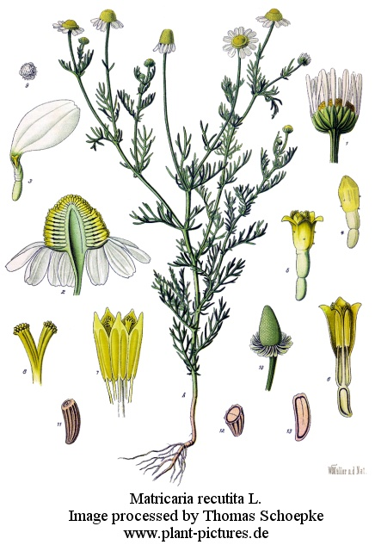
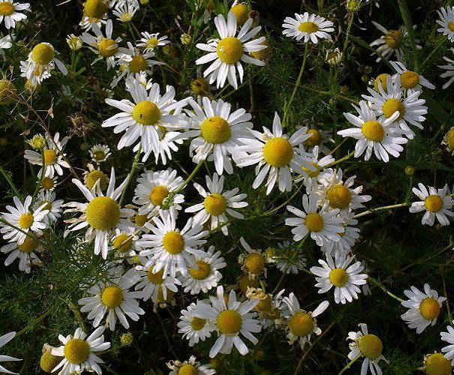
Matricariae flos CzPh 2017
Mother plant: Chamomilla recutita syn. Matricaria recutita, Asteraceae, Chamomile, χαμαίμηλον
  Matricariae etheroleum CzPh 2017
  Matricariae extractum fluidum CzPh 2017
Notes:
Európa, Ázia, Severná Amerika

Slide 21
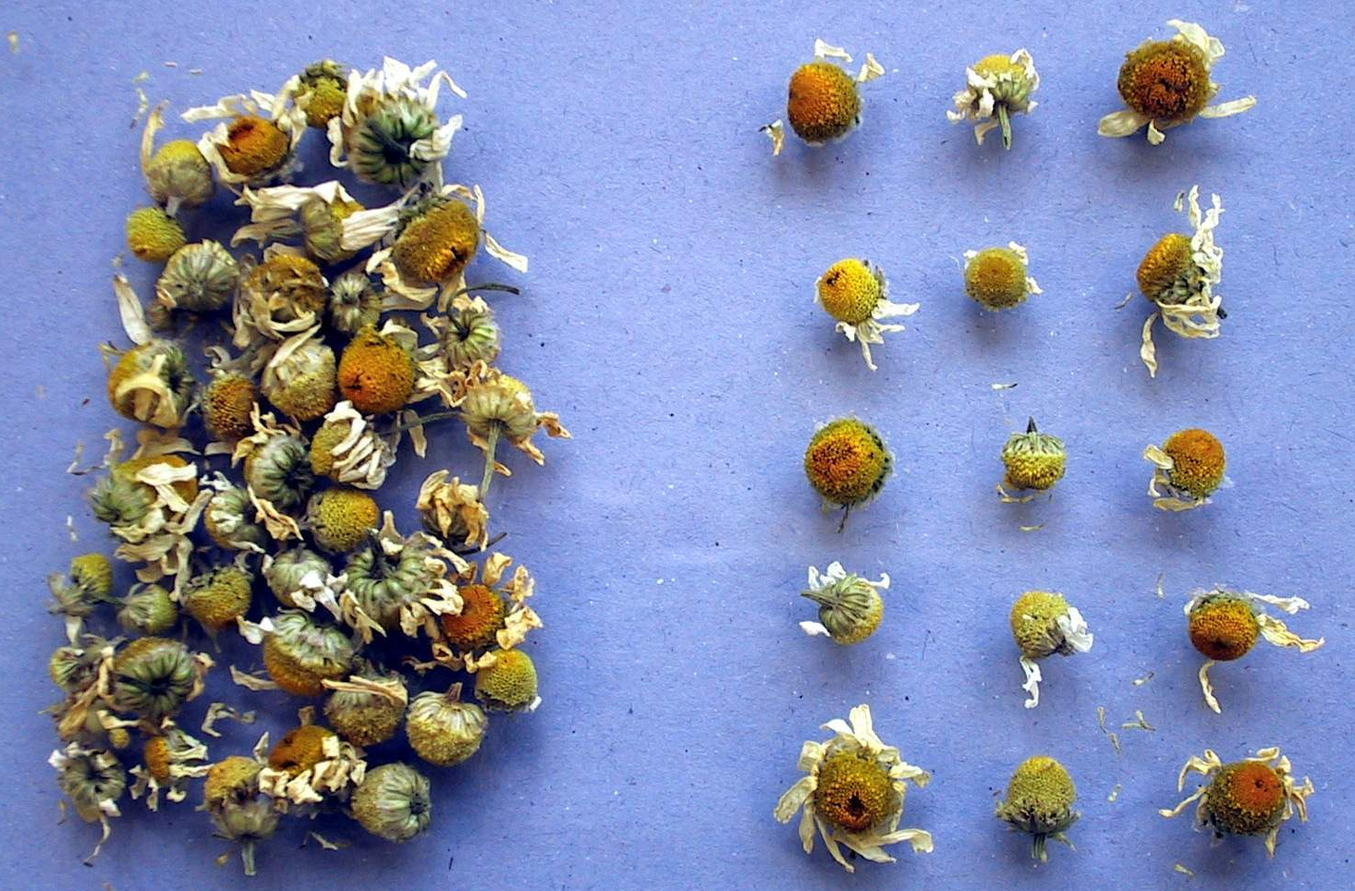
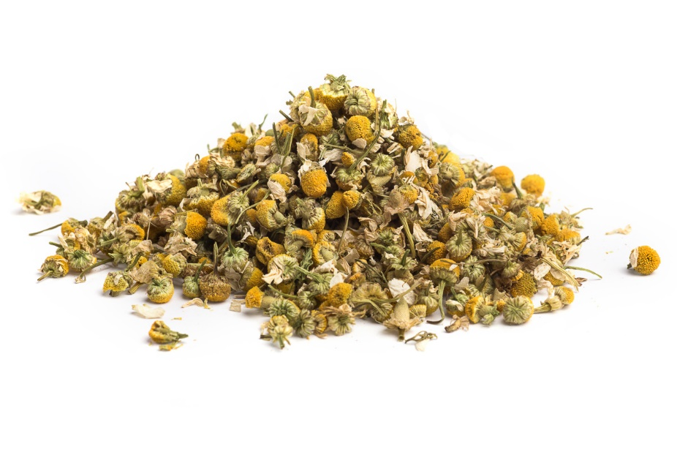
Matricariae flos CzPh 2017
Macroscopy: anthodium (flower heads) with hollow semi-globular receptacle, circumferential pistillate flowers with ray florets corolla, inner disc florets are duplicitous and yellow, several rows of green bracts, strong aromatic odour and taste

Slide 22
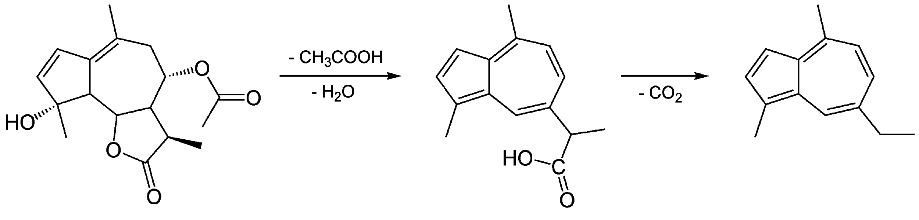
Matricariae flos CzPh 2017
Content compounds: essential oil – sesquiterpens (0.6-2.4%; chamazulene, guaiazulen, bisabolole), bitter substances (matricin), mucilage, flavonoids (apigenin), coumarins
Usage: internally- antiphlogistic, spasmolytic, carminative, stomachic, diaphoretic, mild sedative
externally- healing effect, promotes epithelization (wounds, burns)
matricin (proazulene)
chamazulene
Notes:
Essential oil gained by extraction is yellow or green.
Essential oil gained by distillation is blue.
Heating of water infusion of drug leads to decomposition of matricine – the lactone ring opens, deacetylation occurs and chamazulencarboxylic acid forms. This acid is unstable, it gives CO2 away and transforms to blue chamazulene.
Vodný zápar kvetov je možné užívať aj v tehotenstve
Terapeutický účinok sa pripisuje azulény, bisabolol, flavonoidy

Slide 23
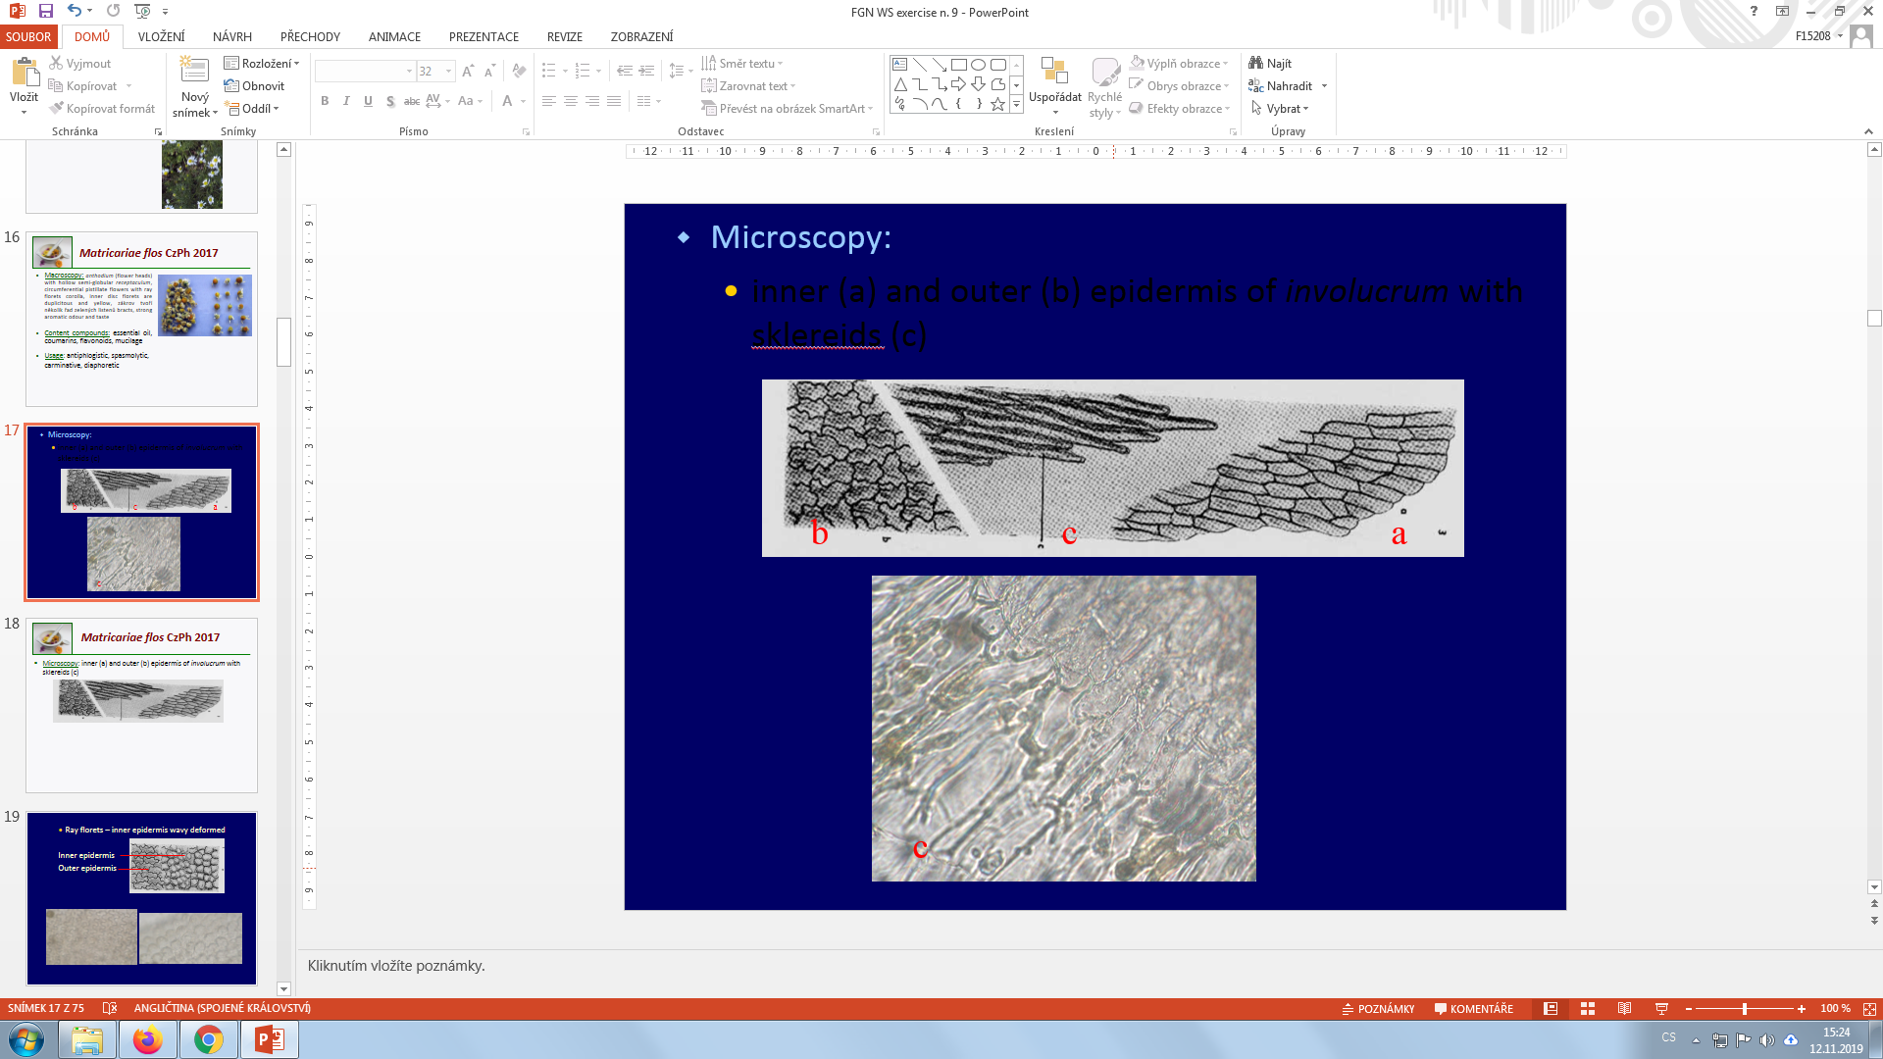
Matricariae flos CzPh 2017
Microscopy: inner (a) and outer (b) epidermis of involucrum (rosette of bracts surrounding an inflorescence) with sclereids (c)

Slide 24
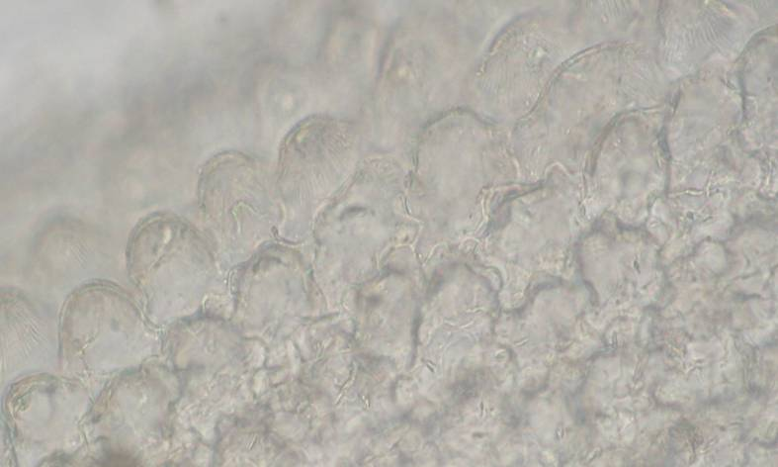
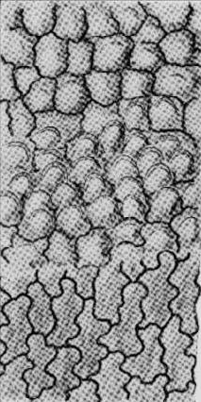
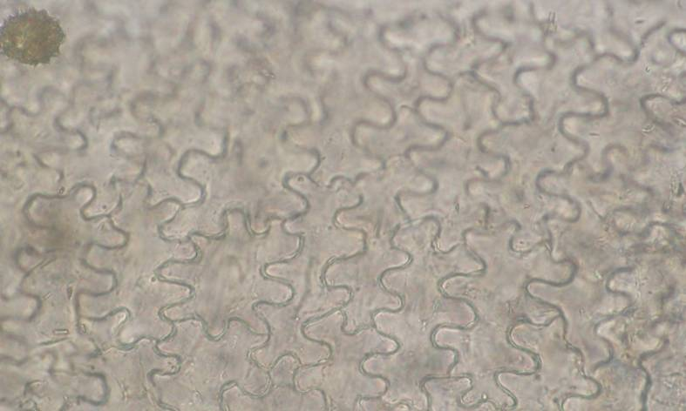
Matricariae flos CzPh 2017
Microscopy: Ray florets – inner epidermis wavy deformed
  inner epidermis - transversal section
  outer epidermis - aerial view

Slide 25
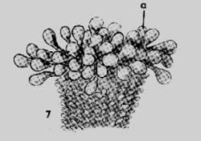
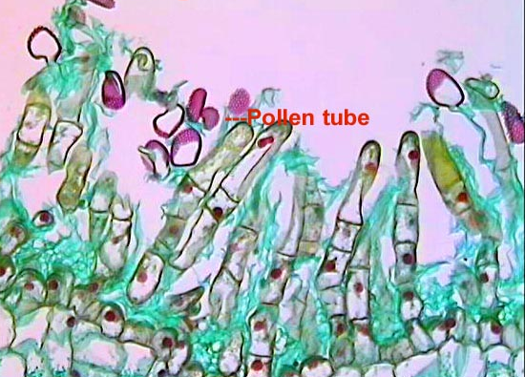
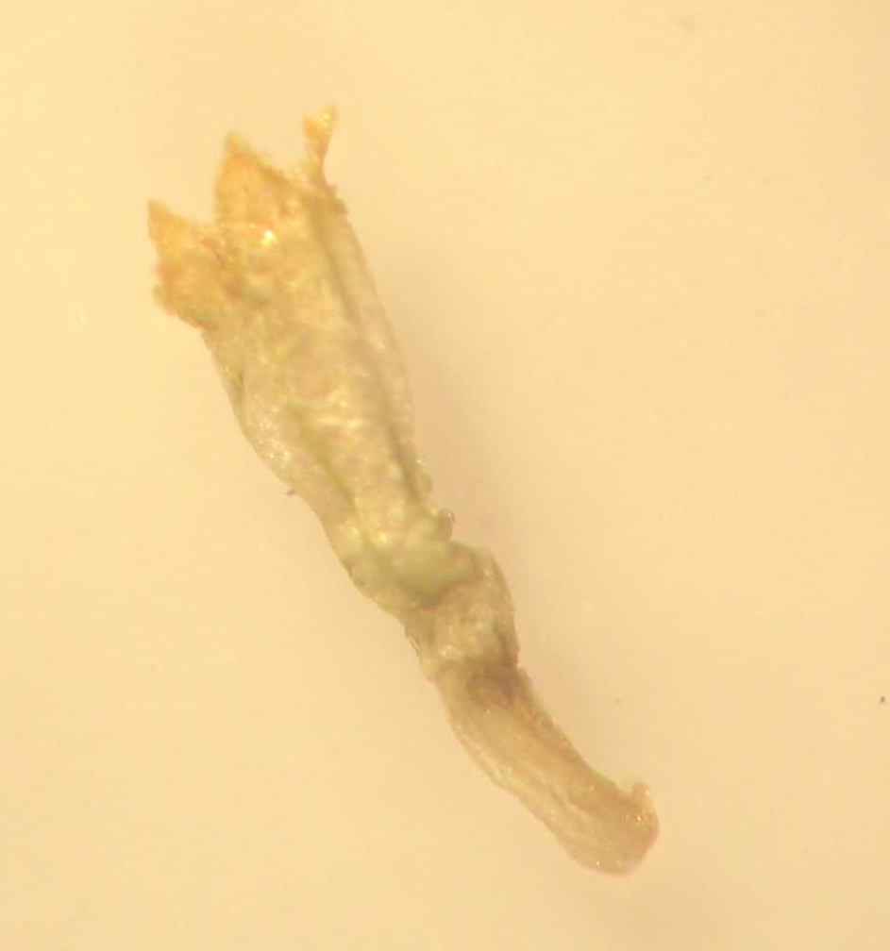
Matricariae flos CzPh 2017
Microscopy:
  stigma with papillas
  single tube flower

Slide 26
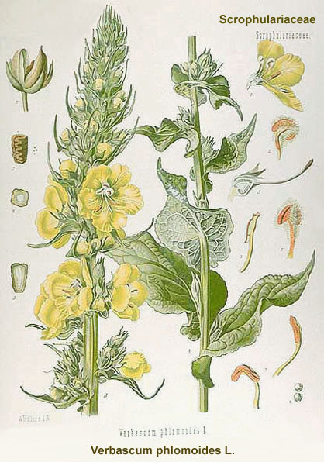
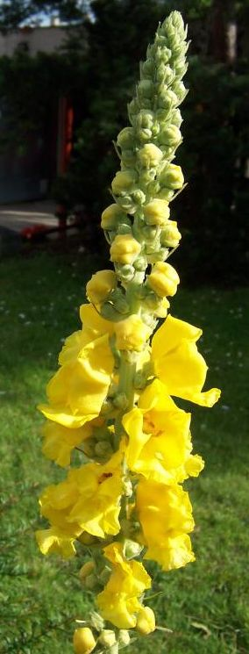
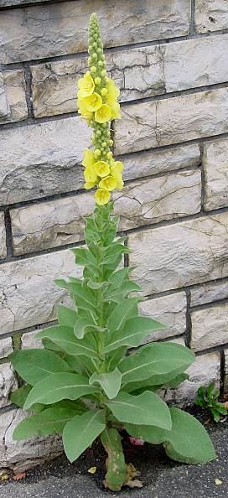
Verbasci flos CzPh 2017
Mother plant: Verbascum densiflorum, V. phlomoides, V. tapsus, Scrophulariaceae (Mullein)
Notes:
Európa

Slide 27
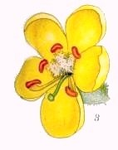
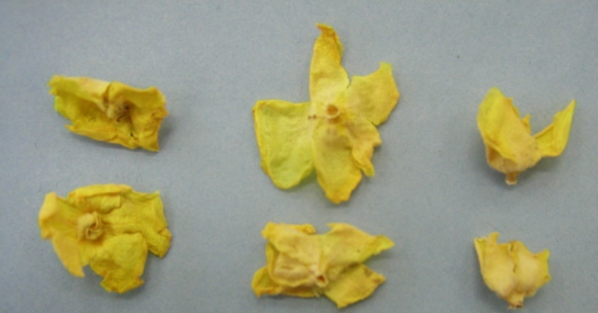

Verbasci flos CzPh 2017
Macroscopy: flat, pipe-like corollas 5-petalled (three lower corners bigger), yellow, 5 stamen, weak honey-like odour, sweet taste, mucilaginous
Content compounds: saponins (verbascosaponin with aglycone verbascogenine), mucilage, flavonoids (apigenin, luteolin), iridoids (aucubine, catalpol)
Usage: expectorant, mucilaginose, antiphlogistic, diaphoretic, mild diuretic
Notes:
Ttriterpenoid Saponins.
The irritative expectorant effect of saponins is softened by mucilage
Expektoračný a protizápalový účinok majú aukubín, verbaskozid. Dráždivý expektoračný účinok saponínov miernia slizy.

Slide 28


Verbasci flos CzPh 2017
  Microscopy:
  stamen - lower smooth, upper with one-cell club-like trichomes
epidermis – big branched covering trichomes (candelabra-like), glandular trichomes

Slide 29

Verbasci flos CzPh 2017
Microscopy:
upper stamen
lower stamen
club-like trichome
candelabra-like trichome

Slide 30
MACROSCOPY

Slide 31


Arnicae flos CzPh 2017
Mother plant: Arnica montana, Asteraceae Leopard´s bane, Mountain Arnica
  Arnicae tinctura CzPh 2017
Notes:
Horské lúky strednej, južnej, východnej Európy, chránená rastlina

Slide 32

Arnicae flos CzPh 2017
Macroscopy: flower heads: ray florets creamy white, circular head yellow disc florets are androgynous, ovary cylindrical, smoothly hairy, aromatic odour, sharp spicy taste
Content compounds: sesquiterpenic lactones (helenalin, dihydrohelenalin), flavonoids, carotenoids, polyphenolic compounds (cynarin), essential oil, triterpenic saponins (arnidiole), polyacetylene type substances
Usage: only external – antiphlogistic, antirheumatic, derivans
(internally – cardiotonic, elevates blood pressure)

Slide 33


Calendulae flos CzPh 2017
Mother plant: Calendula officinalis, Asteraceae, Pot Marigold

Slide 34


Calendulae flos CzPh 2017
Macroscopy: yellow flower head, circumferential ray florets, in disc tubular florets, bracts in two rows, weak odour, bitterish acrid taste
Content compounds: glycosides of oleanolic acid (calendulosides), flavonoids, essential oil, carotenoids and xantophylls, triterpenic alcohols (arnidiole, faradiole)
Usage: antiphlogistic
calenduloside E

Slide 35


Caryophylli flos CzPh 2017
Mother plant: Syzygium aromaticum (Eugenia caryophyllus), Myrtaceae, Cloves
Caryophylli floris etheroleum CzPh 2017

Slide 36



Caryophylli flos CzPh 2017
Macroscopy: long calyx, terminating in four spreading sepals, and four unopened petals which form a small ball in the center, strong aromatic odour and taste
Content compounds: essential oil (eugenol, caryophyllene), flavonoids, phenolic acids, oil, tannins, triterpenes
Usage: essential oil displays antiseptic and anaesthetic properties, antioxidant; analgesic and antirheumatic effect
eugenol
β-caryophyllene

Slide 37


Farfarae flos
Mother plant: Tussilago farfara, Asteraceae, Coltsfoot

Slide 38


Farfarae flos
Macroscopy: flower heads with short stalk, ray florets in several lines, tubular florets with feathers in disc, bracts in one row, felt-like, reddish, without odour, mucilaginous bitterish taste
Content compounds: mucilage, flavonoids, tannins, xanthophylls, traces of pyrrolizidine alkaloids (tussilagine, senkirkin)
Usage: mucilaginose, expectorant, mild astringent and spasmolytic

Slide 39


Lamii albi flos
Mother plant: Lamium album, Lamiaceae, White Deadnettle

Slide 40

Lamii albi flos
Macroscopy: corolla without calyx, petals fused into an upper lip and a lower lip , upper lip dished, side corners 2-3 toothed, creamy white colour, weak honey-like odour, bitterish taste
Content compounds: flavonoids, essential oil, tannins, triterpenic saponins, phenolic acids, mucilage, iridoid glycosides
Usage: mucilaginose, expectorant, sedative; externally as astringent, antiphlogistic

Slide 41


Lavandulae flos CzPh 2017
Mother plant: Lavandula angustifolia (L. officinalis), Lamiaceae, Lavender
Lavandulae etheroleum CzPh 2017

Slide 42


Lavandulae flos CzPh 2017
Macroscopy: small flowers with grey-blue poly-costate pubescent calyx and two-labiate corolla, aromatic odour, bitter taste
Content compounds: essential oil (monoterpens - linalyl-acetate, linalool, cineol, camphor), tannins, rosmarinic acid, flavonoids, coumarins, anthocyanins, bitter substances
Usage: nervinum, sedative, cholagogue, spasmolytic; externally antiseptic, derivans
linalyl-acetate

Slide 43


Malvae sylvestris flos
CzPh 2017
Mother plant: Malva sylvestris, Malvaceae, Common Mallow

Slide 44


Malvae sylvestris flos
CzPh 2017
Macroscopy: flowers located axillary, petals dark-purple (5), opposite-oval, with dark veining, calyx 5-cornered, ovary rounded, without odour, taste mucilaginous

Slide 45

Malvae sylvestris flos
CzPh 2017
Content compounds: mucilage (more than 10%), tannins, essential oil, anthocyanins (malvin)
Usage: mucilaginose, mild astringent, dye
malvin
(= malvidin-3,5-diglucoside)

Slide 46



Primulae flos
Mother plant: Primula veris, P. elatior, Primulaceae, Primrose
Primula veris
Primula elatior

Slide 47


Primulae flos
Macroscopy: flowers with yolk-yellow corolla and spoon-like concave petals (veris) or sulphur-yellow flowers with flat petals with deeper corners (elatior), honey-like odour, sweetish taste
Content compounds: triterpenic saponins, phenolic glycosides, flavonoids, carotenoids, essential oil
Usage: expectorant – secretolytic, mild diuretic
protoprimulagenine

Slide 48


Sambuci nigrae flos
CzPh 2017
Mother plant: Sambucus nigra, Adoxaceae (Sambucaceae), Black Elderberry

Slide 49

Sambuci nigrae flos
CzPh 2017
Macroscopy: small flowers white to yellowish, 5-toothed calyx and deeply 5-cornered corolla with many stamina, strong characteristic odour, mucilaginous taste

Slide 50


Sambuci nigrae flos
CzPh 2017
Content compounds: flavonoids (quercetin glycosides – rutin, hyperoside, isoquercitrin), essential oil, phenolic acids + esters, triterpenic saponins, mucilage, traces of sambunigrine
Usage: diaphoretic, diuretic
quercetin
sambunigrin

Slide 51


Tiliae flos CzPh 2017
Mother plant: Tilia cordata, Tilia platyphyllos, Tilia x vulgaris, Tiliaceae, Lime

Slide 52

Tiliae flos CzPh 2017
Macroscopy: whole small yellow-green hermaphrodite flowers in clusters of five to eleven with a leafy yellow-green subtending bract, characteristic odour, sweet mucilaginous taste

Slide 53

Tiliae flos CzPh 2017
Content compounds: flavonoids (glycosides of quercetin and kaempferol + esters with acids such as tiliroside), mucilage, tannins, phenolic acids (caffeic, chlorogenic), essential oil
Usage: diaphoretic, diuretic, mucilaginose
tiliroside

Slide 54


Echinaceae flos
Mother plant: Echinacea purpurea, Asteraceae, Purple Coneflower
  Echinaceae angustifoliae radix CzPh 2009
  Echinaceae pallidae radix CzPh 2009
  Echinaceae purpureae radix CzPh 2009
  Echinaceae purpureae herba CzPh 2017

Slide 55


Echinaceae flos
Macroscopy: flower heads with strongly concaved receptacle, ray florets are purple, sterile, down directed, tubular florets are androgynous, greenish

Slide 56

Echinaceae flos
Content compounds: essential oil (mono- and sesquiterpens), polyphenols (esters of caffeic acid – cichoric and caftaric acid), polysaccharides, anthocyans
Usage: stomachic, antitussic, immunomodulation
cichoric acid
Notes:
Increases phagocytose

