Slide 1
Stratégie v NMA II
OD APROPRIÁCIE K OTVORENÉMU ZDROJU

Slide 2
OD APROPRIÁCIE K OTVORENÉMU ZDROJU
http://r-s-g.org/PP/ - RSG: prepared PlayStation, 2005 manipulated video game
PREPARED PLAYSTATION
Using PlayStation games
Code bugs,glitches
Creating game loops
Videogames as medium / and as content
No additional editing or found footage

Slide 3
OD APROPRIÁCIE K OTVORENÉMU ZDROJU
http://www.ucl.ac.uk/slade/slide/docs/thap.html
http://www.ucl.ac.uk/slade/slide/docs/thapmov.html
http://www.triggerhappy.org/
Thomson and Craighead:
TRIGGER HAPPY 1998, web-based video game
arcade game, Space Invaders

Slide 4
Eva and Franco Mattes aka 0100101110101101.ORG
Net art pioneers
Subversive approach
Manipulated videogames
Digital collage...
Radical internet coup:
Vaticano.org:
http://www.0100101110101101.org/home/vaticano.org/spoof/index.html
http://www.vatican.va/
Fake identity:
Darko Maver, The most famous made-up artist
1998 – 1999 http://www.0100101110101101.org/home/darko_maver/index.html

Slide 5
OD APROPRIÁCIE K OTVORENÉMU ZDROJU
Hybrids: Online Net Art collages 1998 – 1999
„It is no longer necessary to deface paintings or to put a mustache on postcards of Mona Lisa, now art can be downloaded, modified and uploaded again, with absolute delight“
(Luther Blissett, Art Hacktivism)
http://www.0100101110101101.org/home/hybrids/hybrids.html

Slide 6
OD APROPRIÁCIE K OTVORENÉMU ZDROJU
0100101110101101.ORG:
„Copyright is boring“
Hell.com http://www.0100101110101101.org/home/copies/hell.com/index.html
Art.Teleportacia http://www.0100101110101101.org/home/copies/art.teleportacia.org/index.html
Jodi.org http://www.0100101110101101.org/home/copies/jodi.org/index.html

Slide 7
FLUXUS EFFECT
„The limits of art are never where you expect them to be.“
The Nike Ground 2003 /NIKE PLATZ:
http://www.0100101110101101.org/home/nikeground/video.html

Slide 8
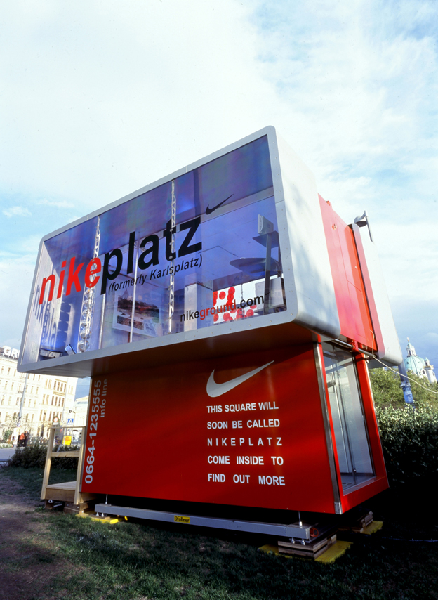
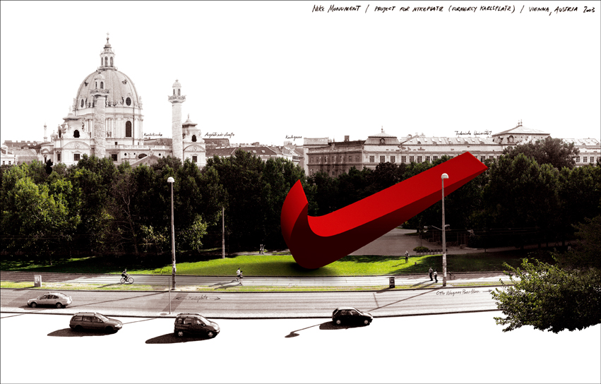

Slide 9
REENACTMENTS in Second Life
Marina Abramovic and Ulay's Imponderabilia 1977
http://www.youtube.com/watch?v=QgeF7tOks4s
0100101110101101.ORG: Reenactment of Marina Abramovic and Ulay's Imponderabilia. 2007, Synthetic Performance
http://www.0100101110101101.org/home/reenactments/performance-abramovic.html

Slide 10
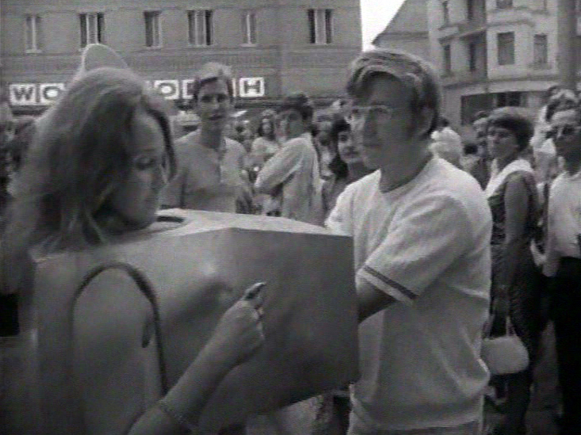
REENACTMENTS in Second Life
Touch cinema
Valie Export 1968-71
http://www.youtube.com/watch?v=JGv7F_S-rYk
http://www.0100101110101101.org/home/reenactments/performance-export.html

Slide 11
REENACTMENTS in Second Life
Chris Burden : Shoot, 1971
http://www.youtube.com/watch?v=JE5u3ThYyl4
0100101110101101.ORG
Reenactment of Chris Burden's Shoot
2007, Synthetic Performance
http://www.0100101110101101.org/home/reenactments/performance-burden.html

Slide 12

Second Life
Matej Vakula:
Videoinštalácia Československo – Second Life
http://artycok.tv/lang/cs-cz/1453/traumwerk

Slide 13
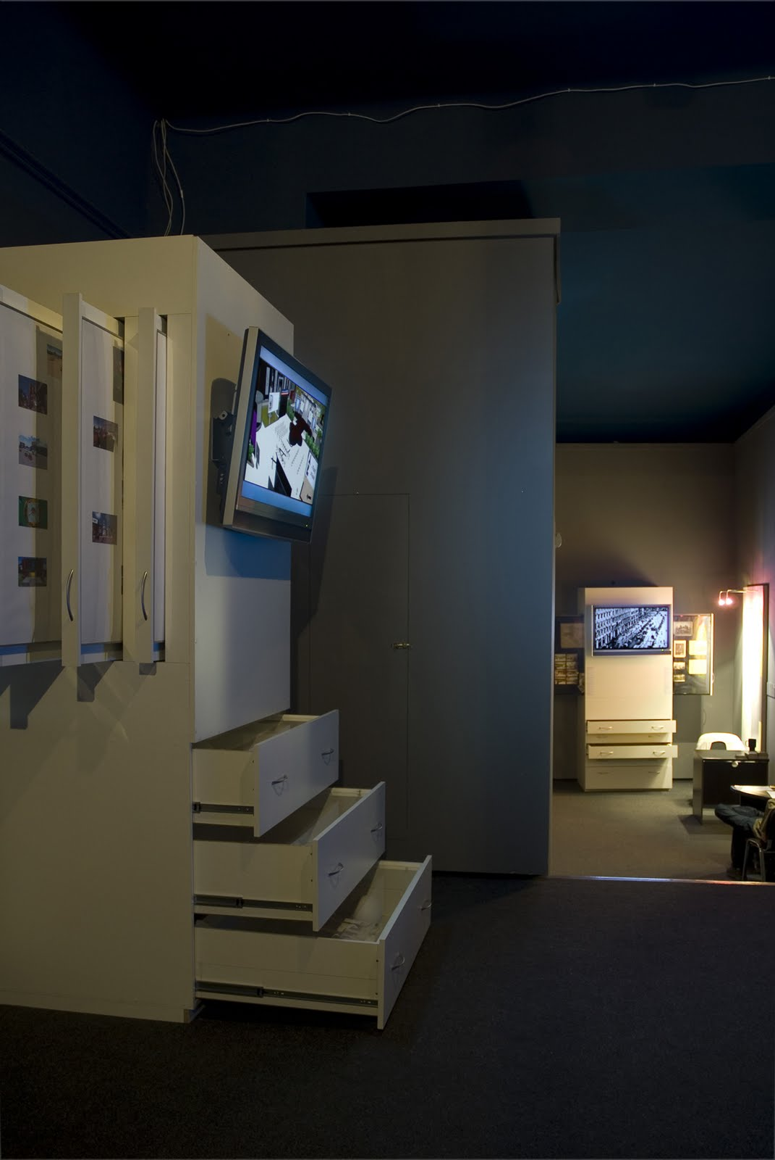
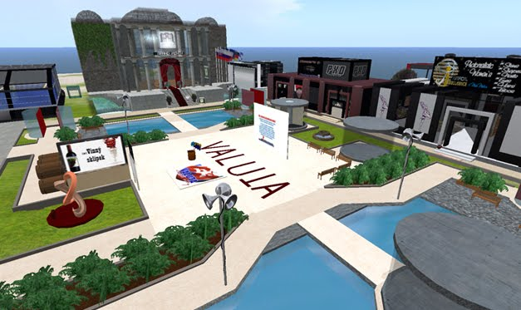

Slide 14
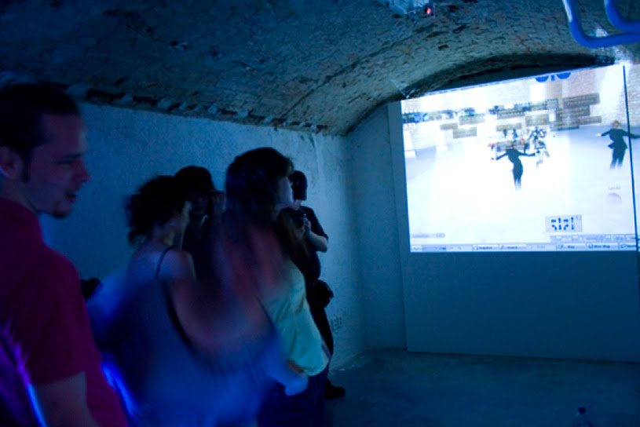
http://artycok.tv/lang/cs-cz/1453/traumwerk

Slide 15
0100101110101101.org
No Fun, 2010, Online Performance
http://www.0100101110101101.org/home/nofun/index.html
My Generation, 2010, Video collage, broken computer
http://www.0100101110101101.org/home/mygeneration/index.html

Slide 16
NMA:
OD APROPRIÁCIE K OTVORENÉMU ZDROJU
Cory Arcangel:
Super Mario Clouds (2002)
http://www.youtube.com/watch?v=ZkkJaqBbXV8
Cory Arcangel: I Shot Andy Warhol (2002)
http://www.coryarcangel.com/things-i-made/ishotandywarhol/
PAPER RAD : Wyld File "Theme Song", 2006
http://www.e--rock.com/

Slide 17
Olia Lialina: MBCBFTW 1996
My boyfriend came back from the war
http://www.teleportacia.org/war/war2.htm -
Olia Lialina : My boyfriend came back from the war
http://myboyfriendcamebackfromth.ewar.ru/
re-enactments / re-makes

Slide 18
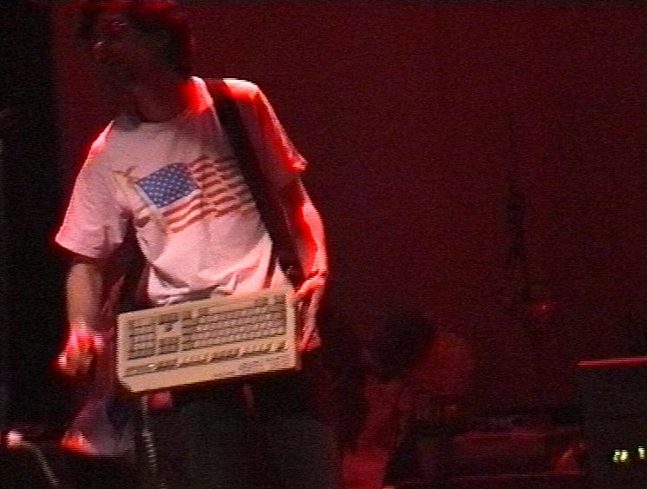
Alexei Shulgin
386 DX, 1998
http://www.easylife.org/386dx/
aesthetics of
obsolence
Aesthetics of
Crudeness
„dirt style“

Slide 19
Alexei Shulgin:
http://www.easylife.org/
FORM ART 1997
http://www.c3.hu/collection/form/
“Turn off the tv set” http://www.desk.nl/~you/turnoff/

Slide 20
Natalie Bookchin, Alexei Shulgin:
March-April 1999: Introduction to net.art (1994-1999)
http://www.easylife.org/netart/

Slide 21
Mark Napier :Digital Landfill 1998
http://potatoland.org/landfill/
Shredder
http://www.potatoland.org/shredder
Mark Napier: Feed 2001 http://potatoland.org/feed/
http://www.siusoon.com/dat/2011/07/06/feed-2001-by-mark-napier/

Slide 22
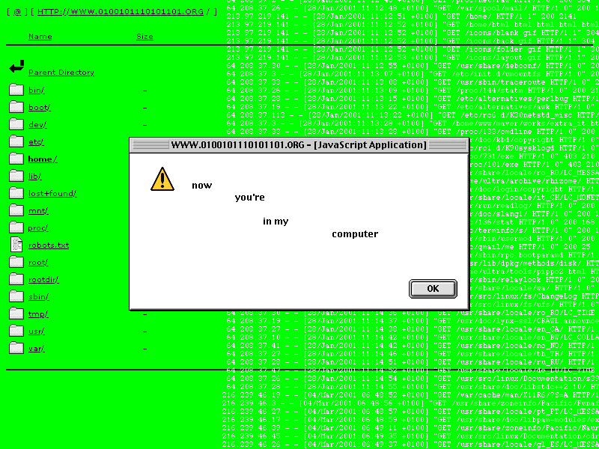
LIFE SHARING
http://interartive.org/index.php/net-art/
http://0100101110101101.org./home/life_sharing

Slide 23
ANGELO PLESSAS: ElasticEnthusiastic, 2004, Courtesy Miltos Manetas collection,
http://www.elasticenthusiastic.com/

Slide 24
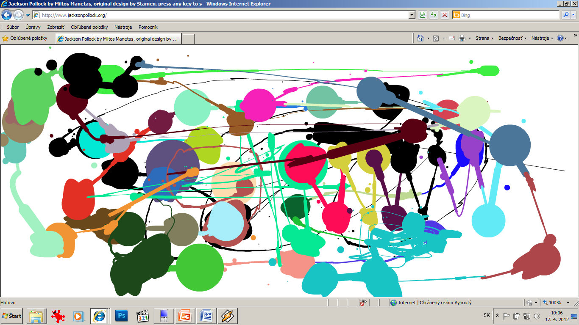
MILTOS MANETAS
JacksonPollock.org

Slide 25
Miltos Manetas :
Jackson Pollock for iPhone:
http://vimeo.com/3099477
SuperMario Sleeping, video, 1998
http://www.supermariosleeping.com/
Flames 1997, By Miltos Manetas.
http://www.youtube.com/watch?v=t1Ih5lojELM

Slide 26
Machinima
vytváranie animovaných filmov v reálnom čase prostredníctvom využívania technológie počítačových hier.
Základnou časťou je herný engine - software vytvorený tvorcami PC hier.
Engine má na starosti zobrazovanie grafiky, textúr, osvetlenie zobrazované scény, hernú fyziku. Teda chod celej hry ako takej.
Za pomoci prostredia a pohybových možností, ktoré hra používateľovi poskytuje, môže hráč natočiť vlastný film, podobne, ako je tomu v klasických hraných filmoch.

Slide 27
Machinima
Stanislav Veselovský:movieGAME
Ateliér Digitálne média
http://idm.aku.sk/stanislav-veselovsky/moviegame

Slide 28
http://interartive.org/index.php/net-art/
Douglas Davis:
THE WORLD'S FIRST COLLABORATIVE SENTENCE, 1994
http://artport.whitney.org/collection/davis/

Slide 29
BEN BENJAMIN: Superbad, 1995
http://www.superbad.com/
Some people would call what you do, "shitty, ignorant and irrelevant trash„
What would you say to them?
BB: Usually, I say, "Geez, Mom. I'm doing the best I can“

Slide 30
Mapa/navigácia
Markéta Baňková: New York City Map 1999
http://www.nycmap.com/

Slide 31
Mapa/navigácia
HEATH BUNTING:
A Visitor's Guide to London Heath Bunting, 1995
http://www.irational.org/heath/london/front.html

Slide 32
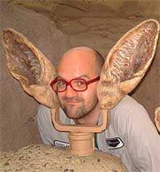
VUK COSIC Ascii Art
ACSII History of Moving Images
http://www.ljudmila.org/~vuk/ascii/film/
Deep Throat. Vuk Cosic. http://www.youtube.com/watch?v=DGktK6OxfJI

Slide 33
BORN DIGITAL III.
http://bookchin.net/projects/intruder.html - Natalie Bookchin: The Intruder
http://www.flong.com/projects/telesymphony/ - Golan Levin: Dialtones: A Telesymphony
http://www.yhchang.com/DAKOTA.html Young-Hae Chang: Heavy Industries
http://turbulence.org/Works/Distance/fps.html - Tina La Porta: Distance
http://www.ecafe.com/getty/table.html#4

Slide 34
Skeptický náhľad na internet
Internet a nová média: Jaká revoluce?
http://www.tedxbrno.cz/tedxbrno-2010/zaznamy-vystoupeni/jakub-macek-internet-a-nova-media-jaka-revoluce-/

