Slide 1
BIOART
Living tissue as a medium

Slide 2
Bioart
“umenie manipulujúce živými procesmi, … vytvárajúce a transformujúce živé organizmy, … ktoré nie je reprezentatívne, ale odohráva sa in vivo, stávajúc sa tak súčasťou živej prírody a evolúcie„
(E.KAC, Signs of Life, 2006, s. 18)

Slide 3
Bioart
manipuluje bio-materiálom za účelom navodenia špecifického správania
používa biotechnológie nezvyčajným alebo subverzívnym spôsobom
vytvára nové alebo transformuje existujúce živé organizmy
(E.KAC, Signs of Life, 2006, s. 18)

Slide 4
bio art (tiež Bio-Art, Bio Art)
umelecké diela zahŕňajúce:
živé organizmy s výnimkou človeka
diela vytvorené v spolupráci s týmito organizmami

Slide 5
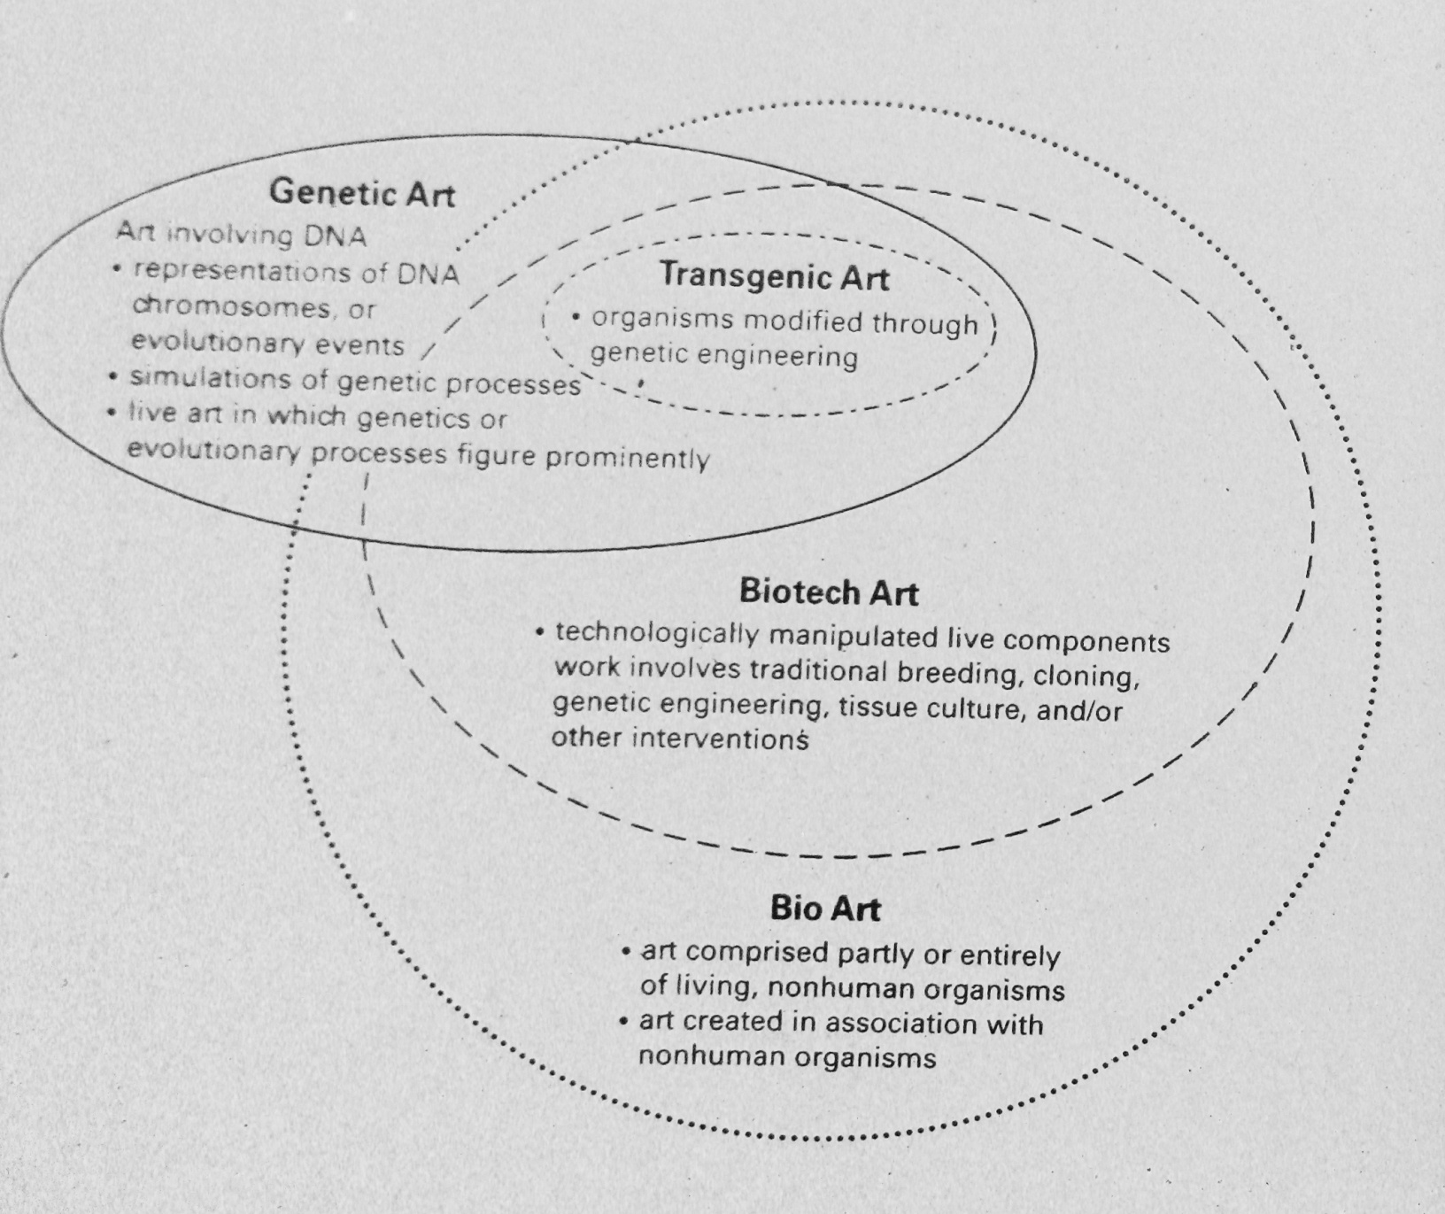
Pier Luigi CAPUCCI, „A Diagram“, in: Jens HAUSER – Pier Luigi CAPUCCI – Franco TORRIANO (eds.), Art Biotech, Bologna: CLUEB 2007, s. 11; cit. dle: George GESSERT, Green Light. Toward an Art of Evolution, Cambridge, MA – Londýn: MIT Press 2010, s. 191

Slide 6
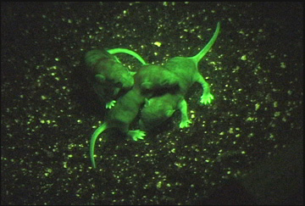
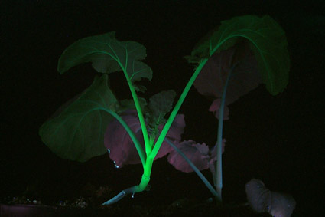
E. Kac: (The Eighth Day, 2000)
„Svetielkujúci ekosystém“: http://www.ekac.org/8thday.html
http://www.digitalarti.com/bains_numeriques/en/video/eduardo_kac_the_eight_day

Slide 7
Jun Takita:Light, Only Light, 2004–).
http://archive.fact.co.uk/index.php/objectui/type,vra.vrawork/id,429

Slide 8
Shiho Fukuhara and Georg Tremmel: Biopresence

Slide 9
George Gessert: Natural Selection
Hybrid 488 Hybridized 1990, first bloom 1994

Slide 10
The Tissue Culture & Art Project/Oron Catts, Ionat Zurr: Victimless Leather:A prototype of a stitch-less jacket grown in a bioreactor

Slide 11
Preparing for Victimless Leather project A layer of pig mesenchymal cells (bone marrow stem cells) grown for six weeks. Grown during Oron Catts and Ionat Zurr's residency as research fellows at Harvard Medical School (2000-2001)
Vrstva kmeňových buniek kostnej drene z ošípaných

Slide 12
Oron Catts with Victimless Leather: A Prototype of Stitch-less Jacket grown in a Technoscientific "Body".

Slide 13
A Semi-Living Worry Doll by the Tissue Culture and Art Project (Oron Catts and Ionat Zurr)

Slide 14
Oron Catts/Ionatt Zurr: The Semi-Living Worry Dolls: The dolls contained in their mini bioreactors

Slide 15
A Semi-Living Worry Doll by the Tissue Culture and Art Project (Oron Catts and Ionat Zurr) - bioreactor

Slide 16
Semi living worry dolls: feeding protocol
http://www.youtube.com/watch?v=lOTpT6asopY
http://sciencegallery.com/visceral/semi-living-worry-dolls

Slide 17
The Human Tissue & Art Project: Pig Wings The Pig Wings installation -where pig cells are grown into the shape of different types of wings.

Slide 18
Pig Wings: The wings created as part of the Pig Wings project - bat wings, bird wings and ancient reptile wings

Slide 19
The Tissue Culture & Art Project : NoArk II Hybridomas cells growing in the WAVE bioreactor, next to taxidermy and preserved specimens (2008)

Slide 20
Untitled Pre-natal sheep skeletal muscle and degradable PGA polymer scaffold. This is the "Semi-Living Steak" after around 4 months of growth

Slide 21
Untitled Pre-natal sheep skeletal muscle and degradable PGA polymer scaffold. This is the "Semi-Living Steak" after around 4 months of growth

Slide 22
48 Star Flag: Study for What They Want Made out of tanned human skin. By Andrew Krasnow

Slide 23
Hamburger 2000 A hamburger made from tanned human skin, containing teeth. By Andrew Krasnow.

Slide 24
Andrew Krasnow, Palette 1992/1999 human skin, thread, 25 x 21 inches photo: Dan Miller, Courtesy ADM Project

Slide 25
Andrew Krasnow's Hollow Muscle, a heart made from human skin.

Slide 26
Tissue Bank A brain cut into pieces at the Tissue Bank, Imperial College London

Slide 27
Tissue Bank. Artists David Marron,and Katharine Dowson in Imperial College's Tissue Bank with Dr Federico Roncaroli looking at brain tissue.

Slide 28
Stelarc: An ear implanted in the forearm of Stelarc (SymbioticA)
http://www.youtube.com/watch?v=k1AhxTbMdF4
http://www.stelarc.va.com.au/projects/earonarm/index.html

Slide 29
1997: Mouse with human ear

Slide 30
Biomediale. Contemporary Society and Genomic Culture". Edited and curated by Dmitry Bulatov. The National Centre for Contemporary art (Kaliningrad branch, Russia), The National Publishing House "Yantarny Skaz": Kaliningrad, 2004. ISBN 5-7406-0853-7
http://biomediale.ncca-kaliningrad.ru/

