Slide 1
EASTER CLASS on STRESS, RHYTHM and INTONATION
It´s MAUNDAY THURSDAY today, followed by GOOD FRIDAY, EASTER SATURDAY and EASTER SUNDAY.

Slide 2

Rule of S&R #1
You
‘only stress
‘words which you
‘wouldn’t leave
‘out in a
‘text message.

Slide 3
Rule of S&R #2
‘Stressed
‘syllables are at
‘constant
‘distances from each
‘other.

Slide 4
Rule of S&R #3
‘Any un-
‘stressed
‘syllables at the be-
‘ginning of a
‘stress group are
‘said
‘very
‘quickly.

Slide 5

S&R exercise #1: Nursery Rhyme
Hot cross buns, hot cross buns,
One a penny, two a penny,
Hot cross buns.
If you have no daughters,
Give them to your sons.
One a penny, two a penny,
Hot cross buns.

Slide 6
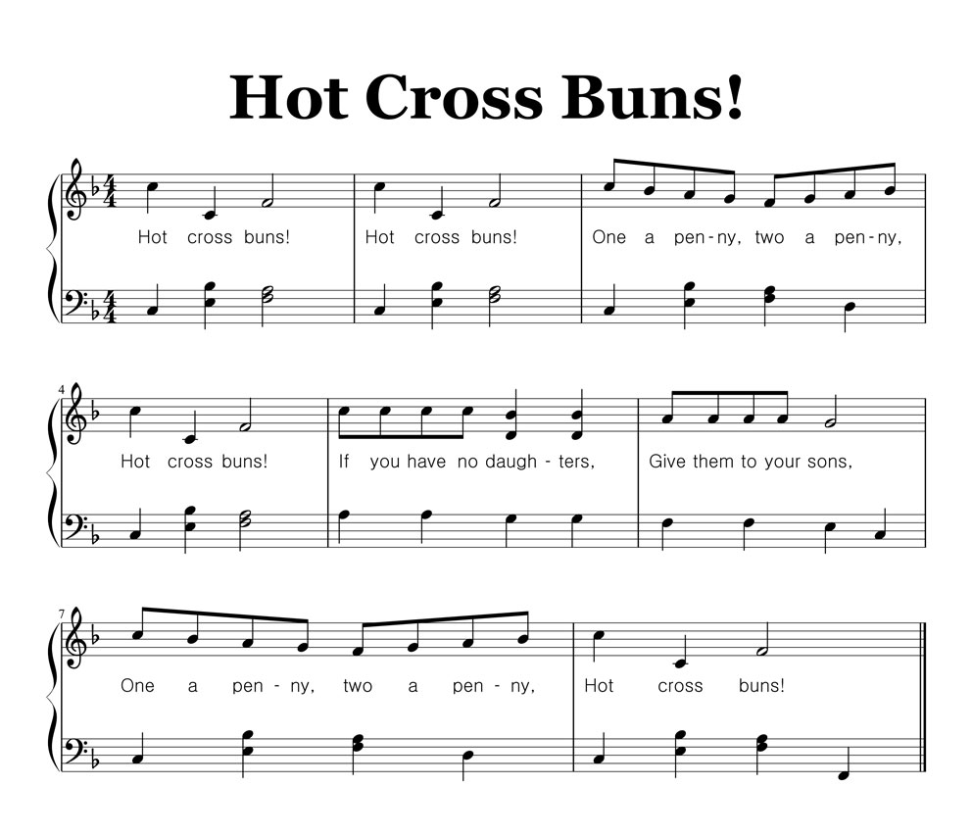
More hot cross buns:

Slide 7
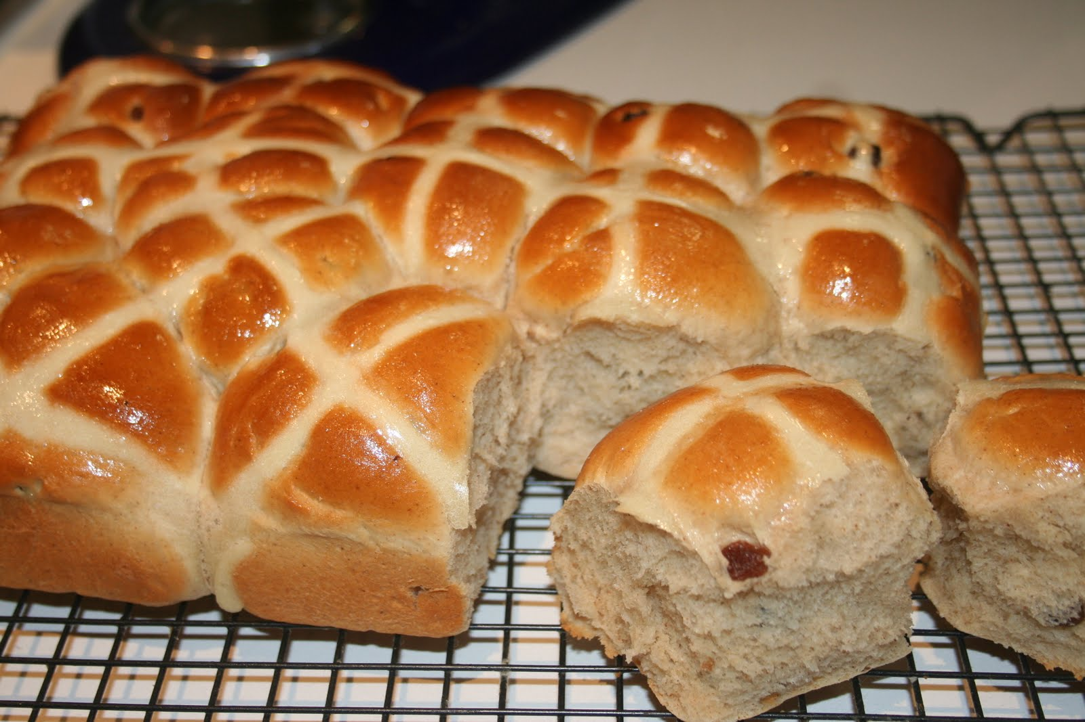
More hot cross buns:

Slide 8

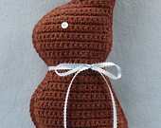
S&R exercise #2: a Dialogue
A: I’ve broken my glasses.
B: How did you do it?
A: I dropped them on the floor.
B: You must get them re- paired.

Slide 9
INTONATION
Don’t give up tunes (especially the falling ones) used in your mother tongues!!!
The four classical tunes as defined by Roger Kingdon are the following:
- H.J. high jump
G.U. glide up
H.D. high dive
T.O. take off

Slide 10
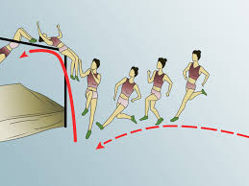
High Jump
Your voice falls on the intonation centre (IC). Used for statements, wh-questions, hearty greetings and thanks. It signals that you have finished.

Slide 11
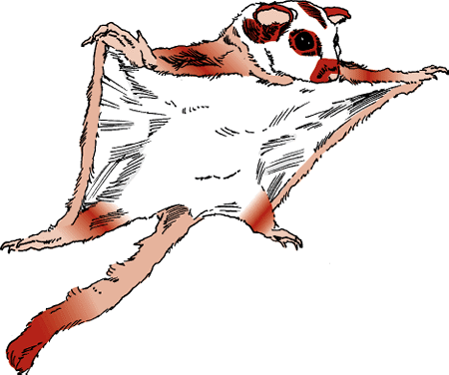
Glide Up
Your voice rises on the IC.
Used for yes-no questions, casual thanks and greetings, for polite reassuring orders (typically when speaking to
children or patients).
Sometimes viewed as
a patronising
tune.

Slide 12
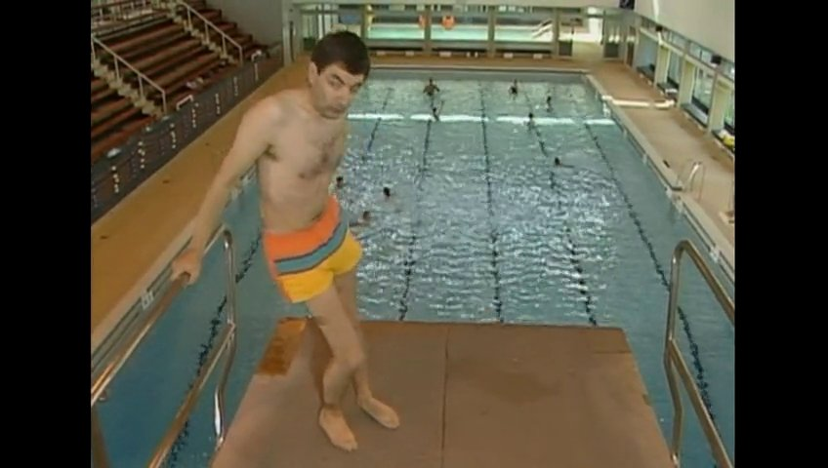
High Dive
Your voice falls deep, vanishes and reemerges, rising. Signals worry, doubt, hesitation and contradiction (an unsaid ‘but’).

Slide 13

Take Off
Voice flat and then rises quickly on the IC.
An extremely unpleasant and rare tune signalling a high degree of distress.

Slide 14
S&R again: INTONATION CENTRE (NUCLEUS)
A sentence can contain some, or all, of these kinds of syllables:
pre-head = unstressed syllables before the first stressed one
head = the stressed syllable(s) before the IC
nucleus (IC) = where the tune is realised
tail = anything after the nucleus = no change in tune

Slide 15
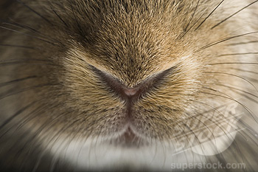

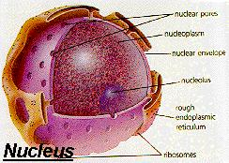
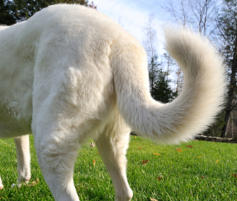
EXAMPLE PHRASE
                For
‘Goodness
‘sake
  ‘come to the
‘guest lecture next
                ‘Thursday please guys.

Slide 16




