Slide 1
Literary Postmodernism
“In a universe where no more explanations are possible, all that remains is to play with the pieces. Playing with the pieces, that is postmodernism” (Jean Baudrillard, The Evil Demon of Images 29).

Slide 2
Outline:
theories of postmodernism: Lyotard, Jameson, Hutcheon
postmodernism and: originality
representation
politics and history
intertextuality
examples from literature and film
Canadian fiction and postmodernism

Slide 3
Jean-Francois Lyotard, The Postmodern Condition (1979/1984)
modernism: ‘grand narratives’-> the Progress of Spirit and the March to Freedom -> unified and communicable meaning
postmodernism: questioning and problematizing the unified meaning, conventions, assumptions; self-critical

Slide 4
Fredric Jameson, “Postmodernism, Or the Cultural Logic of Late Capitalism” (1984)
postmodernism is a “cultural dominant”
industrial capitalism -> cultural dominant of realism
colonial (imperialist) capitalism -> modernism
post-industrial, multinational, or late capitalism -> postmodernism

Slide 5
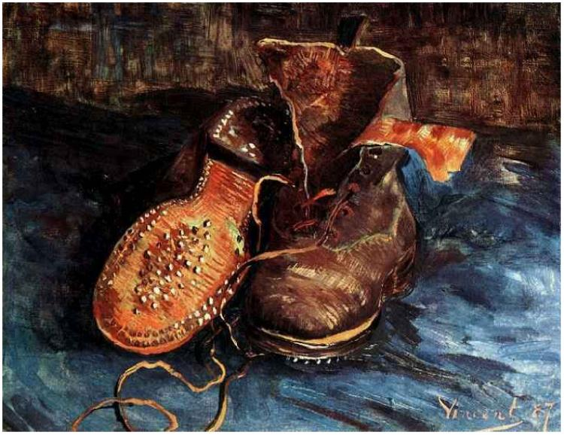
modern and postmodern painting (Jameson)
Vincent Van Gogh, A Pair of Shoes
Andy Warhol, Diamond Dust Shoes

Slide 6
Linda Hutcheon, A Poetics of Postmodernism (1988) and The Politics of Postmodernism (1989)
“What I want to call postmodernism is fundamentally contradictory, resolutely historical, and inescapably political. Its contradictions may well be those of late capitalist society, but whatever the cause, these contradictions are certainly manifest in the important postmodern concept of ‘the presence of the past’” (A Poetics 4).

Slide 7
Venice Biennale 1980 “The Presence of the Past”
Strada Novissima -> “historical parody”
“a critical revisiting, an ironic dialogue with the past of both art and society, a recalling of a critically shared vocabulary of architectural forms” (A Poetics 4)

Slide 8
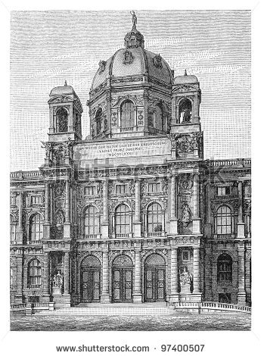
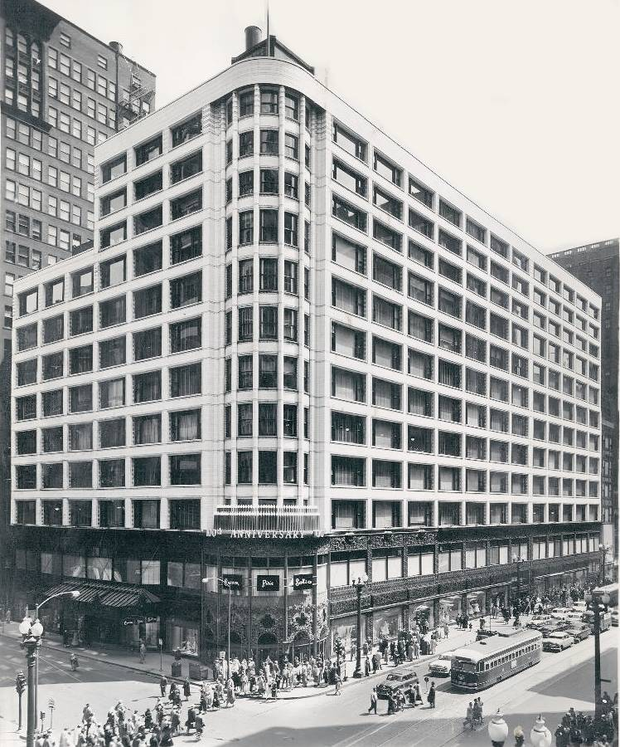
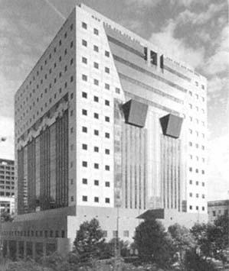

Slide 9
Hutcheon’s postmodernism
“critical revisiting and ironic dialogue”
“a contradictory phenomenon, one that uses and abuses, installs and then subverts, the very concepts it challenges” (A Poetics 3)
the postmodern paradox -> critique and complicity at the same time (The Politics 14)

Slide 10
Hutcheon: historiographic metafiction
-> novels which are “both intensely self-reflexive and yet paradoxically also lay claim to historical events and personages”
-> its theoretical self-awareness of history and fiction as human constructs
-> challenges notions such as historical truth and accurate knowledge of the past

Slide 11
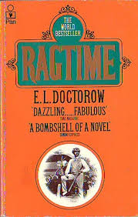
E. L. Doctorow, Ragtime (1975)
blurring fact and fiction
intertextuality
narrator

Slide 12
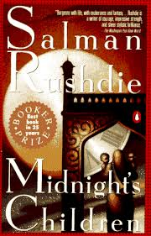
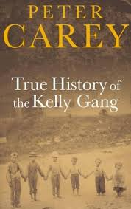

Slide 13
Postmodernism and originality
pull away from the modernist focus on originality and authenticity
deconstruction of the idea of the artistic genius
poststructuralism and Roland Barthes’ “Death of the Author” (1967)
=> is it really possible to produce an original work of art today?

Slide 14
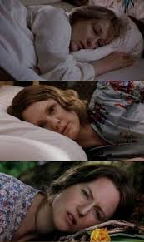
Michael Cunnigham, The Hours (1998)
Virginia Woolf writing Mrs. Dalloway in the 1920s
Laura Brown reading Mrs. Dalloway in the 1950s
Clarissa Vaughn living Mrs. Dalloway’s story in early 2000s

Slide 15
postmodernism and rewriting
metatheatre
Tom Stoppard, Rosencrantz and Guildenstern Are Dead
postcolonial rewritings
J. M. Coetzee, Foe
Jean Rhys, Wide Sargasso Sea
Peter Carey, Jack Maggs
Margaret Atwood, The Penelopiad
pastiche
Angela Carter, The Bloody Chamber
David Lodge, The British Museum is Falling Down

Slide 16
postmodernism: a problem of representation?
representation of fiction -> metafiction
representation of subjectivity -> meta-autobiography

Slide 17
overview of literary postmodernism
skepticism towards objective truth and universal structures
self-reflexivity
instability of meanings
surrender in the face of originality/authenticity
problematizing mimetic (transparent) representations
emphasis on difference and plurality
ironic appropriation of existing images/texts
metafiction and metatextuality
mixing fact and fiction, history and fiction, high and low genres

Slide 18
Linda Hutcheon, “The Canadian Postmodern: English Fiction since 1960”
1960s – flourishing of CanLit
1970s/1980s – “postmodernism had arrived to Canada” (Hutcheon 18)
Canadian ‘ex-centrics’: position in the margin, off the centre but in relation with it:
the (geopolitical) centre shifts in Canada
regional differences
suspicion towards authority

Slide 19
The Canadian Postmodern
‘ex-centricity’ - the Canadian, the postmodern, the feminist - seem to share the self-defining challenge to the dominant tradition, all write from the ‘ex-centric’ position of marginalization
a relation between the national search for Canadian cultural identity and feminist search for a distinctive identity -> takes shape of the postmodern, the paradoxial, the contradictory, contesting the power of dominant cultures
literary tradition: Susanna Moodie, Catharine Parr Trail, Emily Carr, Margaret Laurence, Mavis Gallant, Margaret Atwood, Alice Munro…

Slide 20
The Canadian Postmodern
parody in order to question authority -> inscribing canonical texts (male, British/American) and then subverting their status and authority:
“Parody, then, becomes a major form of critique, allowing a writer to speak to her or his culture from within it but without being totally co-opted by it” (Hutcheon, “The Canadian Postmodern” 23)
recalling the texts of the past (literary or historical) and then re-narrating or re-conceptualizing the past, becoming intertextual: e.g. Atwood’s The Penelopiad
“To render the particular concrete, to celebrate ex-centricity: this is the Canadian postmodern” (Hutcheon, “The Canadian Postmodern” 28)

