Slide 1
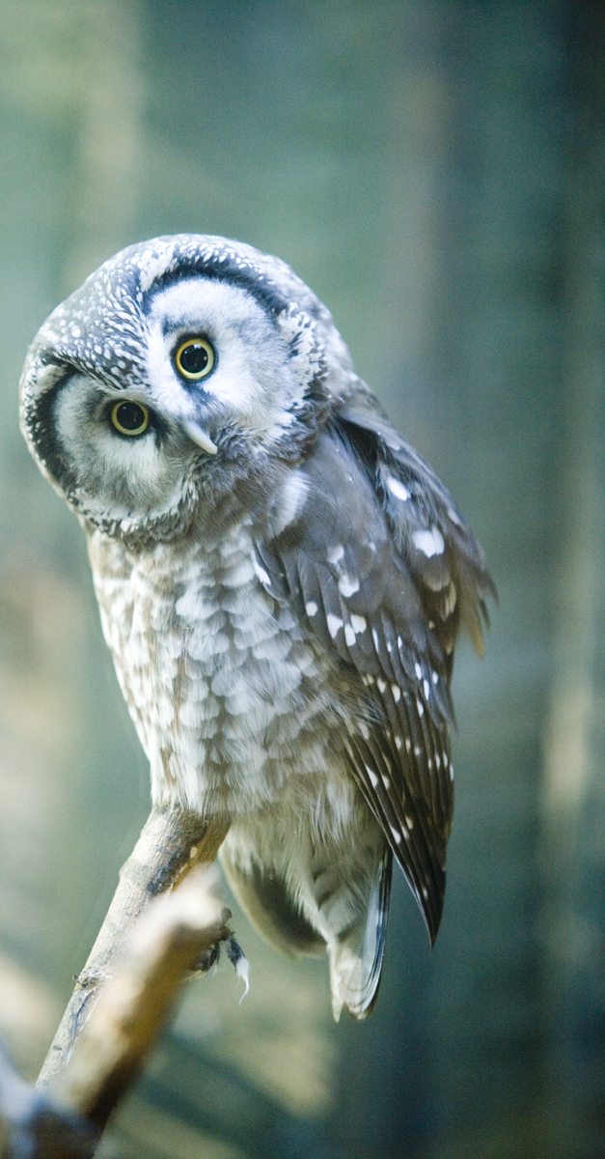
Current Cutting-Edge Estonian Science: Biobank, Satellites and Other Big Ideas from a Small Country
Lecture 2 of course ‘The innovative Estonia’
Arko Olesk
Tallinn University/Postimees

Slide 2
Estonian Science in general
6 universities + a few independent research institutions
29th position in the world (citations per paper)
Fields above world average: environment/ecology, plant & animal science, clinical medicine, molecular biology & genetics, physics, pharmacology & toxicology, psychiatry/psychology
Notes:
https://www.youtube.com/watch?v=4O3mY8QkvQ4

Slide 3
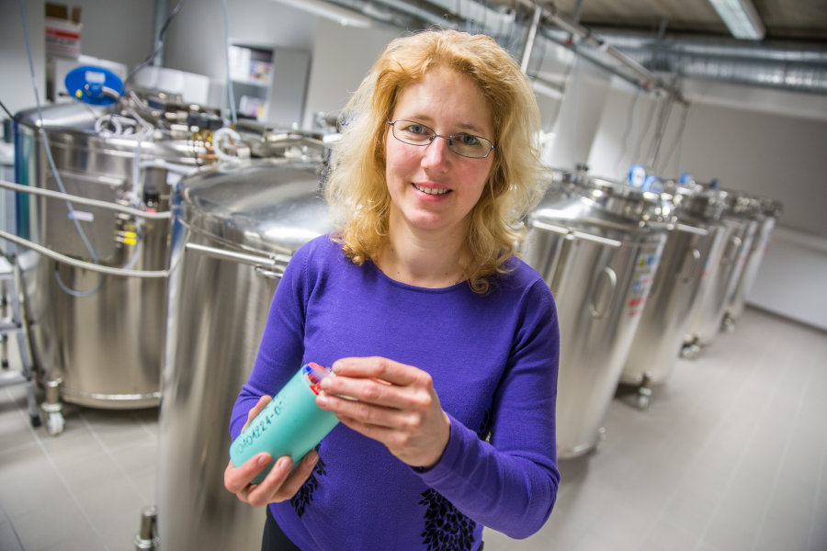
Estonian Biobank
50 000 donors (5% of adult population)
Genetic research
Personalized medicine

Slide 4
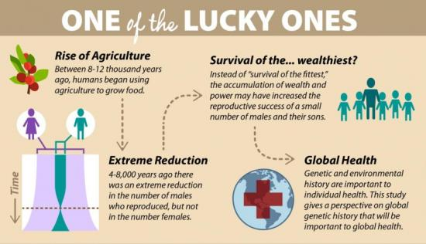
Archaeogenetics
Ancient human migration

Slide 5
EstCube-1
Cubesat standard
Launched in 2013
Experiment with electric solar sail

Slide 6
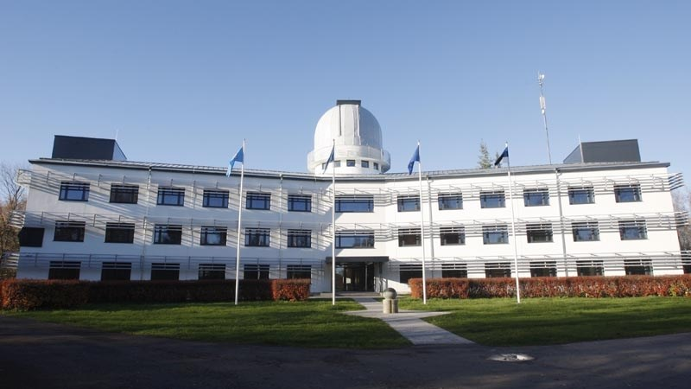
Space research
Galactic filaments
Remote sensing

Slide 7
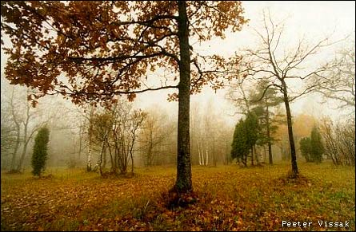
Ecology
Biodiversity patterns (plants and fungae)
Dark biodiversity
Biotic interactions
Laelatu wooden meadow

Slide 8
Plants and climate change
Plant stress
‘smell of forest’
Humidity manipulation

Slide 9
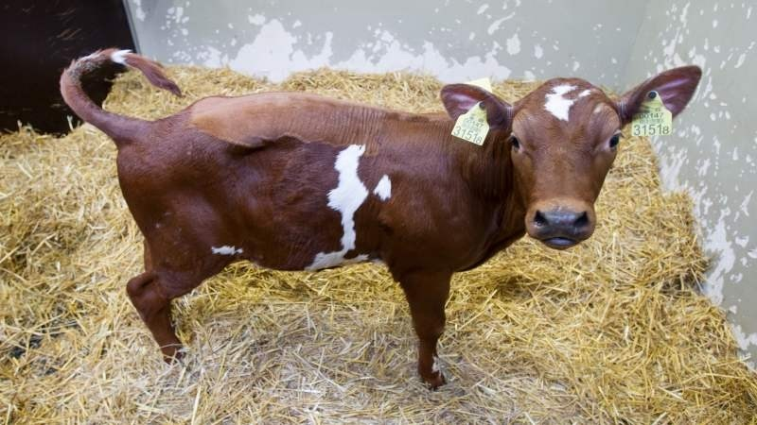
Cloning for medicines
Genetically modified cloned cows

Slide 10
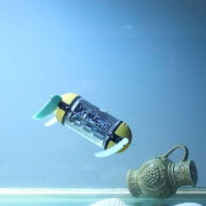
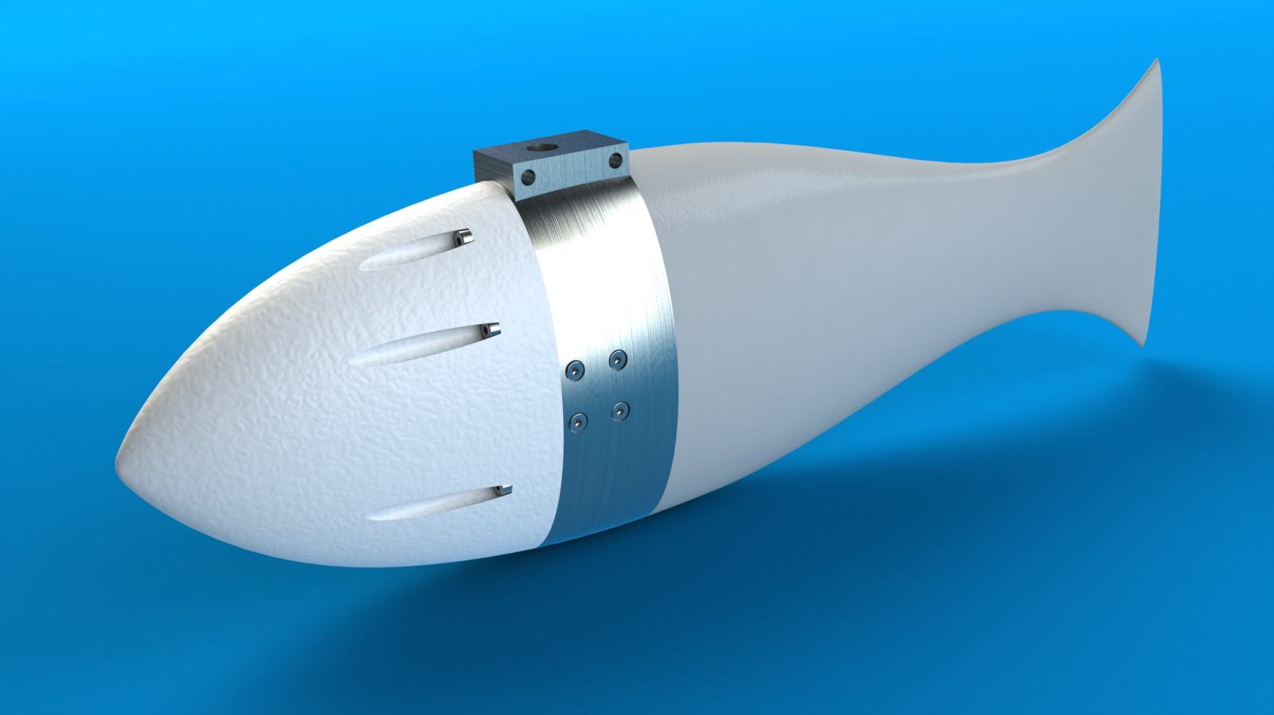
Underwater robots
Archaeology turtle
Fish with articifial lateral line
Notes:
https://www.youtube.com/user/BioroboticsTTU; https://www.youtube.com/watch?v=K6aoolg9f2M

Slide 11
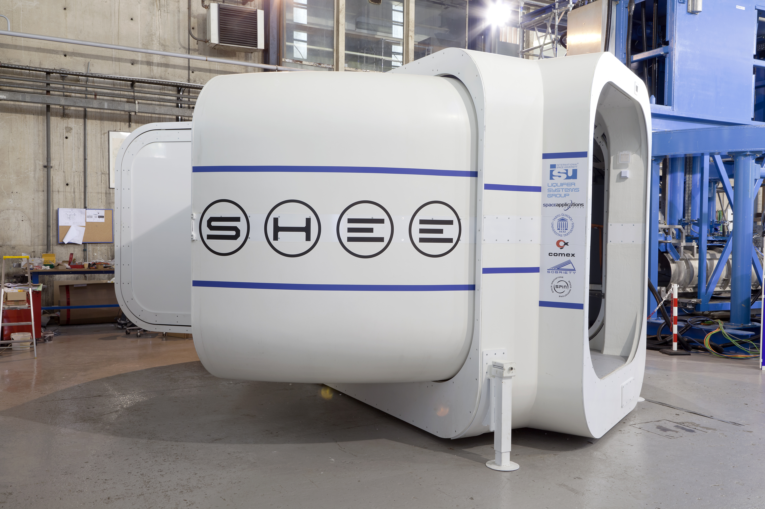
Artificial muscles
electromechanically active polymer materials
And a house that unpacks itself
Notes:
https://www.youtube.com/channel/UC186z2gc0XiLh12hNvPZdUQ

Slide 12
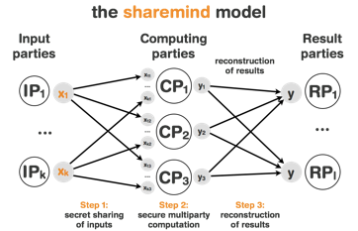
Sharemind
Allows computing encrypted data
Notes:
https://vimeo.com/63275377

Slide 13
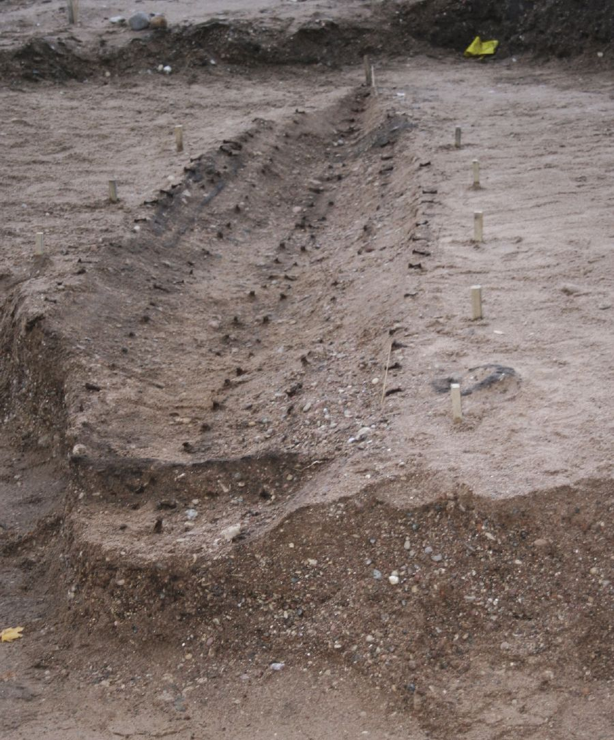
Salme warrior ship
2 pre-viking (8th century) boats
Battle and burial

Slide 14
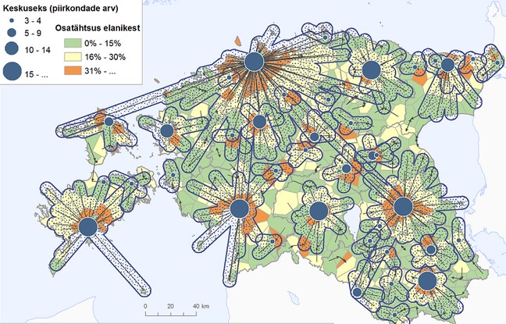
Spatial mobility of people
travel, urban geography and segregation
mobile positioning based methods

