Slide 1
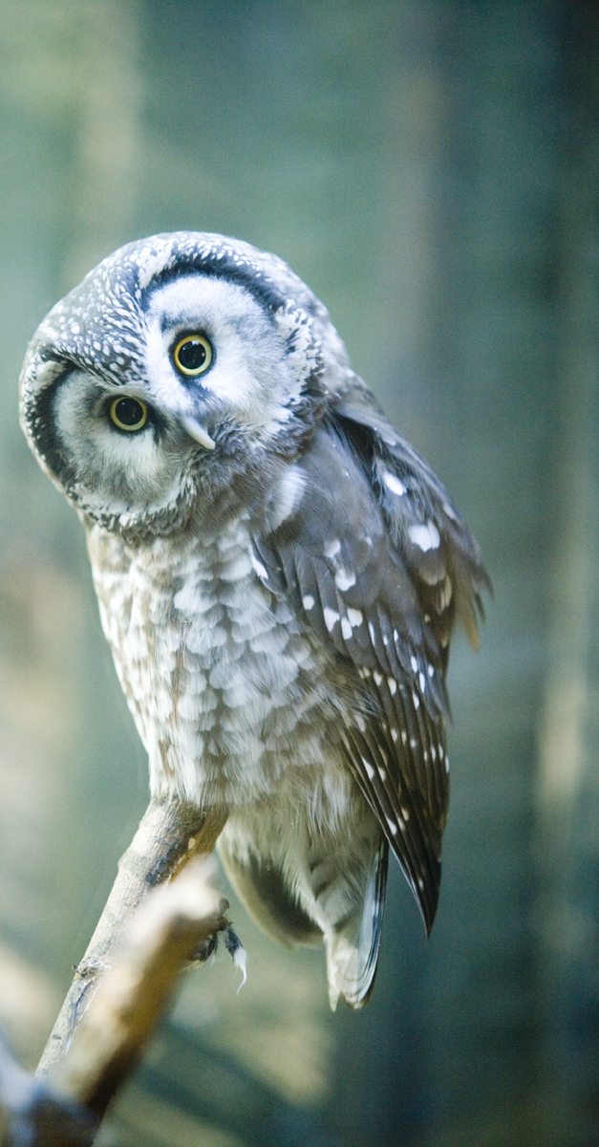


Science and Innovation Communication in Estonia
Lecture 4 of course ‘The innovative Estonia’
Arko Olesk
Tallinn University/Postimees

Slide 2
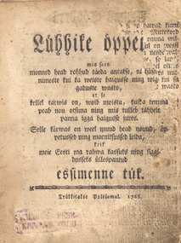
History
1766 – „Lühhike öppetus“
1848 – „Ma-ilm ja mõnda“
1966 – „Teadus“ sociey
1967 – „Horisont“ magazine

Slide 3
Why science communication?
Alienation of scientists
Critique and hostility towards science
Less media attention
Lack of knowledge
Widespread esoteric beliefs
Shrinking number of science students

Slide 4
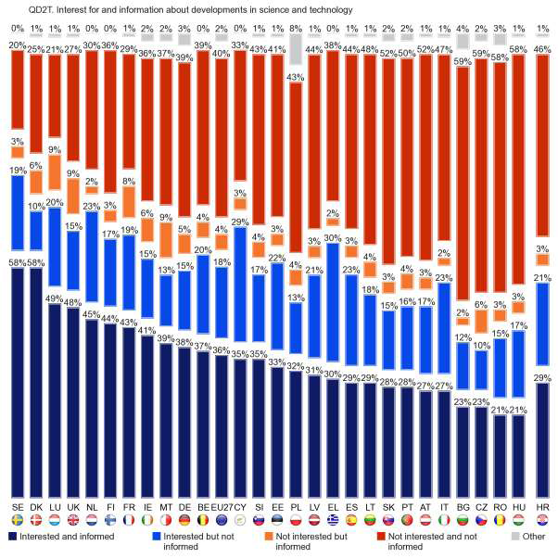
Eurobarometer 401 (2013)

Slide 5
Era of professionalization
Science Bus – 2005
First annual science communication conferences – 2008
National science communication program TeaMe – 2009
  new study materials for science classes
  production of two TV-shows
  science communication training for scientists and journalists
  travel grants for science communicators
  National Year of Science – 2011-12
Association of Science Journalists 2007
National Science Festival (Night of Researchers) 2006

Slide 6
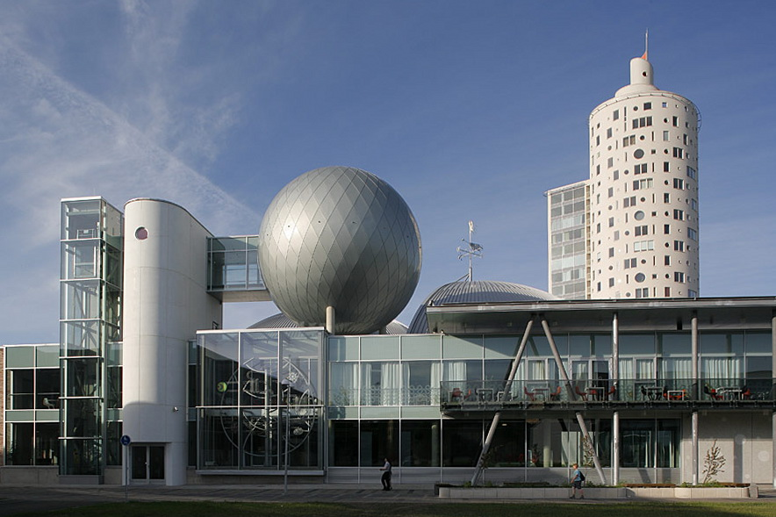
Interactive science centre AHHAA (1997/2011)

Slide 7
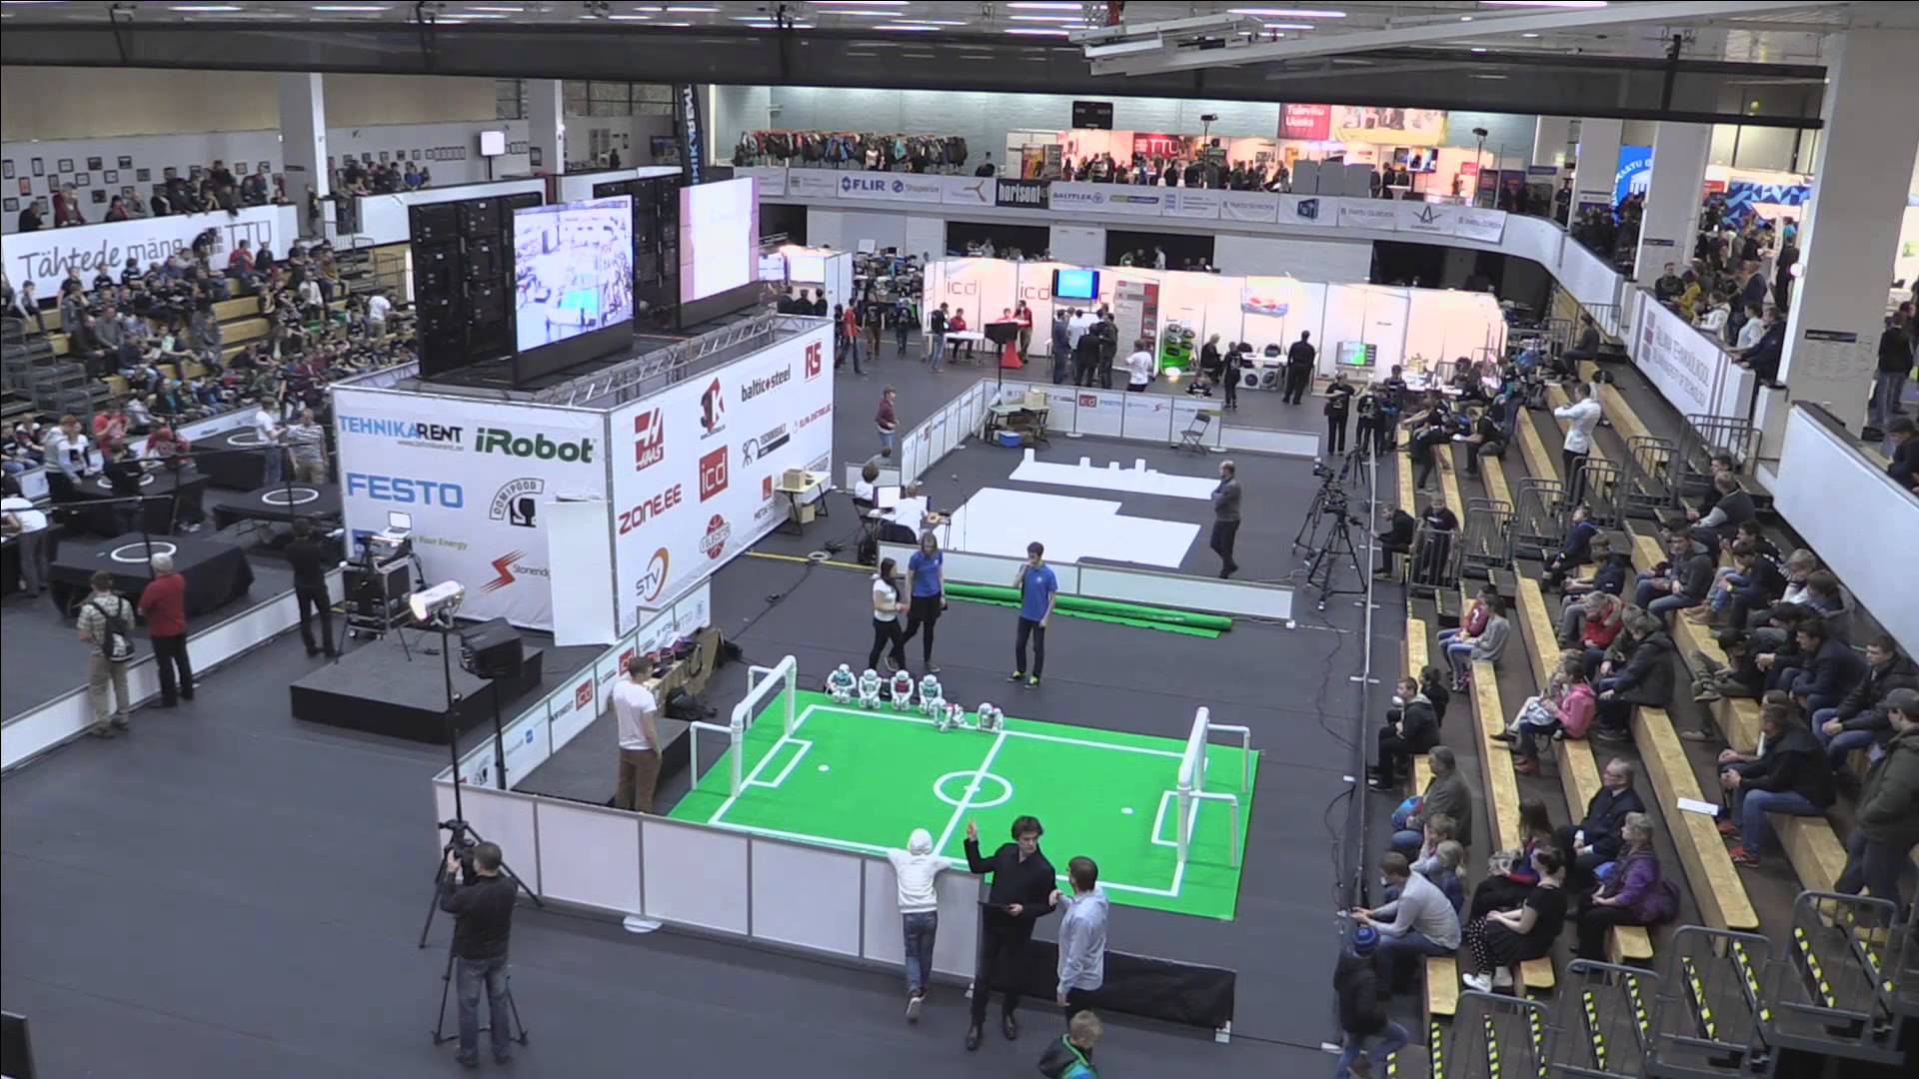
Focus on young people
Robotex
Programming
National support schemes
Notes:
http://www.bbc.com/news/education-25648769

Slide 8

Science in media
Horisont, Imeline Teadus
ERR Novaator
3 weekly radio programs
Daily newspapers
Rakett 69
Notes:
http://etv.err.ee/v/elusaated/rakett_69/saated/16d0d8a6-45a0-4c89-b0a1-136dd3d2c7fb/rakett-69-6-5-laat

Slide 9
Scientists
EstCube example
1 minute lectures
„Buses“
Notes:
https://www.youtube.com/watch?v=nYapcRnGX2o

Slide 10



