Slide 1
Experimental Humanities II (HUMB002) 2016
STATISTICAL ANALYSIS
REVISION
AND EXERCISES
Pavla Linhartová
The lectures and exercises are based on the lectures from the subject PSY117 – Statistical analysis
by Stanislav Ježek and Jan Širůček from Department of Psychology, Faculty of Social Studies MU Brno

Slide 2
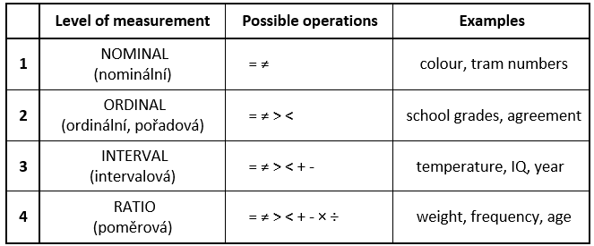
Variables: Levels of measurement
1 + 2 = categorical, qualitative, 3 + 4 = metric, cardinal, quantitative

Slide 3
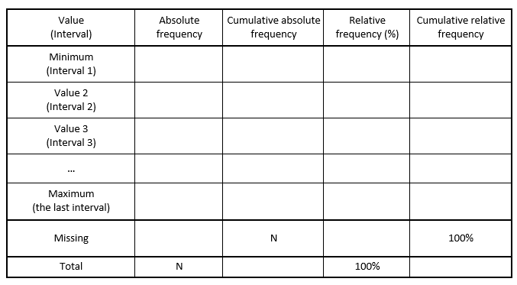
Frequency tables

Slide 4
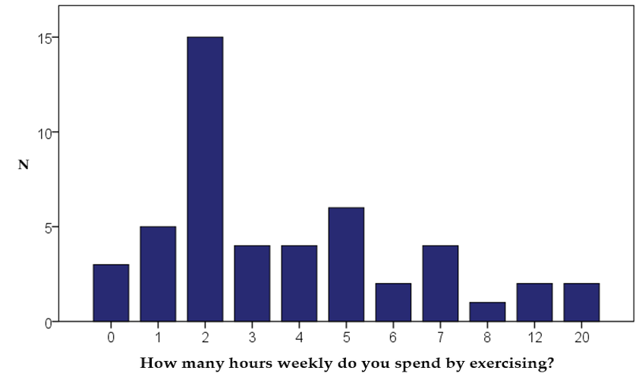
Bar chart vs. Histogram

Slide 5
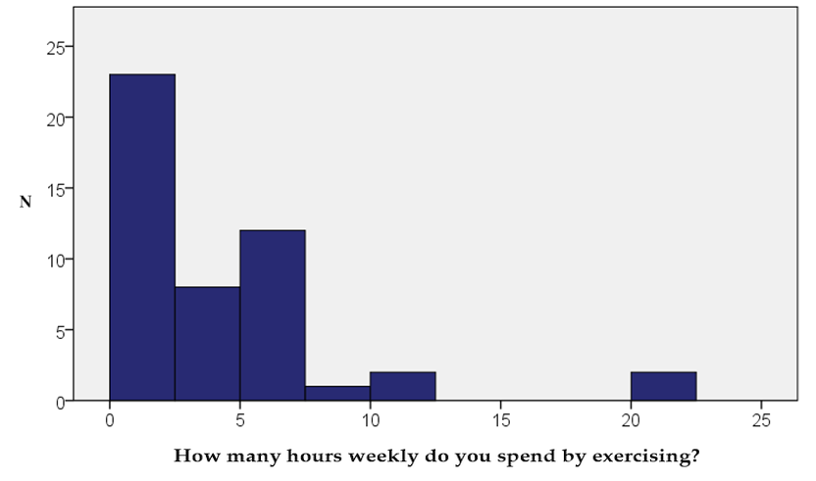
Bar chart vs. Histogram

Slide 6
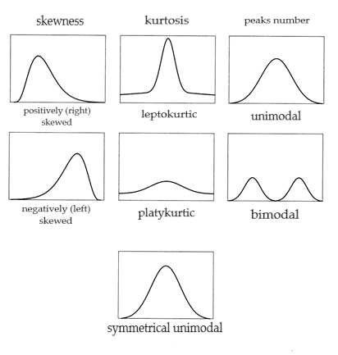
Frequency distribution
Normal
Uniform
Number of peaks: unimodal, bimodal, multimodal
Skewness:
  positively skewed (right-skewed, floor effect)
  negatively skewed (left-skewed, ceiling effect)
Kurtosis: leptokurtic, platykurtic

Slide 7
Mode, median, mean
MODE (MODUS): categorical typical value
  The most frequent value, the value with the highest frequency
  The only possibility for categorical data
MEDIAN: ordinal measure of central tendency
  Value of the element in the middle of the rank-ordered sample
  50. percentile (P50)
  If the total number of values is even, median is the centre of the interval between the two middle values
  Can be used for ordinal data and higher measurement levels
ARITHMETIC MEAN: deviation measure of central tendency
  Only for interval and ratio data
  Easily biased by extreme values

Slide 8
Counting mode, median and mean
Mode
  Read from frequency table
  Excel: MODE(data)
Median
  Categorical variables: read from frequency table (best from cumulative relative frequencies)
  For odd N, Me is Xk (kth element of rank-ordered sequence of variable values), where k = (N+1)/2
  For even N, Me is the mean of Xk and Xk+1, where k = N/2
  Excel: MEDIAN(data), PERCENTIL(data;0.5)
Mean
  Excel: PRŮMĚR(data), AVERAGEA(data)

Slide 9
Group mean X Weighted mean
Group mean: A group of female teachers has average salary of 45 000 CZK and a group of male teacher has average salary of 50 000 CZK. What is the average salary of both groups?
  (45 000 + 50 000) / 2 = 47 500
Weighted mean: If the average salary of 10 female teachers is 45 000 CZK and the average salary of 40 male teachers is 50 000 CZK, what is the average salary of all 50 teachers?
  (10 x 45 000) + (40 x 50 000) / (10 + 40) = 49 000
More on estimating mean, median and mode from group frequencies with examples here:
http://www.mathsisfun.com/data/frequency-grouped-mean-median-mode.html

Slide 10
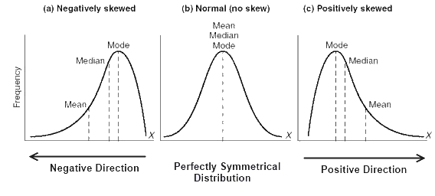
Relations between mode, median and mean

Slide 11
Range, variance, standard deviation
Ordinal measures of variability
  Range: Xmax – Xmin (extremely biased by end values)
  Interquartile range: Q3 – Q1 (P75 – P25), IQR
Deviation measures of variability
  based on deviations from the mean: x = X – M
  variance = average squared deviation, s², VAR(X)
    population: (Sx² / n) vs. sample (Sx² / (n – 1))
    Sx² = sum of squared deviations = sum of squares
  standard deviation – s, SD
    square root of the variance, return to the original units

Slide 12
Counting measures of variability
IQR = Q3 – Q1
  Q1 = Xk (kth element of rank-ordered sequence of variable values),
  where k=(N+1)*0.25 rounded down
  Q3 = Xk, where k=(N+1)*0.75 rounded down
  Excel: PERCENTIL(data, 0.25), resp. PERCENTIL(data, 0.75)
Variance, Standard deviation
  Count deviation score for every value: x_{i} = X_{i} – M
  Count squared deviations
  Sum squared deviation and divide by N-1
  For SD, we square-root the variance
  Excel: VAR.P(data), VAR.S(data), STDEVPA(data) ~ SMODCH.P(data),
  STDEVA(data) ~ SMODCH.VÝBĚR.S(data)

Slide 13
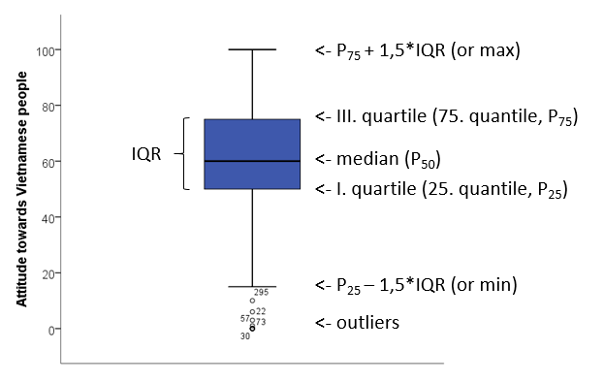
Boxplot (cz: krabicový graf s anténami)

Slide 14
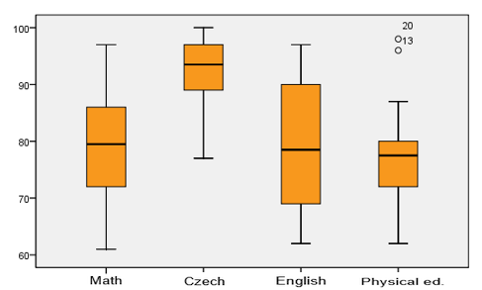

Slide 15
Scores transformation
We often transform observed score for easier understanding
and interpretation
Making interpretation easier – linear transformations
  e.g. multiplying by 10 or 100 for getting rid of the decimals
  distribution shape remains unchanged
  descriptive statistics will change in a predictable way
  possibility of standardization
Change of distribution shape – nonlinear transformations
    log/exp functions, square(root)…
Change of measurement level – ordinal transformation (ranking)

Slide 16
Linear transformation – standardization
The most usual transformation: standardization (z-scores)
  scores transformation, so that M=0, SD=1
  measurement unit becomes SD – we can easily compare scores from different scales (but differences in distribution remain!)
  z_{i} = (X_{i} – M) / SD
Scores derived from z-scores:
  T scores: M=50, SD=10; T_{i} = 50 + 10z_{i}
  IQ scores: M=100, SD=15
  Stens (Standard TENs, cz: steny): M=5.5, SD=2; Sten_{i} = 2z_{i} + 5.5
  Stanines (STAndard NINEs, cz: staniny): M=5, SD=2; Stanine_{i} = 2z_{i} + 5
Normal distribution is always required for correct standardized scores interpretation!

Slide 17
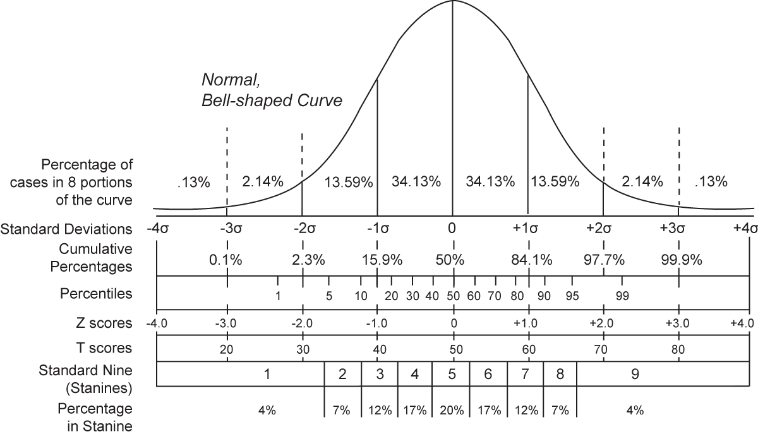

Slide 18
Counting quantiles in Excel
NORM.S.DIST(z;1) – returns corresponding percentile for given
z-score (=how many people have the same or lower z-score)
  Percentage of people between two given z-scores:
  NORM.S.DIST(higher z;1) minus NORM.S.DIST(lower z;1)
NORM.S.INV(p) – returns corresponding z-score for given percentile

Slide 19
Contingency table
 | Math grades |  |  |  |  |  | Total
 |  | 1 | 2 | 3 | 4 | 5
Czech language grades | 1 | 82 | 40 | 8 | 1 | 0 | 131
 | 2 | 71 | 200 | 73 | 17 | 0 | 361
 | 3 | 4 | 75 | 109 | 25 | 0 | 213
 | 4 | 1 | 7 | 23 | 24 | 1 | 56
 | 5 | 0 | 0 | 2 | 1 | 2 | 5
Total |  | 158 | 322 | 215 | 68 | 3 | 766
For any variables, but most suitable for discrete variables with not many values
The cells can contain both absolute or relative frequencies (row, column and total frequencies)
The last row and column contain so called row/column marginal frequencies
Graphical representation of contingency table is 3D bar chart or 3D histogram
High frequencies in diagonals indicate linear relationship between variables

Slide 20
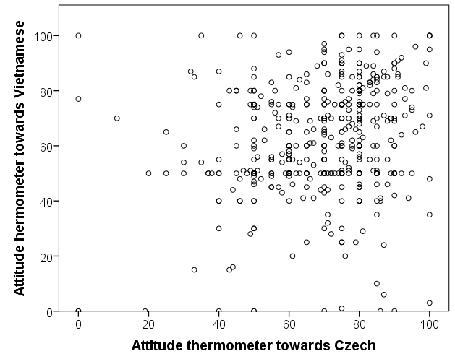
Scatterplot
Substitutes contingency table
for continuous variable
Each axis represents
one variable
Each point represents
one subject (unit)
Frequency of the same
values can be represented
e.g. by the dot size

Slide 21
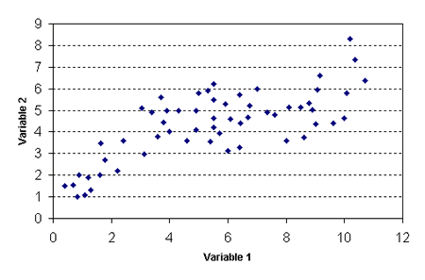
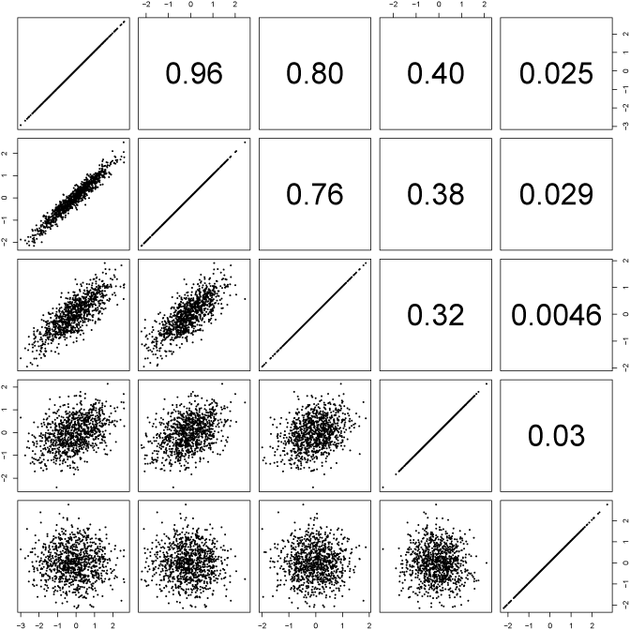
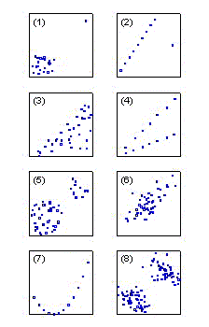
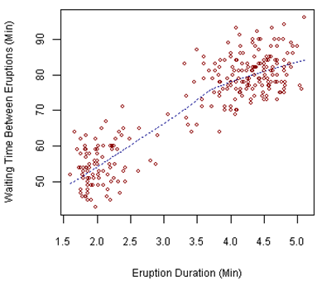
Different forms of associations
LINEAR RELATIONSHIPS

Slide 22
Correlation (=standardized shared variance)
For better interpretation, we standardize the covariance – same as with z-scores,
we divide the deviation score by standard deviation
We already know the circled part: that’s z-score transformation, so to make it easier:
              = Pearson’s product-moment correlation
              (cz: součinový, momentový koeficient korelace)

Slide 23
Characteristics of Pearson’s correlation coefficient
A deviation statistics:
  interval or higher measurement level required
  great impact of extreme values
  suitable for normally distributed variables description (approximately normal distribution of both variables required)
  expresses only the association strength, not causality!!!
Takes values between -1 a +1
  0 = no association
  +1(-1) = perfect positive (negative) association = variables identity
  = direct (indirect relationship)

Slide 24
Characteristics of Pearson’s correlation coefficient
r² = coefficient of determination (R², D)
= proportion of shared variance
Consequence: r 0,3 – r 0,1 ≠ r 0,7 – r 0,5
(0,09-0,01=0,08; 0,49-0,25=0,24)
r=0 doesn’t mean there isn’t any relationship between variables, it only means there is no linear association between them

Slide 25
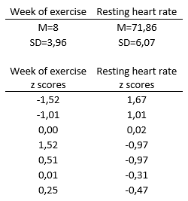
Computing correlation
Check assumptions: interval or higher measurement level, normal distribution of both variables, extreme values, assumption of linear relationship (plot scatterplot and histograms)
Compute z-scores for all observed scores – you will need M and SD for both groups: z_{i} = (X_{i} – M) / SD
Excel: =AVERAGEA(data), =PRŮMĚR(data), =STDEVA(data), =SMODCH.VÝBĚR.S(data), =STANDARDIZE(X;M;SD)
Compute correlation:
r_{xy} = [ (-1,52*1,67) + (-1,01*1,01) + (0,00*0,02) + (1,52*-0,97)
+ (0,51*-0,97) + (0,01*-0,31) + (0,25*-0,47) ] / (7-1) = -0,94
Excel: =COVARIANCE.P(var1, var2), =COVARIANCE.S(var1, var2),
=CORREL(var1, var2)

Slide 26
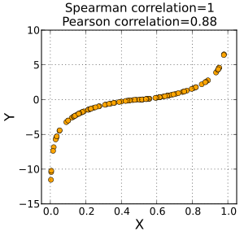
Rank (ordinal) correlation coefficients
Suitable not only for ordinal data, but also for interval data with deviations
from normal distribution
Capture also nonlinear monotonic relationships
To what extent are ranking of the two correlated
variables the same
Spearman rho coefficient - ρ, r_{s}
  Based on differences magnitude in rankings
  Ordinal equivalent for Pearson’s correlation
  r² can be interpreted
  Usually used as a more resistant variant of Pearson’s r
  Calculated in the same way as Pearson’s, but on rankings
Kendall tau coefficient – t (+ „b“ and „c“ variants)
  Based on number of values „out of order“
  No effect of outliers
  b and c variants deal with more values of the same ranking

Slide 27
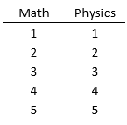
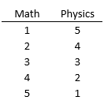
Statistical prediction
Example 1: Imagine that all students have exactly the same grades from math and physics. The variables would be identical:
  What would be the value of correlation between the variables?
    r = 1
  What would be the value of coefficient of determination?
    r² (R², D) = 1² = 1
  What would be the proportion of shared variance? What does it mean?
    R² * 100 = 1 * 100 = 100%
    It means that we can predict 100% of math grades values correctly from physics values (or the other way).
  What of the information above would change if all students had exactly opposite math grades than physics grades?
    r = -1, R² = -1² = 1, R^{2 *} 100 = 100%
Of course, usually we can predict with much less precision, but we’re trying to predict with the highest precision. For that, we need correlates with high correlation with the predicted variable.

Slide 28
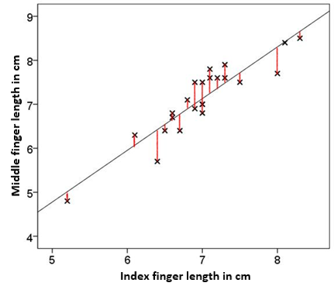
Linear regression
If Pearson correlation well describes relationship between two variables, we can express the relationship by linear function:
Y’ = a + bX; Y = Y’ + e = a + bX + e
a = intercept (cz: průsečík), b = slope (směrnice)
How can we find the best regression line?
  Estimate by least squares estimation – we are trying to minimize the sum of residual squares
b = r_{xy}(SD_{y}/SD_{x})
a = M_{y} – bM_{x}
If the values of X and Y are in z-scores, then b = r_{xy}
a, b – correlation coefficients
The line goes through values M_{x} and M_{y}
The sum of residuals is zero, the sum of squared residuals is the least possible

Slide 29
Predicted values
IF | MF | MF'
6,5 | 6,4 | 6,5413
7 | 7 | 7,1291
7,5 | 7,5 | 7,7169
5,2 | 4,8 | 5,0130
6,6 | 6,7 | 6,6589
6,6 | 6,8 | 6,6589
7 | 7 | 7,1291
6,8 | ?
Y´ = 1,175*X – 1,096 = 1,175*6,8 – 1,096 = 6,894

Slide 30
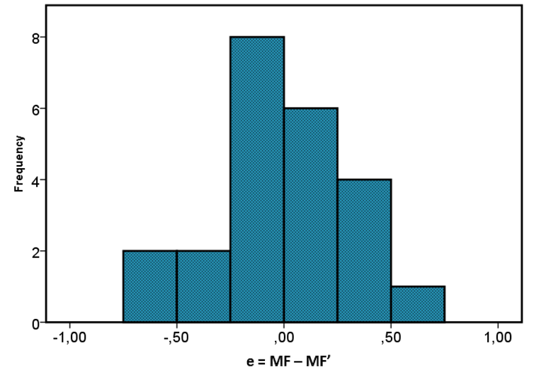
Distribution of residuals
M_{e} = 0
SD_{e} = 0,337

Slide 31
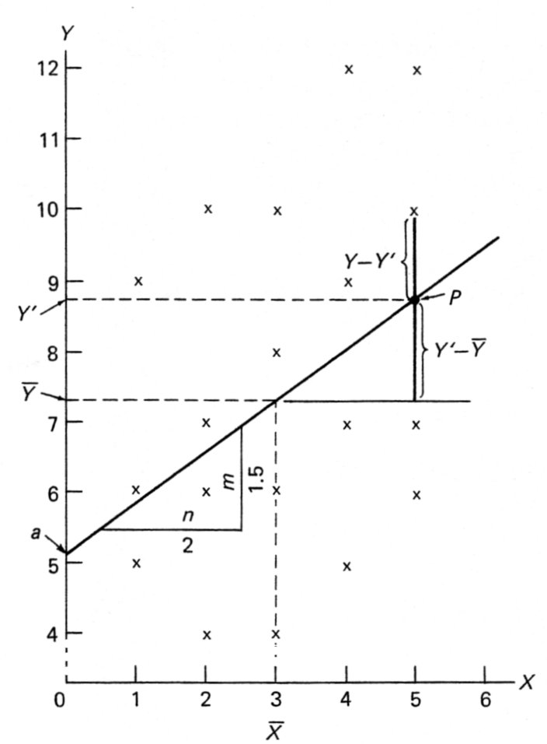
Linear regression: model fit
s_{y}² = s_{reg}² + s_{res}²
R² = s_{reg}² / s_{y}² … s_{res}²= s_{y}²(1−R²)
Coefficient of determination: R²
  Exaplained variance proportion
  Measure of model fit with the data (regression success)
For simple linear regression it applies:
R ² = r ²

Slide 32
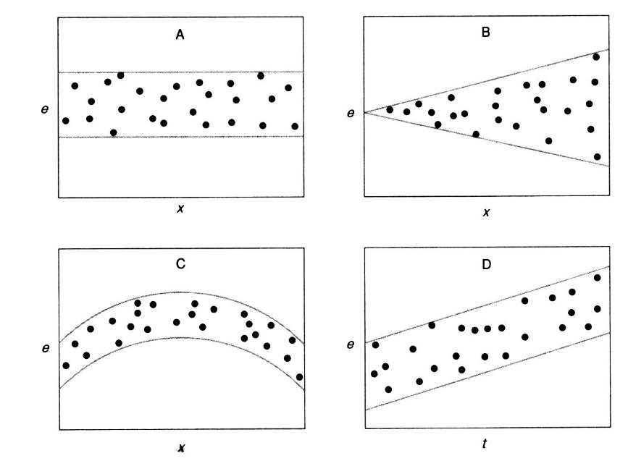
Linear regression: assumptions
Assumptions are the same as for Pearson correlation:
  The basic assumption: the relationship really is linear
  The residuals have normal distribution with M=0 and SD = S_{res}
  It means the 95% of estimation residuals lie approx. between −2s_{res} a +2s_{res}
  homoscedascity (cz: homoskedascita): residuals independency = the residual variance won’t change with increasing X
  The model validity depends on data
  from which was the model extrapolated
  Watch out for extreme values
  (as with all deviation statistics)

Slide 33
Other regression types
Simple linear regression: one independent and one dependent variable
  Multiple linear regression: more independent variables (predictors)
    Y = a +b₁X₁ + b₂X₂ + … + b_{m}X_{m}
    complicated by relationships between the predictors
  Logistic regression:
    Dependent variable is dichotomous (nominal)
    Prediction of dependent variable values probability
  If the relationship isn‘t linear:
    We can try to transform the variables, so that the relationship becomes linear
    We can divide the sample into subgroups in which the relationship is linear

Slide 34
From description to inference
Data description, parameters estimation
Statistical inference (cz: usuzování, inference, indukce)
Random sampling
  every subject has the same probability of being included in the sample
  If we don’t have random sampling, how is our sample different?
sampling
data
population
statistics
parameters
inference

Slide 35
Sampling distribution and standard error
If we compute the same statistics on many independent samples from a population, we get many different parameter estimates
These estimates have some distribution – sampling distribution
(cz: výběrové rozložení)
http://onlinestatbook.com/stat_sim/sampling_dist/index.html
Sampling distribution can be described by:
  Mean – sampling distribution mean is close to parameter
  Standard deviation – in sampling distribution called standard error
  (cz: směrodatná chyba, také střední chyba či výběrová chyba)
  The higher is the number of samples (statistics estimates), the lower is the standard error

Slide 36
Sampling distribution of mean (estimate)
Mean estimate has approximately normal distribution
  With mean μ and standard error:
  This applies even when the distribution
  is not normal – thanks to central limit theorem
  The problem is that we usually don't know σ
If we don't know σ, we have to use s
  Mean is still μ and standard error is now:
  The sampling distribution is not normal,
  but Student's t-distribution

Slide 37
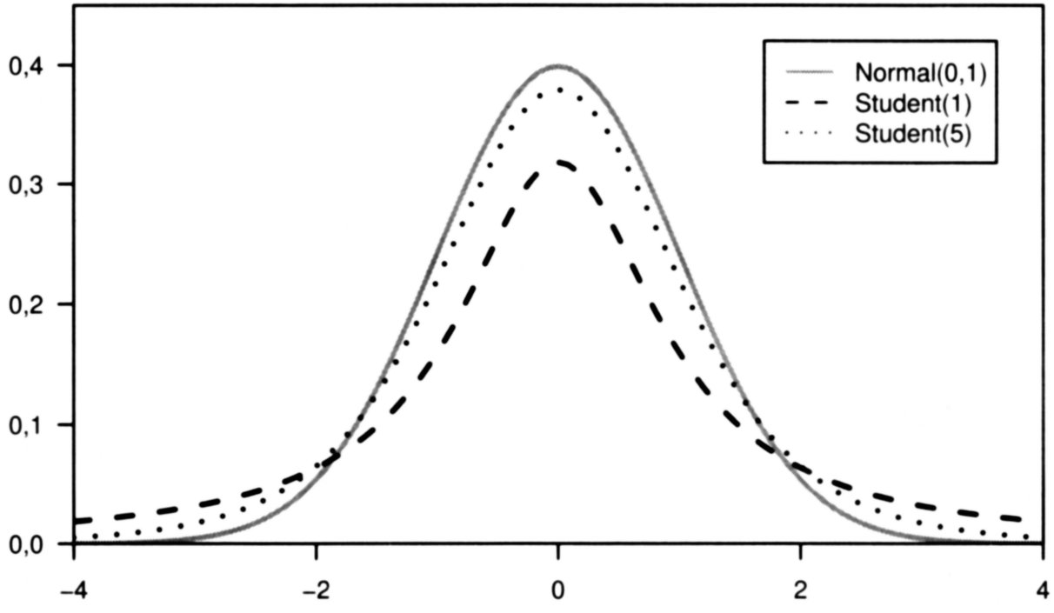
Student's t-distribution

Slide 38
Sampling distribution of other statistics
For every statistics we need to know it theoretical sampling distribution
  Relative frequencies: approximately normal distribution
  Pearson’s r – after Fisher transformation normal distribution

Slide 39
Point vs. Interval estimates
Parameter can be estimated by:
  Point estimate – that we’re trying to estimate the parameter value itself
  (e.g. mean)
  Interval estimate – estimating an interval in which the parameter lies with certain probability
    The result is confidence interval (cz: interval spolehlivosti), CI
    Confidence interval can be computed from point estimate and its sampling distribution (point ± deviation)
    Interval estimate is better – we have more information
    α − error probability, (1 – α) is confidence level (cz: hladina spolehlivosti)
    We typically use 95% or 99% confidence level, then it means that the parameter lies in the confidence interval with 95% probability
    (where α is 0.05 = 5% error probability, (1 – α) = (1 – 0.05))

Slide 40
Computing confidence interval for mean 1
In a sample of 100 children with multicolored eyes we computed mean IQ 130
and we know that σ =15.
  Point parameter estimate (μ) is 130
  Interval parameter estimate:
    Sampling distribution of mean is normal…
    …with centre in μ. We don’t know μ, so we use our point interval m = 130.
    …with standard error of mean s_{m} = σ /√N = 15/ √100 = 1,5.
    We choose our confidence level: 1-α = 95%
    Then we find z-score between which lies 1-α % of normal distribution:
    95% of normal distribution lies between z-scores -1.96 and 1.96
    in other words: _{1-α/2}z = _{0,975}z = 1.96
    Excel: =NORM.S.INV(0.975)
    Confidence interval: (m − 1.96s_{m}; m + 1,96s_{m}) = (130 – 1.96*15; 130 + 1.96*15) = (127.1 ; 132.9)
    That is: with 95% probability 127.1 ≤ μ ≤ 132.9

Slide 42
Computing confidence interval for mean 2
In a sample of 100 children with multicolored eyes we computed mean IQ 130
and s = 15.
  Point parameter estimate (μ) is 130
  Interval parameter estimate:
    We don’t know σ, so the sampling distribution of mean is not normal,
    but Student’s t-distribution with df = N-1 = 99
    The distribution centre will again be our point interval m = 130.
    Standard error of mean is s_{m} = s /√n = 15/ √ 100 = 1,5
    We choose our confidence level: 1-α = 95%
    Then we find t-score between which lies 1-α % of t-distribution:
    95% of t-distribution with df=99 lies between t-scores -1.98 and 1.98
    in other words: _{1-α/2}t (df) = _{0,975}t (99) = 1.98
    Excel: =T.INV(p;df), here =T.INV(0.975;99)
    Confidence interval: (m − 1.98s_{m}; m + 1,98s_{m}) = (130 – 1.98*15; 130 + 1.98*15) = (127.0 ; 133.0)
    That is: with 95% probability 127.0 ≤ μ ≤ 133.0

Slide 43
Sampling distribution of relative frequencies p
…is approximately normal with mean p and standard error
(1-α)% confidence interval thus is:

Slide 44
Sampling distribution of Pearson’s correlation r
We don’t know sampling distribution of correlation…
…but we know sampling distribution of correlation after Fisher transformation:
in Excel: Z = FISHER(r)
Sampling distribution of the Fisher Z is approximately normal with mean Z
and standard error s_{Z}=1/√(n-3)
(1−α)% CI for Z:
Then, we need to transform Fisher Z back to Pearson’s r:
in Excel: =FISHERINV(z)

Slide 45
Confidence interval for correlation
On a sample of 20 children we found correlation between number of hours spend by reading per week and score in a creativity test r=0.45. Compute 90% confidence interval for the correlation.
Transform Pearson’s correlation to Fisher Z in Excel: =FISHER(0.45) = 0.48
Sampling distribution of Fisher Z is approximately normal
Compute standard error for Fisher Z: s_{Z} = 1/√(20-3) = 0.24
Compute border z-scores for 90% confidence interval:
=NORM.S.INV(1-0.1/2) =NORM.S.INV(0.95) = 1.64
90% CI for Fisher Z: (0.48 – 1.64*0.24; 0.48 + 1.64*0.24) = (0.09; 0.88)
Tranform the results back to Pearson’s r:
90% CI for Pearson’s r: (=FISHERINV(0.09); =FISHERINV(0.88)) = (0.09; 0.71)

Slide 46
General procedure for computing CIs
Determine sampling distribution of given statistics:
  for mean with known σ : normal distribution (z-scores)
  for mean with unknown σ : Student’s t-distribution (t-scores) with df=N-1
  for relative frequency: normal distribution (z-scores)
  for Pearson’s correlation: normal after Fisher transformation (then z-scores)
If needed, transform the statistics:
  from the above only for correlation, Excel: =FISHER(r)
Determine standard error for given sampling distribution:
  for mean with known σ : s_{m} = σ /√N
  for mean with unknown σ : s_{m} = s /√N
  for relative frequency: s_{p} = √(p(1-p)/N)
  for Fisher Z: s_{Z} = 1 /√(N-3)

Slide 47
General procedure for computing CIs
4. Determine point estimate for given sampling distribution:
  m, p, r
5. Choose confidence level – typically 95% or 99% (theoretically any):
  for 95%: α = 0.05 = 5% error probability
  1 – α = 1 – 0.05 = 0.95 = 95%,
  1 – α/2 = 1 – 0.025 = 0.975
6. Find boundary scores between which lies (1 – α) % of given distribution:
  for normal distribution (in Excel): =NORM.S.INV(1 – α/2)
  for t-distribution (in Excel): =T.INV(1 – α/2; df)
5. Compute confidence interval:
  CI = point estimate ± boundary score*standard error
  normal distribution: CI = point estimate ± _{1-α/2}z*standard error
  t-distribution: CI = point estimate ± _{1-α/2}t(df)*standard error

Slide 48
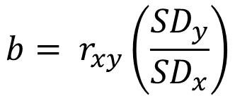
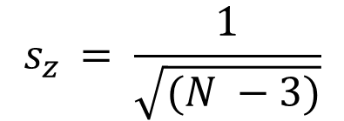
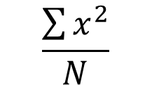


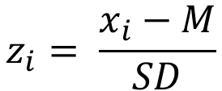

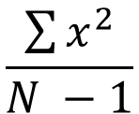

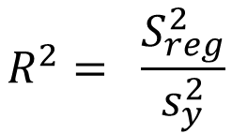
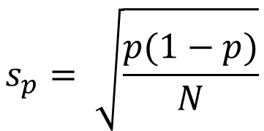
$$\frac{\sum{x^{2}}}{N}$$
$$\frac{\sum{x^{2}}}{N −1}$$
$$z_{i}= \frac{x_{i}−M}{SD}$$
$$T_{i}=50+10z_{i}$$
$$b= r_{xy}\left(\frac{{SD}_{y}}{{SD}_{x}}\right)$$
$$a= M_{y}−bM_{x}$$
$$s_{y}^{2}= s_{reg}^{2}+ s_{res}^{2}$$
$$R^{2}= \frac{S_{reg}^{2}}{s_{y}^{2}}$$
$$s_{res}^{2}= s_{y }^{2}(1−R^{2})$$
$$s_{p}= \sqrt{\frac{p(1−p)}{N}}$$
$$s_{z }= \frac{1}{\sqrt{(N −3)}}$$

Slide 49
A researcher is interested in the influence of media on fear of immigrants. He included ten people in his research. He asked every respondent how many articles about immigrant he read during the past week. Each respondent filled in a questionnaire which measured their fear of immigrants. Based on the questionnaire the researcher assigned to every respondent a number between 1 and 8, where 1 means no fear of immigrants and 8 means extreme fear of immigrants. The following data are hypothetical:
Number of articles: 5, 8, 12, 3, 12, 6, 8, 14, 2, 3
Fear of immigrants: 2, 7, 2, 1, 8, 1, 7, 5, 5, 3
Create frequency tables for both variables. Draw histograms for both variables.
Draw scatterplot. What would you say about the relationship of the variables from the scatterplot?
Compute regression equation for prediction of fear of immigrants from number of articles read per week.
How successful is our prediction? Compute percentage of explained variance. Compute residual variance. Predict fear of immigrants for a person who reads 10 articles per week.
Compute 95% confidence interval for mean of number of articles read per week.
Compute 99% confidence interval for mean of fear from immigrants.

Slide 50
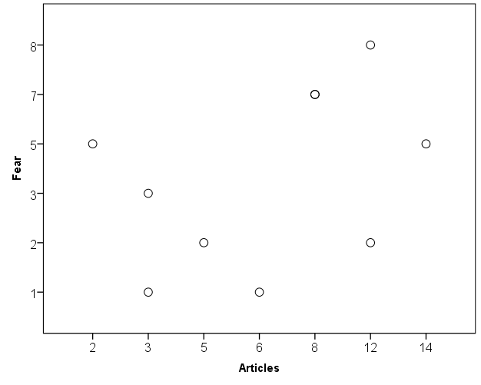
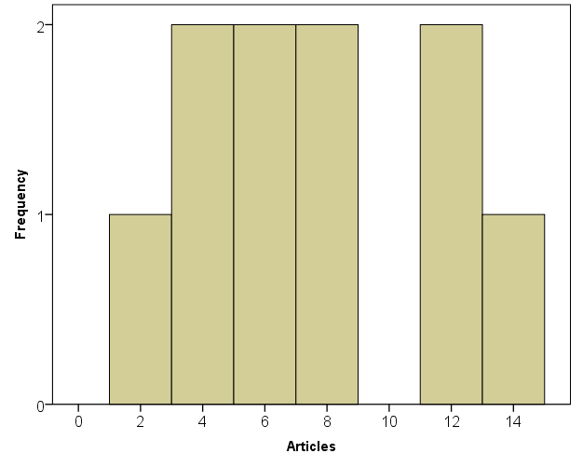
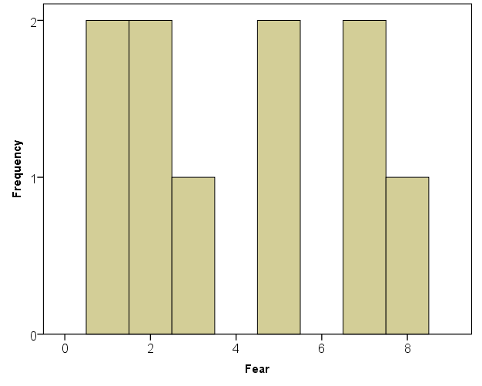
Articles | Frequency | Percent | Cumulative percent
2 | 1 | 10 | 10
3 | 2 | 20 | 30
5 | 1 | 10 | 40
6 | 1 | 10 | 50
8 | 2 | 20 | 70
12 | 2 | 20 | 90
14 | 1 | 10 | 100
Total | 10 | 100
Fear | Frequency | Percent | Cumulative percent
1 | 2 | 20 | 20
2 | 2 | 20 | 40
3 | 1 | 10 | 50
5 | 2 | 20 | 70
7 | 2 | 20 | 90
8 | 1 | 10 | 100
Total | 10 | 100
Although we have a small dataset, from the scatterplot we can assume on moderate positive linear relationship

Slide 51
To compute regression equation, we have to means and standard deviations for both variables and their correlation. We want to predict fear of immigrants from number of articles read. So, fear is our dependent or predicted variable Y and articles are our predictor (or independent variable) X.
M_{x} (articles) = (5+8+12+3+12+6+8+14+2+3)/10 = 7.3
M_{y} (fear) = (2+7+2+1+8+1+7+5+5+3)/10 = 4.1
S²_{x} = [(-2.3)² + (0.7)² + (4.7)² + (-4.3)² + (4.7)² + (-1.3)² + (0.7)² + (6.7)² + (-5.3)² + (-4.3)²] / 9 =
= 18.01
SD_{x} = √18.01 = 4.24
S²_{y} = [(-2.1)² + (2.9)² + (-2.1)² + (-3.1)² + (3.9)² + (-3.1)² + (2.9)² + (0.9)² + (0.9)² + (-1.1)²] / 9 =
= 6.99
SD_{y} = √6.99 = 2.64 Compute z-scores by z_{i} = (X_{i} – M) / SD:
r_{xy} = [(-0.54)*(-0.79) + 0.16*1.10 + 1.11*(-0.79) + (-1.01)*(-1.17) +
+ 1.11*1.48 + (-0.31)*(-1.17) + 0.16*1.10 + 1.58*0.34 + (-1.25)*0.34 +
+ (-1.01)*(-0.42)] / 9 = 0.403
X | x
5 | -2,3
8 | 0,7
12 | 4,7
3 | -4,3
12 | 4,7
6 | -1,3
8 | 0,7
14 | 6,7
2 | -5,3
3 | -4,3
Y | y
2 | -2,1
7 | 2,9
2 | -2,1
1 | -3,1
8 | 3,9
1 | -3,1
7 | 2,9
5 | 0,9
5 | 0,9
3 | -1,1
Zx | Zy
-0.54 | -0.79
0.16 | 1.10
1.11 | -0.79
-1.01 | -1.17
1.11 | 1.48
-0.31 | -1.17
0.16 | 1.10
1.58 | 0.34
-1.25 | 0.34
-1.01 | -0.42

Slide 52

Regression for prediction fear of immigrants from number of articles read:
b = 0.403*(2.64/4.24) = 0.25
a = 4.1 – 0.25*7.3 = 2.28
Y’ = 2.28 + 0.25X
Predicted fear for a person who reads 10 articles per week:
Y’ = 2.28 + 0.25*10 = 4.78
Percentage of explained variance:
R² in simple regression = r² = 0.403² = 0.16
Residual variance:
= 6.99 (1 – 0.16) = 5.87
$$s_{res}^{2}= s_{y }^{2}(1−R^{2})$$

Slide 53
95% confidence interval for mean of number of articles read per week:
M_{x} (articles) = 7.3
SD_{x} = 4.24
s_{mx} = SD_{x} / √N = 4.24 / √10 = 1.34
_{1-α/2}t = T.INV(1-α/2;df) = T.INV(0.975;9) = 2.26
CI_{95%} = (M_{x} - _{1-α/2}t * s_{mx} ; M_{x} - _{1-α/2}t * s_{mx}) = (7.3 – 2.26*1.34 ; 7.3 + 2.26*1.34) = (4.27 ; 10.33)
99% confidence interval for mean fear of immigrants:
M_{y} (fear) = 4.1
SD_{y} = 2.64
s_{my} = SD_{y} / √N = 2.64 / √10 = 0.83
_{1-α/2}t = T.INV(1-α/2;df) = T.INV(0.995;9) = 3.25
CI_{95%} = (M_{y} - _{1-α/2}t * s_{my} ; M_{y} - _{1-α/2}t * s_{my}) = (4.1 – 3.25*0.83 ; 4.1 + 3.25*0.83) = (1.40 ; 6.80)

Slide 54
Bellow you can see grades of 18 students from math and from physics:
Math: 1, 2, 1, 4, 2, 1, 5, 2, 3, 1, 4, 1, 1, 2, 1, 3, 1, 2
Physics: 1, 3, 2, 3, 2, 5, 4, 4, 4, 1, 2, 1, 2, 2, 1, 4, 1, 1
Draw contingency table for the two variables, then draw scatterplot.
What would you judge about the relationship of the variables from the contingency table and scatterplot?
What descriptive statistics would you use for these variables and why?
Compute mode, median and interquartile range for both variables. Draw boxplots for both variables.
What correlation coefficient would you use for inspection of the relationship between these two variables?

Slide 55
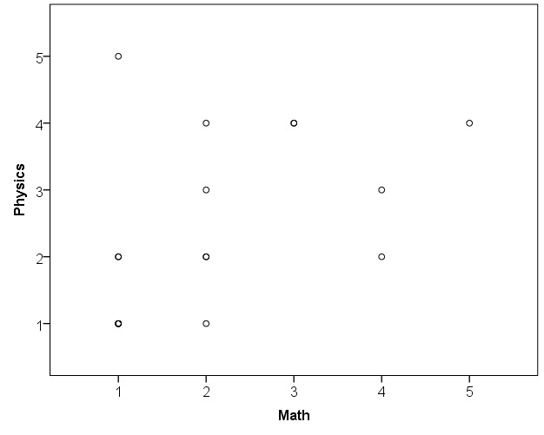
 |  | Math |  |  |  |  | Total
 |  | 1 | 2 | 3 | 4 | 5
Physics | 1 | 5 | 1 | 0 | 0 | 0 | 6
 | 2 | 2 | 2 | 0 | 1 | 0 | 5
 | 3 | 0 | 1 | 0 | 1 | 0 | 2
 | 4 | 0 | 1 | 2 | 0 | 1 | 4
 | 5 | 1 | 0 | 0 | 0 | 0 | 1
Total |  | 8 | 5 | 2 | 2 | 1 | 18
Based on the scatterplot, we can assume on low to moderate positive relationship. The student with 1 from math and 5 from physics would decrease the correlation substantially.
Because grades are ordinal variable, we would prefer to use median and inter-quartile range (and present freqeuncy tables). For finding median and quartiles, rank-order the variable values:
Math rank-ordered values:
1, 1, 1, 1, 1, 1, 1, 1, 2, | 2, 2, 2, 2, 3, 3, 4, 4, 5
The median is 2 (lies „between values 2 and 2“)
Q1 is 1 and Q3 is 3, mode is 1
(or look in frequency table)
IQR = Q3 – Q1 = 3 – 1 = 2
Physics rank-ordered values:
1, 1, 1, 1, 1, 1, 2, 2, 2, | 2, 2, 3, 3, 4, 4, 4, 4, 5
The median is 2, mode is 1
Q1 is 1 and Q3 is 4
(or look in frequency table)
IQR = Q3 – Q1 = 4 – 1 = 3

Slide 56
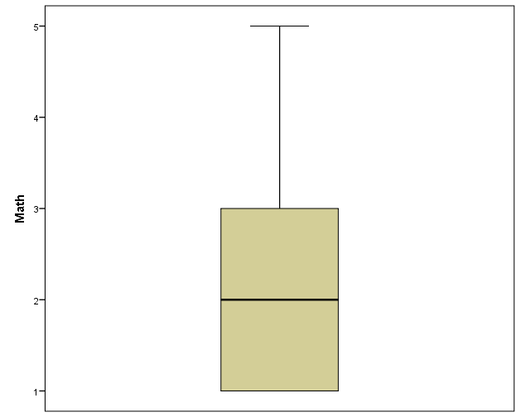
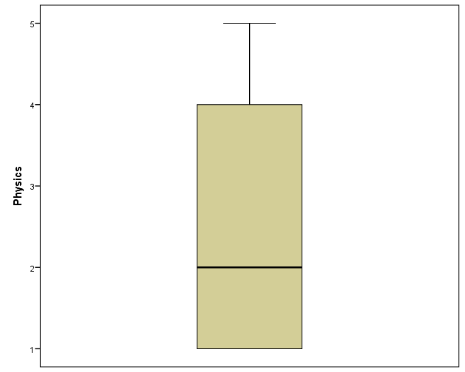
We would prefer to use Spearman rho correlation. (r_{s} = 0.55 – only to complete, you don’t need to compute the correlation)

Slide 57
We measured correlation between number of hours spent by exercising per month and depression rate r = -0.12 on a sample of 120 people. Compute 95% confidence interval for correlation.
We measured mean intelligence of 200 high school students with special program for talented children M = 128. Compute 99% confidence interval for mean intelligence of students educated with this special program if you know that population standard deviation of intelligence in σ = 15.
From a research study we know that the probability of having schizophrenia if one of your parents has it is p = 0.45. The study was conducted with 30 participants. Compute 90% confidence interval for probability of having schizophrenia if one of your parents has it.

Slide 58
We measured correlation between number of hours spent by exercising per month and depression rate r = -0.12 on a sample of 120 people. Compute 95% confidence interval for correlation.
r = -0.12
N = 120
Z =FISHER(-0.12) = -0.121
sz = 1/√(120-3) = 0.09
_{1-α/2}z = NORM.S.INV(1-α/2) = NORM.S.INV (0.975) = 1.96
CI_{95%} = (FISHERINV(Z - _{1-α/2}z * s_{z}) ; FISHERINV(Z - _{1-α/2}z * s_{z}))
= (FISHERINV(-0.121 – 1.96*0.09) ; FISHERINV(-0.121 + 1.96*0.09))
= (FISHERINV(-0.30) ; FISHERINV(0.06)) = (-0.29 ; 0.06)

Slide 59
We measured mean intelligence of 200 high school students with special program for talented children M = 128. Compute 99% confidence interval for mean intelligence of students educated with this special program if you know that population standard deviation of intelligence in σ = 15.
M = 128
σ = 15
σ_{m} = σ / √N = 15 / √200 = 1.06
_{1-α/2}z = NORM.S.INV(1-α/2) = NORM.S.INV (0.995) = 2.58
CI_{99%} = (M - _{1-α/2}z * σ_{m} ; M - _{1-α/2}z * σ_{m}) = (128 – 2.58*1.06 ; 128 + 2.58*1.06) = (125.3 ; 130.7)

Slide 60
From a research study we know that the probability of having schizophrenia if one of your parents has it is p = 0.45. The study was conducted with 30 participants. Compute 90% confidence interval for probability of having schizophrenia if one of your parents has it.
p = 0.45
N = 30
s_{p} = √((p*(1-p))/N) = √((0.45*(1-0.45))/30) = 0.09
_{1-α/2}z = NORM.S.INV(1-α/2) = NORM.S.INV (0.995) = 1.64
CI_{90%} = (p - _{1-α/2}z * s_{p} ; p - _{1-α/2}z * s_{p}) = (0.45 – 1.64*0.09 ; 0.45 + 1.64*0.09)
= (0.3 ; 0.6) = (30% ; 60%)

