Slide 1
BIPOLAR DISORDER
DUYGU SAVCI- 454358
Psychotheraphy
Spring 2016

Slide 2
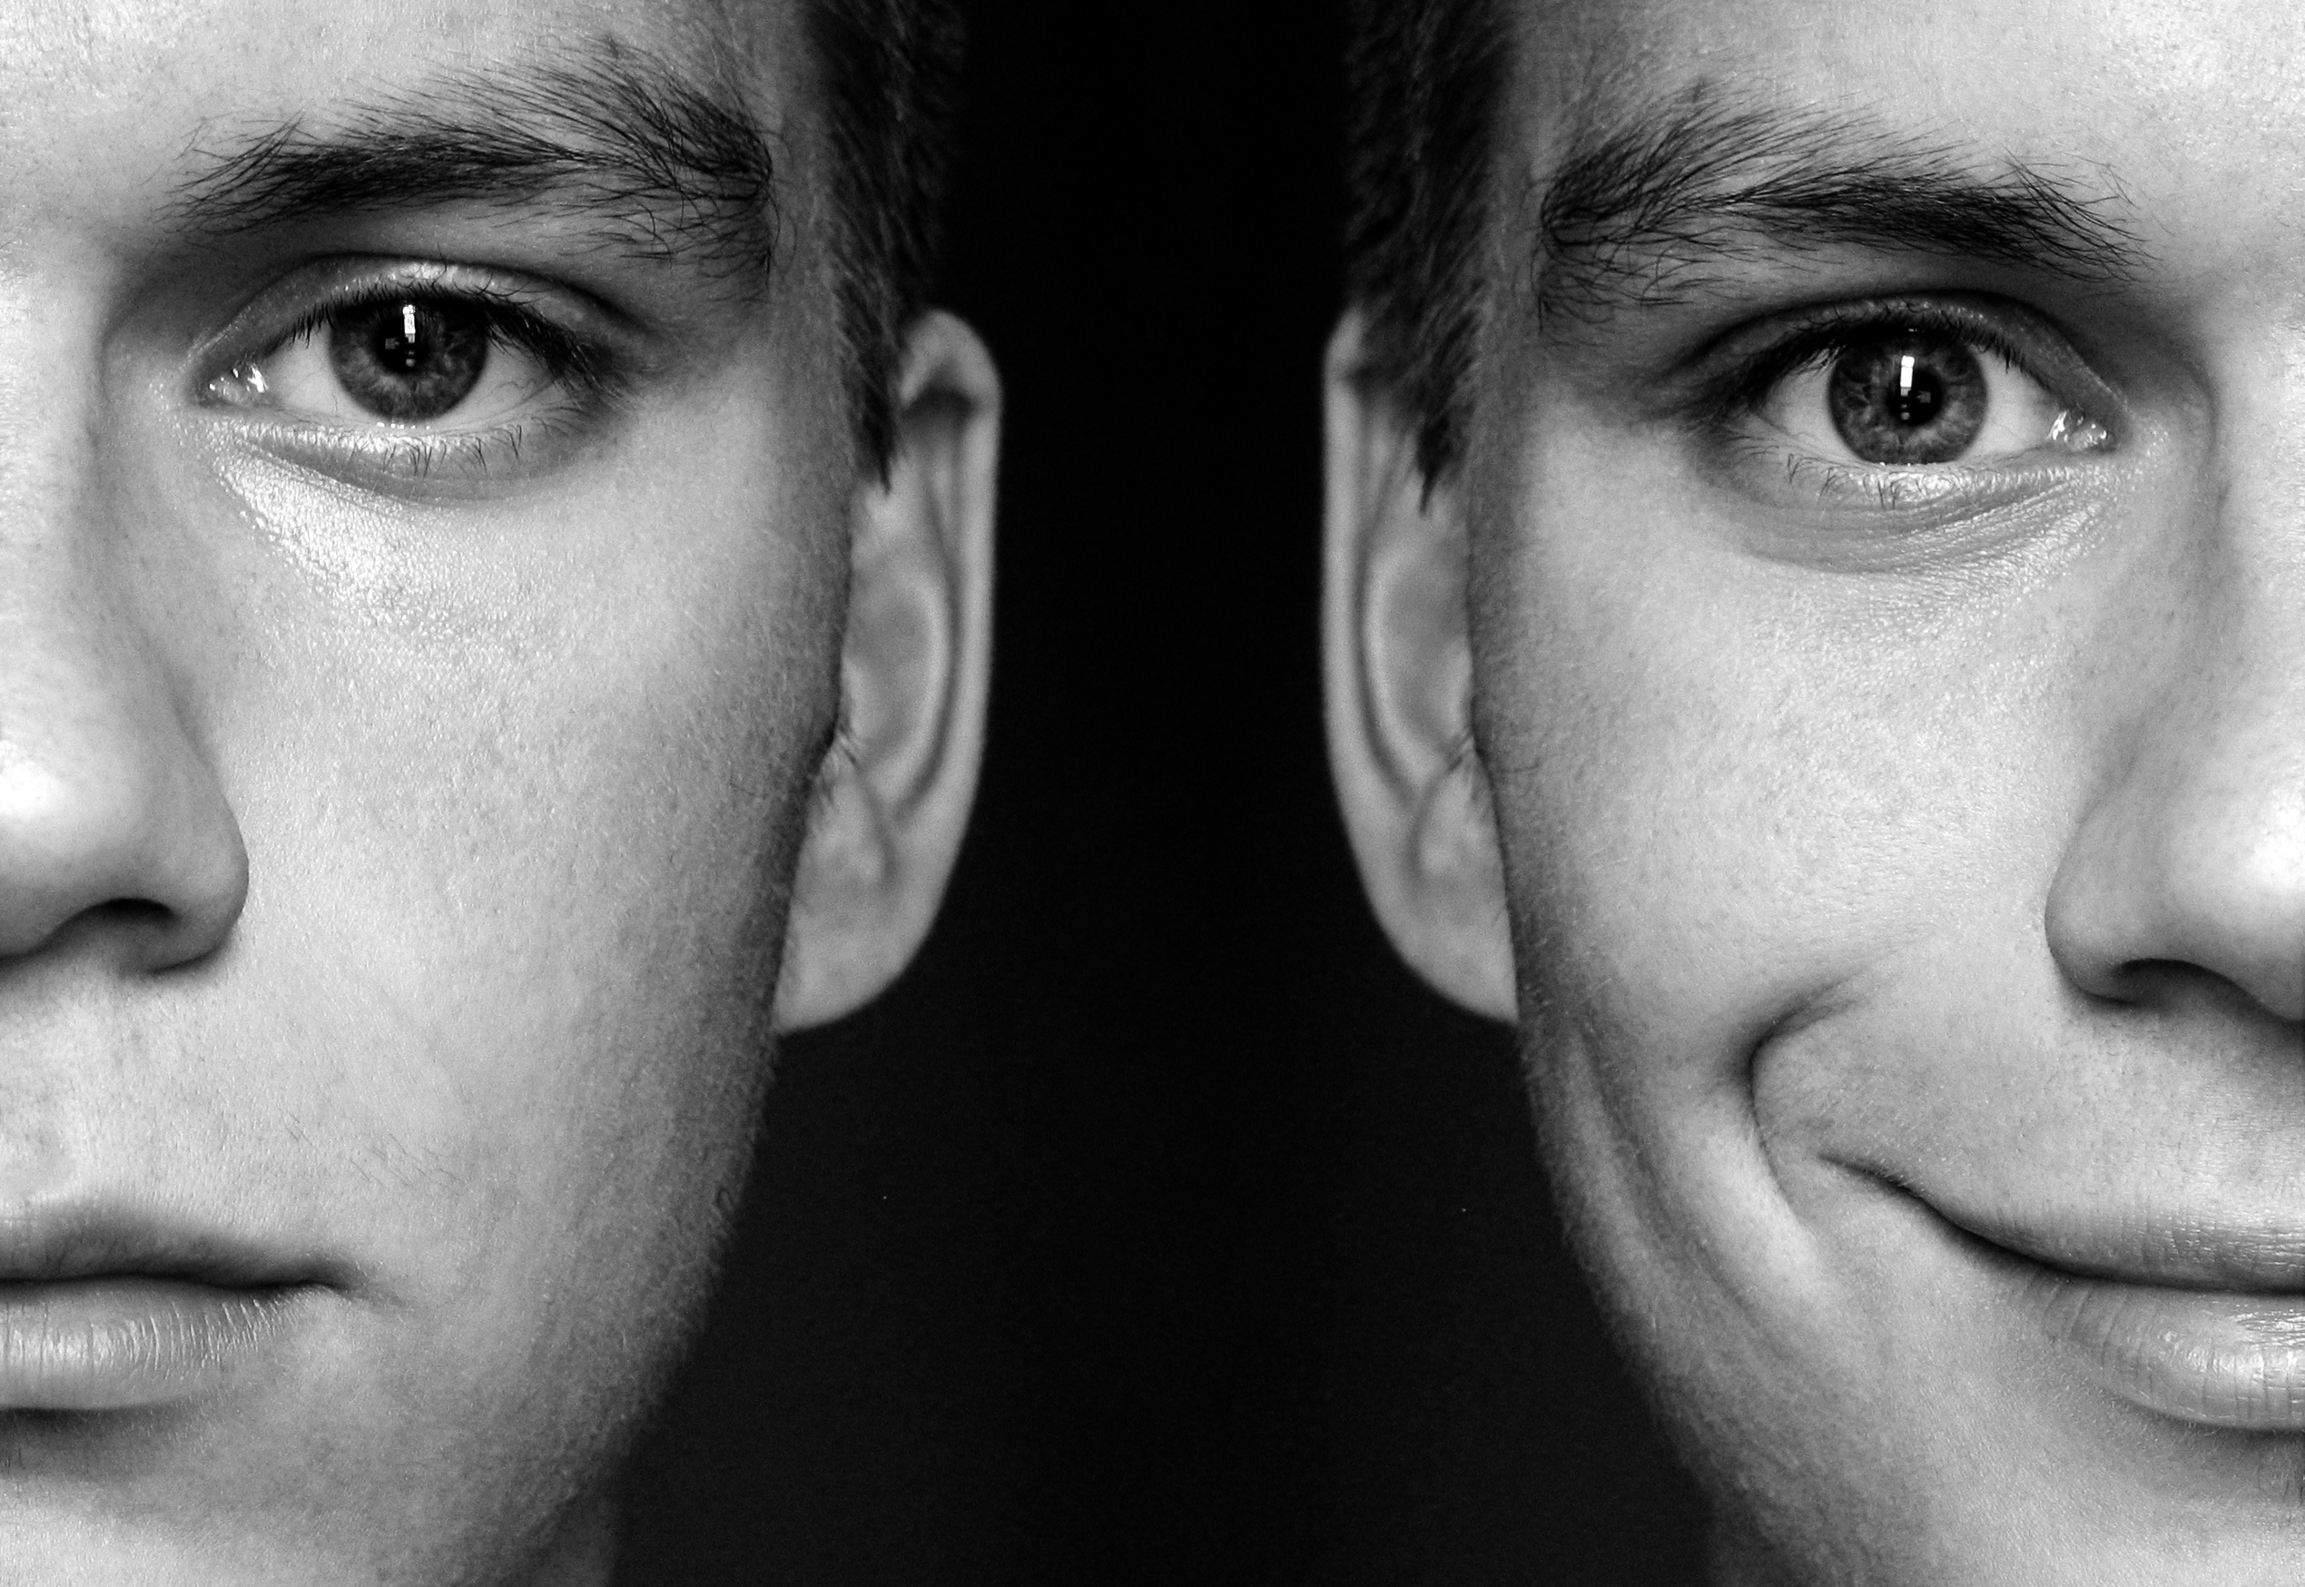
BIPOLAR ?

Slide 3
Bipolar Disorder : What is it ?
Bipolar disorder (manic-depressive illness) is referred as an episodic and lifelong and clinically severe mood disorder
Mania/ manic episode: an elevated, euphoric, and expansive mood,often interfered by outbursts of strong irritability or violence—particularly when others do not go with the manic person’s wishes and thoughts
Depressive episode: markedly depressed mood or loss of interest in pleasurable activities

Slide 4
General Features
Manic and hypomanic periods are tend to be shorter than depressive periods
Hard to distinguish from unipolar major depression
Tends to have psychotic features too
Impairment of occupational and social functioning, hospitalization might be necessary in manic episodes

Slide 5
Bipolar Disorder: Types
Cyclothymic Disorder
Bipolar I
Bipolar II

Slide 6
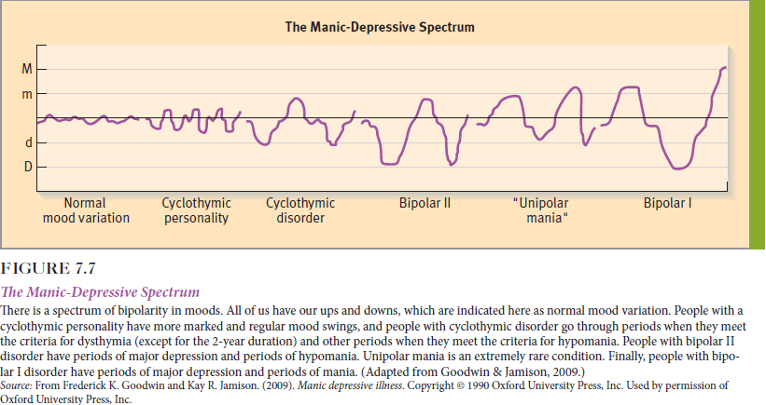

Slide 7
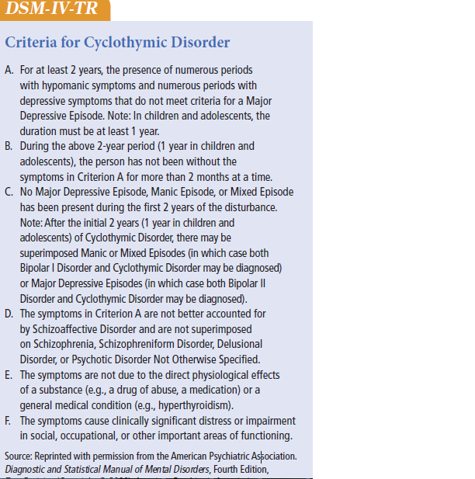
Cyclothymic Disorder: persists for at least 2 years, lacks certain extreme symptoms and psychotic features

Slide 8
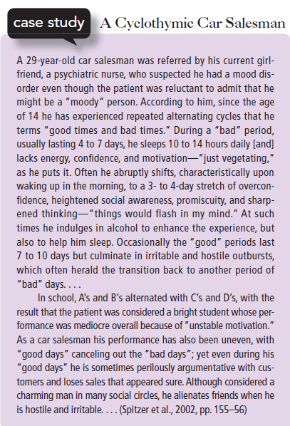

Slide 9
Bipolar I: at least one manic episode or mixed episode
Bipolar II: the person does not experience full-blown manic (or mixed) episodes
Experience of clear-cut hypomanic episodes as well as major depressive episodes as in bipolar I disorder

Slide 10
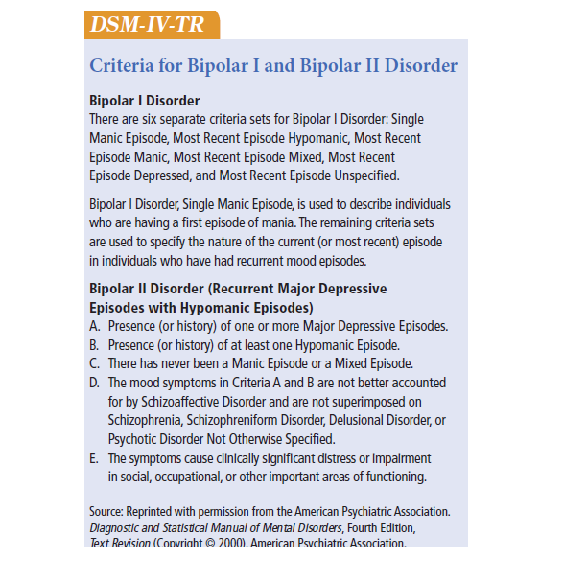

Slide 11
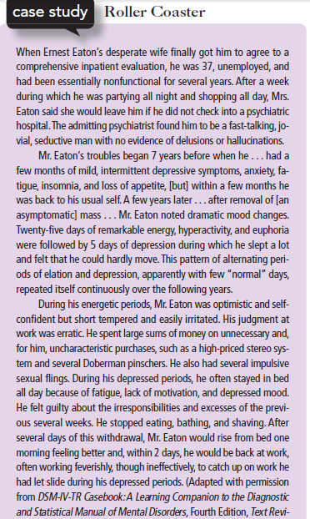

Slide 12
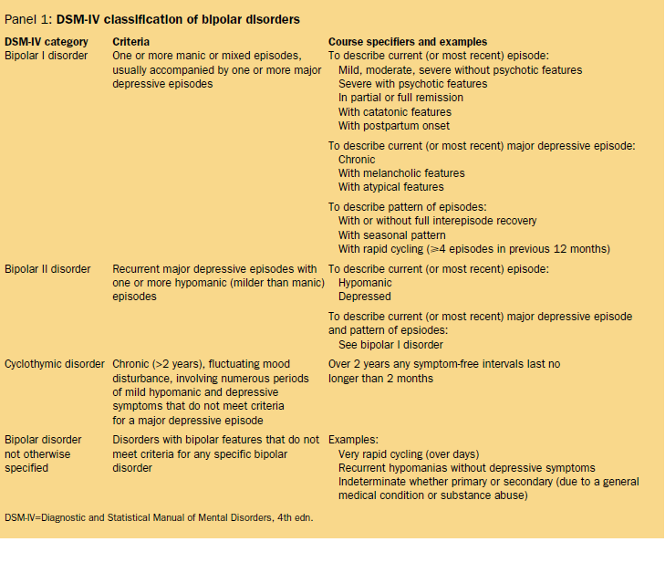

Slide 13
Bipolar Disorder in History
Has its roots in the work of the Greek physicians of the classical period
Mania and melancholia are two of the earliest described human diseases
Classical Era and Hippocrates: mania, melancholia, paranoia, deliria, hysteria
Aretaeus: eclecticism, biological causes and melancholia

Slide 14
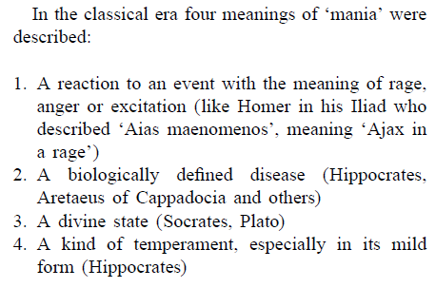

Slide 15
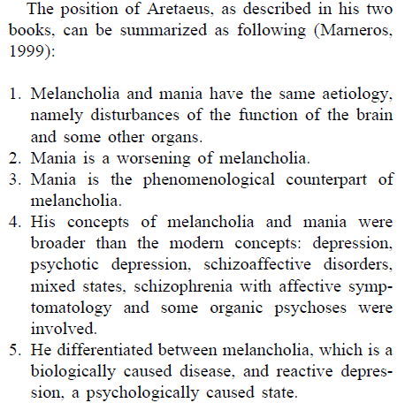

Slide 16
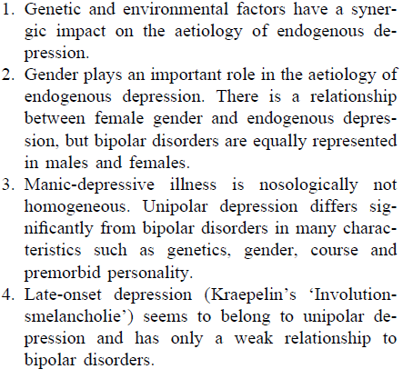
Jean-Pierre Falret: “‘a circle of both types one single disease.”
The modern concept: in France, 19th century, hospital La Salpetriere, Jean-Pierre Falret.
Emil Kraepelin “the father of modern psychiatry”
Counter arguments to bipolar disorder
Re-birth of bipolar disorder: Jules Angst 1966, Switzerland

Slide 17
Epidemiology
Bipolar disorder is seen equally in both men and women but the depressive episodes are more common in women
Average age of onset is 18-22
Bipolar II occurs around 5 years later than Bipolar I
Both recurrent

Slide 18
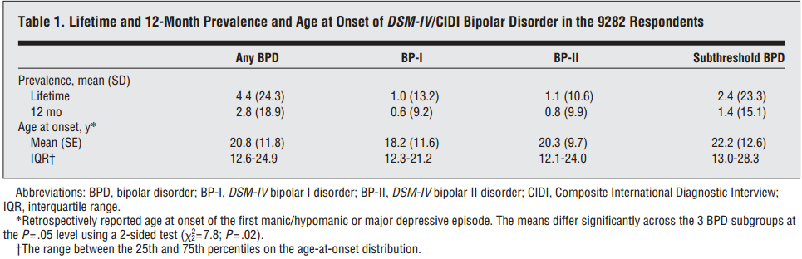
United States
The life time prevalence of Bipolar I: around 0.6%
The life time prevalence of Bipolar II: around 0.8%
(Merikangas, 2007)

Slide 19
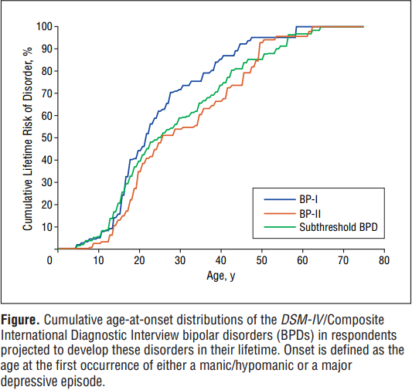

Slide 20
Europe
The life time and 12 months prevalence of Bipolar disorder in general: around 0.9%
Bipolar II > Bipolar I
(Pini, Stefano, 2005)

Slide 21
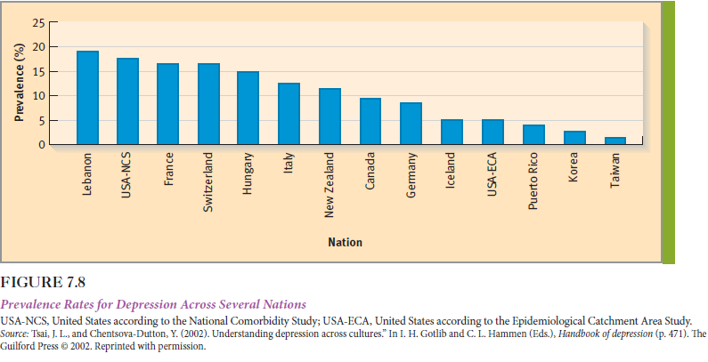
Cross-Cultural Prevalence of Depression Rates

Slide 22
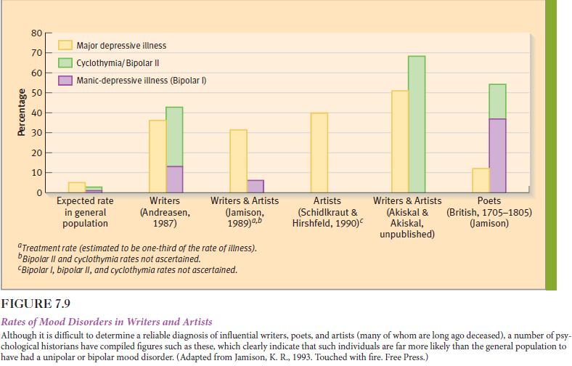

Slide 23
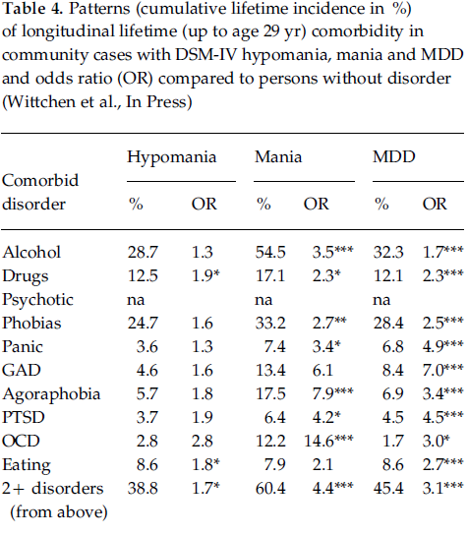
Comorbidity
Wittchen, Hans-Ulrich, Stephan Mühlig, and Lukas Pezawas. "Natural Course and Burden of Bipolar Disorders." The International Journal of Neuropsychopharmacology Int. J. Neuropsychopharm. 6.2 (2003): 145-54. Web.

Slide 24
Etiology
Causal Factors in Bipolar Disorder
Biological causal factors
Genetic factors: 8-10% first degree relatives, twin studies and high concordance (60% in monozygotic, 12% in dizygotic)
Neurochemical factors: norepinephrine, serotonin, dopamine and high dopamanergic activity
Hormonal abnormalities: elevated cortisol, thyroid hormones

Slide 25
Neurological factors: “blood flow to the left prefrontal cortex is reduced during depression, during mania it is increased in certain other parts of the prefrontal cortex (Goodwin & Jamison, 2007)” (Butcher, 246).
Enlarged basal ganglia and amygdala, reduced volume in hippocampal area
Biological rhythms: sleep and circadian rhythms

Slide 26

Psychological Causal Factors
Stressful life events
Social and environmental factors: low social support, neuroticism, cognitive styles and cognitive vulnerability

Slide 27
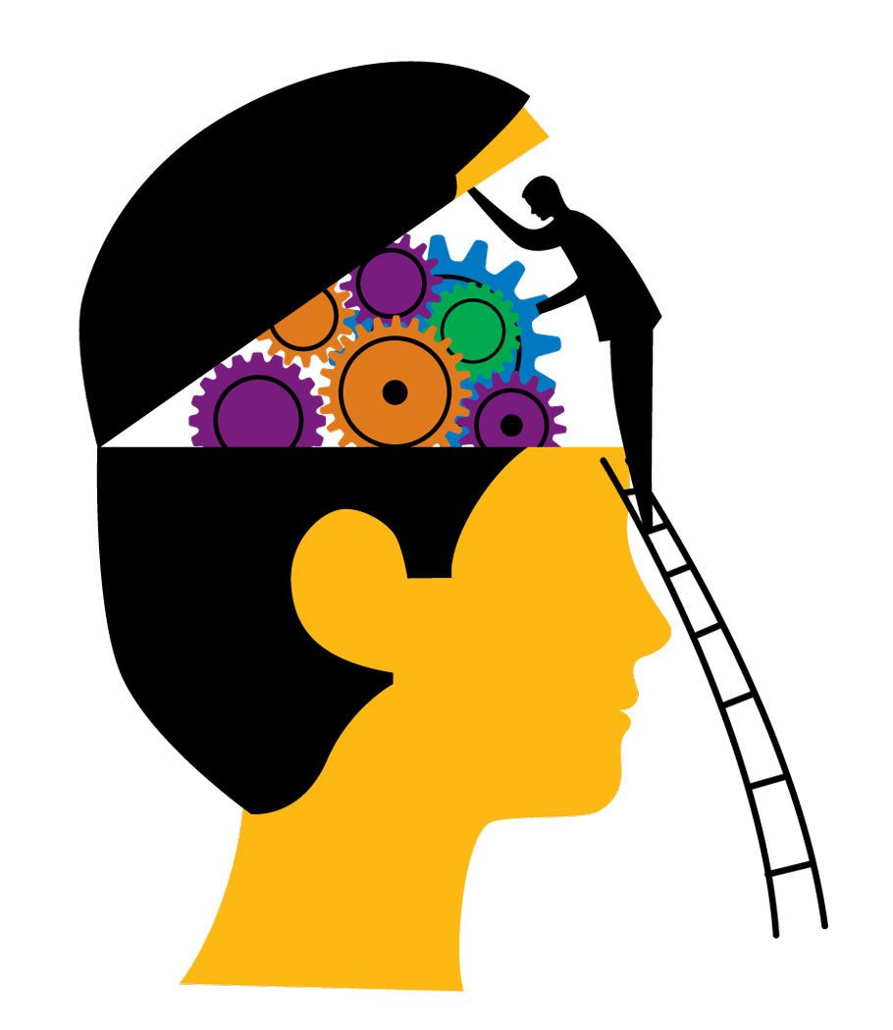
Assessment and Diagnosis
Interview with the patient
Interview with the family or relatives
Observation
DSM-V Criteria

Slide 28
Treatment
The important problem !
People usually tend not to seek help
Relapses
Public awareness
People who can get a treatment and people who cannot get a treatment

Slide 29
Pharmacotheraphy
1950: monoamine oxidase inhibitors (MAOIs)
Treating depression but dangerous / sometimes fatal
1960-1990: tricyclic antidepressants
Side effects
Selective Serotonin Reuptake Inhibitor (SSRI)
Side effects such as sexual dysfunction

Slide 30
Lithium
Mood stabilizer
Especially for manic episodes
Better for preventing cycling
Still some side effects: cognitive slowing, weight gain etc.

Slide 31
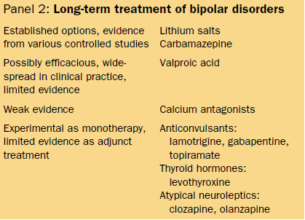

Slide 32
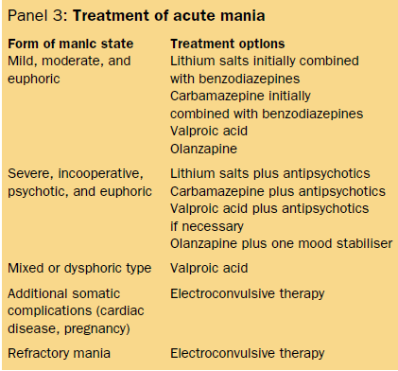

Slide 33
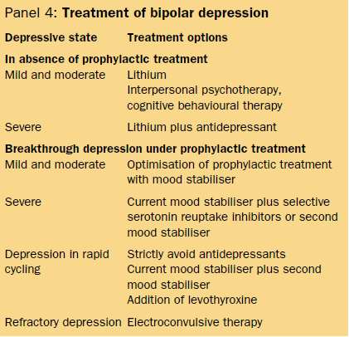

Slide 34
Biological Treatments
Electroconvulsive Theraphy
Severe depression, suicidal risks, for people who deny to take medicine etc.
Transcranial Magnetic Stimulation (TMS)
A magnetic coil is placed near the head of the person and it produces small electric signals to the brain region.
Less side effects to the cognitive functioning
Deep Brain Stimulation
A neurostimulator is placed in the specific brain region which sends electrical signals
Bright Light Theraphy
Exposure to daylight or to specific wavelengths of light

Slide 35
Psychotheraphy
“The belief that people with psychological problems can change—can learn more adaptive ways of perceiving, evaluating, and behaving—is the conviction underlying all psychotherapy” (Butcher, 2007).

Slide 36
Cognitive-Behavioral Theraphy
Combination with medication
Behavioral Activation Theraphy
Interpersonal therapy
Family Theraphy
Criticism reduce and its effect on relapses

Slide 37
Cognitive-Behavioral Theraphy
“A key component addressed in CBT for bipolar depression is the way that the patients deal with the serious losses that experience as a consequence of their bipolar disorder” (Mansell, W., Colom, F., & Scott, J. 2005).
Changing the negative cognitions
Activity schedules which encourages the abilities and activities of the patients that they think they are gone

Slide 38
“In particular, the patient is encouraged to see the benefits of pleasurable behaviour that do not involve large increases in activity and are not directed at achieving highly challenging goals. Having a bath or listening to relaxing music are examples” (Mansell, W., Colom, F., & Scott, J. 2005).

Slide 39
Brief form of treatment (usually 10 to 20 sessions) which focuses on here and present problems
Focus on the results of the disorder on the patient’s life and well being
Focus on suicidal risks
Focus on negative appraisals
Uses pleasurable relaxing activities
Relapse prevention

Slide 40
Behavioral Activation Theraphy
Focuses on helping patients to become more active and become more in interaction with their environment
Scheduling activities
Exploring new behavior to reach goals
Role playing to find out the deficits
Focuses more on changing the behavior than CBT
Positive reinforcement and reduced avoidance

Slide 41
Interpersonal Theraphy:
Focuses on present relationship problems
Focuses on changing the maladaptive relation and interaction patterns
Focuses on stabilizing the daily rhythm and social patterns

Slide 42
Family Theraphy
Relapses can be triggered by the negative elements in the patient’s family life
Criticism as an element for depression relapse
Expressed emotions and hostility in the family as a trigger to bipolar relapses

Slide 43
Family interventions
Providing information for the family about how to deal with the disorder
Marital interventions which focus on marital problems in the patient’s life and to increase marital satisfaction

Slide 44
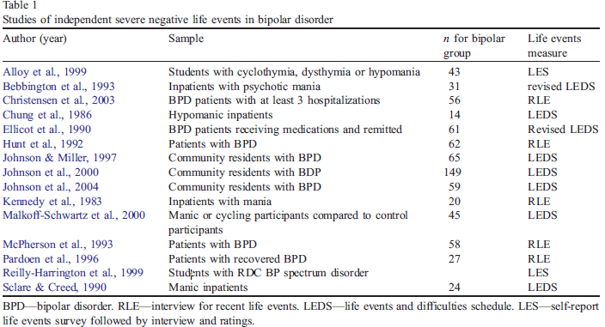
Bipolar Disorder in Real Life
(Johnson, 2005)

Slide 45
“My temperament, moods, and illness clearly, and deeply, affected the relationships I had with others and the fabric of my work. But my moods were themselves powerfully shaped by the same relationships and work. The challenge was in learning to understand the complexity of this mutual beholdenness...” (Alloy, 2005).

Slide 46


Slide 47
References
Alloy, L. B., Abramson, L. Y., Urosevic, S., Walshaw, P. D., Nusslock, R., & Neeren, A. M. (2005). The psychosocial context of bipolar disorder: Environmental, cognitive, and developmental risk factors. Clinical Psychology Review, 25(8), 1043-1075.
Butcher, J. N., Mineka, S., & Hooley, J. M. (2007). Abnormal psychology. Boston: Pearson/Allyn and Bacon.
Johnson, S. L. (2005). Life events in bipolar disorder: Towards more specific models. Clinical Psychology Review, 25(8), 1008-1027.
Mansell, W., Colom, F., & Scott, J. (2005). The nature and treatment of depression in bipolar disorder: A review and implications for future psychological investigation. Clinical Psychology Review, 25(8), 1076-1100.
Mendlewicz, J., Souery, D., & Rivelli, S. K. (1999). Short-term and long-term treatment for bipolar patients: Beyond the guidelines. Journal of Affective Disorders, 55(1), 79-85.

Slide 48
Merikangas, K. R., Akiskal, H. S., Angst, J., Greenberg, P. E., Hirschfeld, R. M., Petukhova, M., & Kessler, R. C. (2007). Lifetime and 12-Month Prevalence of Bipolar Spectrum Disorder in the National Comorbidity Survey Replication. Arch Gen Psychiatry Archives of General Psychiatry, 64(5), 543.
Müller-Oerlinghausen, B., Berghöfer, A., & Bauer, M. (2002). Bipolar disorder.The Lancet, 359(9302), 241-247.
Pini, S., Queiroz, V. D., Pagnin, D., Pezawas, L., Angst, J., Cassano, G. B., & Wittchen, H. (2005). Prevalence and burden of bipolar disorders in European countries. European Neuropsychopharmacology, 15(4), 425-434.
Wittchen, H., Mühlig, S., & Pezawas, L. (2003). Natural course and burden of bipolar disorders. The International Journal of Neuropsychopharmacology Int. J. Neuropsychopharm., 6(2), 145-154.
https://www.youtube.com/watch?v=IJtXLXQ326A

Slide 49
Thank you for listening !

