Slide 1

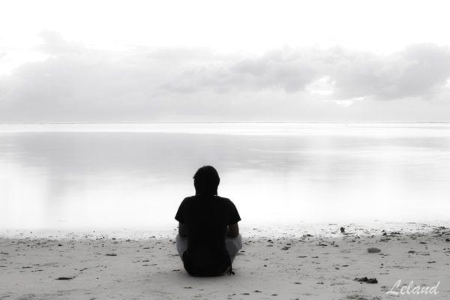
The Costs of a Peaceful Mind
How People Resolve Internal Conflicts

Slide 2



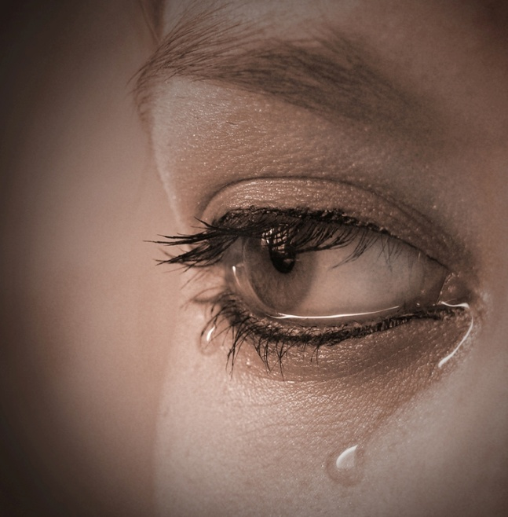
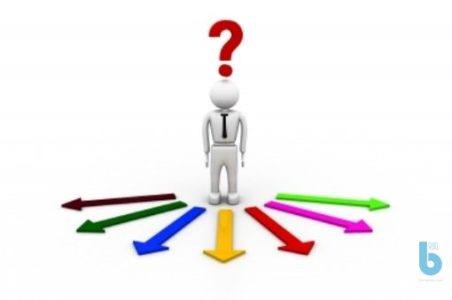
What disturbs people’s peace of mind?

Slide 3
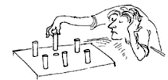
How much is your frustration worth?
Festinger & Carlsmith, 1959

Slide 4
How much is your frustration worth?
Festinger, L., & Carlsmith, J. M. (1959). Cognitive consequences of forced compliance. The Journal of Abnormal and Social Psychology, 58(2), 203.
Group A:
Asked to do a tedious task for more than 1 h
Asked to do a „favour“ for the experiementer:
Persuade next participant that the task was interesting
Paid $ 20
Group B:
Asked to do a tedious task for more than 1 h
Asked to do a „favour“ for the experiementer:
Persuade next participant that the task was interesting
Paid $ 1

Slide 5



How much is your frustration worth?
Festinger, L., & Carlsmith, J. M. (1959). Cognitive consequences of forced compliance. The Journal of Abnormal and Social Psychology, 58(2), 203.
Ratings of task after payment:
 | Enjoyable? | Again?
Control Group
$ 20
$ 1

Slide 6


How much is your frustration worth?
Aronson & Mills, 1959

Slide 7

How much is your frustration worth?
Aronson & Mills, 1959

Slide 8
How much is your frustration worth?
Aronson, E., & Mills, J. (1959). The effect of severity of initiation on liking for a group. The Journal of Abnormal and Social Psychology, 59(2), 177.
Group A:
Ready to join a discussion group
Initiation: Reading sex-related text
Asked to rate conversation of the group they joined
Group B:
Ready to join a discussion group
Initiation: Reading embarrassing pornographic text
Asked to rate conversation of the group they joined

Slide 9

How much is your frustration worth?
Aronson, E., & Mills, J. (1959). The effect of severity of initiation on liking for a group. The Journal of Abnormal and Social Psychology, 59(2), 177.
Ratings of recorded (boring) conversation:
 | Interesting discussion?
Control Group
Low embarrassment
High embarrassment

Slide 10
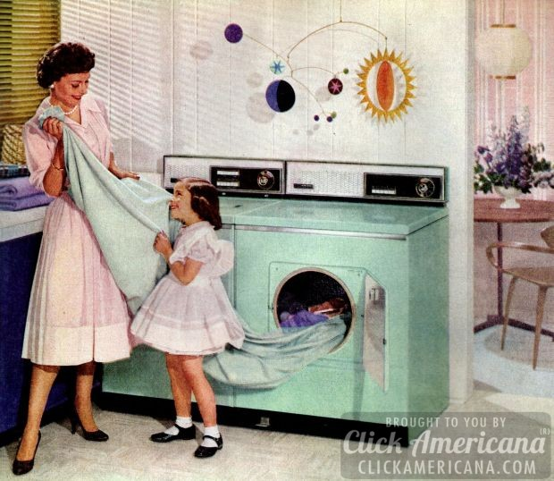
How much is your frustration worth?
Mazis, 1975

Slide 11
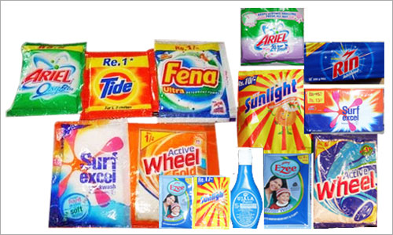
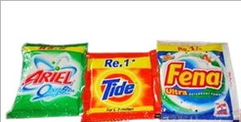
How much is your frustration worth?
Mazis, M. B. (1975). Antipollution measures and psychological reactance theory: A field experiment. Journal of Personality and Social Psychology, 31(4), 654.
Tampa, 1972:
Miami, 1972:
Antipollution law: No phosphates!

Slide 12


How much is your frustration worth?
Mazis, M. B. (1975). Antipollution measures and psychological reactance theory: A field experiment. Journal of Personality and Social Psychology, 31(4), 654.
Quality rating of phosphate detergents:
 | Tampa | Miami
Freshness
Stain removal
Cleans in cold water

Slide 13

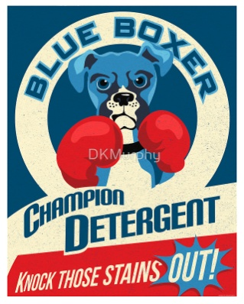


How much is your frustration worth?
Mazis, M. B. (1975). Antipollution measures and psychological reactance theory: A field experiment. Journal of Personality and Social Psychology, 31(4), 654.
Miami
Brand Nonswitchers
Miami
Brand Switchers

Slide 14
How much is your frustration worth?
Mazis, M. B. (1975). Antipollution measures and psychological reactance theory: A field experiment. Journal of Personality and Social Psychology, 31(4), 654.
Difference in rating of phosphate and no-phosphate detergents:
 | Switchers | Nonswitchers
Freshness | 1.63 | .91
Stain removal | 1.66 | .70
Cleans in cold water | 2.36 | .83

Slide 15
What is the difference between the two situations?

Slide 16
Conclusions
Experiment 1 and 2:
Cognitive dissonance
When faced with contradictory beliefs, experiences or behaviours, people tend to reduce the conflict through
Changing one’s thinking and preferences
Changing one’s behaviour
Changing one’s beliefs about the discrepancy between thinking and behaviour

Slide 17
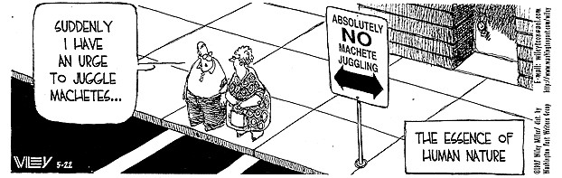
Conclusions
Experiment 3:
Psychological reactance
When one’s freedom of choice is threatened or eliminated, one tends to restore this freedom by
Choosing the ‘forbidden fruit’
Craving the ‘forbidden fruit’

Slide 18
Dissonance x Reactance
Dissonance
NO CHOICE
People tend to seek unambiguousness in information processing. When faced with conflict that cannot be avoided, they tend to reduce this conflict.
Reactance
CHOICE
People are motivated to protect the freedom and range of choice they have previously experienced.

Slide 19
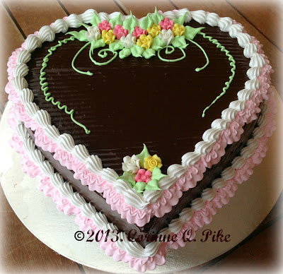
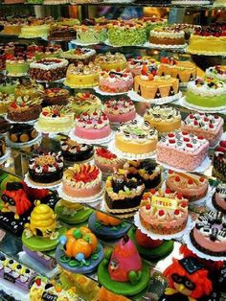
Which one makes you feel better…?
or

Slide 20
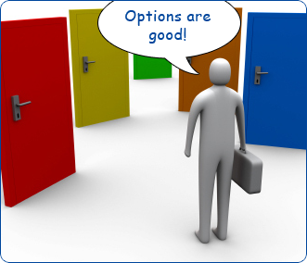
Keeping doors open
Shin & Ariely, 2004

Slide 21
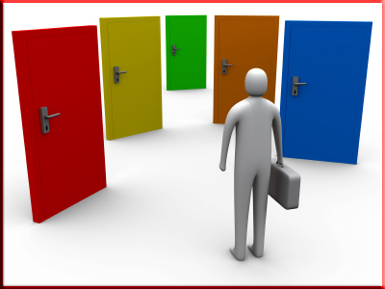
Keeping doors open
Shin, J., & Ariely, D. (2004). Keeping doors open: The effect of unavailability on incentives to keep options viable. Management Science, 50(5), 575-586.

Slide 22
Keeping doors open
Shin, J., & Ariely, D. (2004). Keeping doors open: The effect of unavailability on incentives to keep options viable. Management Science, 50(5), 575-586.
Group A:
Objective: earn as much money as possible
Limited number of clicks
Only clicking inside the room was rewarded
Doors disappeared gradually with each click
Doors could be restored with a single click
Group B:
Objective: earn as much money as possible
Limited number of clicks
Only clicking inside the room was rewarded
Doors stayed the same

Slide 23

Keeping doors open
Shin, J., & Ariely, D. (2004). Keeping doors open: The effect of unavailability on incentives to keep options viable. Management Science, 50(5), 575-586.
Average: 3 ¢
Range: 0-7 ¢
Average: 3 ¢
Range: 1-5 ¢
Average: 3 ¢
Range: -2-10 ¢

Slide 24

3¢

Slide 25
3¢ + 3¢ + 3¢

Slide 26
0

Slide 27
Keeping doors open
Shin, J., & Ariely, D. (2004). Keeping doors open: The effect of unavailability on incentives to keep options viable. Management Science, 50(5), 575-586.
A total of 100 clicks | Unchanged doors | Disappearing doors
No. of room-switching clicks | 7.47 | 16.70
Loss | 8 % | 14 %
Learning | Relatively fast | Gradual

Slide 28
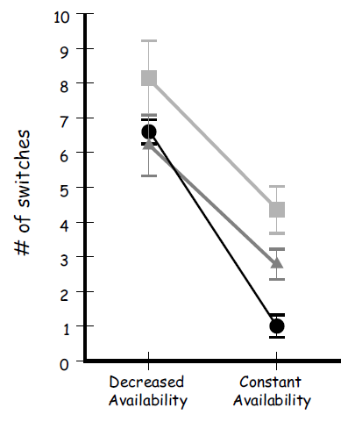
Keeping doors open
Effect of information on reward distribution:

Slide 29

Costs of choice

Slide 30
Costs of choice
A. Kruglanski
Which would you choose?
1. One important goal x One way of achieving the goal
2. One important goal x Several different ways of achieving the goal
Equifinality
Having several means for achieving a goals increases goal attractiveness and goal commitment BUT reduces commitment to individual paths.

Slide 31
Costs of choice
A. Kruglanski
Which would you choose?
1. An activity that serves one need
2. An activity that serves several needs
Multifinality
If an activity leads to several goals, the attractiveness of and commitment to the activity increases BUT if one of the goals becomes unavailable or unattractive, the commitment is drastically reduced.

Slide 32
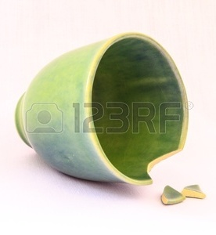
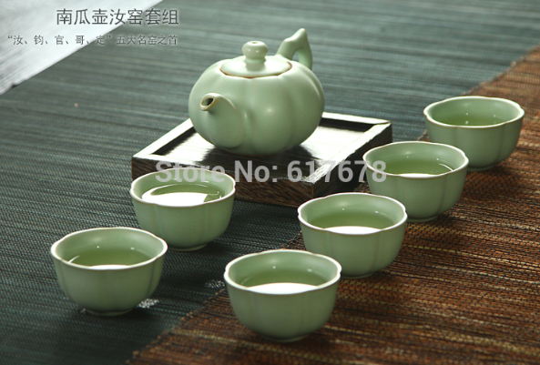
Costs of choice
A. Kruglanski
Which would you choose?
1. An activity that serves one need
2. An activity that serves several needs
Multifinality
Loss aversion

Slide 33
Costs of choice
People are attracted to situations of choice because they represent a possibility of greater reward and more effective coping with future uncertain situations.

Slide 34
Costs of choice
However, decision-making is demanding in terms of self-regulation.
When the options are similarly attractive, human mind tends either to
postpone the choice
or choose the default option

Slide 35
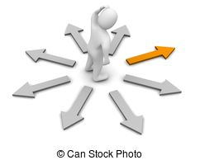
Costs of choice
However, decision-making is demanding in terms of self-regulation, and when the options are similarly attractive, human mind tends either to postpone the choice or choose the default option.

Slide 36
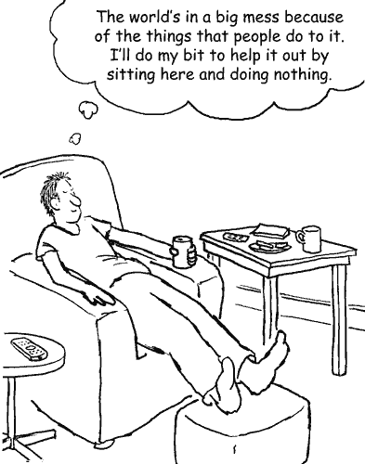
The Costs of a Peaceful Mind
Thank you!

