Slide 1

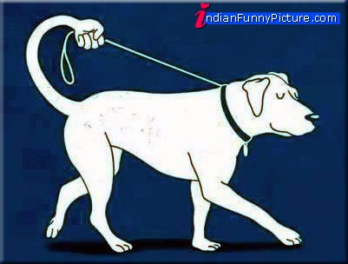
The Principles of Human Struggle
How Self-Control Fails and How It Works

Slide 2

Irrational behaviour cont.
Expected Utility Theory:
Expectancy × Value

Slide 3
Irrational behaviour cont.
Expected Utility Theory:
Expectancy × Value

Slide 4
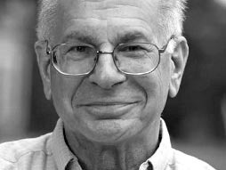
Irrational behaviour cont.
Planning Fallacy
Daniel Kahneman

Slide 5
Irrational behaviour cont.
Planning Fallacy – Kahneman’s examples:
Estimate
Plan to write a textbook on decision making
Estimates of time needed based on available information on resources:
1,5 to 2,5 yrs
Reality
Asked a colleague about other teams who attempted the same
Only 40% success rate (others abandoned the plan)
The others took around 10 yrs
Most teams’ resources were better

Slide 6
Irrational behaviour cont.
Planning Fallacy – Kahneman’s examples:
Estimate
New Scottish Parliament building – initial estimate £40 million
Estimates of American homeowners of how much kitchen remodelling would cost: $18,658
Reality
Finally completed for £431 million
Real cost: $38,769

Slide 7
Planning Fallacy
People tend to…
Only consider best-case scenarios
Disregard “statistics” on actual success rate of previous similar attempts
Why?
Because we do not consider unexpected events and random disruptive factors, which are almost always present
As specific information on them in unavailable, we do not factor them in

Slide 8
Availability Heuristic
People tend to…
Rely on immediate examples that come to mind when considering a situation / problem = AVAILABILITY HEURISTIC
Make decisions based on this immediate information
This information is primed by context (different cues remind us of different things)
The cues may include attributes of the situation, of the present alternatives, of surrounding objects, previous events, inner states, etc.
In addition, we are hard-wired to pay more attention to certain pieces of information rather than others (losses, beginnings and endings, unique features, etc.)

Slide 9
Availability heuristic
What the eye doesn’t see the heart doesn’t ache for.
(Czech proverb)

Slide 10
How our motivation system works

Slide 11
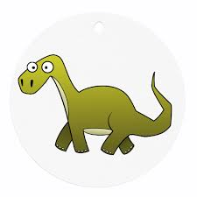
Analogy of three brains
Reptilian brain – basic reflexes

Slide 12
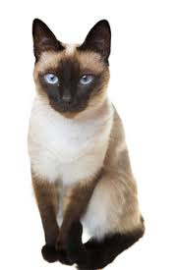
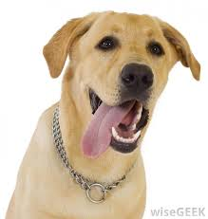
Analogy of three brains
Reptilian brain – basic reflexes
Mammalian brain – emotions

Slide 13
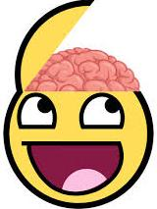
Analogy of three brains
Reptilian brain – basic reflexes
Mammalian brain – emotions
Human brain – reasoning, mental representation, planning – delay of gratification

Slide 14
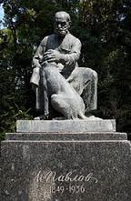
Mammalian brain
I. P. Pavlov
Classical conditioning

Slide 15
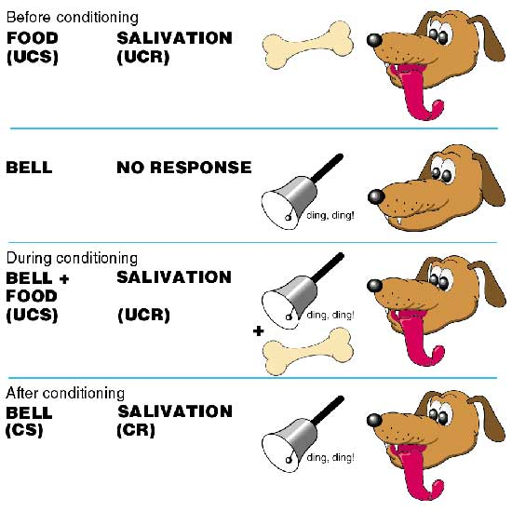
Classical Conditioning

Slide 16
Classical conditioning
Why is this important to us (humans)?
Salivation in Pavlov’s dogs signalizes increased anticipation of reward = increased need
Cues in the environment previously associated with motivational states will become triggers of those motivational states in the future regardless of whether the reward/punishment is currently present or not.

Slide 17
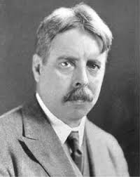
Mammalian brain
E. L. Thorndike
Instrumental learning

Slide 18
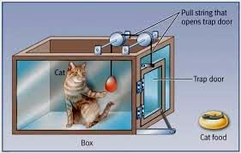
Instrumental conditioning

Slide 19
Instrumental conditioning
Why is this important to us (humans)?
Objects and situations can trigger automatic behavioural responses = HABITS
Always intertwined with classical conditioning (a stimulus triggers a motivational state as well as a behavioural response)

Slide 20
Why is our behaviour not rational?
Our decisions and behaviours are dependent on immediate (here-and-now) cues previously associated with motivational states or hard-wired heuristic systems rather than global judgment of advantages and disadvantages in different situations
While we are capable of making relatively more global judgments, the quality and perceived necessity of these judgments is ALSO influenced by the present context
This is because our capacity of information processing is limited

Slide 21
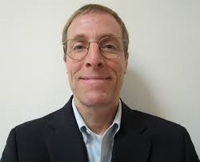
How to resist temptations?
Emotion regulation
J. Gross
PREVENT THOSE EVIL STIMULI FROM ENTERING THE BRAIN AND PRODUCING AUTOMATIC RESPONSES!!!
How…?

Slide 22
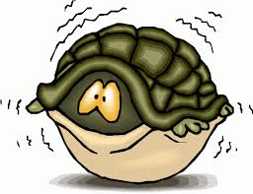
How to resist temptations?
Emotion regulation
Choose sitiation

Slide 23
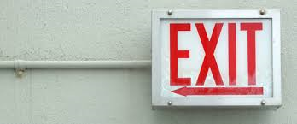
How to resist temptations?
Emotion regulation
Choose situation
Change situation

Slide 24
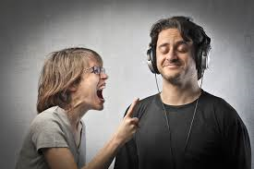
How to resist temptations?
Emotion regulation
Choose situation
Change situation
Divert attention

Slide 25
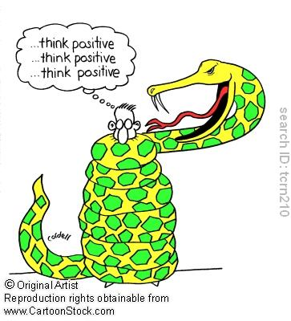
How to resist temptations?
Emotion regulation
Choose situation
Change situation
Divert attention
Change thinking

Slide 26
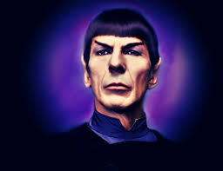
How to resist temptations?
Emotion regulation
Choose situation
Change situation
Divert attention
Change thinking
Act as if nothing happened

Slide 27
How to resist temptations?
Emotion regulation – EFFECTIVENESS:
Situation selection
Situation modification
Attentional deployment
Cognitive change
Response modulation

Slide 28



Reappraisal v. suppression
Gross, J. J. (1998). Antecedent-and response-focused emotion regulation: divergent consequences for experience, expression, and physiology. Journal of personality and social psychology, 74(1), 224.
Three groups watching a disgusting movie:
 | Facial expressions | Physiological reactions
Group 1: No instruction
Group 2: “Think of the movie in way that you’ll feel nothing.”
Group 3: “Behave in a way so that others think you feel nothing.”

Slide 29
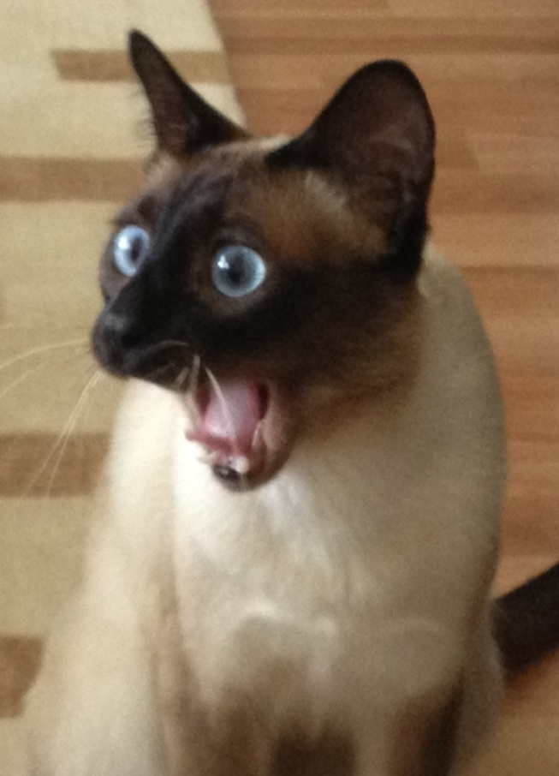
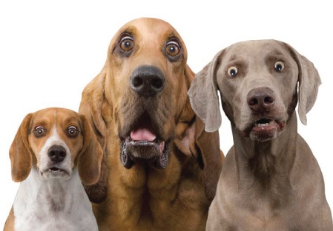
Human brain
The fact that we can exercise self-control should not be taken for granted…

Slide 30
How does self-control work?

Slide 31
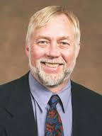
Is our self-control like a muscle?
Ego depletion
Roy Baumeister

Slide 32
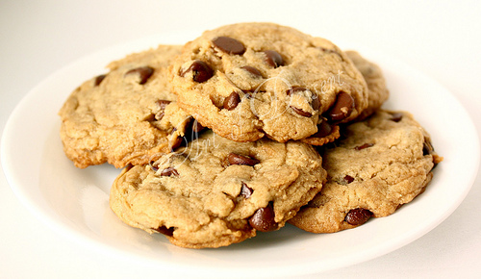
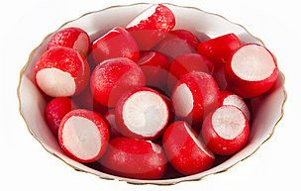
Ego depletion
Baumeister, R. F., Bratslavsky, E., Muraven, M., & Tice, D. M. (1998). Ego depletion: is the active self a limited resource? Journal of personality and social psychology, 74(5), 1252-1265.

Slide 33
Ego depletion
Baumeister, R. F., Bratslavsky, E., Muraven, M., & Tice, D. M. (1998). Ego depletion: is the active self a limited resource? Journal of personality and social psychology, 74(5), 1252-1265.
Three groups:
Instructed to eat: | Group 1 | Group 2 | Group 3 No food
Persistence on subsequent unsolvable figure-drawing task | 18.9 min. | 8.85 min. + more fatigue | 20.86 min.

Slide 34
Our self-control is like a muscle
Muraven, M., & Baumeister, R. F. (2000). Self-regulation and depletion of limited resources: Does self-control resemble a muscle?. Psychological bulletin, 126(2), 247.
It is a limited but renewable resource – it can get depleted
It is common for all types of self-control (inhibition of automatic reactions)
This means that if we use it up for one activity (studying for a test) there won’t be enough for another activity (being nice to your boss)
blue green red yellow

Slide 35
Our self-control is like a muscle
Muraven, M., & Baumeister, R. F. (2000). Self-regulation and depletion of limited resources: Does self-control resemble a muscle?. Psychological bulletin, 126(2), 247.
GOOD NEWS:
It can be restored – rest, motivational reinforcement, good plans/structure
It can be used economically when necessary
It can be trained
OVERSTRAINING IS NOT TRAINING!!!

Slide 36
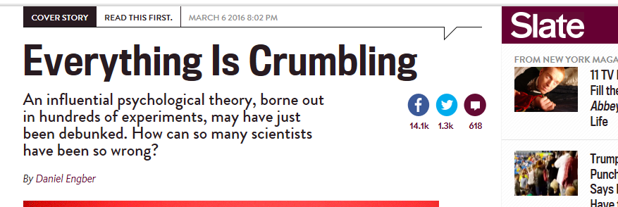
Ego depletion – real?

Slide 37
Irrationality in science
Confirmation bias („Experimenter Effect“) – overstate evidence supporting my theory and neglecting evidence against my theory
Congruence bias – looking for evidence to support my hypothesis rather than test alternative hypothesis
Observer-expectancy effect – subconscious manipulation of experimental situation in order to achieve the desired effect
Hindsight bias – modifying or creating hypotheses after results are known, „I knew it all along“ fallacy
Publication bias – non-significant results are unimportant, hence unpublishable

Slide 38
More cognitive biases...
https://en.wikipedia.org/wiki/List_of_cognitive_biases

Slide 39
Summary
Automatic responses have primacy over deliberate actions
Automatic responses are often non-conscious and undisputed
Automatic responses are context-dependent
Overcoming automatic responses requires exercise of WILL which seems to be based on limited resources
It is therefore best to avoid triggers of automatic responses rather than trying to suppress the responses

Slide 40
Additional materials
Before attempting the second quiz, watch the video on the “Standford marshmallow experiment” available in the interactive syllabus in the IS
Recommended materials:
Roy Baumeister’s videos on ego depletion (for research examples)
James Gross’s video on emotion regulation

Slide 41
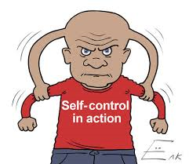
The Brittle Core of Humanity
Thank you!

