Slide 1
Introduction
General Concepts

Slide 2
Understanding the Subject Framework
Mind exercise: “Automatic writing”
DEFINE THE FRAMES OF:
music
industry
business

Slide 3
Understanding the Subject Framework
2. Brainstorm in pairs: “Entry to a Wiki”
WRITE DOWN THE DEFINITIONS FOR:
music
industry
business

Slide 4
Understanding the Subject Framework
3. Group work: “Simplify the concept”
EXPLAIN THE FOLLOWING TO A KID:
music
industry
business

Slide 5
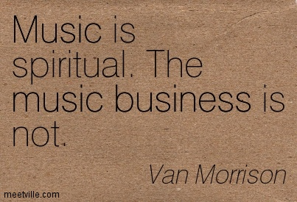
Music V. Business?

Slide 6

Who participates in music?

Slide 7
DEFINE RELATIONSHIP/INFLUENCE?
SOCIAL WORLD
CREATOR RECEIVER
CULTURAL OBJECT

Slide 8
CULTURAL DIAMOND
SOCIAL WORLD
CREATOR RECEIVER
CULTURAL OBJECT

