Slide 1
Academic debate

Slide 2
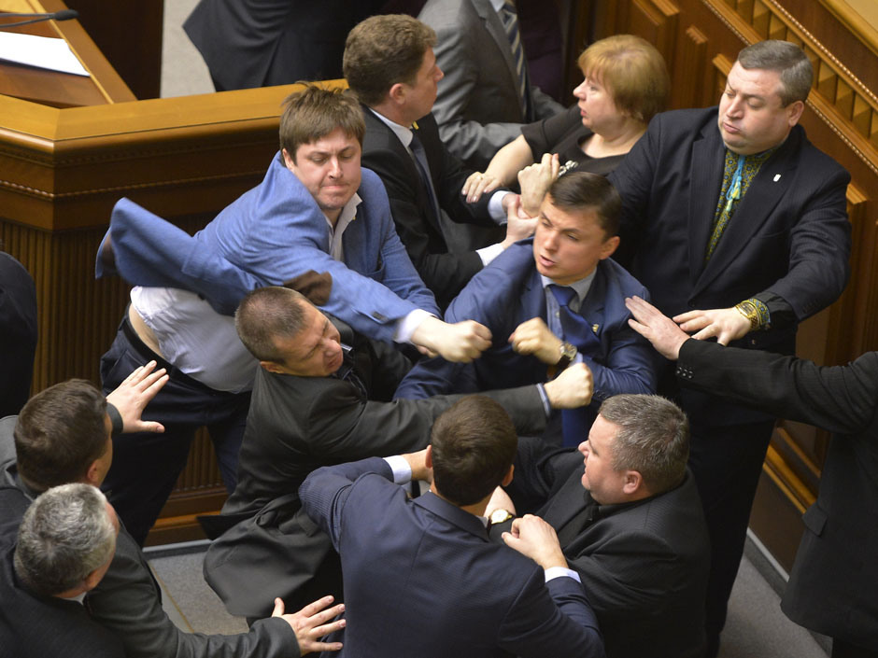

Slide 3
Content
Academic debates
Rules
Formats
Speeches
Addressing
Judging

Slide 4
Academic Debate
The purest form of debate
No embellishments, merely speeches:
  No Parliamentary interruptions
  No heckling (unless specifically permitted)
  No opportunity to question or be questioned (unless permitted)

Slide 5
Heckling
When to Heckle
  To relieve seriousness of the debate
  To underline weakness of fact or reasoning
How to Handle Heckling
  To prevent it
  To respond with more humor
  To ignore

Slide 6
Worlds Style Points of Information
Used at the Worlds Schools Debating Championships
Not recommended for novice debaters
Raised only between the first and final minute of a constructive speech
Take the form of question or remark
Must be brief

Slide 7
Rule # 1
Debaters take sides
  Affirmative
  Negative
Resolution
  No middle ground; either true or false

Slide 8
Rule # 2
Debaters take turns
  Oxford format
  Cambridge format
  Lincoln-Douglas format

Slide 9
Oxford format
1st Affirmative (constructive speech) 5 minutes
1st Negative (constructive & rebuttal speech) 8 minutes
2nd Aff (constructive and rebuttal speech) 8 minutes
2nd Neg (constructive and rebuttal speech) 8 minutes
3rd Aff (constructive and rebuttal speech) 8 minutes
3rd Neg (constructive and rebuttal speech) 8 minutes
1st Aff (rebuttal speech) 3 minutes
Complaints of rule violations, misquotations, etc. by either team.

Slide 10
Cambridge format
1st Affirmative (constructive speech) 5 minutes
1st Negative (constructive speech) 5 minutes
2nd Affirmative (constructive speech) 5 minutes
2nd Negative (constructive speech) 5 minutes
3rd Affirmative (constructive speech) 5 minutes
3rd Negative (constructive speech) 5 minutes
1st Negative (rebuttal speech) 3 minutes
1st Affirmative (rebuttal speech) 3 minutes
2nd Negative (rebuttal speech) 3 minutes
2nd Affirmative (rebuttal speech) 3 minutes
3rd Negative (rebuttal speech) 3 minutes
3rd Affirmative (rebuttal speech) 3 minutes
Complaints of rule violations, misquotations, etc. by either team.

Slide 11
LD format
Affirmative 6 minutes
Negative Cross-examination 3 minutes
Negative 7 minutes
Positive CX 3 minutes
Affirmative 4 minutes
Negative 6 minutes
Affirmative 3 minutes
5 minutes preparation time

Slide 12
Constructive speech
The affirmative
  May define resolution
  Should state the importance of the resolution and the values it contains
  Should present reasonable arguments to support the values
Negative
  May dispute the affirmative definitions
  Should attack both the values and the affirmative’s interpretation and defense
  May present new values

Slide 13
The Rebuttals
New evidence to support old arguments
The affirmative must reply before the last rebuttal
The responsibility of the speaker to defend and to attack

Slide 14
Cross examination
Form of questions and answers
Clarification of an obscure point
Attitude reasonable, cooperative, eager to please
Admissions or information must be used in subsequent speeches
Reasonable length

Slide 15
Rule # 3
No Moving Targets
  Every single argument that Affirmative wants to make must be made in the first speech
  No adding of new arguments in later speeches
  Same for Negative
  Development of arguments

Slide 16
Addressing
In third person by the position
Opening
  Mr. Moderator
  Honorable judges
  Worthy opponents
  Ladies and gentlemen

Slide 17
Judging
Based upon:
  Skill in analysis
  Use of evidence
  Validity of evidence
  Validity of argument
  Clarity of organization
  Effectiveness of delivery
  Strength and conviction

Slide 18
May the best win
Single-sex schools are good for education
Reality television does more harm than good
University education should be free
Mothers should stay at home and look after their children

Slide 19
Thank you for your attention!
Filiter, John D. "An Introduction to Academic Debate." (2004): n. pag. Web
RULES OF LINCOLN-DOUGLAS DEBATE
https://www.youtube.com/watch?v=GINVeAfcvyQ
http://commfaculty.fullerton.edu/jbruschke/theory_and_practice_in_academic_.htm

