Slide 1
CROATIA
CULTURE SHOCK AS YOU MAY NOT KNOW IT

Slide 2
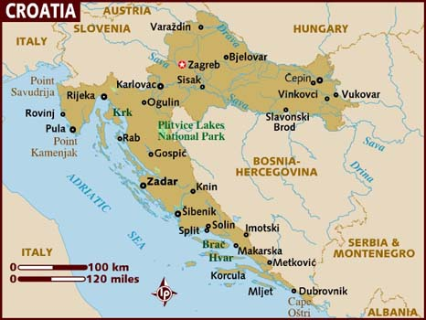
The Country
Female President
Smaller than CR
10% are National Parks
Thousands of islands

Slide 3
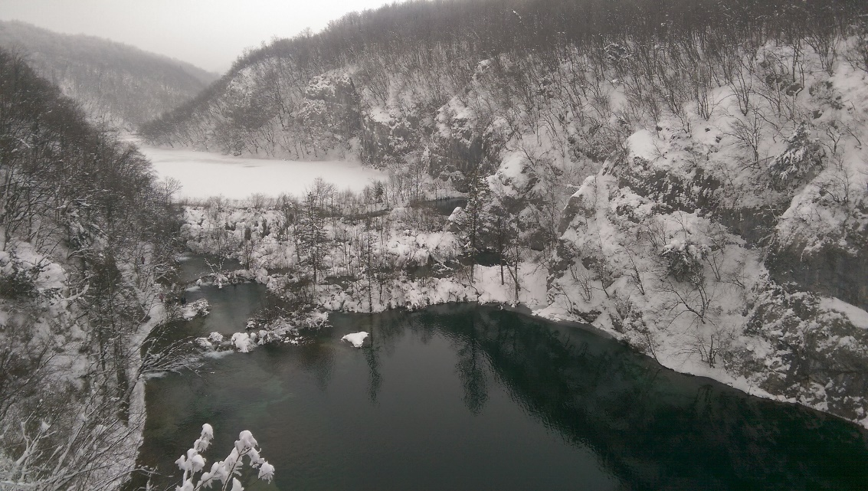
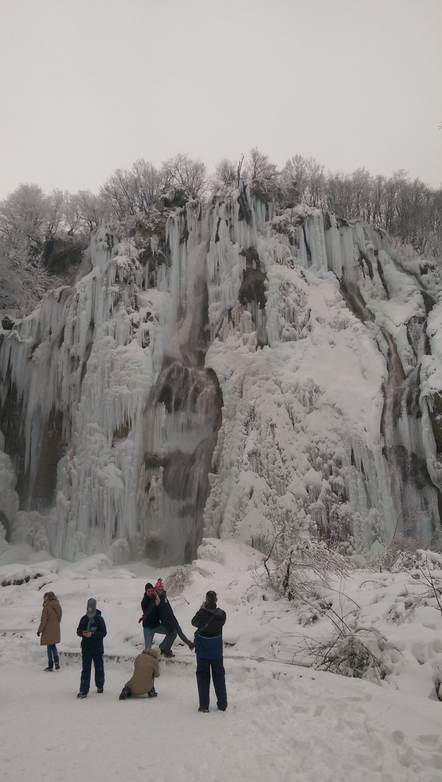
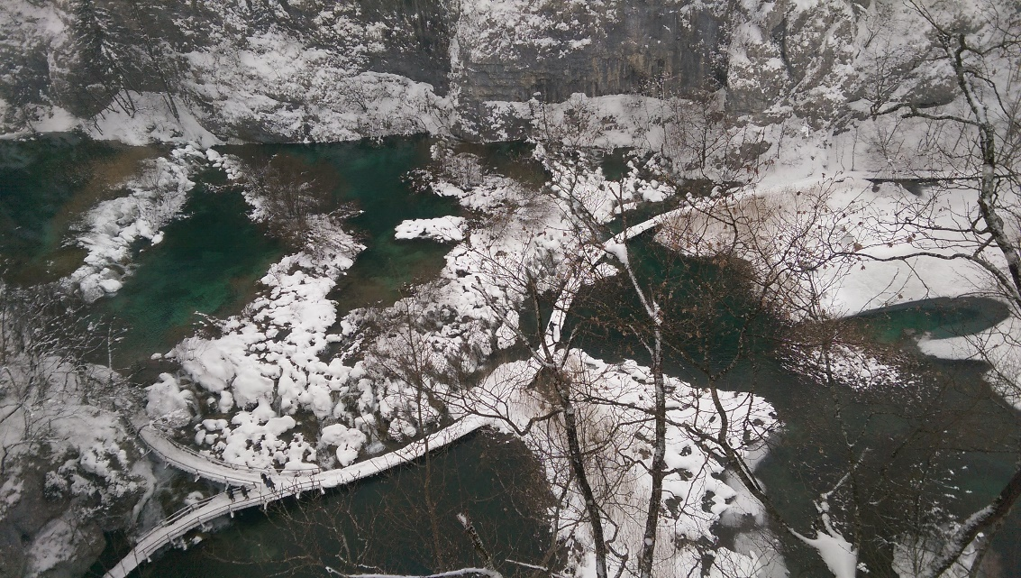
The Country
Female President
Smaller than CR
10% are National Parks
Thousands of islands

Slide 4
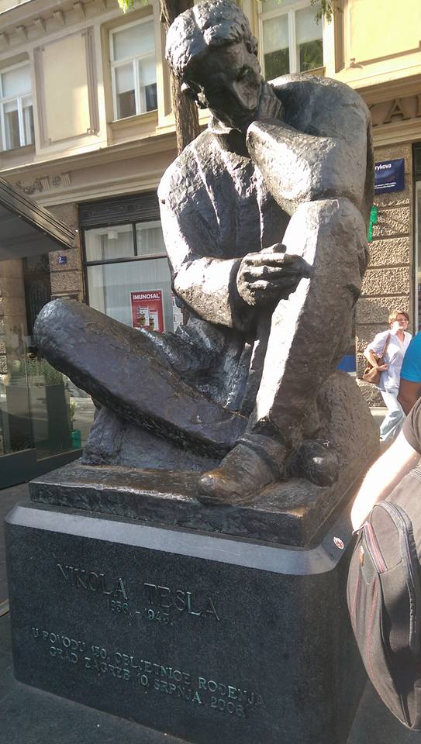
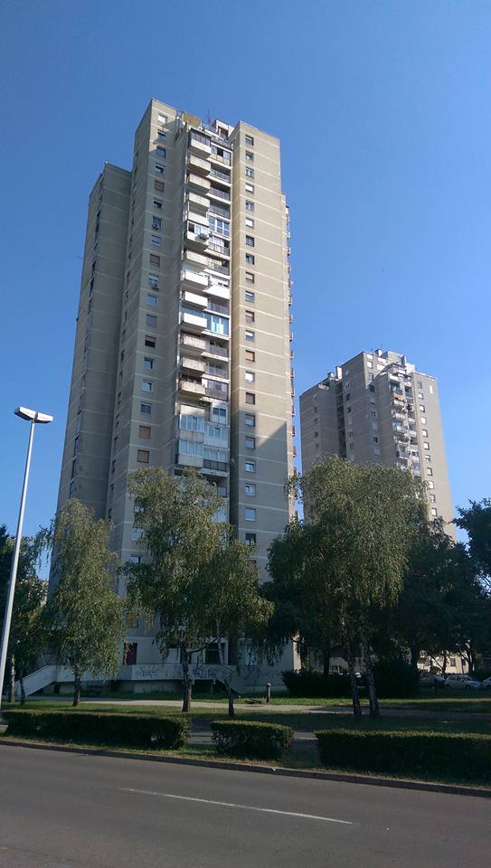
The PEOPLE
Slavs by the sea
Necktie, fountain pen
and the Death ray.
Not just seaside resorts
Poverty covered by development

Slide 5
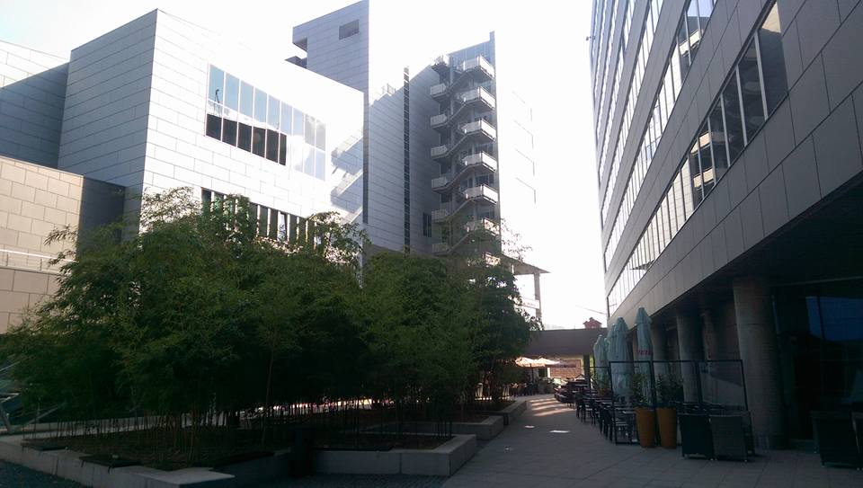
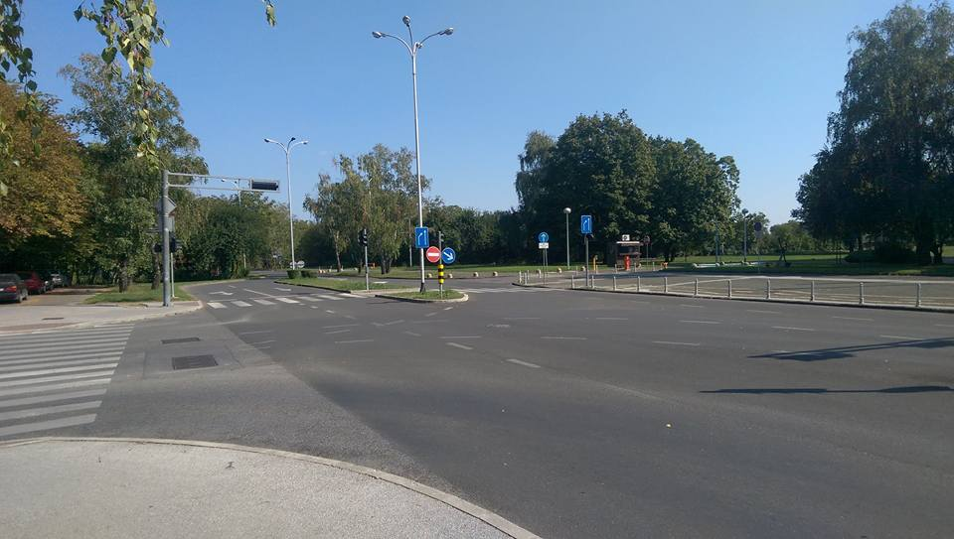
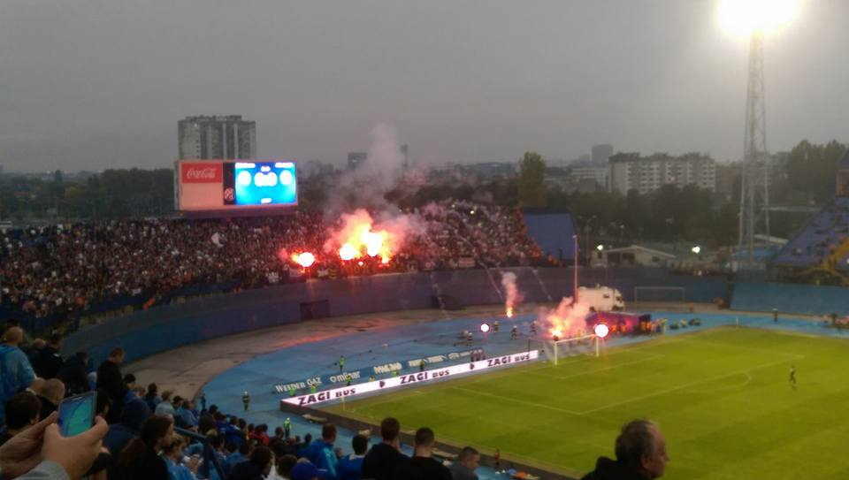
The Culture
Christian traditions still apply
Don‘t touch our days off
Go Sports!

Slide 6
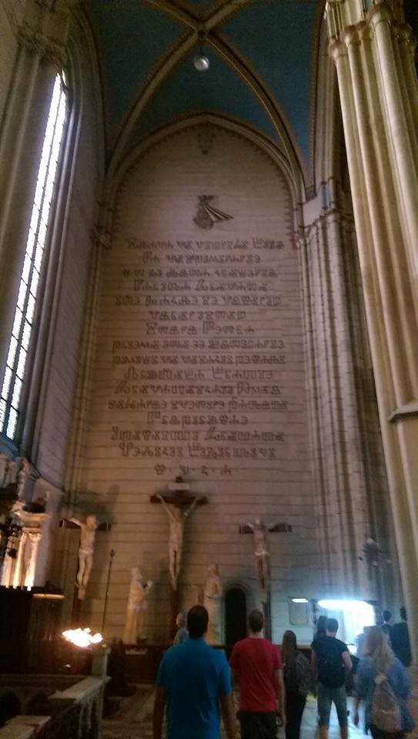
The Language
Slavic family
Ancient and Christian words in use
Do not presume you know
German is the new English
Paid language courses (except dilligent students of Arts)

Slide 7
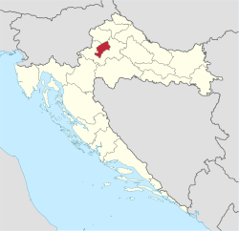
The CITY - Zagreb
Second capital of the country
Twice the population of Brno
Extensive but random public transport
History, brutalism, capitalism and poverty

Slide 8
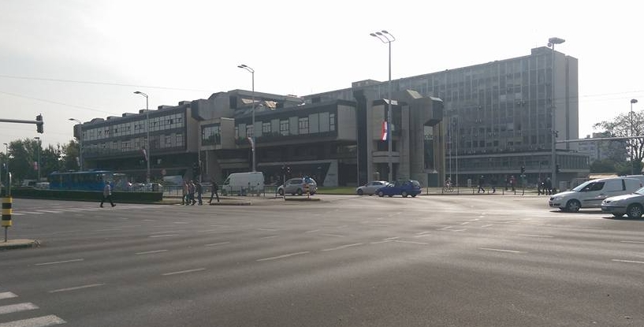
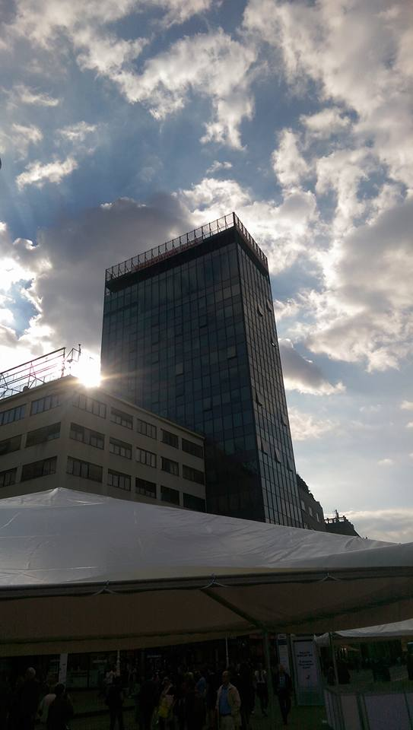
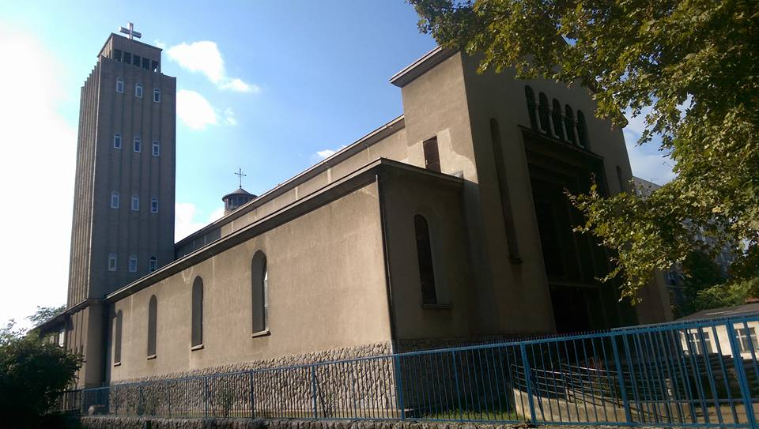

Slide 9
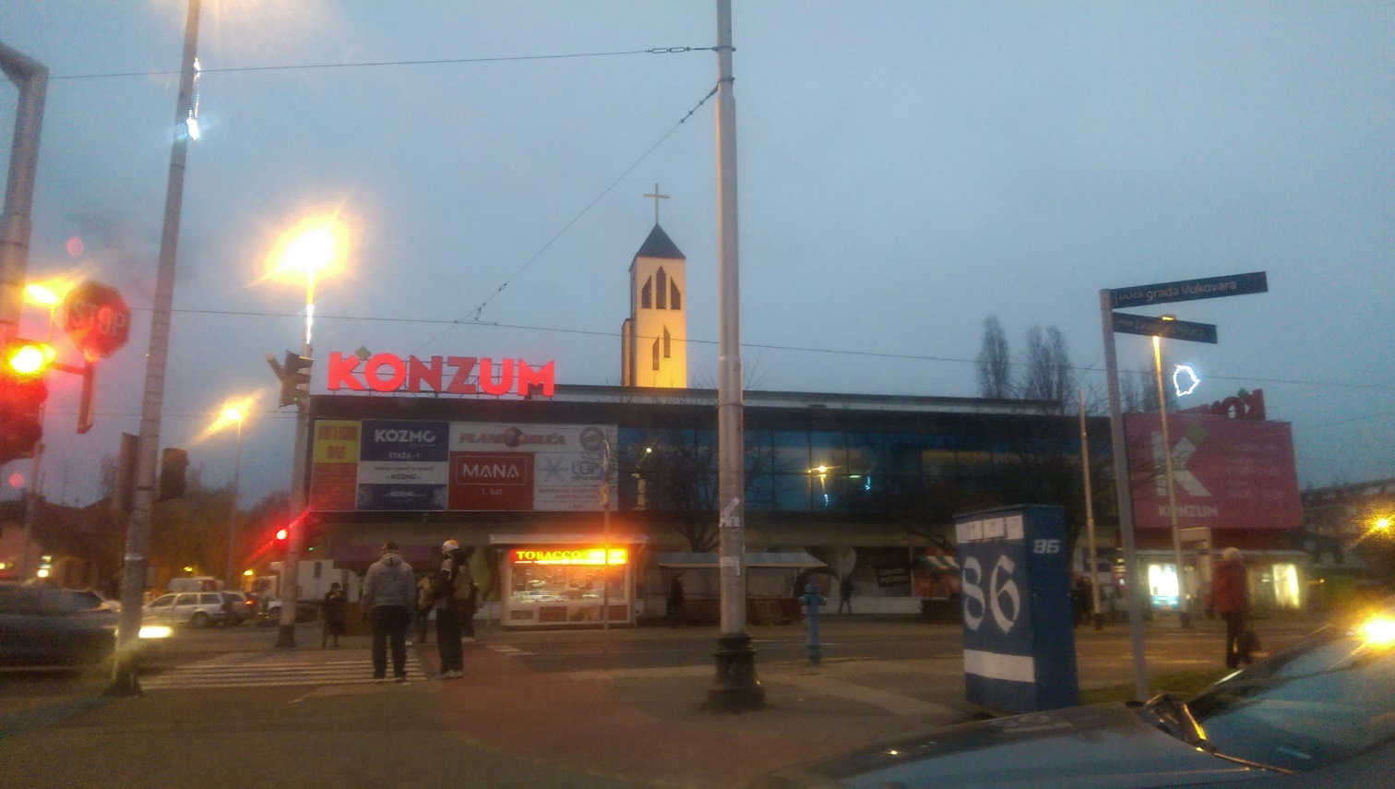
The Shopping
High prices
Limited selection
Student unfriendly
OR: buy in bulk or used

Slide 10
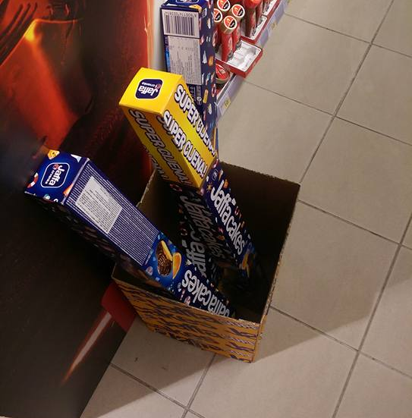
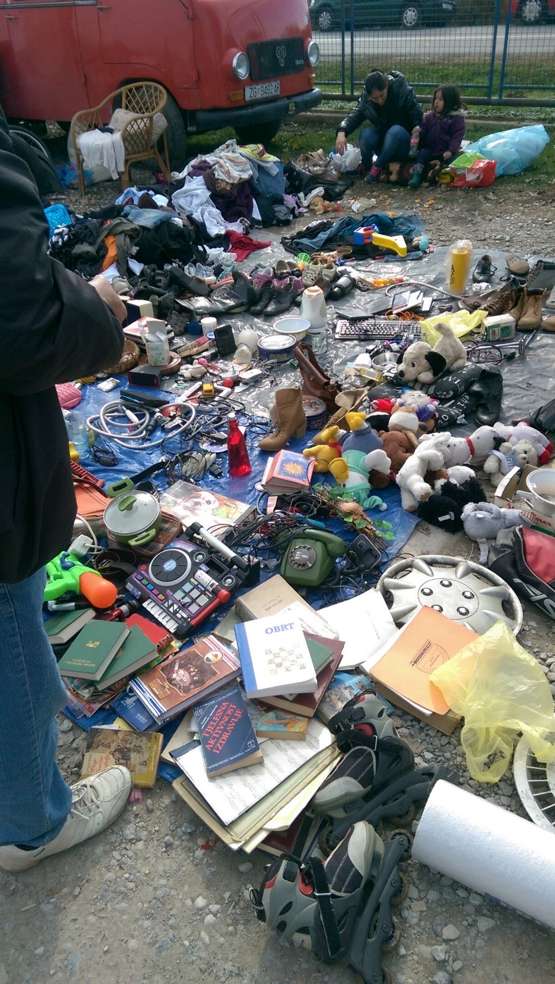
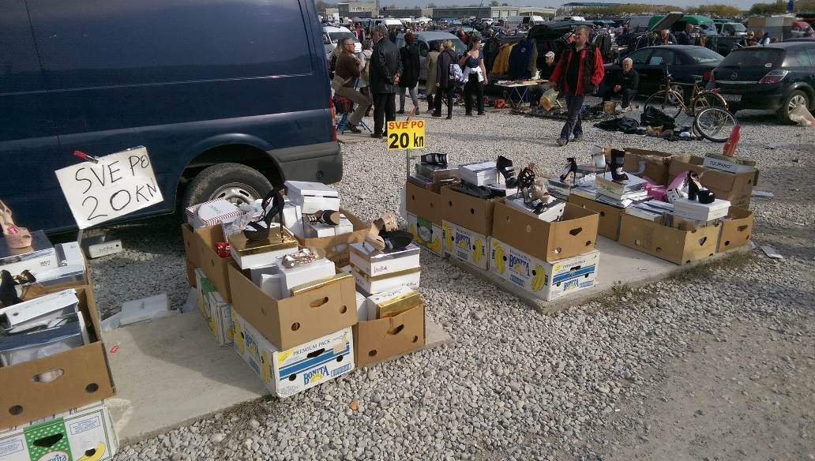
The Shopping
High prices
Limited selection
Student unfriendly
OR: buy in bulk or used

Slide 11
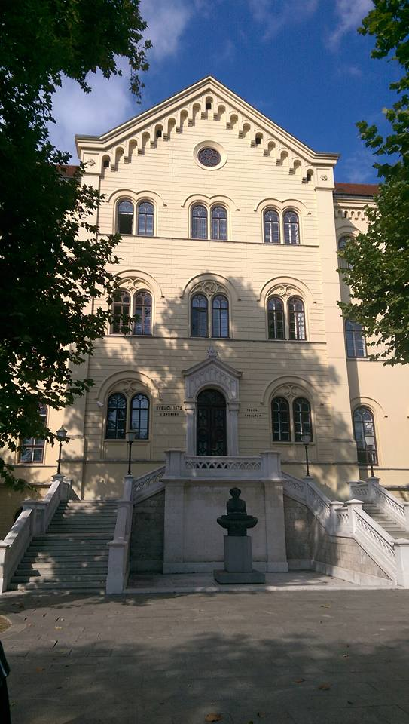
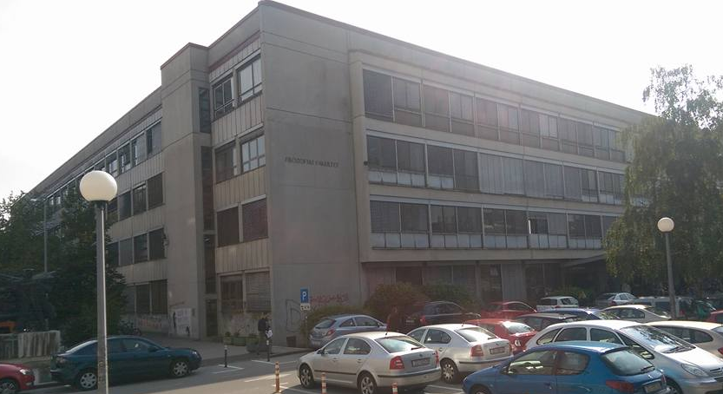
The Students
Great discounts
Good accommodation
Old-school schools
Bureaucracy abounds
Invisible to the system

Slide 12
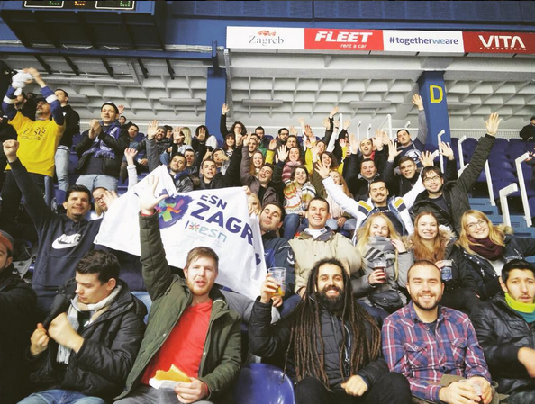
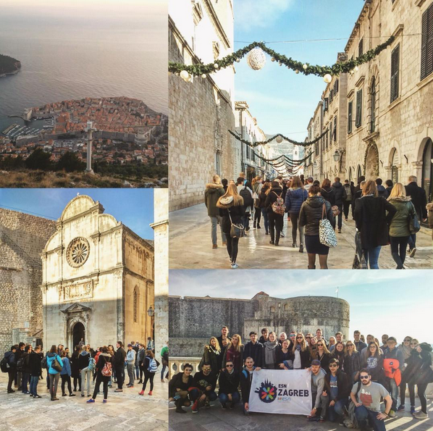
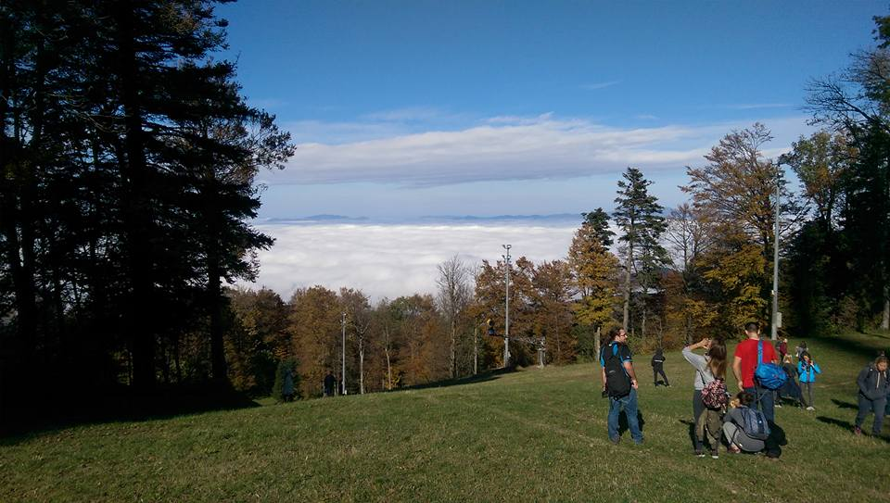
The network
Erasmus Student Network
Paid membership
Discounts
Trips

Slide 13
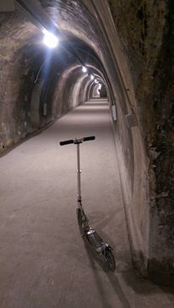
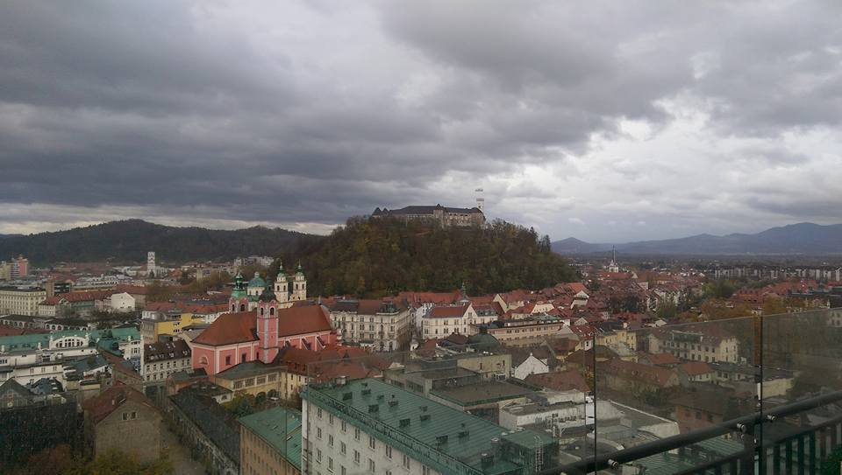
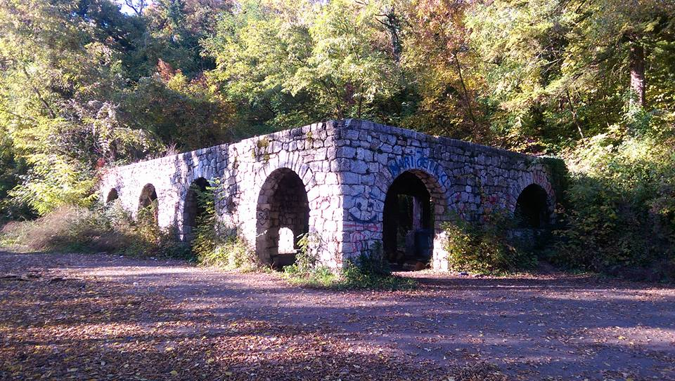
The Individual
Urban exploration
Trips to the sea
National Parks
Culture events

Slide 14
THANK YOU AND DOVIĐENJA!

