Slide 1
visuals
Lenka Zouhar Ludvíková

Slide 2
printed visuals – serif fonts
Baskerville Old Face
Batang
Bodoni MT
Bookman Old Style
Century Schoolbook
Garamond
Modern No.20
Times New Roman

Slide 3
computer / projectors – sans serif fonts
Arial
Calibri Light
Dotum
Franklin Gothic Book
Kalinga
Tahoma
Verdana

Slide 4
corporate identity
font / typeface
colour
logo
consistency

Slide 5
size
nothing too small
nothing too big
24 – 32 size font

Slide 6
upper case?
this heading is quicker and easier to read
THAN THIS HEADING CAN BE READ

Slide 7
upper case?
And this passage can be read and understood and absorbed far more quickly and effortlessly, because your brain recognises the shapes of the words, before it reads the letters...
... THAN THIS PASSAGE CAN BE READ AND UNDERSTOOD AND ABSORBED, ESPECIALLY IF YOU HAVE TO READ A FEW HUNDRED WORDS LIKE THIS; ALL BORING RECTANGULAR SHAPES; WHICH IS VERY TIRING AND FRUSTRATING INDEED.

Slide 8
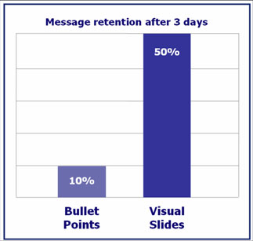
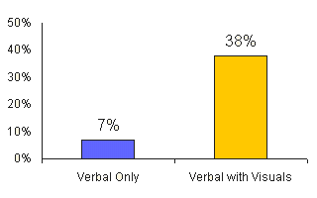
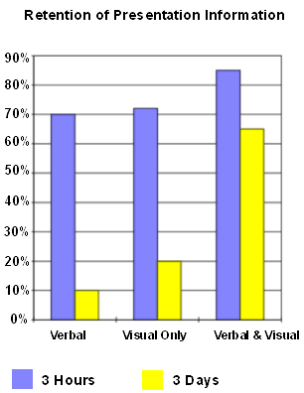
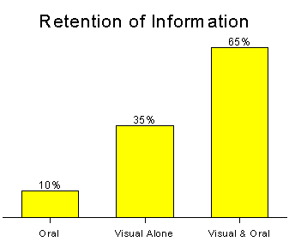
writing?

Slide 9
How much? How many?
1 – 2 slides per minute
4-5 points per slide
Avoid long sentences and wordiness, it is better to use phrases and key words to keep the attention of your audience as you do not want them to read, you want them to listen to you.

Slide 10
software
https://www.g2crowd.com/categories/presentation?order=complete_score

Slide 11
Many happy presentations…
Thank you for your attention.

