Slide 1

Introduction in Localization
Kateřina Gašová

Slide 2
Topics
Who I am, why I am here
Concepts
Translation vs. Localization
Useful references

Slide 3
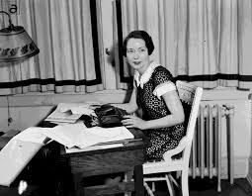
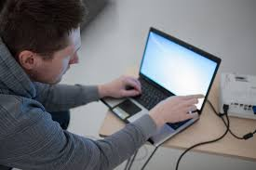

Concepts - People
Translator
Convey the message from one language to another
Localizer
Deliver translated content adapted for the specific locale
Enthusiast
Deliver user experience
(as a part of the localized product)
Notes:
People – their roles have changed over a time but they have always been and always will be the key players in our industry.
Translator ->linguist, master of language ->
Goal: convey the message from one language to another
Localizer ->linguist with computer literacy, understanding of the code (tags) -> goal: deliver translated content adapted for the specific locale
Enthusiast ->loves and knows the product inside out;
Critical skills:
Cultural knowledge both of the source and target language markets
Good knowledge of everyday spoken language and idiomatic expression
Able to perform independent research
Active and enthusiastic users of social media platforms
-> goal: deliver user experience (and localized product)

Slide 4
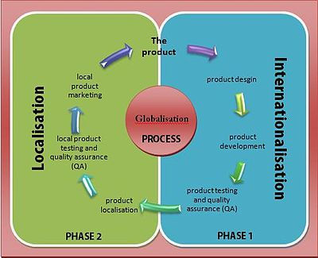
Concepts - Taxonomy
To globalize is to plan the design and development methods for a product in advance, keeping in mind a multicultural audience, in order to avoid increased costs and quality problems, save time, and smooth the localizing effort for each region or country
Internationalization, encompasses the planning and preparation stages for a product that is built by design to support global markets. This process removes all cultural assumptions, and any country- or language-specific content is stored so that it can be easily adapted. The internationalization process is sometimes called translation or localization enablement.
Localization, refers to the actual adaptation of the product for a specific market. The localization phase involves four key elements: linguistic, physical, business and cultural, and technical issues.
A successfully localized service or product is one that appears to have been developed within the local culture
Notes:
Internationalization: a product or service is developed so that localization is relatively easy to achieve - for example, by creating technical illustrations for manuals in which the text can easily be changed to another language and allowing some expansion room for this purpose.
Enablement can include:
Allowing space in user interfaces (for example, hardware labels, help pages, and online menus) for translation into languages that require more characters
Developing with products (such as Web editors or authoring tools) that can support international character sets ( Unicode )
Creating print or Web site graphic images so that their text labels can be translated inexpensively
Using written examples that have global meaning
For software, ensuring data space so that messages can be translated from languages with single-byte character codes (such as English) into languages requiring multiple-byte character codes (such as Japanese Kanji)
In localizing a product, in addition to idiomatic language translation, such details as time zones, money, national holidays, local color sensitivities, product or service names, gender roles, and geographic examples must all be considered.

Slide 5
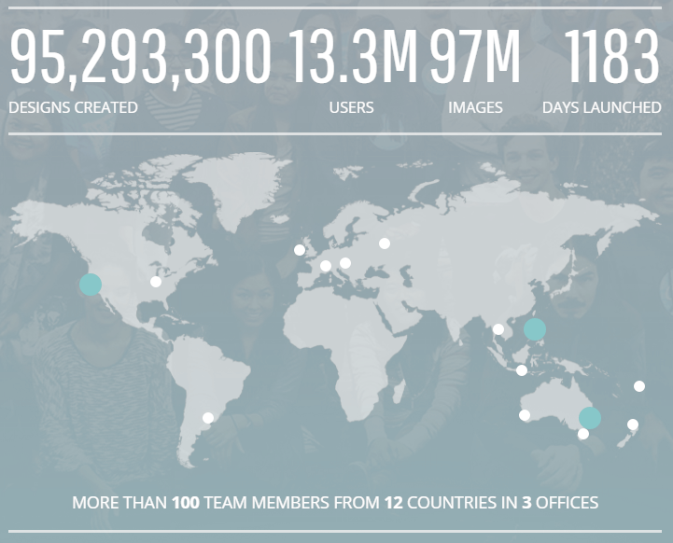
13.3M USERS vs. {0} USERS
13.3M USERS
13,3 mil. UŽIVATELŮ vs. {0} UŽIVATELŮ
65 638 uživatelů, 42 uživatelů
4 uživatelé, 3 uživatelé, 2 uživatelé
1 uživatel
{0, plural, other {# uživatelů} one {1 uživatel} few {# uživatelé} many {# uživatelů}}

Slide 6

Why Internationalization
Money, money, money!
Easy to achieve = fast + cheap.
Easy to achieve = difficult to screw up.
1 error left in the source = {0} errors to be fixed in {0} localized versions.
{0} can be anything above zero!
Almost anything…

Slide 7
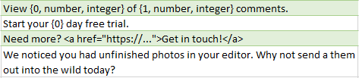


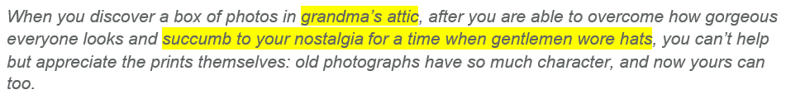

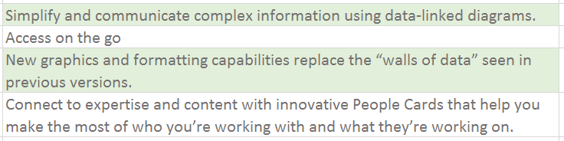

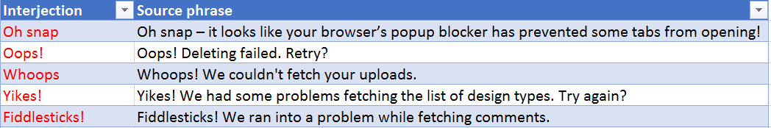
What do we localize today?
Notes:
Why is communication so important? There is such a huge variety of contents to be localized today !
Different contents require different skillsets, and communication is the key for the setting the right expectations
Traditional content to translate…
Typical segmented text – words; complete / uncomplete sentences; descriptive; standard grammar / style / register with a few exceptions; repetitive sentence/structure models.
Text in all forms - idioms, puns, everyday language, connotations, jokes, slang expressions = Excellent comprehension skills in the source language.

Slide 8
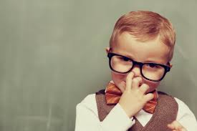
Localizer
Personality profile of a localizer
Skill-sets
It‘s not only about language knowledge
Technical capabilities

Slide 9
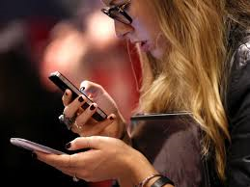
Profile
Native speaker of the target language
Excellent command of source and target languages
Thinks globally, acts locally
Team player
Capable of balancing individualism and team work
Technically equipped
Enthusiast

Slide 10
Useful references
http://www.openoffice.org/specs/collaterals/guides/I18n_in_Software.html#mozTocId174347
Translation environments:
  https://translate.google.com/toolkit/list?hl=cs#translations/active
  https://www.facebook.com/translations/
  https://translate.twitter.com/
Examples of professional CAT tools:
  SDL Trados Studio, SDL Passolo, SDL Idiom, MemoQ, Memsource
Notes:
https://worldready.cloudapp.net/StyleGuide/List

Slide 11


