Slide 1
Philosophy for non-philosophical disciplines students
Radim Bělohrad
Spring term 2018

Slide 2
Course requirements
Attendance: 2 absences allowed
Readings:
up to 4 papers assigned
placed in „course materials“ section in IS
final exam – 8-10 open questions, 60 percent limit to pass

Slide 3
What is philosophy?
Philosophical question
Love of wisdom
What philosophers do
Critical thinking about what most people take for granted – a science of presuppositions
Reflection guided by principles of logic and precision in thought and argumentation on the deepest concepts in which we think about the world
Making sense of the world we live in

Slide 4
What is philosophy?
(x science) inquiry into problems which cannot be resolved by more empirical evidence
How your ideas hang together, rather than whether they are true
Search for a coherent and justified overall world-view.
Philosophy starts where two common-sense notions push in different directions

Slide 5
Why study philosophy?
Charge: philosophy is useless
Usefulness is a relative matter – what do we want to achieve?
Learning to think
Argumentative, analytic, communicative, writing skills
The unexamined life is not worth living

Slide 6
Is philosophy difficult?
Yes – why should it not be?
Could it be easier? Yes - clarity

Slide 7
Concept I - God

Slide 8
Why start with God?
Theoretical question with deep practical relevance
Theism – one God, omnipotent, omniscient, supremely benevolent
Shared by Christians, Jews, Muslims
Can we prove such a God exists?
Theism, atheism, agnosticism

Slide 9
The Design Argument
Teleological Argument (telos – purpose)
Everything is suited to the function it performs
The complexity of some phenomena suggest they must have been designed
The Divine Watchmaker analogy
compare a watch with the human eye, the DNA, the complex processes in ecosystems, etc.

Slide 10
Criticisms
Weakness of analogy
to what extent are watches similar to eyes?
counterargument – design is still more likely than pure chance.
Evolution
Darwin (1809-82) – theory of evolution by natural selection
survival of the fittest – the best adapted pass their genes
does not refute God, but makes him irrelevant

Slide 11
Criticisms
Argument does not prove the Theistic God
not necessarily one
not necessarily allmighty (short-sightedness, cataracts)
not necessarily supremely good – natural catastrophies, disease
Douglas Adams – The Hitchhiker´s Guide – „Slartibartfast“ – the fjord designer ☺

Slide 12
The Fine Tuning Argument
More modern version of Design Argument
The Anthropic Principle
the chance of the world turning out to be conductive to human life to evolve was so tiny, that it must have been designed by a divine architect.
the range of suitable starting conditions for a life-supporting universe is very limited

Slide 13
Criticisms
The Lottery objection
winning in a lottery does not prove your winning was chosen
in a sense it is no surprise that we evolved in one of the possible universes which support life – we could not have evolved elsewhere
Criticisms of the Design Argument apply

Slide 14
The First Cause Argument
An a priori argument
Cosmological Argument
Every event has been caused by a cause. There must have been a cause of the universe – The First Cause – The God

Slide 15
Criticisms
Self-contradictory
everything has been caused x God was not caused
(everything except God? – begs the question)
Not a proof
turn to the future – will there be The Final Effect?
why could not there be an infinite series of causes and effects (comp. infinite series of numbers)
Limitation – omnipotent? not omniscient, not supremely benevolent

Slide 16
The Ontological Argument
Does not rely on evidence at all
God´s existence necessarily follows from the mere definition of God
God = most perfect being imaginable
a God which did not exist would not be most perfect
So, God exists
Seems absurd: can we define sth. into existence?

Slide 17
Criticisms
Absurd consequences
we could define a perfect island – that would not show it exists

Slide 18
The Problem of Evil
An Argument for Atheism

Slide 19
The argument
There is evil in the world
man-caused – Holocaust, terrorism, …
natural – tsunami, earthquakes, fires, …
By definition, God is supremely benevolent
A supremely benevolent being would not allow evil in the world
Thus, there is no God.

Slide 20
Saintliness
Without wars, torture and cruelty no saints or heroes could exist, evil enables moral improvement
Answers:
the amount of evil is too excessive
much of the evil goes unnoticed
world without evil is preferable to world with evil and saints
a cruel method of moral education

Slide 21
Artistic Analogy
World is like a work of art (painting)
It´s beauty is given by a combination of dark and bright spots.
Evil contributes to the overall harmony of the world.
Answer:
evil is beyond human comprehension
sounds sadistic (comp ISIS burning Jordanian soldier „commercial“)

Slide 22
Free Will Defence
Evil is the consequence of human free action
The only alternative is a world of good machines
Answers:
good machines (with illusion of free will) may be preferable to free monsters
perhaps we don´t even have free will (and are designed to be evil)
why does freedom exclude our choices being always good (why aren´t there only good alternatives)?

Slide 23
Free Will Defence
Answers
Why does God not intervene? (He does allegedly do miracles)
Free Will Defence does not answer the problem of natural evil

Slide 24
Laws of Nature
Life would be impossible without regularity
Natural evil is a by-product of laws of nature
Answers:
Omnipotent God could create laws of nature that would not cause evil (Is he bound by the laws of nature?)
Why does he not intervene more often?

Slide 25
Pascal´s Wager
Blaise Pascal (1623-62) – French mathematician
not designed to proove God´s existence, but the rationality of belief
starts from the agnostic position
four options:
disbelieve and be wrong (ultimate loss)
disbelieve and be right (limited gain)
believe and be right (ultimate gain)
believe and be wrong (limited loss)

Slide 26
Pascal´s Wager
answers
egoistic belief (God should not encourage)
believe and be wrong is not limited loss.

Slide 27
Metaphysics
Personal Identity

Slide 28
Motivations
Metaphysical
Identity at a time – individuation
Identity over time – persistence
motivating thought experiment
Ship of Theseus:

Slide 29
Ship of Theseus

Slide 30
Ship of Theseus

Slide 31
Motivations 2
Practical motivations
Anticipation of afterlife
Abortion and euthanasia
Advance directives
Cloning
Responsibility
Compensation

Slide 32
Two questions
1. How could I possibly survive my death?
2. Would such survival give me what I want from survival?
Why are you looking forward to tomorrow?
Mad surgeon example: you are kidnapped by a mad surgeon who decides to replace your mental and bodily states until you have the qualities of Donald Trump.

Slide 33
Soul and immortality
Soul: Christian theology, Cartesian dualism
Immaterial, indivisible, (indestructible)
Independent of body and particular mental contents
I could gain a new body and new thoughts.
P1 = P2 if they have the same soul
I can survive the death of my body if my soul continues to exist.

Slide 34
Soul and immortality
Problem: epistemic inaccessibility of souls
No verification of my own identity via mental or bodily features.
I don´t know when I started lecturing to you.
Lesson: our own identity should be known to us.
Survival uninteresting
Features I care about are tied to the body and mind, if those vanish, the survival of mere soul does not give me what I want.

Slide 35
Body and immortality
P1 = P2 iff they have the same body.
What counts as the same?
Sameness of matter (atoms, tissues)
Continuity of matter.
Can I survive my bodily death?
No.

Slide 36
Memory theory
John Locke – We are sure of our own persistence. How? We remeber it.
PI consists in sameness of consciousness, that is, memory connectedness.
P1 = P2 if P2 can remember P1´s experiences.
Explanation of afterlife
Survival is interesting
Explanation of responsibility (mind swap)

Slide 37
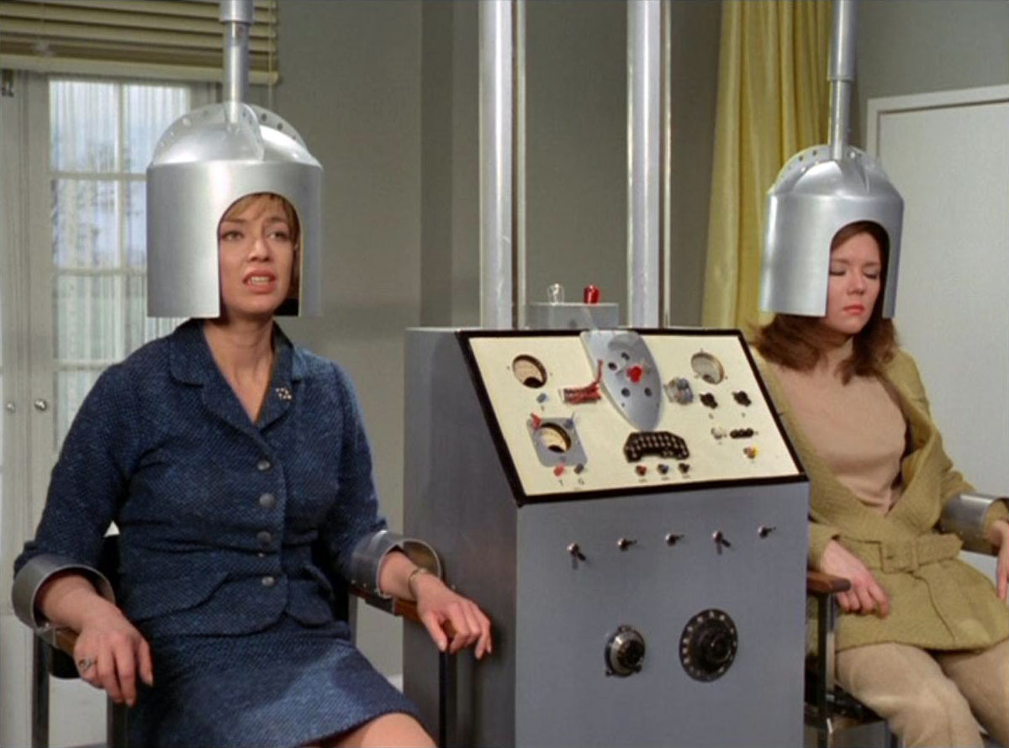
Memory theory
Prince and Cobbler experiment (mind swap)

Slide 38
Problems of memory theory
I have not done what I cannot remember
Identity is transitive:
If P1=P2 and P2=P3, then P1=P3
Boy-officer-general story (paradox)
Officer remebers boy (=)
General remebers officer (=)
General does not remember boy (not =)
But general = boy (by transitivity)

Slide 39
Psychological theory
P1 = P2 if P1 is psychologically continuous with P2
PC – a chain of direct psychological connections
Memories, intentions, beliefs, character traits etc.
Rope analogy
PT can explain the boy-general case

Slide 40
Psychological theory
Can explain afterlife
PI is epistemically accessible
Can account for responsibility
Implications for
Abortion, euthanasia, advance directives

Slide 41
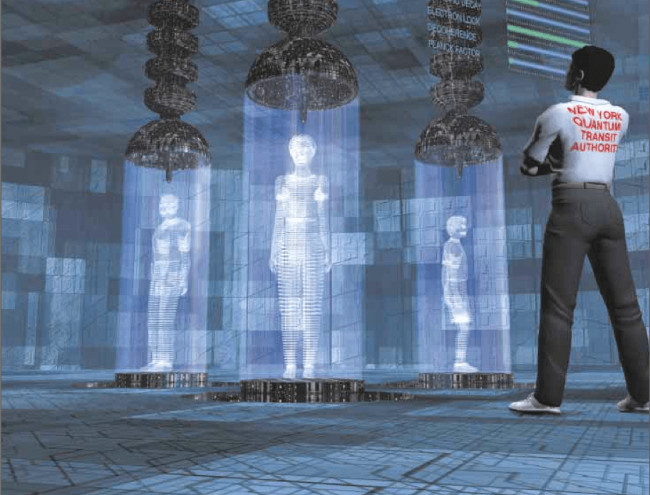
Problems of PT
D. Parfit – teleportation (travel or death?)
See documentary Brainspotting 7:30

Slide 42
Problems of PT
Lesson: PI cannot be psychological continuity, because PI cannot branch.
Fix: „No branching condition“
P1=P2 iff P2 is psychologically continuous with P1 and no-one else is.
Further problems:

Slide 43
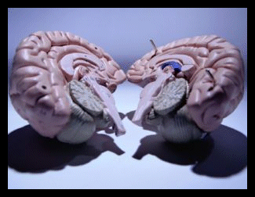
Problems of PT
Split brain operation + double hemisphere transplant

Slide 44
Problems
A´s brain is split and transplanted into a body B and a body C.
B and C are psychologically continous with A
Therefore: A has died.
If only one hemisphere were transplanted, A would survive
A should bribe a nurse to destroy one hemisphere. (reductio).

Slide 45
Identity does not matter
Parfit: After all, PI does not matter for survival, anticipation, responsibility, etc.
Double hemisphere transplant secures all the features of a regular survival.

Slide 46
Animalism
Rejection of claim that psychological continuity is necessary for identity.
PI has nothing to do with psychology.
Two arguments: the fetus problem, the thinking animal problem

Slide 47
The fetus problem
I was a fetus (ultrasound image)
Common sense and biology
Fetus has no mental states – no continuity between me and me-fetus
Thus, PT has to deny that I was a fetus.
Also, I cannot end up as a vegetable (PVS).
reductio

Slide 48
Popular answer
Fetus – mature organism – vegetable
I „share matter“ with adult organism, but I am not the organism
Organism can survive loss of mental properties
I cannot
I and my organism co-exist.

Slide 49
Problem
The idea of co-existing but non-identical material objects is paradoxical.
I think, I share matter with animal, animal must think. Two thinkers at one place
Two sets of mental states (e.g. pains)
Absurd consequences (hurt only embryos)
How could material duplicates have different persistence conditions?

Slide 50
Animalism and the practical
Immortality impossible
Identity with fetus and PVS - OK
Advance directives – OK
Responsibility – KO
Brain transplants – KO
Answer: identity does not matter – ethical concerns do not relate to identity.

Slide 51
Concept 2 - Morality

Slide 52
Motivating questions
How should I live?
How should I act?
What makes an action right or wrong?
Normative vs. applied ethics
Looking for a principle or a set of principles guiding our behavior.

Slide 53
Consequentialism

Slide 54
Basics
Right and wrong based on consequences
Utilitarianism
J. Bentham (1748-1832), J. S. Mill (1806-73)
Good conseqences – maximize happiness
Probable consequences
Includes animals

Slide 55
Theories of happiness
Hedonism (Bentham, Mill)
The only good is pleasure, higher and lower kinds
Mental state theory
There are valuable mental states besides pleasure
Happiness is subjective
Preferential theory
Value inheres in preferences being satisfied
Preferences must be rational
Semi-objective
Objective theory

Slide 56
Criticisms
Difficulty of calculation
Interpersonal comparison
Who to include (animals, future generations)
Prediction of consequences
Total or average happiness?
Problem cases
Transplant, framing an innocent person, trolley problems, breaking promises

Slide 57
Rule utilitarianism
Combination of consequentialism and duty based ethics
Focus not on acts, but on rules
Rules with best consequences are the moral ones
Avoids calculation problems
Charge of rule worshipping

Slide 58
Duty-based theories

Slide 59
Basics
Each of us has duties
Actions we ought (not) to perform
Acting morally amounts to acting in accordance with duty
Actions are absolutery right or wrong
Consequences do not matter
Christian ethics, Kantian ethics

Slide 60
CHRISTIAN ETHICS
Dominant in West
Based on Ten Commandments
Authority derived from God
Absolute validity
Further rules and distnctions (love your neighbor, doing and allowing, double effect)
Dostoevsky - if God does not exist, anything is permitted

Slide 61
What is God´s will?
How do we determine what God wants us to do?
Bible open to numerous interpretations, contains contradictions
Advocates behavior we find morally abhorrent
The Lord is speaking to Abraham in this story where God commands him to sacrifice his son: ‘Take your son, your only son Isaac, whom you love, and go to the land of Moriah, and offer him there as a burnt-offering on one of the mountains that I shall show you.’ (Genesis 22:2)
Samuel, one of the early leaders of Israel, orders genocide against a neighbouring people: “This is what the Lord Almighty says... ‘Now go and strike Amalek and devote to destruction all that they have. Do not spare them, but kill both man and woman, child and infant, ox and sheep, camel and donkey.’” (1 Samuel 15:3)

Slide 62
The Euthyphro Dilemma
1) Does God aprove of actions, because they are morally good, or 2) are actions morally good, because God aproves of them?
1) objectivism, rationalism
God is not the source of morality,
Moral rules would exist even without God.
His powers and freedom of will are limited.
2) divine command theory, voluntarism
Morality is arbitrary, not based on reasons, anything might be good.
Acting only out of fear of God
Objection: God would not command anything bad, because God is good
Circular – „good“ means „aproved of by God“

Slide 63
KANTIAN ETHICS
Immanuel Kant (1724-1804)
What actions are moral?
Those performed out of a sense of DUTY, not self-interest, emotion or consequences
Morality cannot be based on factors beyond our control.

Slide 64
The Categorical Imperative
As rational human beings we have categorical duties – absolute, unconditional.
Our morality is a set of categorical imperatives
Compare with hypothetical
One basic C.I.: „Act only on maxims which you can at the same time will to be universal laws.“ – principle of universalizability
Maxim – generalized intention behind an act
E.g. Always help those in need when it is in your interest; always keep your promises, etc.

Slide 65
The Categorical Imperative
Moral action has to be universalizable
Hold for everyone in the same situation
One must be impartial
E.g. „Always free-ride when possible“
There would be no-one to free-ride on
Alternative formulation
„Treat other people as ends in themselves, never as means to an end.“

Slide 66
Criticism
Empty theory – no guidance
In cases duty conflicts
„madman“ example
Presupposes rational decision-making
Not supported by psychology (Kahneman, Haidt)
No place for moral emotions – compassion, guilt, remorse
Disregard for consequences.

Slide 67
Criticism
It is difficult to avoid doing harm
Breaking promise in order to save a person
Deontological theories
Doing vs. allowing harm
Intending vs. forseeing harm
Treating somebody as a means vs. as an end

Slide 68
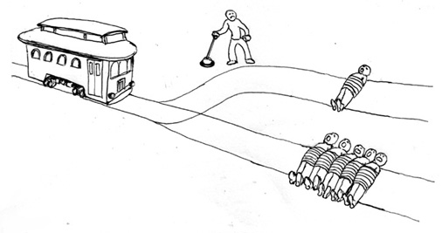
Doing harm vs. allowing harm
Test cases: transplant dilemma; switch dilemma

Slide 69
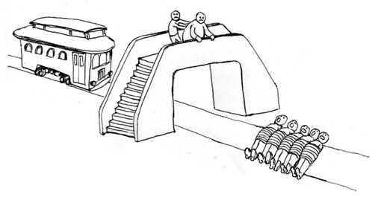
Intending harm vs. forseeing harm
Test cases: switch dilemma; fatman dilemma

Slide 70
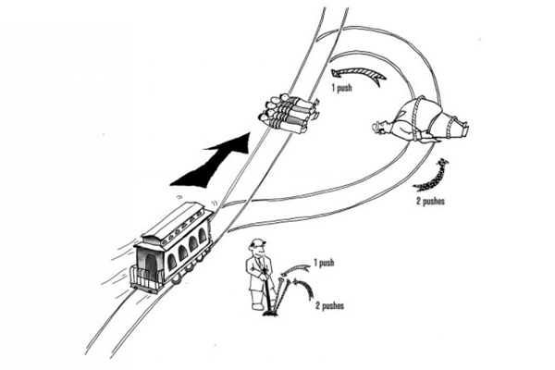
A means vs. an end
Test cases: switch, fatman, loop.

Slide 71
Virtue Theory

Slide 72
Basics
Inspired by Aristotle´s Nicomachean Ethics
Key question: how should I live, what character should a good person have
Cultivating virtues leads to a good life.
Everyone seeks flourishing (eudaimonia)
Certain ways of living promote flourishing
Applies to non-humans

Slide 73
VIRTUE THEORY
Cultivation of virtues leads to flourishing
Virtue
Pattern of behaviour and feeling
Tendency to act, desire and feel in certain ways in appropriate situations
Involves intelligent judgment of circumstances
Compassion with those in need, etc.
Prudence, courage, temperance, modesty…
Doctrine of the mean

Slide 74
Criticisms
Which virtues should one adopt?
Differences between virtue theorists
Danger of bias and reinforcing cultural stereotypes (is monogamy or sexual independence a virtue?)
Experimental research shows our characters are not as stable (generosity, cruelty, cheating, loyalty…)

Slide 75
Appearance and Reality
Epistemology

Slide 76
Outline
Knowledge of the world through the senses.
Relationship between what I perceive and what is really out there?
Can we be certain?
Could we be dreaming / living in the Matrix?
Do objects exist when nobody is perceiving them?
Do we experience objects directly?
THEORY OF KNOWLEDGE - EPISTEMOLOGY

Slide 77
Common-sense realism

Slide 78
The most common view of non-philosophers
There are physical objects
We perceive these objects directly
The objects exist independently of perception
They are what they appear to be
Our senses are generally reliable
Challenged by sceptical arguments
Scepticism – our knowldge is never certain

Slide 79
The Illusion Argument
Senses sometimes mislead us
Friend in the distance, stick in water
Apple after grape or honey
Railway tracks converge
Heat above the road creates „puddles“
Colors look different in different light
The moon looks larger above the horizon
The sun seems to revolve around the earth
Undermines the certainty that our perception is always acurate.

Slide 80
Criticisms
Degrees of certainty
We have uncontroversial cases of knowledge
We can discern the illusions, because we have certain knowledge
Sceptic: not sure we have cases of knowldge
Vivid dreams
Experiencing dream does not feel different.
Some ordinary experiences may be dream-like.
The possibility of hallucinating

Slide 81
Brain in a vat
Brain wired to a supercomputer
Virtual reality machine (The Matrix)
Stimulating my nerves
Producing mental states
(thought experiment)

Slide 82
Memory reliability
The thesis that senses are reliable is based on memory.
Memory is notoriously unreliable.
The supermarket experiment
Memory reconstructive
In sum: althought it feels as if we directly perceive reality as it is, we cannot be certain.

Slide 83
An answer to the sceptic
René Descartes – Cogito ergo sum
I cannot doubt my own existence
Conclusions limited – I am a thinking thing
Ayer: even that much does not follow
Thinking is going on
Not necessarily true that processes must have a subject
Comp. „It is raining“

Slide 84
Representative Realism

Slide 85
Modification of common-sense realism
All perception is a result of inner representations of external world
We perceive „inner pictures“ caused by objects
Explains Illusion Argument:
Colors – not in objects, but in the mind

Slide 86
Primary and secondary qualities
John Locke
Primary – in object – size, shape, movement, texture
Our representations resemble them
Secondary – in the mind – color, smell, taste
Redness – the power of objects to produce red images in normal viewer under normal conditions.
Ideas of secondary qualities do not resemble the actual objects
They are combined products of objects and mind.

Slide 87
Criticisms
Perceiver in the head – pushes problem a stage back
If we observe internal images (a film), who is the observer?
A smaller person interpreting the images?
Who interprets the interpretations?
Infinite regress

Slide 88
Criticism
The real world is unknowable
We cannot perceive the world directly
We perceive only images
No way to see if the images correspond to the world.
Cannot leave the cinema

Slide 89
Idealism

Slide 90
George Berkeley – esse est percipi
All experience is that of mental representations
External world does not exist
Objects only exist when perceived
No need to postulate independent objects
Our realist language is a convenient way of speaking
There is nowhere to go from the cinema

Slide 91
Criticisms
How does an idealist explain dreams and illusions?
unsystematic, unpredictable
Solipsism – all that exists is my mind – no other people
Reductio: we presuppose the existence of other people in everyday life
Shame, embarrasment would be absurd

Slide 92
Criticisms
Simplest explanation
What causes the experiences?
How come they are so stable?
We cannot prove objects do exist, but their existence is the best explanation of our observation

Slide 93
Causal Realism

Slide 94
Evolutionary assumption –
The role of the senses is to navigate through environment
We acquire beliefs about environment through senses
These beliefs are generally true, as long as they are caused by external objects (not drugs, etc.)
Assumption: there is external world
Criticism: no reason selection should track true beliefs as opposed to advantageous ones

Slide 95
Positive illusions – enhance our health prospects
Clinical delusions – explain unusual experiences due to brain damage
Self-deception – hides undesirable truths
Confabulation – fills gaps in memory
Religious beliefs – support a sense of community

Slide 96
knowledge

Slide 97
How to define knowledge
John has no belief whatsoever about the date of Anne´s birthday. Does he know the date?
John believes it is Anne´s birthday. Anne´s birthday is in a week. Does John know that?
John throws a dart into a caledar shouting „Anne“. He hits today. In fact, it is Anne´s birthday today. Does John know that?
John sees Anne´s driving license showing it is Anne´s birthday today. He has no reason to suspect the license is fake. As a result, he forms a belief that it is Anne´s birthday today. It really is Anne´s birthday. Does John know that?

Slide 98
How to define knowledge
P knows that T =df
P has a belief T
T is true
P is justified in believing T

Slide 99
The Gettier Problem
Smith and Jones have applied for a particular job. Smith has been told by the director that Jones will get the Job. Further, Jones has shown Smith that he has ten coins in his pocket. As a result, Smith forms the following belief:
The guy who will get the job has ten coins in his pocket
However, it is Smith who gets the job in the end and, in fact, Smith also has ten coins in his pocket.
His belief is true and justified, but is not knowledge.

Slide 100
Justification
Foundationalism – knowledge has a pyramidal structure
Basic beliefs, justified prima facie, a priori
Derived beliefs – inferred from basic beliefs by reliable rules of inference
Criticism: there are no basic beliefs, infinite regress
Coherentism – beliefs are mutually justified in a network of beliefs
All beliefs are derived
Justificatory circle, need not be vicious.

Slide 101
Truth
Correspondence theory –
Sentences correspond to facts
Shared logical form
Facts are truthmakers
Coherence theory
A sentence is true iff it coheres with a set of accepted sentences
Pragmatist theory
A sentence is true iff its acceptance is useful in explaining phenomena, promoting further research, leading to fruitful hypotheses, etc
Consensual theory
A sentence is true iff it is accepted by the scientific community.

Slide 102
Critical thinking

Slide 103
1. key concepts
Logic, Arguments, Premises, Conclusion, Statements, , etc.

Slide 104
Logic
Science that evaluates arguments.
A system of methods and principles that we use as criteria for evaluating arguments.
Formal logic, informal logic, critical thinking

Slide 105
Argument
A group of statements
One or more premises
One conclusion

Slide 106
Unsupported statements
- It is going to rain later.
- The world is facing environmental catastrophe.
- Physicists are odd people.
- TOP 09 has a better political program than Social Democrats.

Slide 107
Statement
A sentence that can have a truth value.
Truth value: truth or falsity of a statement.
Other types: question, proposal, suggestion, command, exclamation
Arguments can only consist of statements

Slide 108
Premises
Statements that are claimed to give support to the statement presented in the conclusion
All crimes are violations of the law
Theft is a crime
Theft is a violation of the law
Note: are claimed – not necessarily do give support

Slide 109
Conclusion
A statement that is claimed to follow from the premises
All humans are mammals
Jack is a human
Jack is a mammal
Note: is claimed – not necessarily follows

Slide 110
Good/bad arguments
True premises support conclusion – good argument.
Premises do not support conclusion or are false – bad argument.
All men are mortal. All skinheads are fascist
Socrates is a man. Peter is a fascist
Socrates is mortal. Peter is a skinhead

Slide 111
2. recognizing arguments

Slide 112
A passage contains an argument if it purports to prove something
Factual condition: At least one statement must be claimed to present evidence.
Inferential condition: The claim that there is something that follows from the evidence.

Slide 113
Frequent types of non-arguments 1.Passages lacking an inferential claim
A) Statements of belief or opinion
I think a nation such as ours, with its high moral tradition and commitments, has a further responsibility to know how we became drawn into this conflict and to learn the lessons it has to teach us for the future.

Slide 114
Frequent types of non-arguments 1.Passages lacking an inferential claim
B) Loosely associated statements
A nation has the right to know its history. A nation has the right to define its identity. A nation has the obligation to honor its elite.

Slide 115
Frequent types of non-arguments 1.Passages lacking an inferential claim
C) Report
A powerful car bomb blew up outside the regional telephone company headquarters in Medellin, injuring 25 people and causing millions of dollars of damage to nearby buildings, police said.

Slide 116
Frequent types of non-arguments 1.Passages lacking an inferential claim
D) Expository passage – a topic sentence followed by one or more sentences that develop the topic sentence. The object is to develop the sentence, not to prove it.
There is a stylized relation of artist to mass audience in the sports, especially in baseball. Each player develops a style of his own – the swagger as he steps to the plate, the unique windup a pitcher has, the clean-swinging and hard-driving hits, the precision, quickness and grace of infield and outfield.

Slide 117
Frequent types of non-arguments 1.Passages lacking an inferential claim
E) Illustration – a statement about a subject followed by one or more specific instances that exemplify the statement
Chemical elements, as well as compounds, can be represented by molecular formulas. Thus, oxygen is represented by O2, sodium chloride by NaCl and sulfuric acid by H2SO4.

Slide 118
Frequent types of non-arguments 1.Passages lacking an inferential claim
Note: some expository passages and illustrations can be interpreted as arguments – when the topic sentence is not well-known, generally accepted or is controversial. Also, the kinds of non-arguments are not mutually exclusive.
Water is an excellent solvent. It can dissolve a wide range of materials that will not dissolve in other liquids. For example, salts do not dissolve in most common solvents, such as gasoline, kerosene, turpentine and cleaning fluids. But many salts dissolve readily in water.

Slide 119
Frequent types of non-arguments 2. Conditional Statements
Form: “if…, then…”
Antecedent - consequent
Conditional statements do not meet the factual condition. We do not claim that either the antecedent or the consequent are true.
If air is removed from a solid closed container, then the container will weigh less than it did.

Slide 120
Frequent types of non-arguments 2. Conditional Statements
Conditional statements are not arguments, but can serve as premises or conclusions of arguments.
If Peter has stolen the money, he should be punished.
Peter has stolen the money.
He should be punished.

Slide 121
Frequent types of non-arguments 3. Explanation
A passage that consists of some statements that purport to shed light on some phenomenon that is usually accepted as a matter of fact.
The sky appears blue from the earth’s surface because light rays from the sun are scattered by particles in the atmosphere.
Cows can digest grass, while humans cannot, because their digestive systems contain enzymes not found in humans. .

Slide 122
Frequent types of non-arguments 3. Explanation
Explanandum → explanans
Explanation similar to arguments (“because”), but argument shows that something is the case while explanation shows why something is the case.
To distinguish, ask: “Is the statement that represents the possible explanandum or conclusion something that is considered controversial, generally unknown, or is it a well-established and accepted fact?”

Slide 123
4. induction and deduction

Slide 124
Two types of inferential relationship between premises and conclusion
Deductive argument: if premises are true, then it is impossible for the conclusion to be false
Inductive argument: if premises are true, it is improbable that the conclusion be false

Slide 125
Since the universe is so vast, there are many planets with the atmosphere similar to the Earth’s. Therefore, it is likely that on some of them there exists life.
Every crime should be punished. Theft is a crime. Therefore, theft should be punished.

Slide 126
Typical deductive arguments
1. Argument based on mathematics – conclusion depends on arithmetic or geometric computation or measurement.
This piece of land is 100 feet on each side.
Therefore, it contains 10,000 square feet.
Note: statistics – exception

Slide 127
Typical deductive arguments
2. Argument from definition – the conclusion depends merely on the definition of a word in the premise.
John is a bachelor
Therefore, John is unmarried

Slide 128
Typical deductive arguments
3. Categorical syllogism.
Syllogism – an argument with exactly two premises and a conclusion.
Categorical syllogism - Each statement begins with “all”, “some”, or “no”
All lasers are optical devices
Some lasers are surgical instruments
Therefore, some optical devices are surgical instruments

Slide 129
Typical deductive arguments
4. Hypothetical syllogism – a syllogism which contains a conditional statement in one or both premises
If electricity flows through a conductor, then a magnetic field is produced
If magnetic field is produced, then a nearby compass will be deflected
Therefore, if electricity flows through a conductor, then a nearby compass will be deflected
If diamond scratches glass, then diamond is harder than glass.
Diamond scratches glass
Therefore, diamond is harder than glass.

Slide 130
Typical deductive arguments
5. Disjunctive syllogism – a syllogism which contains an “either…, or…” statement
Either breach of contract is a crime or it is not punishable by law.
Breach of contract is not a crime.
Therefore, breach of contract is not punishable by law.

Slide 131
Typical inductive arguments
1. Prediction – premises describe some known events in the past or present, conclusion moves beyond to some events in the future
The atmosphere is very unstable and cumulus clouds are growing very fast. Therefore, it is likely that there is going to be a storm soon.

Slide 132
Typical inductive arguments
2. Argument from analogy – depends on the existence of similarity between two facts. Certain properties that are had by the first fact are on the basis of such similarity attributed to the other fact as well.
Peter has a German car and it is very reliable. Christina also has a German car, so it must also be reliable.

Slide 133
Typical inductive arguments
3. Inductive generalization – premises describe a sample which has certain characteristics, conclusion extends the characteristics to the whole group.
Opinion polls – 35% of the population would vote Social Democrats.
Did they ask everybody?

Slide 134
Typical inductive arguments
4. Argument from authority – conclusion depends on a statement made by some presumed authority.
Vaclav Klaus claims that global warming is a myth. Therefore, global warming is a myth.

Slide 135
Typical inductive arguments
5. Argument based on signs – premises describe a certain sign, conclusion states the situation that the sign symbolizes.
There is a sign that the road is closed. Therefore, the road is probably closed.

Slide 136
Typical inductive arguments
6. Causal inference – proceeds from the knowledge of the cause to the knowledge of an effect, or conversely.
There is thick black smoke on the horizon. There must be fire somewhere.
The beer was left in the freezer overnight. The bottle has probably broken.

Slide 137
Conclusion
Three things to watch out for when deciding if an argument is deductive or inductive:
Indicators
Strength of inferential link
Typical inductive and deductive arguments

Slide 138
5. extended arguments

Slide 139
Arguments in newspapers, magazines and ordinary speech may be very complex – arguments, sub arguments, multiple conclusions, conclusions serving as premises, etc.
For the sake of clarity, the form of extended arguments must be analyzed

Slide 140
Types of argument structure
Vertical pattern
Horizontal pattern
Conjoint premises
Multiple conclusions

Slide 141
Vertical pattern
The conclusion of a prior argument becomes a premise of another argument
(1)The selling of human organs should be banned. (2)Allowing human organs to be sold will lead to a situation in which only the rich will be able to afford transplants. This is so because (3)whenever something scarce is bought and sold as a commodity, the price always goes up. (4)The law of supply and demand requires it.

Slide 142
Vertical pattern
(4)
↓
(3)
↓
(2)
↓
(1)

Slide 143
Horizontal pattern
Conclusion supported by more independent premises
(1)The selling of human organs should be banned. (2) If it is allowed, people in financial need will start selling their organs. Also, (3) criminals will start killing healthy young people and sell their organs on black market.

Slide 144
Horizontal Pattern
(2) (3)
❍ 
(1)

Slide 145
Conjoint premises
Two or more premises, which independently give little or no support to conclusion, but together give substantial support.
(1) Whenever it is raining, it is wet. (2) It is raining. Therefore, (3) it is wet.

Slide 146
Conjoint premises
(1) (2)
(3)

Slide 147
Multiple conclusion
Strictly speaking each argument has only one conclusion. This is a simplification.
(1) Dropping out of school and bearing children outside of marriage are two of the primary causes of poverty in this country. (2) Therefore, to eliminate poverty we must offer incentives for people to get high school diplomas. (3) Also, we must find some way to encourage people to get married before they start having children.

Slide 148
Multiple conclusion
(1)
(2) (3)

Slide 149
Hidden premises
It is frequent that some arguments contain only one premise, where there should in fact be two conjoint premises
The arguer does not express the other premise, because:
a) she thinks that it is obvious
b) she wants to hide a statement that might be false

Slide 150
example
P1: The number of
crimes is increasing
C:The capital punishment should be re-introduced
This argument is very weak. If you think that it is OK, you
assume that something else is true:

Slide 151
P1:The number of
crimes is increasing
P2: The re-introduction of CP
can reduce the number of
crimes
C:The capital punishment should be re-introduced
The first premise works only if the second premise is true. This
is therefore a case of conjoint premises

Slide 152
P1:The number of
crimes is increasing
P2: The re-introduction of CP
can reduce the number of
crimes
C:The capital punishment should be re-introduced

Slide 153
Michael Jordan said so
????????
Chicago Bulls are the best basketball team in NBA

Slide 154
Michael Jordan said so
Michael Jordan is
an authority on basketball
Chicago Bulls are the best basketball team in NBA

Slide 155
Peter´s car is reliable
????????
Mary´s car will be reliable

Slide 156
Peter´s car is reliable
Peter´s car is like Mary´s
Mary´s car will be reliable

Slide 157
Peter has been in jail.
????????
We shouldn´t trust Peter

Slide 158
Peter has been in jail.
Ex-prisoners are not
to be trusted.
We shouldn´t trust Peter

Slide 159
My daughter failed the
entrance exams
??????????
You will never get to Masaryk University

Slide 160
My daughter failed the
entrance exams
My daughter is
smarter than you
You will never get to Masaryk University

Slide 161
It will prevent poachers from
killing them
????????
We should remove elephants´ tusks

Slide 162
Poachers kill elephants
when they want to remove
their tusks.
It will prevent poachers from
killing them
We should remove elephants´ tusks

Slide 163
6. basic properties of arguments
validity, soundness

Slide 164
Assessment of conditions
Two conditions for arguments:
Factual condition – the arguer presents certain statements as true
Inferential condition – the arguer infers a new statement from the statements
Evaluation examines if the statements are true and if the inference is correct. Inferential condition more important – evaluated first

Slide 165
Validity, invalidity
VALID deductive argument – if the premises are assumed true, it is impossible/improbable for the conclusion to be false.
INVALID deductive argument – if the premises are assumed true, it is possible for the conclusion to be false.

Slide 166
Validity, invalidity
Examples:
P1: All cats are mammals
P2: All mammals are animals
C: All cats are animals
P1: All cats are mammals
P2: All dogs are mammals
C: All cats are dogs
Ask: if the premises are assumed true, could the conclusion still be false?

Slide 167
Soundness
Sound argument = valid argument + true premises and true conclusion
Therefore:
If an argument has false premises or false conclusion or both, or if it is invalid, it is unsound.
If an argument has true premises and true conclusion, it still may not be sound, because it may be invalid.

Slide 168
Summary
Arguments
Valid
Sound
Unsound
Invalid (all unsound)

Slide 169
Summary
When analysing argument always ask two questions in the following order:
Do the premises support the conclusion? (i.e., is the argument valid?)
Are the premises true? (i.e., is the argument sound?)

Slide 170
INFORMAL FALLACIES Fallacies of relevance
Fallacies of relevance: premises are logically irrelevant to the conclusion. However, they frequently are relevant psychologically, therefore the argument may appear convincing or persuasive.

Slide 171
Example 1
Secretary: I deserve a raise in salary for the coming year. After all, you know how friendly I am with your wife, and I am sure you would not want her to find out what has been going on between you and that sexpot client of yours.

Slide 172
Appeal to force
Instead of offering legitimate premises for a conclusion, the arguer threatens to use a force if the recipient does not accept the conclusion

Slide 173
Example 2
Taxpayer to judge: Your Honor, I admit that I declared thirteen children as dependents on my tax return, even thought I have only two. But if you find me guilty of tax evasion, my reputation will be ruined. I will probably lose my job, my poor wife will not be able to have the operation that she desperately needs, and my kids will starve.

Slide 174
Appeal to pity
Arguer poses a conclusion and then attempts to evoke pity from the listener.

Slide 175
Example 3
Of course you want to buy the new Colgate toothpaste. Why, 90 percent of America brushes with Colgate.

Slide 176
Appeal to people
Direct approach: the arguer tries to excite emotions and enthusiasm of the crowd to win acceptance of their conclusion. Used by propagandists and demagogues.
Indirect approach: focuses not on the crowd, but on an individual and his or her relationship to the crowd. Often used in advertising industry (Bandwagon argument )

Slide 177
Example 4
After Sally presents an eloquent and compelling case for a more equitable taxation system, Sam asks the audience whether we should believe anything from a woman who isn't married, was once arrested, and smells a bit weird.
You tell me I should never lie, but you lied yourself when you told mom that you had not got a salary bonus.

Slide 178
Argument ad hominem
Instead of arguing against a person´s claim the opponent attempts to disqualify the person as such, and, as a result, the disputed claim.

Slide 179
Example 5
Mr. Goldberg has argued against prayer in the public schools. Obviously Mr. Goldberg advocates atheism. But atheism is what they used to have in Russia. It leads to the suppression of all religions and the replacement of god by an omnipotent state. Clearly Mr. Goldberg’s argument is nonsense.

Slide 180
Straw Man
A person instead of arguing against the opponent’s argument distorts it and knocks down the distorted version.

Slide 181
Example 6
Your friend Margie says that Taster’s Choice coffee tastes better than Folgers. But Folgers has that brilliant marketing campaign with the penguins. It is so funny. Surely, she cannot be serious about that.

Slide 182
Red Herring
The arguer diverts the attention of the reader or listener by changing the subject to some totally different issue.

Slide 183
Example 7
Crimes of theft and robbery have been increasing at an alarming rate lately. The conclusion is obvious: we must reinstate the death penalty.

Slide 184
Missing the point
When an arguer draws a different conclusion than the one that logically follows from the premises.

Slide 185
Fallacies of weak induction

Slide 186
Fallacies of weak induction
When premises do not give sufficient support to the conclusion

Slide 187
Example 1
I am sure that global warming is a myth. Our president has declared it, so it must be true. He is a smart guy.

Slide 188
Appeal to unqualified authority
Appeal to authority – the conclusion is accepted because an authority accepts it.
P1: X accepts that P
C: Therefore, P
For the argument to be successful, the cited authority must be an expert in the field.
When the authority is not trustworthy, the argument is fallacious

Slide 189
untrustworthiness
person lacks expertise in the field
person is biased
person has a motive to misinform
the person does not have the requisite abilities to perceive or recall information

Slide 190
Example 2
People have been trying for centuries to provide conclusive evidence for the claims of astrology, and no one has ever succeeded. Therefore, we must conclude that astrology is a lot of nonsense.
People have been trying for centuries to disprove the claims of astrology, and no one has ever succeeded. Therefore, we must conclude that the claims of astrology are true.

Slide 191
Appeal to ignorance
The premises state that nothing has been proved one way or the other about something, and the conclusion makes a definite assertion about that thing. The issue usually involves something that has not yet been proved or is incapable of being proved.

Slide 192
Example 3
After only one year the alternator went out in Mr. Grady’s new Chevy. Mrs. Dodson’s Oldsmobile developed a transmission problem after six months. The conclusion is obvious that cars made by GM are just a pile of junk these days.

Slide 193
Hasty generalization
Occurs in inductive generalizations
When the sample group is not representative or is too small

Slide 194
Example 4
During the past two months every time that the cheerleaders have worn blue ribbons the team has been defeated. Therefore, to prevent defeats in the future the cheerleaders should not wear blue ribbons

Slide 195
False cause
The link between the premises and the conclusion depends on some imagined causal connection that probably does not exist

Slide 196
varieties
a) coincidental occurence
Here the fact that the defeat occurs after the cheerleaders wear the ribbon is mistaken for the fact that the ribbons cause the defeat.

Slide 197
Successful business executives are paid salaries in excess of $ 50,000. Therefore, the best way to ensure that Ferguson will become a successful executive is to raise his salary to at least $ 50,000.
Here the result is mistaken for the cause
There are more laws in the books today than ever before, and more crimes are being committed than ever before. Therefore, to reduce crime we must eliminate the laws
Here the coincidence is taken to be a causal relationship

Slide 198
b) oversimplified cause
When what is taken to be the sole cause of an event is in fact only part of the cause.
The quality of education in our high schools has been declining for years. Clearly, our teachers just are not doing their job these days.
Here the cause of the decline in the quality of education is definitely more complex than just the incompetence of teachers.

Slide 199
Example 5
Immediate steps should be taken to outlaw pornography once and for all. The continued manufacture and sale of pornographic material will almost certainly lead to an increase in sex-related crimes such as rape and incest. This in turn will gradually erode the moral fabric of society and result in an increase in crimes of all sorts. Eventually a complete disintegration of law and order will occur, leading in the end to the total collapse of civilization.

Slide 200
Slippery slope
The conclusion depends on an alleged chain reaction that is unlikely to occur.
The argument is that the first step will with a high degree of probability lead to the last step via a chain of highly probable causes. It is disputable, if the whole chain is highly probable, though.
Consider one common argument against the legalization of marihuana – it is the first step to hard drugs.

Slide 201
Example 6
Mary has bought a small brown dog and it does not poop all around the house. Maybe we should get rid of our rottweiler and get a small brown dog too. We will not have to clean up so frequently.

Slide 202
Weak analogy
Analogy is weak when:
the compared properties of analogates are irrelevant
there are few similar properties between analogates
there are substantial differences between analogates

