Slide 1
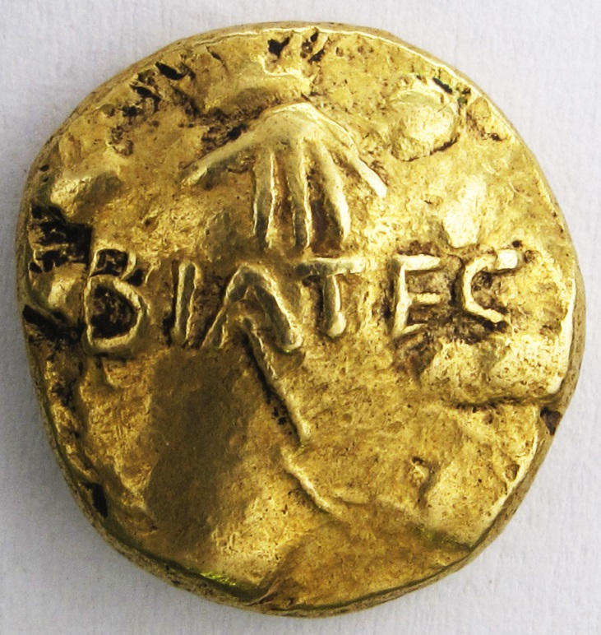
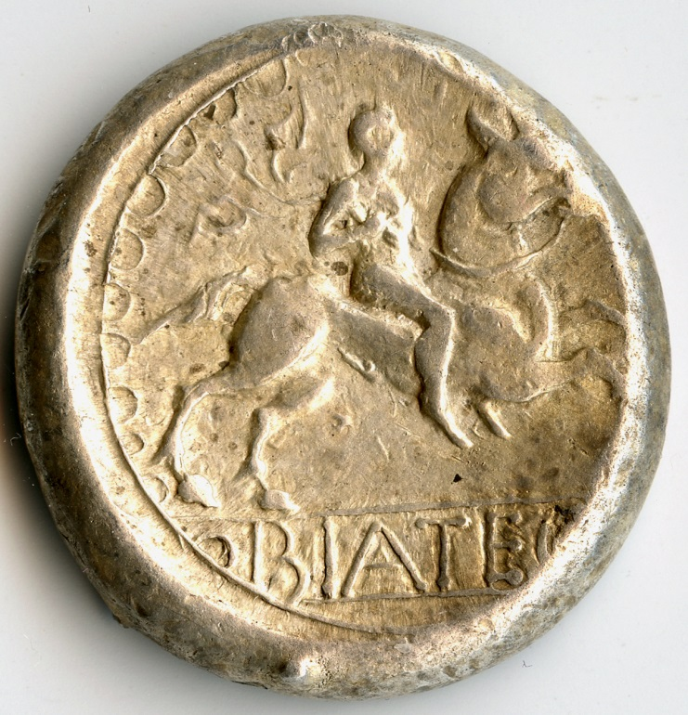
Schatzfund der keltischen Münzen von Deutsch Jahrendorf – die Revision des Fundkomplexes

Slide 2
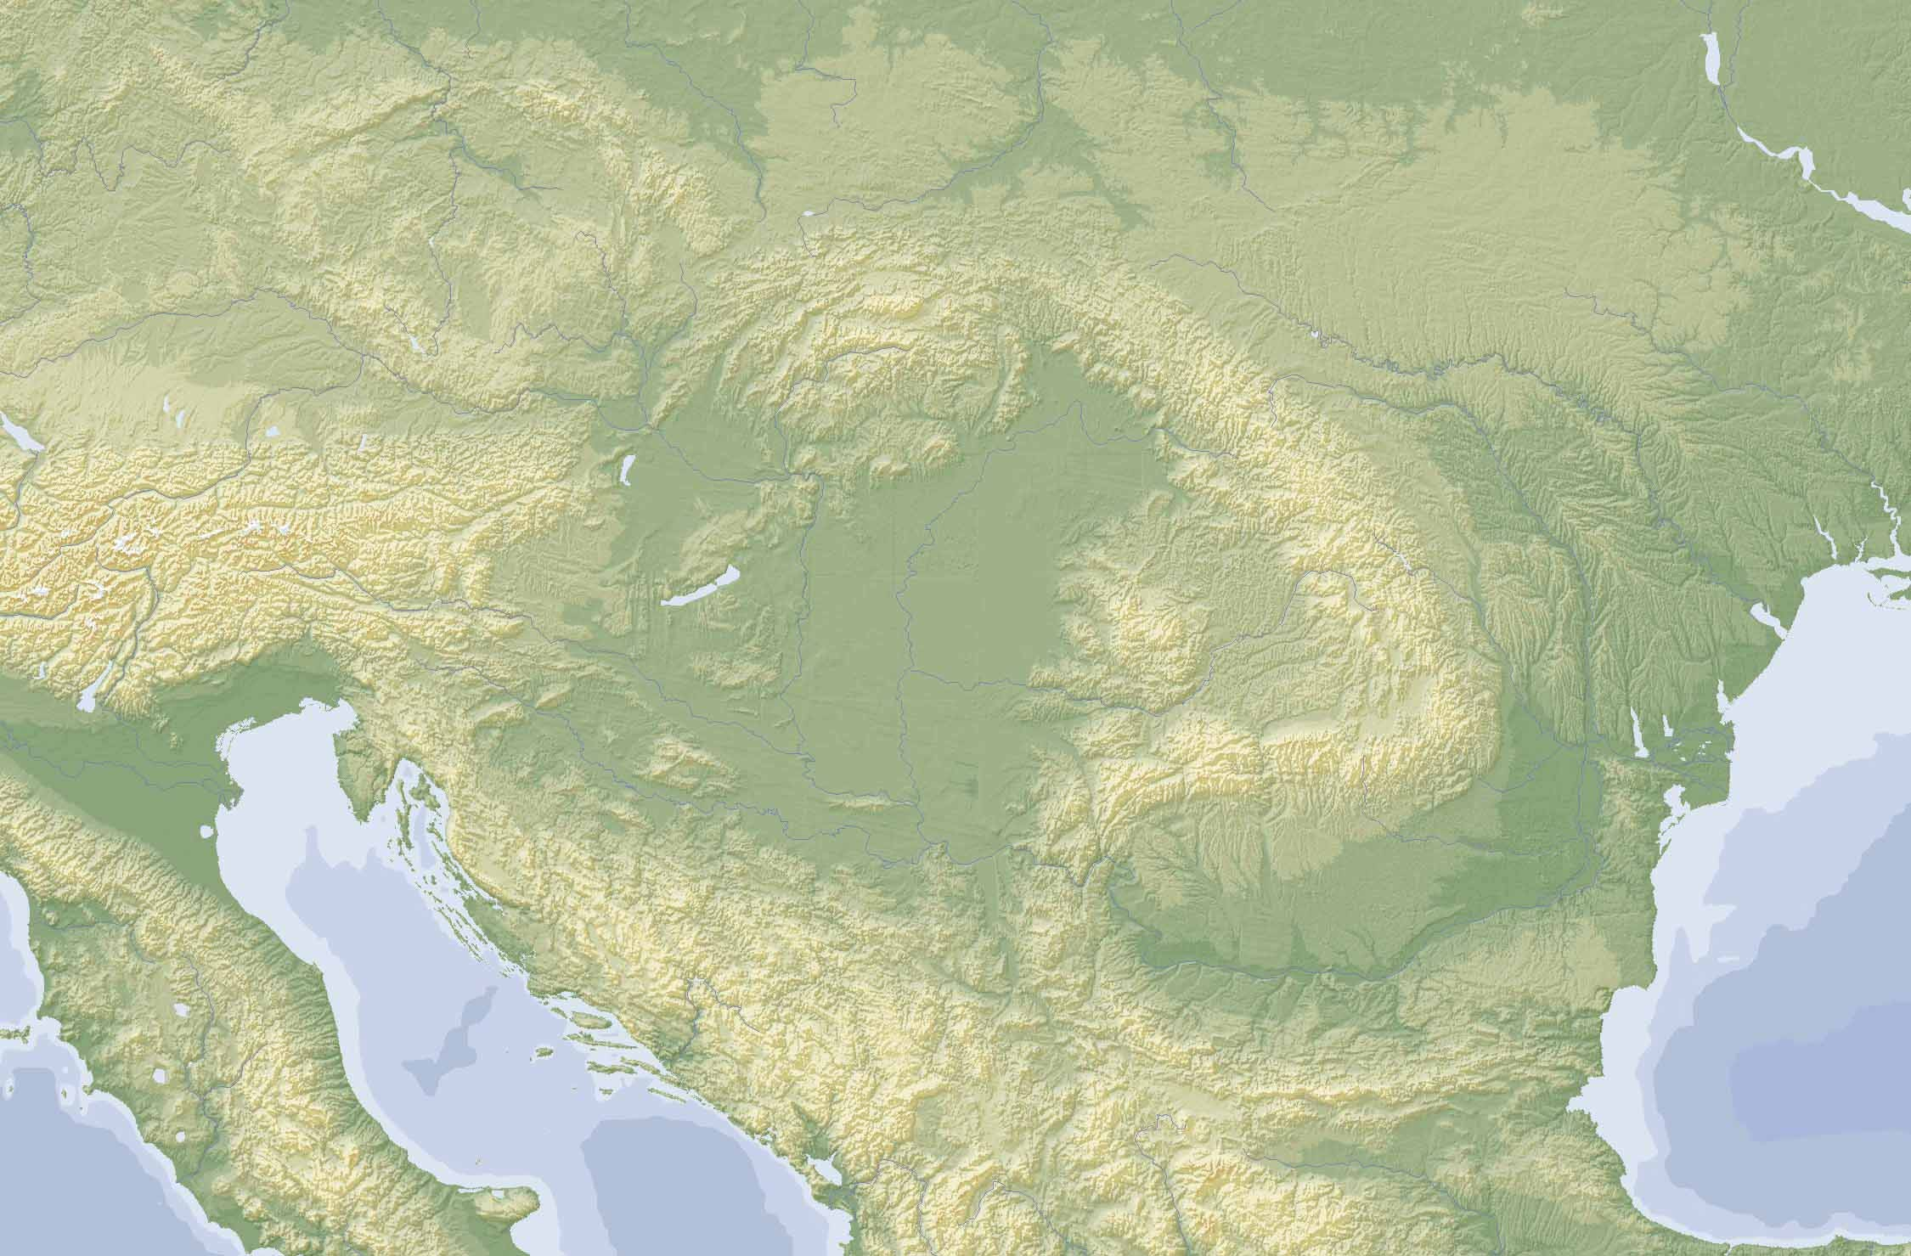
OPPIDA LT D
Boii
Vindelici
Cotini?
Norici
PANONIEN
Taurisci
SIEBENBURGEN
Bastarni
GALLIA
CISALPINA
Skordisci
DACIEN

Slide 3
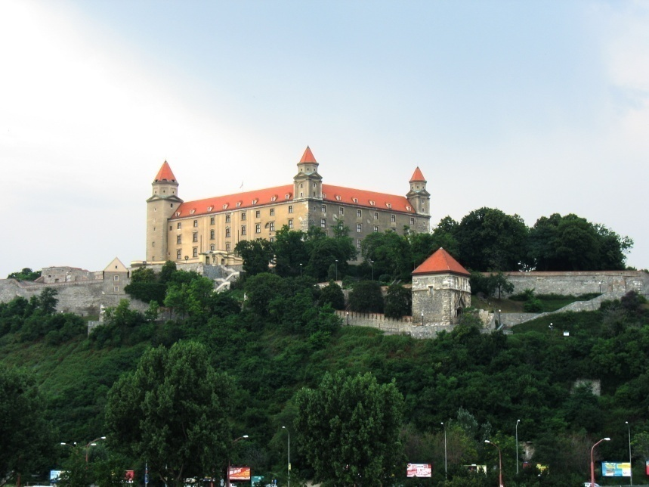
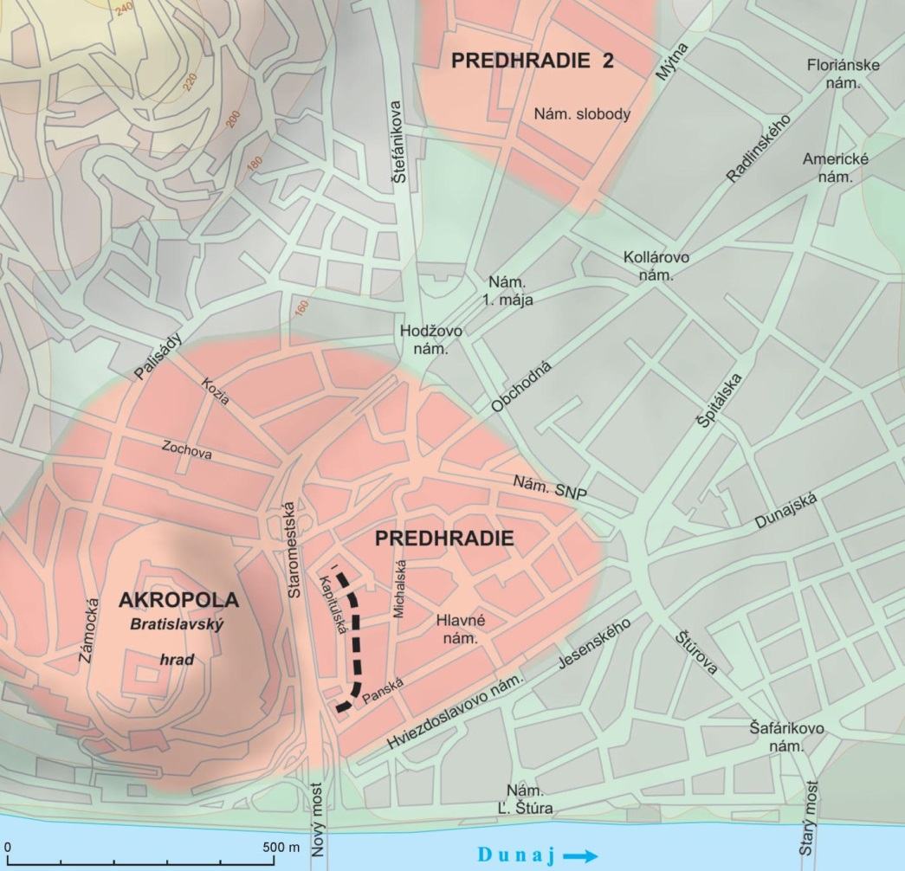
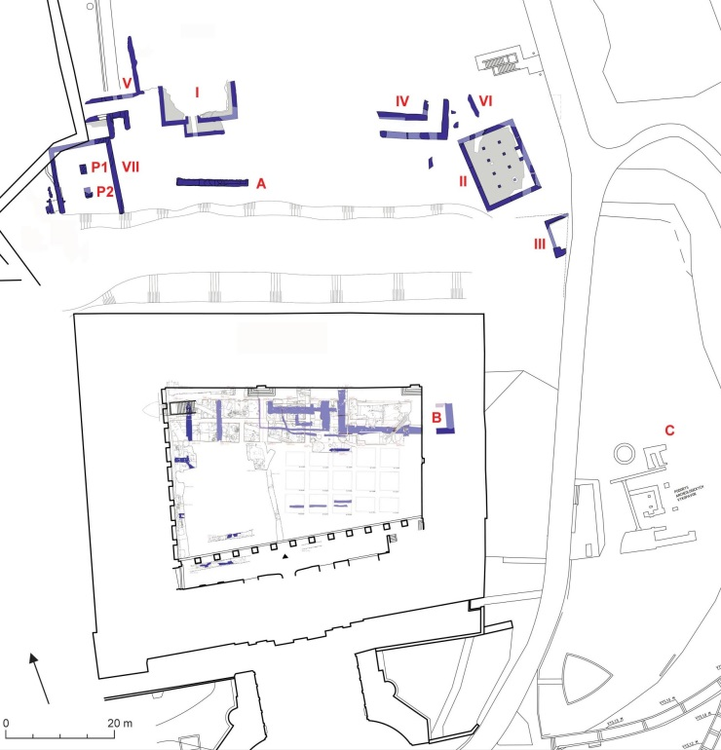
Oppidum Bratislava

Slide 4
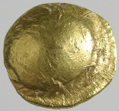
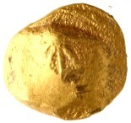
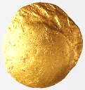
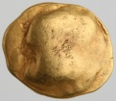

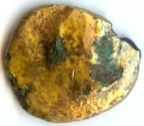
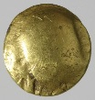





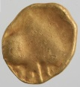
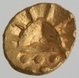
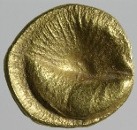
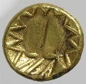

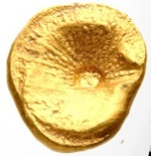
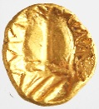

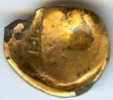

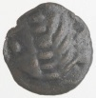
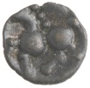
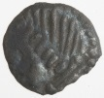
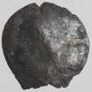






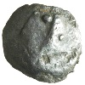

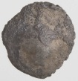
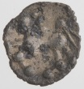
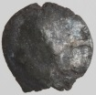
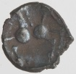
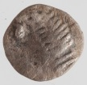
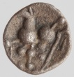
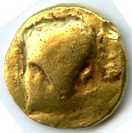
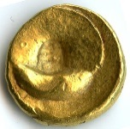


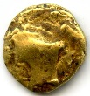


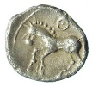






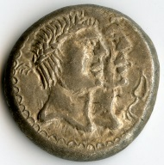
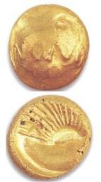
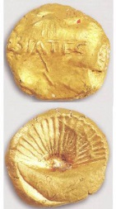
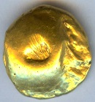
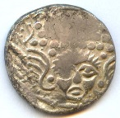
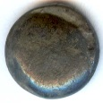

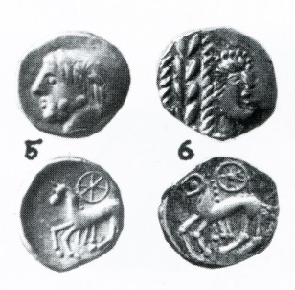
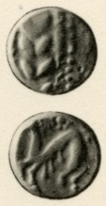


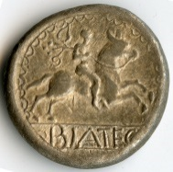
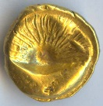


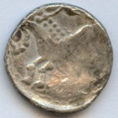
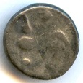
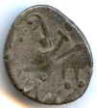
Stradonice
České
Lhotice
Třísov
Hrazany
Závist
Staré
Hradisko
Bratislava
Oberleiserberg
Ostříhom (?)

Slide 5
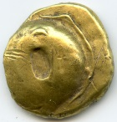
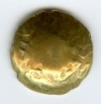
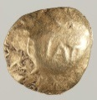







Keltisches Münzsystem in Bratislava
GOLD
Stater 1/3-Stater 1/8-Stater

Slide 6


Keltisches Münzsystem in Bratislava
SILBER
Hexadrachme Drachme typ Simmering Obol Typ Karlstein

Slide 7



Slide 8



Slide 9



Slide 10




LATTV (neuer Typ)

Slide 11





Nachahmungen von republikanische Denaren
- post quem
 | Göbl 1994 | Datation | RRC Typ
COISA | VI/1 | 80/71 v. Ch. | av - RRC, Nr. 381/1a oder 401/1
BIATEC | II/1(1, 2/1–2, 3, 4), II/2(1–2), II/3 | 70 v. Ch. | av - RRC, Nr. 403/1
BVSSVMARVS | III/1 | 79/68 v. Ch. | av - RRC, Nr. 383/1a oder 407/1
BVSSV | IV/1 | 79/68 v. Ch. | av - RRC, Nr. 383/1a oder 407/1
NONNOS | XIV/1 | 66 v. Ch. (?) | av - RRC, Nr. 410/1
BIATEC | II/6 | 68/60 v. Ch. | rv - RRC, Nr. 407/1 oder 402
BIATEC | II/6 | 46 v. Ch. | av - RRC, Nr. 464/1

Slide 12


Slide 13




Slide 14

Mai 1855
Gefunden von Paul Eder

Slide 15



prof. Karl Julius Schröer
(1825–1900)
Gekauft 26 AV
a 101 AR St.

Slide 16

Kupido, F. S. 1866: Die Silbermünzen des Jarendorfer Fundes. Wiener Numismatische Monatshefte 2, 98–106.

Slide 17



Paulsen, R. 1933: Die Münzprägungen
der Boier. Leipzig – Wien.

Slide 18
Deutsch Jahrndorf – Sammlungen (167 St.)
 | AV | AR | St.
KHM Wien | 1–3, 5–10, 15–17, 22, 24–26, 28, 30 | 31, 34, 52, 60–61, 71, 77, 84–85, 87, 92–94, 96, 98, 100, 103, 106, 108, 143–144, 146, 157 | 41
MNM Budapest | 4, 11–14, 18–21, 27, 29 | 32–33, 35–46, 48–49, 51, 53–54, 56–59, 62–71, 73, 75–76, 78–79, 81–83, 89, 95, 99, 101–102, 104–105, 107, 110–115, 117–142, 147–156, 158–159, 161–162 | 106
MNM Budapest (unbk.) |  | 164–167 | 4
MK Berlin |  | 97 | 1
BN Paris |  | 145 | 1
Geldmuseum Utrecht |  | 47, 55, 90, 163 | 4
Slg. Ch. Röttger |  | 116 | 1
Slg. Windisch-Grätz (unbk.) | 23 | 91 | 2
Privatslg. (unbk.) |  | 50, 74, 80, 86, 88, 109, 160 | 7

Slide 19
Deutsch Jahrndorf – goldene Münzen
1 | Stater | Var. I.1 | 6,43 g | 1 St.
2 | Stater | Var. I.2 | 6,45 g | 1 St.
3 | Stater | Var. I.3 | 6,18 g | 1 St.
4 | Stater | Var. II.1 | 6,74 g | 1 St.
5–6 | Stater | Var. II.2 | 6,48–6,47 g | 2 St.
7–9 | Stater | Var. II.3 | 6,49–6,42 g | 3 St.
10 | Stater | Var. II.4 | 6,44 g | 1 St.
11 | Stater | Var. III.1 | 6,63 g | 1 St.
12 | Stater | Var. IV.1 | 6,51 g | 1 St.
13–14 | Stater | Var. IV.2 | 6,49 g | 2 St.
15 | Stater | Var. IV.3 | 6,46 g | 1 St.
16 | Stater | Var. V.1 | 6,51 g | 1 St.
17 | Stater | Var. VI.1 | 6,47 g | 1 St.
18 | Stater | Var. VII.1 | 6,46 g | 1 St.
19 | 1/3-Stater | Var. 1/3-E/VI:02 | 2,25 g | 1 St.
20–22 | 1/3-Stater | Var. 1/3-F/VII:01 | 2,14–2,10 g | 3 St.
23 | 1/3-Stater | Var. (?) | 2,10 g | 1 St.
24 | 1/8-Stater | Var. 1/8-XIII:01 | 0,87 g | 1 St.
25–27 | Stater - BIATEC | Var. VIII.1 | 6,48–6,46 g | 3 St.
28 | 1/3-Stater - BIAT | Var. 1/3-F/VII:02 | 2,14 g | 1 St.
29–30 | 1/8-Stater - BIAT | Var. 1/8-XIV:01 | 0,83–0,80 g | 2 St.

Slide 20






AV Stater, Muscheltyp, Var. I.1
AV Stater, Muscheltyp, Var. I.2
AV Stater, Muscheltyp, Var. I.3
1 | Stater | Var. I.1 | 6,43 g | 1 St.
2 | Stater | Var. I.2 | 6,45 g | 1 St.
3 | Stater | Var. I.3 | 6,18 g | 1 St.

Slide 21






AV Stater, Muscheltyp, Var. II.1 AV Stater, Muscheltyp, Var. II.2 – 2 St.
AV Stater, Muscheltyp, Var. II.3 – 3 St. AV Stater, Muscheltyp, Var. II.4
4 | Stater | Var. II.1 | 6,74 g | 1 St.
5–6 | Stater | Var. II.2 | 6,48–6,47 g | 2 St.
7–9 | Stater | Var. II.3 | 6,49–6,42 g | 3 St.
10 | Stater | Var. II.4 | 6,44 g | 1 St.

Slide 22








AV Stater, Muscheltyp, Var. III.1 AV Stater, Muscheltyp, Var. IV.1
AV Stater, Muscheltyp, Var. IV.2 – 2 St. AV Stater, Muscheltyp, Var. IV.3
11 | Stater | Var. III.1 | 6,63 g | 1 St.
12 | Stater | Var. IV.1 | 6,51 g | 1 St.
13–14 | Stater | Var. IV.2 | 6,49 g | 2 St.
15 | Stater | Var. IV.3 | 6,46 g | 1 St.

Slide 23






AV Stater, Muscheltyp, Var. V.1 AV Stater, Muscheltyp, Var. VI.1
AV Stater, Muscheltyp, Var. VII.1
16 | Stater | Var. V.1 | 6,51 g | 1 St.
17 | Stater | Var. VI.1 | 6,47 g | 1 St.
18 | Stater | Var. VII.1 | 6,46 g | 1 St.

Slide 24






AV 1/3-Stater, Muschelreihe, Var. Militký (2015) E/VI:02
AV 1/3-Stater, Muschelreihe, Var. Militký (2015) F/VII:01
19 | 1/3-Stater | Var. 1/3-E/VI:02 | 2,25 g | 1 St.
20–22 | 1/3-Stater | Var. 1/3-F/VII:01 | 2,14–2,10 g | 3 St.

Slide 25
AV 1/8-Stater, Muschelreihe, Var. Militký (2015) XIII:01
24 | 1/8-Stater | Var. 1/8-XIII:01 | 0,87 g | 1 St.

Slide 26





AV Stater, Muscheltyp – BIATEC, Var. VIII.1
3 St.

Slide 27
AV 1/3-Stater, Muschelreihe – BIAT, Var. Militký (2015) F/VII:02
1 St.

Slide 28


AV 1/8-Stater, Muschelreihe – BIAT, Var.
Militký (2015) XIV:01
2 St.

Slide 32
31 | AINORIX | I/1-26 | 16,80 g | 1 St.
32–49 | BIATEC | II/1 (1)-1 | 17,22–16,58 g | 18 St.
50–52 | BIATEC | II/1 (2/1)-2 | 17,30–17,12 g | 3 St.
53–59 | BIATEC | II/1 (2/2)-3 | 17,42–16,84 g | 7 St.
60–71 | BIATEC | II/1 (3)-4 | 17,31–16,94 g | 12 St.
72–76 | BIATEC | II/2 (2)-6 | 17,21–16,83 g | 5 St.
77–78 | BIATEC | II/3-12 | 17,12–17,05 g | 2 St.
79 | BIATEC | II/4-3 | 17,02 g | 1 St.
80–83 | BIATEC | II/4-7 | 17,30–17,09 g | 4 St.
84–85 | BVSSVMARVS | III/1-24 | 17,15–17,09 g | 2 St.
86–91 | BVSV | IV/1-28 | 17,1–16,62 g | 6 St.
92–93 | COBROVOMARVS | V/1-18 | 17,27–17,11 g | 2 St.
94 | COISA | VI/1-21 | 17,17 g | 1 St.
95–97 | COVIOMARVS | VII/1-23 | 17,50–16,79 g | 3 St.
98–100 | DEVIL (DEVII) | IX/1-16 | 17,26–17,01 g | 3 St.
101–103 | DEVIL (DEVII) | IX/1-20 | 17,07–17,00 g | 3 St.
104 | EVOIVRIX | X/2-19 | 16,54 g | 1 St.
105–108 | IANTVMARVS | XII/1-14 | 17,02–16,89 g | 4 St.
109–127 | NONNOS | XIV/1A-8 | 17,47–16,85 g | 19 St.
128–139 | NONNOS | XIV/1B-9 | 17,48–16,47 g | 12 St.
140–142 | NONNOS | XIV/1C-10 | 17,24–16,80 g | 3 St.
143–145 | NONNOS | XIV/3-11 | 17,23–16,98 g | 3 St.
146–159 | (NONNOS) | XIV/2 (1)-13 | 17,25–16,79 g | 14 St.
160 | NONNOS | ? | 17,12 g | 1 St.
161–163 | TITTO | XV/1-25 | 17,08–16,95 g | 3 St.
164–167 | ? | ? | ? | 4 St.

Slide 33


AR Hexadrachme, Typ Biatec – AINORIX
Lit.: Göbl 1994, Taf. 2:I/1-26.
1 ks
31 | AINORIX | I/1-26 | 16,80 g | 1 / 25 St.

Slide 34


AR Hexadrachme, Typ Biatec – BIATEC
Lit.: Göbl 1994, Taf. 2:II/1 (1)-1
18 ks
32–49 | BIATEC | II/1 (1)-1 | 17,22–16,58 g | 18 / 234 St.

Slide 35


AR Hexadrachme, Typ Biatec – BIATEC
Lit.: Göbl 1994, Taf. 2:II/1 (2/1)-2
3 ks
50–52 | BIATEC | II/1 (2/1)-2 | 17,30–17,12 g | 3 / 16 St.

Slide 36


AR Hexadrachme, Typ Biatec – BIATEC
Lit.: Göbl 1994, Taf. 2:II/1 (2/2)-3
7 ks
53–59 | BIATEC | II/1 (2/2)-3 | 17,42–16,84 g | 7 / 85 St.

Slide 37


AR Hexadrachme, Typ Biatec – BIATEC
Lit.: Göbl 1994, Taf. 2:II/1 (3)-4
12 ks
60–71 | BIATEC | II/1 (3)-4 | 17,31–16,94 g | 12 / 99 St.

Slide 38


AR Hexadrachme , Typ Biatec – BIATEC
Lit.: Göbl 1994, Taf. 3:II/2 (2)-6
5 ks
72–76 | BIATEC | II/2 (2)-6 | 17,21–16,83 g | 5 / 81 St.

Slide 39


AR Hexadrachme , Typ Biatec – BIATEC
Lit.: Göbl 1994, Taf. 3:II/3-12
2 ks
77–78 | BIATEC | I II/3-12 | 17,12–17,05 g | 2 / 69 St.

Slide 40


AR Hexadrachme , Typ Biatec – BIATEC
Lit.: Göbl 1994, Taf. 3:II/4-3
1 ks
79 | BIATEC | II/4-3 | 17,02 g | 1 / 6 St.

Slide 41


AR Hexadrachme, Typ Biatec – BIATEC
Lit.: Göbl 1994, Taf. 3:II/4-7
5 ks
80–83 | BIATEC | II/4-7 | 17,30–17,09 g | 4 / 87 St.

Slide 42


AR Hexadrachme, Typ Biatec – BVSSVMARVS
Lit.: Göbl 1994, Taf. 3:III/1-24
2 ks
84–85 | BVSSVMARVS | III/1-24 | 17,15–17,09 g | 2 / 9 St.

Slide 43


AR Hexadrachme, Typ Biatec – BVSV
Lit.: Göbl 1994, Taf. 4:IV/1-28
6 ks
86–91 | BVSV | IV/1-28 | 17,1–16,62 g | 6 / 60 St.

Slide 44


AR Hexadrachme, Typ Biatec – COBROVOMARVS
Lit.: Göbl 1994, Taf. 4:V/1-18
2 ks
92–93 | COBROVOMARVS | V/1-18 | 17,27–17,11 g | 2 / 29 St.

Slide 45


AR Hexadrachme, Typ Biatec – COISA
Lit.: Göbl 1994, Taf. 4:VI/1-21
1 ks
94 | COISA | VI/1-21 | 17,17 g | 1 / 16 St.

Slide 46


AR Hexadrachme, Typ Biatec – COVIOMARVS
Lit.: Göbl 1994, Taf. 4:VII/1-23
3 ks
95–97 | COVIOMARVS | VII/1-23 | 17,50–16,79 g | 3 / 7 St.

Slide 47


AR Hexadrachme, Typ Biatec – DEVIL
Lit.: Göbl 1994, Taf. 4:IX/1-16
3 ks
98–100 | DEVIL (DEVII) | IX/1-16 | 17,26–17,01 g | 3 / 36 St.

Slide 48


AR Hexadrachme, Typ Biatec – DEVIL
Lit.: Göbl 1994, Taf. 4:IX/1-20
3 ks.
101–103 | DEVIL (DEVII) | IX/1-20 | 17,07–17,00 g | 3 / 37 St.

Slide 49


AR Hexadrachme, Typ Biatec – EVOIVRIX
Lit.: Göbl 1994, Taf. 4:X/2-19
1 ks
104 | EVOIVRIX | X/2-19 | 16,54 g | 1 / 16 St.

Slide 50


AR Hexadrachme, Typ Biatec – IANTVMARVS
Lit.: Göbl 1994, Taf. 5:XII/1-14
4 ks
105–108 | IANTVMARVS | XII/1-14 | 17,02–16,89 g | 40 / 4 St.

Slide 51


AR Hexadrachme, Typ Biatec – NONNOS
Lit.: Göbl 1994, Taf. 5:XIV/1A-8
19 ks
109–127 | NONNOS | XIV/1A-8 | 17,47–16,85 g | 19 / 99 St.

Slide 52


AR Hexadrachme, Typ Biatec – NONNOS
Lit.: Göbl 1994, Taf. 5:XIV/1B-9
12 ks
128–139 | NONNOS | XIV/1B-9 | 17,48–16,47 g | 12 St.

Slide 53


AR Hexadrachme, Typ Biatec – NONNOS
Lit.: Göbl 1994, Taf. 5:XIV/1C-10
3 ks
140–142 | NONNOS | XIV/1C-10 | 17,24–16,80 g | 3 / 91 St.

Slide 54


AR Hexadrachme, Typ Biatec – NONNOS
Lit.: Göbl 1994, Taf. 6:XIV/3-11
3 ks
143–145 | NONNOS | XIV/3-11 | 17,23–16,98 g | 3 / 32 St.

Slide 55


AR Hexadrachme, Typ Biatec – (NONNOS)
Lit.: Göbl 1994, Taf. 6:XIV/2 (1)-13
14 ks
146–159 | (NONNOS) | XIV/2 (1)-13 | 17,25–16,79 g | 14 / 180 St.

Slide 56


AR Hexadrachme, Typ Biatec – TITTO
Lit.: Göbl 1994, Taf. 6:XV/1-25
3 ks
146–159 | (NONNOS) | XIV/2 (1)-13 | 17,25–16,79 g | 3 / 26 St.

Slide 57
31 | AINORIX | I/1-26 | 1 St. | 25 St.
32–49 | BIATEC | II/1 (1)-1 | 18 St. | 234 St.
50–52 | BIATEC | II/1 (2/1)-2 | 3 St. | 16 St.
53–59 | BIATEC | II/1 (2/2)-3 | 7 St. | 85 St.
60–71 | BIATEC | II/1 (3)-4 | 12 St. | 99 St.
 | BIATEC | II/1 (4)-5 |  | 11 St.
 | BIATEC | II/2 (1)-5 |  | 3 St.
72–76 | BIATEC | II/2 (2)-6 | 5 St. | 81 St.
77–78 | BIATEC | I II/3-12 | 2 St. | 69 St.
79 | BIATEC | II/4-3 | 1 St. | 6 St.
80–83 | BIATEC | II/4-7 | 5 St. | 86 St.
 | BIATEC | II/5-12 |  | 1 St.
84–85 | BVSSVMARVS | III/1-24 | 2 St. | 9 St.
86–91 | BVSV | IV/1-28 | 6 St. | 60 St.
92–93 | COBROVOMARVS | V/1-18 | 2 St. | 29 St.
94 | COISA | VI/1-21 | 1 St. | 16 St.
95–97 | COVIOMARVS | VII/1-23 | 3 St. | 7 St.
 | COVNOS | VIII/1-15 |  | 5 St.
98–100 | DEVIL (DEVII) | IX/1-16 | 3 St. | 36 St.
101–103 | DEVIL (DEVII) | IX/1-20 | 3 St. | 37 St.
 | EVOIVRIX | X/1-19 |  | 10 St.
104 | EVOIVRIX | X/2-19 | 1 St. | 16 St.
 | FARIARIX (FAPIARIX) | XI/1-27 |  | 24 St.
105–108 | IANTVMARVS | XII/1-14 | 4 St. | 40 St.
 | MACCIVS | XIII/1-22 |  | 3 St.
109–127 | NONNOS | XIV/1A-8 | 19 St. | 99 St.
128–139 | NONNOS | XIV/1B-9 | 12 St. | 107 St.
 | NONNOS | XIV/1B-10 |  | 1 St.
140–142 | NONNOS | XIV/1C-10 | 3 St. | 91 St.
143–145 | NONNOS | XIV/3-11 | 3 St. | 32 St.
146–159 | (NONNOS) | XIV/2 (1)-13 | 14 St. | 180 St.
161–163 | TITTO | XV/1-25 | 3 St. | 26 St.
 | LATTV | - |  | 3 St.
 | Anonym | XVI/1-17 |  | 11 St.
 | BVSVMARVS+TITTO | III/1+XV/1 |  | 2 St.

Slide 59
 |  | DJ | B1942 | B1923 | B1937 | B1930 | Reca | Lattu | Σ
AINORIX | I/1-26 | 1 | 2 |  |  | 2 |  |  | 25 St.
BIATEC | II/1 (1)-1 | 18 | 44 | 7 | 12 | 9 | 4 |  | 234 St.
BIATEC | II/1 (2/1)-2 | 3 | 2 | 2 |  | 1 | 1 |  | 16 St.
BIATEC | II/1 (2/2)-3 | 7 | 22 | 4 | 1 | 1 | 5 | 1 | 85 St.
BIATEC | II/1 (3)-4 | 12 | 31 | 4 | 4 | 3 | 1 | 1 | 99 St.
BIATEC | II/1 (4)-5 |  |  | 2 |  |  |  |  | 11 St.
BIATEC | II/2 (1)-5 |  | 1 |  |  |  |  |  | 3 St.
BIATEC | II/2 (2)-6 | 5 | 6 | 11 | 1 | 1 | 1 |  | 81 St.
BIATEC | I II/3-12 | 2 | 7 | 1 | 6 | 1 | 3 | 1 | 69 St.
BIATEC | II/4-3 | 1 | 1 |  |  |  |  | 1 | 6 St.
BIATEC | II/4-7 | 5 | 23 | 6 | 2 | 2 | 5 | 1 | 86 St.
BIATEC | II/5-12 |  | 1 |  |  |  |  |  | 1 St.
BVSSVMARVS | III/1-24 | 2 | 1 |  |  |  |  |  | 9 St.
BVSV | IV/1-28 | 6 | 7 | 2 | 4 | 1 | 1 | 1 | 60 St.
COBROVOMARVS | V/1-18 | 2 | 1 |  |  |  | 1 | 1 | 29 St.
COISA | VI/1-21 | 1 | 1 |  |  |  |  | 3 | 16 St.
COVIOMARVS | VII/1-23 | 3 |  |  |  |  |  |  | 7 St.
COVNOS | VIII/1-15 |  | 1 |  |  | 1 |  |  | 5 St.
DEVIL | IX/1-16 | 3 | 10 | 1 | 3 | 2 | 2 | 1 | 36 St.
DEVIL | IX/1-20 | 3 | 7 |  | 3 | 1 |  | 2 | 37 St.
EVOIVRIX | X/1-19 |  | 3 |  |  |  |  |  | 10 St.
EVOIVRIX | X/2-19 | 1 |  |  |  |  |  |  | 16 St.
FARIARIX | XI/1-27 |  | 2 | 1 |  | 4 |  |  | 24 St.
IANTVMARVS | XII/1-14 | 4 | 4 | 3 | 1 |  | 2 | 1 | 40 St.
MACCIVS | XIII/1-22 |  | 3 |  |  |  |  |  | 3 St.
NONNOS | XIV/1A-8 | 19 | 21 | 3 | 3 | 6 | 1 | 2 | 99 St.
NONNOS | XIV/1B-9 | 12 | 23 | 6 | 2 | 1 | 2 | 1 | 107 St.
NONNOS | XIV/1B-10 |  |  | 1 |  |  |  |  | 1 St.
NONNOS | XIV/1C-10 | 3 | 5 | 25 | 1 |  | 3 |  | 91 St.
NONNOS | XIV/3-11 | 3 | 10 | 1 | 1 |  | 1 | 2 | 32 St.
(NONNOS) | XIV/2 (1)-13 | 14 | 26 | 7 | 13 | 2 | 4 | 1 | 180 St.
TITTO | XV/1-25 | 3 | 3 |  | 1 | 1 | 3 |  | 26 St.
LATTV | - |  |  |  |  |  |  | 2 | 3 St.
Anonym | XVI/1-17 |  | 3 |  |  |  | 2 |  | 11 St.
Hybrid | III/1+XV/1 |  |  |  |  |  |  |  | 2 St.

Slide 60



Bratislava 2009 – Bau I

Slide 61











Podle: E. Kolníková a J. Fröhlich

Slide 62
Beziehungen
Bratislava - Stradonice
Boii
Stradonice
Vindelici
Cotini?
Boii
Bratislava
Norici
PANONIEN
Taurisci
SIEBENBURGEN
Bastarni
GALLIA
CISALPINA
Skordisci
DACIEN

Slide 63



Deutsch Jahrndorf 1855
Stradonice

Slide 64
Nachahmungen von republikanische Denaren
- post quem
 | Göbl 1994 | Datation | RRC Typ
COISA | VI/1 | 80/71 v. Ch. | av - RRC, Nr. 381/1a oder 401/1
BIATEC | II/1(1, 2/1–2, 3, 4), II/2(1–2), II/3 | 70 v. Ch. | av - RRC, Nr. 403/1
BVSSVMARVS | III/1 | 79/68 v. Ch. | av - RRC, Nr. 383/1a oder 407/1
BVSSV | IV/1 | 79/68 v. Ch. | av - RRC, Nr. 383/1a oder 407/1
NONNOS | XIV/1 | 66 v. Ch. (?) | av - RRC, Nr. 410/1
BIATEC | II/6 | 68/60 v. Ch. | rv - RRC, Nr. 407/1 oder 402
BIATEC | II/6 | 46 v. Ch. | av - RRC, Nr. 464/1

Slide 65

Chronologische Schemen (unrealistisch):
Göbl (1994): 51-41 v. Ch.
Röttger (2015): 40-9 v. Ch.
Realistische chronologie (Kolníková, Militký):
Um 70/60-40/30 (oder später?)

Slide 66

Ich bedanke mich
für ihre Aufmerksamkeit!

