Slide 1
reviewing +
comparing and contrasting
ISKM09 - week 5

Slide 2
review
Do you read reviews? Reviews of what? Have you ever written a review?
Comment in IS “discussion forum” please…

Slide 3
review - how to...
Some good sources that will help you with writing a review are listed below:
BOOK
https://writingcenter.unc.edu/tips-and-tools/book-reviews/
FILM
https://edusson.com/blog/how-to-write-movie-review
RESTAURANT
https://www.grammarly.com/blog/how-to-write-a-restaurant-review/

Slide 4
review - practice
Write a review of your choice…
100 - 200 words long
in the discussion forum, so that you can comment on other people´s reviews
include the review in your portfolio

Slide 5
literature review
a part of scientific papers, including your master / diploma thesis
traces th intellectual progression in the research field (to date)
includes major theories or debates or recent / similar studies
prepares the grounds for your research
identifies the potential gaps in the research which you intend to fill with your research (partly)

Slide 6
literature review - how to...
In case you have to write a literature review, these are some useful links:
https://advice.writing.utoronto.ca/types-of-writing/literature-review/
https://libguides.usc.edu/writingguide/literaturereview
https://www.youtube.com/watch?v=-ny_EUJXHHs
https://libguides.uwf.edu/c.php?g=215199&p=1420828

Slide 7
comparing and contrasting - linking words
Can you think of some linking words and phrases that are used for comparing and contrasting?

Slide 8
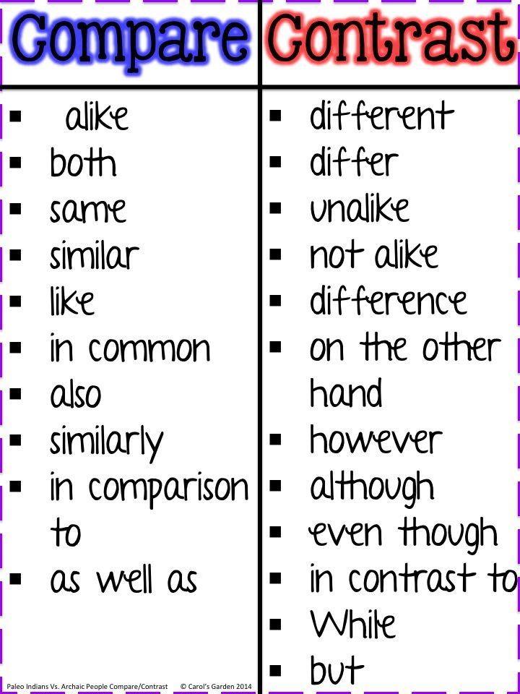
comparing and contrasting - linking words
From: https://sites.google.com/a/npsct.org/room-21/language-arts-units-1-and-2/unit-3-making-meaning-ct/comparingthealgonquinwayoflifetotodayinnewington

Slide 9
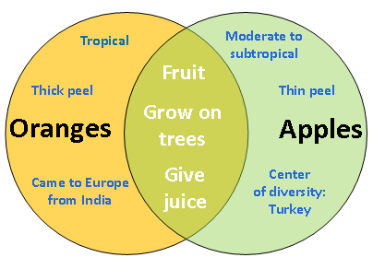
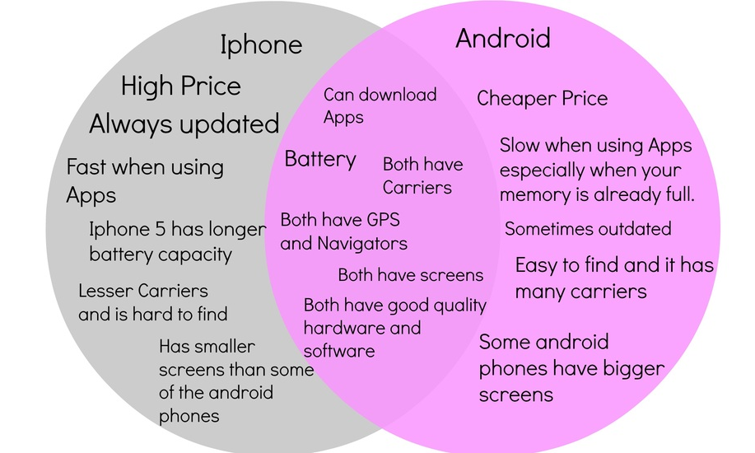
comparing and contrasting - first steps...

Slide 10
Got it?
Do the thinking first, list the similarities and differences… and only then start to write:) How?
This is a guy who an help: https://www.youtube.com/watch?v=hvMSeg1s7uc

