Slide 1
chī fàn
吃 饭
Dining
Li Xin Yu

Slide 2
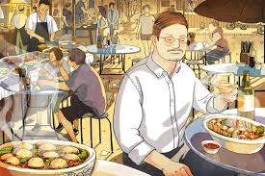
fàn guǎn(r)
饭馆(儿)
restaurant

Slide 3
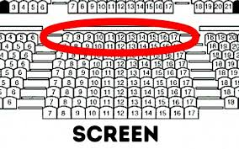
wèi zi
位子
seat

Slide 4
好像下雪了。
hǎo xiàng xià xuě le.
It seems to be snowing.
好像没有位子了。
hǎo xiàng méi yǒu wèi zi le.
It doesn't look like there's a table left.
hǎo xiàng
好像
to seem; to be like

Slide 5
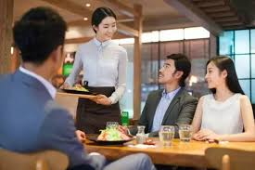
fú wù yuán
服务员
waiter;attendant

Slide 6
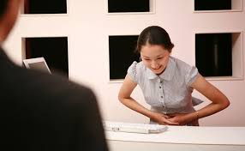
fú wù
服务
to serve; to provide service

Slide 7
In a restaurant, one may address a staff member, either male or female, as 服务员(fú wù yuán, waiter). In Beijing, however, some customers would address a young waiter as 小伙子(xiǎo huǒ zi, young man) and a young waitress as 小妹(xiǎo mèi,lit.,little sister), while some older or middle-aged people would call a young waitress 姑娘(gū niang, girl;miss). In Taiwan, it is proper to address a waiter as 先生(xiān shēng) and a waitress as 小姐(xiǎo jiě).

Slide 8
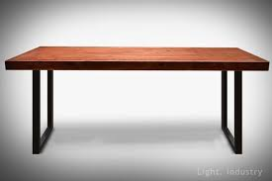
zhuō zi
桌子
table

Slide 9
diǎn cài
点菜
to order food

Slide 10
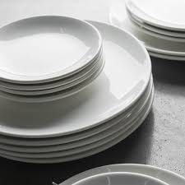
pán
盘
plate; dish

Slide 11
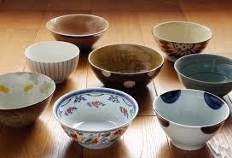
wǎn
碗
bowl

Slide 12
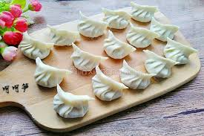
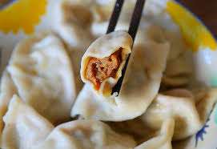
jiǎo zi
饺子
dumplings(with vegetable and/or meat filling

Slide 13
Nouns for containers or vessels such as 碗(wǎn,bowl), 杯(bēi,cup/glass), and 盘(pán,plate/dish) can serve as measure words, e.g., 一碗饭(yì wǎn fàn,a bowl of rice), 一杯水(yì bēi shuǐ, a glass of water), and 一盘饺子(yì pán jiǎo zi, a plate of dumplings).

Slide 14
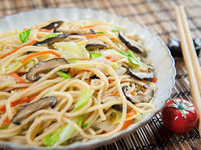
sù
素
vegetarian; made from vegetables

Slide 15
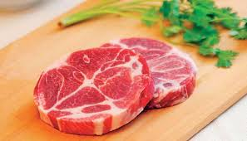
ròu
肉
meat

Slide 16
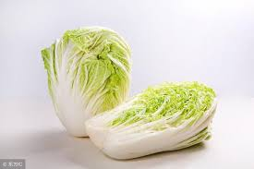
bái cài
白菜
bok choy

Slide 17
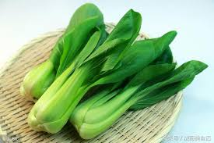
qīng cài
青菜
green/leafy vegetable

Slide 18
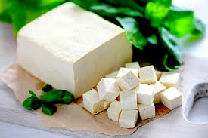
dòu fu
豆腐
tofu; bean curd

Slide 19
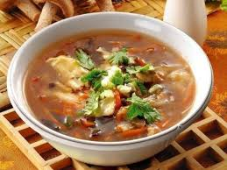
suān là tāng
酸辣汤
hot and sour soup

Slide 20
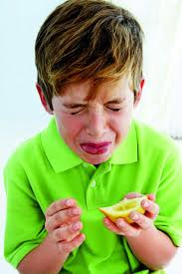
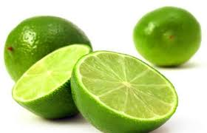
suān
酸
sour

Slide 21
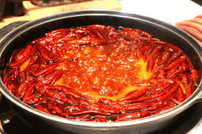
là
辣
spicy; hot

Slide 22
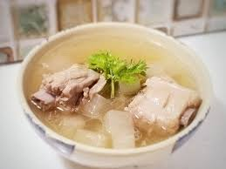
tāng
汤
soup

Slide 23
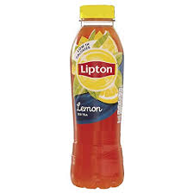
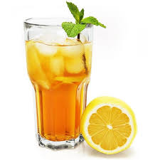
bīng chá
冰茶
iced tea

Slide 24
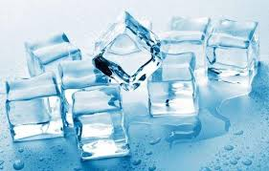
bīng
冰
ice

Slide 25
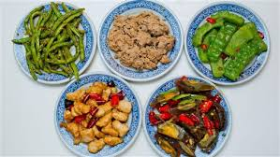
jiā cháng
家常
home-style

Slide 26
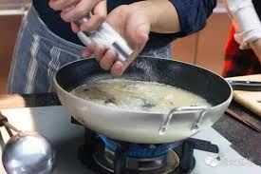
fàng
放
to put; to place

Slide 27
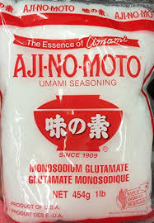
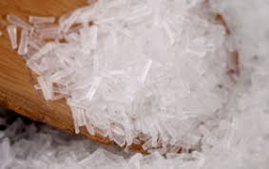
wèi jīng
味精
monosodium glutamate(MSG)

Slide 28
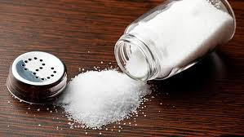
yán
盐
salt

Slide 29
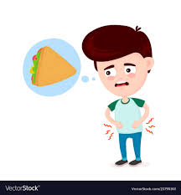
è
饿
hungry

Slide 30
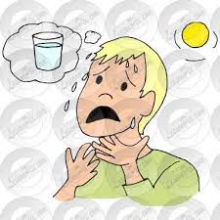
kě
渴
thirsty

Slide 31
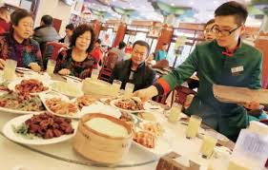
shàng cài
上菜
to serve food

Slide 32
gāng
刚
just

Slide 33
3. 刚(gāng)vs. 刚才(gāng cái)
As an adverb, 刚(gāng) denotes that the action or change in situation took place in the most recent past.
1. 我哥哥刚从中国来，一个朋友都没有。
wǒ gē ge gāng cóng zhōng guó lái, yí ge péng you dōu méi yǒu.
My older brother just came from China. He doesn`t have a single friend here.
2. 我刚洗完澡，舒服极了。
wǒ gāng xǐ wán zǎo, shū fu jí le.
I just showered, and feel so great.

Slide 34
3. 刚(gāng)vs. 刚才(gāng cái)
刚才(gāng cái) is a noun that refers to the time shortly before the act of speaking.
3. A: 你知道王朋在哪儿吗？
nǐ zhī dào wáng péng zài nǎr ma ？
Do you know where Wang Peng is ?
B: 他刚才在这儿，我不知道他去哪儿了。
tā gāng cái zài zhèr, wǒ bù zhī dao tā qù nǎr le.
He was here a moment ago. I don`t know where he went.
4.弟弟刚才吃了十五个饺子，喝了两碗酸辣汤。
dì di gāng cái chī le shí wǔ ge jiǎo zi, hē le liǎng wǎn suān là tāng.
My younger brother finished fifteen dumplings and two bowls of hot and sour soup a moment ago.

Slide 35
3. 刚(gāng)vs. 刚才(gāng cái)
Although 刚(gāng) and 刚才(gāng cái) are similar in meaning, they are classified as different parts of speech and are therefore used differently.
a. 刚(gāng) can be followed by an expression that indicates the duration of time.
5. 他刚走了两天。
tā gāng zǒu le liǎng tiān.
He left only two days ago.
他刚才走了两天。(X)
tā gāng cái zǒu le liǎng tiān

Slide 36
3. 刚(gāng)vs. 刚才(gāng cái)
Unlike 刚才(gāng cái), 刚(gāng) cannot be followed by the negation words 不(bù) or 没(méi).
6.A: 你刚才为什么没说？
nǐ gāng cái wèi shén me méi shuō ？
Why didn`t you say it a moment ago?
你刚为什么没说？(X)
nǐ gāng wèi shén me méi shuō ？
B: 我刚才不想说。
wǒ gāng cái bù xiǎng shuō.
我刚不想说。
wǒ gāng bù xiǎng shuō.(X)

Slide 37
3. 刚(gāng)vs. 刚才(gāng cái)
b.A sentence that includes 刚才(gāng cái) often ends with 了(le), but a sentence including 刚(gāng) cannot have 了(le) at the end .
7. A: 你刚才去哪儿了？老师要你去办公室找他。
nǐ gāng cái qù nǎr le ？lǎo shī yào nǐ qù bàn gōng shì zhǎo tā.
Where were you a moment ago? The teacher wanted you to go to his office.
B: 我刚才去图书馆了。
wǒ gāng cái qù tú shū guǎn le.
I went to the library.

Slide 38
3. 刚(gāng)vs. 刚才(gāng cái)
b.A sentence that includes 刚才(gāng cái) often ends with 了(le), but a sentence including 刚(gāng) cannot have 了(le) at the end .
8. A: 明天的考试你开始准备了吗？
míng tiān de kǎo shì nǐ kāi shǐ zhǔn bèi le ma ？
Have you started preparing for tomorrow`s test?
B: 刚开始准备。
gāng kāi shǐ zhǔn bèi.
I just got started.
刚开始准备了。（X）
gāng kāi shǐ zhǔn bèi le.

Slide 39
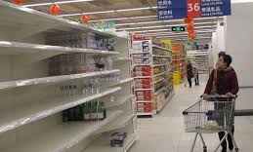
mài wán
卖完
to be sold out

Slide 40
wán
完
finished

Slide 41
xiē
些
吃些肉。
chī xiē ròu。
to eat some meat.
(measure word for an indefinite amount); some

Slide 42
gòu
够
enough
As an adjective, 够(gòu) functions only as a predicate, and never as an attributive before nouns. Thus one says 我的钱不够(wǒ de qián bú gòu, my money is not enough), but never 我没有够钱(wǒ méi yǒu gòu qián)(X)

Slide 43
1. 一...也/都...不/没...(yì ...yě /dōu ...bù /méi)
These structures are used to form an emphatic negation meaning “not at all ” or “not even one.”
A. Subject+一(yì)+Measure Word+Object+也/都(yě /dōu)+不/没(bù /méi)+Verb
1.小李一个朋友也没有。
xiǎo lǐ yí ge péng you yě méi yǒu.
Little Li does not have a single friend.

Slide 44
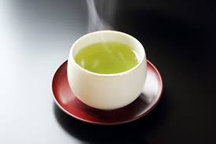
1. 一...也/都...不/没...(yì ...yě /dōu ...bù /méi)
These structures are used to form an emphatic negation meaning “not at all ” or “not even one.”
A. Subject+一(yì)+Measure Word+Object+也/都(yě /dōu)+不/没(bù /méi)+Verb
2.爸爸今天一杯茶都没喝。
bà ba jīn tiān yì bēi chá dōu méi hē.
My father didn`t have a single cup of tea today.

Slide 45
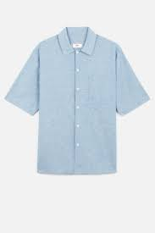
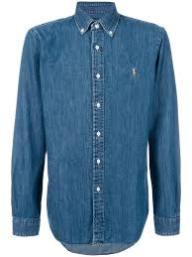
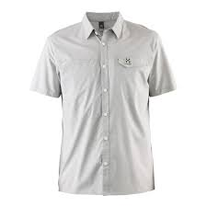
1. 一...也/都...不/没...(yì ...yě /dōu ...bù /méi)
These structures are used to form an emphatic negation meaning “not at all ” or “not even one.”
B.Topic(+Subject)+一(yī)+Measure Word+也/都(yě /dōu)+不/没(bù /méi)+Verb
3.这些衬衫我一件也不喜欢。
zhè xiē chèn shān wǒ yí jiàn yě bù xǐ huan.
I don`t like any of these shirts.

Slide 46
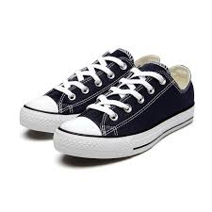
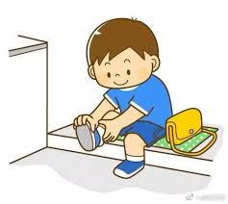
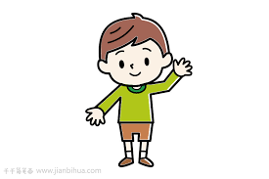
1. 一...也/都...不/没...(yì ...yě /dōu ...bù /méi)
These structures are used to form an emphatic negation meaning “not at all ” or “not even one.”
B.Topic(+Subject)+一(yī)+Measure Word+也/都(yě /dōu)+不/没(bù /méi)+Verb
4.哥哥的鞋，弟弟一双都不能穿。
gē ge de xié, dì di yì shuāng dōu bù néng chuān.
The younger brother cannot wear any of his older brother`s shoes.
哥哥的鞋
弟弟

Slide 47
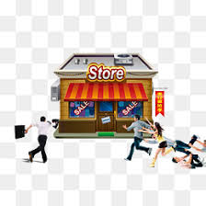
1. 一...也/都...不/没...(yì ...yě /dōu ...bù /méi)
These structures are used to form an emphatic negation meaning “not at all ” or “not even one.”
C.Subject+一点儿(yì diǎnr)+Object+也/都(yě /dōu)+不/没(bù /méi)+Verb
5.他去了商店，可是一点儿东西也没买。
tā qù le shāng diàn, kě shì yì diǎnr dōng xi yě méi mǎi.
He went to the store, but he didn`t buy anything at all.

Slide 48
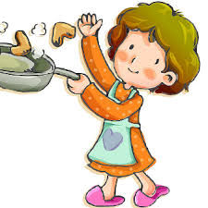
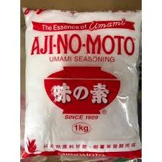
1. 一...也/都...不/没...(yì ...yě /dōu ...bù /méi)
These structures are used to form an emphatic negation meaning “not at all ” or “not even one.”
C.Subject+一点儿(yì diǎnr)+Object+也/都(yě /dōu)+不/没(bù /méi)+Verb
6.妈妈做菜一点儿味精都不放。
mā ma zuò cài yì diǎnr wèi jīng dōu bú fang.
Mom doesn`t use any MSG in her cooking.

Slide 49
1. 一...也/都...不/没...(yì ...yě /dōu ...bù /méi)
These structures are used to form an emphatic negation meaning “not at all ” or “not even one.”
If the noun after 一(yī) is countable, a proper measure word should be used between 一(yī) and the noun, as in(1),(2),(3), and (4). If the noun is uncountable, the phrase 一点儿(yì diǎnr) is usually used instead, as in (5) and (6)
(1a) 小李没有一个朋友。(X)
xiǎo lǐ méi yǒu yí ge péng yǒu.
(3a) 这些衬衫我不喜欢一件。(X)
zhè xiē chèn shān wǒ bù xǐ huan yí jiàn.
(5a) 他东西没买一点儿。(X)
tā dōng xī méi mǎi yì diǎnr.
小李一个朋友也没有。
Little Li does not have a single friend.
这些衬衫我一件也不喜欢。
I don`t like any of these shirts.
他一点儿东西也没买。
he didn`t buy anything at all.

Slide 50
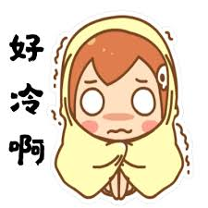
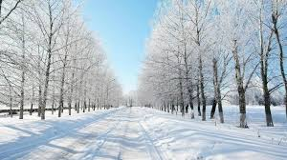
1. 一...也/都...不/没...(yì ...yě /dōu ...bù /méi)
These structures are used to form an emphatic negation meaning “not at all ” or “not even one.”
The construction 一点儿(yì diǎnr)+也/都(yě /dōu)+不(bù) can also be used before an adjective to express emphatic negation
7.这儿的冬天一点儿也不冷。
zhèr de dōng tiān yì diǎnr yě bù lěng.
Winter here is not cold at all.

Slide 51
1. 一...也/都...不/没...(yì ...yě /dōu ...bù /méi)
These structures are used to form an emphatic negation meaning “not at all ” or “not even one.”
The construction 一点儿(yì diǎnr)+也/都(yě /dōu)+不(bù) can also be used before an adjective to express emphatic negation
8.那个学校一点儿也不漂亮。
nà ge xué xiào yì diǎnr yě bú piào liang.
That school is not pretty at all.

Slide 52
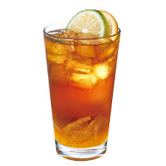
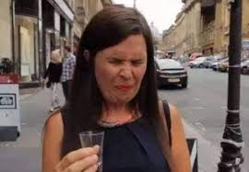
1. 一...也/都...不/没...(yì ...yě /dōu ...bù /méi)
These structures are used to form an emphatic negation meaning “not at all ” or “not even one.”
The construction 一点儿(yì diǎnr)+也/都(yě /dōu)+不(bù) can also be used before an adjective to express emphatic negation
9.这杯冰茶一点儿都不好喝。
zhè bēi bīng chá yì diǎnr dōu bù hǎo hē.
This glass of iced tea doesn`t taste good at all.

Slide 53
2. Adverb 多/少(duō /shǎo)+V
多(duō) and 少(shǎo) are two adjectives whose usage is rather unusual. To express the idea of doing something “more” or “less,” one place 多(duō) or 少(shǎo) before the verb.
1.爸爸告诉妈妈做菜的时候少放盐，多放点儿糖。
bà ba gào su mā ma zuò cài de shí hou shǎo fàng yán, duō fàng diǎnr táng.
Dad asked Mom to add less salt and more sugar when she cooks.
2.上中文课得多说中文，少说英文。
shàng zhōng wén kè děi duō shuō zhōng wén, shǎo shuō yīng wén.
In Chinese class, one should speak more Chinese and less English.

Slide 54
2. Adverb 多/少(duō /shǎo)+V
多(duō) and 少(shǎo) are two adjectives whose usage is rather unusual. To express the idea of doing something “more” or “less,” one place 多(duō) or 少(shǎo) before the verb.
3.你多找了我一块钱。
nǐ duō zhǎo le wǒ yí kuài qián.
You gave me one dollar too many.
4.老师说要写五十个字，我写了四十五个，少写了五个。
lǎo shī shuō yào xiě wǔ shí ge zì, wǒ xiě le sì shí wǔ ge, shǎo xiě le wǔ gè.
The teacher told us to write fifty characters, I wrote foerty-five. I was five short.

Slide 55
4. Resultative Complements(I)
Following a verb, an adjective or another verb can be used to denote the result of the action, hence the term resultative complement.
1.小白菜卖完了。
xiǎo bái cài mài wán le.
Baby bok choy is sold out.
2.你找错钱了。
nǐ zhǎo cuò qián le.
You gave me the incorrect change.

Slide 56
4. Resultative Complements(I)
Following a verb, an adjective or another verb can be used to denote the result of the action, hence the term resultative complement.
3.那个人是谁你看清楚了吗？
nà gè rén shì shuí nǐ kàn qīng chu le ma ？
Did you see clearly who that person was?
[清楚 qīng chu, clear]
4.太好了，这个字你写对了。
tài hǎo le, zhè ge zì nǐ xiě duì le.
Great! You wrote this character correctly.

Slide 57
4. Resultative Complements(I)
Generally, the negative form of a resultative complement is formed by placing 没(méi) or 没有(méi yǒu) before the verb.
1.小白菜卖完了。
xiǎo bái cài mài wán le.
Baby bok choy is sold out.
5.小白菜还没卖完。
xiǎo bái cài hái méi mài wán.
Baby bok choy is not sold out yet.

Slide 58
4. Resultative Complements(I)
Generally, the negative form of a resultative complement is formed by placing 没(méi) or 没有(méi yǒu) before the verb.
2.那个人是谁你看清楚了吗？
nà gè rén shì shuí nǐ kàn qīng chu le ma ？
Did you see clearly who that person was?
Positive form
Negative form
那个人我看清楚了。
nà ge rén wǒ kàn qīng chu le.
I see clearly who that person was.
6.那个人我没看清楚。
nà ge rén wǒ méi kàn qīng chu.
I didn`t see clearly who that person was.

Slide 59
4. Resultative Complements(I)
Generally, the negative form of a resultative complement is formed by placing 没(méi) or 没有(méi yǒu) before the verb.
4.太好了，这个字你写对了。
tài hǎo le, zhè ge zì nǐ xiě duì le.
Great! You wrote this character correctly.
Negative form
7.糟糕，这个字你没有写对。
zāo gāo, zhè ge zì nǐ méi yǒu xiě duì.
Shoot! You didn`t write this character correctly.

Slide 60
5. 好(hǎo) as a Resultative Complement
好(hǎo) can serve as a complement following a verb, indicating the completion of an action. It often indicates readiness to start the next action or event.
1.饭做好了，快来吃吧。
fàn zuò hǎo le, kuài lái chī ba.
The food is ready, Come and eat.
2.功课做好了，我要睡觉了。
gōng kè zuò hǎo le, wǒ yào shuì jiào le.
My homework is done. I want to go to bed.
3.衣服我已经帮你买好了，明天晚会你就可以穿了。
yī fu wǒ yǐ jīng bāng nǐ mǎi hǎo le, míng tiān wǎn huì nǐ jiù kě yǐ chuān le.
I`ve already bought the dress for you. You can wear it for the party tomorrow night.

Slide 61
1.In Beijing, 这么(zhè me) is commonly pronounced as zè me.
人怎么这么多？(rén zěn me zhè me duō?)
How come there are so many people?
2.点儿(diǎnr) here is the abbreviated form of 一点儿(yì diǎnr). When used to modify nouns, (一)点儿([yì]diǎnr) can soften the tone and therefore make the sentence more polite.
喝点儿什么呢？(hē diǎnr shén me ne )
What would you like to drink?

