Slide 1
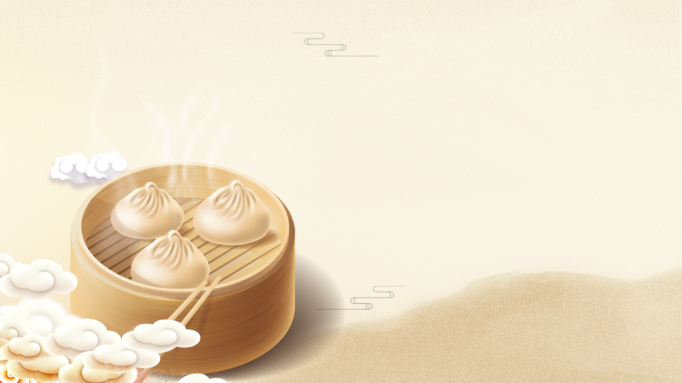
chī fàn
吃 饭
Dining
Li Xin Yu

Slide 2

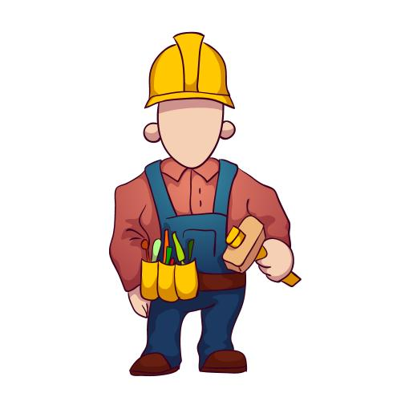

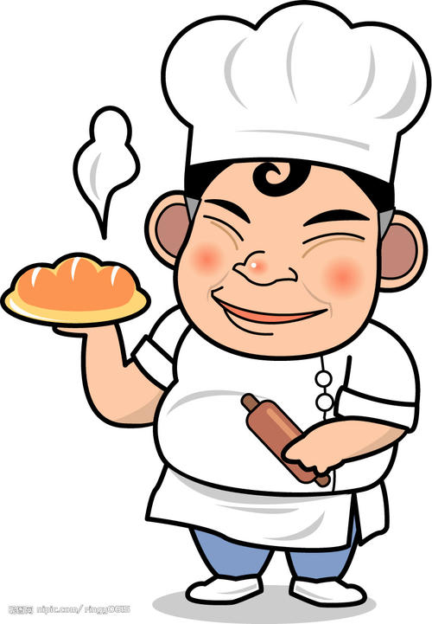
shī fu
师傅
master worker
师傅(shī fu, master worker) is a common term to address a stranger, especially a blue- collar worker such as a taxi driver or a chef.

Slide 3
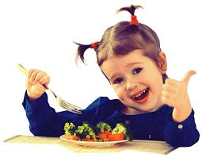
hǎo chī
好吃
delicious

Slide 4
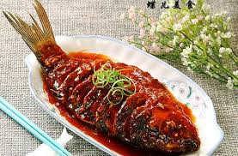
táng cù yú
糖醋鱼
fish in sweet and sour sauce

Slide 5
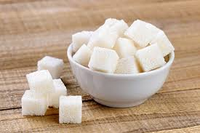
táng
糖
sugar

Slide 6
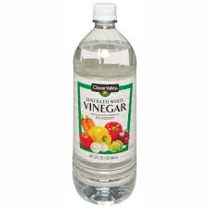
cù
醋
vinegar

Slide 7
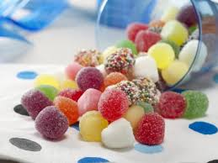
tián
甜
sweet

Slide 8
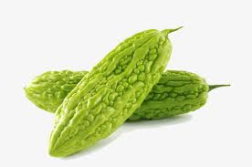
kǔ
苦
bitter
Bitter gourd

Slide 9
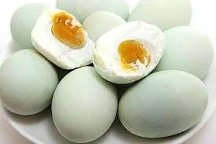
xián
咸
salty

Slide 10
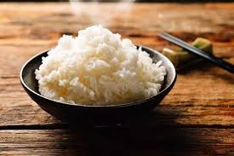
mǐ fàn
米饭
cooked rice

Slide 11
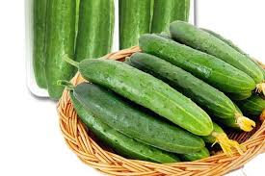
huáng gua
黄瓜
cucmber

Slide 12
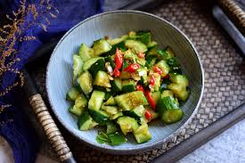
liáng bàn
凉拌
(of food) cold “blended”；cold tossed

Slide 13
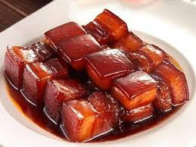
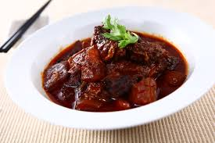
hóng shāo
红烧
to braise in soy sauce

Slide 14
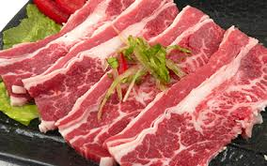
niú ròu
牛肉
beef

Slide 15
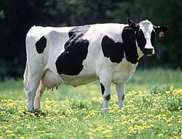
niú
牛
cow;ox

Slide 16
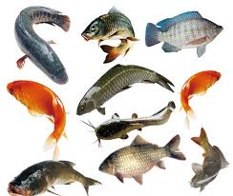
yú
鱼
fish

Slide 17

jí
极
extremely
When used after an adjective or a verb, 极了(jí le) usually indicates the superlative degree: 今天热极了。(jīn tiān rè jí le, it is extremely hot today) 他高兴极了。(tā gāo xìng jí le. he is overjoyed.)

Slide 18
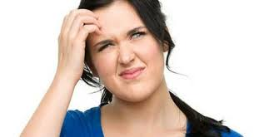
wàng
忘
to forget

Slide 19

dài
带
to bring; to take; to carry; to come with

Slide 20

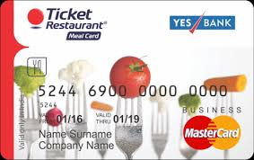
fàn kǎ
饭卡
meal card

Slide 21

cuò
错
wrong

Slide 22

qīng chu
清楚
clear

Slide 23
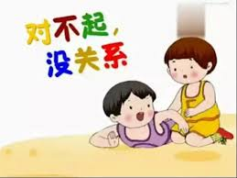
méi guān xi
没关系
it doesn`t matter
没关系(méi guān xi, it doesn`t matter): When someone apologizes by saying 对不起(duì bu qǐ), it is common to respond by saying 没关系(méi guān xi, it doesn`t matter)

Slide 24

shàng hǎi
上海
Shang hai

Slide 25
6. Reduplication of Adjectives
Some Chinese adjectives can be reduplicated. When monosyllabic adjectives are reduplicated, the accent usually falls on the second occurrence. When the reduplicated monosyllabic adjective takes a “r” suffix, like 慢慢儿(màn mānr), its second occurrence is usually pronounced in the first tone, regardless what the adjective`s original tone is. Reduplication of adjectives often suggests an approving and appreciative attitude on the speaker`s part.
1.王朋高高的，很帅。
wáng péng gāo gāo de, hěn shuài.
Wang Peng is tall and handsome.
2.可乐凉凉的，很好喝。
kě lè liáng liáng de, hěn hǎo hē.
The cola is nicely chilled and tastes good.

Slide 26
6. Reduplication of Adjectives
Some Chinese adjectives can be reduplicated. When monosyllabic adjectives are reduplicated, the accent usually falls on the second occurrence. When the reduplicated monosyllabic adjective takes a “r” suffix, like 慢慢儿(màn mànr), its second occurrence is usually pronounced in the first tone, regardless what the adjective`s original tone is. Reduplication of adjectives often suggests an approving and appreciative attitude on the speaker`s part.
3.酸辣汤酸酸的、辣辣的，非常好喝。
suān là tāng suān suān de, là là de, fēi cháng hǎo hē.
The hot and sour soup is a bit sour and a bit hot; it tastes great.
Reduplication of adjectives usually does not appear in the negative form.

Slide 27
7. The Verb 来(lái)
In colloquial expressions, the verb 来(lái) can serve as a substitute for certain verbs, mostly in imperative sentence：
1.A: 先生，你们想吃点儿什么？
xiān sheng, nǐ men xiǎng chī diǎnr shén me ？
Sir, what would you like?
B: 来一盘糖醋鱼，一碗酸辣汤和一碗米饭。
lái yì pán táng cù yú, yì wǎn suān là tāng hé yì wǎn mǐ fàn.
Give me a plate of sweet and sour fish, a bowl of hot and sour soup, and a bowl of rice, please.

Slide 28
7. The Verb 来(lái)
In colloquial expressions, the verb 来(lái) can serve as a substitute for certain verbs, mostly in imperative sentence：
(At a party, when someone has sung a song)
2.再来一个！
zài lái yí ge.
Encore!
The use of 来(lái) in this sense is rather limited. It is usually used in restaurants and stores, especially when buying small things or coaxing someone to sing a song.

