Slide 1

问路（Asking Directions)
Li Xin Yu
THIS IS A ART TEMPLATE , THANK YOU WATCHING THIS ONE. THIS IS A ART

Slide 2
上哪儿去(shàng nǎr qu) is a more casual way of asking 去哪儿(qu nǎr).
生词
shàng
上
to go [colloquial(ly)]
上哪儿去(shàng nǎr qu) is a more casual way of asking 去哪儿(qu nǎr)——where to go.

Slide 3
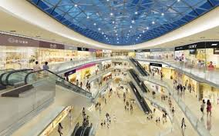

生词
zhōng xīn
中心
center

Slide 4



生词
王朋喜欢打球
tīng shuō
听说
王朋，听说你喜欢打球
to be told; to hear of
王朋

Slide 5

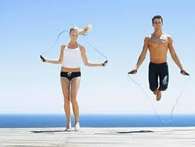

生词
yùn dòng
运动
sports

Slide 6

生词
chǎng
场
field

Slide 7
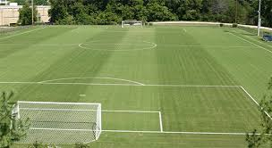
生词
yùn dòng chǎng
运动场
sports field

Slide 8
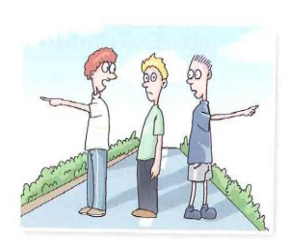
生词
páng biān
旁边
side

Slide 9
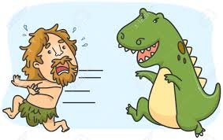
生词
lí
离
away from

Slide 10

生词
yuǎn
远
far

Slide 11

生词
jìn
近
near

Slide 12
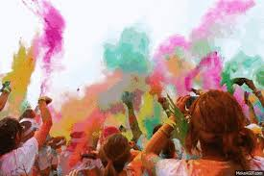
生词
huó dòng
活动
activity

Slide 13
生词
zhōng jiān
中间
middle

Slide 14

生词
shū diàn
书店
bookstore

Slide 15

生词
dì fang
地方
place

Slide 16

生词
lǐ bian
里边
inside

Slide 17
1.Direction and Location Words
Direction words 上/下/前/后/左/右/东/南/西/北/里/外/旁(shàng /xià /qián /hòu /zuǒ /yòu /dōng /nán /xī /běi /lǐ /wài /páng) often combine with suffixes such as 边(biān),面(miàn), and 头(tóu) are all pronounced in the neutral tone, with the exception of the 边(biān) in 旁边(páng biān), which remains in the full first tone.

Slide 18
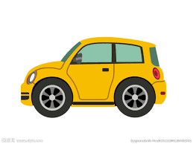
1.Direction and Location Words
上边/面/头
shàng bian /mian /tou
top
前边/面/头
qián bian /mian /tou
front
后边/面/头
hòu bian /mian /tou
back
下边/面/头
xià bian /mian /tou
bottom

Slide 19
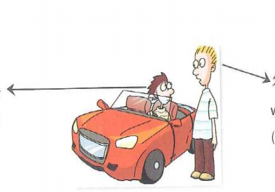
1.Direction and Location Words
外边/面/头
wài bian /mian /tou
outside
里边/面/头
lǐ bian /mian /tou
inside

Slide 20
1.Direction and Location Words
中间
zhōng jiān
middle
左边/面
zuǒ bian /mian
left side
右边/面
yòu bian /mian
right side
旁边
páng biān
side

Slide 21
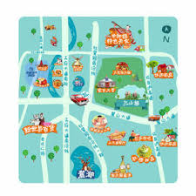
1.Direction and Location Words
北边/面
běi bian /mian
north side
西边/面
xī bian /mian
west side
东边/面
dōng bian /mian
east side
南边/面
nán bian /mian
south side

Slide 22
1.Direction and Location Words
Direction words 上(shàng, on) or 里(lǐ , in) combines with a noun to form a location expression, e.g., 桌子上(zhuō zi shang, on the table), 衣服上(yī fu shang, on the clothes), 书上(shū shang, in/on the book), 学校里(xué xiào li, in the school), 办公室里(bàn gōng shì li, on TV). The word 里(lǐ) cannot be used after some proper nouns such as the name of a country or a city.
学校里有很多学生。
xué xiào li yǒu hěn duō xué sheng.
There are many students at school.

Slide 23
1.Direction and Location Words
北京有很多学生。
běi jīng yǒu hěn duō xué sheng.
There are many students in Beijing.
北京里有很多学生。
běi jīng li yǒu hěn duō xué sheng.
There are many students in Beijing.
(V)
(X)

Slide 24
1.Direction and Location Words
The combination of a direction word plus 边(biān)/面(miàn)/头(tóu) can follow a noun to indicate a location, e.g., 图书馆(的)旁边(tú shū guǎn [de]páng biān,near the library); 学校(的)里面(xué xiào [de] lǐ mian, inside the school); 桌子(的)上头(zhuō zi [de] shàng tou, on the table); 教室(的)外面(jiāo shì [de] wài mian, outside the classroom); 城市(的)北边(chéng shì [de] běi bian, north of the city). In these expressions the particle 的(de) following the noun is optional.
Noun+(的)+direction word+边/面/头

Slide 25


2.Comparative Sentences with 没(有)(méi yǒu)
Besides using 比(bǐ), another way to make a comparison is to use 没(有)(méi yǒu). In a comparative sentence with 没有(méi yǒu), the pronoun 那么(nà me) is sometimes added to the sentence.
1.我弟弟没有我高。
wǒ dì di méi yǒu wǒ gāo.
My younger brother is not as tall as I am.【I am taller than my brother.】
弟弟
我

Slide 26
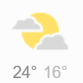
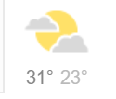
2.Comparative Sentences with 没(有)(méi yǒu)
Besides using 比(bǐ), another way to make a comparison is to use 没(有)(méi yǒu). In a comparative sentence with 没有(méi yǒu), the pronoun 那么(nà me) is sometimes added to the sentence.
2.北京没有上海热。
běi jīng méi yǒu shàng hǎi rè.
It is not as hot in Beijing as in Shanghai.
北京
上海

Slide 27
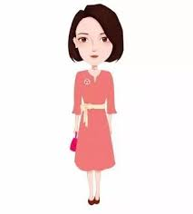

2.Comparative Sentences with 没(有)(méi yǒu)
Besides using 比(bǐ), another way to make a comparison is to use 没(有)(méi yǒu). In a comparative sentence with 没有(méi yǒu), the pronoun 那么(nà me) is sometimes added to the sentence.
3.他姐姐没有他妹妹那么喜欢买东西。
tā jiě jie méi yǒu tā mèi mei nà me xǐ huan mǎi dōng xi.
(His older sister does not like shopping as much as his younger sister does.)
【His older sister might like shopping too, but not as much as his younger sister.】
like shopping
like shopping very much
姐姐
妹妹

Slide 28


2.Comparative Sentences with 没(有)(méi yǒu)
Besides using 比(bǐ), another way to make a comparison is to use 没(有)(méi yǒu). In a comparative sentence with 没有(méi yǒu), the pronoun 那么(nà me) is sometimes added to the sentence.
4.我没有她那么喜欢刷卡。
wǒ méi yǒu tā nà me xǐ huan shuā kǎ.
【I do use credit cards, but she likes to use them more than I do.】
like use credit cards
like use credit cards very much
我
她

Slide 29
2.Comparative Sentences with 没(有)(méi yǒu)
A. 没有(méi yǒu) B... vs. A 不比(bù bǐ) B...
While 没有(méi yǒu)... is used to say that one thing is of a lesser degree than another, 不比(bù bǐ)... mean “no more than...” The two things being compared may be equal, but what is specifically stated is that A is no more than B.

Slide 30
2.Comparative Sentences with 没(有)(méi yǒu)
A. 没有(méi yǒu) B... vs. A 不比(bù bǐ) B...
5.A:今天比昨天热吗？
jīn tiān bǐ zuó tiān rè ma ？
Is today hotter than yesterday?
B:今天不比昨天热。
jīn tiān bù bǐ zuó tiān rè.
Today is not any hotter than yesterday.【It could be the same temperature
or cooler than yesterday.】
C:今天没有昨天热。
jīn tiān méi yǒu zuó tiān rè.
Today is not as hot as yesterday. 【Today is cooler.】

Slide 31
2.Comparative Sentences with 没(有)(méi yǒu)
A. 没有(méi yǒu) B... vs. A 不比(bù bǐ) B...
6.A:这篇课文比那篇课文短吗？
zhè piān kè wén bǐ nà piān kè wén duǎn ma?
Is this text shorter than that one?
B: 这篇课文不比那篇课文短，两篇一样长。
zhè piān kè wén bù bǐ nà piān kè wén duǎn, liǎng piān yí yàng cháng.
This text is not any shorter than that one. They are the same length.
C: 是吗？我觉得这篇课文没有那篇长。
shì ma? wǒ jué de zhè piān kè wén méi yǒu nà piān cháng.
Really? I think this text is not as long as that one.
【This text is shorter than that one.】

Slide 32
2.Comparative Sentences with 没(有)(méi yǒu)
A. Quick Summary of Comparative Sentences
A 比(bǐ) B 大(dà) A>B
A不比(bù bǐ) B 大(dà) A≤B
A没有(méi yǒu) B 大(dà) A<B

Slide 33
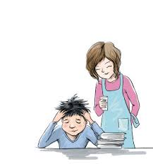


3.那么(nà me) Indicating Degree
那么(nà me) is often placed before adjectives or verbs such as 想(xiǎng), 喜欢(xǐ huan), 会(huì), 能(néng), and 希望(xī wàng), to denote a high degree.
1. 你那么不喜欢写日记，就别写了吧。
nǐ nà me bù xǐ huan xiě rì jì, jiù bié xiě le ba.
Since you dislike writing journals so much, why don`t you quit doing it ?

Slide 34


3.那么(nà me) Indicating Degree
没有...那么...(méi yǒu...nà me...) means “not reaching the point of.”
2.弟弟没有哥哥那么帅，那么酷。
dì di méi yǒu gē ge nà me shuài, nà me kù.
The younger brother is not as handsome and cool as the older brother.
帅、酷
弟弟
哥哥

Slide 35
3.那么(nà me) Indicating Degree
没有...那么...(méi yǒu...nà me...) means “not reaching the point of.”
By using 那么(nà me), the speaker affirms the certain attribute of something or somebody in question. By stating that the younger brother does not reach the same standard of handsomeness and coolness as the older brother, (2), for instance, acknowledges that the older brother is handsome and cool.

Slide 36
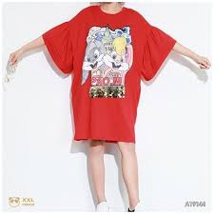
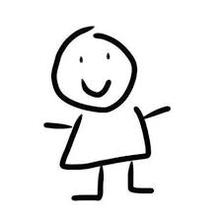
3.那么(nà me) Indicating Degree
没有...那么...(méi yǒu...nà me...) means “not reaching the point of.”
3.这个样子没有你说的那么合适。
zhè ge yàng zi méi yǒu nǐ shuō de nà me hé shì.
This style is not as suitable as you said.
合适

Slide 37
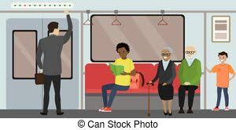

3.那么(nà me) Indicating Degree
没有...那么...(méi yǒu...nà me...) means “not reaching the point of.”
4.坐地铁没有坐公共汽车那么麻烦。
zuò dì tiě méi yǒu zuò gōng gòng qì chē nà me má fán.
Riding the subway is not as much of a hassle as riding the bus.
麻烦

Slide 38


3.那么(nà me) Indicating Degree
没有...那么...(méi yǒu...nà me...) means “not reaching the point of.”
5.这张地图没有那张地图那么新。
zhè zhāng dì tú méi yǒu nà zhāng dì tú nà me xīn。
This map is not as new as that one.
新

Slide 39


4.到(dào)+Place+去(qù)+Action
In this structure, the combination of “到(dào)+Place+去(qù)+Action” denotes the purpose of going somewhere.
1.我要到电脑中心去上网。
wǒ yào dào diàn nǎo zhōng xīn qù shàng wǎng.
I want to go to the computer center to use the internet.
我

Slide 40
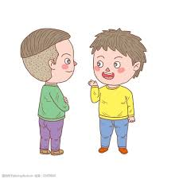

4.到(dào)+Place+去(qù)+Action
In this structure, the combination of “到(dào)+Place+去(qù)+Action” denotes the purpose of going somewhere.
2.他到朋友的宿舍去聊天儿了。
tā dào péng you de sù shè qù liáo tiānr le.
He went to his friend`s dorm to chat.

Slide 41



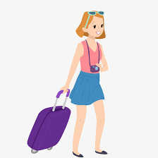
4.到(dào)+Place+去(qù)+Action
In this structure, the combination of “到(dào)+Place+去(qù)+Action” denotes the purpose of going somewhere.
3.我们到飞机场去送李小姐。
wǒ men dào fēi jī chǎng qù sòng lǐ xiǎo jiě.
We went to the airport to see Miss Li off.
李小姐

Slide 42
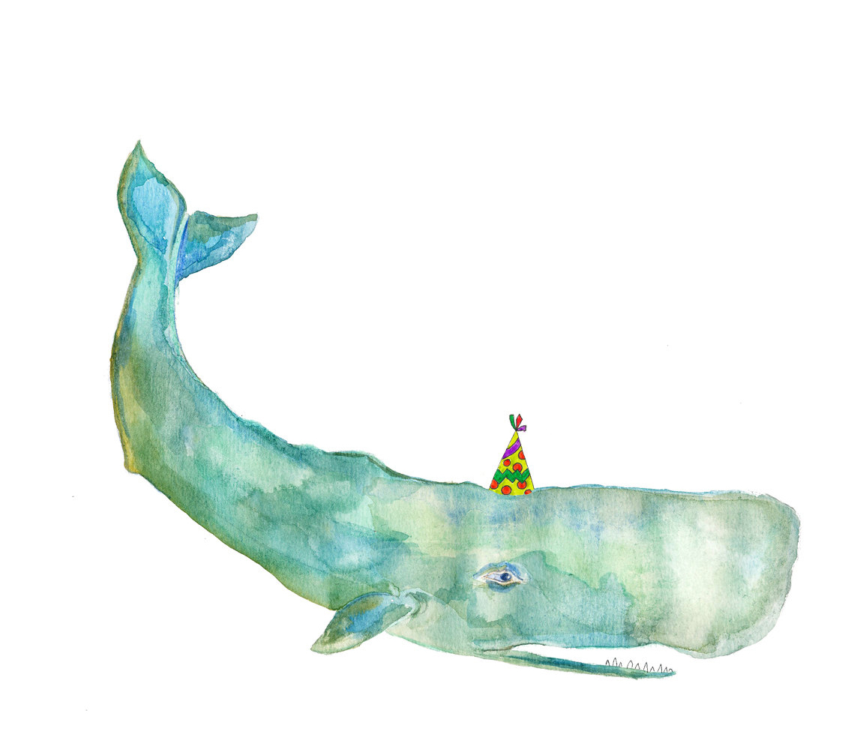
1.Here 哪里(nǎ li) is a question word meaning “where” It is interchangeable with 哪儿(nǎr). People in northern China, especially in Beijing, speak with an “儿(ér) ending” quite often. For example, some people say 明儿(míngr) for “tomorrow” instead of 明天(míng tiān), and 这儿(zhèr) for “here” instead of 这里(zhè li).
2.什么地方(shén me dì fang,lit., what place) is generally interchangeable with 哪儿(nǎr) or 哪里( nǎ li).

