Slide 1

问路（Asking Directions)
Li Xin Yu
THIS IS A ART TEMPLATE , THANK YOU WATCHING THIS ONE. THIS IS A ART

Slide 2
生词
guo
过
(particle used after a verb to indicate a past experience

Slide 3

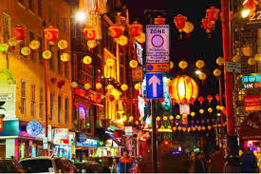
生词
zhōng guó chéng
中国城
Chinatown

Slide 4

生词
chéng
城
town; city

Slide 5

生词
dì tú
地图
map

Slide 6


生词
ná
拿
to take; to get

Slide 7
生词
三次考试
sān cì kǎo shì
Three exams
一次旅行
yí cì lǚ xíng
A trip
cì
次
(measure word for frequency)

Slide 8


生词
cóng
从
from

Slide 9
生词
yì zhí
一直
一直直走。
yì zhí zhí zǒu
Keep going straight.
straight； continuously

Slide 10
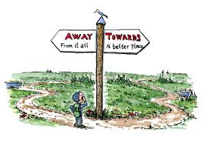
生词
wǎng
往
towards

Slide 11

生词
guò
过
to pass

Slide 12
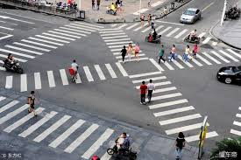
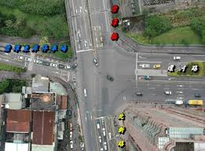
生词
lù kǒu
路口
intersection

Slide 13


生词
guǎi
拐
to turn
拐(guǎi), in the sense of “ to turn,” is used mainly in northern China. In the south, 转(zhuǎn) is more commonly used instead, which is also the more formal substitute for 拐(guǎi) in the north.

Slide 14

生词
āi
哎
(exclamatory particle to express surprise or dissatisfaction)

Slide 15
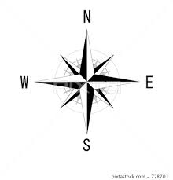
生词
dōng
东
east

Slide 16
生词
nán
南
south

Slide 17
生词
xī
西
west

Slide 18
生词
běi
北
north

Slide 19
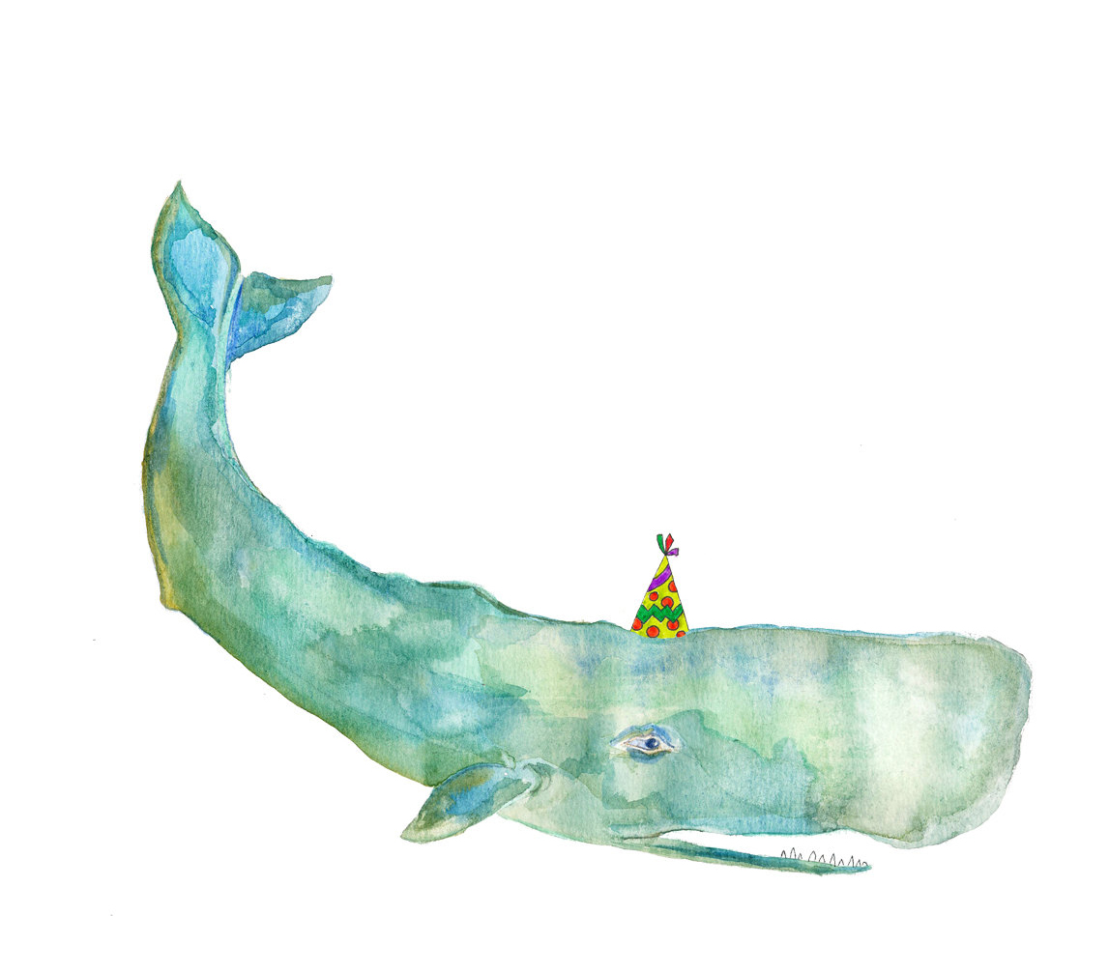
Chinese speakers customarily mention the four directions in a set sequence, 东南西北(dōng nán xī běi) or 东西南北(dōng xī nán běi). For southeast and northeast, one says 东南(dōng nán) and 东北(dōng běi), never 南东(nán dōng) or 北东(běi dōng). Similarly, for southwest and northwest, one says 西南(xī nán) and 西北(xī běi), never 南西(nán xī) or 北西(běi xī)

Slide 20

生词
qián
前
forward；ahead

Slide 21
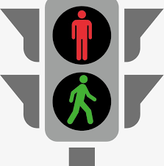

生词
hóng lǜ dēng
红绿灯
traffic light

Slide 22

生词
dēng
灯
light

Slide 23

生词
yòu
右
right

Slide 24
生词
zuǒ
左
left

Slide 25
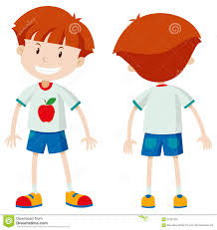
生词
qián mian
前面
ahead; in front of

Slide 26
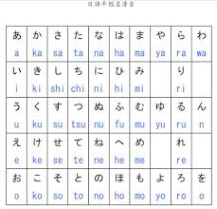
生词
rì wén
日文
Japanses

Slide 27
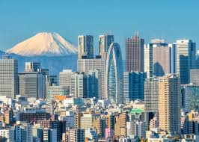
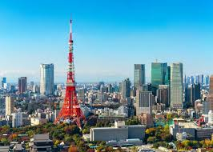
生词
dōng jīng
东京
Tokyo

Slide 28

生词
rì běn
日本
Japan

Slide 29
5.The Dynamic Particle 过(guo)
The dynamic particle 过(guo) is used to denote a past experience or occurrence that did not continue to the present but, typically, had an impact on the present.
1.我在中国城工作过一年，所以我知道怎么走。
wǒ zài zhōng guó chéng gōng zuò guo yì nián, suǒ yǐ wǒ zhī dào
zěn me zǒu.
I worked in Chinatown for a year, so I know how to get there.
[The fact that the speaker worked in Chinatown for a year is the
reason why he/she knows how to get there.]

Slide 30
5.The Dynamic Particle 过(guo)
The dynamic particle 过(guo) is used to denote a past experience or occurrence that did not continue to the present but, typically, had an impact on the present.
2.我见过李友，(所以知道）她很高。
wǒ jiàn guo lǐ yǒu, (suǒ yǐ zhī dào）tā hěn gāo.
I`ve met Li You before, (so I know) she is tall.

Slide 31
5.The Dynamic Particle 过(guo)
The dynamic particle 过(guo) is used to denote a past experience or occurrence that did not continue to the present but, typically, had an impact on the present.
3.A: 运动场远不远，你知道吗？
yùn dòng chǎng yuǎn bù yuǎn, nǐ zhī dào ma ？
Do you know if the sports field is far from here?
B: 运动场我去过，(所以我知道）不远，很近。
yùn dòng chǎng wǒ qù guo, (suǒ yǐ wǒ zhī dào) bù yuǎn, hěn jìn.
I`ve been to the sports field, (so I know) it is not far away. It`s very close.

Slide 32
5.The Dynamic Particle 过(guo)
In this kind of sentence,expressions of time are often either unspecified or completely absent. If there is no time expression, the implied time for the action or event is 以前(yǐ qián) can appear in the sentence as well.
4.我以前去过中国城，知道怎么走。
wǒ yǐ qián qù guo zhōng guó chéng, zhī dào zěn me zǒu.
I`ve been to Chinatown before. I know how to get there.
5.以前我们见过面，可是没说过话。
yǐ qián wǒ men jiàn guo miàn, kě shì méi shuō guo huà.
We`re met before, but we `ve never spoken to each other.

Slide 33
5.The Dynamic Particle 过(guo)
An expression indicating a specific time can also occasionally appear in a sentence with 过(guo).
6. A: 你见过李小姐吗？
nǐ jiàn guo lǐ xiǎo jiě ma ？
Have you ever met Miss Li ?
B: 见过, 上个月还见过她。
jiàn guo, shàng ge yuè hái jiàn guo tā.
Yes, I saw her as recently as last month.

Slide 34
6.Reduplication of Verbs
Like adjectives, verbs can also be reduplicated. Reduplication of a verb in this lesson refers to an anticipated or requested action, and it makes the tone of the sentence milder.
1. 老师，您再说说什么时候用”了“，好吗？
lǎo shī, nín zài shuō shuo shén me shí hou yòng ”le “, hǎo ma ?
Teacher, would you say a bit more about when to use “le”, please?

Slide 35
6.Reduplication of Verbs
Like adjectives, verbs can also be reduplicated. Reduplication of a verb in this lesson refers to an anticipated or requested action, and it makes the tone of the sentence milder.
2.你考完试，我们一起去公园走走，聊聊天儿。
nǐ kǎo wán shì, wǒ men yì qǐ qù zǒu gōng yuán zǒu zou, liáo liao
tiānr.
Let`s take a walk in the park and have a chat after your exam.

Slide 36
6.Reduplication of Verbs
Like adjectives, verbs can also be reduplicated. Reduplication of a verb in this lesson refers to an anticipated or requested action, and it makes the tone of the sentence milder.
3. 妈，您看，我这样写对不对？
mā, nín kàn , wǒ zhè yàng xiě duì bu duì ？
Mom, take a look——did I write this correctly or not ?
3a 妈，您看看，我这样写对不对？
mā, nín kàn kan, wǒ zhè yàng xiě duì bu duì ？
Mom, take a look——did I write this correctly or not ?

Slide 37
6.Reduplication of Verbs
Like adjectives, verbs can also be reduplicated. Reduplication of a verb in this lesson refers to an anticipated or requested action, and it makes the tone of the sentence milder.
4. 我用你的电脑可以吗？
wǒ yòng nǐ de diàn nǎo kě yǐ ma ？
May I use your computer for a minute ?
4a. 我用用你的电脑可以吗？
wǒ yòng yong nǐ de diàn nǎo kě yǐ ma ？
May I use your computer for a minute ?

Slide 38
6.Reduplication of Verbs
Like adjectives, verbs can also be reduplicated. Reduplication of a verb in this lesson refers to an anticipated or requested action, and it makes the tone of the sentence milder.
5.你帮我找我的笔，好吗？
nǐ bāng wǒ zhǎo wǒ de bǐ, hǎo ma ？
Could you heip me look for my pen for a second ?
5.你帮我找找我的笔，好吗？
nǐ bāng wǒ zhǎo zhao wǒ de bǐ, hǎo ma ？
Could you heip me look for my pen for a second ?

Slide 39
6.Reduplication of Verbs
If a sentence includes both a modal verb and an action verb, only the action verb can be reduplicated.
6. 她想看我的新手机。
tā xiǎng kàn wǒ de xīn shǒu jī.
She wants to take a look at my new cell phone.
6a.她想看看我的新手机。
tā xiǎng kàn kan wǒ de xīn shǒu jī.
She wants to take a look at my new cell phone.

Slide 40
7.Resultative Complements
Let`s review all the resultative complements that we have introduced so far, and learn some new ones that can be formed from the verbs and complements you already know.
a. 完(wán):
看完(kàn wán) (finish reading)
吃完(chī wán) (finish eating)
喝完(hē wán) (finish drinking)
考完(kǎo wán) (finish taking a test)
买完(mǎi wán) (finish buying)
卖完(mài wán) (sell out)

Slide 41
7.Resultative Complements
Let`s review all the resultative complements that we have introduced so far, and learn some new ones that can be formed from the verbs and complements you already know.
b. 到(dào):
找到(zhǎo dào) (find[something or someone] successfully)
看到(kàn dào) (see[something or someone])
听到(tīng dào) (hear[something or someone])
买到(mǎi dào) (buy[something] successfully)

Slide 42
7.Resultative Complements
Let`s review all the resultative complements that we have introduced so far, and learn some new ones that can be formed from the verbs and complements you already know.
c. 见(jiàn)
看见(kàn jiàn)
(see [something or someone])——same as 看到(kàn dào)
听见(tīng jiàn)
(hear[something or someone])——same as 听到(tīng dào)

Slide 43
7.Resultative Complements
Let`s review all the resultative complements that we have introduced so far, and learn some new ones that can be formed from the verbs and complements you already know.
d. 好(hǎo):
做好(zuò hǎo)
(complete doing something, which is now ready)
买好(mǎi hǎo)
(complete buying something, which is now ready)
准备好(zhǔn bèi hǎo)
(prepare something, which is ready)

Slide 44
7.Resultative Complements
Let`s review all the resultative complements that we have introduced so far, and learn some new ones that can be formed from the verbs and complements you already know.
e. 错(cuò):
买错(mǎi cuò) (buy the wrong thing)
找错(zhǎo cuò) (give the wrong change;find the wrong
person or thing)
写错(xiě cuò) (write[something] incorrectly)
说错(shuō cuò) (say[something] incorrectly)
走错(zǒu cuò) (go to wrong way)

Slide 45
7.Resultative Complements
Let`s review all the resultative complements that we have introduced so far, and learn some new ones that can be formed from the verbs and complements you already know.
f. 懂(dǒng):
听懂(tīng dǒng) (comprehend what one hears)
看懂(kàn dǒng) (comprehend what one reads or sees)

Slide 46
7.Resultative Complements
Let`s review all the resultative complements that we have introduced so far, and learn some new ones that can be formed from the verbs and complements you already know.
g. 清楚(qīng chu):
看清楚(kàn qīng chu) (see[something] clearly)
听清楚(tīng qīng chu) (hear[something] clearly)

Slide 47
7.Resultative Complements
Let`s review all the resultative complements that we have introduced so far, and learn some new ones that can be formed from the verbs and complements you already know.
h. 会(huì)
学会(xué huì)
(acquire the skills[for doing something that one was previously
unable to do])

Slide 48



8. 一...就...(yī ...jiù ... as soon as... then...)
This structure connects two actions. It can be used to combine actions in two different types of situations: habitual situations or one-time situations. In a habitual situation, whenever the first action occurs, the second action immediately follows:
1.他一上课就想睡觉。
tā yí shàng kè jiù xiǎng shuì jiào.
He feels sleepy every time the class starts.

Slide 49


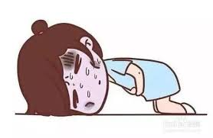
8. 一...就...(yī ...jiù ... as soon as... then...)
This structure connects two actions. It can be used to combine actions in two different types of situations: habitual situations or one-time situations. In a habitual situation, whenever the first action occurs, the second action immediately follows:
2.小张平常只吃青菜，一吃肉就不舒服。
xiǎo zhāng píng cháng zhǐ chī qīng cài, yì chī ròu jiù bù shū fu.
Little Zhang normally eats only vegetables. He feels sick whenever he eats meat.
小张

Slide 50


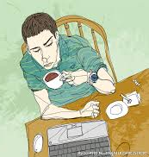
8. 一...就...(yī ...jiù ... as soon as... then...)
This structure connects two actions. It can be used to combine actions in two different types of situations: habitual situations or one-time situations. In a habitual situation, whenever the first action occurs, the second action immediately follows:
3.李律师一累就喝咖啡。
lǐ lǜ shī yí lèi jiù hē kā fēi.
Attorney Li drinks coffee whenever he feels tired.
李律师

Slide 51
8. 一...就...(yī ...jiù ... as soon as... then...)
In a one-time situation, the second action takes place as soon as the first is completed:
4.我们一进饭馆儿，服务员就告诉我们没位子了。
wǒ men yí jìn fàn guǎnr, fú wù yuán jiù gào sù wǒ men méi wèi zi le.
As soon as we got into the restaurant, the waiter told us there were no seats available.

Slide 52
8. 一...就...(yī ...jiù ... as soon as... then...)
In a one-time situation, the second action takes place as soon as the first is completed:
5.这课的语法很容易，我一看就懂。
zhè kè de yǔ fǎ hěn róng yì ，wǒ yí kàn jiù dǒng.
The grammar in this lesson was very easy. I understood it the moment I read it.
6.活动中心离这儿不远，到第二个路口，往右一拐就到了。
huó dòng zhōng xīn lí zhèr bù yuǎn, dào dì èr ge lù kǒu, wǎng yòu yì guǎi jiù
dào le.
The activity center is not far from here. Turn right at the second intersection, and
you`ll be there.

Slide 53
没问题(méi wèn tí, no problem) vs 没关系(méi guān xi, it doesn`t matter): One uses 没问题(méi wèn tí) to assure someone that their request will be met or a problem will be solved, e.g.”开车送你去机场？没问题！”(kāi chē sòng nǐ qù jī chǎng ？méi wèn tí. Drive you to the airport? No problem!) 没关系(méi guān xi), on the other hand, downplays the severity or impact of an issue, and is often used in response to someone`s apology for a minor mistake.

