Slide 1




Party
shēng rì wǎn huì
生日晚会
LI XIN YU

Slide 2

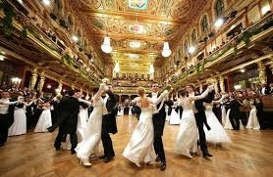
wǔ huì
舞会
dance party; ball

Slide 3

1.爸爸姐姐/妹妹的女儿
biǎo jiě
3.妈妈的哥哥/弟弟的女儿
表姐
older female cousin
2.妈妈的姐姐/妹妹的女儿

Slide 4
The kinship term 表姐(biǎo jiě) is more narrowly defined than its translation “oider female cousin” would suggest. One`s “older female cousin” will be a 表姐(biǎo jiě) if she is a daughter of one`s father`s sisiter or one`s mother`s sister or brother. But if she is one`s paternal uncle`s daughter, she will then be a 堂姐(táng jiě) instead of a 表姐(táng jiě). For more Chinese kinship terms.

Slide 5
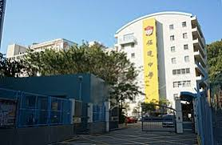
zhōng xué
中学
middle school; secondary school

Slide 6


年龄 | 学校
6岁 | 小学1年级
7岁 | 小学2年级
8岁 | 小学3年级
9岁 | 小学4年级
10岁 | 小学5年级
11岁 | 小学6年级
12岁 | 初中1年级
13岁 | 初中2年级
14岁 | 初中3年级
15岁 | 高中1年级
16岁 | 高中2年级
17岁 | 高中3年级
18岁 | 大学1年级
中学

Slide 7

sòng
送
to give as a gift

Slide 8
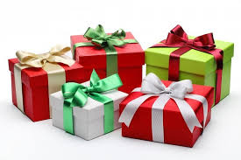
lǐ wù
礼物
gift;present

Slide 9

běn
本
(measure word for books)

Slide 10
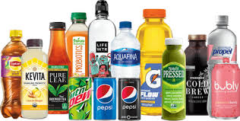
yǐn liào
饮料
beverage

Slide 11
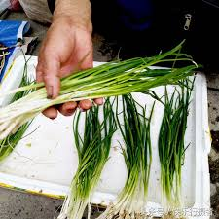
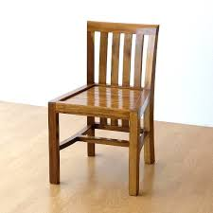
bǎ
把
(measure word for bunches of things, and chairs)

Slide 12
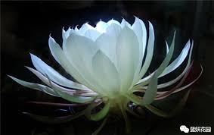


huā
花
flower

Slide 13


ài
爱
to love; to like; to be fond of

Slide 14
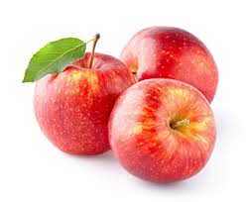
píng guǒ
苹果
apple

Slide 15
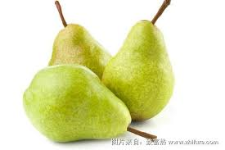
lí
梨
pear

Slide 16
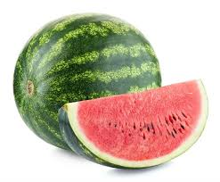
xī gua
西瓜
watermelon

Slide 17
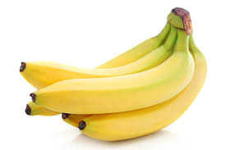
xiāng jiāo
香蕉
banana

Slide 18
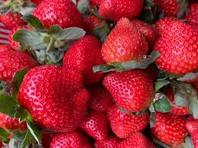
cǎo méi
草莓
Strawberry

Slide 19
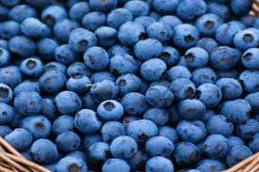
lán méi
蓝莓
blueberry

Slide 20
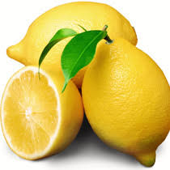
níng méng
柠檬
lemon

Slide 21
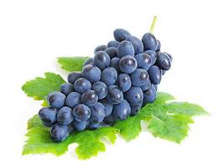
pú táo
葡萄
grape

Slide 22
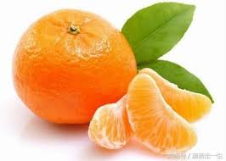
jú zi
桔子
orange

Slide 23
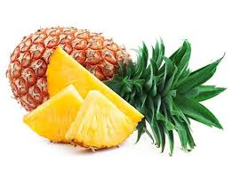
bō luó/ fèng lí
菠萝/凤梨
pineapple

Slide 24
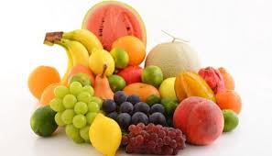
shuǐ guǒ
水果
fruit

Slide 25
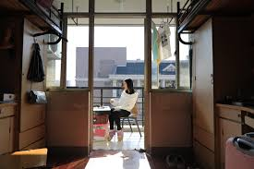
zhù
住
to live (in a certain place)
我住在宿舍。
I live in a dormitory

Slide 26
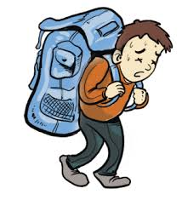
zhòng
重
heavy; serious

Slide 27

qīng
轻
light, soft, gentle

Slide 28
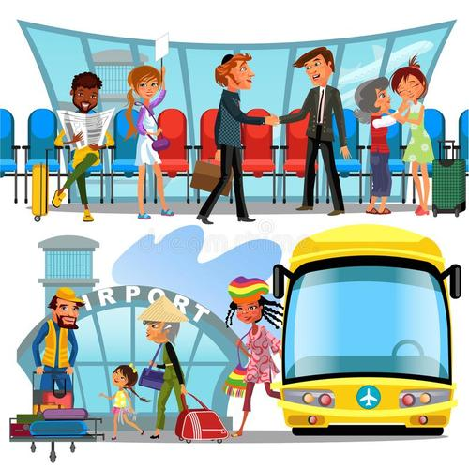
jiē
接
to catch; to meet; to welcome

Slide 29
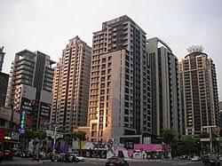
lóu
楼
multi-storied building; floor(of a multi-level building
A:你家住几楼？ A: How many floors do you live in?
B:我家住22楼 B: I lives on the 22nd floor

Slide 30
1.呢(ne) Indicating an Action in Progress
呢(ne), at the end of a sentence, indicates that the action is in progress. It is like 在(zài), which is never used at the end of a sentence, but rather before a verb.
1. 你写什么呢？
nǐ xiě shén me ne ？
What are you writing?
2. 你找什么呢？
nǐ zhǎo shén me ne ？
What are you looking for?

Slide 31
1.呢(ne) Indicating an Action in Progress
呢(ne) can be used in conjunction with 在(zài):
3. 你在写什么呢？
nǐ zài xiě shén me ne ？
What are you writing?
4. 你在找什么呢？
nǐ zài zhǎo shén me ne ？
What are you looking for?
在(zài) alone indicates that an action is in progress, therefore, the 呢(ne) in (3) and (4) above can be omitted.

Slide 32
1.呢(ne) Indicating an Action in Progress
在(zài) can be preceded by 正(zhèng). The phrase 正在(zhèng zài) places extra emphasis on the progressive nature of an action.
5. 我昨天给他打电话的时候，他正在做功课呢。
wǒ zuó tiān gěi tā dǎ diàn huà de shí hou, tā zhèng zài zuò gōng kè ne.
When I called him yesterday, he was right in the middle of doing his homework.
6. 别去找他，他正在睡觉呢。
bié qù zhǎo tā, tā zhèng zài shuì jiào ne.
Don`t go look for him. He is sleeping.

Slide 33

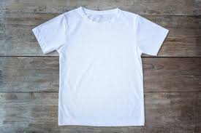
2.Verbal Phrases and Subject-Predicate Phrases Used as Attributives
In Chinese, attributives, often followed by the particle 的(de), always appear before the elements that they modify. Verbs, verbal phrases, and subject-object phrases can all serve as attributives.
1.买的衣服。
mǎi de yī fu.
clothes to buy.

Slide 34
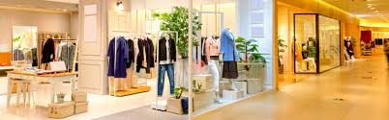
2.Verbal Phrases and Subject-Predicate Phrases Used as Attributives
In Chinese, attributives, often followed by the particle 的(de), always appear before the elements that they modify. Verbs, verbal phrases, and subject-object phrases can all serve as attributives.
2.在商店买的衣服。
zài shāngdiàn mǎi de yī fu.
Clothes bought in a store.

Slide 35
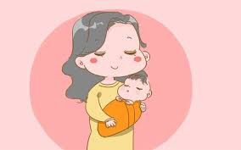
2.Verbal Phrases and Subject-Predicate Phrases Used as Attributives
In Chinese, attributives, often followed by the particle 的(de), always appear before the elements that they modify. Verbs, verbal phrases, and subject-object phrases can all serve as attributives.
3.我妈妈在商店买的衣服。
wǒ māma zài shāngdiàn mǎi de yī fú.
Clothes that my mother bought in a store.

Slide 36
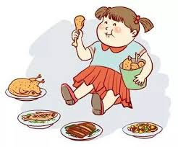
2.Verbal Phrases and Subject-Predicate Phrases Used as Attributives
In Chinese, attributives, often followed by the particle 的(de), always appear before the elements that they modify. Verbs, verbal phrases, and subject-object phrases can all serve as attributives.
1.吃的东西
chī de dōng xi
things to eat

Slide 37
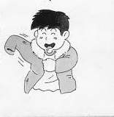
2.Verbal Phrases and Subject-Predicate Phrases Used as Attributives
In Chinese, attributives, often followed by the particle 的(de), always appear before the elements that they modify. Verbs, verbal phrases, and subject-object phrases can all serve as attributives.
2.穿的衣服
chuān de yī fu
clothes to wear, or clothes being worn.

Slide 38
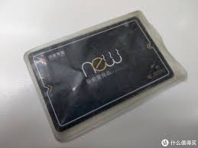
2.Verbal Phrases and Subject-Predicate Phrases Used as Attributives
In Chinese, attributives, often followed by the particle 的(de), always appear before the elements that they modify. Verbs, verbal phrases, and subject-object phrases can all serve as attributives.
3.新买的饭卡
xīn mǎi de fàn kǎ
newly-bought meal cards

Slide 39

2.Verbal Phrases and Subject-Predicate Phrases Used as Attributives
In Chinese, attributives, often followed by the particle 的(de), always appear before the elements that they modify. Verbs, verbal phrases, and subject-object phrases can all serve as attributives.
5.以前认识的朋友
yǐ qián rèn shi de péng you
the friend[s] one got acquainted with in the past

Slide 40
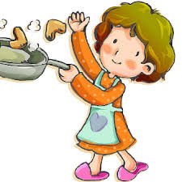
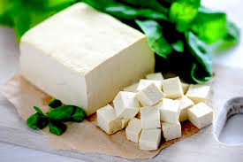
2.Verbal Phrases and Subject-Predicate Phrases Used as Attributives
In Chinese, attributives, often followed by the particle 的(de), always appear before the elements that they modify. Verbs, verbal phrases, and subject-object phrases can all serve as attributives.
6.我妈妈做的豆腐
wǒ mā ma zuò de dòu fu
the tofu dish that my mother makes/made

Slide 41

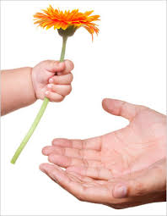

2.Verbal Phrases and Subject-Predicate Phrases Used as Attributives
In Chinese, attributives, often followed by the particle 的(de), always appear before the elements that they modify. Verbs, verbal phrases, and subject-object phrases can all serve as attributives.
7.老师给我们的功课
lǎo shī gěi wǒ men de gōng kè
the homework the teacher assigned us

Slide 42

2.Verbal Phrases and Subject-Predicate Phrases Used as Attributives
In Chinese, attributives, often followed by the particle 的(de), always appear before the elements that they modify. Verbs, verbal phrases, and subject-object phrases can all serve as attributives.
8.朋友送的苹果
péng you sòng de píng guǒ
the apples given by a friend

Slide 43
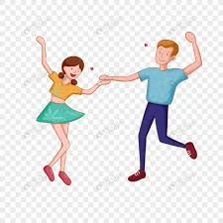
2.Verbal Phrases and Subject-Predicate Phrases Used as Attributives
In Chinese, attributives, often followed by the particle 的(de), always appear before the elements that they modify. Verbs, verbal phrases, and subject-object phrases can all serve as attributives.
9.请你跳舞的那个人
qǐng nǐ tiào wǔ de nà gè rén
that person who asked you to dance

Slide 44
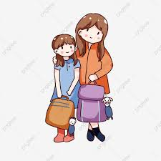
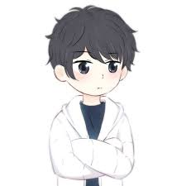

2.Verbal Phrases and Subject-Predicate Phrases Used as Attributives
In Chinese, attributives, often followed by the particle 的(de), always appear before the elements that they modify. Verbs, verbal phrases, and subject-object phrases can all serve as attributives.
10.我妹妹爱的那个很帅的男人
wǒ mèi mei ài de nà ge hěn shuài de nán ren
that very handsome man that my sister loves.

Slide 45
Apart from 过生日(guò shēng rì, to celebrate one`s birthday), the verb 过(guò, to live [a life]; to observe [a holiday]; to celebrate [a festival]);appears in many other expressions such as 过年(guò nián, to celebrate the New Year), 过节(guò jié, to celebrate a festival), and 过日子(guò rì zi, to live one`s life; to live from day to day).

Slide 46


Language Practice

Slide 47

zhōng tóu
钟头
hour
钟头(zhōng tóu) is the colloquial equivalent of 小时(xiǎo shí)

Slide 48
以为(yǐ wéi) is often used to signify an understanding or judgment which has proved to be erroneous. If someone has realized that she was mistaken in assuming someone else to be vegetarian, she could say to that person: 我以为你吃素(wǒ yǐ wéi nǐ chī sù. I thought you were a vegetarian).
yǐ wéi
以为
to assume erroneously

Slide 49

cōng ming
聪明
smart; bright;clever
About the formation of the adjective 聪明(cōng ming; clever): 聪(cōng) literally means “able to hear well.” and 明(míng) means “able to see clearly,” among other things. Therefore, 聪明 describes someone who is perceptive or bright

Slide 50

yòng gōng
用功
hard-working;diligent;studious

Slide 51

shǔ qī
暑期
summer term

Slide 52

bān
班
class

Slide 53
The Chinese words 班(bān) and 课(kè) denote two different concepts that are represented by the same word, “class” in English. While 课(kè) refers to a course or a meeting time for the course. 班(bān) is the term for the group of students who take a course together. Thus one says “我今天有电脑课。”(wǒ jīn tiān yǒu diàn nǎo kè, I have a computer class today), but “我的电脑班有二十个人”(wǒ de diàn nǎo bān yǒu èr shí ge rén, There are twenty people in my computer class).

Slide 54
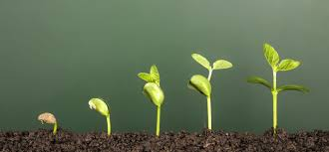
zhǎng
长
to grow; to appear
The character 长(zhǎng/cháng) has two different meanings and pronunciations. As a verb, it is pronounced “zhǎng”, meaning “to grow.” When used as an adjective, it is pronounced “cháng”, and means “long.”

Slide 55


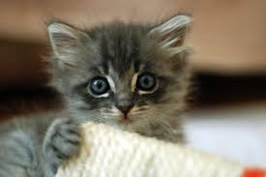
kě ài
可爱
cute; lovable

Slide 56

qù nián
去年
last year

Slide 57

shǔ
属
to belong to

Slide 58
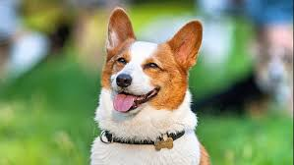
gǒu
狗
dog

Slide 59

yuán
圆
round

Slide 60

liǎn
脸
face

Slide 61
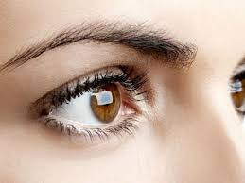
yǎn jing
眼睛
eye

Slide 62
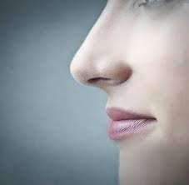
bí zi
鼻子
nose

Slide 63
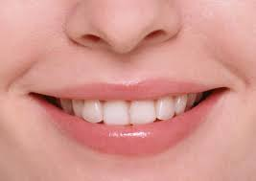
zuǐ
嘴
mouth

Slide 64

tóu fa
头发
hair

Slide 65
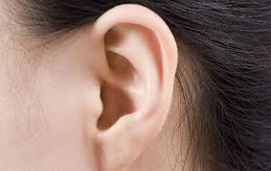
ěr duo
耳朵
ears

Slide 66
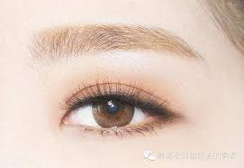
méi mao
眉毛
eyebrows

Slide 67
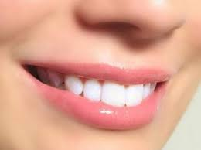
yá chǐ
牙齿
teeth

Slide 68
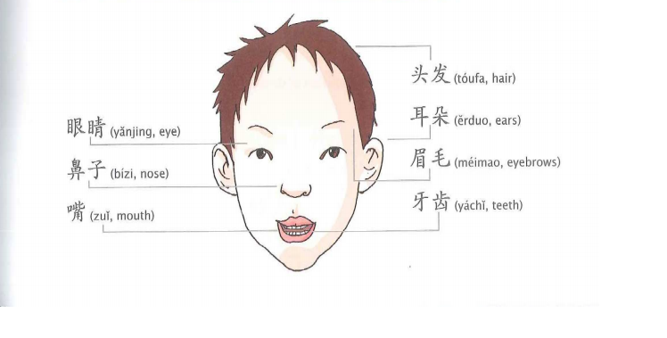

Slide 69
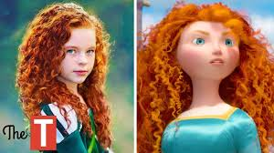
xiàng
像
to be like;to look like; to take after
他长得像他的爸爸。(tā zhǎng de xiàng tā de bà ba)
He looks like his father.

Slide 70
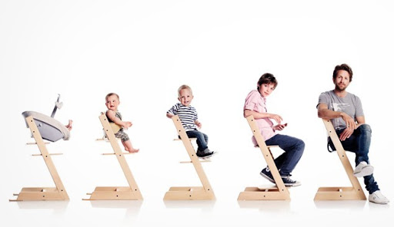
zhǎng dà
长大
to grow up

Slide 71

yí dìng
一定
certain(ly);definite(ly)

Slide 72
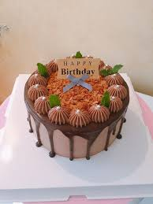
dàn gāo
蛋糕
cake

Slide 73

zuì
最
most, (of superlative degree)-est

Slide 74
3.Time Duration
To indicate the duration of an action
Subject+Verb+Duration of time
1.老高想在上海住一年。
lǎo gāo xiǎng zài shàng hǎi zhù yì nián.
Old Gao wishes to live in Shanghai for a year.
2.我每天在书店工作三个钟头。
wǒ měi tiān zài shū diàn gōng zuò sān ge zhōng tóu.
I work in a bookstore for three hours every day.

Slide 75
3.Time Duration
To indicate the duration of an action
Subject+Verb+Object+Verb+了+Duration of time
3.昨天下雪下了二十分钟。
zuó tian xià xuě xià le èr shí fēn zhōng.
It snowed for twenty minutes yesterday.
4.你上暑期班上了多长时间？
nǐ shàng shǔ qī bān shàng le duō cháng shí jiān ？
How long were you in summer school?

Slide 76
3.Time Duration
Sentences in this pattern must be in the affirmative. If the verb takes an object, the verb has to be repeated, as in (3) and (4). If the verb has an object, the following alternative pattern can be used to express the same idea.
Subject+Verb+(了)+Duration of time+(的)+Object
5. 昨天下了二十分钟(的)雪。
zuó tiān xià le èr shí fēn zhōng (de)xuě.
It snowed for twenty minutes yesterday.

Slide 77
3.Time Duration
Sentences in this pattern must be in the affirmative. If the verb takes an object, the verb has to be repeated, as in (3) and (4). If the verb has an object, the following alternative pattern can be used to express the same idea.
Subject+Verb+(了)+Duration of time+(的)+Object
6. 我上了四个星期(的)暑期班。
wǒ shàng le sì ge xīng qī (de)shǔ qī bān.
I was in summer school for four weeks.
6a 我四个星期上了暑期班。（X）
wǒ sì gè xīng qī shàng le shǔ qī bān.

Slide 78
4.Sentences with 是...的(shì ...de)
To describe or inquire about the time, the place, the manner,or the initiator of an action that we know already happened, we need to use the 是...的(shì ...de) structure. The use of 是(shì), however, is optional.
1.A: 你去过北京吗？
nǐ qù guo běi jīng ma?
Have you been to Beijing?
B: 我去过北京。
wǒ qù guo běi jīng.
Yes, I`ve been to Beijing.

Slide 79
4.Sentences with 是...的(shì ...de)
Person A now becomes aware of Person B`s action of 去北京(qù běi jīng,went to Beijing), and wants to find out when, how, and with whom that action was performed:
A: 你是跟谁一起去的？
nǐ shì gēn shéi yì qǐ qù de？
With whom did you go?
B: 我是跟我表姐一起去的。
wǒ shì gēn wǒ biǎo jiě yì qǐ qù de.
I went with my cousin.

Slide 80
4.Sentences with 是...的(shì ...de)
Person A now becomes aware of Person B`s action of 去北京(qù běi jīng,went to Beijing), and wants to find out when, how, and with whom that action was performed:
A: 你们是什么时候去的？
nǐ men shì shén me shí hou qù de?
When did you go?
B: 我们是寒假去的。
wǒ men shì hán jià qù de.
We went during the winter break.

Slide 81
4.Sentences with 是...的(shì ...de)
Person A now becomes aware of Person B`s action of 去北京(qù běi jīng,went to Beijing), and wants to find out when, how, and with whom that action was performed:
A: 你们是怎么去的？
nǐ men shì zěn me qù de?
How did you go?
B: 我们是坐飞机去的。
wǒ men shì zuò fēi jī qù de.
We went there by airplane.

Slide 82
4.Sentences with 是...的(shì ...de)
2.A: 你看过这张碟吗？
nǐ kàn guo zhè zhāng dié ma?
Have you watched this DVD?
B: 看过。
kàn guo.
Yes, I have.

Slide 83
4.Sentences with 是...的(shì ...de)
A: 是什么时候看的？
shì shén me shí hou kàn de?
When did you watch it?
[A already knows that the action 看(kàn) was completed
B: 上个周末看的。
shàng ge zhōu mò kàn de.
It was last weekend that I watched it.

Slide 84
4.Sentences with 是...的(shì ...de)
3.A: 你这条裤子真好看。是在哪儿买的？
nǐ zhè tiáo kù zi zhēn hǎo kàn. shì zài nǎr mǎi de?
These pants of yours look great. Where did you get them?
[It`s assumed that one generally buys pants (as opposed to making them at home, ect.), so the action 买(mǎi) is already known.]

Slide 85
4.Sentences with 是...的(shì ...de)
4.A: 你吃饭了吗？
nǐ chī fàn le ma？
Have you eaten yet?
B: 吃了。
chī le.
Yes, I have.
[The action 吃(chī) is now known]

Slide 86
4.Sentences with 是...的(shì ...de)
A: 在哪儿吃的？
zài nǎr chī de?
Where did you eat?
B: 在学生餐厅吃的。
zài xué shēng cān tīng chī de.
In the student cafeteria.

Slide 87
4.Sentences with 是...的(shì ...de)
5. A: 你学过电脑吗？
nǐ xué guo diàn nǎo ma ？
Have you ever studied computers?
B: 学过。
xué guo.
Yes, I have.

Slide 88
4.Sentences with 是...的(shì ...de)
A: 是跟谁学的？
shì gēn shéi xué de?
With whom did you study?
B: 是跟王老师学的。
shì gēn wáng lǎo shī xué de.
With Teacher Wang.

Slide 89
5. 还(hái, still)
还(hái), as an adverb, can mean “still.”
1.上午十一点了，他还在睡觉。
shàng wǔ shí yī diǎn le ，tā hái zài shuì jiào.
It`s 11 a.m., and he is still sleeping.
2.今天的功课，我还没写完。
jīn tiān de gōng kè ，wǒ hái méi xiě wán.
I`m still not done with today`s homework.
3.这个语法老师教了，可是我还不懂。
zhè ge yǔ fǎ lǎo shī jiāo le ，kě shì wǒ hái bù dǒng.
The teacher has gone over this grammar point, but I still don`t understand it.

Slide 90
6. 又...又...（yòu ...yòu ..., both...and...）
The two adjectives used in this structure are either both positive or both negative in meaning, e.g., 又聪明又用功(yòu cōng ming yòu yòng gōng, smart and hardworking)[both adjectives are positive in meaning], 又多又难(yòu duō yòu nán, too much and difficult)[both adjectives are negative in meaning].

Slide 91
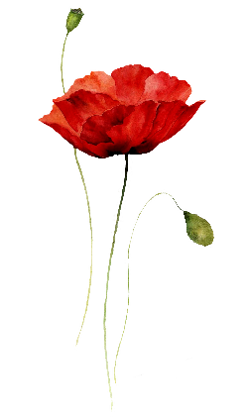
你们来了(nǐ men lái le, You`re here) not only acknowledges the visitors` arrival, but also serves as a casual greeting.

