Slide 1

kàn bìng
看病
Seeing a Doctor
Li Xin Yu

Slide 2
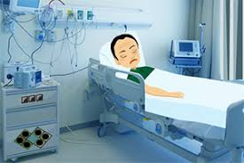
bìng rén
病人
patient

Slide 3
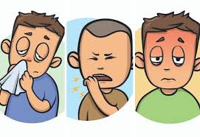
bìng
病
illness; to become ill

Slide 4

yī yuàn
医院
hospital

Slide 5
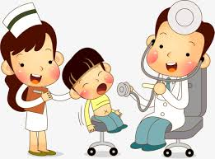
kàn bìng
看病
to see a doctor;
(of a doctor) to see a patient

Slide 6

dù zi
肚子
belly;abdomen

Slide 7
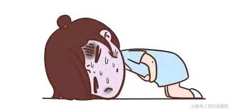
téng sǐ
疼死
really painful

Slide 8

téng
疼
aching

Slide 9


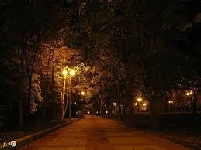
yè li
夜里
at night

Slide 10

hǎo jǐ
好几
quite a few

Slide 11
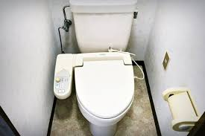
cè suǒ
厕所
restroom,toilt

Slide 12
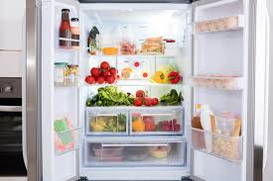
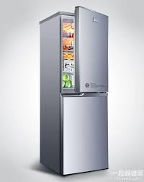
bīng xiāng
冰箱
refrigerator

Slide 13
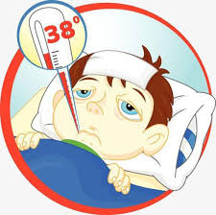
fā shāo
发烧
to have a fever

Slide 14

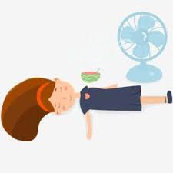
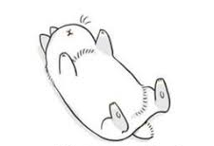
tǎng xia
躺下
to lie down

Slide 15


tǎng
躺
to lie

Slide 16
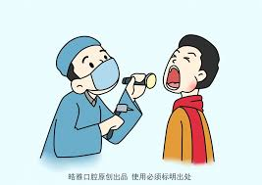


jiǎn chá
检查
to examine

Slide 17
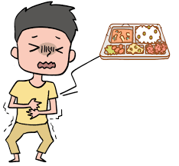
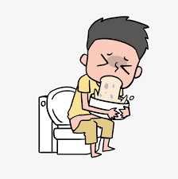
chī huài
吃坏
to get sick because of bad food

Slide 18



huài
坏
bad

Slide 19
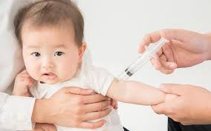
dǎ zhēn
打针
to get an injection

Slide 20
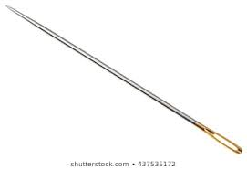
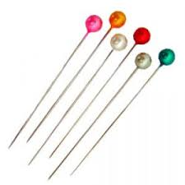

zhēn
针
needle

Slide 21

yào
药
medicine
“To take medicine” is 吃药(chī yào), literally “to eat medicine.” A more formal expression is 服药(fú yào), which is commonly written on prescriptions and prescription instructions.

Slide 22
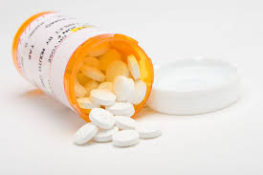

piàn
片
(measure word for tablet; slice)

Slide 23
1.读两遍课文。
dú liǎng biàn kèwén.
Read the text twice.
2.这部电影我看了三遍。
zhè bù diànyǐng wǒ kànle sān biàn.
I watched this movie three times.
piàn
遍
(measure word for complete courses of an action or instances of an action)

Slide 24
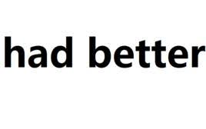
zuì hǎo
最好
had better

Slide 25

xiǎo shí
小时
hour

Slide 26

bàn fǎ
办法
method; way(of doing something)

Slide 27

sǐ
死
to die;(a complement
indicating an extreme
degree)

Slide 28

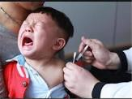
1.死(sǐ) Indicating an Extreme Degree
Placed after an adjective, 死(sǐ) can serve as a complement to indicate an extreme degree of the condition named by the adjective.
Adj+死+了:Extreme Degree
1.打针疼死了。( It`s extremely painful to get a shot.)
dǎ zhēn téng sǐ le.

Slide 29
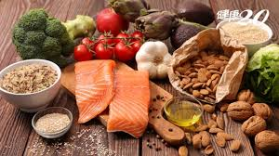

1.死(sǐ) Indicating an Extreme Degree
Placed after an adjective, 死(sǐ) can serve as a complement to indicate an extreme degree of the condition named by the adjective.
2.我饿死了。( I`m starving.)
wǒ è sǐ le.

Slide 30
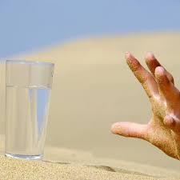
1.死(sǐ) Indicating an Extreme Degree
Placed after an adjective, 死(sǐ) can serve as a complement to indicate an extreme degree of the condition named by the adjective.
2.我渴死了。( I am thirsty)
wǒ kě sǐ le.

Slide 31


1.死(sǐ) Indicating an Extreme Degree
Placed after an adjective, 死(sǐ) can serve as a complement to indicate an extreme degree of the condition named by the adjective.
3.今天热死了。(It`s awfully hot today.)
jīn tiān rè sǐ le.

Slide 32
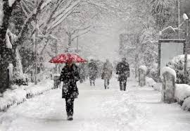
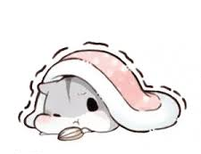
1.死(sǐ) Indicating an Extreme Degree
Placed after an adjective, 死(sǐ) can serve as a complement to indicate an extreme degree of the condition named by the adjective.
3.今天冷死了。(It`s awfully cold today.)
jīn tiān lěng sǐ le.

Slide 33

1.死(sǐ) Indicating an Extreme Degree
死(sǐ) often follows an adjective with a pejorative meaning and therefore the combination carries a negative connotation, as shown in the examples above. Occasionally, however, it may also be used in a positive context.
pejorative adj +死+了（often）
4.知道了这件事，他高兴死了。
zhī dào le zhè jiàn shì, tā gāo xìng sǐ le.
He was tickled pink when he learned about this.

Slide 34
1.死(sǐ) Indicating an Extreme Degree
Most complimentary adjectives cannot be followed by 死(sǐ). People therefore seldom say:
5.那件衣服漂亮死了。(X)
nà jiàn yī fu piào liang sǐ le.
6.他跟他女朋友好死了。(X)
tā gēn tā nǚ péng you hǎo sǐ le.

Slide 35


2.Times of Actions
次(cì) is the measure word most frequently used to indicate that an action is performed a certain number of times. The “number+次(cì)” combination follows the verb.（Verb+了+number+次）
1.上午我打了两次电话。
shàng wǔ wǒ dǎ le liǎng cì diàn huà.
I made two phone calls in the morning.

Slide 36


2.Times of Actions
次(cì) is the measure word most frequently used to indicate that an action is performed a certain number of times. The “number+次(cì)” combination follows the verb.（Verb+了+number+次）
2. 昨天我吃了三次药。
zuó tiān wǒ chī le sān cì yào.
I took the medicine three times yesterday.

Slide 37
2.Times of Actions
If the object is not a person or a place, 次(cì) should be placed between the verb and the object. If the object represents a person or a place, 次(cì) can go either between the verb and the object or after the object.
Verb+了+number+次+object(not a person or a place)
Verb+了+number+次+object(a person or a place)
Verb+了+object(a person or a place)+number+次

Slide 38
2.Times of Actions
If the object is not a person or a place, 次(cì) should be placed between the verb and the object. If the object represents a person or a place, 次(cì) can go either between the verb and the object or after the object.
3. A: 去年我去了一次中国。你呢？
qù nián wǒ qù le yí cì zhōng guó. nǐ ne？
Last year I went to China once. How about you?
B: 去年我去了中国两次。
qù nián wǒ qù le zhōng guó liǎng cì.
Last year I went to China twice.

Slide 39
2.Times of Actions
If the object is not a person or a place, 次(cì) should be placed between the verb and the object. If the object represents a person or a place, 次(cì) can go either between the verb and the object or after the object.
4. A: 昨天我找了三次王医生。
zuó tiān wǒ zhǎo le sān cì wáng yī shēng.
I went looking for Dr. Wang three times yesterday.
B: 是吗？昨天我也找了王医生三次。
shì ma ？zuó tiān wǒ yě zhǎo le wáng yī shēng sān cì.
Is that right ? I also went looking for Dr. Wang three times yesterday.

Slide 40
2.Times of Actions
If the object is a personal pronoun, however, 次(cì) must follow the object.
5. 我昨天找了他两次，他都不在。
wǒ zuó tiān zhǎo le tā liǎng cì, tā dōu bú zài.
Yesterday I went looking for him twice, but he was not in either time.

Slide 41
2.Times of Actions
Verb+了+number+次+object(not a person or a place)
Verb+了+number+次+object(a person or a place)
Verb+了+object(a person or a place)+number+次
Verb+了+object(a personal pronoun)+number+次

Slide 42
2.Times of Actions
遍(biàn) is another measure word for occurrences of actions, but it pertains to the entire course of the action from the beginning to the end.
6. 请你念一遍课文。
qǐng nǐ niàn yí biàn kè wén.
Please read the text [from the beginning to the end] once.

Slide 43
2.Times of Actions
Nouns denoting body parts involved in the actions can also sometimes serve as measure words for occurrences of actions. （uncommon）
昨天晚上我吃了几口...
zuó tiān wǎn shang wǒ chī le jǐ kǒu ...
I ate a few mouthfuls last night...

Slide 44
3.起来(qǐ lai)
起来(qǐ lai) indicates the moment when something static becomes dynamic, that is, it signifies the beginning of an action or state.
1. 我们一见面就聊了起来。
wǒ men yí jiàn miàn jiù liáo le qǐ lai.
We began chatting as soon as we met.
2. 他一回家就写起信来。
tā yì huí jiā jiù xiě qi xìn lai.
He began to write a letter as soon as he got home.

Slide 45
3.起来(qǐ lai)
起来(qǐ lai) indicates the moment when something static becomes dynamic, that is, it signifies the beginning of an action or state.
3. 下了课以后，学生们打起球来。
xià le kè yǐ hòu, xué sheng men dǎ qi qiú lai.
The students started to play ball after the class was over.
Note that the object is placed between 起(qi) and 来(lai), rather than after 起来(qǐ lai).Verb+起+object+来
打球起来（X）打起球来（V）

Slide 46
4.把(bǎ) Construction(I)
In general, a sentence in the 把(bǎ) construction highlights the subject`s disposal of or impact upon the object, with the result of the disposal or impact indicated by the element following the verb.
Subject + 把(bǎ) + Object + Verb + Other Element (Complement/了[le], etc)
1.我把你要的书找到了。
wǒ bǎ nǐ yào de shū zhǎo le.
I have found the books that you wanted.
[ The resultative complement 到(dào) serves as the “other element.”]
In (1), the subject 我exerts an impact on the book through the action of 找(zhǎo), of which 到(dào) is the result.

Slide 47
4.把(bǎ) Construction(I)
In general, a sentence in the 把(bǎ) construction highlights the subject`s disposal of or impact upon the object, with the result of the disposal or impact indicated by the element following the verb.
Subject + 把(bǎ) + Object + Verb + Other Element (Complement/了[le], etc)
2.你把这个字写错了。
nǐ bǎ zhè ge zì xiě cuò le.
You wrote this character incorrectly.
[ The resultative complement 错(cuò) serves as the “other element.”
In (2), the subject 你 exerts an impact on the character through the action of 写(xiě), of which 错(cuò) is the result.

Slide 48
4.把(bǎ) Construction(I)
Subject + 把(bǎ) + Object + Verb + Other Element (Complement/了[le], etc)
3.请把那条裤子给我。
qǐng bǎ nà tiáo kù zi gěi wǒ .
Please pass me that pair of pants.
[The indirect object 我 serves as the “other element.”]
4.你把这篇课文看看。
nǐ bǎ zhè piān kè wén kàn kan.
Would you take a look at this text?
[The reduplicated verb 看 serves as the “other element.”]

Slide 49
4.把(bǎ) Construction(I)
Subject + 把(bǎ) + Object + Verb + Other Element (Complement/了[le], etc)
5.把这杯咖啡喝了！
bǎ zhè bēi kā fēi hē le ！
Finish up this cup of coffee!
[The particle 了(le) serves as the “other element.”]
6.你怎么把女朋友的生日忘了？
nǐ zěn me bǎ nǚ péng you de shēng rì wàng le ？
How did you manage to forget your girlfriend`s birthday?
[The particle 了(le) serves as the “other element.”]

Slide 50
4.把(bǎ) Construction(I)
Subject + 把(bǎ) + Object + Verb + Other Element (Complement/了[le], etc)
In the 把(bǎ) construction, the object is often something already known to both the speaker and the listener. For example, 你要的书(nǐ yào de shū) in (1), 这个字(zhè ge zì) in (2), 那个裤子(nà tiáo kù zi) in (3), and 女朋友的生日(nǚ péng you de shēng rì) in (6) are all things that are already known.

Slide 51
4.把(bǎ) Construction(I)
7.老王给了小张一些钱。
lǎo wáng gěi le xiǎo zhāng yì xiē qián.
Old Wang gave Little Zhang some money.
8.老王把钱给小张了。
lǎo wáng bǎ qián gěi xiǎo zhāng le.
Old Wang gave the money to Little Zhang.
The object in (7) ,”some money,” is unspecified. However, in (8), the speaker expects the listener to know what money is being referred to.

Slide 52
4.把(bǎ) Construction(I)
7.老王给了小张一些钱。
lǎo wáng gěi le xiǎo zhāng yì xiē qián.
Old Wang gave Little Zhang some money.
8.老王把钱给小张了。
lǎo wáng bǎ qián gěi xiǎo zhāng le.
Old Wang gave the money to Little Zhang.
The object in (7) ,”some money,” is unspecified. However, in (8), the speaker expects the listener to know what money is being referred to.

Slide 53
4.把(bǎ) Construction(I)
（1）If the subject of a sentence is given
（2）the object is something known to both the speaker and listener.
（3）the verb is followed by a complement in the form of a prepositional phrase with 在 or 到(dào)
If the condition (1)、(2)、(3) is met
that sentence must appear in the 把(bǎ) construction.

Slide 54
4.把(bǎ) Construction(I)
你把笔放在桌子上。
nǐ bǎ bǐ fàng zài zhuō zi shang.
Put the pen on the desk.
你放笔在桌子上。
nǐ fàng bǐ zài zhuō zi shàng

Slide 55
4.把(bǎ) Construction(I)
请你把这封信送到律师的办公室。
qǐng nǐ bǎ zhè fēng xìn sòng dào lǜ shī de bàn gōng shì.
Please deliver this letter to the attorney`s office.
请你送这封信到律师的办公室。
qǐng nǐ sòng zhè fēng xìn dào lǜ shī de bàn gōng shì.

Slide 56
1.A combination of two adjacent numbers can be used to denote an approximate number, e,g., 五十六、七岁(wǔ shí liù, qī suì, fifty-six or fifty-seven years old), 十八、九块钱(shí bā, jiǔ kuài qián, eighteen or nineteen dollars), 三、四天(sān, sì tiān, three or four days), 两、三枝笔(liǎng, sān zhī bǐ , two or three pens). However, the numbers nine and ten cannot be used this way since it could lead to ambiguity; It would be difficult to distinguish 九、十天(jiǔ, shí tiān) from 九十天(jiǔ shí tiān) in speech.
2.前(qián, before) in 饭前(fàn qián, before meals) and 后(hòu,after) in 饭后(fàn hòu; after meals) are the shortened forms of 以前(yǐ qián, before) and 以后(yǐ hòu, after) respectively.

Slide 57
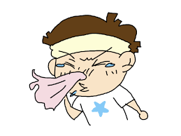
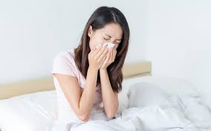
gǎn mào
感冒
to have a cold

Slide 58
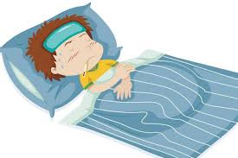

shēng bìng
生病
to get sick

Slide 59
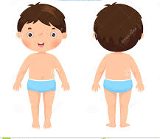
shēn tǐ
身体
body;health

Slide 60
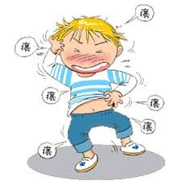
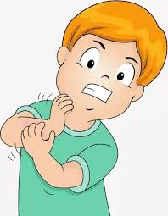
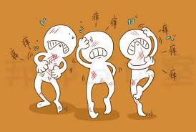
yǎng
痒
itchy

Slide 61
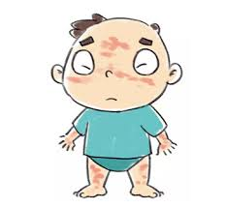

guò mǐn
过敏
to be allergic to

Slide 62


yào diàn
药店
pharmacy

Slide 63
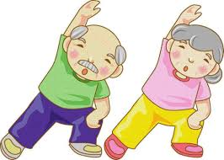
jiàn kāng
健康
healthy;health

Slide 64

bǎo xiǎn
保险
insurance

Slide 65



gǎn kuài
赶快
right away; quickly； in a hurry

Slide 66

yào bù rán
要不然
otherwise

Slide 67

shàng cì
上次
last time

Slide 68



xiū xi
休息
to take a break; to rest

Slide 69
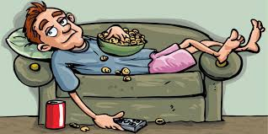

lǎn
懒
lazy

Slide 70

zài shuō
再说
moreover

Slide 71

luàn
乱
randomly; arbitrarily;messily

Slide 72
1.这个数字是我乱选的。
zhè ge shùzì shì wǒ luàn xuǎn de.
I chose this number randomly.
2.这个房间很乱。
zhè ge fángjiān hěn luàn.
This room is messy.

Slide 73

yuè lái yuè
越来越
more and more

Slide 74
5. The Preposition 对(duì)
The preposition 对(duì) introduces the person or thing that receives a certain effect from someone or something else. Its English translation varise depending on the context.
1. 这种药对感冒很有用。
zhè zhǒng yào duì gǎn mào hěn yǒu yòng.
This medicine is very effective for colds.
2. 他的电脑对他练习发音很有用。
tā de diàn nǎo duì tā liàn xí fā yīn hěn yǒu yòng.
His computer is very useful for his pronunciation practice.
3. 你一定对什么东西过敏了。
nǐ yí dìng duì shén me dōng xi guò mǐn le.
You must be allergic to something.

Slide 75
6. 越来越...(yuè lái yuè...)
The structure 越来越...(yuè lái yuè...) denotes a progressive change over time.
1. 李友的中文越来越好。
lǐ yǒu de zhōng wén yuè lái yuè hǎo.
Li You`s Chinese is getting better and better.
2. 天气越来越暖和了。
tiān qì yuè lái yuè nuǎn huo le.
The weather is becoming warmer and warmer.
3. 表姐考试考得越来越糟糕。
biǎo jiě kǎo shì kǎo de yuè lái yuè zāo gāo.
My cousin is doing worse and worse on her exams.

Slide 76
7. 再说(zài shuō)
The expression 再说(zài shuō) introduces an additional reason for an action that has been taken or decision that has been made. It is different from 再+说(zài shuō, to say again.)
1.A:你为什么不去纽约？
nǐ wèi shén me bú qù niǔ yuē ？
Why aren`t you going to New York?
B:我没有时间，再说，也没有钱。
wǒ méi yǒu shí jiān, zài shuō, yě méi yǒu qián.
I don`t have the time, and besides, I don`t have the money.

Slide 77
7. 再说(zài shuō)
The expression 再说(zài shuō) introduces an additional reason for an action that has been taken or decision that has been made. It is different from 再+说(zài shuō, to say again.)
2.我不喜欢今天晚上的舞会，音乐不好，再说人也太少。
wǒ bù xǐ huan jīn tiān wǎn shang de wǔ huì, yīn yuè bù hǎo, zài shuō rén yě tài shǎo.

Slide 78
7. 再说(zài shuō)
Like再说(zài shuō) ,而且(ér qiě, moreover; in addition) also conveys the idea of “ furthermore,additionally,” ect., but the clause that follows it may or may not be explanatory in nature.
3. A:你为什么不去纽约？
nǐ wèi shén me bú qù niǔ yuē ？
Why aren`t you going to New York?
B:我没有时间，而且，也没有钱。
wǒ méi yǒu shí jiān, ér qiě, yě méi yǒu qián.
I don`t have the time. Besides, I don`t have the money.

Slide 79
7. 再说(zài shuō)
4. 这是王先生，他不但是我的老师，而且也是我的朋友。
zhè shì wáng xiān sheng, tā bú dàn shì wǒ de lǎo shī, ér qiě yě shì wǒ de péng yǒu.
This is Mr. Wang. He is not only my teacher but also my friend.
4a. 这是王先生，他不但是我的老师，再说也是我的朋友。（X）
zhè shì wáng xiān sheng, tā bú dàn shì wǒ de lǎo shī, zài shuō yě shì wǒ de péng yǒu.

Slide 80
1.The two phrases 看医生(kàn yī shēng) and 看病(kàn bìng) are interchangeable, although in northern China 看病(kàn bìng) is much more common than 看医生(kàn yī shēng).
2. When tasting or trying the flavor of a food or drink, one says 我尝尝(wǒ cháng chang, Let me taste it) instead of 我试试(wǒ shì shi, Let me try), although one says 试试(shì shi) when trying most other things.

