Slide 1
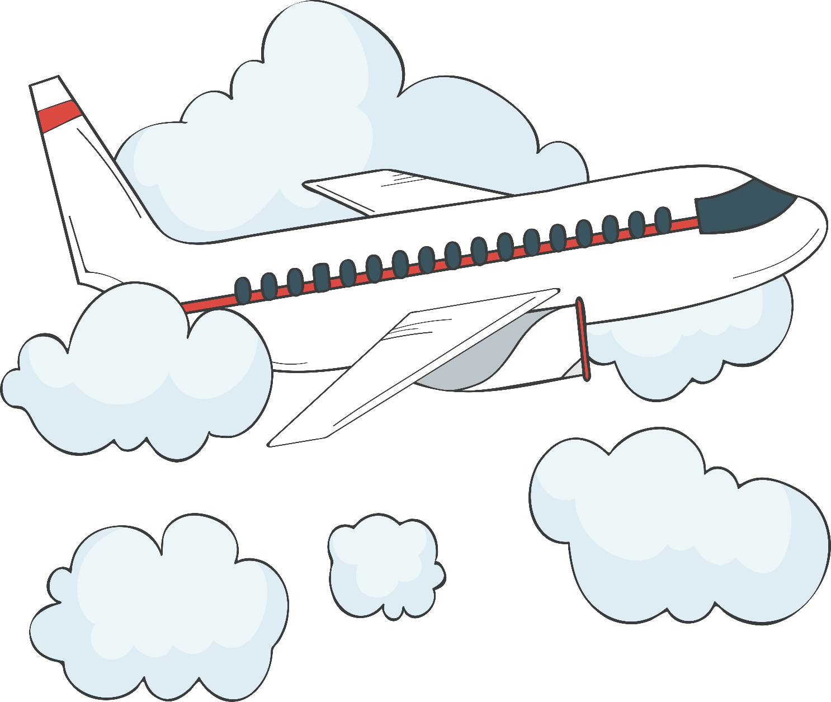
zài jī chǎng
在机场
At the Airport
Li Xin Yu

Slide 2
xíng li
行李
麻烦您把行李放上来。
má fan nín bǎ xíng li fàng shang lai.
Please put the luggage up here.
luggage

Slide 3
tuō yùn
托运
你们有几件行李要托运？
nǐ men yǒu jǐ jiàn xíng li yào tuō yùn?
How many pieces of checked luggage do you have?
to check(luggage)

Slide 4
bāo
包
这个包不托运，我们带上飞机。
zhè ge bāo bù tuō yùn, wǒ men dài shàng fēi jī.
We won`t check this bag. We`ll take it on board.
bag; sack; bundle;
package

Slide 5
xiāng zi
箱子
把箱子给我吧，我帮你拿。
bǎ xiāng zi gěi wǒ ba, wǒ bāng nǐ ná.
Give me the suitcase, let me help you
suitcase; box

Slide 6
chāo zhòng
超重
这个箱子没超重吧。
zhè ge xiāng zi méi chāo zhòng ba.
This suitcase is not over the weight limit?
to be overweight (of luggage, freight,ect.

Slide 7
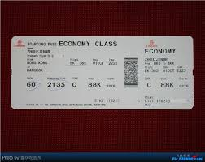
dēng jī pái
登机牌
boarding pass

Slide 8
The Chinese word for boarding pass is either 登机牌(dēng jī pái,lit., boarding card) or 登机证(dēng jī zhèng, lit., boarding certificate)

Slide 9
pái
这是我的工作牌。
zhè shì wǒ de gōng zuò pái.
This is my work card.
这是我的车牌。
zhè shì wǒ de chē pái.
This is my license plate
牌
plate; tablet; card

Slide 10
dēng jī kǒu
登机口
请到五号登机口上飞机。
qǐng dào wǔ hào dēng jī kǒu shàng fēi jī.
Please go to Gate 5 to board the plane.
boarding gate

Slide 11
In mainland China, boarding gates are called 登机口(dēng jī kǒu). In Taiwan and Hong Kong, they are called 登机门(dēng jī mén) and 闸口(zhá kǒu) respectively.

Slide 12
kǒu
口
这是逃生出口。
zhè shì táo shēng chū kǒu.
This is the exit.
opening; entrance; mouth

Slide 13
kū
哭
你别哭，我们几个星期就回来。
nǐ bié kū, wǒ men jǐ gè xīng qī jiù huí lai.
Don`t cry , we`ll be back in just a few weeks.
to cry; to weep

Slide 14
zhào gu
别担心，我姐姐会照顾你。
bié dān xīn, wǒ jiě jie huì zhào gu nǐ.
Don`t worry. My sister will take good care of you.
照顾
to look after; to care for; to attend to

Slide 15
qǐ fēi
起飞
飞机几点起飞？
fēi jī jǐ diǎn qǐ fēi?
When does the plane leave?
(of airplanes) to take off

Slide 16
xiǎo xīn
开车小心。
kāi chē xiǎo xīn.
Drive carefully.
小心点儿，别弄坏了。
xiǎo xīn diǎn er, bié nòng huài le.
Be careful, don't break it.
小心
to be careful

Slide 17
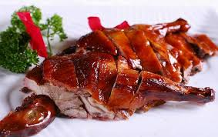
kǎo yā
烤鸭
roast duck

Slide 18
yí lù píng'ān
一路平安
祝你们一路平安。
zhù nǐ men yí lù píng'ān.
Have a safe trip.
have a good trip;
bon voyage

Slide 19
1. 的(de), 得(de), 地(de) Compared
A.的(de) usually follows an attributive but not an adverbial. The attributive can be formed by an adjective, a noun, or a verbal phrase.
1. 漂亮的女孩子
piào liang de nǚ hái zi.
pretty girl
2. 哥哥的公司
gē ge de gōng sī.
older brother`s company

Slide 20
1. 的(de), 得(de), 地(de) Compared
A.的(de) usually follows an attributive but not an adverbial. The attributive can be formed by an adjective, a noun, or a verbal phrase.
3. 我的卧室
wǒ de wò shì.
my bedroom
4. 刚买的机票。
gāng mǎi de jī piào.
a recently purchased plane ticket

Slide 21
1. 的(de), 得(de), 地(de) Compared
A.的(de) usually follows an attributive but not an adverbial. The attributive can be formed by an adjective, a noun, or a verbal phrase.
5. 妈妈给我们做的蛋糕。
mā ma gěi wǒ men zuò de dàn gāo.
the cake Mom made for us.
In most cases, 的 is followed by a noun, as seen in (1) to (5)

Slide 22
1. 的(de), 得(de), 地(de) Compared
It can also precede an adjective or verb if that adjective or verb serves as the subject or object in the sentence.
6. 南京的热[是有名的]
nán jīng de rè [shì yǒu míng de]
Nanjing`s heat/That Nanjing is hot [is well-known]
7. 他的死[大家最近才听说]
tā de sǐ [dà jiā zuì jìn cái tīng shuō]
His death/That he has died [became known to everyone only recently]

Slide 23
1. 的(de), 得(de), 地(de) Compared
B.地(de) links an adverb or adverbial to a following verb. An adjective, an adverb, or a set phrase can serve as an adverbial if followed by 地(de)
1. 慢慢儿地吃
màn mānr de chī
to eat slowly
2. 很高兴地说
hěn gāo xìng de shuō
to say happily

Slide 24
1. 的(de), 得(de), 地(de) Compared
B.地(de) links an adverb or adverbial to a following verb. An adjective, an adverb, or a set phrase can serve as an adverbial if followed by 地(de)
3. 一直地走
yì zhí de zǒu
to walk straight forward.
4. 好好儿地玩儿
hǎo hāor de wánr
to have some real fun.

Slide 25
1. 的(de), 得(de), 地(de) Compared
C.得(de) is used after a verb or an adjective to connect it with a descriptive complement or a complement of degree.
1. 跑得很快
pǎo de hěn kuài
to run fast
2. 做菜做得很好
zuò cài zuò de hěn hǎo
to cook well

Slide 26
1. 的(de), 得(de), 地(de) Compared
C.得(de) is used after a verb or an adjective to connect it with a descriptive complement or a complement of degree.
3. 高兴得跳起来
gāo xìng de tiào qǐ lái
to leap up with joy
4. 危险得不得了
wēi xiǎn de bù dé liǎo
unbelievably dangerous

Slide 27
1. 的(de), 得(de), 地(de) Compared
Compare the following two sentence:
5. 他高兴地唱着歌走回宿舍。
tā gāo xìng de chàng zhe gē zǒu hui sù shè.
He sang happily on his way back to the dorm.
6. 他高兴得唱起歌来了。
tā gāo xìng de chàng qi gē lai le.
He was so happy that he started to sing.
In (5) 高兴(gāo xìng) is used to describe the manner of his singing. In (6) 高兴(gāo xìng) is the cause of his singing

Slide 28
1. 的(de), 得(de), 地(de) Compared
A Quick Reference Table for 的，地，得
Attributive + 的(de) + Noun
Adverbial + 地(de) + Verb
Verb/Adj + 得(de) + Adj/Verb

Slide 29
2. ...的时候(...de shí hou) and ...以后(... yǐ hòu) Compared
In a sentence of the pattern “V1 的时候(de shí hou), V2...,” the second action and the first action take place simultaneously.
1. 走的时候别忘了带些钱。
zǒu de shí hou bié wàng le dài xiē qián.
Don`t forget to take some money with you when you leave.
2. 我看见他的时候，他正在打球。
wǒ kàn jiàn tā de shí hou, tā zhèng zài dǎ qiú.
When I saw him, he was playing ball.

Slide 30
2. ...的时候(...de shí hou) and ...以后(... yǐ hòu) Compared
In a sentence of the pattern “V1 的时候(de shí hou), V2...,” the second action and the first action take place simultaneously.
3. 妹妹看短信的时候，一边看一边笑。
mèi mei kàn duǎn xìn de shí hou, yì biān kàn yì biān xiào.
When my little sister was reading the text messages, she smiled as she
read along.

Slide 31
2. ...的时候(...de shí hou) and ...以后(... yǐ hòu) Compared
However, in a sentence of the pattern “V1 以后(yǐ hòu), V2...,” the second action takes place after the first one.
4. 他走了以后，才想起来忘了带钱。
tā zǒu le yǐ hòu, cái xiǎng qi lai wàng le dài qián.
He didn`t realize until after he had left that he had forgotten to take any
money with him.

Slide 32
2. ...的时候(...de shí hou) and ...以后(... yǐ hòu) Compared
The ...的时候(...de shí hou) structure describes two simultaneous actions. One may say in English, “When I get to China, I will eat Beijing roast duck,” when one really means, “After I get to China, I`ll eat Beijing roast duck.” In Chinese, that idea has to be conveyed with 以后(yǐ hòu):
5. 我到中国以后要吃北京烤鸭。
wǒ dào zhōng guó yǐ hòu yào chī běijīng kǎo yā.
I will eat some Beijing roast duck after I arrive in China.

Slide 33
When asking others for help, one polite way is to begin the request with 麻烦(má fan).
麻烦您把箱子拿上来。(má fan nín bǎ xiāng zi ná shàng lái.)
Please put the suitcase up here.

Slide 34
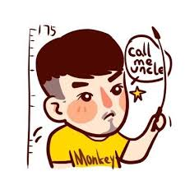
shū shu
叔叔
uncle

Slide 35

ā yí
阿姨
aunt

Slide 36
huān yíng
欢迎光临。
huān yíng guāng lín.
welcome
欢迎您的到来。
huān yíng nín de dào lái.
welcome
欢迎
to welcome

Slide 37
shòu
瘦
小朋，你好像瘦了点儿。
xiǎo péng, nǐ hǎo xiàng shòu le diǎnr.
Xiao Peng, you seem to have lost some weight.
thin,slim(usually of a person or animal); lean

Slide 38
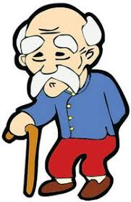
yé ye
爷爷
paternal grandfather

Slide 39
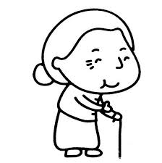
nǎi nai
奶奶
paternal grandmother

Slide 40
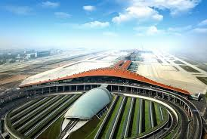
shǒu dū jī chǎng
首都机场
the Capital Airport(in Beijing)

Slide 41
还(hái)+Positive Adjective
还(hái) when used before a commendatory adjective may indicate that something is acceptable if not truly outstanding.
1. A: 你对那家旅馆的印象怎么样？
nǐ duì nà jiā lǚ guǎn de yìn xiàng zěn me yàng?
What was your impression of that hotel?
B: 还好。
hái hǎo.
It`s okay.

Slide 42
还(hái)+Positive Adjective
还(hái) when used before a commendatory adjective may indicate that something is acceptable if not truly outstanding.
2. 这个厨房还可以，挺干净的。
zhè ge chú fáng hái kě yǐ, tǐng gān jìng de.
This kitchen is all right. It`s pretty clean.
3. 那套公寓还行，带家具。
nà tào gōng yù hái xíng, dài jiā jù.
That apartment is not too bad. It`s furnished.

Slide 43
还(hái)+Positive Adjective
还(hái) when used before s commendatory adjective may indicate that something is acceptable if not truly outstanding.
4. 那个饭馆的红烧牛肉和家常豆腐还不错。
nà ge fàn guǎn de hóng shāo niú ròu hé jiā cháng dòu fu hái bú cuò.
That restaurant`s beef braised in soy sauce and family-style tofu are pretty good.

Slide 44
Kinship Terms
The system of kinship terms in Chinese is rather complicated, especially because Chinese people make a distinction between paternal and maternal relatives, older and younger siblings, even among differently related uncles and aunts, ect.
The following is a list of Chinese kinship terms;
[f]: indicates a more formal way of address;
[n]: northern Chinese usage;
[s]: southern Chinese usage.

Slide 45
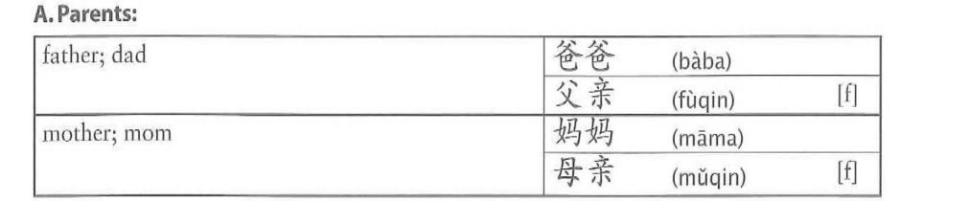
Kinship Terms

Slide 46
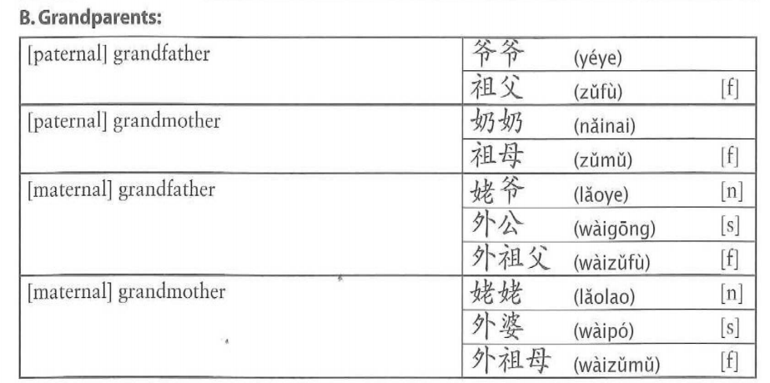
Kinship Terms

Slide 47
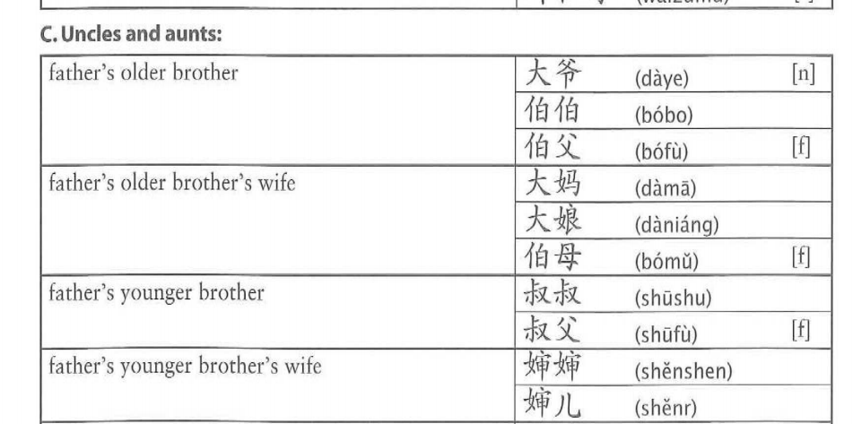
Kinship Terms

Slide 48
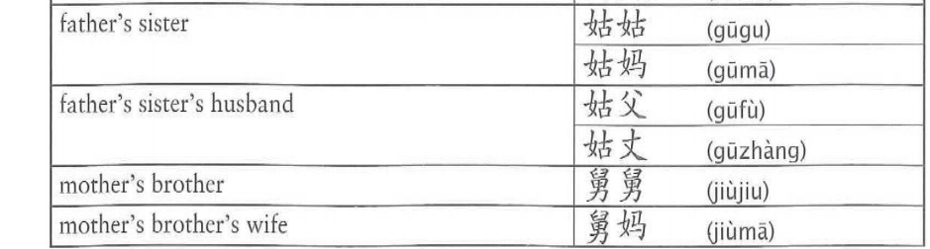
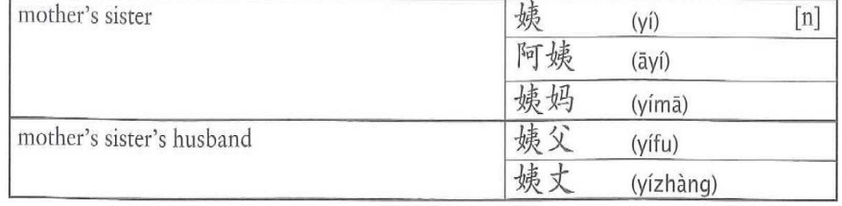
Kinship Terms

Slide 49
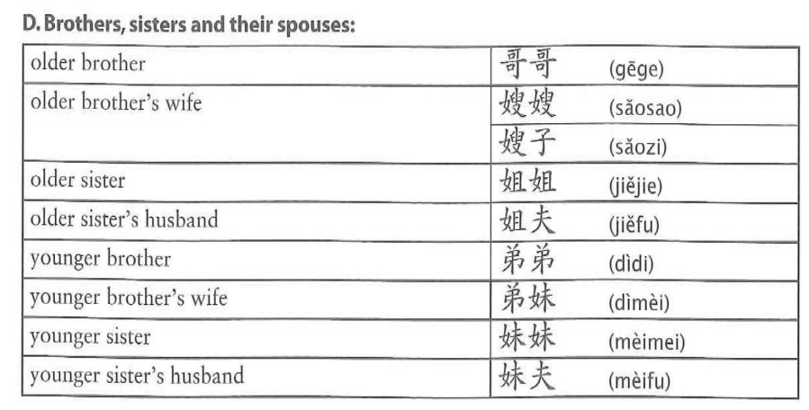
Kinship Terms

Slide 50
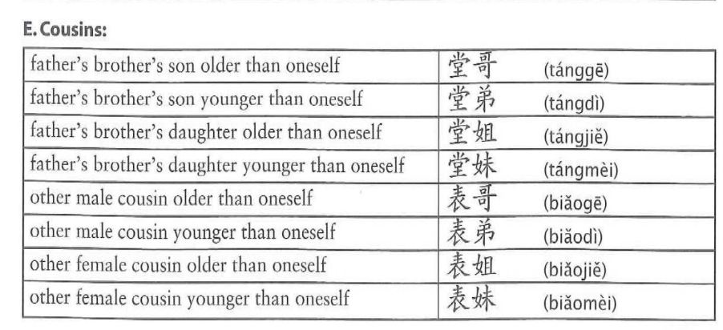
Kinship Terms

Slide 51
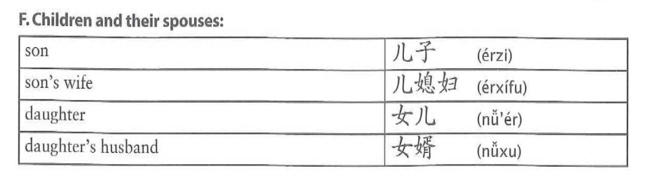
Kinship Terms

Slide 52
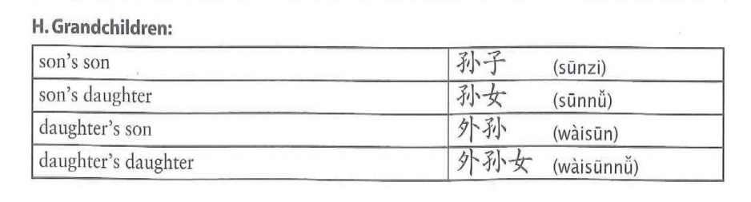
Kinship Terms

Slide 53
One can address a person to whom one is not related as 叔叔(shū shu,uncle) or 阿姨(ā yí, aunt) if the person is about one`s parents`age. These respectful forms of address can be applied even to strangers.

Slide 54
Final exam time:
June 8 (6月8日)
June 15 (6月15日)
June 22 (6月22日)
Examinations: Online oral test (We have no written exam this semester)

Slide 55
Examination Content: For the oral test, I will prepare 5-8 topics (I will tell the students before this Friday). The students randomly choose 1 topic to answer, at least 5 minutes for each topic.During the exam, I will use hour meter timing. If your answer is less than five minutes, you will not pass this exam, of course, you can still take the second and third exams, but If you take three times the exam, each exam less than five minutes .I am so sorry, you will be fall.

Slide 56
This Friday I will upload your results to study materials before 8pm (> 70 points you can take the final exam)
L11-L20 homework submission date is before 12 noon on this Friday, and after 12 noon will not accept the handed in homework

Slide 57
The specific time for the final exam is 10: 00-11: 10 (10 people)
11: 20-12: 30 (10 people)
13: 30-14: 40 (10 people)
14: 50-16: 00 (10 people)
16: 10-17: 20 (10 people)
You can choose to participate in any of the above time periods (choose one), but if the time period exceeds 10 people, you also can`t at other times, we will discuss the time again

