Slide 1

青/春/就/是/一/场/旅/行
lǚ xíng
旅 行
Travel
Li Xin Yu

Slide 2
mǎ shàng
我马上整理我的房间。
wǒ mǎ shàng zhěng lǐ wǒ de fáng jiān.
I will clean up my room right away
我马上去写功课。
wǒ mǎ shàng qù xiě gōng kè.
I will write my homework right away.
马上
immediately；right away

Slide 3
fàng jià
放假
马上就要放假了，你想去哪儿旅行。
mǎ shàng jiù yào fàng jià le, nǐ xiǎng qù nǎr lǚ xíng.
It's vacation soon, where do you want to travel.
go on vacation;
have time off

Slide 4
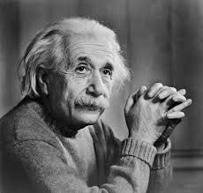
yǒu míng
这家餐厅的糖醋鱼很有名。
Zhè jiā cāntīng de táng cù yú hěn yǒumíng
The sweet and sour fish in this restaurant is famous.
爱因斯坦很有名
ài yīn sī tǎn hěn yǒu míng.
Einstein is famous.
有名
famous; well-known

Slide 5
gōng sī
明天我要去公司上班。
míng tiān wǒ yào qù gōng sī shàng bān..
I'm going to work at the company tomorrow.
这家公司很有名。
zhè jiā gōng sī hěn yǒu míng.
This company is very famous.
公司
company

Slide 6
shí xí
他明天要去公司实习。
tā míng tiān yào qù gōng sī sh íxí.
He is going to intern in the company tomorrow.
你在哪里实习？
nǐ zài nǎr shí xí.
Where do you intern.
实习
to intern

Slide 7
马上就要放假了，你有什么计划？
mǎ shàng jiù yào fàng jià le, nǐ yǒu shén me jì huà
It's vacation soon, what are your plans?
我计划明天早上开始工作。
wǒ jì huà míng tiān zǎo shang kāi shǐ gōng zuò.
I plan to start work tomorrow morning.
jì huà
计划
plan; to plan

Slide 8
While the verbs 打算(dǎ suàn) and 计划(jì huá) are synonyms, the former is more colloquial and the latter more formal.

Slide 9
我打算寒假去公司实习。
wǒ dǎ suàn hán jià qù gōng sī shí xí.
I plan to go to the company for an internship during the winter vacation.
我有我的打算。
wǒ yǒu wǒ de dǎ suàn.
I have my plan.
dǎ suàn
打算
to plan; plan

Slide 10
dǎ gōng
打工
A: 假期你要做什么？
jià qī nǐ yào zuò shén me ?
What are you going to do on vacation?
B: 我要回家打工。
wǒ yào huí jiā dǎ gōng.
I'm going home to work.
to work at a temporary job
(often part time)

Slide 11

fù mǔ
王先生对父母很孝顺。
wáng xiān sheng duì fù mǔ hěn xiào shun.
Mr. Wang is very filial to his parents.
父母
parents; father and mother

Slide 12
shǔ jià
我暑假打算回北京去看父母。
wǒ shǔ jià dǎ suàn huí běi jīng qù kàn fù mǔ.
I plan to go back to Beijing to see my parents during the summer vacation.
下个暑假我们一起去旅行吧。
xià gè shǔ jià wǒ men yì qǐ qù lǚ xíng ba.
Let's travel together next summer vacation.
暑假
summer vacation

Slide 13
shǒu dōu
北京是中国的首都。
Běi jīng shì zhōng guó de shǒu dū.
Beijing is the capital of China.
布拉格是捷克的首都。
Bù lā gé shì jié kè de shǒu dū.
Prague is the capital of the Czech Republic.
首都
capital city

Slide 14
他很喜欢中国文化。
tā hěn xǐ huan zhōng guó wén huà.
He likes Chinese culture very much.
北京是中国的文化中心。
Běi jīng shì zhōng guó de wén huà zhōng xīn.
Beijing is the cultural center of China.
wén huà
文化
culture

Slide 15
zhèng zhì
华盛顿是美国的政治中心。
huá shèng dùn shì měi guó de zhèng zhì zhōng xīn.
Washington is the political center of the United States.
政治
politics

Slide 16
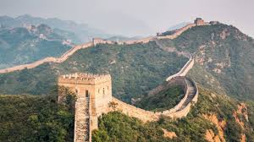
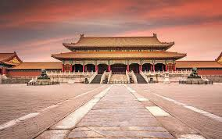
míng shèng gǔ jì
名胜古迹
famous scenic spots and historic sites

Slide 17
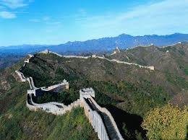
cháng chéng
长城
the Great Wall

Slide 18
北京有很多名胜古迹。
Běi jīng yǒu hěn duō míng shèng gǔ jì.
There are many places of famous historic sites in Beijing.
There are four Imperial Palace（故宫） in China. The most commonly mentioned is the Beijing Imperial Palace（北京故宫）, also known as the Forbidden City（紫禁城）. The other three, one in Shenyang（沈阳 Shěnyáng）, one in Nanjing（南京nánjīng）, and one in Taipei（台北）.
故宫 gù gōng
紫禁城 zǐ jìn chéng
Imperial Palace
Forbidden City

Slide 19

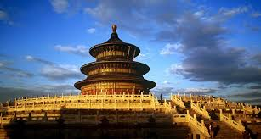
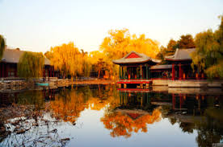
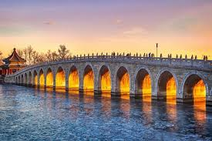
天坛 tiān tán
the Temple of Heaven
颐和园 yí hé yuán
Summer Palace

Slide 20
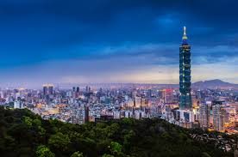
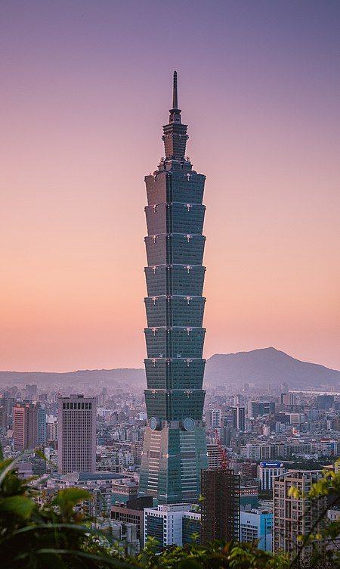
tái běi
台北
Taipei
台北101
Tái běi yī líng yī
Taipei 101

Slide 21
dǎo yóu
那你跟我一起回去吧，我给你当导游。
nà nǐ gēn wǒ yì qǐ huí qù ba, wǒ gěi nǐ dāng dǎo yóu.
Why don`t you go with me, I could be your guide.
导游
tour guide

Slide 22
hù zhào
请出示你的护照。
qǐng chū shì nǐ de hù zhào.
Your passport please.
请拿好你的护照。
qǐng ná hǎo nǐ de hù zhào.
Please take your passport.
护照
passport

Slide 23
dìng
我想订一张去台北的票。
wǒ xiǎng dìng yì zhāng qù tái běi de piào.
I want to book a ticket to Taipei
我想订间旅馆。
wǒ xiǎng dìng jiān lǚ guǎn.
I want to book a hotel.
订
to reserve; to book (a ticket, a hotel room, ect)

Slide 24
qiān zhèng
护照我已经有了，我得赶快办签证。
hù zhào wǒ yǐ jīng yǒu le, wǒ děi gǎn kuài bàn qiān zhèng.
I already have a passport, I will have to apply for a visa at once.
签证
visa

Slide 25
lǚ xíng shè
我马上给旅行社打电话订飞机票。
wǒ mǎ shàng gěi lǚ xíng shè dǎ diàn huà dìng fēi jī piào.
I`ll give the travel agency a cell right away and get the plane tickets.
旅行社
travel agency

Slide 26
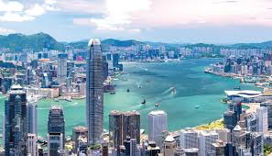
xiāng gǎng
香港
Hong Kong

Slide 27
1. 不得了(bù dé liǎo, extremely)
The expression 不得了(bù dé liǎo, extremely), which often follows the structure “adjective+得(de),” indicates a high degree, in the speaker`s judgment, of the attribute signified by the adjective,
For example, if one cannot stand the summer heat in a certain place, one can comment on it by saying:
那个地方夏天热得不得了。
nà ge dì fang xià tiān rè de bù dé liǎo.
Summer is unbearably hot in that place.

Slide 28
1. 不得了(bù dé liǎo, extremely)
The expression 不得了(bù dé liǎo, extremely), which often follows the structure “adjective+得(de),” indicates a high degree, in the speaker`s judgment, of the attribute signified by the adjective.
If the Great Wall is extremely crowded, one can describe the scene by saying:
长城上的人多得不得了。
cháng chéng shàng de rén duō de bù dé liǎo.
There was an incredible number of people on the Great Wall.

Slide 29
To apply for a certificate or official documentation, one usually uses the verb 办(bàn), especially in spoken Chinese, as in 办护照(bàn hù zhào, to apply for a passport) and 办签证(bàn qiān zhèng, to apply for a visa). More examples: 办学生证(bàn xué shēng zhèng, to apply for a student ID), 办手续(bàn shǒu xù, to do the paperwork), and 办结婚证(bàn jié hūn zhèng, to apply for a marriage license.)

Slide 30
chū
请问六月初到北京的机票多少钱？
qǐng wèn liù yuè chū dào běi jīng de jī piào duō shǎo qián?
How much is a ticket to Beijing for the beginning of June?
初
beginning

Slide 31
1.月初(yuè chū) refers to the first few days of the month, typically from the 1st to the 5th or 6th.
月中(yuè zhōng) is for the middle of the month, roughly from the 14th to 16th or 17th.
月底(yuè dǐ) means the final days of the month, usually from the 27th or 28th.
One can also say 年初(nián chū,beginning of the year)、年中(nián zhōng, middle of the year)、and 年底(nián dǐ, end of the year). The words 初(chū, beginning), 中(zhōng, middle), and 底(dǐ,end; bottom) usually compound with either 月(yuè) or 年(nián) and are never used with 星期(xīng qī)

Slide 32
dān chéng
单程
我买的是单程票。
wǒ mǎi de shì dān chéng piào.
I bought a one-way ticket.
one-way trip

Slide 33
wǎng fǎn
A: 您要买单程票还是往返票？
nín yào mǎi dān chéng piào hái shì
wǎng fǎn piào?
One way or round trip?
B: 我要买两张往返票。
wǒ yào mǎi liǎng zhāng wǎng fǎn piào.
Two round trip tickets.
往返
make a round trip;
go there and back

Slide 34
háng kōng
你想买哪家航空公司的票？
nǐ xiǎng mǎi nǎ jiā háng kōng gōng sī de piào？
Which airline ?
航空
aviation

Slide 35
chá
请等等，我查一下。
qǐng děng děng, wǒ chá yí xia.
Please wait a moment. Let me check.
你能帮我查一下吗？
nǐ néng bāng wǒ chá yí xià ma?
Can you check it for me?
查
to check; to look into

Slide 36
好几家航空公司都有航班。
hǎo jǐ jiā háng kōng gōng sī dōu yǒu háng bān.
Quite a few airlines fly there.
今天天气不好，好几个航班都延误了。
jīn tiān tiān qì bù hǎo, hǎo jǐ ge háng bān dōu yán wù le.
The weather is bad today, and several flights have been delayed
háng bān
航班
scheduled flight

Slide 37
In Taiwan, people say 班机(bān jī) instead of 航班(háng bān)

Slide 38
qiān
这件衣服要一千三百块。
zhè jiàn yī fu yào yì qiān sān bǎi kuài.
This dress costs 1,300 yuan.
这张机票只要两千块。
zhè zhāng jī piào zhǐ yào liǎng qiān kuài.
This ticket costs only two thousand yuan.
千
thousand

Slide 39
zhí fēi
你们有没有直飞新加坡的航班？
nǐ men yǒu méi yǒu zhí fēi xīn jiā pō de háng bān?
Do you have direct flights to Singapore?
我将为你预订直飞伦敦的航班。
wǒ jiāng wèi nǐ yù dìng zhí fēi lún dūn de háng bān.
I will book a direct flight to London for you.
直飞
fly directly

Slide 40
zhuǎn jī
我要从这里转机去俄罗斯。
wǒ yào cóng zhè lǐ zhuǎn jī qù é luó sī.
I am here to transfer to Russia.
我不想买转机的票。
wǒ bù xiǎng mǎi zhuǎn jī de piào.
I don't want to buy a transfer ticket.
转机
change planes

Slide 41
dǎ zhé
这家航空公司正在打折，差不多一千四百六十，可是要转机。
zhè jiā háng kōng gōng sī zhèng zài dǎ zhé, chà bù duō yì qiān sì bǎi liù shí, kě shì yào zhuǎn jī.
This airline is having a sale. About $1,460, but you have to change planes.
打折
to sell at a discount; to give a discount

Slide 42
The approach to describing a discount in Chinese is different from that in English.
In English the emphasis is on the amount that is given as a discount, e.g., 10% off, 20% off, ect.
In Chinese, however, the emphasis is on the proportion of the original price that is actually paid. Therefore, 九折(jiǔ zhé) means that the price is 90% of the original price; or 10% off; 七五折(qī wǔ zhé) means 75% of the original price; or 25% off;and 对折(duì zhé) 50% of the original price.

Slide 43

Original price：$300
current price: $225
这件衣服打几折？
这件衣服打___折
225 300 =0.75
=75% (七五折）
=25% off ·

Slide 44
chuāng hu
我们家的窗户很大。
wǒ men jiā de chuāng hu hěn dà.
The windows in our house are large.
请把窗户打开。
qǐng bǎ chuāng hu dǎ kāi.
Please open the window.
窗户
window

Slide 45
kào
他靠在椅子上。
tā kào zài yǐ zi shang.
He leaned on the chair.
他靠着窗户。
tā kào zhe chuāng hu.
He leaned against the window.
靠
to lean on; to lean against; to be next to

Slide 46
zǒu dào
走道
你们喜欢靠窗户的还是靠走道的？
nǐ men xǐ huan kào chuāng hu de hái shì kào zǒu dào de?
Do you prefer window or aisle seats ?
aisle

Slide 47
fèn
来一份牛肉面。
lái yí fèn niú ròu miàn.
Give me a beef noodle.
请给我一份鸭肉饭。
qǐng gěi wǒ yí fèn yā ròu fàn.
Please give me a duck rice.
份
(measure word for meal order, job)

Slide 48
sù cān
我朋友吃素，麻烦帮她订一份素餐。
wǒ péng you chī sù, má fan bāng tā dìng yí fèn sù cān.
My friend is a vegetarian, Could you please order vegetarian meals for her.
你们这儿有素餐吗？
nǐ men zhèr yǒu sù cān ma?
Do you have vegetarian meals here?
素餐
vegetarian meal

Slide 49
zū
你要租车吗？
nǐ yào zū chē ma?
Do you want to rent a car?
我想租一辆自行车。
wǒ xiǎng zū yí liàng zì xíng chē.
I want to rent a bicycle.
租
to rent

Slide 50
lǚ guǎn
A: 您在北京要订旅馆、租车吗？
nín zài běi jīng yào dìng lǚ guǎn, zū chē ma?
While in Beijing, do you need to make
reservations for a hotel or car rental?
B: 不用，谢谢。
bú yòng, xiè xiè.
No, thank you.
旅馆
hotel

Slide 51
Zhōng guó guó jì háng kōng gōng sī
中国国际航空公司
Air China

Slide 52
中国国际航空公司(zhōng guó guó jì háng kōng gōng sī, literally,“China International Airlines”) is often shortened to 国航(guó háng) it`s known in English as Air China.

Slide 53
xī běi háng kōng gōng sī
西北航空公司
Northwest Airlines

Slide 54
2. Question Pronouns as Indefinite References (Whoever, Whatever,ect.)
A question pronoun repeated in two separate but related clauses of the same sentence forms the equivalent of the “question pronoun+-ever” expression in English. Its first occurrence refers to an indefinite person, object, time,place,ect. Its second occurrence then refers to that same person, object, time, place,ect.
1. 谁想去，谁就去。
shéi xiǎng qù, shéi jiù qù.
Whoever wants to go can go.

Slide 55
2. Question Pronouns as Indefinite References (Whoever, Whatever,ect.)
1. 谁想去，谁就去。
shéi xiǎng qù, shéi jiù qù.
Whoever wants to go can go.
In the kind of sentence, sometimes the two occurrences of the question pronoun play the same grammatical role, i.e, both are subjects, as in (1);

Slide 56
2. Question Pronouns as Indefinite References (Whoever, Whatever,ect.)
2. 你吃什么，我就吃什么。
nǐ chī shén me, wǒ jiù chī shén me.
I`ll have whatever you`re having.
In the kind of sentence, sometimes the two occurrences of the question pronoun play the same grammatical role, both are objects, as in (2)

Slide 57
2. Question Pronouns as Indefinite References (Whoever, Whatever,ect.)
3. 哪双鞋便宜，就买哪双。
nǎ shuāng xié pián yí, jiù mǎi nǎ shuāng.
Buy whichever pair of shoes is the cheapest.
Sometimes the two occurrences of the question pronoun perform different grammatical functions. In (3), for example, the first 哪双(nǎ shuāng) is the subject whereas the second 哪双(nǎ shuāng) is the object. The adverb 就 often precedes the verb in the second clause,

Slide 58
2. Question Pronouns as Indefinite References (Whoever, Whatever,ect.)
4. Taxi Driver: 您想怎么走？
nín xiǎng zěn me zǒu?
Which way do you want to take?
Passenger: 怎么近，怎么走。
zěn me jìn, zěn me zǒu.
I`ll take whichever is the shortest distance.

Slide 59
2. Question Pronouns as Indefinite References (Whoever, Whatever,ect.)
The adverb 就 often precedes the verb in the second clause, but not always, as shown in (5) and (6) below.
5. 哪儿安静，我住哪儿。
nǎr ān jìng, wǒ zhù nǎr.
I`ll live wherever it`s quiet.

Slide 60
2. Question Pronouns as Indefinite References (Whoever, Whatever,ect.)
The adverb 就 often precedes the verb in the second clause, but not always, as shown in (5) and (6) below.
6. A: 他找谁帮他搬家具？
tā zhǎo shéi bāng tā bān jiā jù?
Who is he going to ask to help him move his furniture?
B: 谁身体棒，他找谁。
shéi shēn tǐ bàng, tā zhǎo shéi.
He`ll ask whoever is strong.

Slide 61
3. Numbers over One Thousand
You have already learned how to count in Chinese up to a thousand.
Number | Chinese | Pinyin | English
1 | 一 | yī | one
10 | 十 | shí | ten
100 | 百 | bǎi | hundred
1000 | 千 | qiān | thousand

Slide 62
3. Numbers over One Thousand
However, in Chinese the next larger unit after a thousand is not called “十千”, but 万(wàn). Even though the Chinese share the international practice of segmenting a long Arabic number into three-digit sets in writing or in print, they mentally divide the number into four-digit sets instand when they read it, Starting at the fifth digit from the right is the four-digit set of 万(wàn), and the next four-digit set is that of 亿(yì).

Slide 63
3. Numbers over One Thousand
English | Arabic Number | Chinese Mental Division | Chinese | Pinyin
thousand | 1000 | 1000 | (一)千 | (yì) qiān
ten thousand | 10,000 | 1`0000 | (一)万 | (yí) wàn
hundred thousand | 100,000 | 10`0000 | 十万 | shí wàn
million | 1,000,000 | 100`0000 | (一)百万 | (yì) bǎi wàn

Slide 64
3. Numbers over One Thousand
English | Arabic Number | Chinese Mental Division | Chinese | Pinyin
ten million | 10,000,000 | 1000`0000 | (一)千万 | (yì) qiān wàn
hundred million | 100,000,000 | 1`0000`0000 | (一)亿 | (yí) yì
billion | 1,000,000,000 | 10`0000`0000 | 十亿 | shí yì

Slide 65
Examples of large numbers:
12,345 (1`2345)
25,000 (2`5000)
340,876 (34`0876)
1,000,900,000 (10`0090`0000)
一万两千三百四十五
yí wàn liǎng qiān sān bǎi sì shí wǔ
两万五千 liǎng wàn wǔ qiān
三十四万零八百七十六
sān shí sì wàn líng bā bǎi qī shí liù
十亿零九十万 shí yì líng jiǔ shí wàn

Slide 66
Practice:
1012,345 (101`2345)
37,001 (3`7001)
10,174 (1`0174)
1,309,400,050 (13`0940`0050)
1072(1072)

Slide 67
4. Comparative Sentences with 比（bǐ）
In a sentence where 比(bǐ) is used, a numeral+measure word combination can be placed after the adjective to indicate the disparity.
A+比(bǐ)+B+Adjective+Numeral+Measure Word+Noun
1. 我们班比你们班多四个学生。
Wǒ men bān bǐ nǐ men bān duō sì ge xué sheng.
Our class is larger than yours by four students,

Slide 68
4. Comparative Sentences with 比（bǐ）
In a sentence where 比(bǐ) is used, a numeral+measure word combination can be placed after the adjective to indicate the disparity.
A+比(bǐ)+B+Adjective+Numeral+Measure Word+Noun
2. 这件衬衫比那件衬衫贵二十块钱。
zhè jiàn chèn shān bǐ nà jiàn chèn shān guì èr shí kuài qián.
This shirt is twenty dollars more expensive than that shirt.

Slide 69
4. Comparative Sentences with 比（bǐ）
In a sentence where 比(bǐ) is used, a numeral+measure word combination can be placed after the adjective to indicate the disparity.
A+比(bǐ)+B+Adjective+Numeral+Measure Word+Noun
3. 我的房租比你的便宜五百块。
wǒ de fáng zū bǐ nǐ de pián yi wǔ bǎi kuài.
My rent is five hundred dollars cheaper than yours.

Slide 70
4. Comparative Sentences with 比（bǐ）
In a sentence where 比(bǐ) is used, a numeral+measure word combination can be placed after the adjective to indicate the disparity.
A+比(bǐ)+B+Adjective+Numeral+Measure Word+Noun
4. 我表弟比我小三岁。
wǒ biǎo dì bǐ wǒ xiǎo sān suì.
My cousin is three years younger than I.

Slide 71
4. 走(zǒu) basic meaning is “to walk”. Here 走(zǒu) means to leave or to depart.
哪一天走？(What are the dates for departure?)

Slide 72
5. 对了(duì le) is often used when one suddenly thinks of something.
For instance, if a student is saying goodbye to his classmate, and all of a sudden it occurs to him that they need to study for a test the next day, he can say:
明天见。...对了，明天考试，别忘了复习。
míng tiān jiàn....duì le, míng tiān kǎo shì, bié wàng le fù xí.
See you tomorrow.... Oh yes, we have a test tomorrow. Don`t forget to review.

