Slide 1
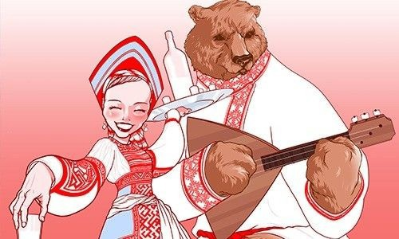

Russian accent. Runglish
By Darya Shcharbienkova,
504104

Slide 2
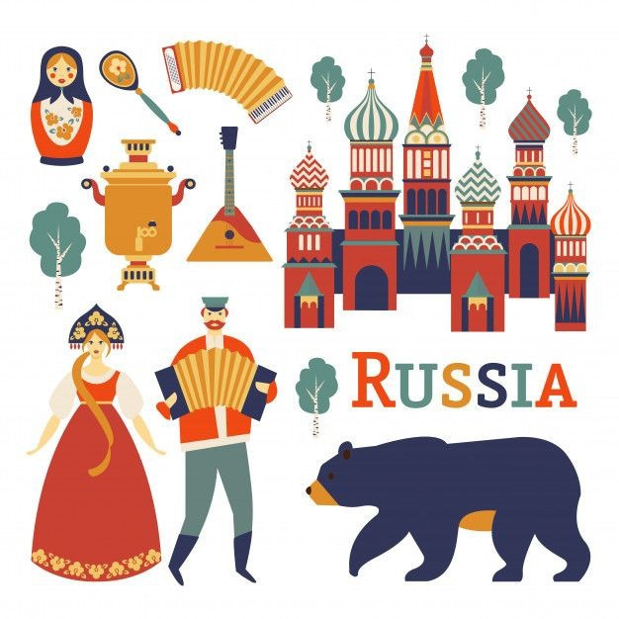
Around 25-30 million of Russians
live abroad of the RF;
it makes Russian diaspora second
largest in the world

Slide 3
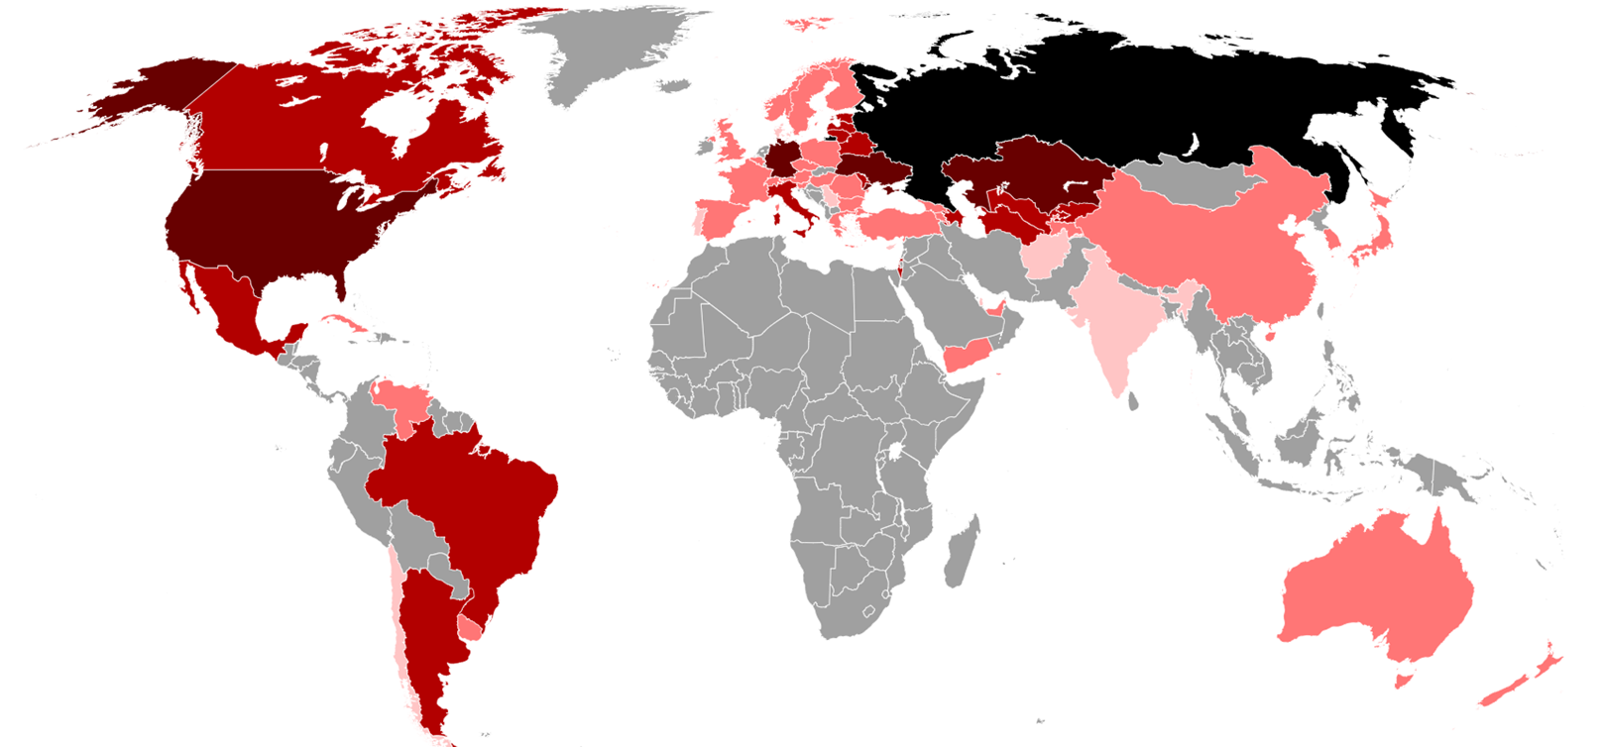
Russian diaspora in the world
Russia
+1 000 000 + 100 000 + 10 000 + 1,000 people

Slide 4
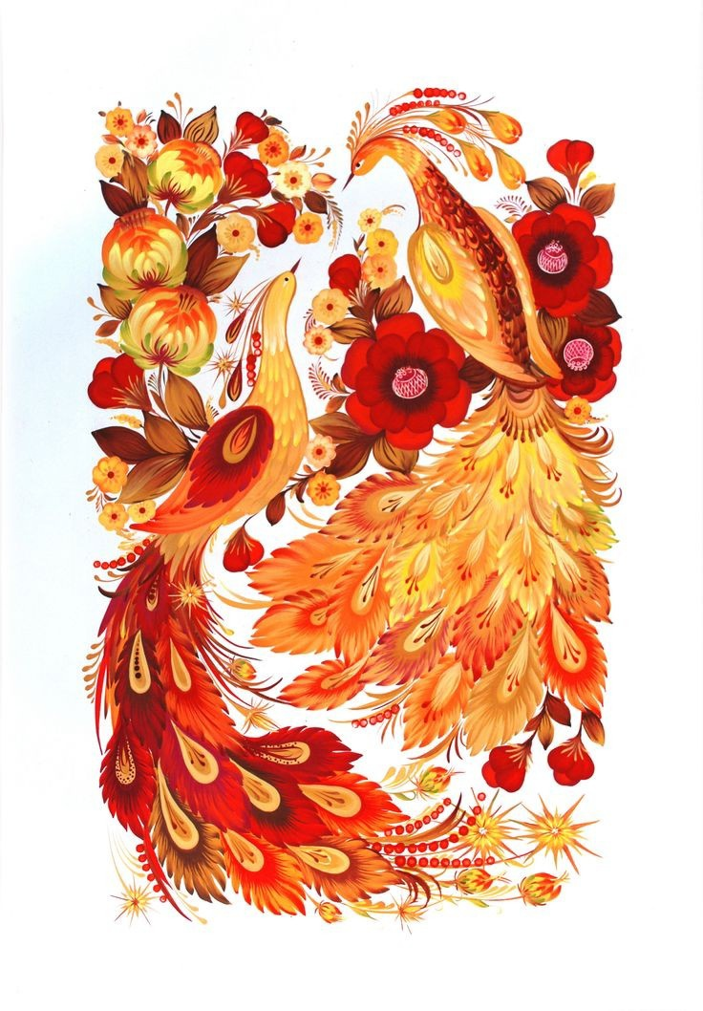
Sounds
Pronunciation features

Slide 5
Vowels
[ u: ]
[ ʊ ]
Boot: [bu:t] – [bʊt]
Root: [ru:t] – [rʊt]
[ ɔ: ]
[ ɔ/o ]
So what: [səʊ wɒt] - [sɔ vɔt]
Go: [ɡoʊ] – [go]

Slide 6
Features
[eɪ]
[aɪ]
Fake [feɪk]
The same Stake [steɪk]
My [maɪ]
[ i: ]
[ ɪ ]
Tree: [tri:] – [trɪ]
Free: [fri:] – [frɪ]
Sheep
Ship
=
[ʃɪp]
[y]
Really: [ˈriːəli] – [‘rylɪ]
Surnames: Krylov, Lysenko

Slide 7
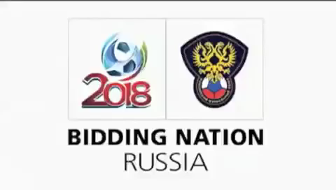
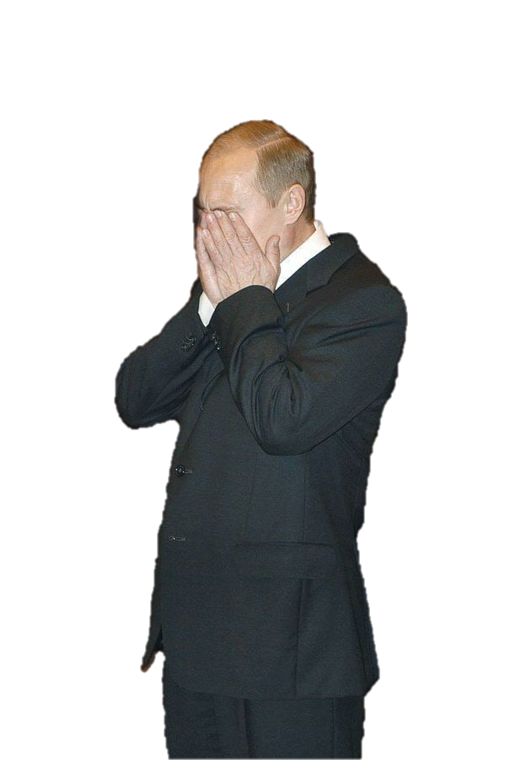

Really-really Russian pronunciation (stereotypical)

Slide 8
Consonants
[w]
[v]
Wonderful: [ˈwʌndəfl] - [ˈvʌndərful]
Whale
Vale
[ŋ]
[g/k]
=
[veɪl]
Going: [‘ɡəʊ.ɪŋ] – [‘go.ɪng]
Doing: [‘duː.ɪŋ] – [‘dʊ.ɪnk]
[ð]
[z]
This: [ðɪs] – [zɪs]
Brother: [‘brʌðə] - [‘brʌzər]
[θ]
[s]
Think: [θɪŋk] – [sɪnk]
Thick: [θɪk] – [sɪk]

Slide 9

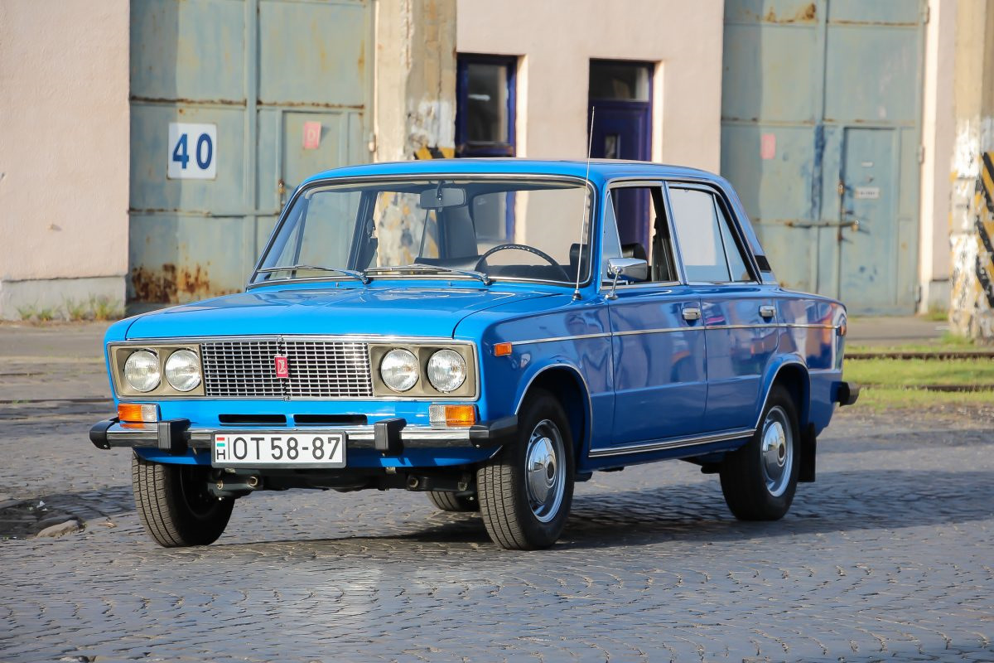
Features
[h]
[x]
- pronounced like heavy exhale
[r]
- is very clear, pronounced in any position
R-r-r-r

Slide 10
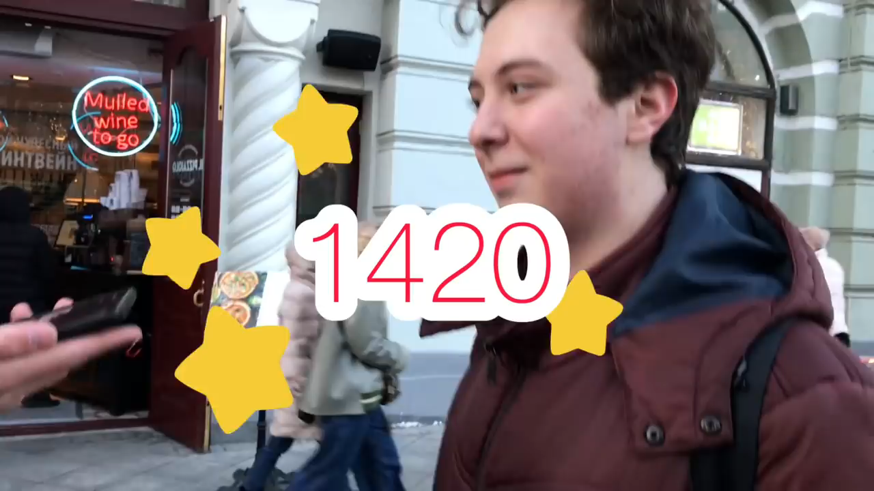

Slide 11
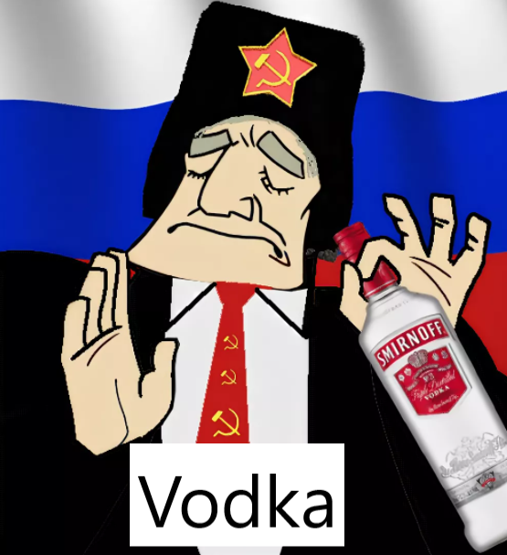
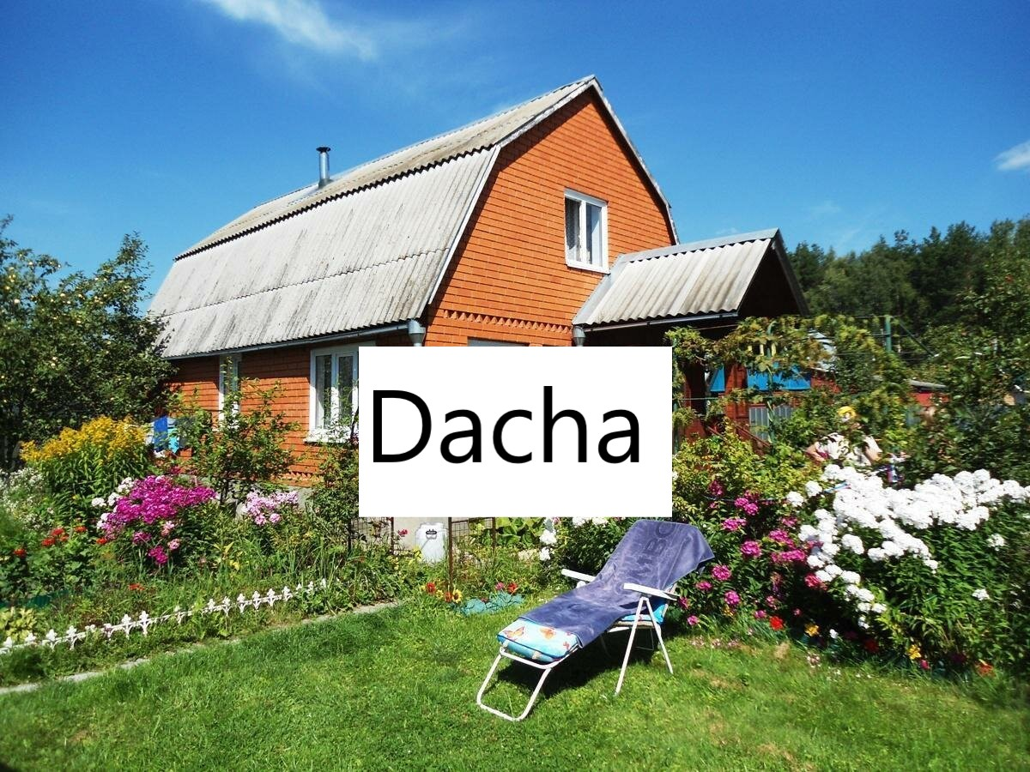
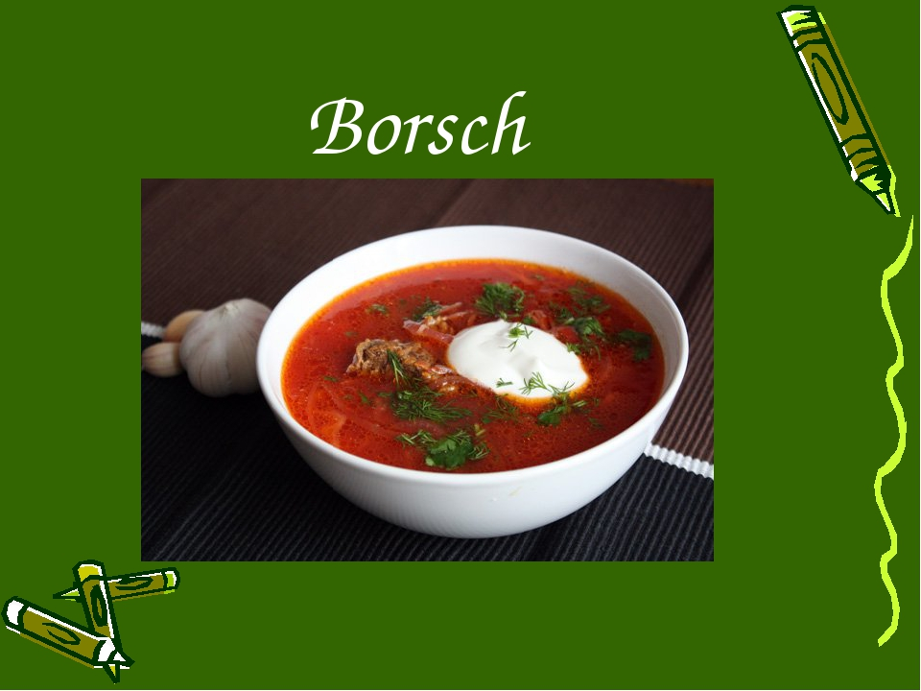
Features
Frequent omission of articles
Russian words in speech
I’m teacher
This is cat
I was in UK

Slide 12
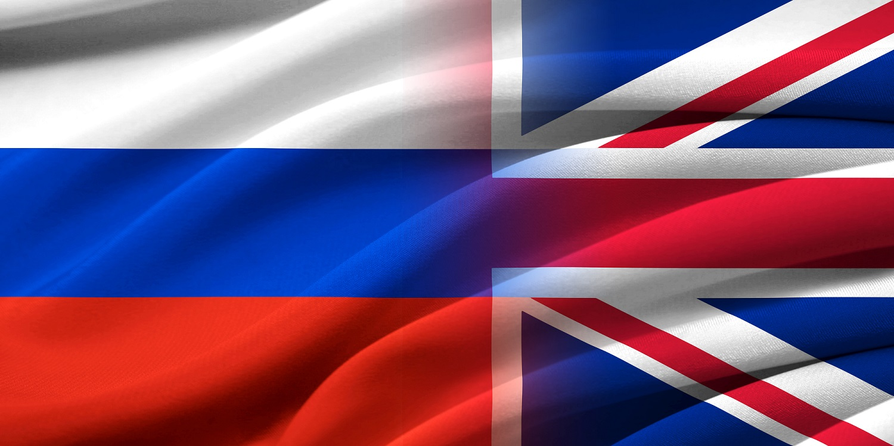
Runglish

Slide 13
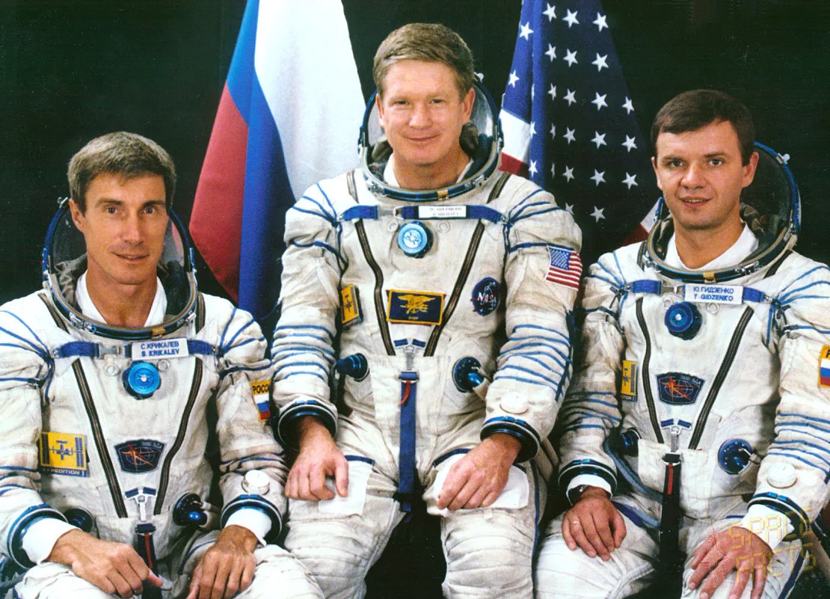
History
Sergey Krikalev introduced a definition in one of the interviews, mentioning that the cosmonauts at the ISS use a mixture of Russian and English

Slide 14
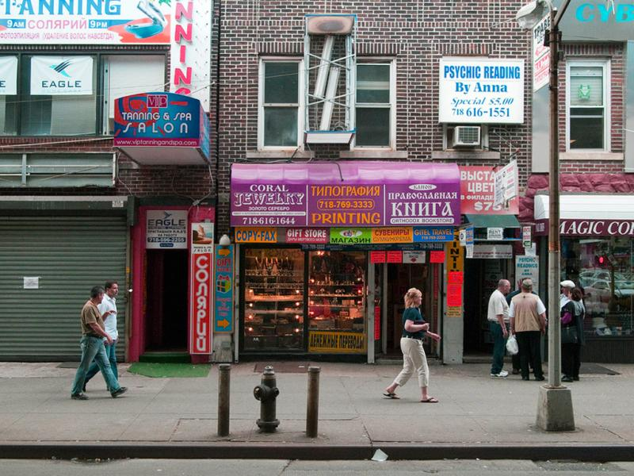
Brighton Beach, or Little Odessa
The place of soviet and post-soviet immigrants since 1970s

Slide 15
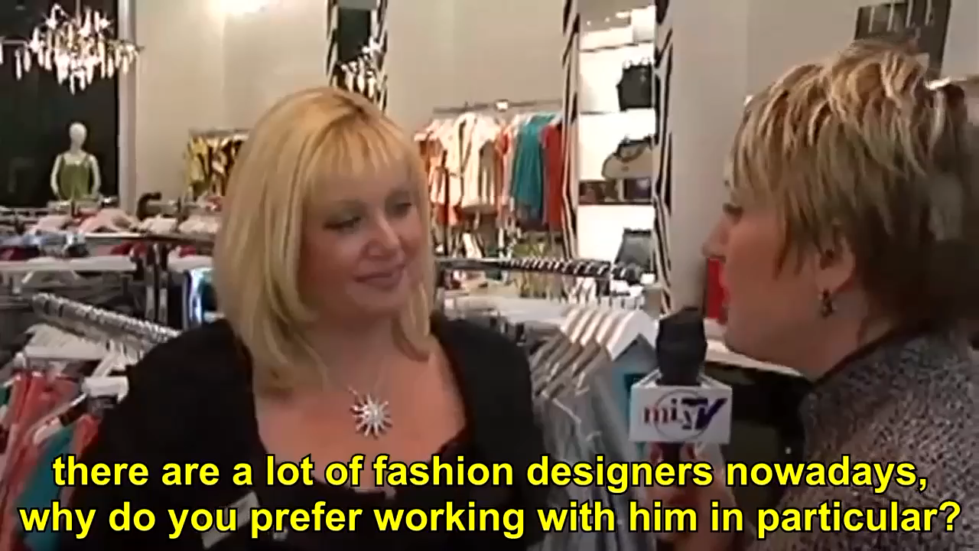


Slide 16
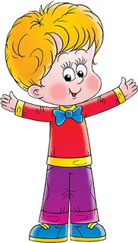
Symbiotic words
V1,2,3
Votali (voted)
Slicit (slice)
Drivaem (drive)
Boychik

Slide 17
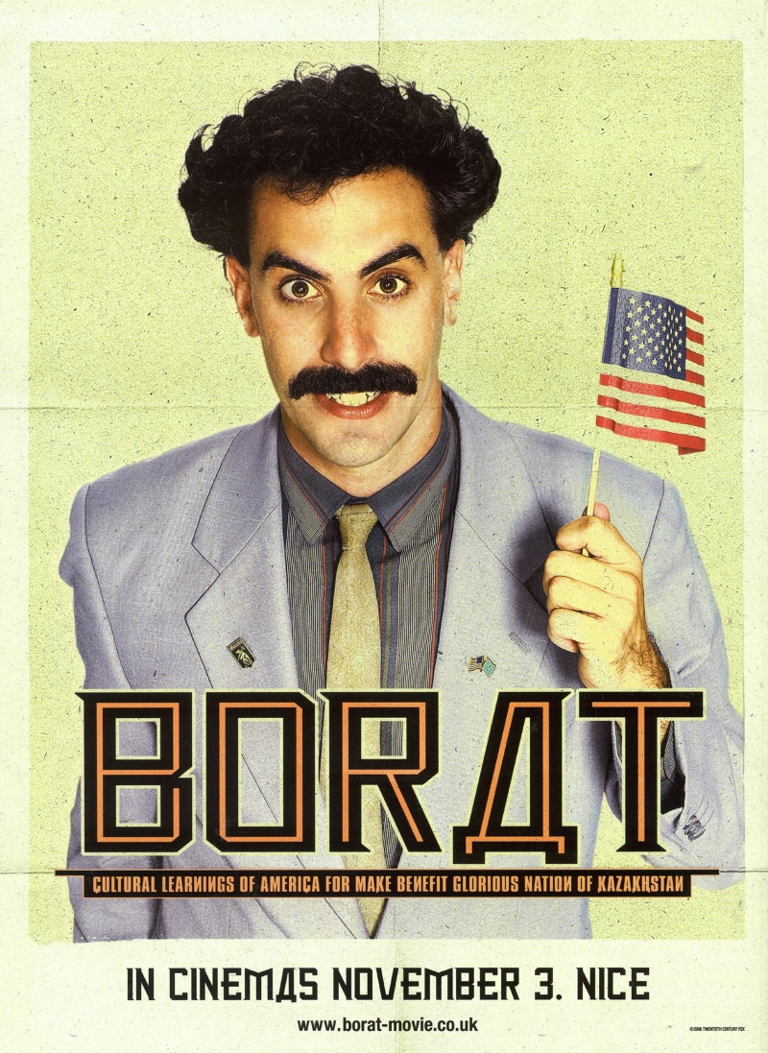
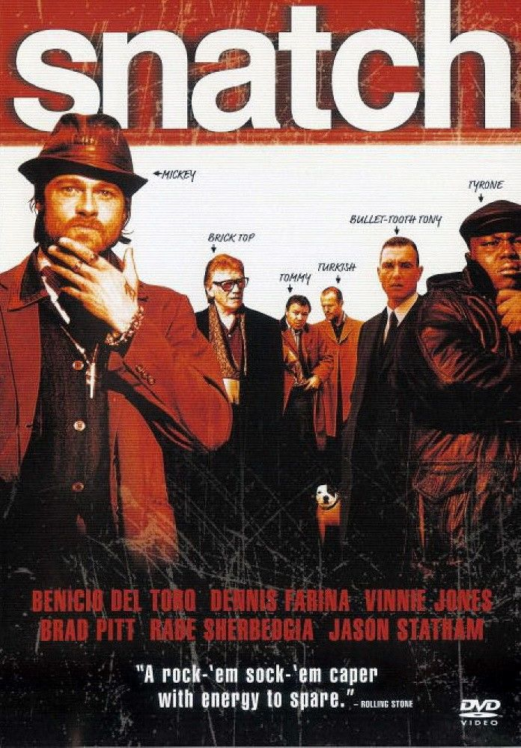

Recommendations

Slide 18
References
1420, Russians try to speak English, https://youtu.be/V7yWAhHT1fQ
NFKRZ, Runglish- The Russian + English Mix Language, https://youtu.be/dFlsbktQwZU
Vitaly Mutko’s speech, https://youtu.be/y6xNL41CB9o
Wikipedia, Russian diaspora, https://en.wikipedia.org/wiki/Russian_diaspora

Slide 19
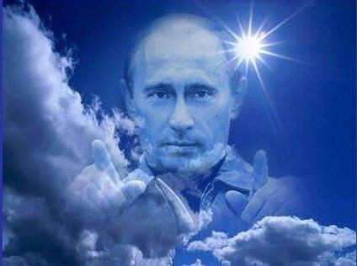
Thank you for attention

