Slide 1


English in the
Jewel in the Crown
-Indian English-
Rochana Jayasinghe

Slide 2
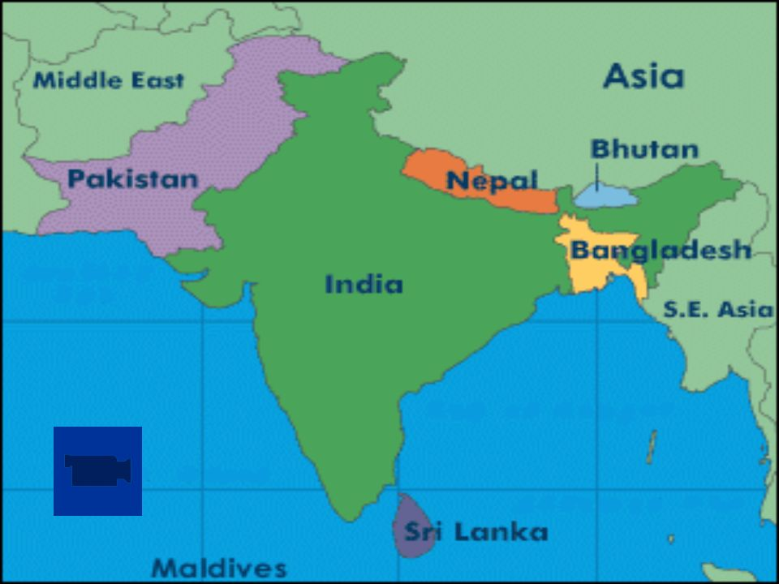

Slide 3
Number of English speakers in the Indian subcontinent – 200 million to 333 million
India is among the leading English-using nations in the world; 125 million
The third largest English book printing country in the world after the UK and the US
India publishes more books in English than in any other language

Slide 4

HOW? WHY?
BRITISH RAJ (1858-1947)
Jewel in the Crown

Slide 5
One of the 22 official languages
Widely used in administration, education, media, cross cultural communication
Plays the most prominent role in the prestigious domains of education, science and technology
The instrument that various poliical leaders utilized for national awakening and freedom struggles

Slide 6
https://www.youtube.com/watch?v=AL2TShb6fFs

Slide 7
English is ‘nativized’
When a language is transported to new cultures as in South Asia, it undergoes striking changes
It is not a uniform variety

Slide 8
What is your good name?
Today morning, yesterday night
Cousin sister, cousin brother
Prepone
Do the needful

Slide 9
Auntie/uncle
Timepass
Kindly adjust
Don’t eat my head
To pass out

Slide 10
On/off the lights
‘Only’
Revert back
Do one thing
Himalayan Blunder

Slide 11
I have a doubt
Batch/batchmates
Cut the call
Current went/current came
‘No’

Slide 12
Sri Lankan English
Hi
How have you been lately?
What a shame
Dont be silly
No way!
I accept that
They're dating

Slide 13
This is my son's girlfriend
Everybody
Everything is alright
Is that ok?
Don't worry
Late night partying
This is ridiculous
Dont make me repeat myself
Unfortunately

Slide 14
Can you turn the air conditioner on?
Can you switch off the light?
My arm hurts
There you go
There was so much traffic on the road today
You must be so tired
That's what I told you!
Yes, that's right
I didn't know at all

Slide 15
Oh alright. That could be done, yes
Could you come down for a second?
Bon Appetit!

Slide 16
Sounds ridiculous?
Is it wrong?

Slide 17
https://www.youtube.com/watch?v=1hfX9z8uIX8

Slide 18
THANK YOU

