Slide 1
Cantonese II
Week 12

Slide 2
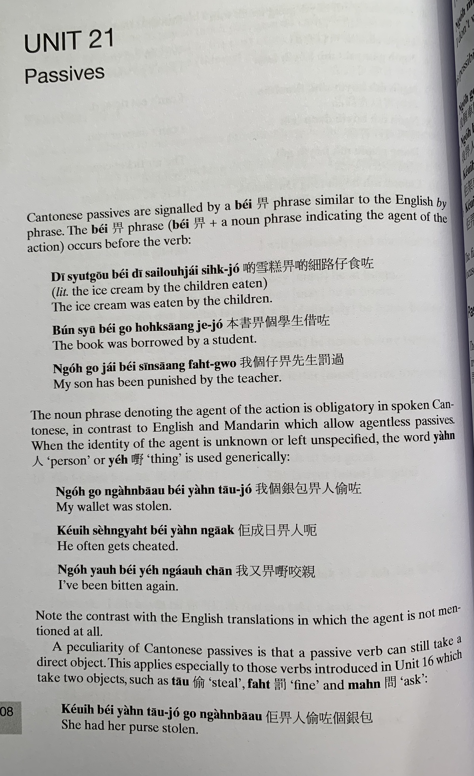
bei2
di1 syut3 gou1 bei2 di1 sai3 lou6 zai2 sik6 zo2
bun2 syu1 bei2 go3 hok6 saang1 ze3 zo2
ngo5 go3 zai2 bei2 sin1 saang1 fat6 gwo3

Slide 3
jan4
je5
ngo5 go3 ngan4 baau1 bei2 jan4 tau1 zo2
keoi5 sing4 jat6 bei2 jan4 aak1
ngo5 jau6 bei2 je5 ngaau5 can1
tau1
fat6
man6
keoi5 bei2 jan4 tau1 zo2 go3 ngan4 baau1

Slide 4
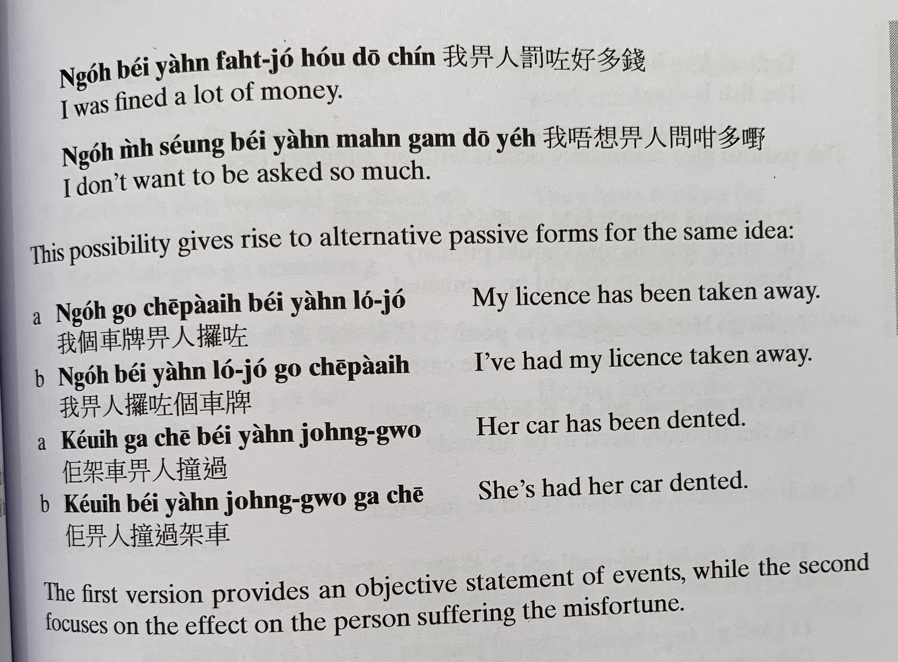
ngo5 bei2 jan4 fat6 zo2 hou2 do1 cin2
ngo5 m4 soeng2 bei2 jan4 man6 gam3 do1 je5
ngo5 go3 ce1 paai4 bei2 jan4 lo2 zo2
ngo5 bei2 jan4 lo2 zo2 go3 ce1 paai4
keoi5 gaa3 ce1 bei2 jan4 zong6 gwo3
keoi5 bei2 jan4 zong6 gwo3 gaa3 ce1

Slide 5
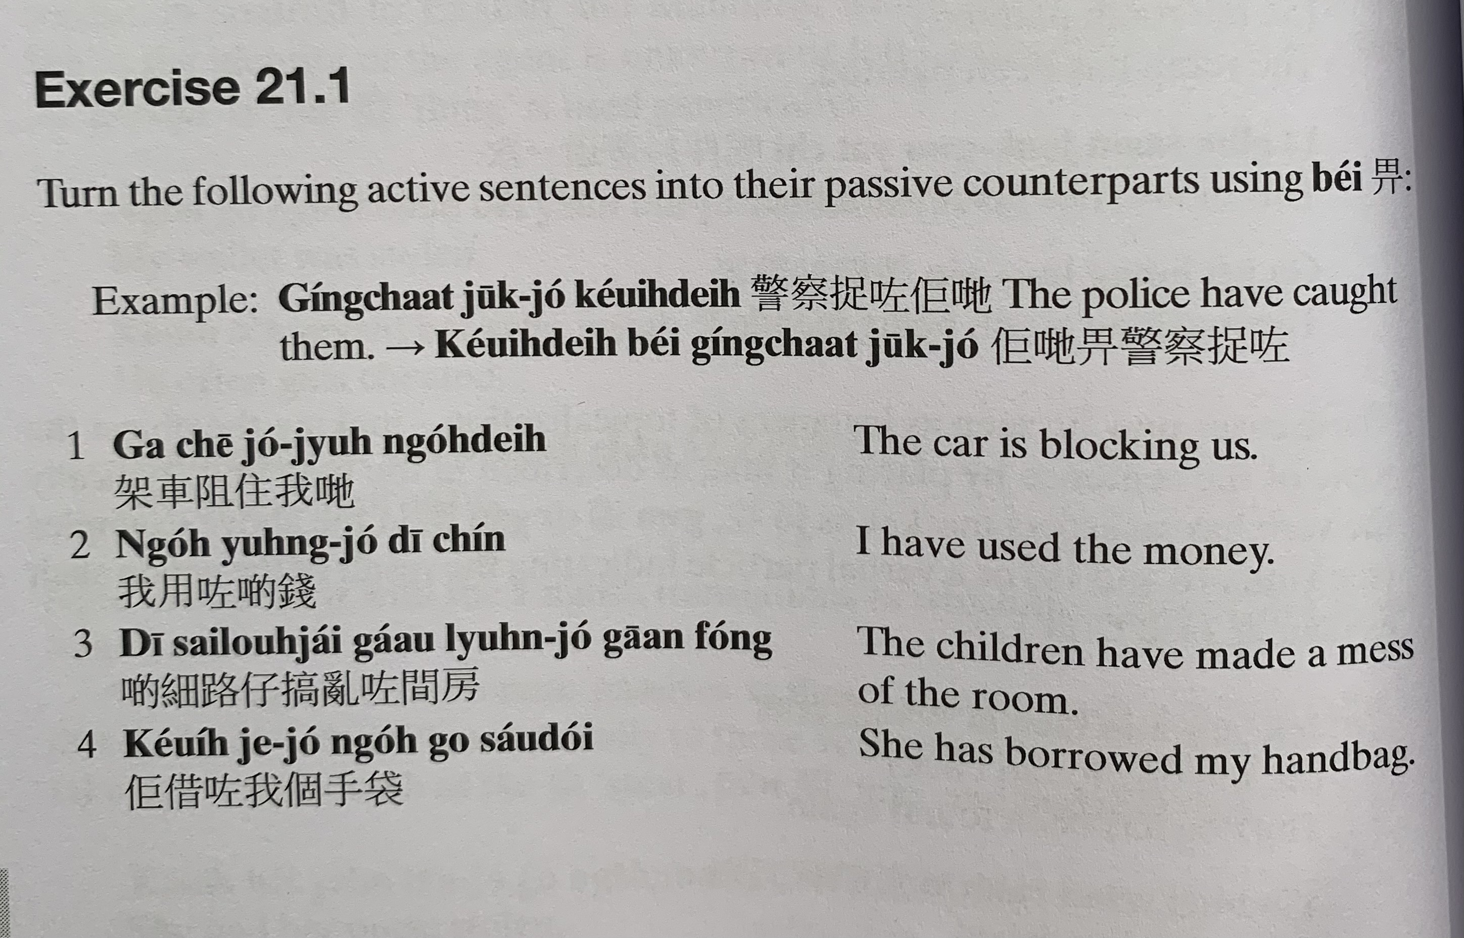
ging2 caat3 zuk1 zo2 keoi5 dei6
keoi5 dei6 bei2 ging2 caat3 zuk1 zo2
gaa3 ce1 zo2 zyu6 ngo5 dei6
ngo5 jung6 zo2 di1 cin2
di1 sai3 lou6 zai2 gaau2 lyun6 zo2 gaan1 fong2
keoi5 ze3 zo2 ngo5 go3 sau2 doi2

Slide 6
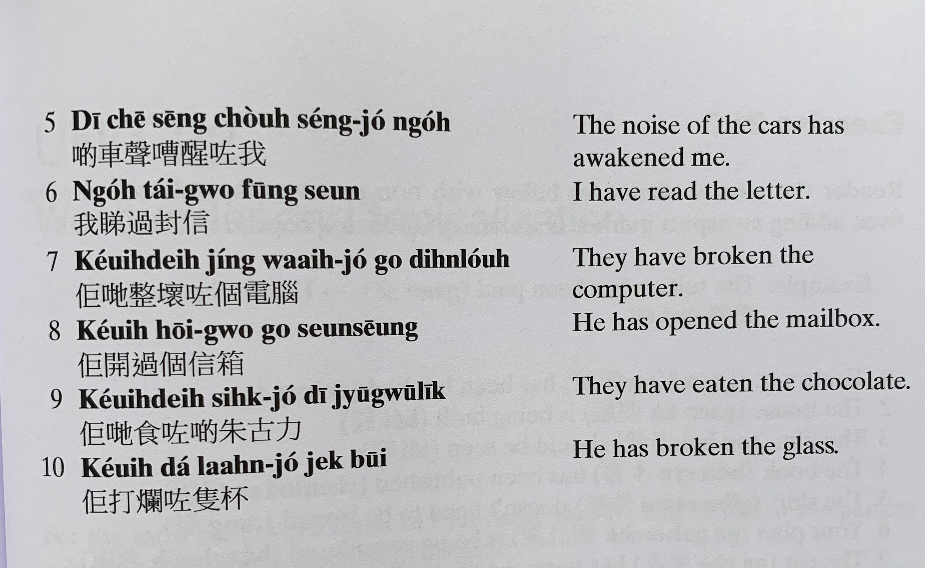
di1 ce1 seng1 cou4 seng2 zo2 ngo5
ngo5 tai2 gwo3 fung1 seon3
keoi5 dei6 zing2 waai6 zo2 go3 din6 nou5
keoi5 hoi1 gwo3 go3 seon3 soeng1
keoi5 dei6 sik6 zo2 di1 zyu1 gu1 lik1
keoi5 daa2 laan6 zo2 zek3 bui1

Slide 7
jau5 jan4 lo2 zo2 ngo5 go3 sau2 biu1
jau5 jan4 hoi1 zo2 dou6 mun4
jau5 jan4 sik1 zo2 laang5 hei3 gei1
jau5 jan4 aak1 zo2 keoi5 di1 cin2
jau5 jan4 maai5 zo2 di1 syu1
jau5 je5 ngaau5 dou2 ngo5 zek3 sau2
jau5 di1 je5 faan4 dou2 keoi5
jau5 di1 je5 jing2 hoeng2 dou2 keoi5
ge3 sam1 cing4

Slide 8
Translate the following into Cantonese and also in passive voice.
1. Someone ate my bread （min6 baau1 麵包）
2. Someone borrowed my money （ze3 cin2 借錢）
3. My father broke （zing2 waai6 整壞） the computer （bou6 din6 nou5 部電腦）
4. I washed （sai2 洗） the clothes （saam1 衫）
5. He has broken (daa2 laan6打爛) the glass (zek6隻 bui1 杯）
6. Someone open the box (soeng1 箱）
7. Someone stole （ tau1 偷）her wallet （ ngan4 baau1 銀包）
8. Someone scammed （ aak1呃） his money

Slide 9
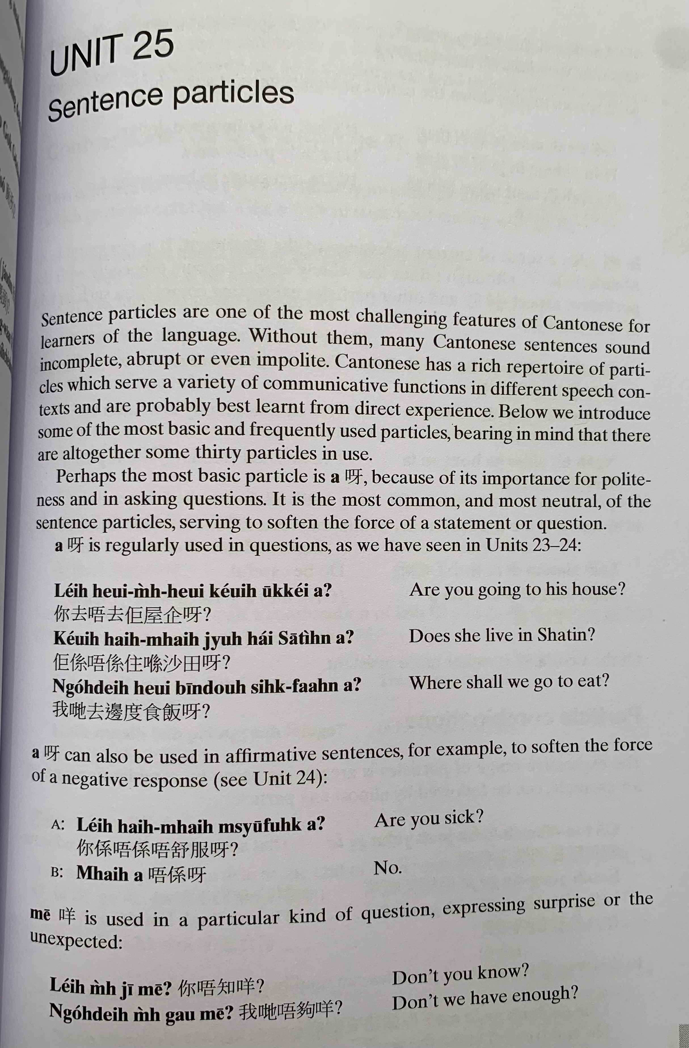
aa3
aa3
nei5 heoi3 m4 heoi3 keoi5 uk1 kei2 aa3 ?
keoi5 hai6 m4 hai6 zyu6 hai2 saa1 tin4 aa3 ?
ngo5 dei6 heoi3 bin1 dou6 sik6 faan6 aa3 ?
aa3
nei5 hai6 m4 hai6 m4 syu1 fuk6 aa3？
m4 hai6 aa3

Slide 10
me1
nei5 m4 zi1 me1 ?
ngo5 dei6 m4 gau3 me1?

Slide 11
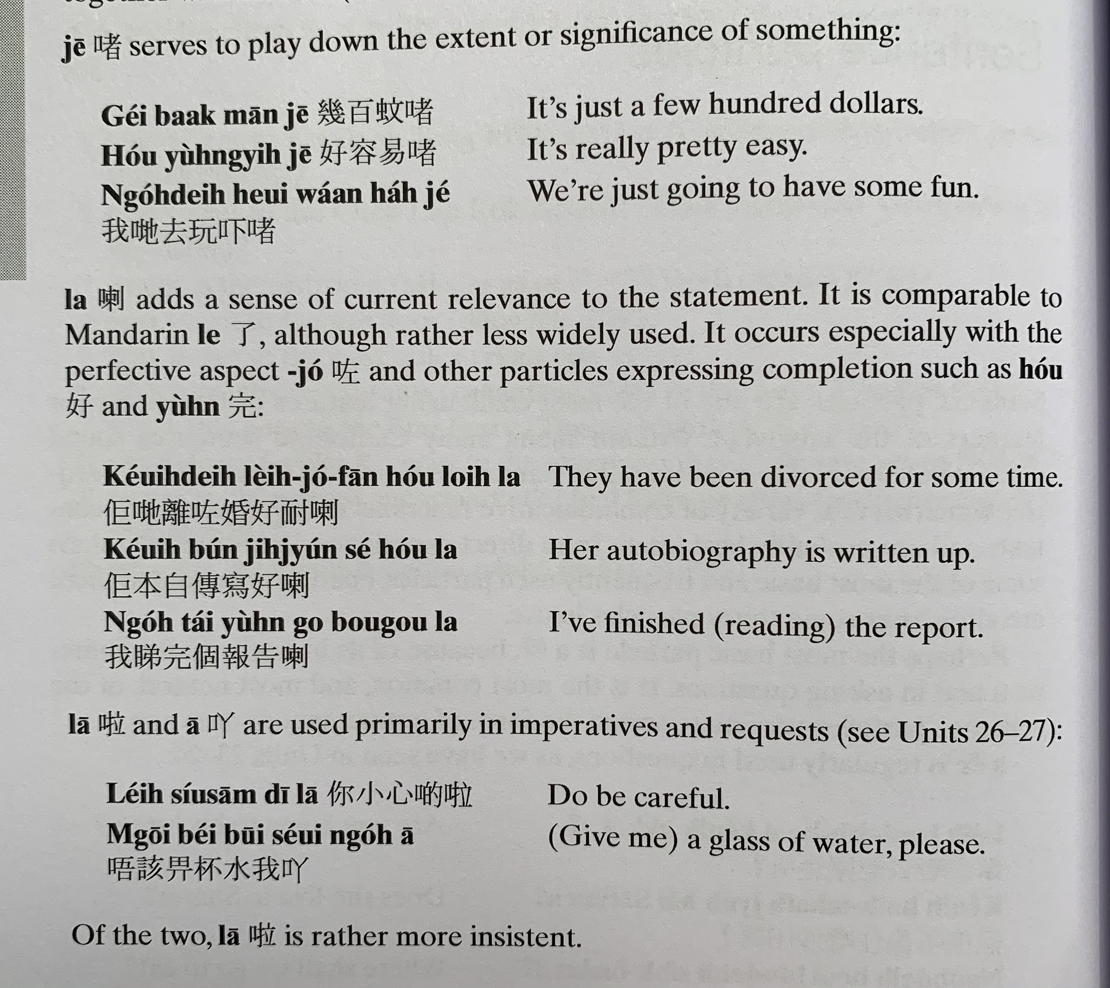
ze1
gei2 baak3 man1 ze1
hou2 jung4 ji6 ze1
講笑啫
Gong2 siu3 ze1
ngo5 dei6 heoi3 waan2 haa5 ze1
laa3
zo2
hou2
Jyun4 完
keoi5 dei6 lei4 zo2 fan1 hou2 noi6 laa3
keoi5 bun2 zi6 cyun4 se2 hou2 laa3
ngo5 tai2 jyun4 go3 bou3 gou3 laa3
laa1
aa1
nei5 siu2 sam1 di1 laa1
m4 goi1 bei2 bui1 seoi2 ngo5 aa1

Slide 12
go2 tou3 din6 si6 kek6 zou6 jyun4 ge3 laa3
keoi5 gong2 siu3 ge3 ze1
nei5 ji5 wai6 ngo5 so4 ge3 me1 ?
nei5 sik1 lou6 ge3 laa3 me1 ?
keoi5 hai6 siu2 hok6 saang1 lai4 ge3 zaa3 wo3 !

Slide 13
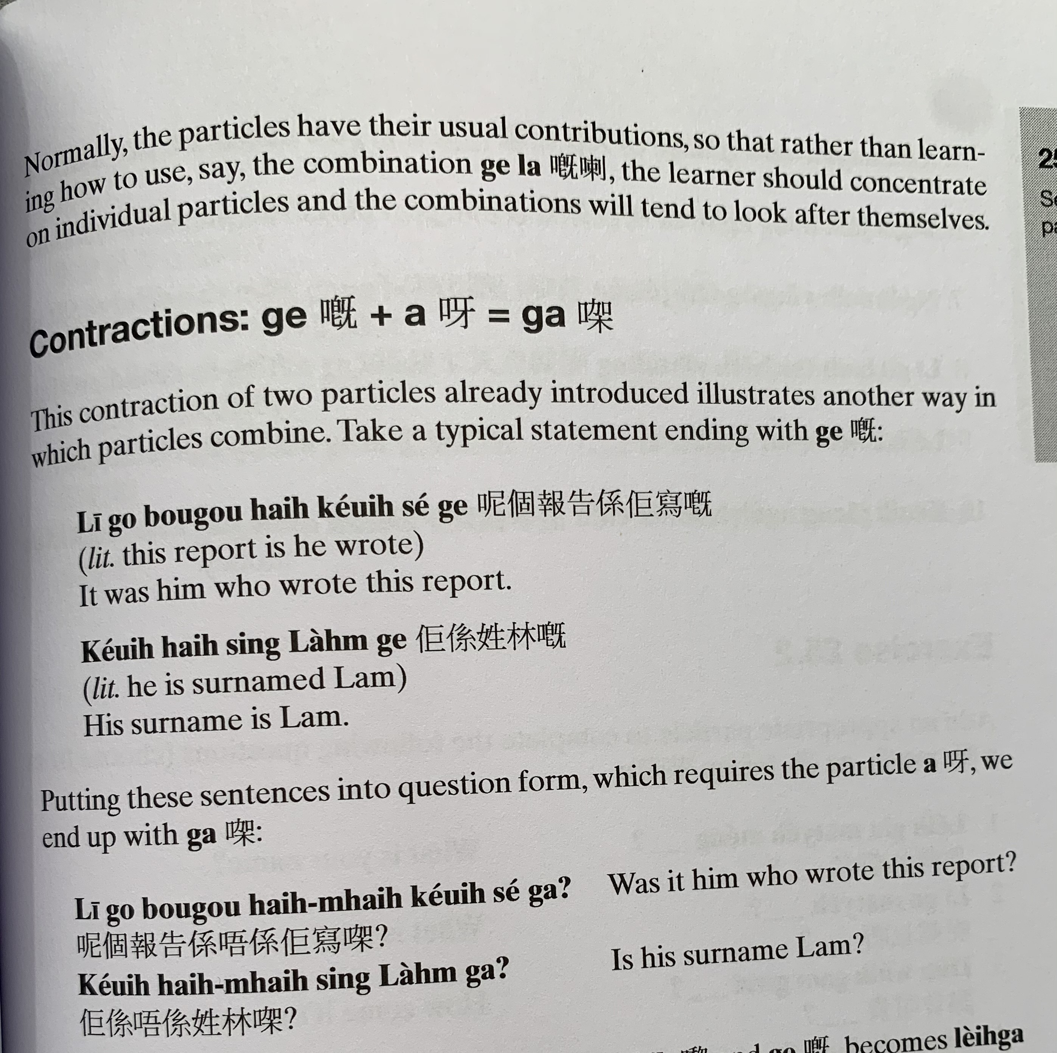
ni1 go3 bou3 gou3 hai6 keoi5 se2 ge3
keoi5 hai6 sing3 lam4 ge3
ni1 go3 bou3 gou3 hai6 m4 hai6 keoi5 se2 gaa3 ?
keoi5 hai6 m4 hai6 sing3 lam4 gaa3 ?

Slide 14
Particle | Jyutping | Usage | Example
呀 | aa3 | Used in neutral questions. Also used to soften the tone of affirmative statements so they don't sound as abrupt. | Nei5 heoi3 bin1aa3? 你去邊呀? Where are you going? Ngo5 faan1 uk1 kei2 aa3. 我返屋企呀 I'm going home.
嘅 | ge3 | Used in assertions where something is emphasized (usually 係 hai6 is in front of what is being emphasized). Pronouncing it as ge2 adds a sense of puzzlement about the situation. This is equivalent to the Mandarin/written Chinese 的 dik1. | Ngo5 hai6 gam1 jat6 faan1 uk1 kei2 ge3. 我係今日返屋企嘅 I'm going home today. (the "today" is emphasized)
㗎 | gaa3 | Contraction of the combination 嘅呀 ge3 aa3. Can be used in question and answer. | 你係幾時返來㗎? When are you coming back? (the "when" is emphasized) Use for defending your argument or emphasis. Stronger than嘅ge3. Hai6 ngo5 gaa3! 係我架! It’s mine!
啦 | laa1 | Used in requests and imperatives. This is one particle where leaving it out could make the sentence sound rude. This is equivalent to the Mandarin/written Chinese sentence final 吧 baa6. | Bei2 ngo5 laa1 畀我啦 Give it to me [please].
啫 | ze1 | Can be used to mean "only" or "that's all," or used to play down the significance of the situation. | Keoi5 faan1 yat1 yat6 ze1 佢返一日啫 He's only coming back for one day.

Slide 15
keoi5 faan1 zo2 uk1 kei2 佢返咗屋企 ("He went home")
佢返咗屋企 aa3 呀 – (informing the listener) “He went home!” 佢返咗屋企 laa3 喇 – (informing the listener) “He already went home!” 佢返咗屋企 wo3 喎 – “Oh… He already went home though.” 佢返咗屋企 gwaa3 啩 – (with uncertainty) “He went home, I guess” 佢返咗屋企 me1 咩? – “Oh, he went home?” 佢返咗屋企 lo1 囉 – (with emphasis) “He went home already.” 佢返咗屋企 laa3 maa3 啦嘛 – “He went home already! (so he can’t be here right now)”

Slide 16
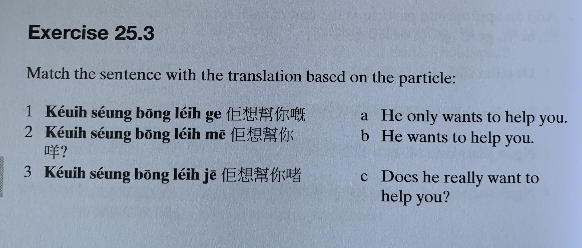
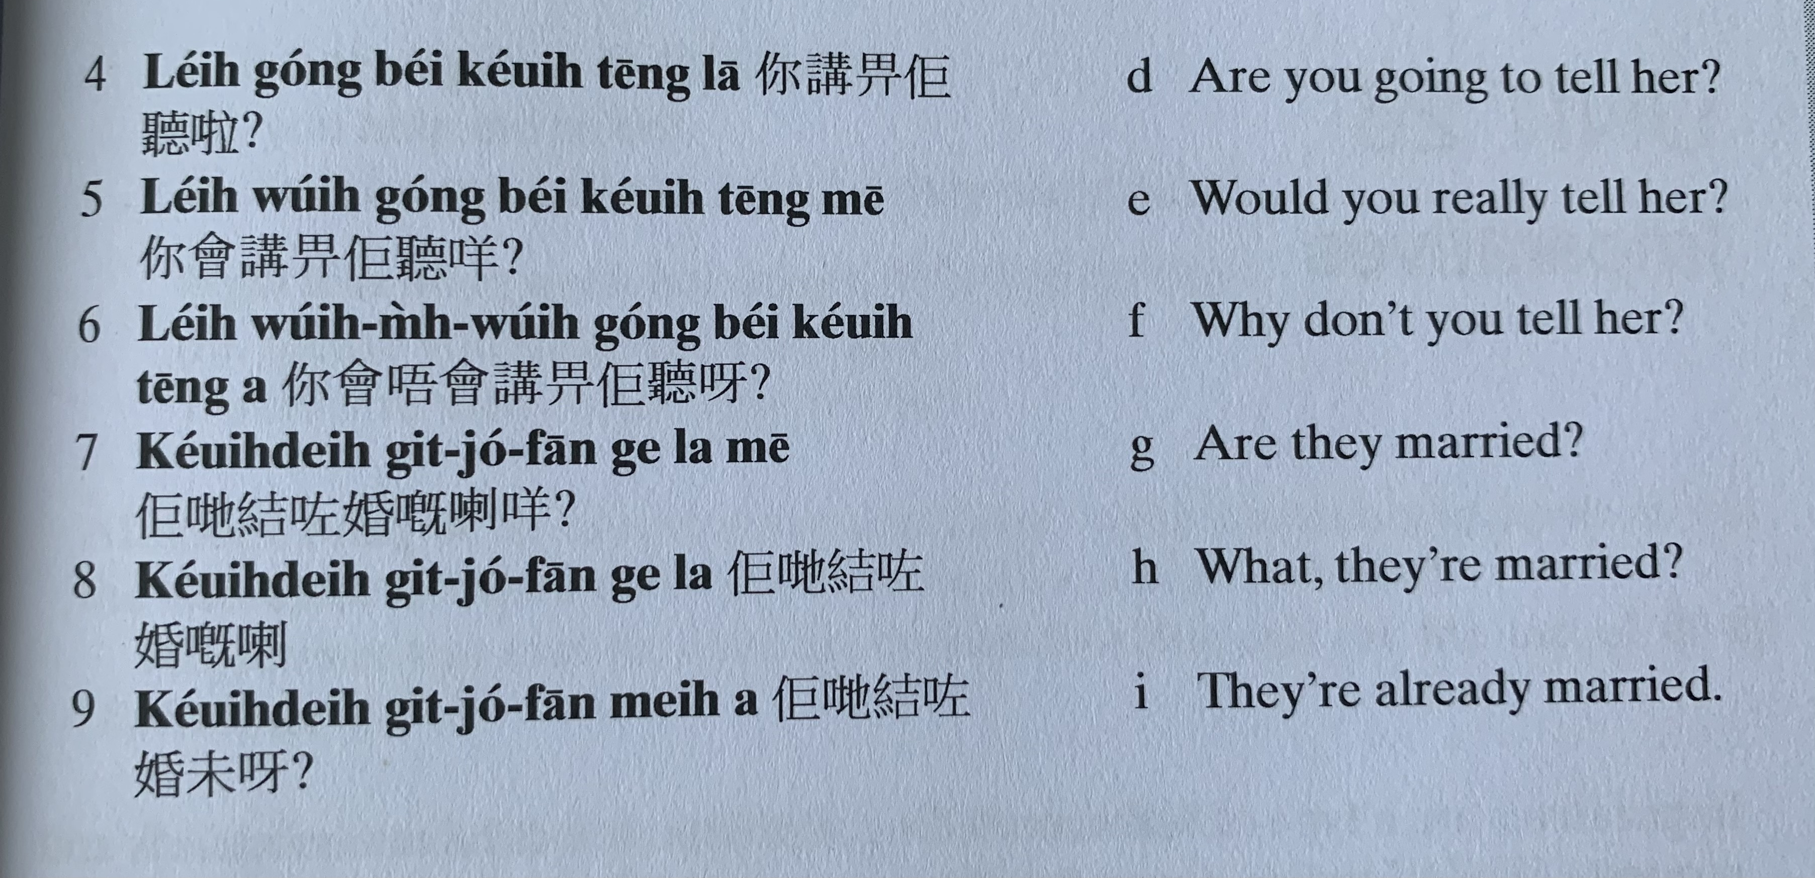
keoi5 soeng2 bong1 nei5 ge3
keoi5 soeng2 bong1 nei5 me1?
keoi5 soeng2 bong1 nei5 ze1
nei5 gong2 bei2 keoi5 teng1 laa1?
nei5 wui5 gong2 bei2 keoi5 teng1 me1?
nei5 wui5 m4 wui5 gong2 bei2 keoi5 teng1 aa3?
keoi5 dei6 git3 zo2 fan1 laa3 me1?
keoi5 dei6 git3 zo2 fan1 ge3 laa3
keoi5 dei6 git3 zo2 fan1 mei6 aa3?

Slide 17
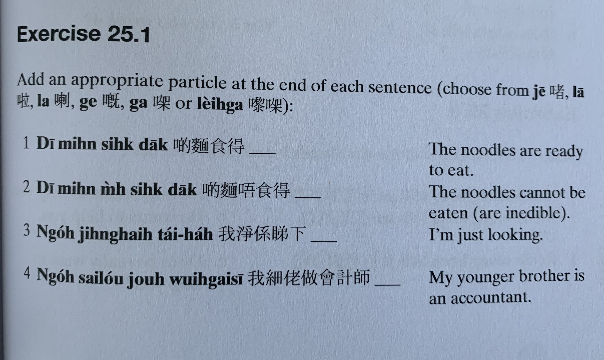
ze1
laa1
ge3
gaa3
lai4 gaa3
laa3
di1 min6 sik6 dak1
di1 min6 m4 sik6 dak1
ngo5 zing6 hai6 tai2 haa5
ngo5 sai3 lou2 zou6 wui6 gai3 si1

Slide 18
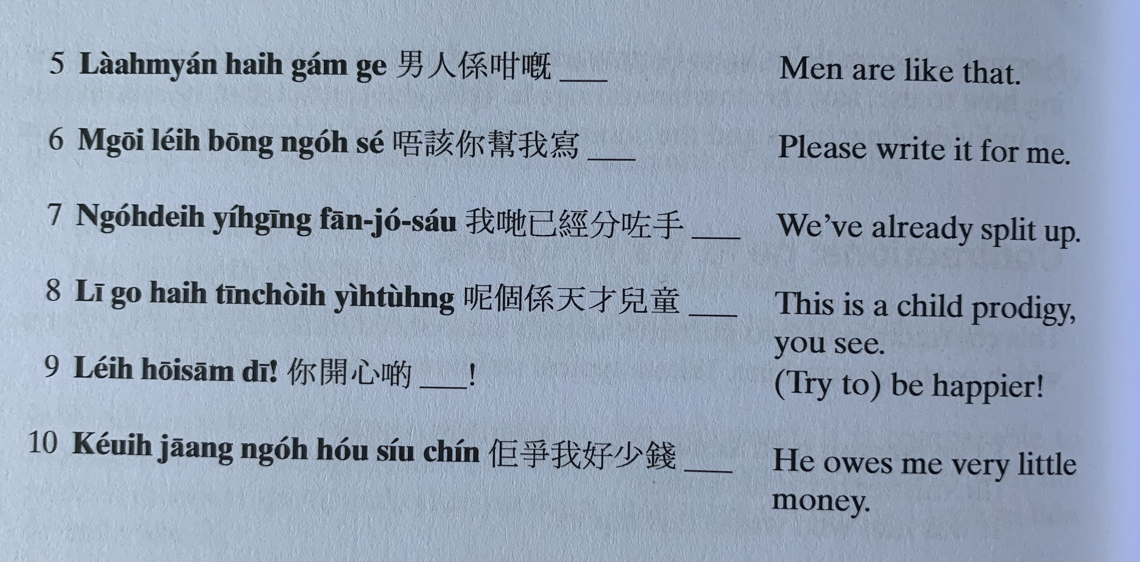
naam4 jan2 hai6 gam2 ge3
m4 goi1 nei5 bong1 ngo5 se2
ngo5 dei6 ji5 ging1 fan1 zo2 sau2
ni1 go3 hai6 tin1 coi4 ji4 tung4
nei5 hoi1 sam1 di1
nei5 zaang1 ngo5 hou2 siu2 cin2

Slide 19
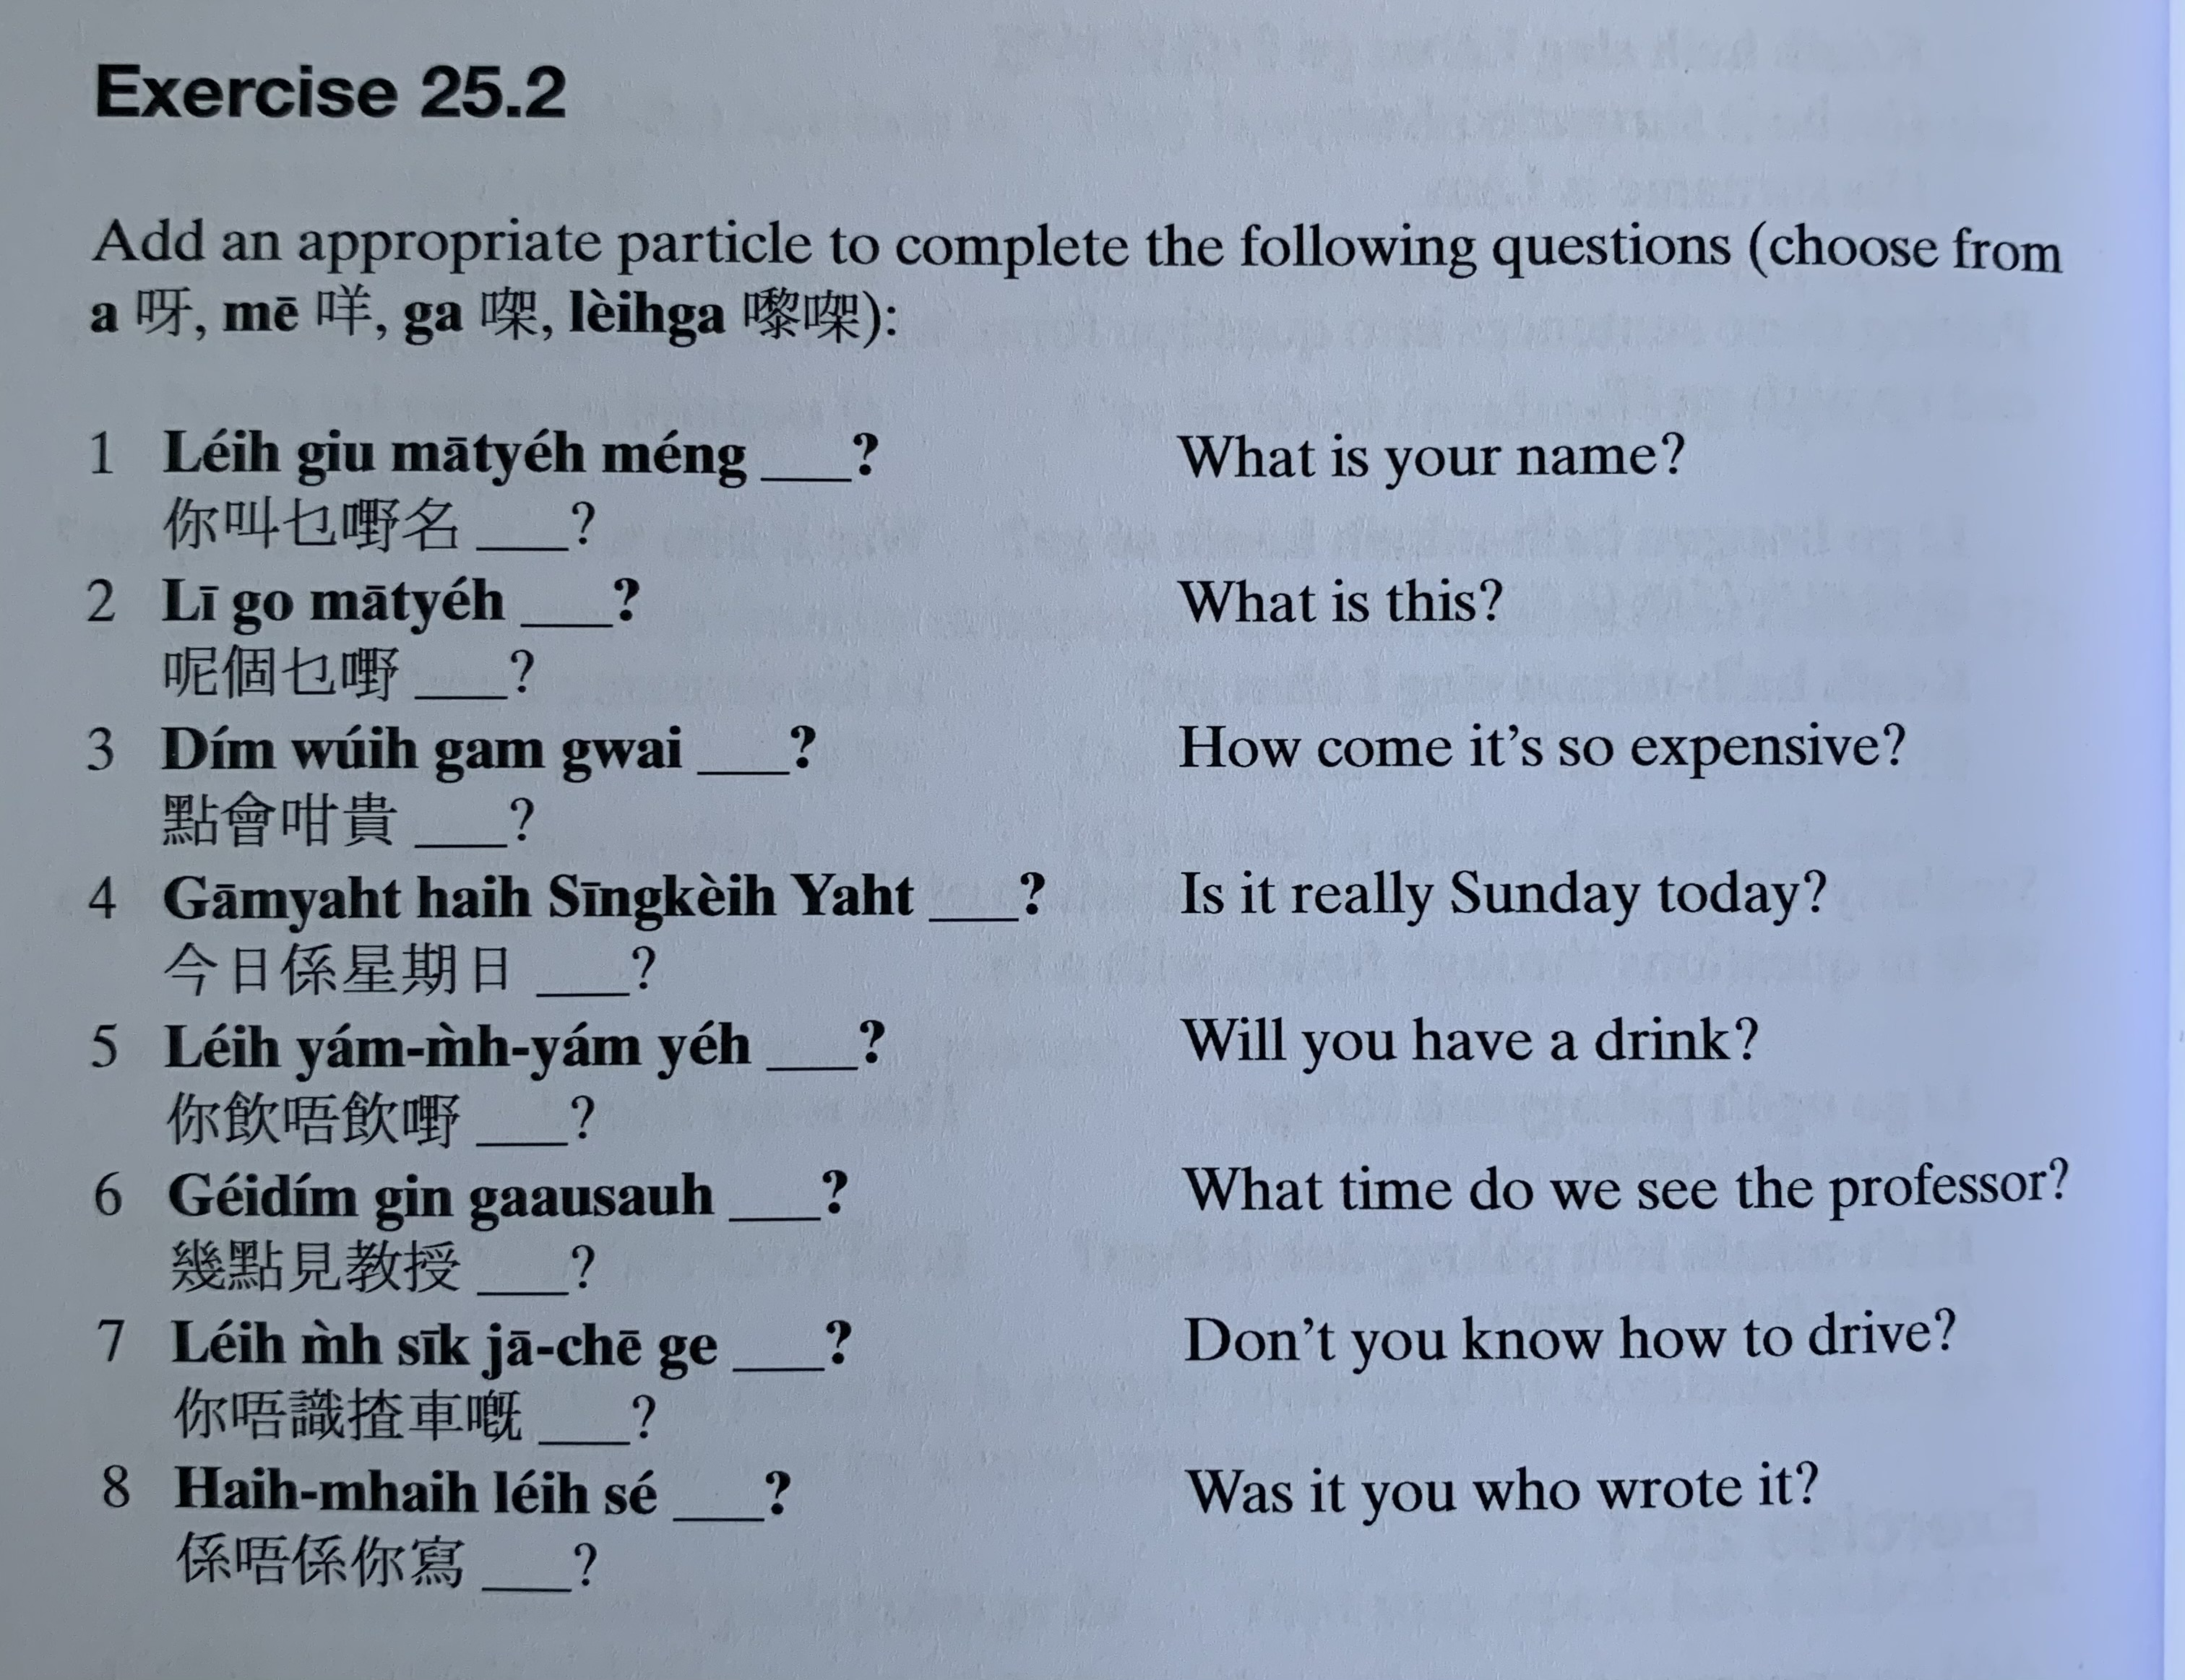
aa3
lai4 gaa3
me1
gaa3
nei5 giu3 mat1 je5 meng2
ni1 go3 mat1 je5
dim2 wui5 gam3 gwai3
gam1 jat6 hai6 sing1 kei4 jat6
nei5 jam2 m4 jam2 je5
gei2 dim2 gin3 gaau3 sau6
nei5 m4 sik1 zaa1 ce1 ge3
hai6 m4 hai6 nei5 se2

Slide 20
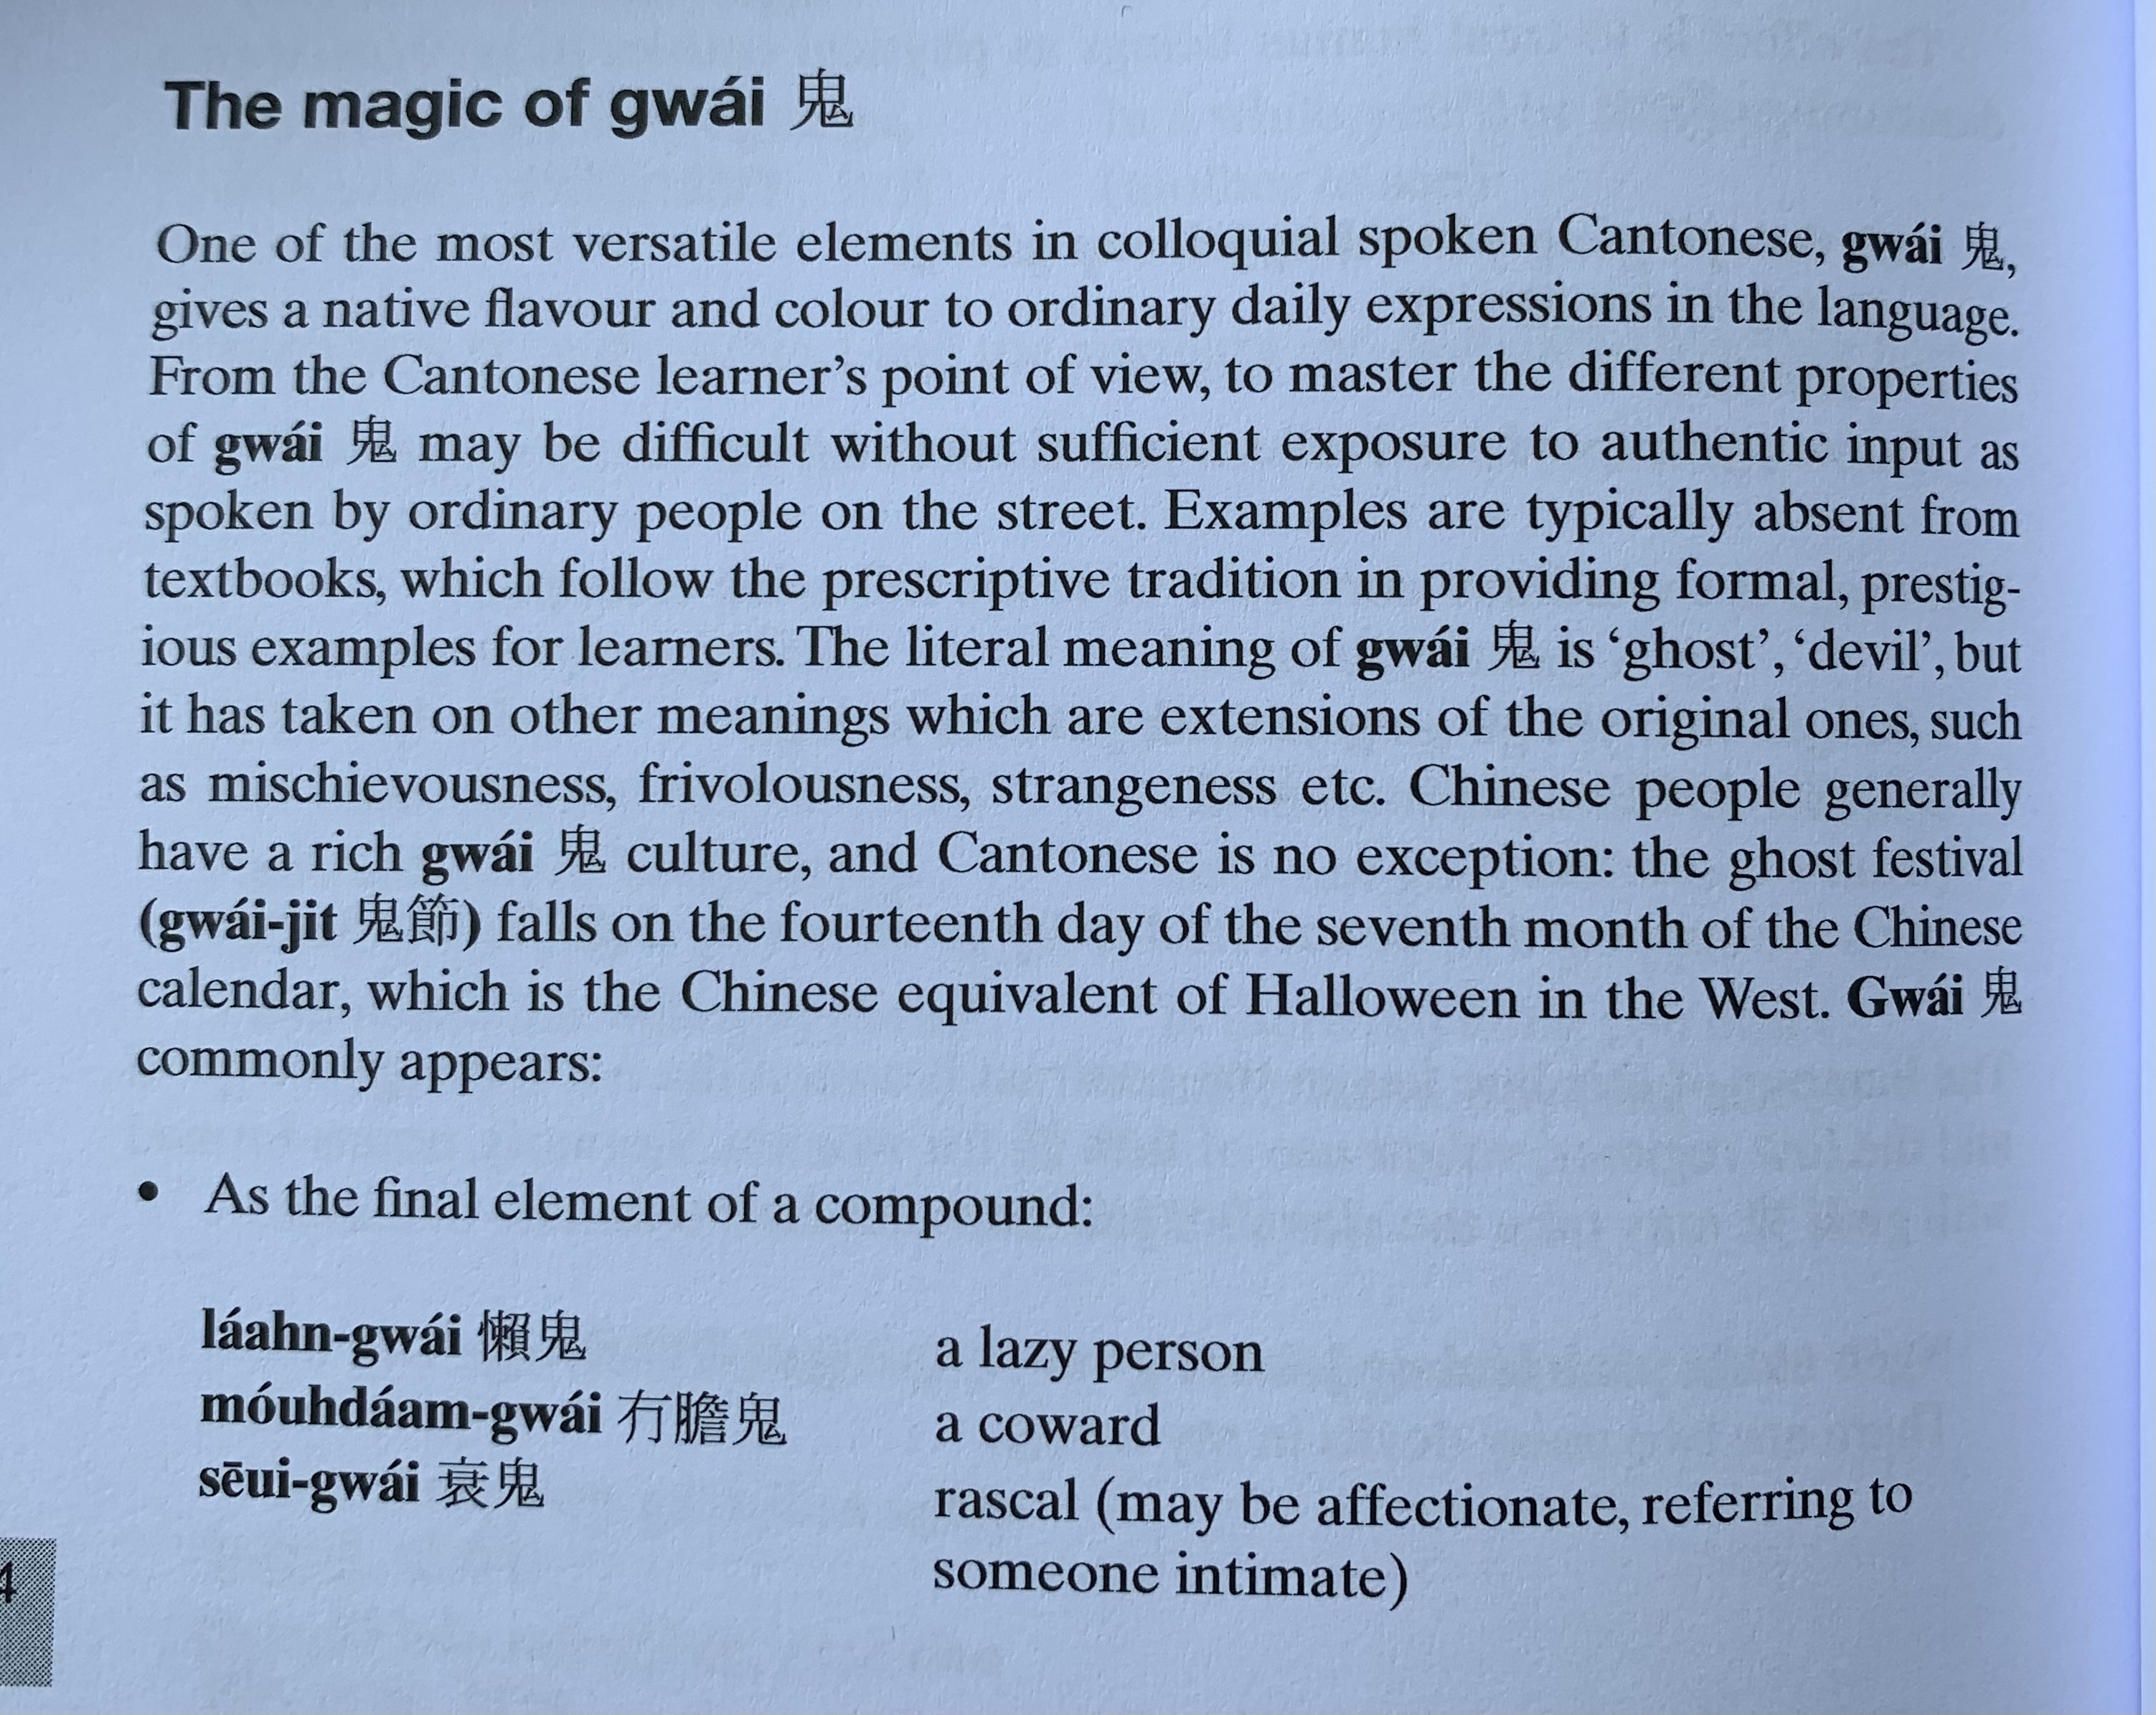
gwai2
laan5 gwai2
mou5 daam2 gwai2
seoi1 gwai2
zau2 gwai2 酒鬼

Slide 21
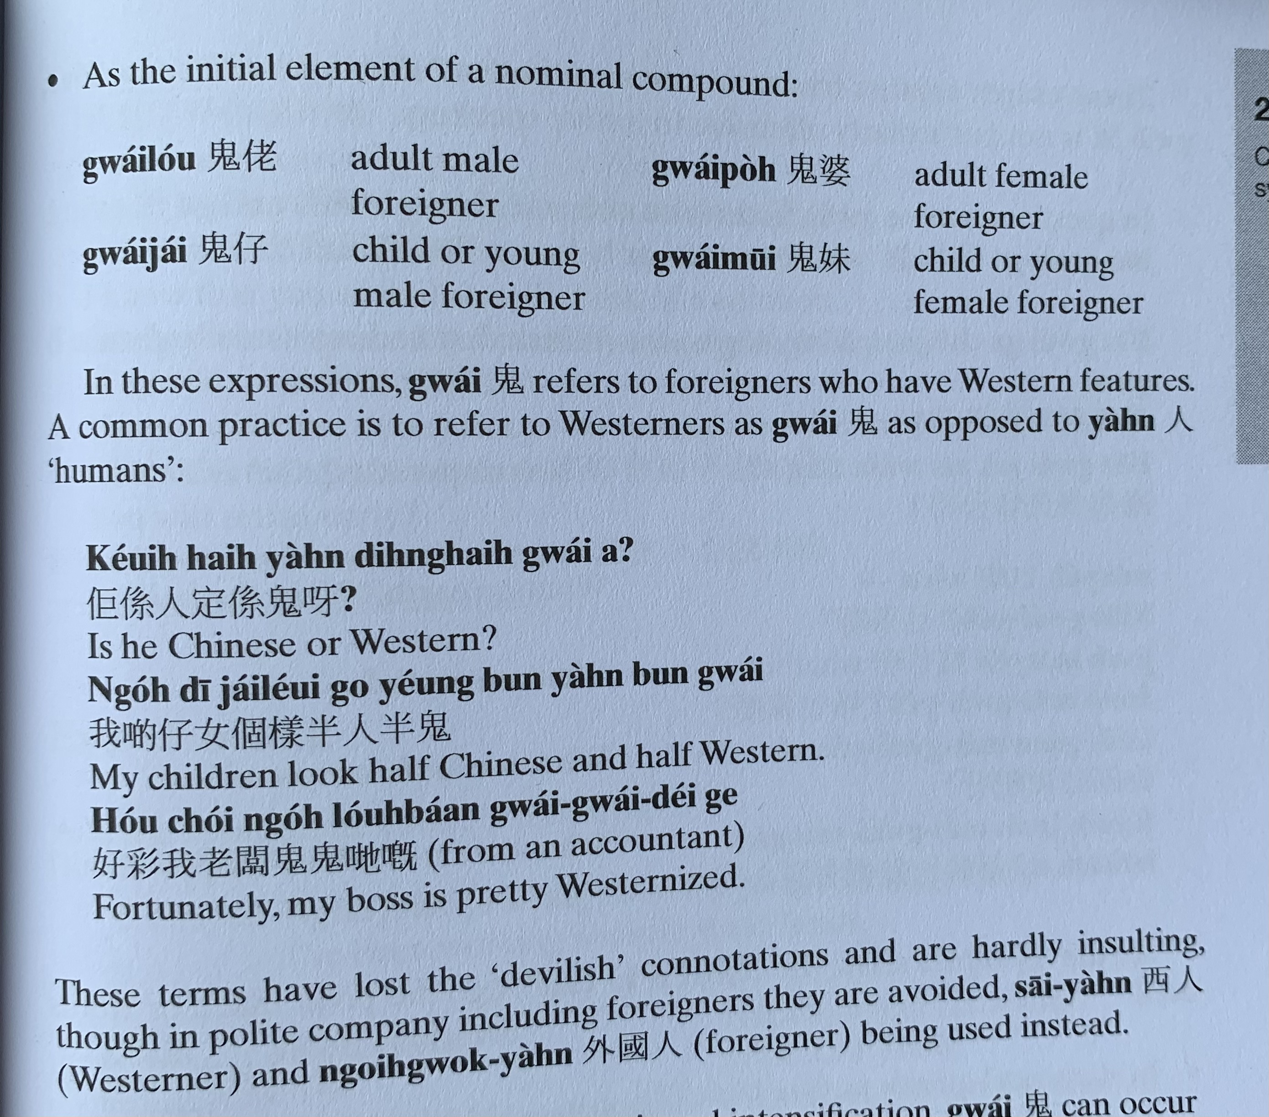
gwai2 lou2
gwai2 po4
gwai2 zai2
gwai2 mui1
keoi5 hai6 jan4 ding6 hai6 gwai2 aa3 ?
ngo5 di1 zai2 neoi2 go3 joeng2 bun3 jan4 bun3 gwai2
hou2 coi2 ngo5 lou5 baan2 gwai2 gwai2 dei2 ge3
sai1 jan4
ngoi6 gwok3 jan4

Slide 22
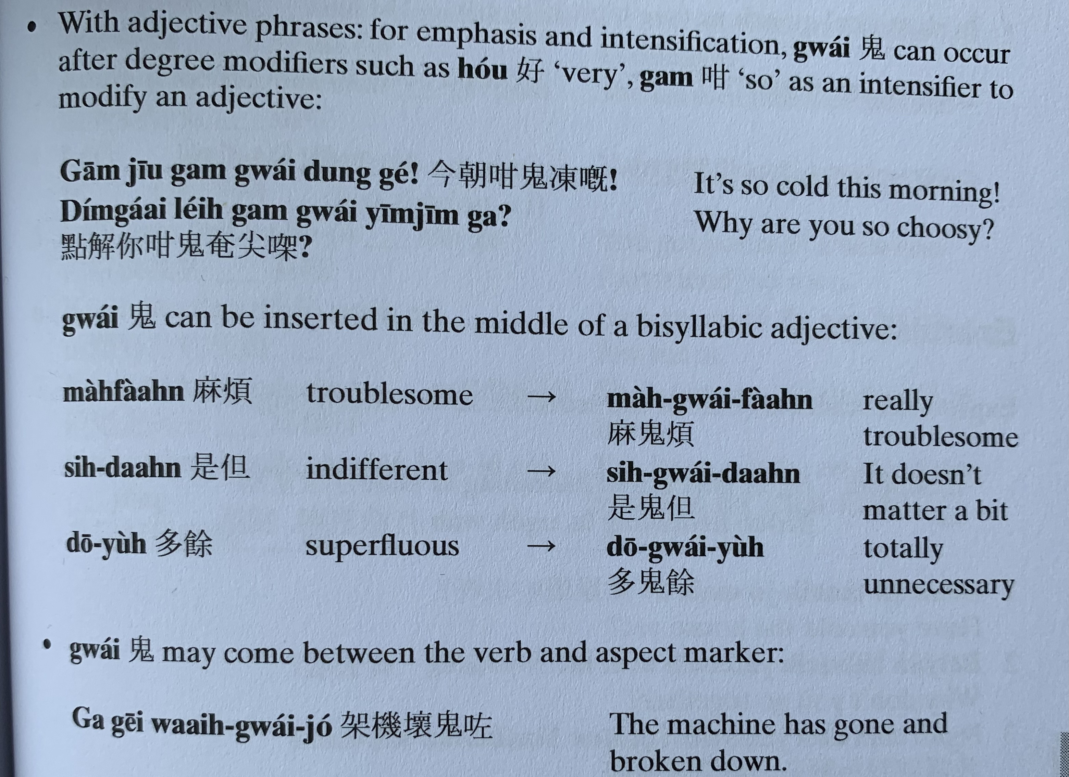
hou2
gam3
gam1 ziu1 gam3 gwai2 dung3 ge3 !
dim2 gaai2 nei5 gam3 gwai2 yim1 zim1 gaa3?
maa4 faan4
si6 daan6
do1 jyu4
gaa3 gei1 waai6 gwai2 zo2

Slide 23
bin1
go3
bin1 gwai2 go3
bin1 gwai2 gaa3 ce1 zong6 faa1 ngo5 gaa3 ce1 aa3?
gwai2 zi1 me1?
gwai2 bong1 keoi5 aa3

Slide 24
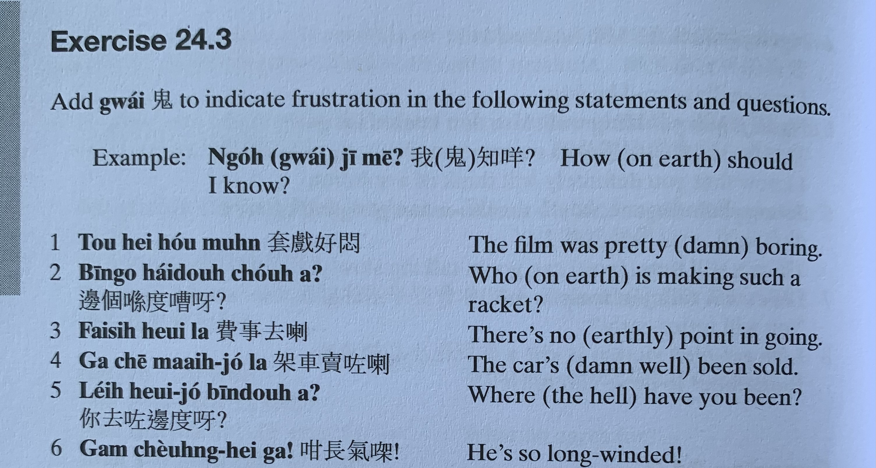
ngo5 gwai2 zi1 me1 ?
tou3 hei3 hou2 mun6
bin1 go3 hai2 dou6 cou4 aa3?
fai3 si6 heoi3 laa3
gaa3 ce1 maai6 zo2 laa3
nei5 heoi3 zo2 bin1 dou6 aa3?
gam3 coeng4 hei3 gaa3!

Slide 25
邊個 | Who | Bin1 go6
咩 / 乜嘢 | what | Me1 / Mat1 je5
邊度 | Where | Bin1 dou6
點解 | Why | Dim2 gaai2
幾時 | When | Gei2 si4
點（樣） | How | Dim2 （yoeng2）
幾多 | How many/ much | Gei2 do1

