Slide 1
Korean Language Class
백지윤 Jiyun Baek

Slide 2
The Ending Form for verbs and adjectives
Including nuance of tense, aspect, speech levels etc.
Pre-final endings & final ending depending on where they placed in verb or adjective ex) 행복합니다 (I am) happy [haeng-bog-hab-ni-da] 가르치시다 teach [ga-leu-chi-si-da]

Slide 3
The pre-final ending -(으)시
Inflectional element between the stem and final ending
Respectful, honorific suffix
Form is changing depending on whether it is after a consonant or a vowel. Not depending on if it is adjectives or verbs.
After ends in a consonant, -으시 [eu-si] ex) 찾으시다 look for [chaj-eu-si-da] After ends in a vowel, -시 [si] ex) 가시다 go [ga-si-da]

Slide 4
The pre-final ending 겠
“Will” in English
겠 expresses the speaker’s intentions ex) 열심히 공부하겠습니다 (l) will study hard [yeol-sim-hi gong-bu-ha-gess-seub-ni-da]
겠 asks the listener’s intentions ex) 어디로 가시겠습니까? Where will (you) go? [eo-di-lo ga-si-gess-seub-ni-kka?]

Slide 5
The pre-final ending 겠
“I guess/think” or “do you think that…” in English
겠 indicates the speaker’s conjecture ex) 내일 시험이 어렵겠어요 (I guess that) tomorrow’s test will be difficult [nae-il si-heom-i eo-lyeob-gess-eo-yo]
겠 asks the listener’s idea ex) 내일 시험이 어렵겠어요? (Do you think that) tomorrow’s test will be difficult? [nae-il si-heom-i eo-lyeob-gess-eo-yo?]

Slide 6
건너시다

Slide 7
Form is changing depending on whether it is after a consonant or a vowel. Not depending on if it is adjectives or verbs.
After ends in a consonant, -으시 [eu-si] ex) 찾으시다 look for [chaj-eu-si-da] After ends in a vowel, -시 [si] ex) 가시다 go [ga-si-da]

Slide 8
Will (you) watch the movie

Slide 9
The non-sentence final ending
Non-sentence final endings & sentence-final endings ex) -다
-고 and then [go]
-어/아서 because [eo/a-seo]
-으면서 while [eu-myeon-seo]
-지만 although [gi-man]
-도록 in order to [do-rok]

Slide 10
나는
While eating rice, (I) watch TV
I drink coffee and then I eat ice-cream

Slide 11
The sentence final ending
Non-sentence final endings & sentence-final endings
Six speech level: the speaker’s interpersonal relationship with addresses or attitude toward them ex) social meaning such as intimacy ad formality of the situation

Slide 12
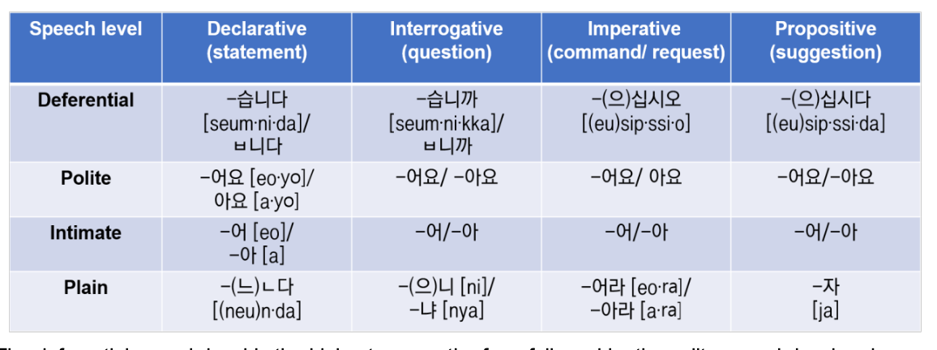

Slide 14
앉읍시다
앉아요
앉아
앉자

