Slide 1
Slavic accents in English
Mgr. Yurii Chybras

Slide 2
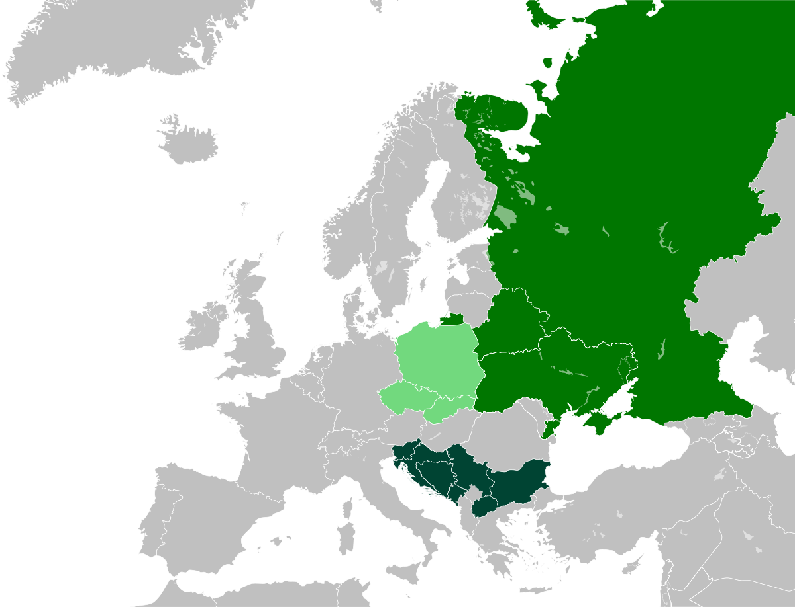

Slide 4
1. /h/ > /x/
2. /h/ > /ɦ/
3. /v/~/w/ merger, i.e. both phonemes may occur interchangeably with no patterns whatsoever
4. /s/~/z/ devoicing, i.e./z/ is regularly devoiced to /s/ following the spelling
5. <th> fronting
6. <th> stopping
7. <th> alveolarisation
8. aspiration
9. vowel approximation
10. vowel reduction and its degree
11. /ɪ/ > /i/ merger
12. final-obstruent devoicing
13. <r> realisation as /r/
14. affricate and fricative palatalisation, i.e. the respective sounds are pronounced as palatal rather than post-alveolar
15. affricate and fricative retroflexion, i.e. the respective sounds are pronounced as post-alveolar retroflex
16. [ɫ] > /l/
17. /i/ palatalisation, i.e. consonants preceding /i/ are pronounced palatalised
18. /s/, /z/~/θ/, /ð/ merger

Slide 5
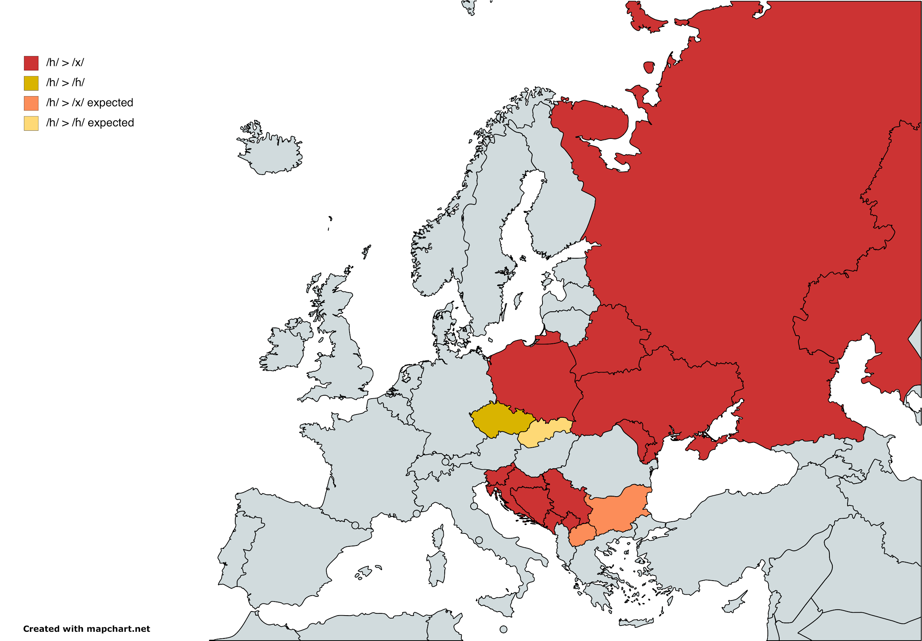

Slide 6
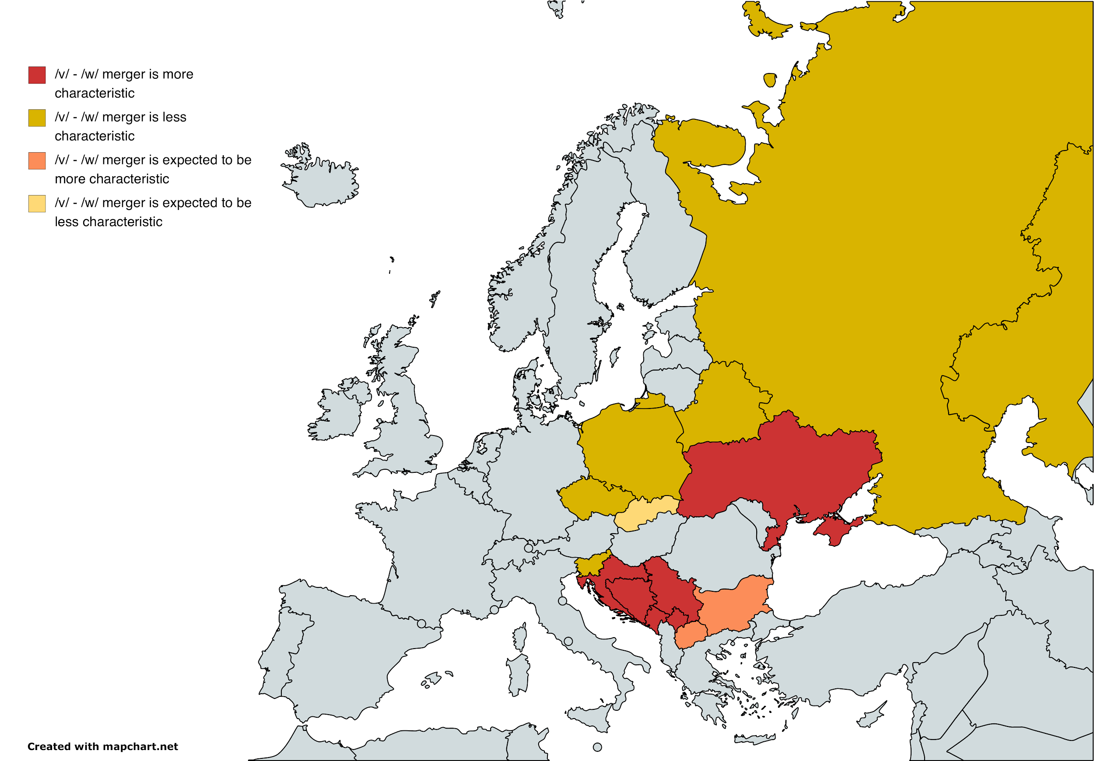

Slide 7
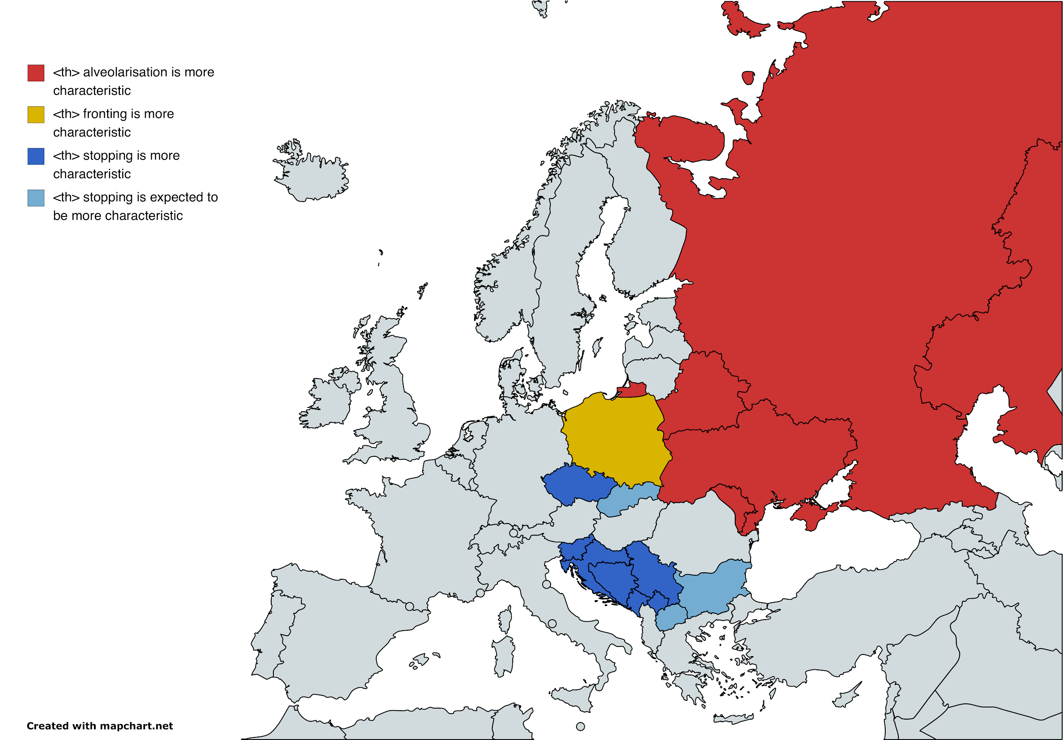

Slide 8
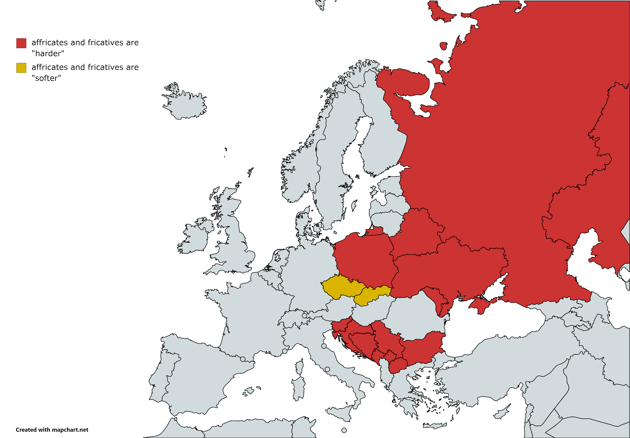

Slide 9
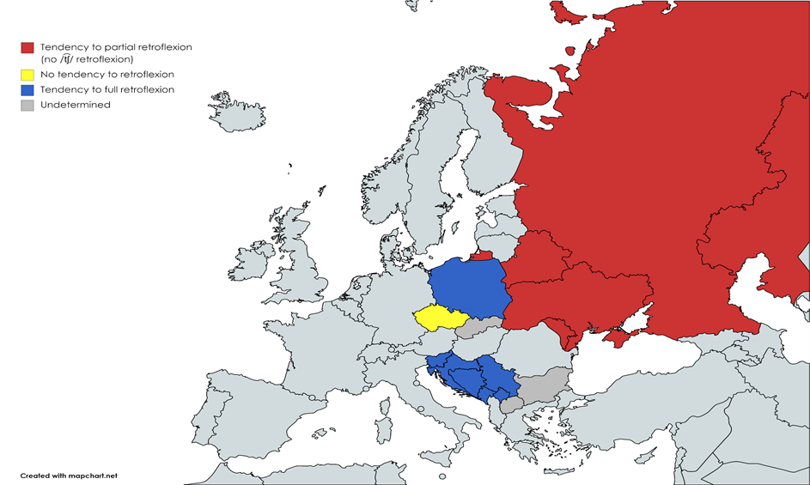

Slide 10
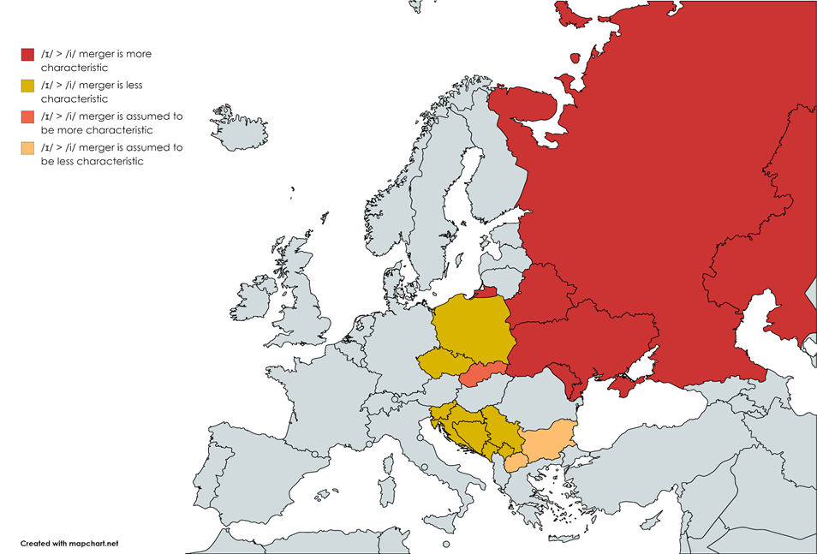

Slide 11
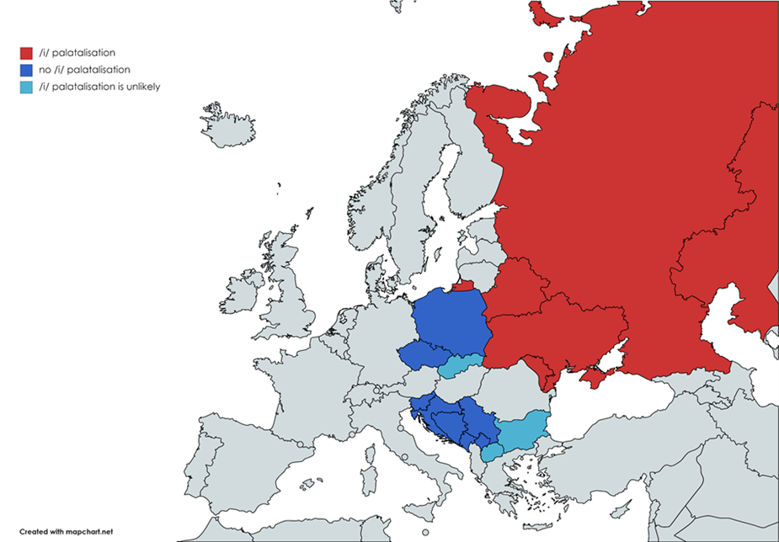

Slide 12
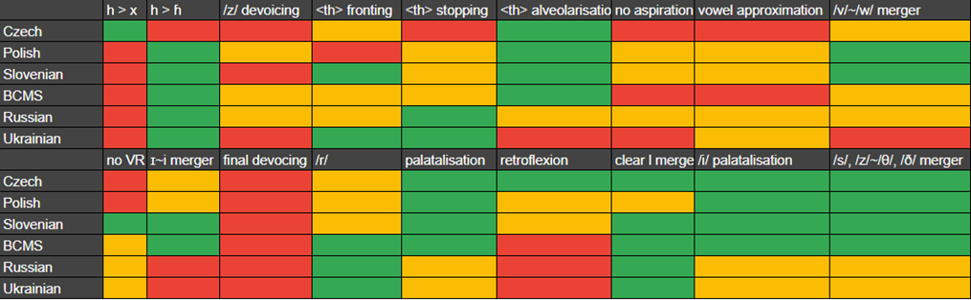

Slide 13
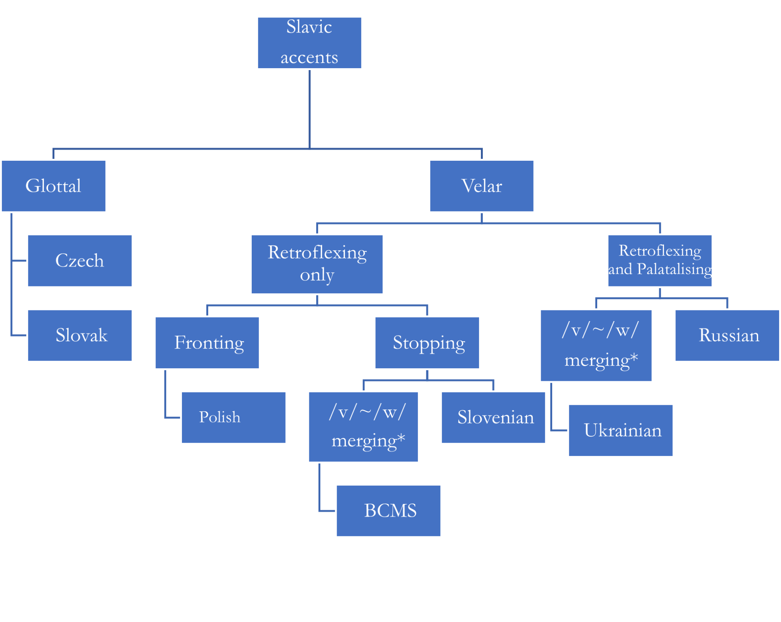

Slide 14

Senk yu for yo atenshn

