Slide 1
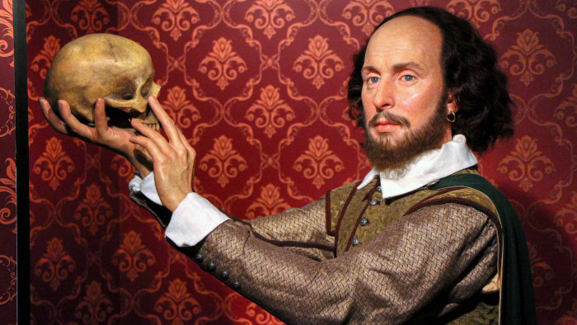

Slide 2
What is OP
Original Pronunciation
Early Modern English = EModE or EME
Around the year 1600
Different versions- not just one OP: eg musician

Slide 3
How can we reconstruct OP?
Shakespeare‘s contemporaries writing about how words were pronounced: Ben Johnson: doggy sound
Spelling: film as philome
Rhymes and puns: lines and loins
90 % accuracy

Slide 4
How OP changes the play
Faster and less reverential than RP
Earthier accent, guttural sounds
Makes actors move differently
Makes more sense:
  ’Tis but an hour ago since it was nine,
  And after one hour more ‘twill be eleven.
  And so from hour to hour we ripe and ripe,
  And then from hour to hour we rot and rot;
  And thereby hangs a tale.’
  (As You Like It, II.vii.14–28)

Slide 5
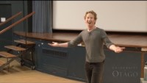
Around the Globe in One Line
Norfolk, Suffolk, Kent, Cornwall, Devon, Middlands, Scotland and Ireland
“yet I will hammer it out“
(Richard II, V.v.5)
https://www.youtube.com/watch?v=iqmgeth4tFY&ab_channel=DivisionofHumanities%2CUniversityofOtago

Slide 6

Some Characteristics of OP
  Rhotic accent
  “trippingly upon the tongue” (Hamlet, III. ii. 2)
  The mouth lexical set started with the schwa, or neutral vowel [ə], resulting in [əʊ]
    Examples: out, loud, noun, count, crowd, bough
  The goat, near, square, face, and cure sets were more monophthongal in EME. We would have heard [goːt, fɪː˞, skʍɛː˞, fɛːs, kçuː˞]
    Examples: goat, home, near, beer, square, bare, bear, face, stay, fatal, cure, tour, poor
  The bath and start sets together, telling us that [a] is the target
    Examples: staff, path, brass, blast, ask, master, basket, AND start, heart, barn, sergeant
  Fuller soundings of -sion and -tion spellings [sɪən] instead of [ʃən]

Slide 7
Some Characteristics of OP
  Weak forms and elisions: and [ən], as [əz], being [bɪn, bən], for [fə˞], he [ə], I [a], my [mɪ], mine [mɪn], thine [ðɪn], must [məs], of [ə], or [ə], them [əm], thou [ðə], thee [ðɪ], thy [ðɪ], to [tə]
  Initial /h/ on he, he’s, him, his, him, her, hers, in unstressed positions will be dropped.
  Medial /v/ and voiced /th/ [ð] consonants in some common words will be elided. Hence: heaven [hɛə̆n], even [iə̆n], seven [sɛə̆m], eleven [əlɛə̆m], devil [diːə̆ɫ], hither [hɪə˞], thither [ðɪə˞]
  -ing suffixes should be reduced to [ɪn]: calling [kɑlɪn], singing [sɪŋɪn], praying [pɹɛːɪn].
  /wh/ should be aspirated in words like which [ʍɪt͡ʃ], when [ʍɛn], why [ʍəɪ], whither [ʍɪðə˞], whence [ʍɛns]

Slide 8

Sonnet 116
Let me not to the marriage of true minds
Admit impediments. Love is not love
Which alters when it alteration finds,
Or bends with the remover to remove.
O no! it is an ever-fixed mark
That looks on tempests and is never shaken;
It is the star to every wand'ring bark,
Whose worth's unknown, although his height be taken.
Love's not Time's fool, though rosy lips and cheeks
Within his bending sickle's compass come;
Love alters not with his brief hours and weeks,
But bears it out even to the edge of doom.
If this be error and upon me prov'd,
I never writ, nor no man ever lov'd.
https://www.youtube.com/watch?v=tMwAHeAdL80

Slide 9
Sources
https://www.youtube.com/watch?v=uQc5ZpAoU4c&ab_channel=BGSEnglish
https://www.youtube.com/watch?v=tMwAHeAdL80
https://www.youtube.com/watch?v=iqmgeth4tFY&ab_channel=DivisionofHumanities%2CUniversityofOtago
https://www.youtube.com/watch?v=gi7IyqOjarA
http://www.paulmeier.com/OP.pdf
Crystal, David, and Ben Crystal. Shakespeare's Words: A Glossary and Language Companion. Puffin Books, 2002.

Slide 10
Thank you for your attention

