Slide 1

AJL22066 Pronunciation Varieties of English
RP
R.I.P.
Mariia Minaeva

Slide 2

Accent as a social maker
Countermovement
1974 Tony Harrison “Them and [uz]”
The poet was told off for reciting Keats in his native Leeds accent instead of RP
“All poetry (even Cockney Keats?) you see
‘s been dubbed by [Λs] into RP,
Received Pronunciation, please believe [Λs]
your speech is in the hands of the Receivers.’ “
“You can tell the Receivers where to go
(and not aspirate it) once you know
Wordsworth’s matter/water are full rhymes”
“(I …) spoke the language that I spoke at home.
RIP RP, RIP T.W.
I’m Tony Harrison no longer you!”
reading

Slide 3


1991 David Abercrombie “RP RIP?”
1988 Paul Tench English Pronouncing Dictionary (15th edition )
asks to replace the phrase RP with BBC English
notes that many regular BBC speakers have a local accent and RP is “on its way out”

Slide 4
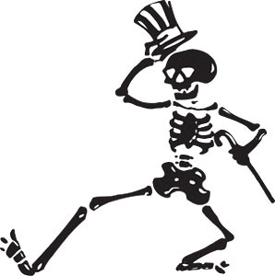
1991 David Abercrombie “RP RIP?”
“No accent or dialect remains static” it is normal that RP undergoes changes
“accent bar” (from “colour bar”)
RP as a sign of privilege is hated more and more
Young people choose to speak with their local accent
Scottish accent as a pronunciation model for the learners

Slide 5

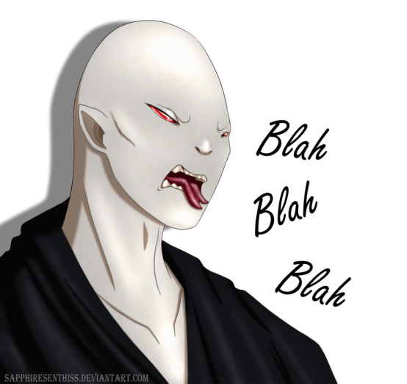
2011 Melvyn Bragg BBC programme “RP RIP?“
For the foreign listeners, RP is associated with "lovable fops" as Hugh Grant and Stephen Fry
VS
with villains, such as Ralph Fiennes in Harry Potter, Terence Stamp in Superman 2, Ian McKellen as Magneto in the X-Men films, Paul Bettany in The Da Vinci Code

Slide 6
To prove that RP is already gone
2015 letter to the Times
“Sir, I was alarmed to hear on the news about the rapidly growing
number of psychopaths in London. Halfway through the story I
realised that they were reporting an increase in cycle paths. I miss
Received Pronunciation.”
psychopath in SBE, including RP, is [ˈsaikəˌpæθ]
cycle path Home Counties SBE [ˈsaikwˌpɑθ]

Slide 7

Chumbawamba “RIP RP”
“Goodbye RP,
Let our words go free,
Coo and howl,
Lay flat your vowels
Ah ay ee”
Home Counties SBE: open [æ] instead of [aʊ] in RP

Slide 8
Sources
RIP RP – RP RIP? Swphonetics, 2018. https://swphonetics.com/2018/12/14/rip-rp-rp-rip/
Them and [Uz] by Tony Harrison. The English and Media Centre. http://poetrystation.org.uk/poems/them-and-uzhttp://poetrystation.org.uk/poems/them-and-uz
RIP RP by Chumbawamba. 2008. https://www.youtube.com/watch?v=DFhdS21E7qs
RP RIP? BBC Radio 4, 2016. https://www.bbc.co.uk/programmes/b012zy1c
Ghost picture. This Photo by Unknown Author is licensed under CC BY-NC
Skeleton picture. This Photo by Unknown Author is licensed under CC BY-SA-NC
Voldemorte picture. This Photo by Unknown Author is licensed under CC BY-NC-ND

