Slide 1

Scottish accent made simple(R)
AJL22066, EE Varieties
Bc. Ella Sykorova

Slide 2

What are we focusing on?
-shortenting of vowels
-vowel shift
-monopthongization
-rhoticity
-Dark Ls
-aspiration of /p/t/k/w/
-glottal stop /ʔ/
/x/ sound (loch ness)
Vowels
consonants
slang
Wee, dannae, naw, haggis
/i/,/ai/ /ə/, /əʊ/, /ʌ/, and /u:/
/ɫ/, /r/, /ph/, /th/, /kh/, /ʔ/

Slide 3

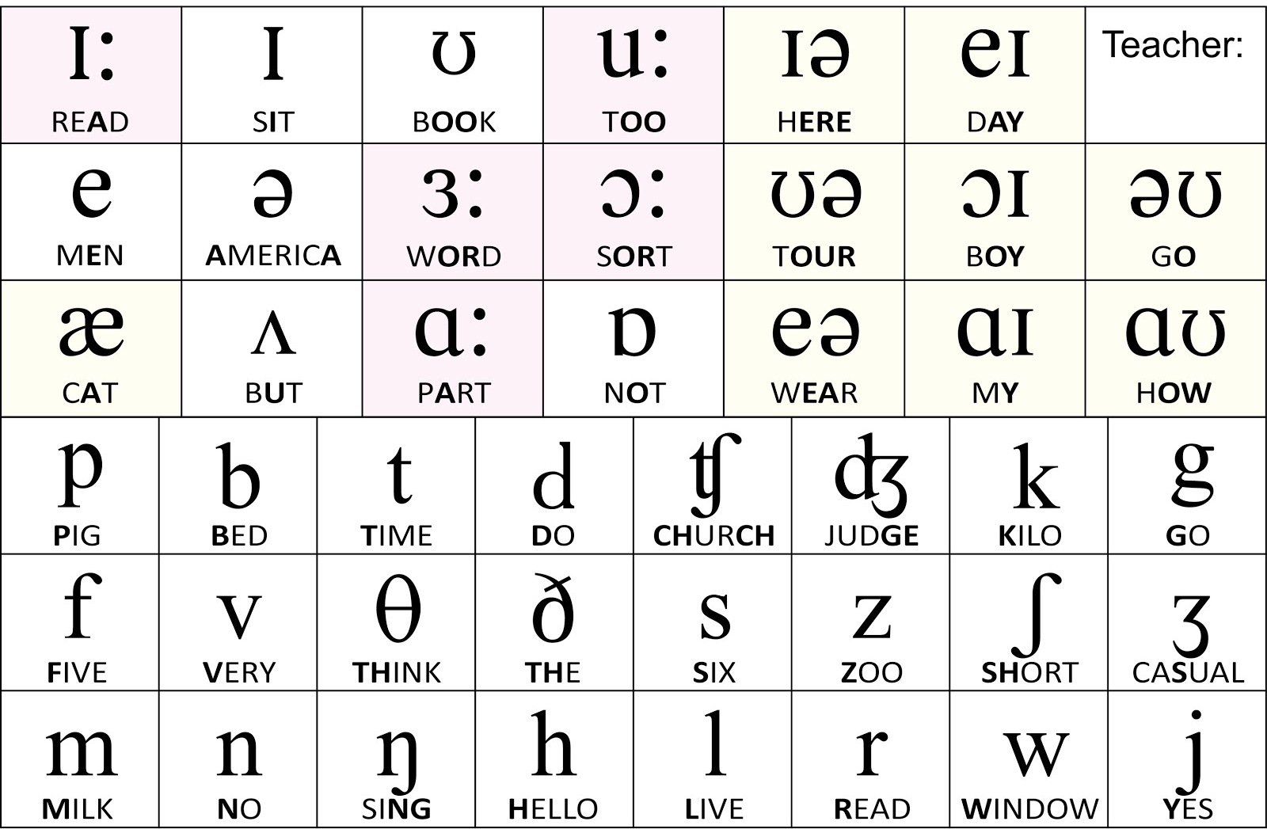
VOWELS
(IPA)

Slide 4
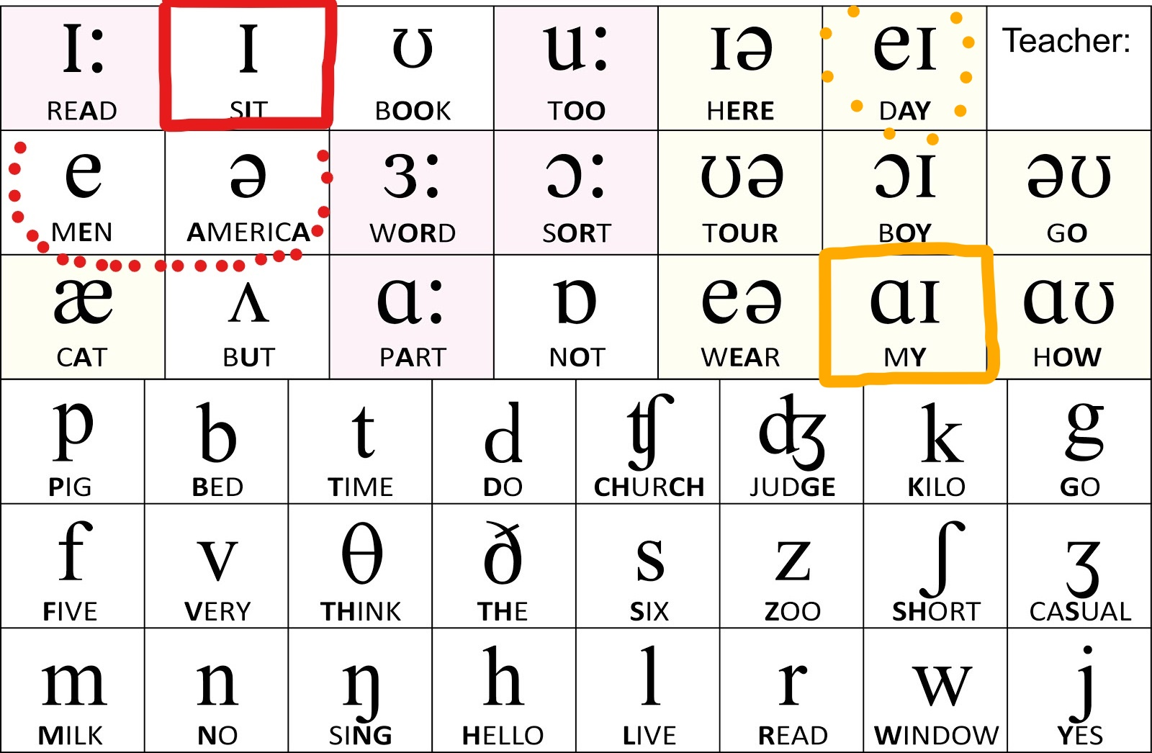
VOWELS /i/,/ai/ and / ə /
/i/ is closer to /e/ and /ə/
Sick -) /sᵻk/
Right -) /reit/
It – /ᵻt/
/ ə/ turns into a clearer /e/
-from -) /frem/
/ai/ is morphed into /ei/
-kind -) /keind/
My -) /mei/

Slide 5
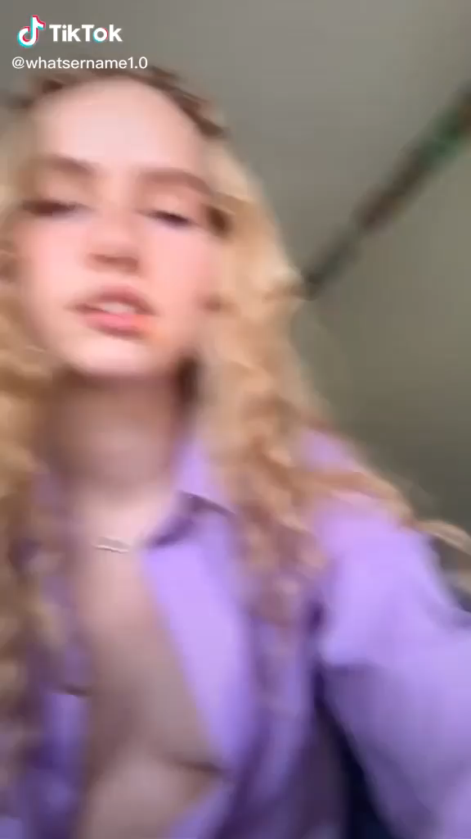
sick
it
right
like

Slide 6
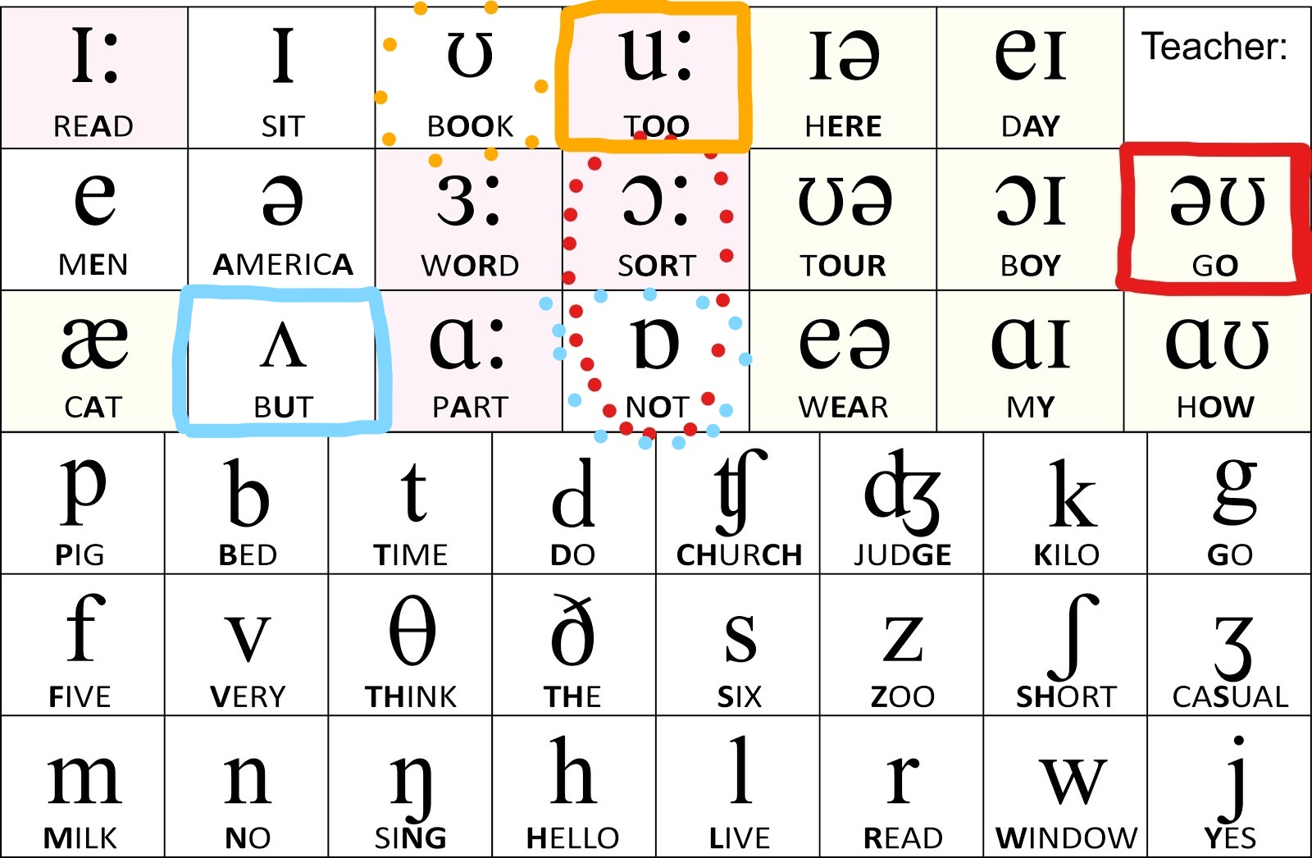
VOWELS /əʊ/,/ei/ /ʌ/, and /u:/
Diphtong usually smoothed e.g. /ei/ into /e/
Way -) /whe/
/əʊ/ is shortened into a /ɔː/ and /ɒ/
-Glasgow -) /glɑːzgɔː/
/ʌ/ turns into /ɒ/
-Fuck – /fok/
/u:/ is also shortened into a /ʊ/
-You – /yu/ (ye)
-Who – /whu/ (whe)
Good and food have the same sound

Slide 7

Mental note:
Something scottish
cut
fuck
pedo
you

Slide 8
CONSONANTS

Slide 9
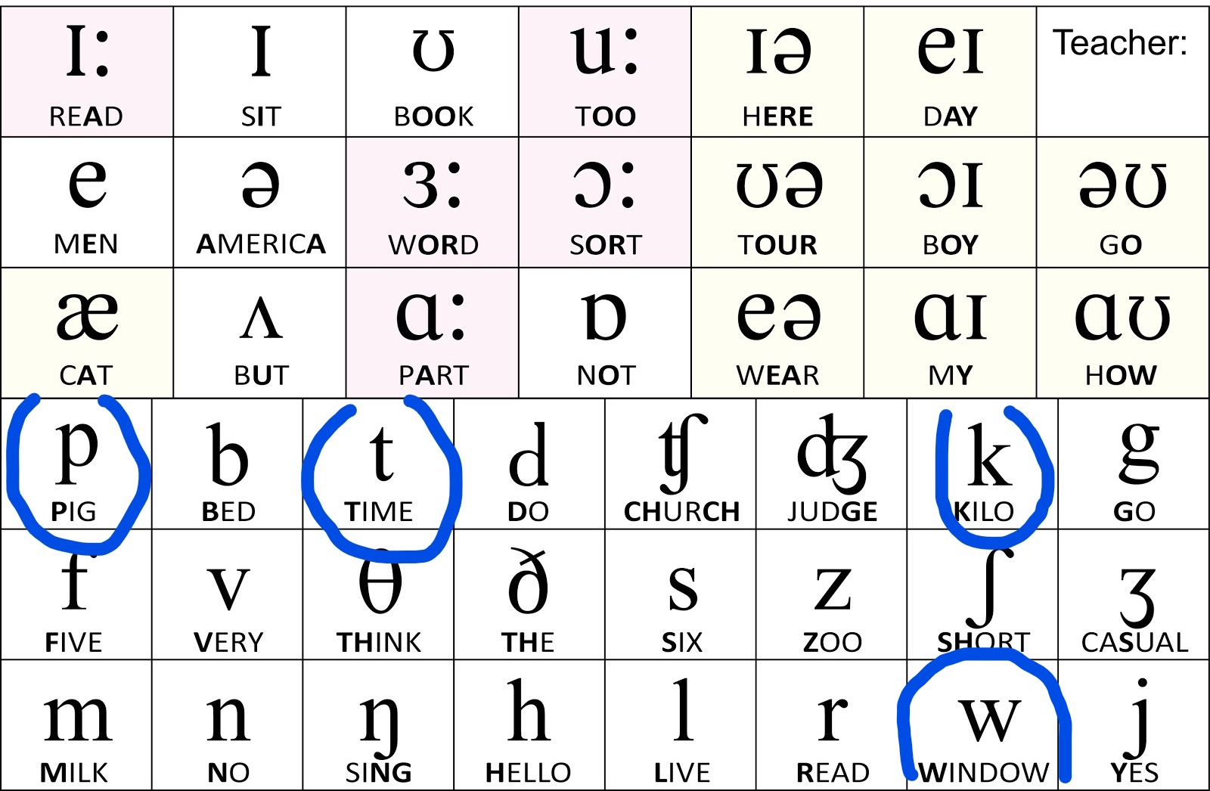
CONSONANTS /p/t/k/, /w/ and /ʔ/
the glottal stop is used in regional variants
-Scottish –) /skɒʔɪʃ/
-shut up -) /ʃʌʔɒp/
-Plunk it -) /pleŋk et/
/p/t/k/ are often aspirated
-timetable –/t^{h}eɪmt^{h}eɪbəl/
/w/ is preceded by /h/ sound
-what – /hwat/

Slide 10
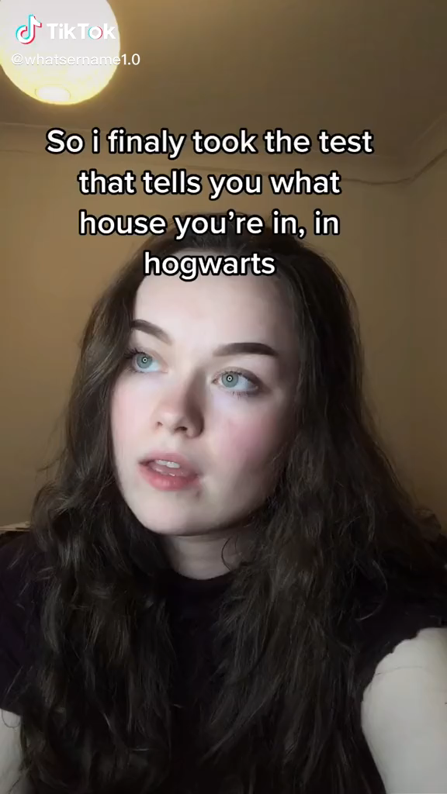
Mental note:
Expellibawbag,
didnae
Shut up
Plunk it
I´m a what?
timetable

Slide 11
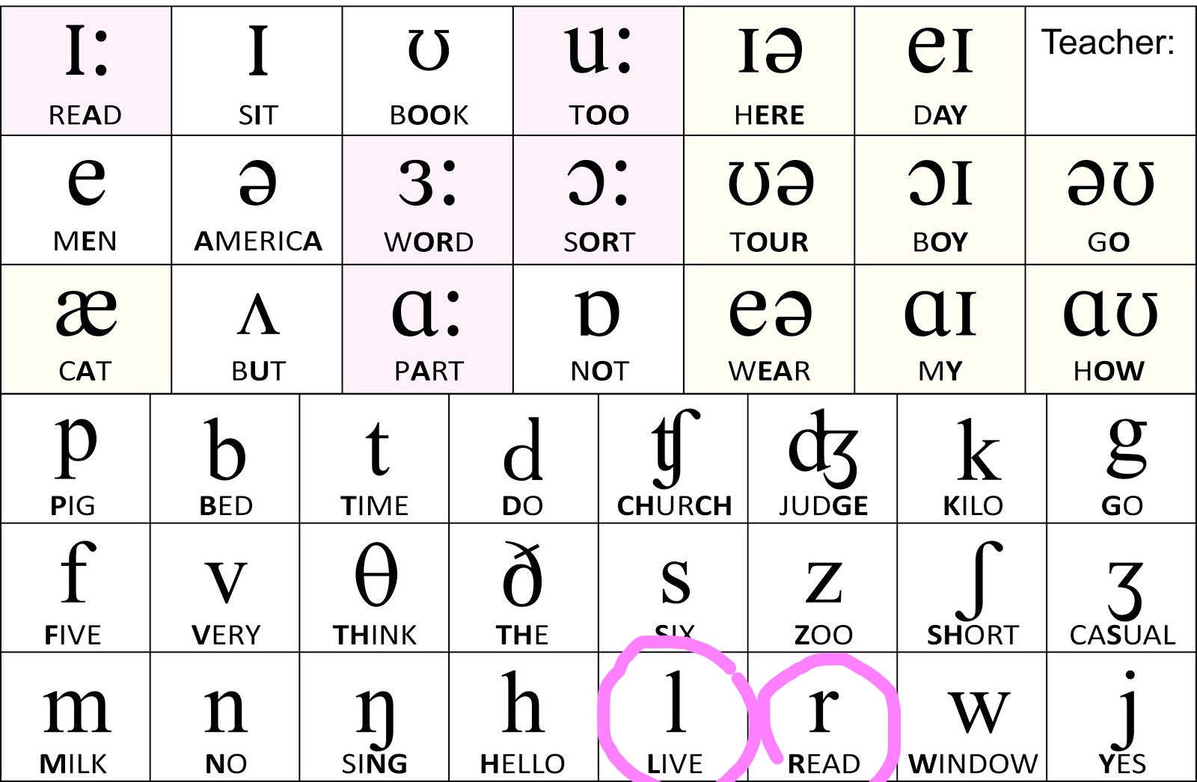
CONSONANTS dark L and rhotic R
In some variants, the L is darker (merida - highlands)
-girl -) /´geˌɾəɫ/(two sylables)
World -) /´wʌˌɾəɫd/
-/r/ is rhotic usually tapped r /ɾ/ not alveolar trill
-Alexander is – linking R trill
/ælɪgzɑːndərez/
-/fɾi:k/, /θɾi:/, /meɾəda/, /bɾeid/….

Slide 12
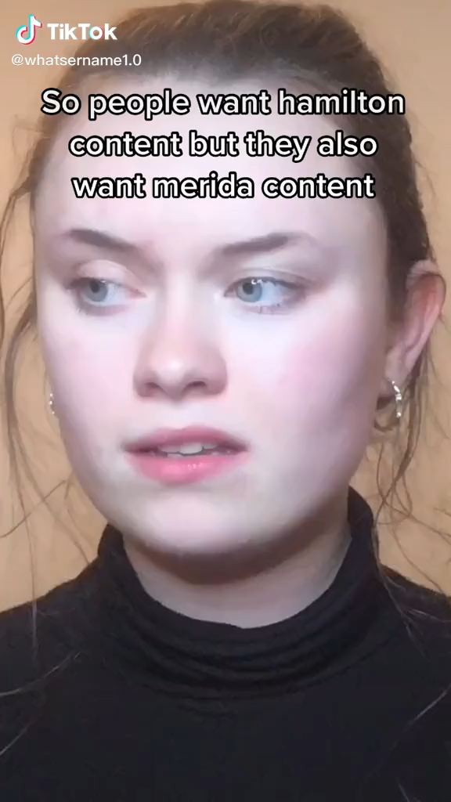
.
freak
world
Merida
Alexander is…
three
girl

Slide 13

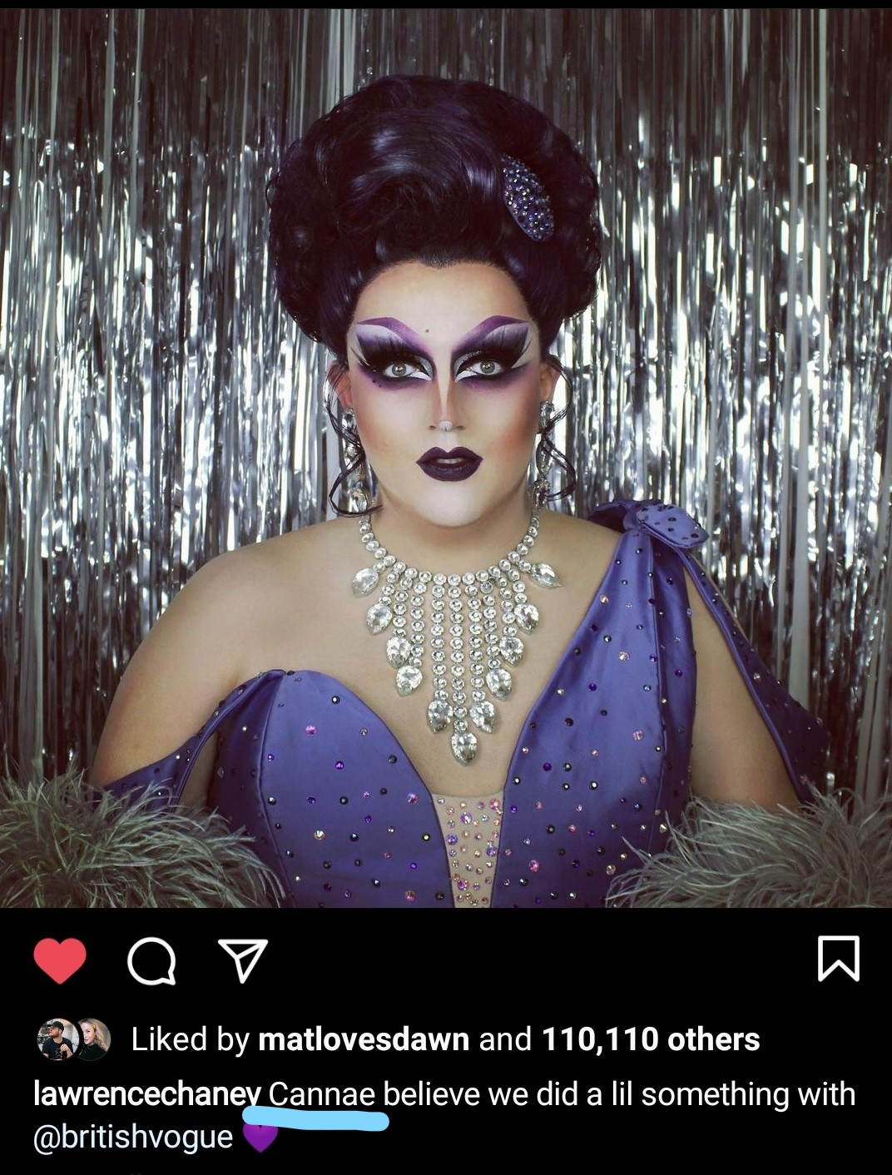


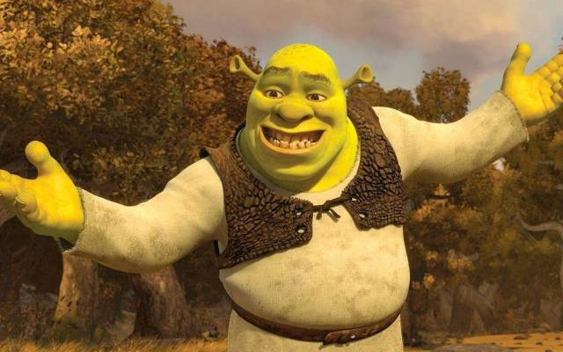
SLANG – SCOTTICISMS
Profanities and swear words as a regular part of speech
- Negative expressed with sufix –ny/nay/nae (havenae, danney, cannae)
NO is on the cusp of being a different pronunciation and slang word NAW
Aye means yes
Diminutive WEE –little, small
Irn bru – type of drink
Bawbag – scronum (expellibawbag)
Haggis (explained in the video:))

Slide 14
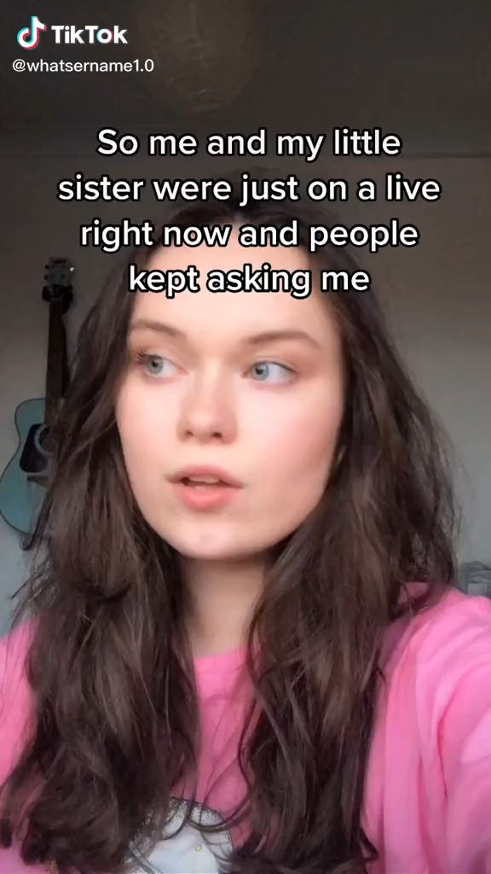

Slide 15
Sources:
Vm.tiktok.com/ZMemSujNj
https://cdn3.evostore.io/productimages/vow_premium/l/brt00053.jpg
https://i.ytimg.com/vi/CNo5SyAWY-U/sddefault.jpg
https://www.instagram.com/lawrencechaney/?hl=cs
https://en.wikipedia.org/wiki/Scottish_English
https://www.highlandtitles.com/blog/scottish-slang
https://www.youtube.com/watch?v=3FBDCmibOM4
https://www.youtube.com/watch?v=mALkCGVA2BU
https://i.ytimg.com/vi/oj-AMrUyoLQ/maxresdefault.jpg
https://www.kinobox.cz/data/clanky/640x400x1/shrek-5-zmeni-tvar-serie.jpg
https://c4.wallpaperflare.com/wallpaper/162/491/699/princess-merida-brave-animation-disney-princess-wallpaper-preview.jpg
https://www.vhv.rs/viewpic/TTJiixm_parental-advisory-parental-advisory-png-small-transparent-png/

