Slide 1

Sociolinguistics: Aspects of Accents
Mgr. Pavel Čanecký
Brno, 22nd October 2021

Slide 2
Definition of basic terms
1. The roads are dirty.
vs
2. The roads is mucky.

Slide 3
Definition of basic terms
Accent
  pronunciation
Dialect
  syntax, morphology, lexicon and pronunciation
Idiolect
  from the Greek idio- meaning “one’s own” and –lect
  the specific way that a single person speaks
  "[A person's idiolect is] not just vocabulary; it's everything from how we pronounce certain words to how we put them together to what we imagine they mean. Ever have a disagreement with someone over whether an ambiguously-shaded object was actually blue or green? Congratulations, you've witnessed differences in idiolect.... „
  (Gretchen McCulloch)

Slide 4
Traditional dialect
a coherent alternative language variety
found in various parts of England
not so common outside the British Isles
  Newfoundland and the Appalachians
relexification
primary vs secondary dialect features

Slide 5
Geographical variation
Accents as powerful indicators of geographical identity
Socially distinct: vulgar vs posh
Geographically distinct: Scottish accent, Australian accent, southern accent, American accent,…
regionality
RP vs GenAm
urban vs rural
geographical diffusion (Trudgill)

Slide 6
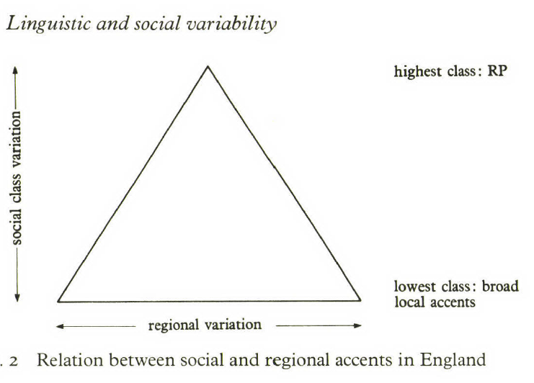
Socio-economic class
Speech stratification correlates with social stratification

Slide 7
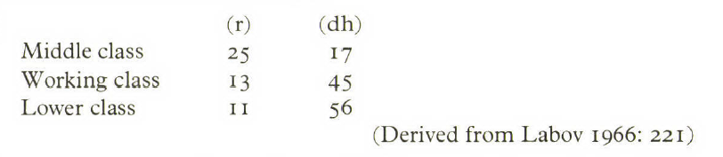
Socio-economic class
William Labov
  The Social Stratification of English in New York City (1966)
  -> Variability in a New York accent is socially stratified

Slide 8
Age
Innovations in the speech of children and adolescents
mouse -> mouses
thin /f/

Slide 9
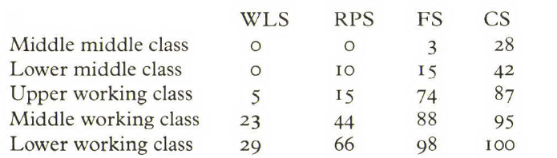
Styles and roles
social context
casual style (CS)
formal style (FS)
reading-passage style (RPS)
word-list style (WLS)

Slide 10
Styles and roles
Labov-hypercorrection

Slide 11
Projecting an image
convergence x divergence

