Slide 1
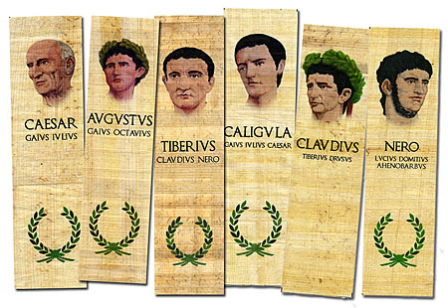
The Buildings and the Images of the Imperial Cult
IIII Julio-Claudian dynasty

Slide 2
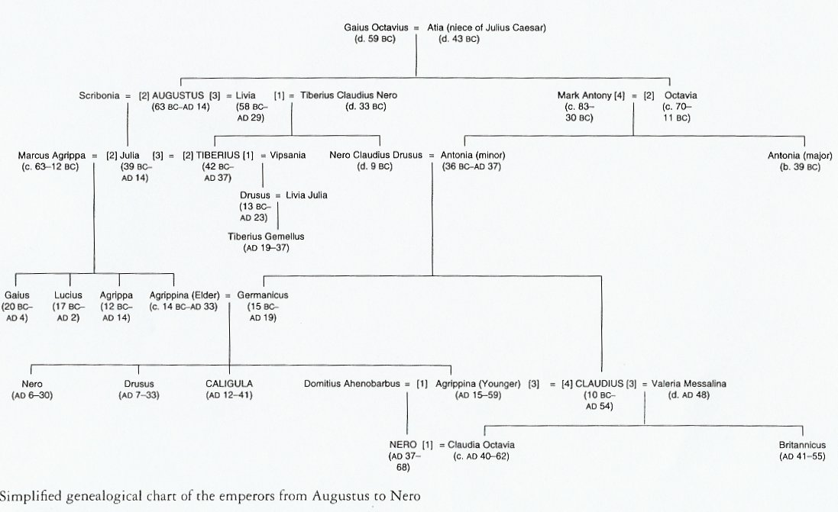

Slide 3
Acta Fratrum Arvalum (Arval Acta)
The Arval Brothers – a college of priests dedicated to the worship of Dea Dia, it became prominent under Augustus (started to undertake also imperial sacrifice), kept record until mid. 3rd century AD, 12 members elected for life, emperors themselves belonged to them
earliest surviving record – 55 AD – sacrifice of a bull – early in the reign of Nero (previous mentions, scarce, during the reign of Claudius)
important for studying the development of the imperial cult
main literary source for the period of Julio – Claudian dynasty

Slide 4
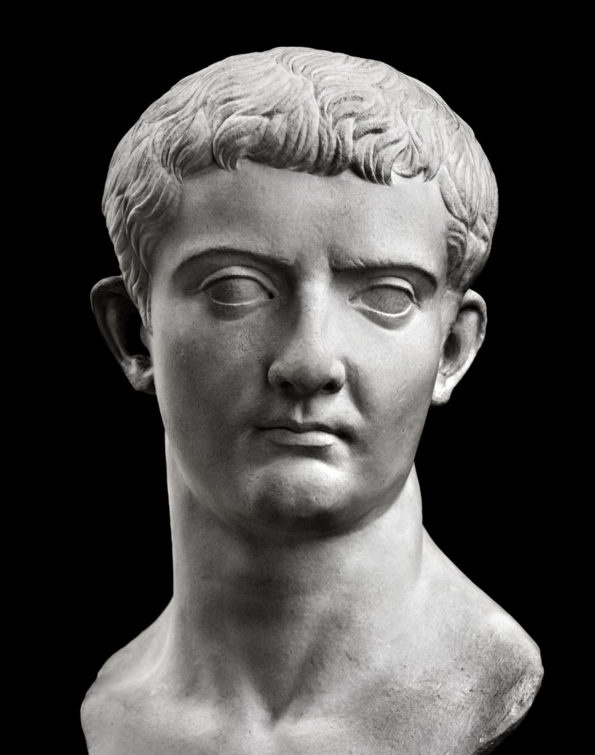
TIBERIUS (Tiberius Claudius Nero)
Born: November 16th , 42 BC
Died: March 16th , 37 AD
Parents: Livia, Tiberius Claudius Nero
Accession: Augustus, 4 AD (the fourth choice after Agrippa, Lucius and Gaius)
- succeeded Augustus by formal powers, by his adoption and Augustus’ will – the main heir
conservative, 23 years of reign
completely loyal to Augustus’ domestic and foreign policies
Reign:
- always extremely cautious and deferential in his formal dealings with the Senate, never accepted honors
forbade the setting up of his portraits without permission and banned completely the erection of his portraits among the cult images of the gods – so forbade any formal divine worship to himself
final establishing of the cult – the cult of Divus Augustus, not himself or his Genius

Slide 5
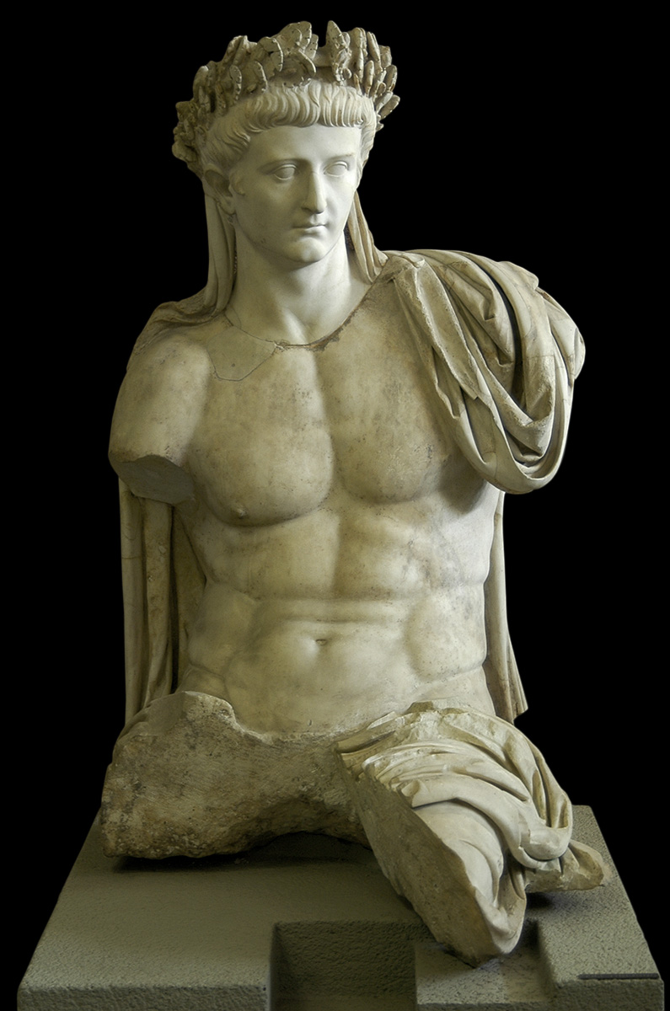
IMAGES
Posthumous portrait – a seated statue of the emperor Tiberius as Jupiter – Cerveteri
set up by Claudius, dated ca. 45-50 AD
Vatican Museums
- a group of eight related statues found in Cerveteri in the 1840s.

Slide 6
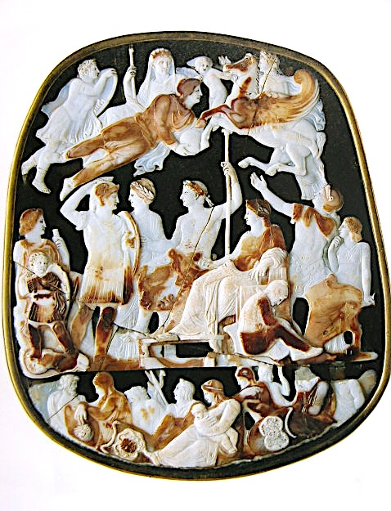
Grand Camée
- eight-layer sardonyx: white the upper, brown the lower.
irregular shape (not the original)
appears to be complete
the largest ancient surviving cameo
(H. 31 cm; w. 26.5 cm) in Paris,
23-29 AD, Tiberius, or after 50 AD Claudius (different interpretations)
a lot of reworked faces – some figures are hard to identify
Subject: Enthroned Tiberius is surrounded by various members of the Julio-Claudian family (living and deceased).
- three levels of scenes, instead of two like in the Gemma Augustea
- in the lowest one there are northern and eastern defeated barbarians

Slide 7
more interesting part is between the middle and the highest registers
corresponding to an earthly dimension (living members of the family at the moment of production and the celestial (dead members of the clan, at the same moment)
1 – Tiberius as Jupiter, holding lituus, wearing laurel wreath (not a corona civica) 2 - Julia (Augustus’ daughter) but the marriage ended up quickly, never married again, so this is Livia (mother), stressing his succession rights
3 – Nero Germanici,
4 - Julia Drusi, Nero Germanici’s wife
5 - Slightly older boy behind Livia – Drusus Caesar, with a trophy
6 - Agrippina Maior, Germanicus’ widow
7 - Gaius Caesar
8 - Claudia Livilla, Germaicus’ sister and widow of Drusus the Younger
3, 5, and 7 – brothers - sons of Germanicus and Agrippina
9 – Augustus, 10 - Drusus the Younger, 11 – Germanicus, 12 – Eros, 13 – Mithras (Aion – eternal time, Marc Anthony, Alexander the Great, Iulus Ascanius)
9
12
11
10
13
8
4
1
3
2
5
6
7

Slide 8
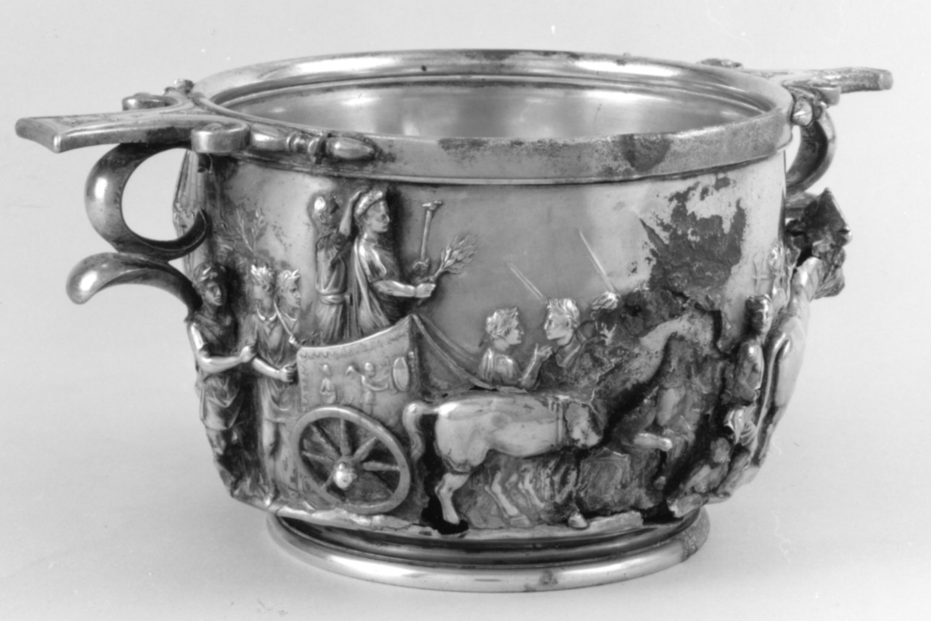
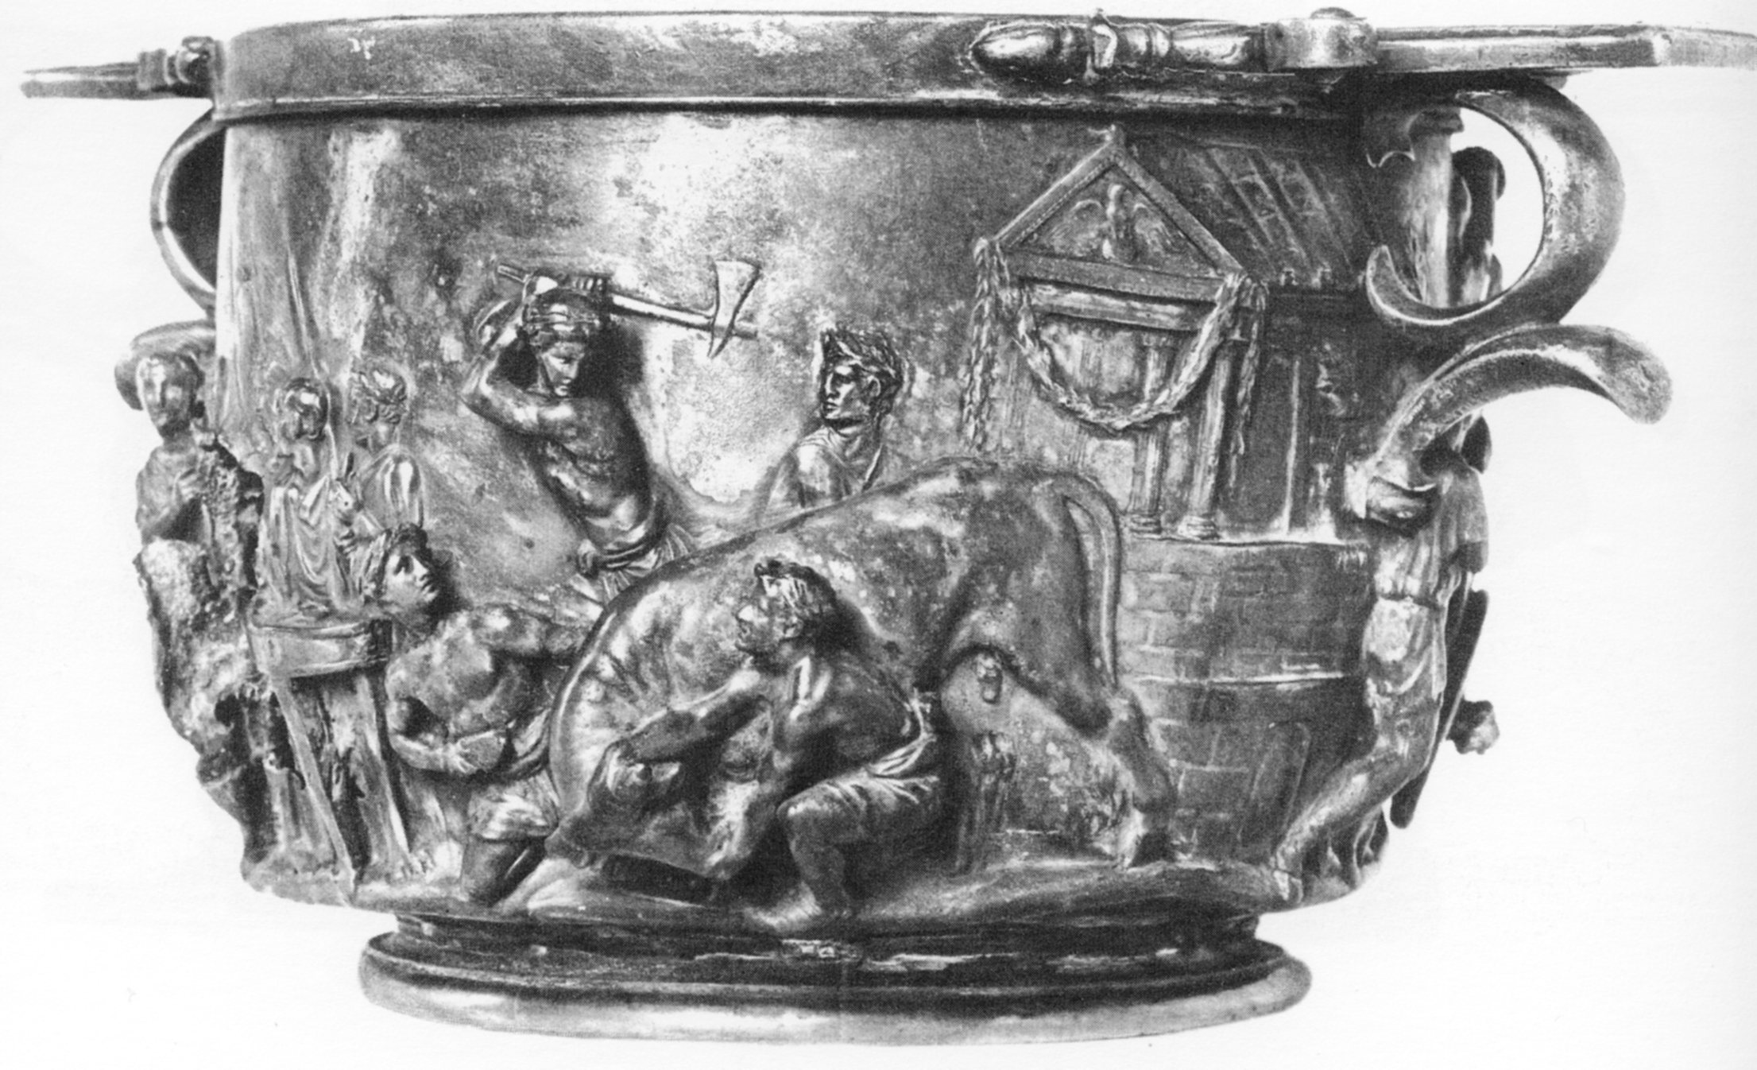
Boscoreale cup
triumph (awarded in 8 BC and celebrated in 7 BC) of Tiberius
The triumphus de Germanis of Tiberius, who after his brother’s Drusus’ death in 9 BC led the campaign to Germany
Tiberius – triumphator with servus publicus
The triumphal chariot is carefully detailed.
The decoration of the chariot was formed by a trophy flanked by two winged Victories putting other weapons on the trophy. Behind Victory there is a wingless female personification.
The other side:
The scene of sacrifice in front of the the Temple of Jupiter Capitoline – probably before leaving Rome

Slide 9
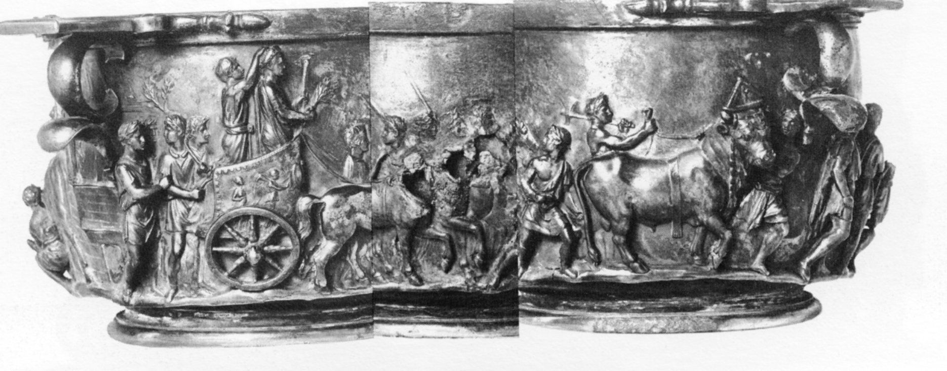
attendants – two groups: walking behind the chariot and by the horses.
by the horses: a slave is guiding the horses, whose heads were originally in full relief and are lost now (the same as Tiberius’ head and chest), four lictors on the far side of the horses with rods over their shoulders
- behind the chariot: the four behind the quadriga wear tunics and ankle-length boots, the two foremost bearing laurel branches (high-ranking officers), the figure just behind the chariot wheel wears smooth torques with swollen ends, another young officer walks between the reins loped up before Tiberius in a place of honour. He wears tunica ad paludamentum
- the right side - the scene of the victim group - a massive bull with two attendants.
- the bull wears a dorsuale and a triangular fastigium (head plaque), from which a garland is hanging; it is decorated with an eagle on a globe

Slide 10
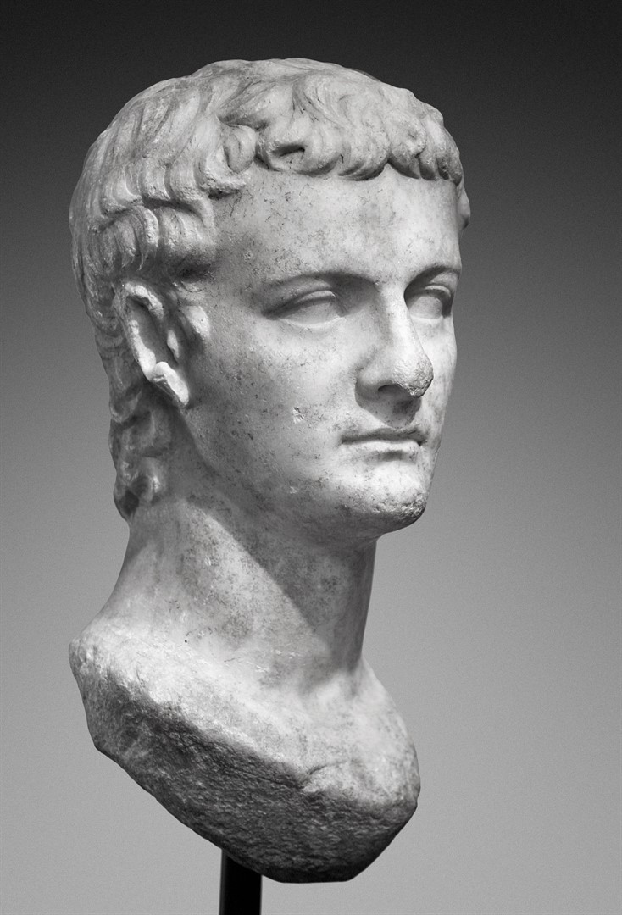
2 CALIGULA (Gaius Julius Caesar Augustus Germanicus)
Born: August 31st , 12 AD
Died: January 24th , 41 AD (stabbed 30 times)
Parents: Germanicus, Agrippina the Elder
Accession: Germanicus (father) adopted by Tiberius (died before him), Tiberius had two heirs – Caligula and Tiberius Gemellus (grandson)
- not so clear succession, the Senate claimed the will invalid and chose Caligula as the only heir
- he couldn’t claim the principate by auctoritas
- the Senate gave him imperial powers (probably by a decree) – so the principate was firstly identified as an office (the right moment to define principate as an office with absolute powers)
Reign:
the beginnings of his reign quite peaceful and in the agreement with the Senate
senate’s decree ordering sacrifices to Caligula’s Genius – the emperor vetoed (modesty? fear?)
then humiliated this body, emphasized his limitless power, the Senate duly cooperated – personal fear

Slide 11
THE STATE CULT
Literary sources - deified while alive, but no epigraphical (no change in his title), nor archaeological sources
problematic nature: Suetonius – sensationalist
Dio – no critical ability
(a habit to generalize from single incident),
Seneca – hatred of the emperor
Jewish writes Philo and Josephus – Caligula’s conflict with Jews, no other aspects
Caligula’s personality does not depend on his craving for divine honors
Dio – divine honors were paid to Caligula and he was called by divine titles (Jupiter, deus, divus), but no official decree
The opinion of public deification during his life based on his hobby of dressing up:
- impersonating different gods:
a) in the beginning - part men-part gods: Hercules, the Dioscuri
b) continued with full-blown gods: Mercury, Apollo and Mars (Jupiter is not included, strange)
- Suetonius and Cassius Dio – his behavior is the sign of madness
- the emperors dress should have been the same as the senators – through this he showed them his absolute power and monarchical position
- the dress used as an emblematic dress to define position without courting death (the state deification would have) - the emperor could, however, dress up as anything he liked without affecting his formal role in the Roman constitution

Slide 12
the senators never refused the priesthood (not popular, costly) – the higher the emperor the higher was the relative placement of the senators
instead Caligula developed the system in the private sphere (Augustus and Tiberius were worshipped in private cults), encouraged the phenomenon
Caligula’s cult – far less sensational than might be expected
- a disaster emperor, but no reason to assume that his cult or flirtation with divinity caused his murder – but his general incompetence and singular ability to insult everybody
- behavioral pattern was something for emperors to avoid in general - emperors were more anxious to avoid any too obvious and active flirt with the divinity – public or private
- he never received state deification or divine worship in the Roman state

Slide 13
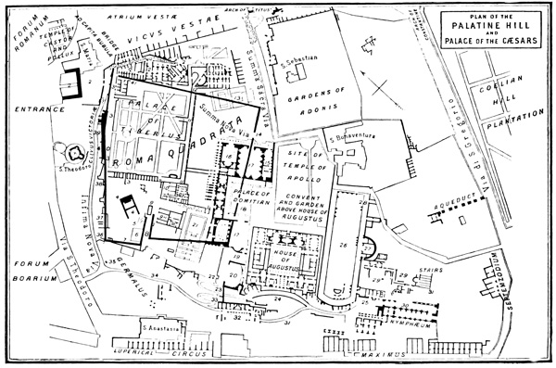
BUILDINGS
The palace of Caligula (Suetonius describes it as a domus)
the northern side of the Palatine, built in a series of terraces against the Palatine Hill, the construction showing work of Caligula, Trajan, and Septimius Severus, discovered in 2003
the lowest level - chambers warmed by hypocaustum, containing fragments of statuary
the terrace above - there is an arcade paved with blocks of silex, and on one side shops
a flight of travertine steps conducts to some small chambers above with mosaic pavements and frescoes (Caligula - frescoes, Hadrian – mosaics on the pavement)
the side walls and vaults are decorated with frescoes of the time of Hadrian
connected with the House of Tiberius by a vaulted portico

Slide 14
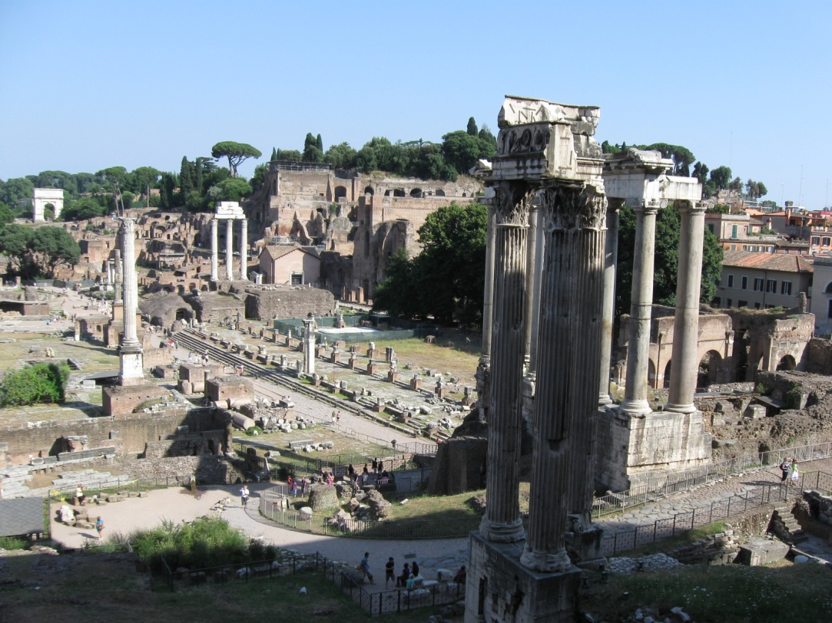
– a massive brick construction from the period of Domitian and Hadrian, under this – traces of earlier buildings behind the temple of Dioscuri, probably an impressive atrium
- east of the remains – large piscine with an inscription to Caligula from a statue base confirms his palace extension, a room projecting from its south side and placed on its central axis (tablinum?) could have housed Caligula’s cult image
- Dioscurii as gatekeepers – the Temple of Castor and Polux included to the complex as an entrance - implies a close physical connection between their temple and his own sanctuary, Caligula would have received the worshippers in the propylon, standing between Castor and Polux – appearing as Jupiter, their father
- recent excavations – the temple of Dioscuri couldn’t have been incorporated into these buildings – the atrium is not aligned with the temple, no alternations were made to it in this period – no walls, doorway, no alternations to the base, but certainly a close relation of the temple and the palace

Slide 15
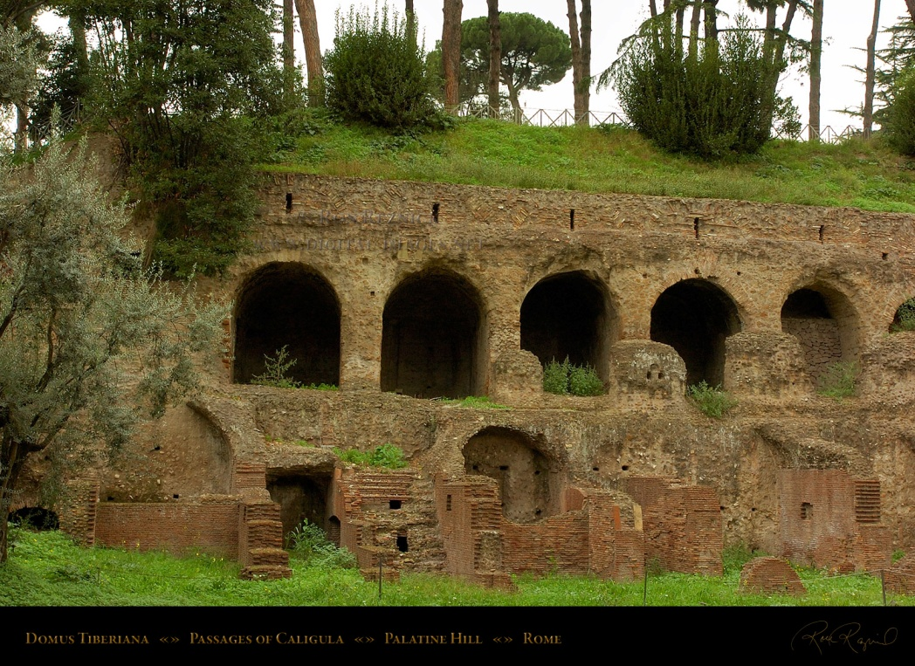
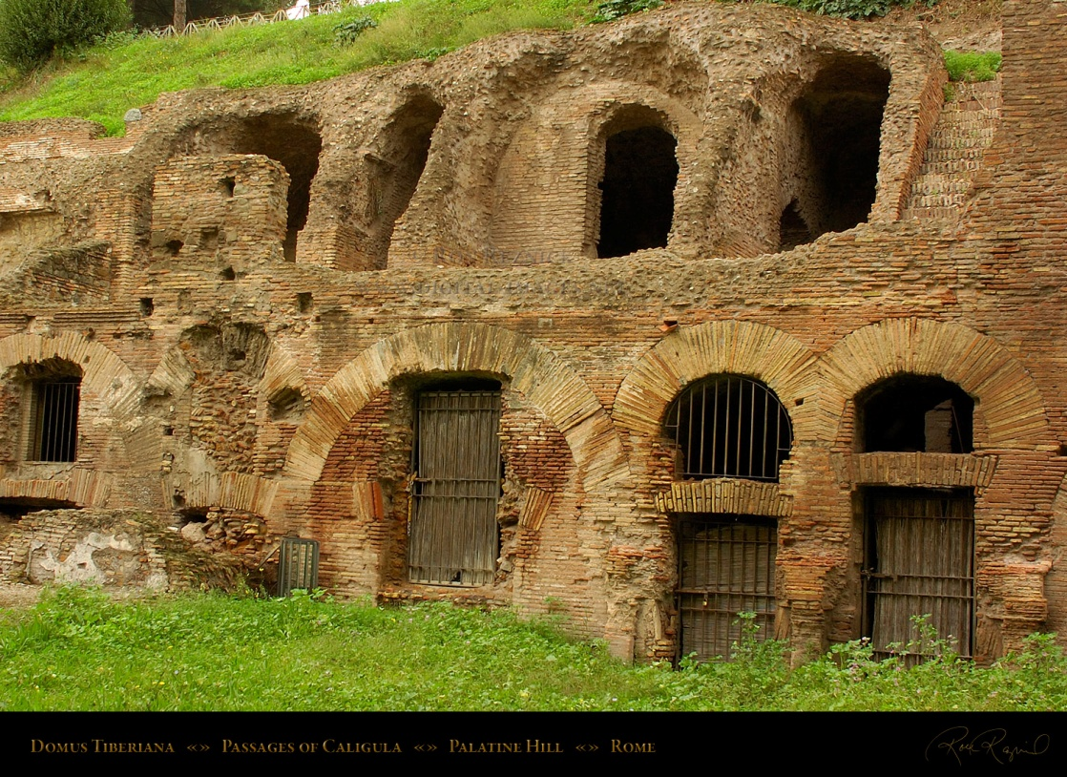
Problem with the buildings:
Building (palace) – situated behind the temple of Dioscuri - incorporated into it (literary sources)
- close proximity of the temple and palace could have caused mixing the two cults,
- Dio - Claudius restored the temple to Castor and Pollux – probably only removed Caligula’s statue

Slide 16
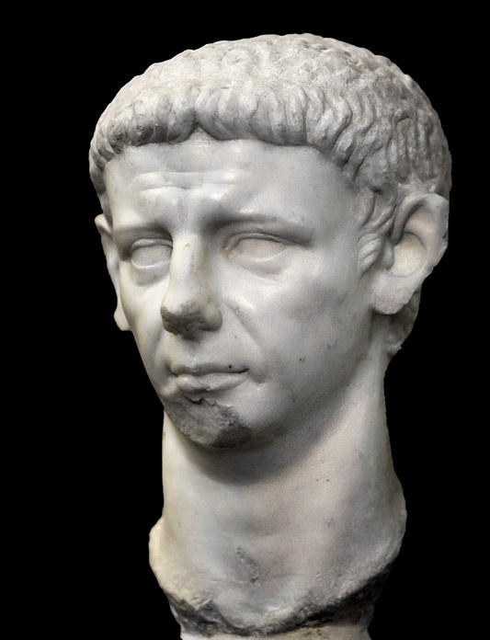
3 CLAUDIUS (Tiberius Claudius Caesar Augustus Germanicus)
Born: August 1st , 10 BC
Died: October 13th , 54 AD
Parents: Drusus the Elder, Antonia the Younger
Accession: after Caligula’s murder, he was chosen to be the emperor by the guardsmen (who killed the former emperor)
title’s permanent place - a formal definition of powers and auctoritas
under Tiberius – served as an Augustan priest
Reign:
early part of his reign – he wanted to accommodate the leading senators
distanced himself from the absolutist pretensions
modest as well as legitimate
prevented to dishonor Caligula, made the senate divinize Livia (against her will, 17 years after her death)
Vestal Virgins – duty to offer proper sacrifice to Augustus and Livia
ordered women to use Livia’s name in taking oaths
forbade sacrifice and worship of himself

Slide 17
THE STATE CULT
huge changes in the state cult, the most important time in the development of the role of the Genius
provinces – worshiped – temples of Claudius at Cos, Priene, …
the right person to start with the worship development – Caligula not a good example, he wasn’t a “good emperor”
chronological order - Claudius received the title of pater patriae, Livia’s deification - Claudius Genius included in the ritual
clear limit- did not receive a cult statue in the temple and a temple in Rome – minimized provocation
- emperor’s Genius joined the state pantheon of Rome
- beginnings – Claudius wanted to stress himself as the heir of Augustus
- state worship – position of the emperor in the state clearly expressed – paterfamilias for the whole people (pater patriae only a honorary title)
- senators became his clients, having a servile position

Slide 18
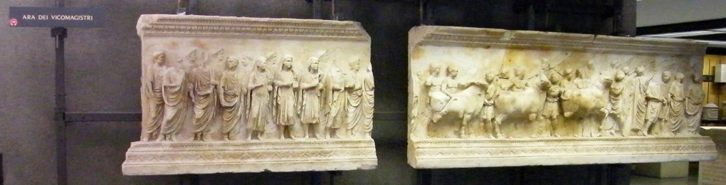
Archaeological evidence:
The Frieze of the Vicomagistri
- the name: after the four ministry
a part of a rectangular monument or a statue base
an early stage of depicting religious state ceremonies, the iconographic vocabulary has not yet frozen into the stock depiction of the emperor sacrificing - well known from later representations
the monument stood indoors, placed about 1 m above the ground - probably on a statue base in a temple
Found: Campo Marzio under the Palazzo Cancelleria in 1937-39 together with the Cancelleria relief panes (Domitian) – a secondary sculptor’s workshop
Depiction: religious procession with togati, musicians, attendants and sacrificial animals
Height: 1.05 m, a third is occupied by sculptured frieze, top and button – boarder
Length: 4.74 (but a piece is missing (probably two half figures in foreground, another background figure) – 5.05m

Slide 19
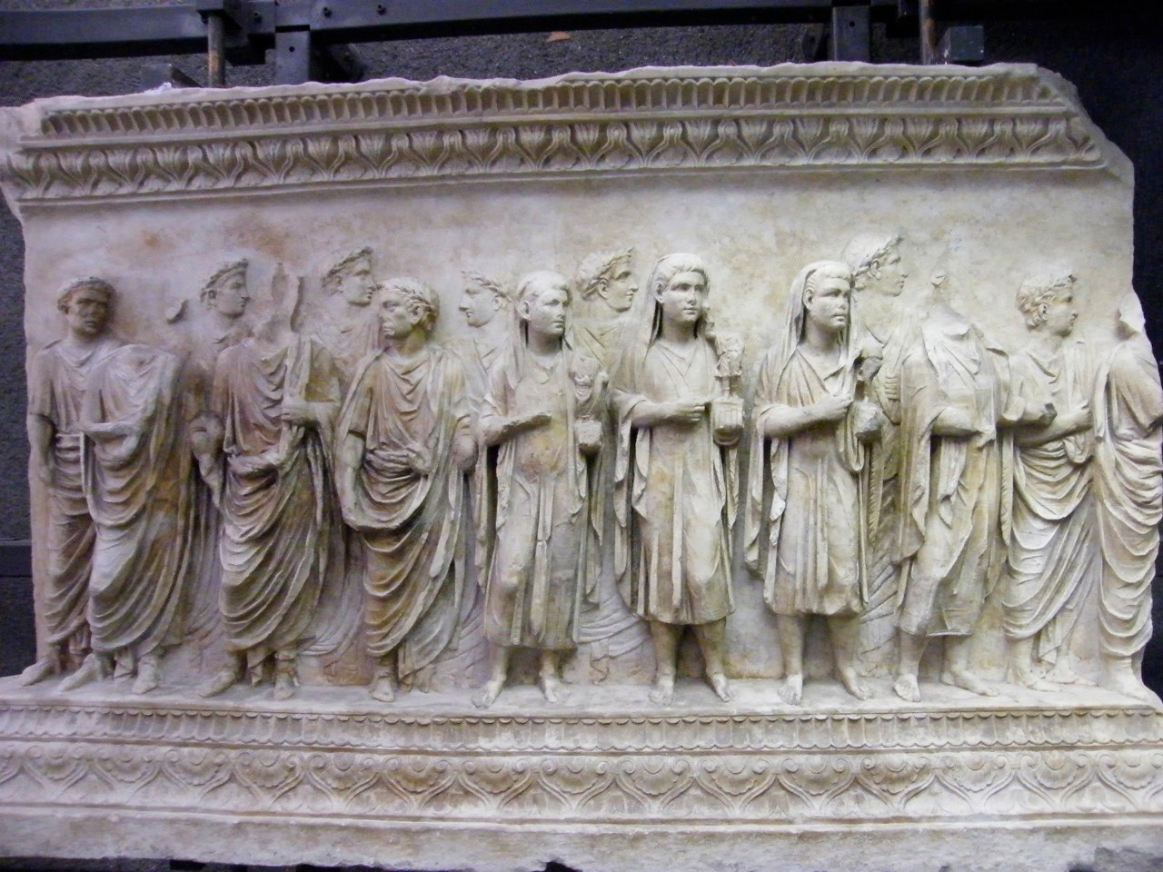
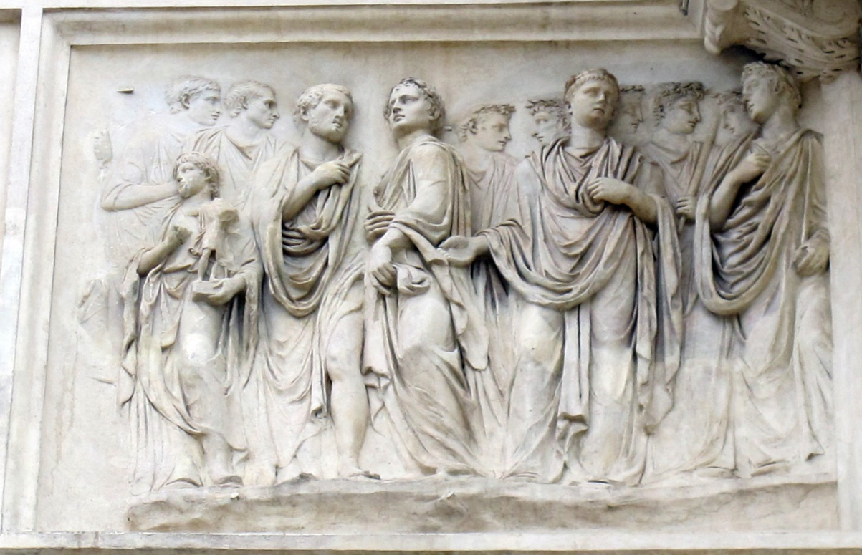
The togate figures
“magistri” – only four of them depicted in compital cults
here 9 - only four of them depicted in a more prominent position
these not on an equal footing as in compital cults
on the very left – three-quarters profile behind the three more prominent ones, the three left ones, the one in the middle is the only one frontal, the other two looking at him and he is taller
the one is the emperor Claudius -depicted in the same manner on Villa Medici reliefs

Slide 20
The ministri – four –coincidence, in state cult not termed ministri, but performing the same functions
two groups: publici (public slaves) and pueri ingenui patrimi et matrimi (senators’ young sons), who will one day function as priests
the number four – The Arval Brothers also had four – probably a standard number
the four boys occupy a prominent position, especially the ones carrying the statuettes – almost frontally
carry statuettes of the emperor’s Genius and Lares
bring forward the importance of the images they carry, further attention – they are pointing at them with their free hand,
the youth heading the group is less prominent, the object has broken off

Slide 21
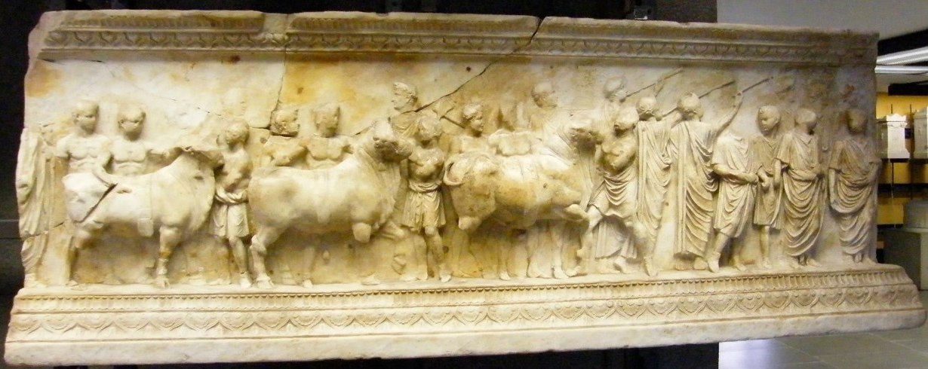
- the right edge – lion’s paw – part of the hind leg of a throne, the front leg remains and a part of the left side on the bottom
two almost frontal togati, three lictors, two tunicate figures, presumably camilli, three hornblowers, three bovine victims – a bull, a steer and a young heifer each pulled by a victimarius, group of musicians, part is missing
The two togati – sodales Augustales – priestly college established in 14 to worship Divus Augustus. The sodales were 21 plus the members of the imperial family, that’s why Claudius among them
the two small togate leaders – magistri of the college for this particular year, three lictors (strange number - sodales augustales headed by three annual magistri, that’s why three lictors, one magister missing)
The background – crowded with several minor figures, e.g. a victimarius carrying a tray, other carrying a cauldron,

Slide 22
Claudius – problems claiming legitimacy as an emperor, the first Augustus’ successor who did not descent from the first emperor, Livia was his grandmother by blood, to stress this connection – divinization
- the size and quality of the monuments points to a state monument, but which cult?
- to answer – victims, their nature and order (Rome was a strictly hierarchical society confirmed by the Arval Acta, rank of each god worshipped is strictly codified, e.g. Capitoline Triad – always Jupiter, Juno, Minerva)
Bull – the highest rank – Jupiter or the living emperor’s Genius
Steer – male and infertile gods – underworld (but why to sacrifice to infertility?), male Divi, gods of underworld inappropriate in connection with the living emperor’s Genius (till 54 AD – only 1 Divus Augustus)
Heifer – below Divus – Diva – deceased and deified empress
- Arval brothers worshipped all Divi together, the fact that we have one divus and one diva allows dating:
Claudius deified Livia as Diva Augusta in 42 AD, in 54 AD he was himself deified as Divus Claudius – the monument antedates his deification
- the scene: consecration of Livia and the procession to the temple of Divus Augustus with her statue (the part of the throne) and rededication of the temple to both of them
the frieze placed on the base of a new cult statue of Divus Augustus and Diva Livia
Genius of the living emperor included in the state cult for the first time!

Slide 23
Deification
- died in 54 AD – Agrippina was an active participant in the funeral – priestess of Claudius
Two changes:
conflicting version of achieving his apotheosis:
I senatorial decree (senatorial deification), then the funeral (Tacitus, Seneca)
II the funeral and then senatorial decree (senatorial deification) (tradition, Suetonius - testimony)
no eyewitness - the custom fell into disuse, symbolically performed by the release of an eagle from the pyre shortly after it was set on fire during the funeral
- valid until Antonine dynasty
Death of the emperor
Formal deification by the decree of the Roman Senate
Official consecration by the new emperor
Public imperial funeral
Either before or after the senatorial decree
Symbolical apotheosis performed by the release of an eagle from the funeral pyre
Official consecration by the new emperor

Slide 24
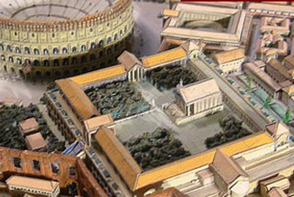
BUILDINGS
Temple of Divus Claudius – Caelian hill (peripheral site), side of Claudius’ private domus
54 AD died – wife Agrippina began the construction
excavated in 1880
- partially preserved:
W side: within the bell tower in the Convent of Sancti Giovanni e Paolo
- Constructed immediately after the death
- the oldest phase - interconnecting rooms, two floors high, travertine blocks
- piers – Doric pilasters, only capitals are finished, heavy architrave
radial walls – bricks, ceiling vaulted
S side: fewer has remained
N side: little has survived – row of
rooms built against a brick wall
- a large cascading fountain – during the reign of Nero – large marble fountain head in the form of ship’s prow with a boar’s head
E side: the most monumental and best preserved, Nero’s modification of the building
Large brick wall with a series of niches and a larger chamber in the middle – enormous nympheum
- colonnaded porticus

Slide 25
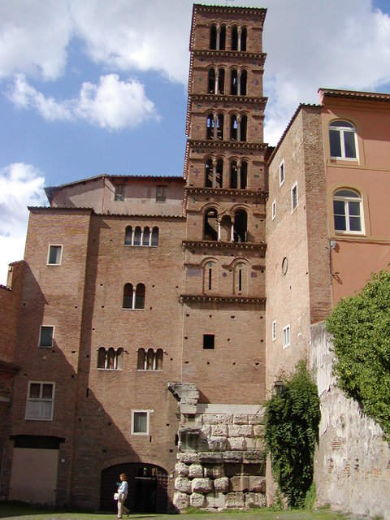
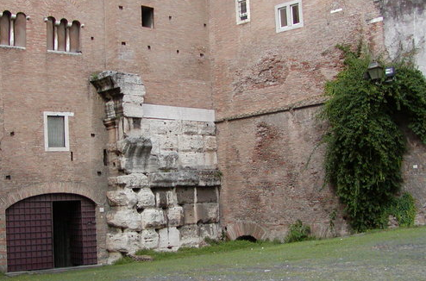
- no trace of the temple above the platform foundations - Severan Marble Plan – prostyle, hexastyle, 3 columns on the sides
- the rest of the area – garden

Slide 26
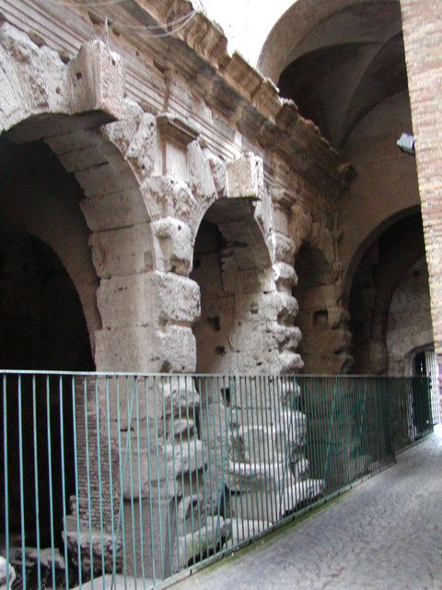
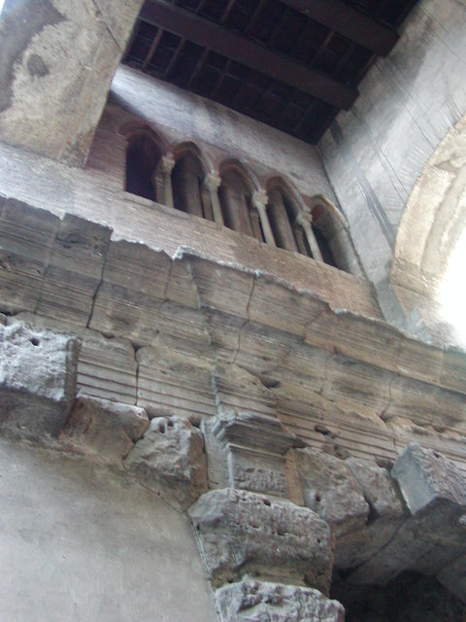
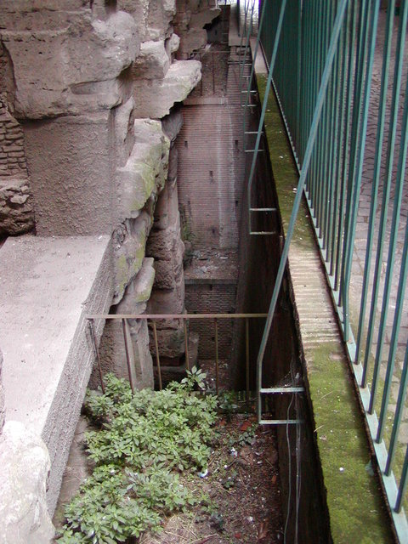
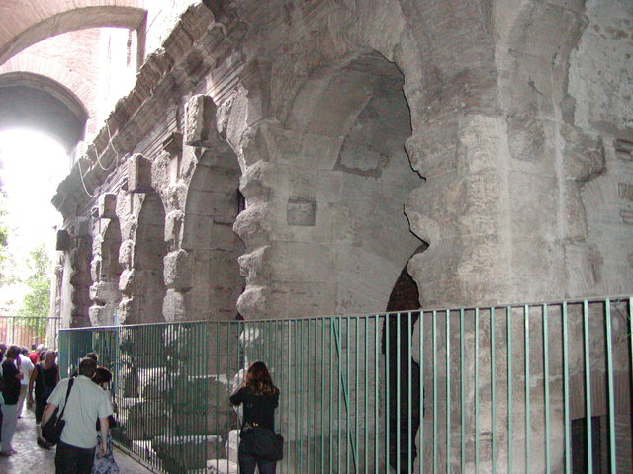

Slide 27
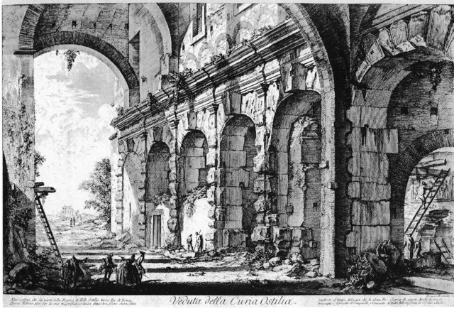
- Nero cancelled several Claudian acts, destroyed the temple and built Domus Aurea instead
Vespasian restored Claudius’ divine honors, because he served under his command and Titus grew up with Britannicus
restored and rebuilt several of his buildings

Slide 28
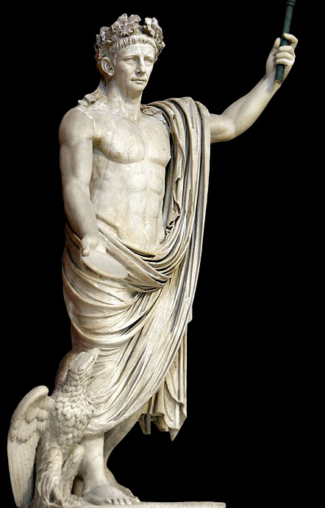
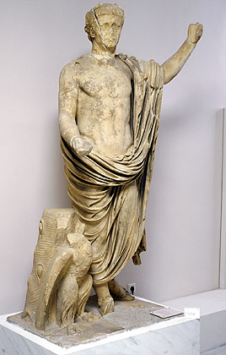
IMAGES
Portrait from Lanuvium
dedicatory inscription found near the piece (today lost) – the statue was erected in honor of Claudius by the Senate and the people of Lanuvium
- Claudius shown with a Julio-Claudian cap of layered hair with comma shaped locks parted near the center, brushed to either side, broad cranium, tapering chin
- represented not youthful – in his fifties, bags under eyes, sagging jowls, furrows on his forehead
- idealized body type, stands in contraposto, a scepter in his left hand patera in the right
- next to his leg – an eagle with outstretched wings
- an eagle and a scepter – attributes of Jupiter
- the same bronze prototype had also the statue of the emperor from the Metroon in Olympia

Slide 29
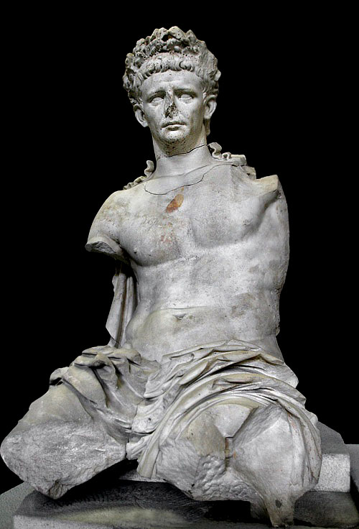
Seated statue from Cerveteri as Jupiter
- a part of a Claudian dynastic group – Claudius, Tiberius, Agrippina, Britannicus

Slide 30
Cameos
Grand Camée
1 Tiberius
2 Livia
3 Germanicus
4 Agrippina the Elder (in front of Tiberius)
5 Claudius – behind Tiberius
6 Agrippina Younger – Claudius’ wife and niece at the same time
7 The child on the left – Nero
8 Behind Nero – Providentia Augusti
9 Augustus in the middle, up
10 Drusus the Younger – on the left of Augustus
11 Drusus the Elder – on the right of Augustus (died falling of the horse)
12 Eros
13 Mithra/Sol Invictus – Nero was born on the 15th December, close to Mithra’s birthday –Nero loved himself showing as Sol, astrological reference to the birth (similar to Gemma Augustea)
Seated oriental figure - Ti. Claudius Balbillus – a personal counsellor of Nero – oriental origin, living on the court, connection to the Claudians
9
12
11
10
13
8
4
1
3
2
5
6
7

Slide 31
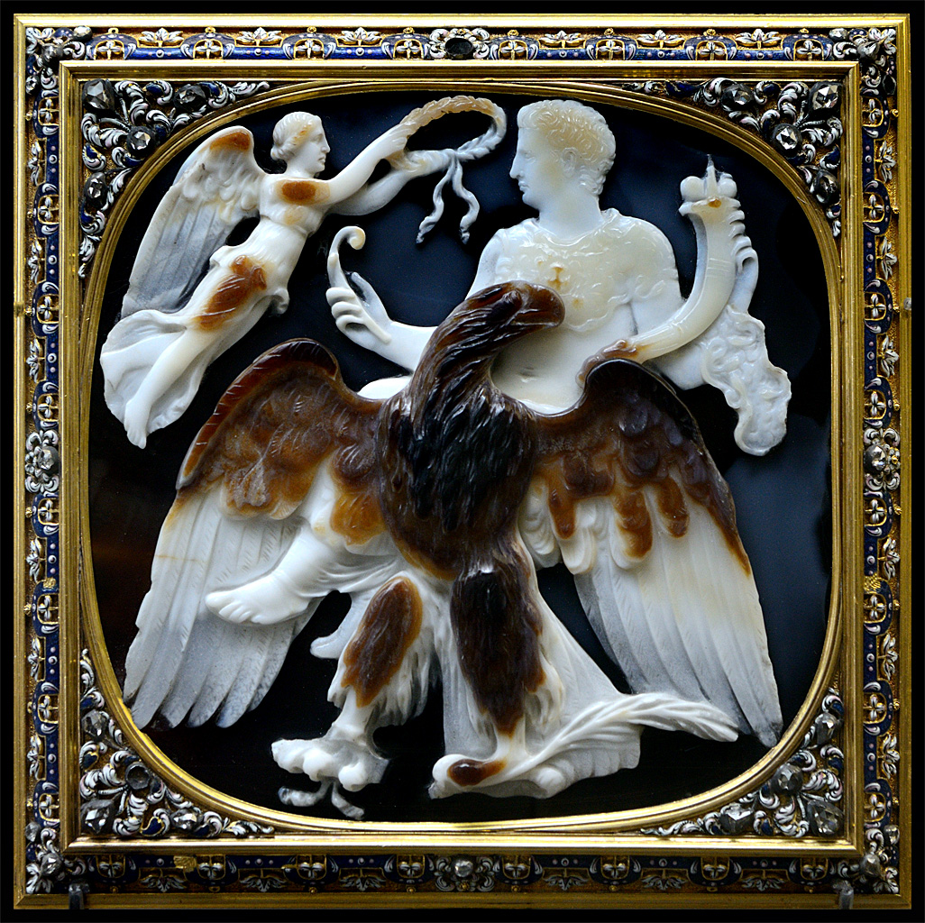
Claudius apotheosis, mid 1st century AD, four layers, sardonyx

Slide 32
The Ravenna Relief (Claudian date between 45-50 AD)
Two marble relief fragments from a Claudian monument, possibly an altar honoring the imperial family
The smaller fragment – sacrifice in honor of the imperial cult, a bull is being sacrificed
The bigger fragment – a series of frontally positioned imperial figures against a blank background
- Augustus – distinctive coiffure and characteristic facial features, wearing corona civica, hole in forehead for a bronze star, left foot on a globe with the signs of zodiac, in the guise of Mars Ultor with a short sword and a spear
- Livia – assimilated to Venus, with Eros on her left shoulder, wears a tiara, posture and drapery based on Venus Genetrix
- Julio-Claudian youth – a full cap of layered hair, bare chest and mantle draped over the lower part of his body, like Augustus – bronze star – Germanicus
- Older man in cuirass and paludamentum – originally held a sword and a spear – Drusus the Elder
Seated draped, headless woman – Claudius’ mother – Antonia (or Pietas)

Slide 33
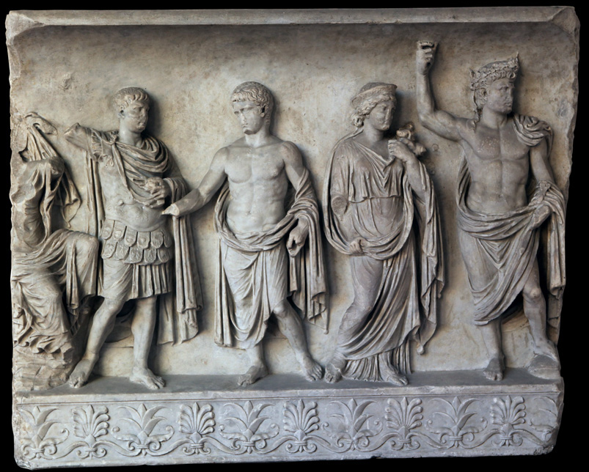

Slide 34
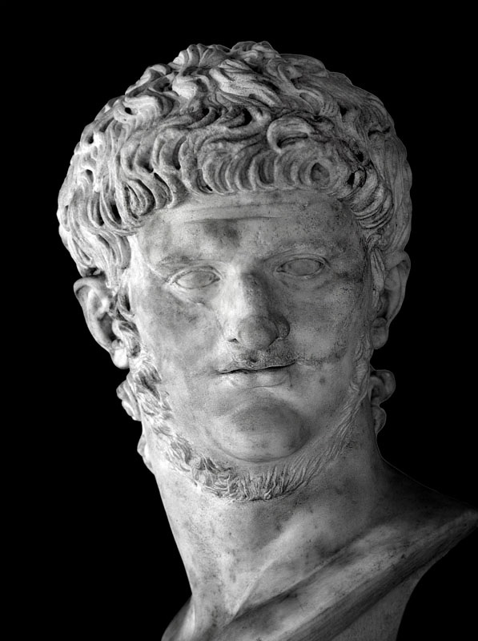
NERO (Lucius Domitius Ahenobarbus, Claudius
Caesar Augustus Germanicus or Nero
Claudius Drusus Germanicus)
Born: December 15th , 37 AD
Died: June 9th , 98 AD
Parents: Gnaeus Domitius Ahenobarbus, Agrippina the Younger
Accession: adopted by Claudius
the last julio-claudian emperor
Reign:
early part of his reign – influenced by his mother, Seneca and Burrus (Praetorian commander)
an oath formula by Jupiter Optimus Maximus, the Divi and the Genius – became standard, the official state oath (archive in Pompeii)
later – independent ruler – cruel
persecuted Christians
committed an “assisted” suicide

Slide 35
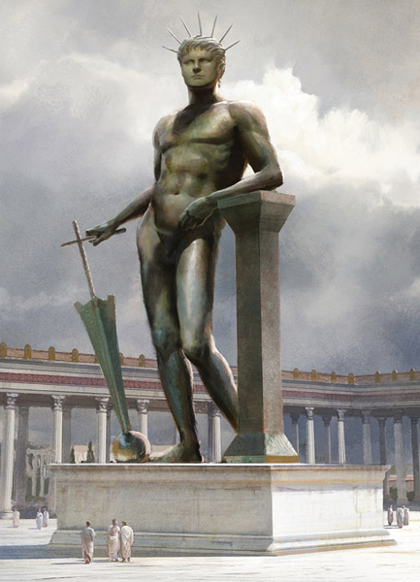
STATE CULT
- the worship of Genius continued – The Arval Acta – even more frequent – dies natalis, dies imperii, even when he recovered from a sorethroat! (also more frequent during Galba, Otho and Vitellius)
(not a togate one as Genius Augusti)
- change of iconography – The god depicted as Genius populi romani - semi-nude heroic form, evidence – coins
- reason of the change: difficult to distinguish the Genius of emperor and every other man.
The Colossus Neronis 30 m bronze statue,
in the vestibule of his Domus Aurea.
resembling himself and the Roman sun god, Sol
holds a rudder on the globe which is a symbolic gesture of his power over land and sea.
modified by Nero's successors into a statue of the sun god Sol (only), moved to a spot outside the Flavian Amphitheatre
last mentioned in the 4th century AD

Slide 36
PRIVATE CULT
the sources fail – texts and monuments created for the public eye, private cults had a well informed insiders – no need of explanatory monuments
literary sources ignore private life (only eccentric aberrations)
- there is hardly any archaeological evidence of emperor worship in the domus – mosaics and wall paintings never refer to emperor, but why would they? – emperors weren’t permanent, they changed quite fast and the imperial honors focused on the ruling emperor rather than on the Divi (the emperor was the one who could change something in their lives, not the dead ones)
- Pompeian wall painting – scene of fantasy architecture or mythology, specific cults only in lararia
- portraits in private homes – only temporary, not elaborate ones, modest character (Fronto to his imperial pupil Marcus Aurelius – images painted on the wooden panels – no chance they are preserved even in Pompey)
- sculptured miniature portraits – Herculaneum – two busts of Augustus, Livia in The Villa dei Misterii in Pompeii, another villa – young Julian prince in a back room, a life-size silver bust of Galba in Herculaneum, a collection of imperial Julio-Claudian bronze portraits…
literary evidence – Ovid – Augustus, Vitellius father of the emperor – golden image of Claudius, Marcus Aurelius – golden portraits of his teachers, Hadrian – bronze miniature bust of Augustus – all the text one in common – represent exceptions

Slide 37
Imperial libation before private banquets
- to the living emperor
- 30BC after the conquest of Egypt – the Senatorial Decree – a libation poured to the emperor, not to his Genius, at all banquets, public and private
- no evidence it was ever performed before public banquets
- private: Ovid, Horace, Petronius in connection with ceremonies with lares – but libation to the emperor himself, the idea of the Genius – later
- a wall painting from Pompeii – a libation performed to the Genius, in the garden of a private house, small lararium, it was destroyed many years ago, no photo or other reproduction
- before the meal, or between two courses

