Slide 1
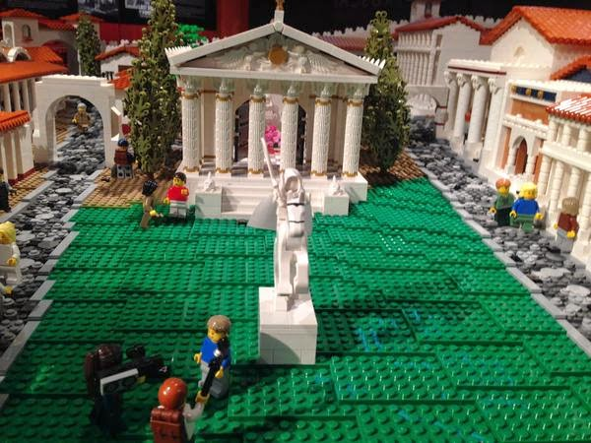
The Buildings and the Images of the Imperial Cult
III. Augustus, Pompeii

Slide 2
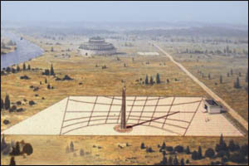
I Ara pacis
- dynastic ambitions, social policies, religious affinities, military victories
Complex
mausoleum, ustrinum, sundial and altar
Location
nearby Via Flaminia – Augustus took it on his return to Rome from Spain and Gaul after the pacification
Date
4th July 13BC - foundation stone
30th January , 9 BC – dedication - on Livia’s birthday – Augustus (peace to the empire), Livia (the foundation of the imperial family and its Concordia)
Obelisk – Egyptian – victory monument over Egypt, Cleopatra and Marcus Antonius – victory over eastern provinces
Altar- victory over western provinces (Hispania, Gallia)
- the peace brought to the entire Roman world
Ustrinum and mausoleum – Augustus’ triumph over death
Res Gestae:
“On my return from Spain and Gaul, after successfully restoring law and order to these provinces, the Senate decided under the consulship of Tiberius Nero and Publius Quintilius to consecrate the Ara Pacis Augustae on the Campus Martius in honor of my return, at which officials, priests and Vestal Virgins should offer an annual sacrifice.”

Slide 3
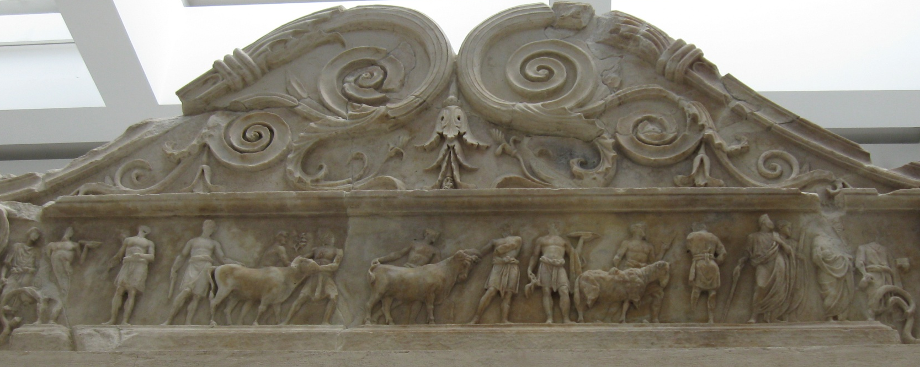
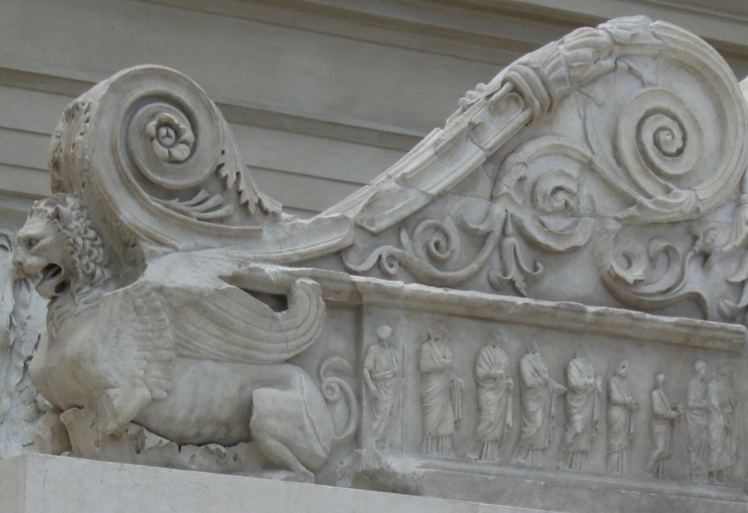
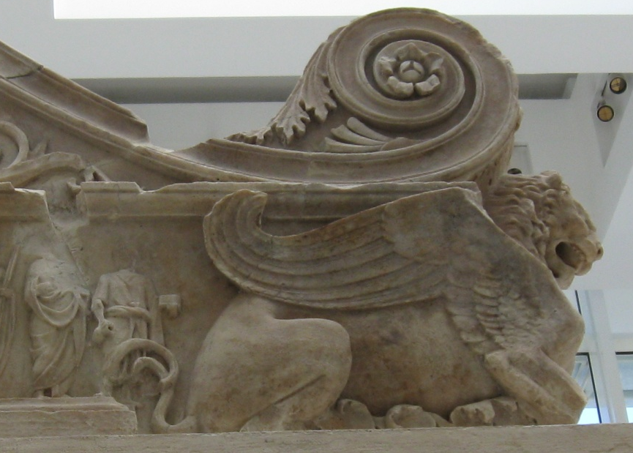
Decoration
Altar (interior):
frieze of animals led to a sacrifice (the annual sacrifice to Pax)
figures distinguished by their costumes but not individual features
framed by majestic, horned-winged lions and a series of acanthus tendrils

Slide 4
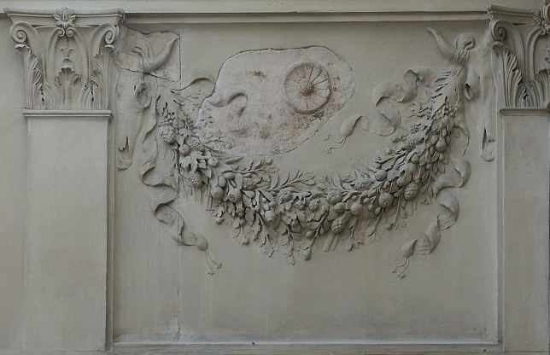
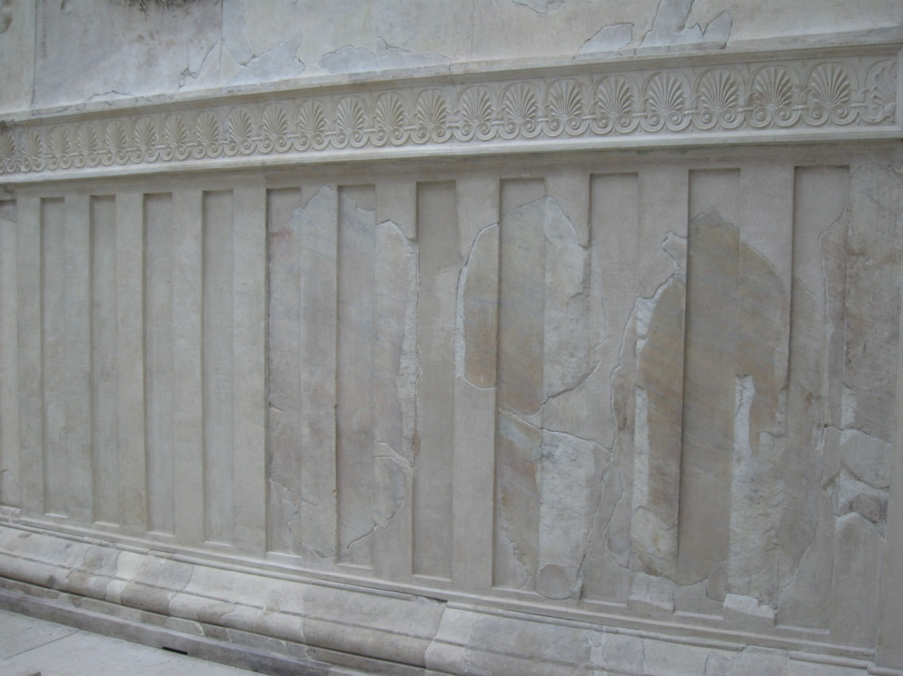
- wooden fence and garlands hanging from wooden posts, garlands laced with fruits, paterae and bucrania

Slide 5
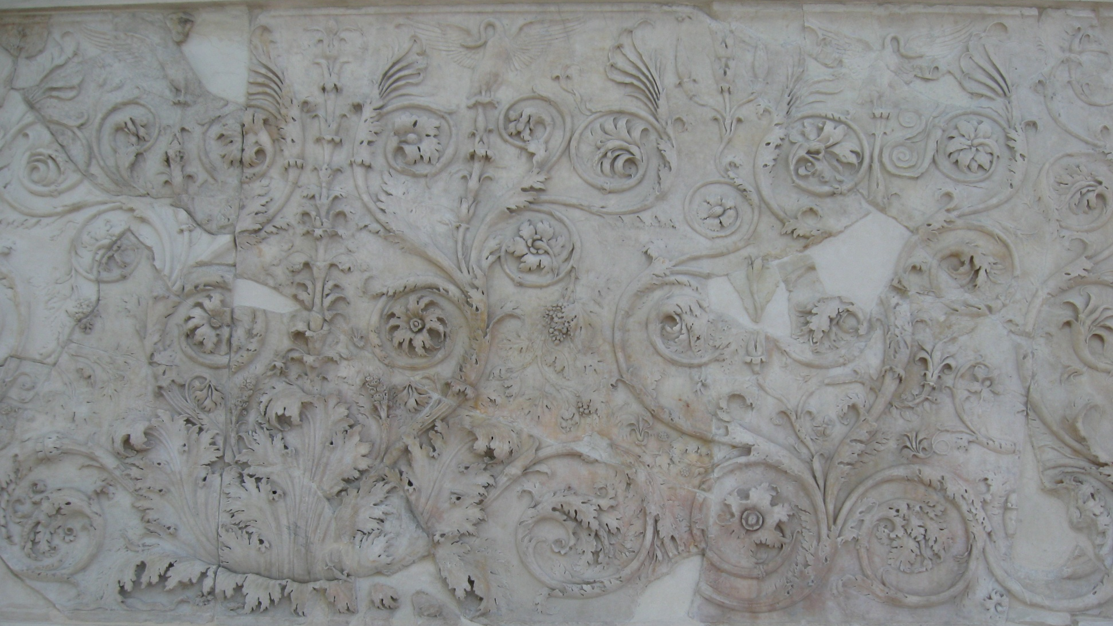
exterior:
floral panels with animals - acanthus leaves, wines,…
- swans (sacred birds of Apollo), frogs, birds, snakes…
peace leads to growth and rebirth

Slide 6
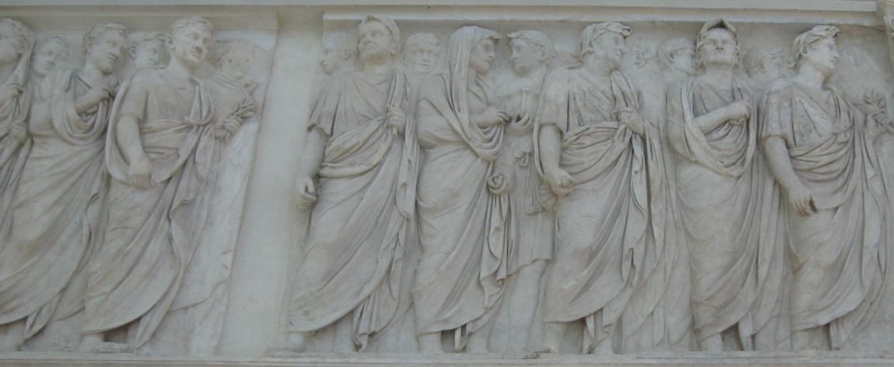
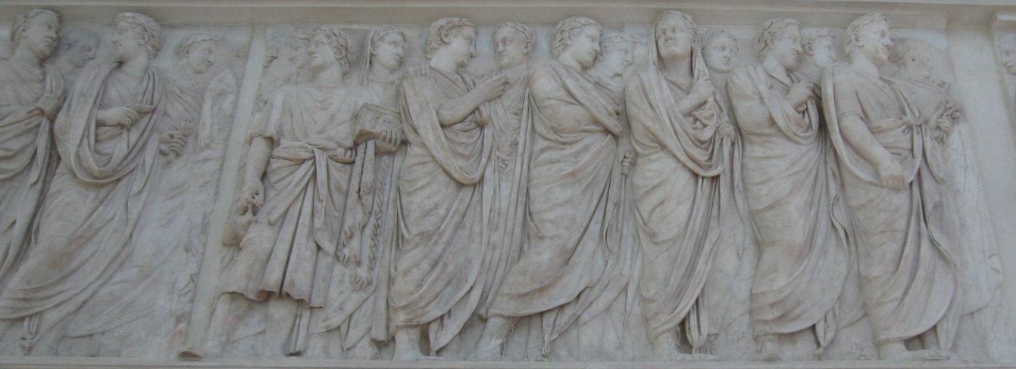
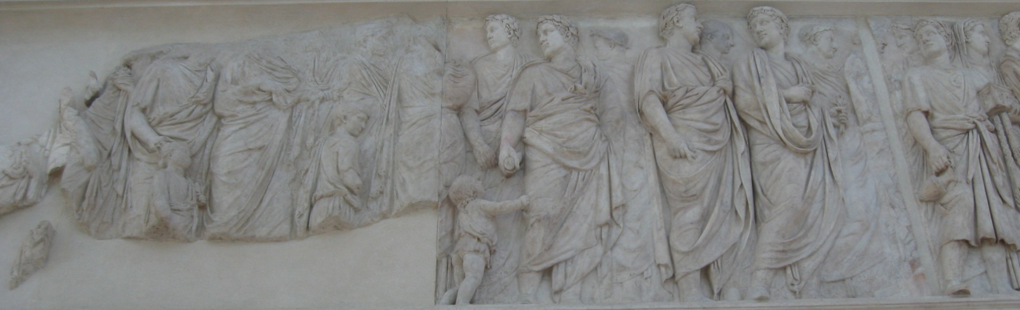
Processions (or two parts of the same procession??)
its obvious model in Parthenon procession
north frieze – faces reworked in renaissance – senators and dignitaries, followed by families, prominent – Julia and Octavia

Slide 7
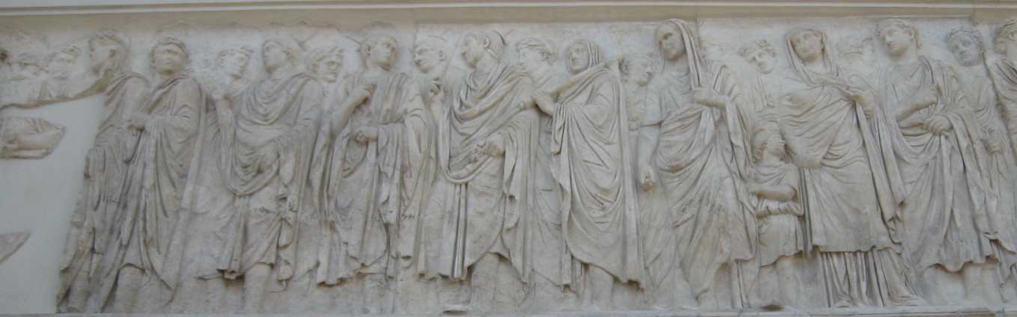
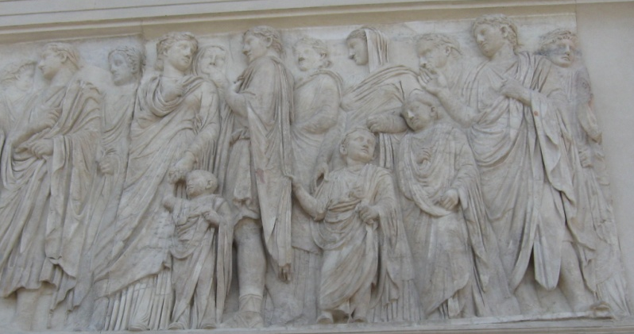
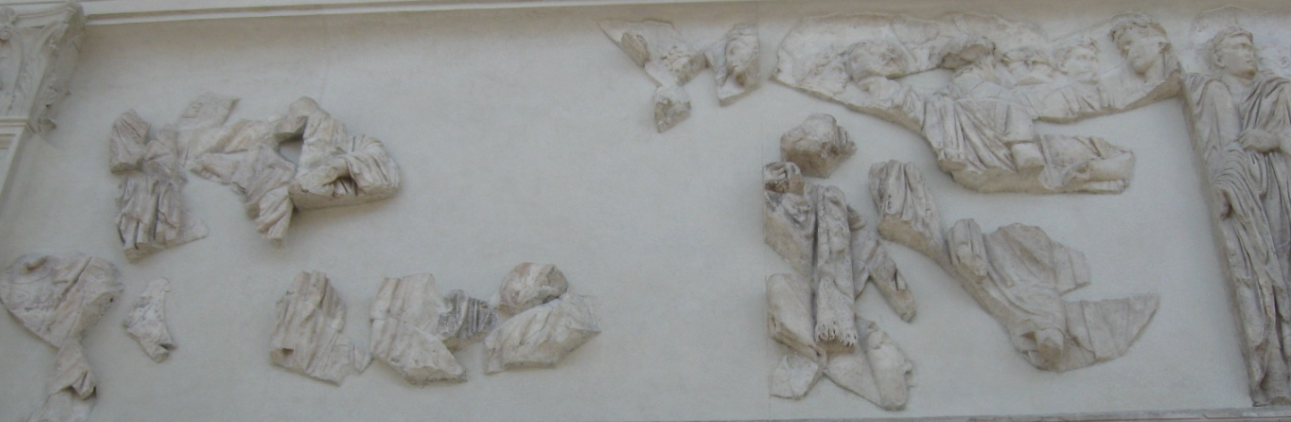
south frieze – left to right – Augustus (holding a lituus – associated with the chief state gods Jupiter and Apollo), lictors, members of the imperial family – Marcus Agrippa, Livia, two sons - Drusus and Tiberius, Drusus’s wife Antonia the Younger (niece), their son Germanicus, Antonia the Elder (niece), Lucius Domitius Ahenobarbus, their son and daughter
– inclusion of children – dynastic policy – social policy, law reforms – marriage and raising children
– Pax (missing)- in front of Augustus (?)

Slide 8
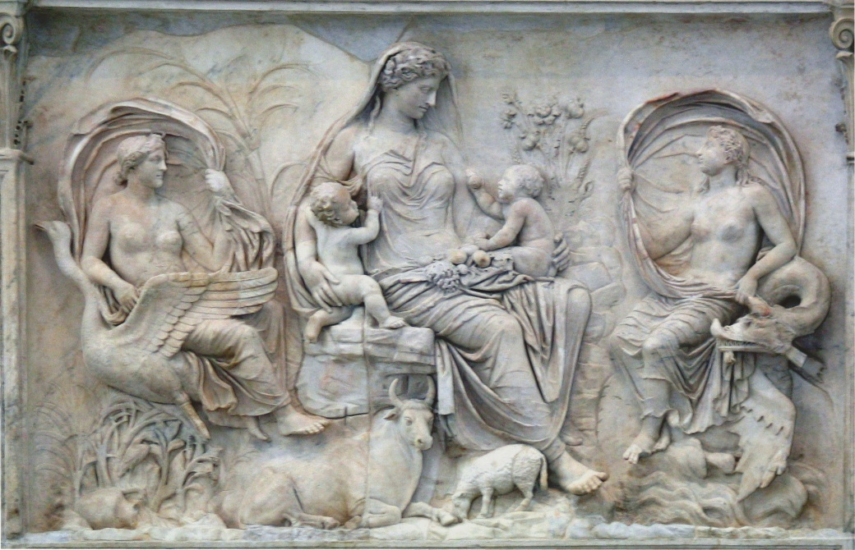
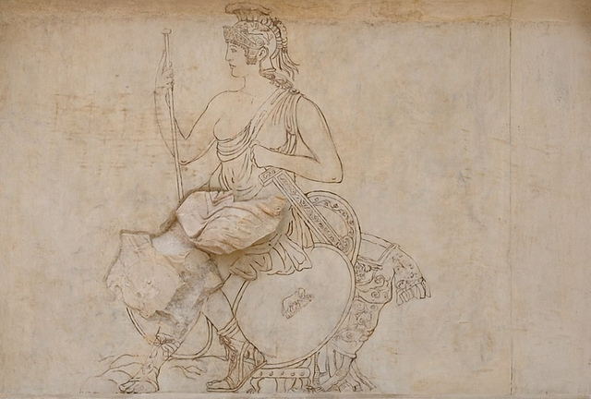
legendary panels
Tellus or Italia
two babies, personifications of breezes and sea
animals, flowers, fruit, symbols of fertility and growth
the message – peace brings prosperity and time for planting and harvesting and the security to raise children and plan for the future.
Roma
- originally flanked by Honos and Virtus - in Amazonian costume – welcome to a victorious emperor

Slide 9
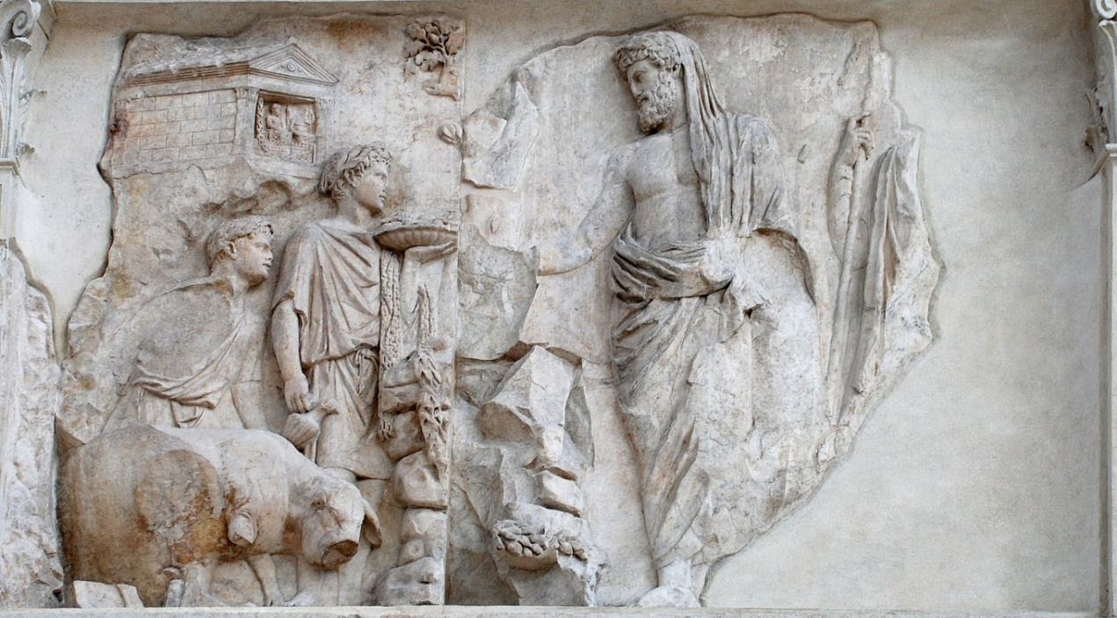
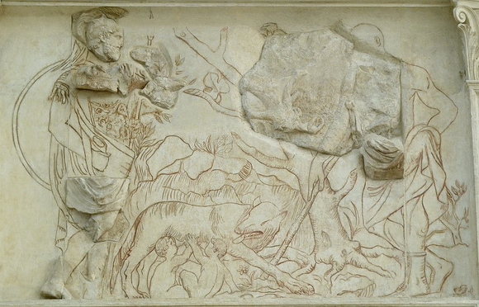
Aeneas making a sacrifice to the penates or household gods
founder of the Julian family – divine descent from Venus through Aeneas
Augustus return from Spain is the parallel to Aeneas’ arrival in Italy
Aeneas accompanied with Julus Ascanius – Julian family recieved the name.
Mars with Romulus and Remus – badly damaged
Mars symbolizes the war by which Augustus brought peace to Rome
Mars – father of Romulus and so of the Roman people

Slide 10
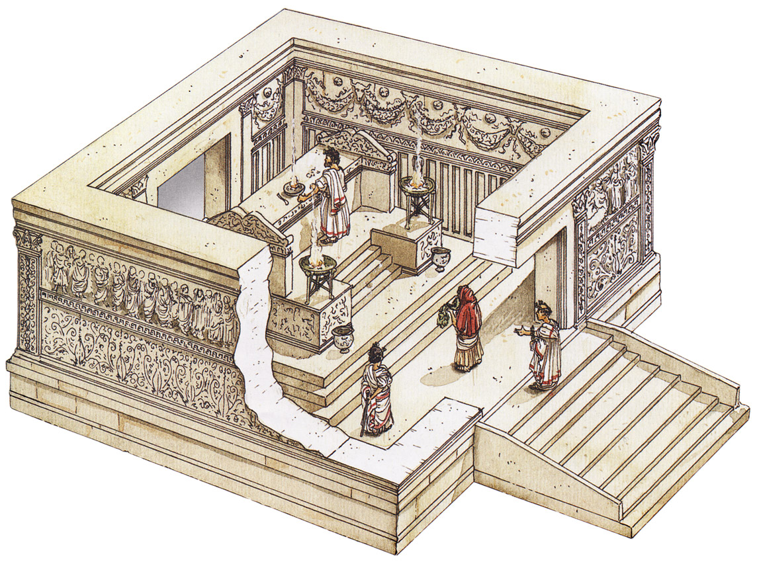
meaning
- the peace brought by Augustus to Rome and the empire through diplomatic efforts in provinces
- opportunity to consolidate family and to raise children – children will ensure the continuity of the Julian dynasty and preserve Augustan peace
- divine ancestry – Venus
The association of the name of Augustus with peace, the rebirth of Italy and the earth under the universal dominion of Rome (Roma, Tellus), the city whose origin is associated with the offspring of Aeneas (Aeneas, Mars)

Slide 11
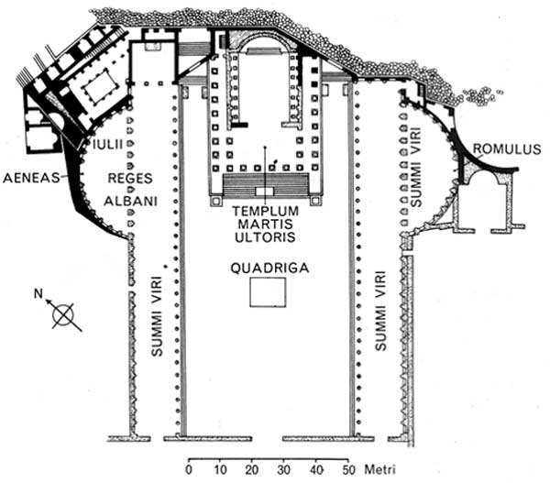
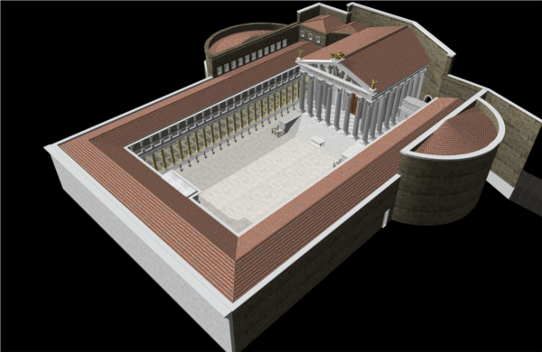
II The forum of Augustus
ideological manifesto summing the foundation myths, the mythic history of Rome, the summi viri, divine lineage – everything points to Augustus’ imperium maximum
Location: next to the Caesar’s forum
Date: building started after Actium, finished 2BC, decision made before Philippi
Material and dimensions: Luna marble (Carrara – western coast of Italy), 125x118m, rectangular
surrounded by a precinct wall, about 35 metres height – protection from fire and tenements
two long porticoes, the temple of Mars Ultor (the east end), two exedrae, the forum, the Hall of the colossus

Slide 12
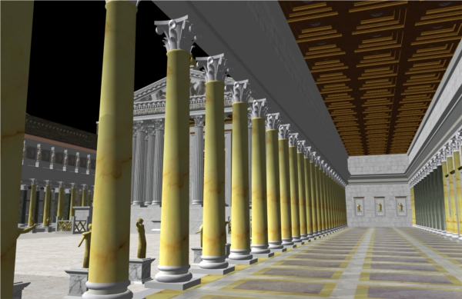
The porticoes
– two stories, the first - Corinthian columns, the second decorated - caryatids that flank shields ornamented with heads of divinities
in display: real weapons (Res Gestae), shields (imagines clipeatae – Jupiter Ammon, Galatians), dozens of statues (over-lifesize – mythological and historical Romans, great man of the Republic, Augustus’ ancestors)
caryatids – copies of the ones on the Erechtheion (Augustan golden age = Periclean Athens)
round shields – victory of Alexander the Great (hung shields in Parthenon)

Slide 13
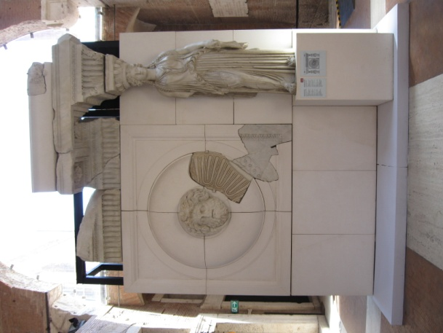
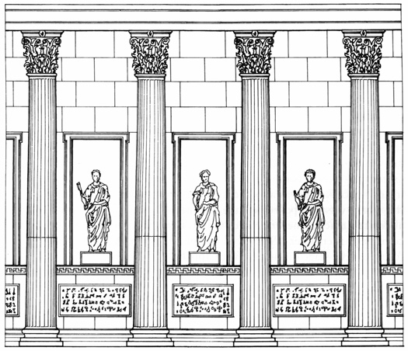

Slide 14
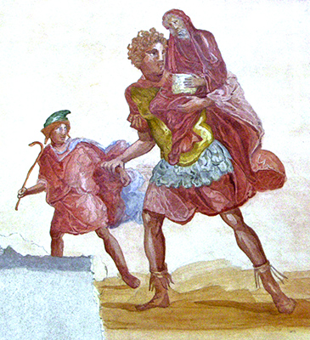
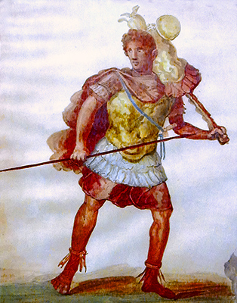
Exedrae
left exedra: Aeneas flying from Troy, with his father Anchises and son Iulus
right exedra: Romulus – founder of Rome with spolia optima
We know about these groups from copies and paintings (wall of a house at Pompeii)

Slide 15
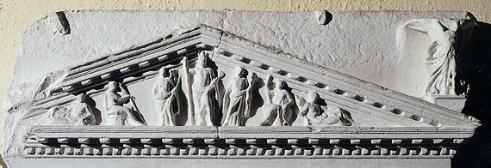
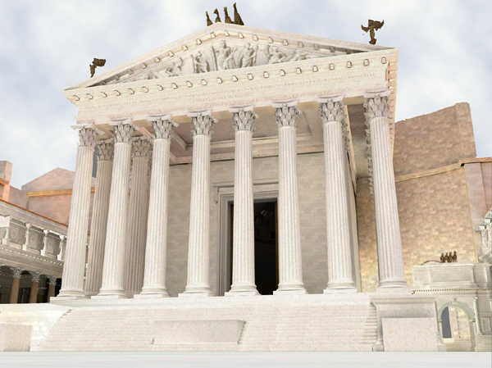
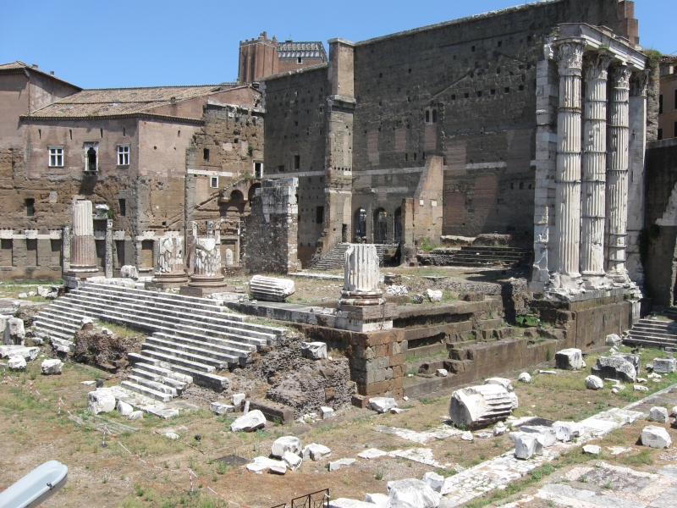
The temple
– etruscan-roman type, closed back wall, high podium, staircase on one side, deep porch, octastyle, constructed or faced with marble, corinthian capitals (or their variations)
pediment: center a heroically semidraped Mars Ultor, to the left – Venus, her left shoulder small Eros, seated Romulus, on the right – Fortuna, seated Roma, corners - personifications of the Palatine hill and the Tiber River
representation in miniature from the Claudian “Ara pietatis augustae” – pediment filled with marble statuary

Slide 16
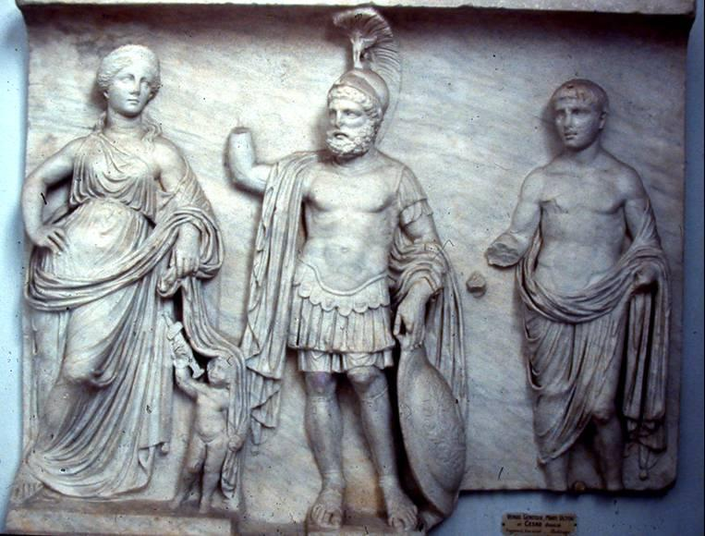
Inside the temple
– a statuary group of Mars, Venus and Divus Julius – not preserved
representation: Algier Relief - marble bases in the relief suggest they are statues
a) Mars - fully armed, bearded, helmet, shield, cuirass, spear
b) Venus - leans on a column
c) Eros - resemblance of the Prima Porta statue
d) a young man with bare chest and Augustan cap of hair – Julius Caesar

Slide 17
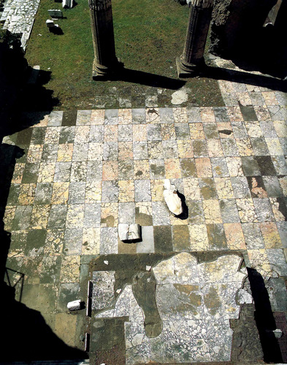
Hall of the Colossus
Location: at the east end of the north portico, divided from the portico by two columns,
originally lighted by a clerestory above the roof of the colonnade
Dimensions: room – 12 x 13 m, podium – 1.22 x 1.40 x 2.80m
pavement – checkerboard pattern of rectangular giallo antico and pavonazzetto slabs with a cipollino border
Back of the room – pavonazzetto-clad base that supported the colossus

Slide 18
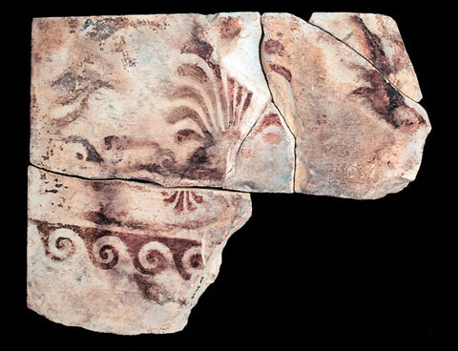
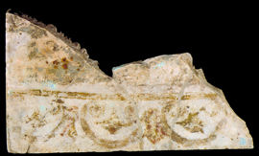
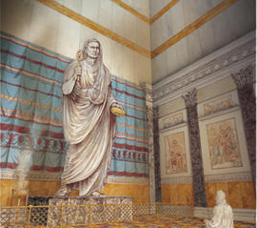
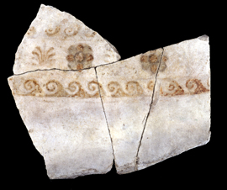
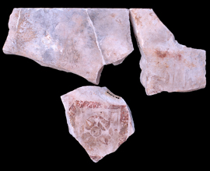
North and south sides of the room – Corinthian pilasters with pavonazzetto shafts
the north bays – two tiers of famous greek figural paintings (attributed to Apelles), marble slabs to the height of about 11 metres (as height as the statue)
The wall at the back of hall - faced with rectangular Luna marble slabs (up to the height of the statue at least) that were slightly rounded (different width of the slabs), to resemble draped fabric, a sort of backdrop, which was painted with decorative plant motifs, some of them painted in gold on a Egyptian blue.
Base - upper surface – pavonazzetto marble slabs, show a negative print of the feet of a lost statue,
Left side of the podium – traces of holes – maybe a tripod
Holes all arounnd the podium – maybe transennae

Slide 19
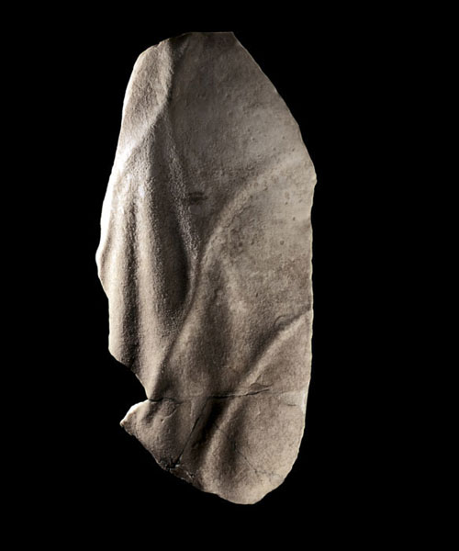
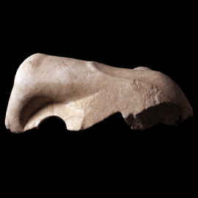
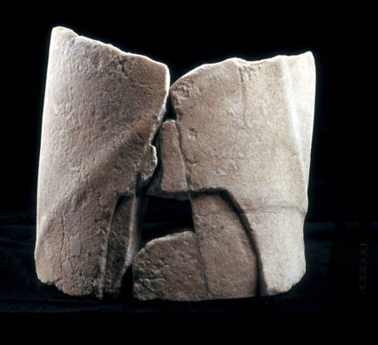
Statue
material: white Greek marble from Paros (similar to the Prima Porta statue)
size: about 11 metres, left foot 177 cm, right foot 166 cm long
description: weight of the figure was resting on the left foot (positioned in front of the right), the right almost touching the wall behind, the right hand clasping a symbolic circular object, the left one holding a tool for sacrifice
technique: the torso made of wood or iron, concealed by drapery or gilding, marble feet, head and hands exposed, marble parts are extraordinarily life-like – veins delicatedly and realistically curved
fragments:
a) right hand with the first phalange of the index finger
b) a part of a right forearm
c) the extended back of the left hand
a
b
c

Slide 20
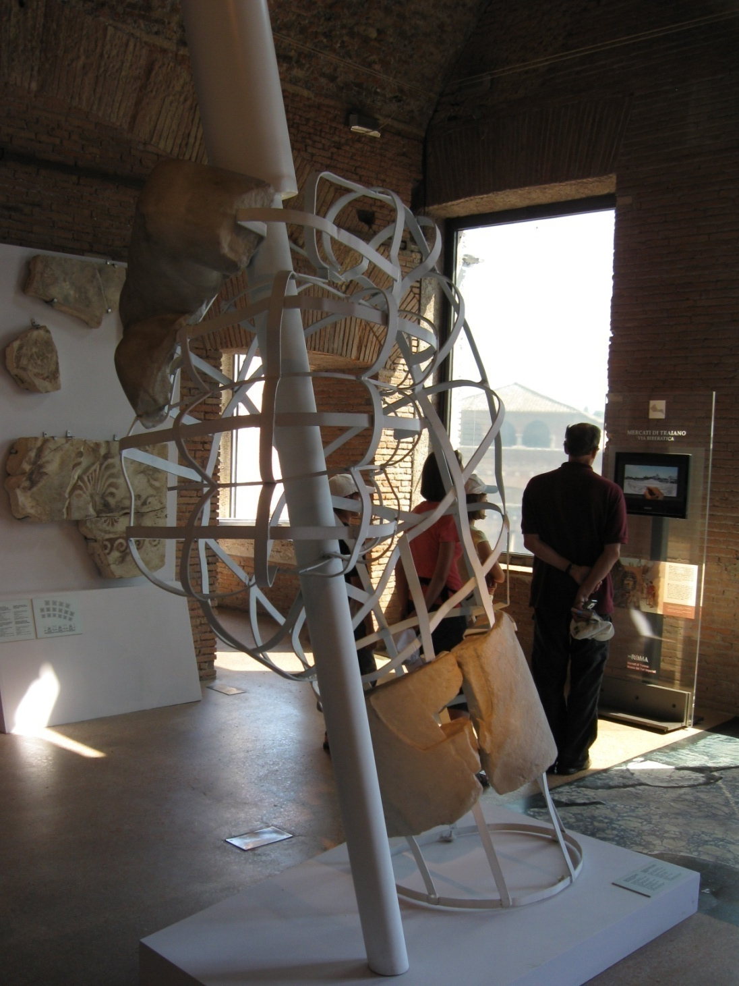
Statue identification
– Genius Augusti – in toga, velato capite
- possible atributes:
- patera – compital altar of the Vicus Sandalarius patera and lituus
- corncucopia and patera
acerra
the choice of such statuary type:
a) continuity with the image of Divus Julius (coins from 36 BC)
b) stress on the pietas of Augustus
c) affinity with the familiar image of the genius of the paterfamilias
The hall is a cult space in the Forum Augusti, containing a statue not of Augustus himself, but of his Genius – the location links Augustus with ancestors - mythological and divine.

Slide 21
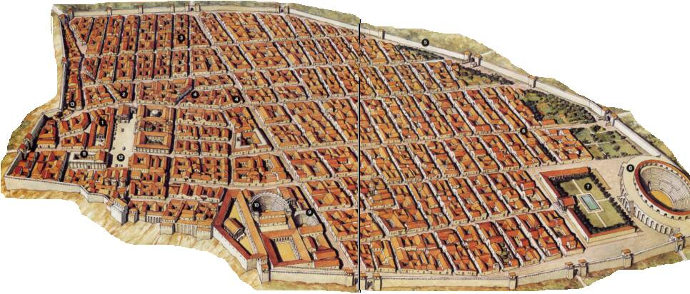
III Pompeii – The Forum
- the principate of Augustus until 79 AD – the forum of Pompeii communicated with Rome by displaying social, political and religious connections as well as architectural allusions to the Imperial family
- Pompeii and Imperial family – building projects – east side of the forum
- local elites – dedicated buildings to glorify and define themselves – local parallels to the members of the Imperial family
- after earthquake – 62 AD – rebuilding – standardized the Imperial presence emphasizing dynasty and creating visual continuity
From elite patronage to direct imperial control over a unified space
3 phases of the Forum:
a) Early: 6th century BC - Augustus
b) Augustan and early imperial
c) Late: 62 AD to 79 AD

Slide 22
Augustan period and the earthquake:
During Augustus’ reign – emperor worship widespread throughout Italy and the provinces, citizens sacrificed and dedicated temples to the living emperor
The peace, safety and economical development of the first half of Augustus’ reign – return to the faith in the ancient gods and the rebirth of the ancient mores (behaviors) and virtutes (values)
Roman cities – the beginning of the empire – domi nobiles (notable families) – devoted the vast majority of the sanctuaries sponsored by themselves to an indirect form of the imperial cult – superhuman qualities and the divine power of the princeps
Prominent citizens – roles for the administration of the imperial cult, no dictated practices – flamen and sacerdos leaders of the cult giving it the look
Patrons and patronesses – rebuilding and building
Domi nobiles – in the buildings for the imperial cult a new self-representation

Slide 23
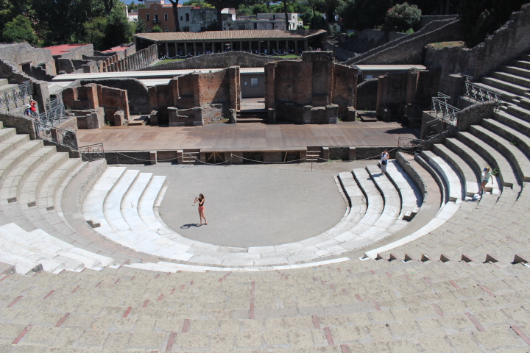
e.g. Marcus Holconius Rufus
- sacerdos and flamen
- restoration of the theatre, addition of marble facing, tribunal, scaenae frons – from Hellenistic to Roman Theatre
- similar to Augustus in Rome – city of wood to city of marble
- 1 BC – 14 AD – inscription emphasizing the emperor’s title as pater patriae and himself as patronus coloniae –a position analog to Augustus

Slide 24
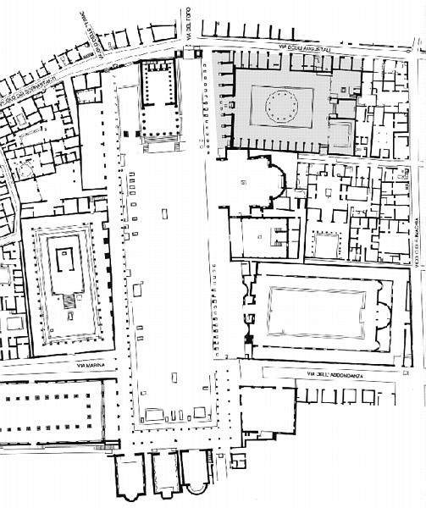
Topography:
Northern side – the temple and two arches
The temple of Jupiter – etrusco-italic style – high podium, hexastyle Corinthian, deep pronaos, interior – ionic colonnade, 3 vaulted chambers, Capitoline cult
Approach – two narrow staircases flank rostrum, altar in the middle, equestrian statues
It was damaged during the earthquake, never fully restored, the cult statue probably stored elsewhere
Eastern side and the centre
Macellum
Lararium (Lares Publici)
The Temple of Vespasian
The building of Eumachia
The centre
- base of an altar (didn’t belong to the temple – had one), possibly – to the imperial cult
Western side
noticeable smaller bases – the notables of the city
the Sanctuary of Apollo is one of the oldest cult places in Pompeii, from the 6th century BC, the north of it
market building – symmetry to the Macellum
South side – in the middle arched monument, which might have supported a bronze quadriga, square bases, in the axis – equestrian statue – represented members of the imperial family

Slide 25
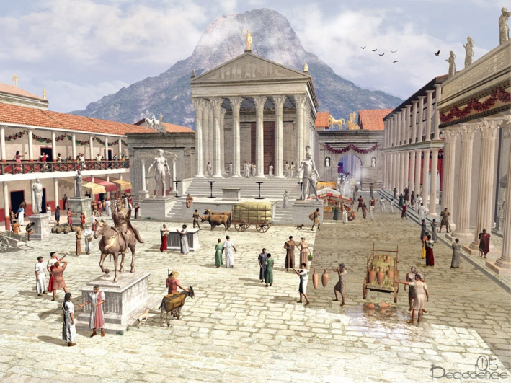
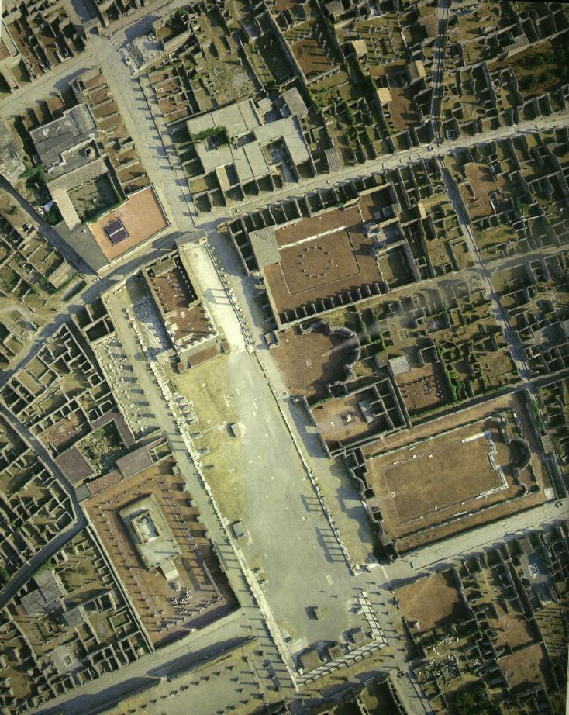
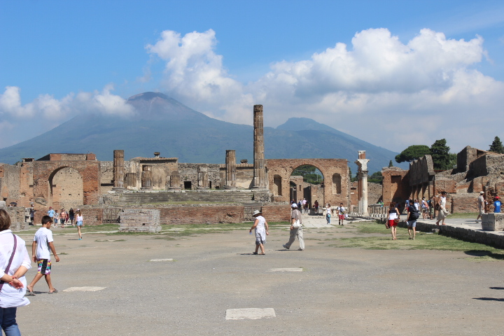
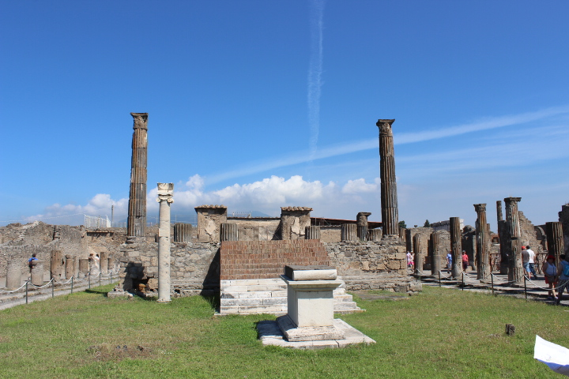

Slide 26
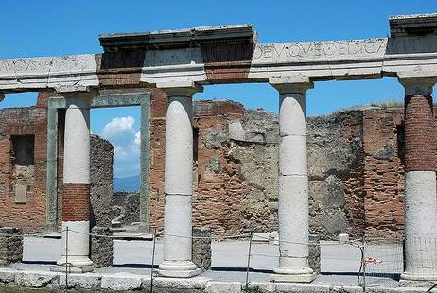
The Eumachia building
wealth of architectural, sculptural and epigraphic evidence
Date: the reign of Tiberius or Augustus (late Augustan)
Size: 67 x 40 m, travertine
Function: market for wool or clothing in general, luxury goods, slave market – multipurpose building
Patron: Eumachia (public priest), daughter of Lucius Eumachius, with her son Marcus Nemistrius Fronto
- dedicated the structure to display prominence while honoring Imperial Rome
at her own expanses, with her son – building consecrated to the Augustan Concord and Piety
structural resemblance to the Porticus of Livia – double porticoes, rectangular, dedicated with son (Tiberius) – local counterpart to Livia
Inscription on the frieze, above the columns

Slide 27
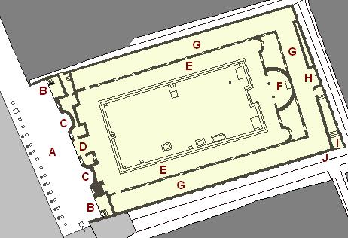
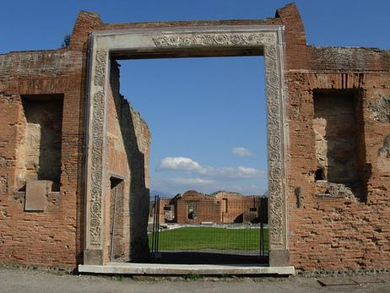
3 parts:
Chalcidium – between forum and colonnade (A)
Porticus – interior colonnade (E)
Crypta – covered corridor behind the interior colonnade (G)
Chalcidium
articulated façade to the forum
curved (C) and rectangular exedrae (B) (the latter with podia with stairs – auctions or speeches) and sculptural niches – flank the main portal
- long series of bases for statues – gallery of honorary statues
entrance (D) – acanthus scrolls - similar to Ara Pacis
on the right – porter’s lodge – 3rd style wall painting – entrance to the portico
on the left – service passage to the Sanctuary of Augustus
Statues: Aeneas and Romulus (similar to Augustus Forum) – Augustan program or Pompeian analogy of local summi viri

Slide 28


Porticus (E)
- surrounds an open-air court – eastern end - apse flanked by two smaller apses (exedrae)
Statue(s) : fragments found – a statue of Livia, sides – Concordia and Pietas
Crypta (G)
3 entrances – 2 western ends, 1 south-eastern entrance
- central eastern part (H) – the statue of Eumachia – priestess, velato capite, idealized face, late Classicism – Augustan period
ample windows with low marble sills and shutters connected the crypta and porticus, so the crypta was adequately lighted
possibility to shut the windows
and all the entrances
- small gardens behind
the cultic apses

Slide 29



The Temple of Vespasian
The Sanctuary of Augustus
Problem with datation: generally known as the temple of Vespasian, but
a) court (B) – inscription (unidentified few years ago) – dedicated by Mamia (Priestess Mamia – lived at the age of Augustus – couldn’t dedicate to Vespasian)
b) fits to the model of elite patronage, dedicated to the Genius of Pompeii or Augustus
c) technical analysis of the
building techniques and
materials – Augustan date
Temple (D,E)– two lateral staircases
– similar to the Venus Genetrix and
Divus Iulius (unusual feature),
remains of the base for a cult
statue in the back of cella
The sacred space defined by an precinct wall, an ample entrance (A),inside a covered (?) vestibule (B), the main space – open court (C) and temple against the rear wall (D,E), an altar in front of the temple, east of the court, 3 service rooms (F, G, H)

Slide 30





Marble altar
Main panel – Augustan period – hooded figure sacrificing a bull at an latar (Augustus, flamen Augusti – Marcus Holconius Rufus
presence of the sun – takes place in summer temporary movable tripod altar, imply the ceremony – dedication of the temple – before the present altar probably on the imperial anniversary (August 1st – conquest of Alexandria, 23rd September – birthday)
Two smaller panels – sacrificial imagery – acerra, lituus, patera, oinochoes, crops sacrificies
The back panel - laurel trees, corona civica – Augustus’ attributes

Slide 31


Lararium
The sanctuary of Lares Publici
probably later than Augustan Era but earlier than the earthquake 62 AD
- marble pavement still in situ
- discussions – roofed or not?
- statues depicting members of the Imperial family
- altar in the middle (D) – sacrifices to Lares of the city and the Imperial house
- the architectural design begins with Nero’s Domus Aurea

Slide 32


one large apse (B) -accommodated at least 9 statues probably set between columns
two large lateral exedrae (C) (each exedra – base for a statue and footings of two columns which screened its entrance)
- integral part (A) – eight large columns – forum colonnade and façade colonnades

Slide 33

Macellum
Date: 30s or 40s AD - later than The Sanctuary of Augustus and The Building of Eumachia
Function: traditionally identified as a market place, but recently – change – a multicultural place
Problem: is market a right place for the imperial cult?
- formerly - markets dedicated to Mercurius (the god of trading), in the market – the emperor (deus praesens) providing order in economic transaction
- demonstrated a connection to Imperial Rome,
Monumental entrance – statue bases, an aedicula (a temple-like statue niche) flanked by shops and/or offices leads to once colonnaded interior

Slide 34



- colonnaded entrance (A) in front of the entrance (B) - aedicula – a statue niche, I and J – other entrances
- internal colonnade surrounding the main court (C)
shrine (E) – base for the main statue, 2 niches in each side wall
2 statues excavated in the southern wall – identity in doubt – members of the imperial family,
fragment of a statue – larger than a life-size – a left hand clutching a globe, a statue of an emperor – on the base
two large rooms:
D – shop selling meat and fish (counter along three sides of the room)
F – room for sacrificial banquets – low altar
- southern side – shops
- in the center - a pavilion supported by 12 bases (H), fish were sold here
- northern space – religious (meetings of a cultic corporation) and feasts

Slide 35



The temple of Fortuna Augusta
Dedicated to the emperor’s worship
Sponsor: Marcus Tullius, M. fillius,
“Marcus Tullius the son of Marcus, duumvir with judiciary authority for the third time, quinquennial duumvir, augur and military tribune by the choice of the people, erected this temple to Fortuna Augusta on his own ground and at his own expense.”
Location: north of the forum
Material: travertine, covered with marble

Slide 36

Augustus’ successful return from east and west – altars and temples dedicated to Fortuna Redux
Unclear why not in the forum:
not a place
too much?
Other buildings already concieved
sponsor and the architect – aware of the trends in Rome
Podium and altar (A) – model of early Augustan temples in Rome, cella (C, D) (alongside niches for statues of the sponsor, his family, members of the imperial family)
- the emperor here only synnaos (who shares the cella) – thus private sponsor became synnaoi of the emperor

