Slide 1
Cantonese II
Week 1

Slide 2
Nei5 sem break zou6 zo2 di1 me1 aa3?
你sem break做咗啲咩呀？
What did you do during semester break?

Slide 3
What to expect in Cantonese II?
Interact more in Cantonese
More practice

Slide 4
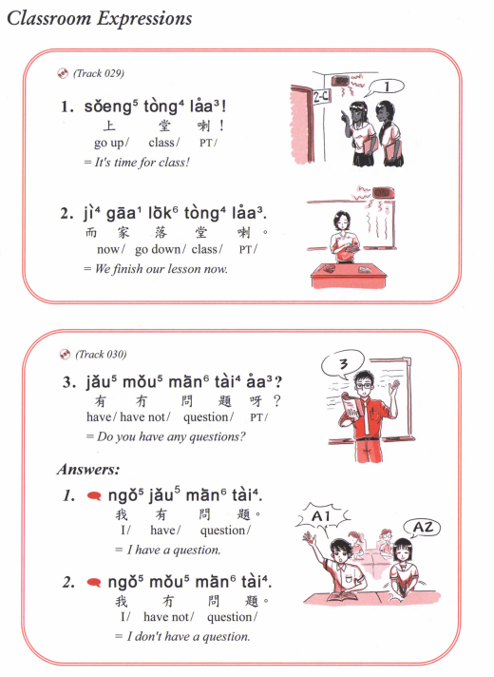

Slide 5
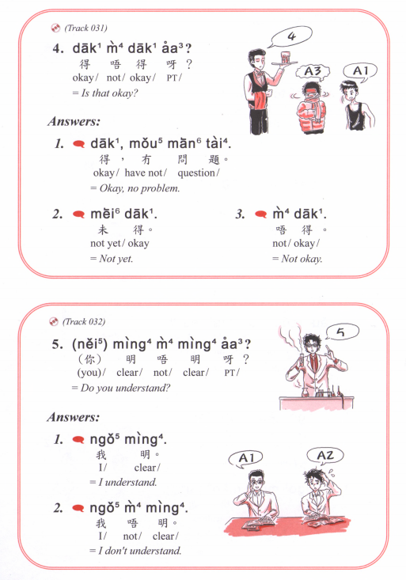
Dak1 mei6 aa3?
得未呀？
Is it ready yet?

Slide 6
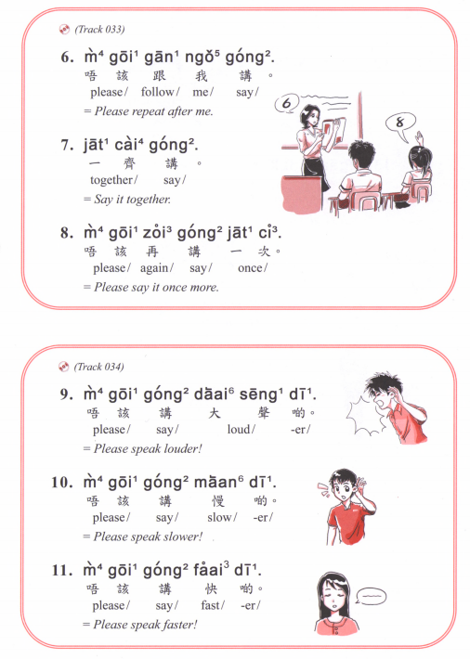

Slide 7
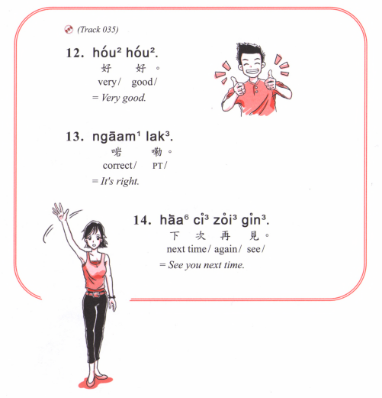

Slide 8
My bill, please | 埋單 | maai4 daan1 | to buy eggs | 買蛋 | maai5 daan2
culture | 文化 | man4 faa3 | to smell flowers | 聞花 | man4 faa1
cigarette lighter | 打火機 | daa2 fo2 gei1 | beat up the waiter | 打伙記 | daa2 fo2 gei3
hungry | 肚餓 | tou5 ngo6 | diarrhoea | 肚屙 | tou5 ngo1
summer holiday | 暑假 | syu2 gaa3 | book shelf | 書架 | syu1 gaa2
charity | 慈善 | ci4 sin6 | crazy | 黐線 | ci1 sin3
Brother | 哥哥 | Go4 go1 | That one | 嗰個 | Go2 go3
A box of | 一盒 | Jat1 hap6 | One box | 一個盒 | Jat1 go3 hap2
To be | 係 | hai6 | At | 喺 | hai2
Lazy | 懶 | laan5 | Rotten/ broken | 爛 | laan6
To know | 識 | Sik1 | To eat | 食 | sik6
Handsome guy | 靚仔 | Leng3 jaai2 | Young boy | 𡃁仔 | Leng1 jaai2
Wet market | 街市 | Gaai1 si5 | Chicken faeces | 雞屎 | Gai1 si2
Soup | 湯 | tong1 | Sugar/candy | 糖 | Tong4 / tong2

Slide 9
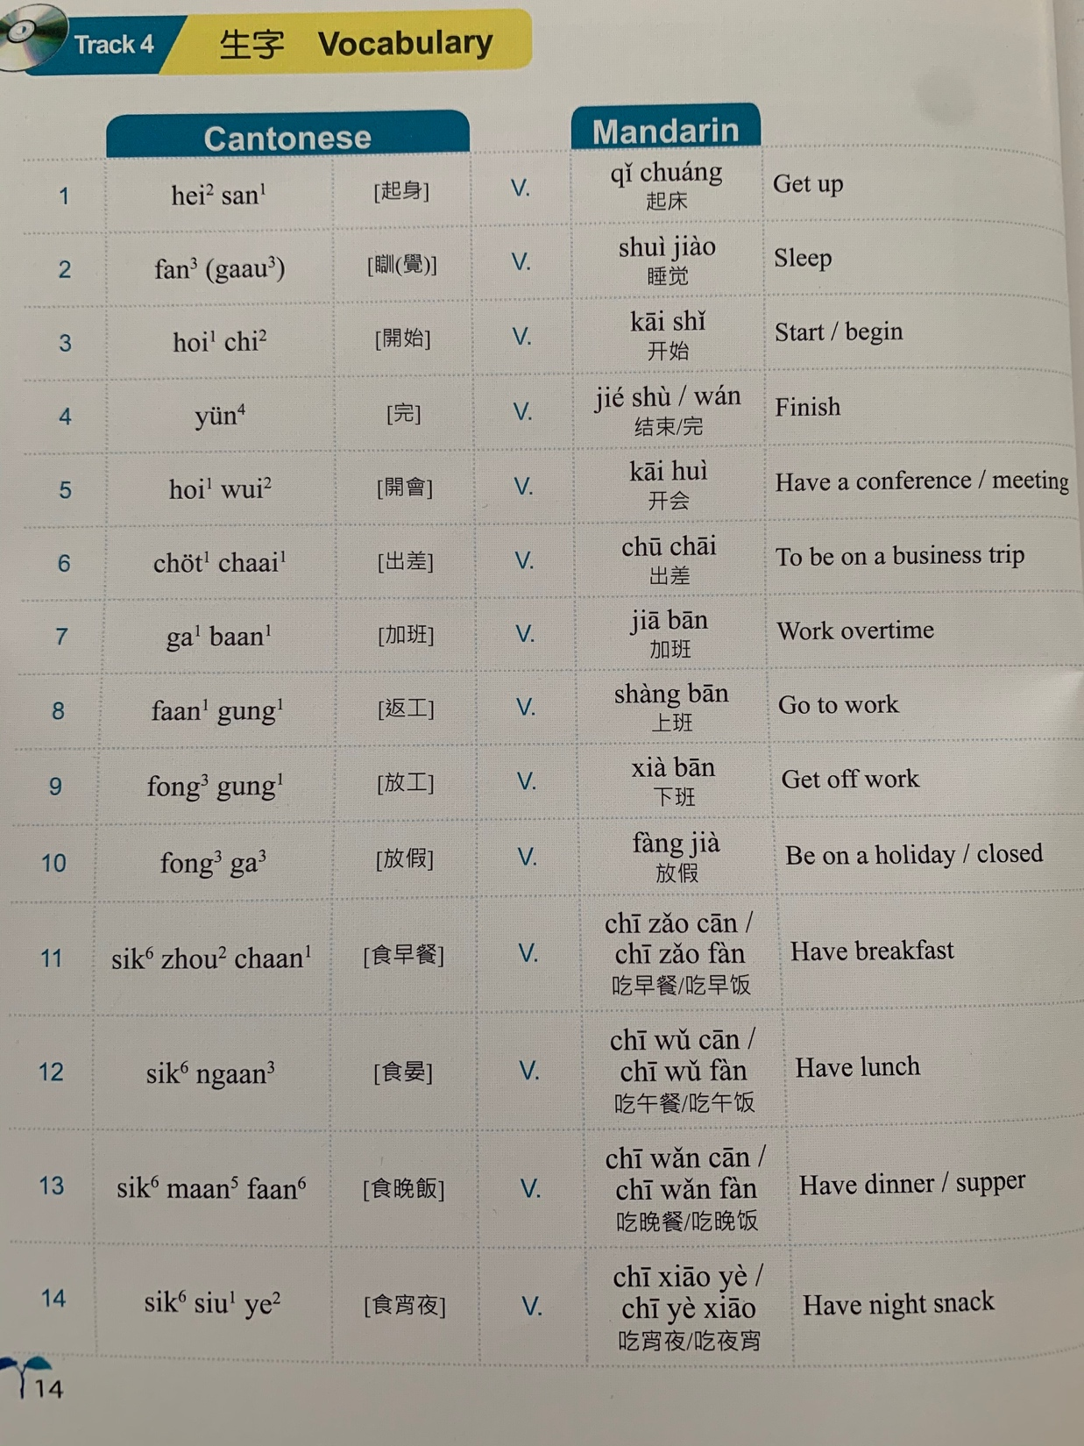

Slide 10
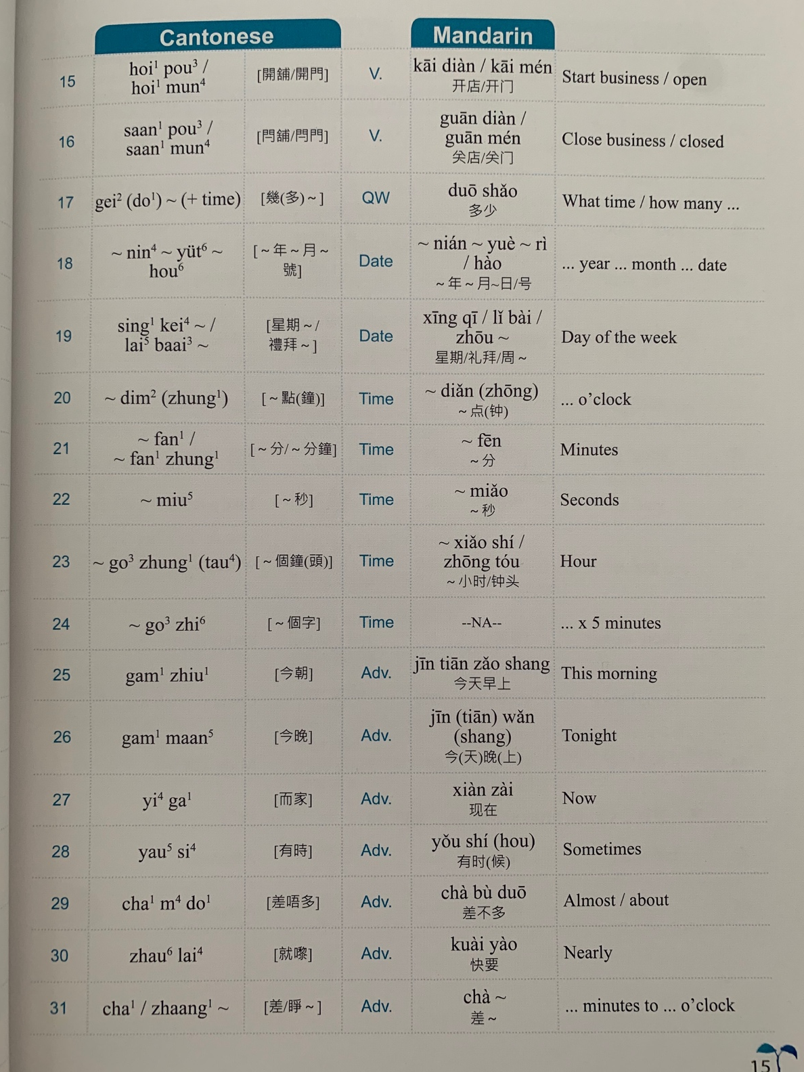

Slide 11
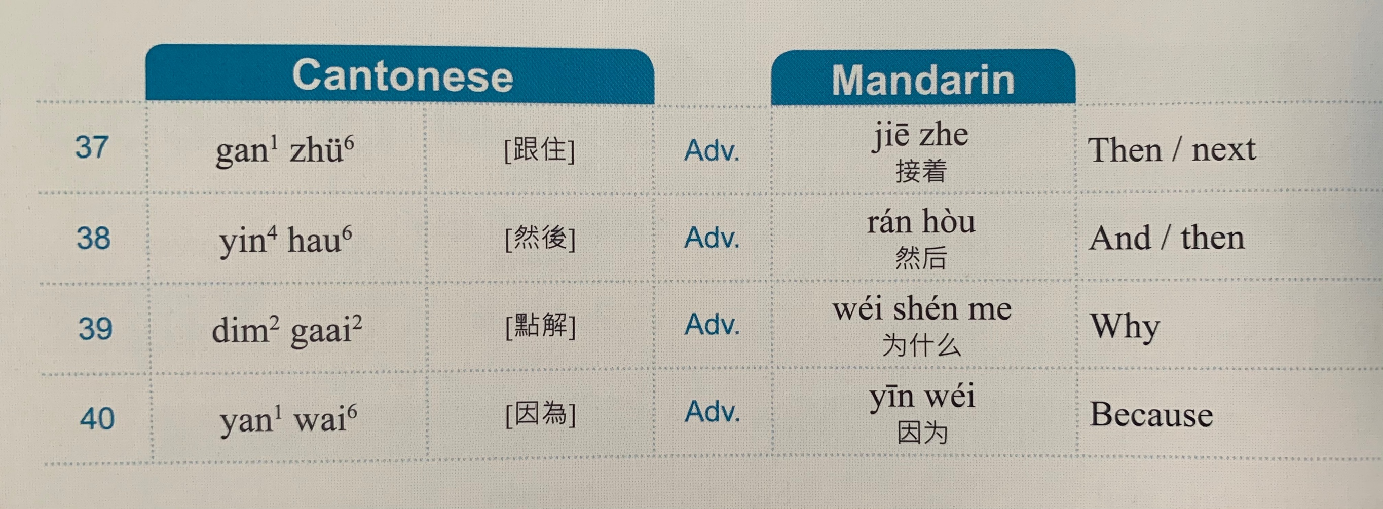

Slide 12
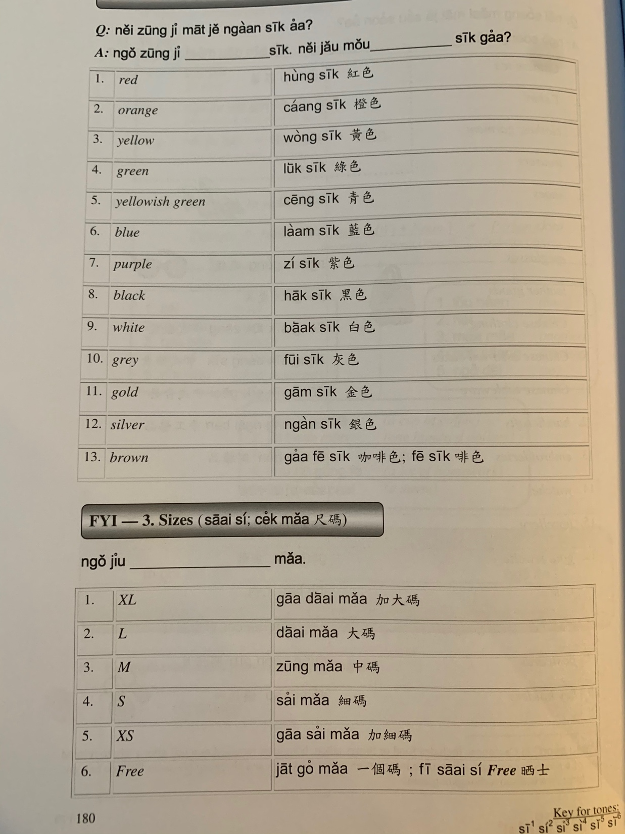

Slide 13
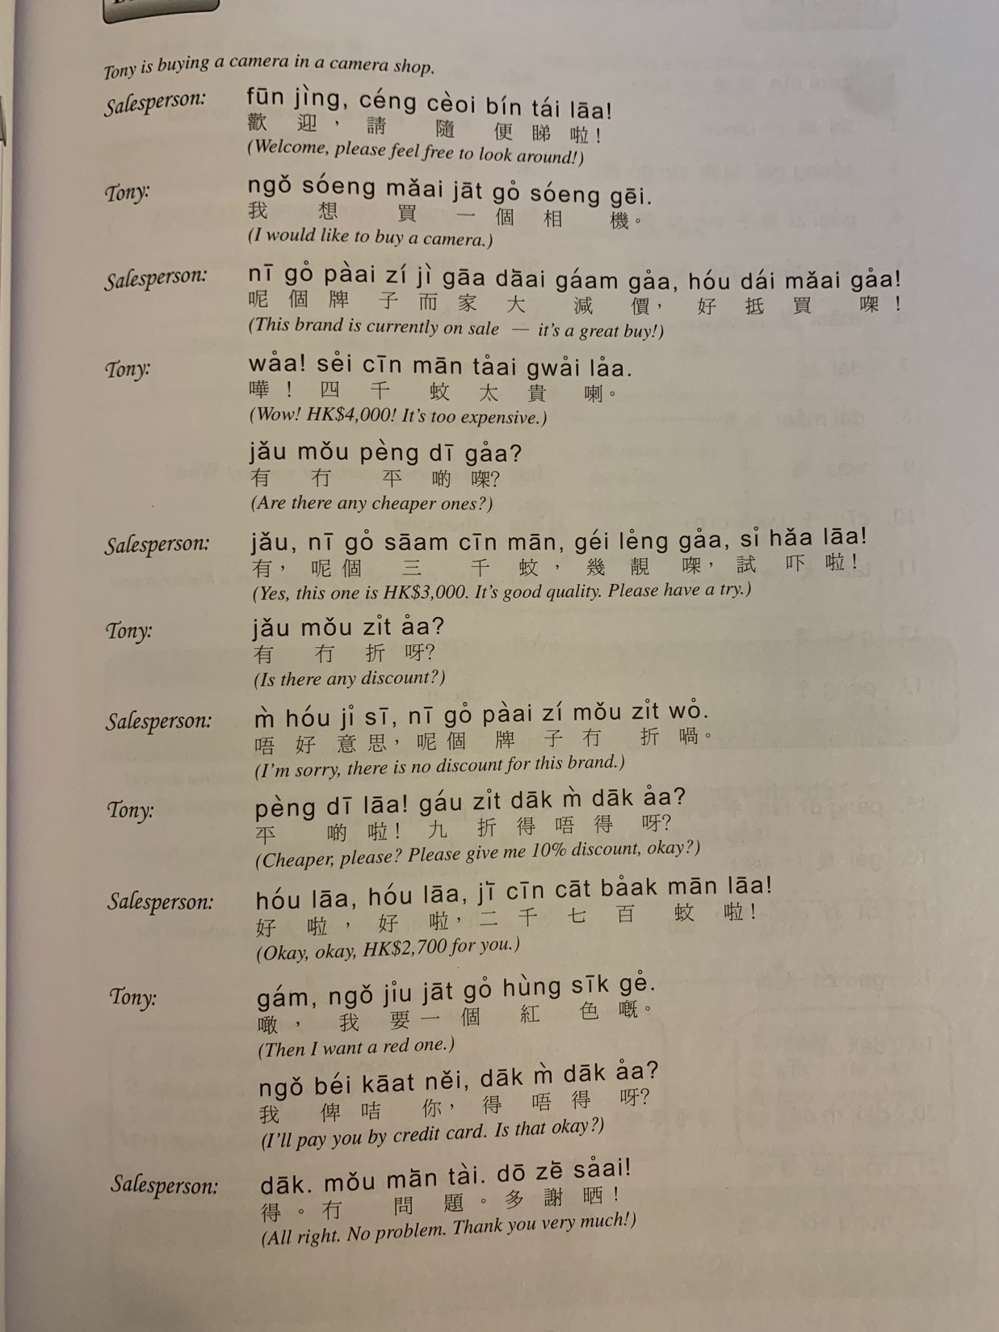

Slide 14
Particle | Jyutping | Usage | Example
呀 | aa3 | Used in neutral questions. Also used to soften the tone of affirmative statements so they don't sound as abrupt. | Nei5 heoi3 bin1aa3? 你去邊呀? Where are you going? Ngo5 faan1 uk1 kei2 aa3. 我返屋企呀 I'm going home.
嘅 | ge3 | Used in assertions where something is emphasized (usually 係 hai6 is in front of what is being emphasized). Pronouncing it as ge2 adds a sense of puzzlement about the situation. This is equivalent to the Mandarin/written Chinese 的 dik1. | Ngo5 hai6 gam1 jat6 faan1 uk1 kei2 ge3. 我係今日返屋企嘅 I'm going home today. (the "today" is emphasized)
㗎 | gaa3 | Contraction of the combination 嘅呀 ge3 aa3. Can be used in question and answer. | 你係幾時返來㗎? When are you coming back? (the "when" is emphasized) Use for defending your argument or emphasis. Stronger than嘅ge3. Hai6 ngo5 gaa3! 係我架! It’s mine!
啦 | laa1 | Used in requests and imperatives. This is one particle where leaving it out could make the sentence sound rude. This is equivalent to the Mandarin/written Chinese sentence final 吧 baa6. | Bei2 ngo5 laa1 畀我啦 Give it to me [please].
啫 | ze1 | Can be used to mean "only" or "that's all," or used to play down the significance of the situation. | Keoi5 faan1 yat1 yat6 ze1 佢返一日啫 He's only coming back for one day.

Slide 15
keoi5 faan1 zo2 uk1 kei2 佢返咗屋企 ("He went home")
佢返咗屋企 aa3 呀 – (informing the listener) “He went home!”
佢返咗屋企 laa3 喇 – (informing the listener) “He already went home!”
佢返咗屋企 wo3 喎 – “Oh… He already went home though.”
佢返咗屋企 gwaa3 啩 – (with uncertainty) “He went home, I guess”
佢返咗屋企 me1 咩? – “Oh, he went home?”
佢返咗屋企 lo1 囉 – (with emphasis) “He went home already.”
佢返咗屋企 laa3 maa3 啦嘛 – “He went home already! (so he can’t be here right now)”

Slide 16
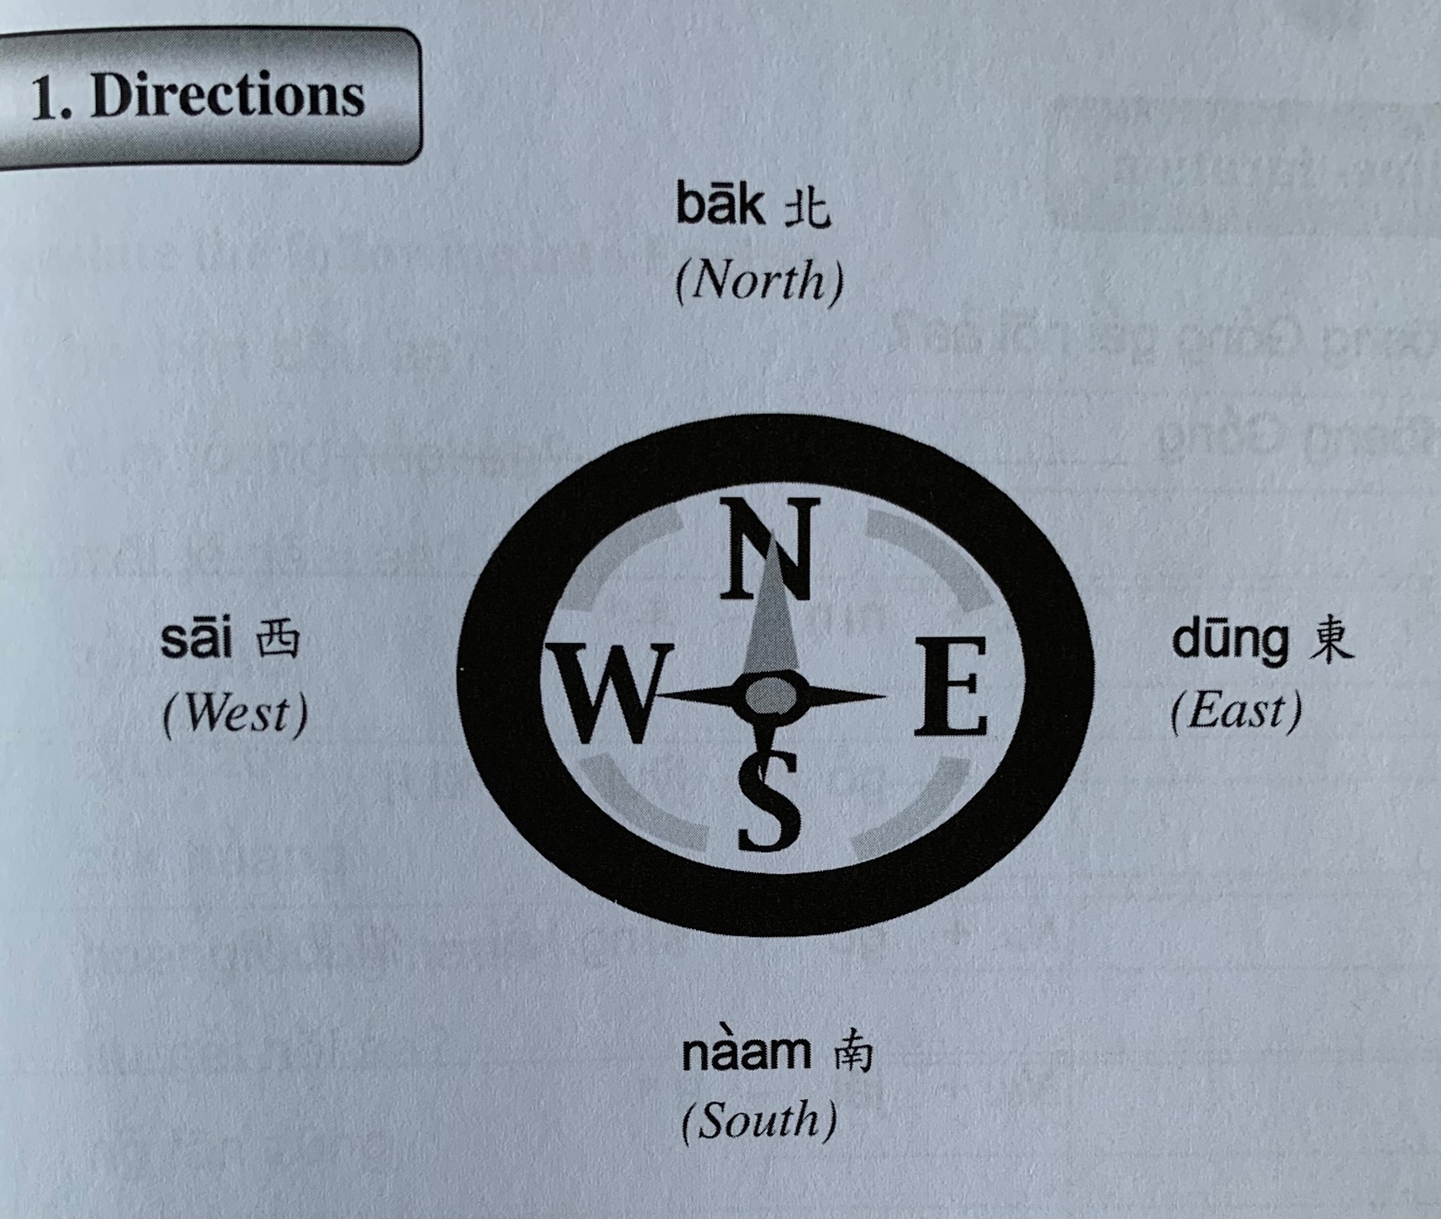

Slide 17
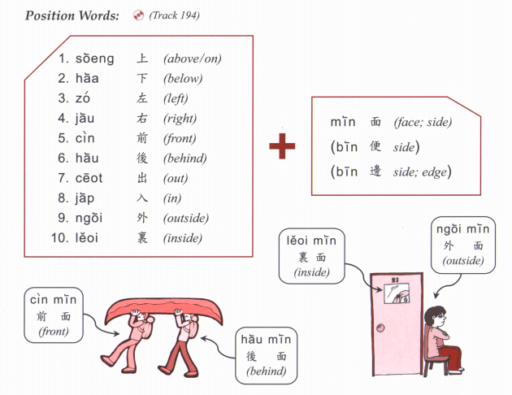

Slide 18
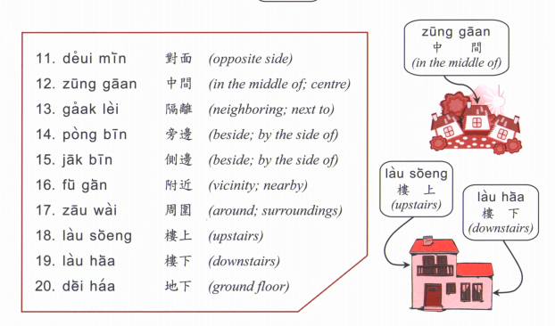

Slide 19
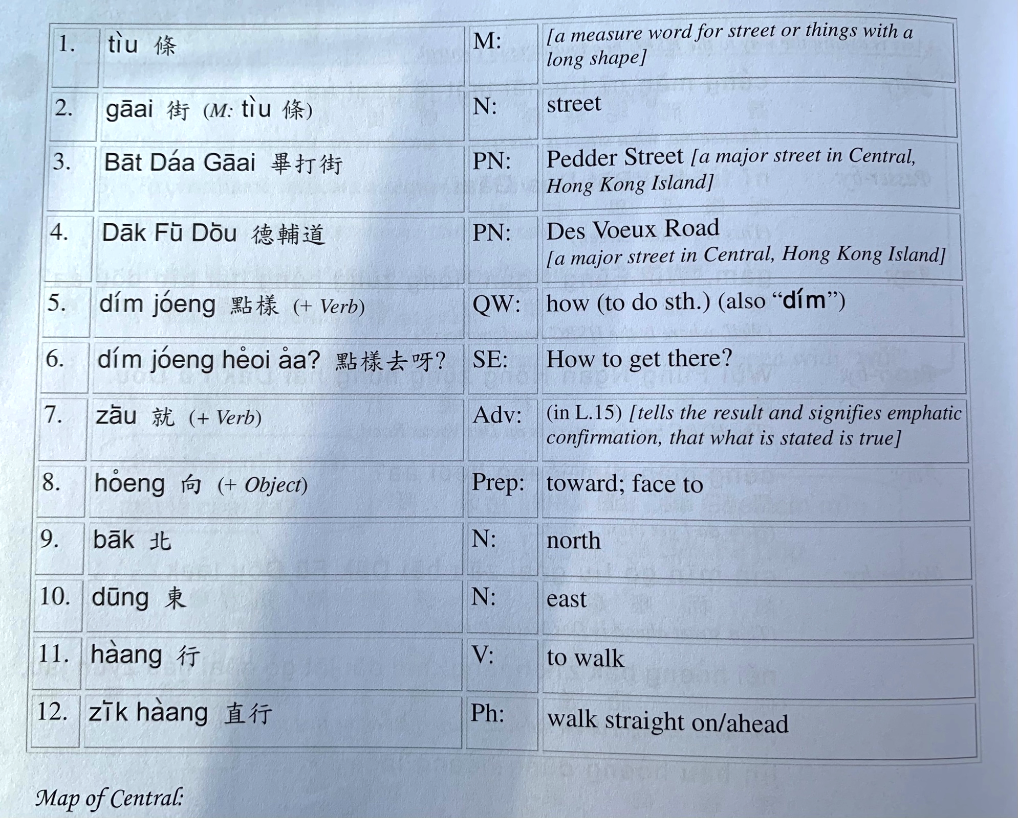

Slide 20
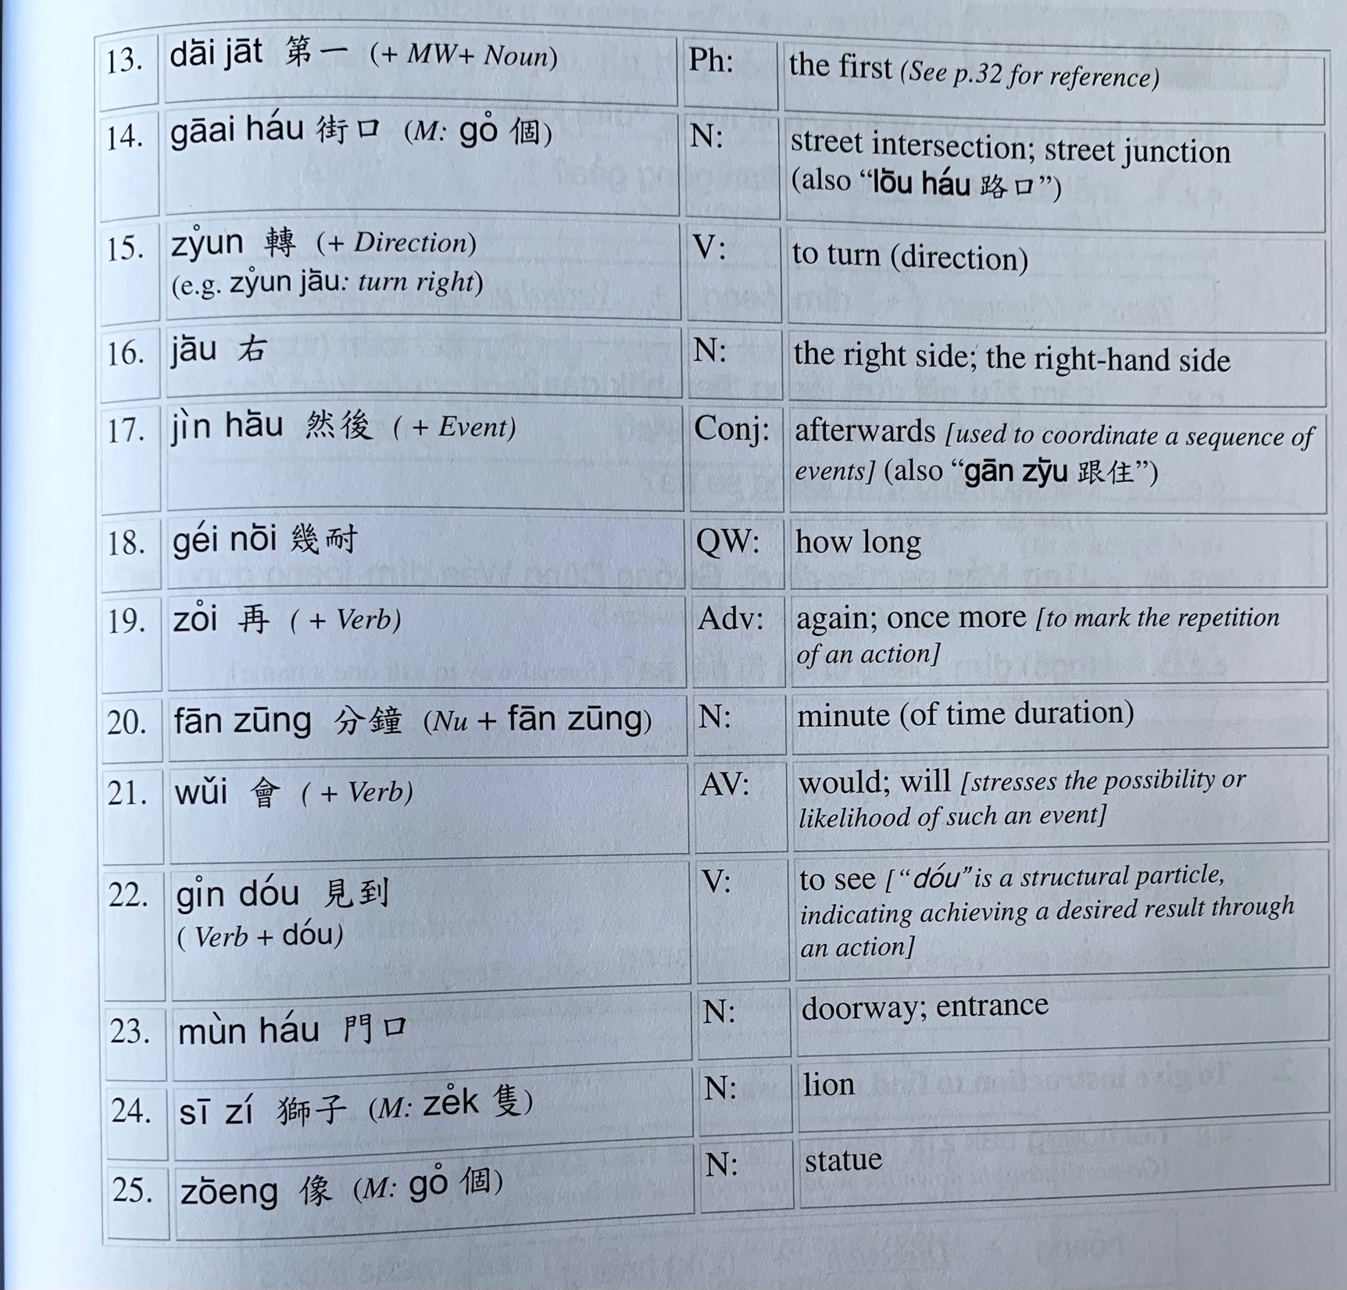

Slide 21
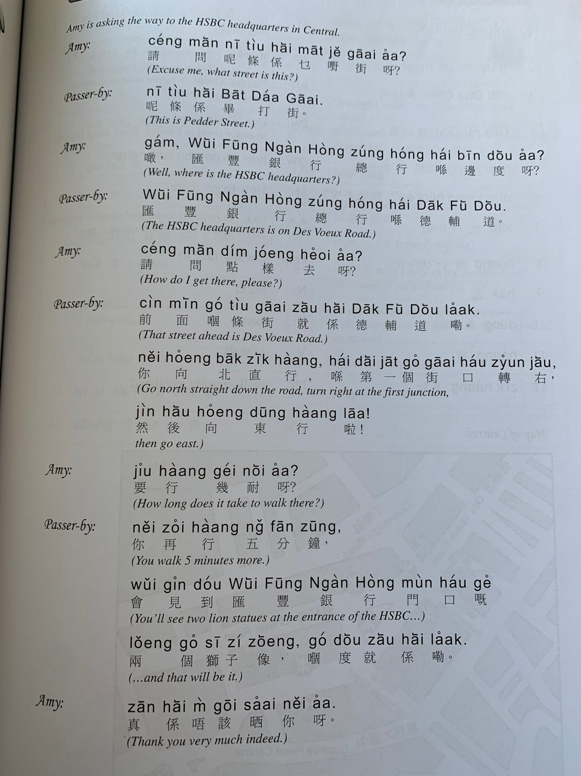

Slide 22
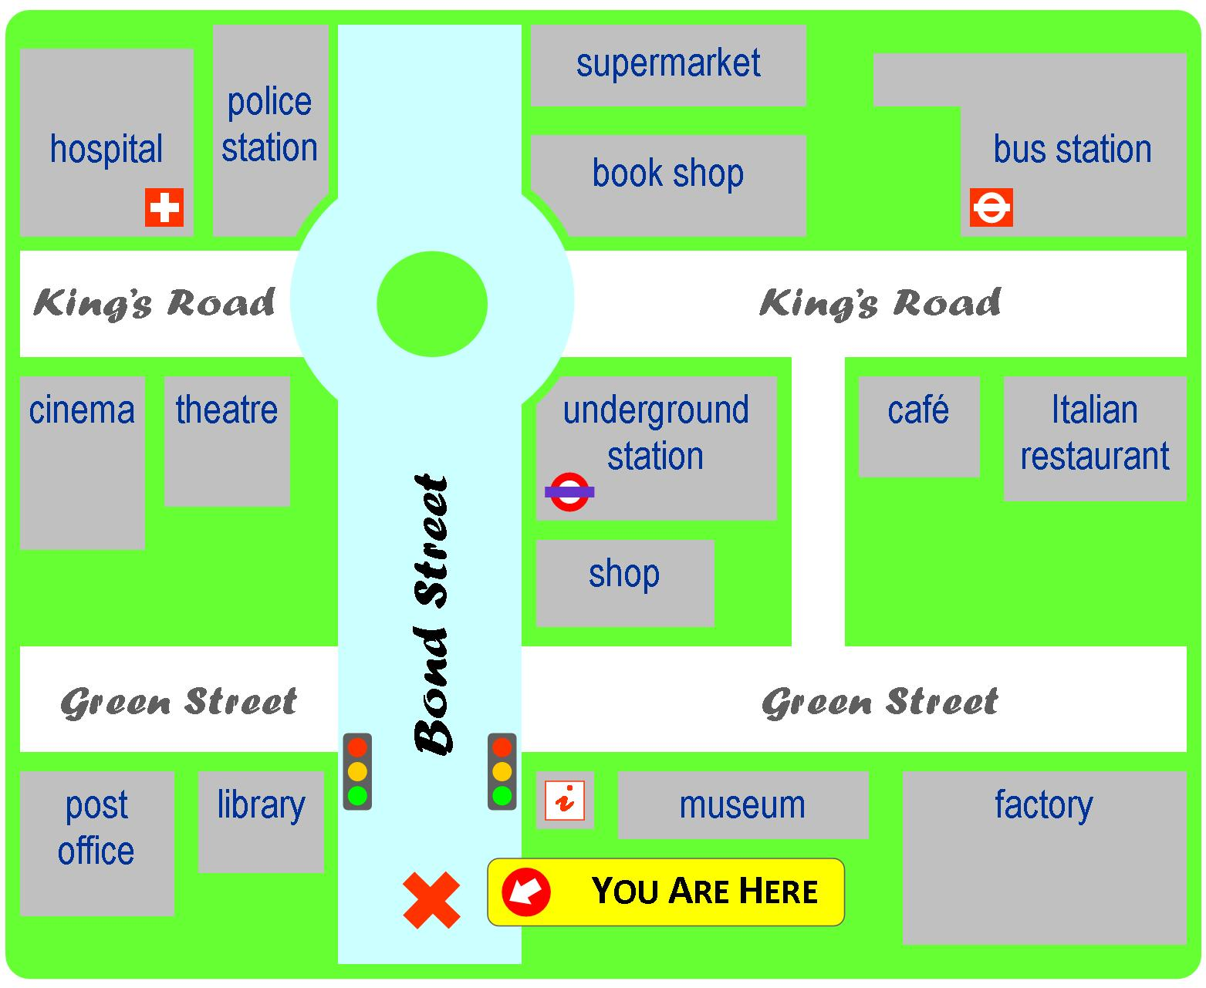
Yi1 jyun2
Ciu1 kap1 si5 coeng4
baa1 si2 zaam6
ging2 guk6
syu1 guk2
dei6 tit3 zaam6
hei3 jyun2
kek6 coeng4
gaa3 fe1 teng1
caan1 teng1
soeng1 dim3
hung4 luk6 dang1
bok3 mat6 gun2
Tou4 syu1 gun2
gung1 cong2
jau4 guk2

