Slide 1
Sigrid Undsetová známá i neznámá
Romány o středověku
jako texty o současnosti?

Slide 2
Historické romány
Walter Scott Waverley 1814
Victor Hugo
Henryk Sienkiewicz Quo vadis 1895
Václav Beneš Třebízský Královna Dagmar
Alois Jirásek Psohlavci 1884
Lion Feuchtwanger
Johannes V Jensen
Mika Waltari
Ken Follett

Slide 3
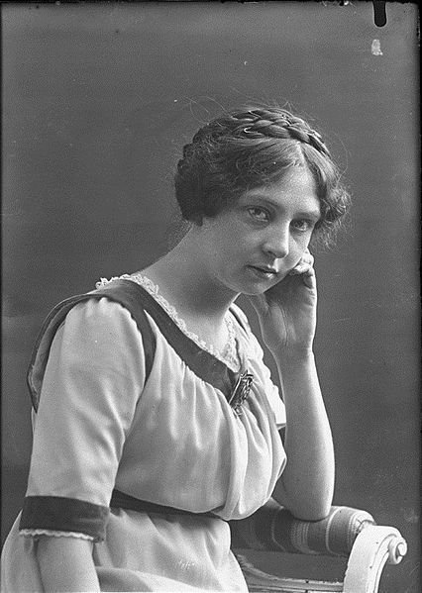
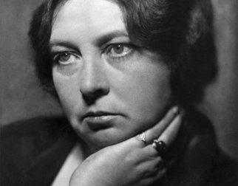
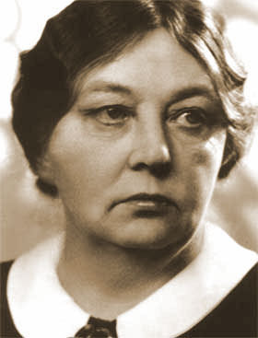

Slide 4
SU: første selvpresentasjon (1909)
Middelalderens stil er ikke den størknede skorpe om et avdødt tankeliv. I islandske sagaer, i danske ridderviser, i tysk minnesang, har de menneskelige følelser og tanker, som er til alle tider, fått fast og konsis form og kunstnerisk uttrykk.

Slide 5
From Margaret Atwood Masterclass
Elements of Historical Fiction
Setting: The setting is the most important part of a historical fiction novel. It should take place during an authentic period in history and be set in a real historical place. For example, New York City during the Great Depression or Paris, France during World War II.
Plot: The plot in a historical fiction novel is a combination of real events and fictional events. You can invent characters, cities, and events, but they still must make sense to the time period. For example, a novel set in London, England in 1666 would benefit from incorporating the Great Fire of London, a major turning point in the city’s history.
Characters: The characters can be real, fictional, or both, but they should all look, speak, and act in ways that accurately reflect the era. For example, if you are writing a book about Mary Tudor, it shouldn’t disregard or reinvent her family history as the daughter of Henry VIII and sister to Elizabeth I, who both played an important role in Mary’s reign.
Dialogue: The dialogue must be authentic to the time period and should reflect the status of the characters who are speaking. For example, British soldiers in the Revolutionary War wouldn’t use Western slang of today.
Conflict: The problems the characters encounter should be conflicts people of that era would encounter. For example, your book might describe the hesitation and fear German soldier feels as he is to the Eastern Front, where he knows he is likely to die.

Slide 6
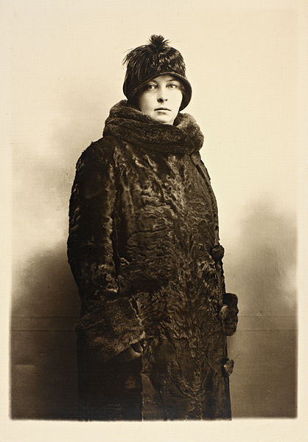
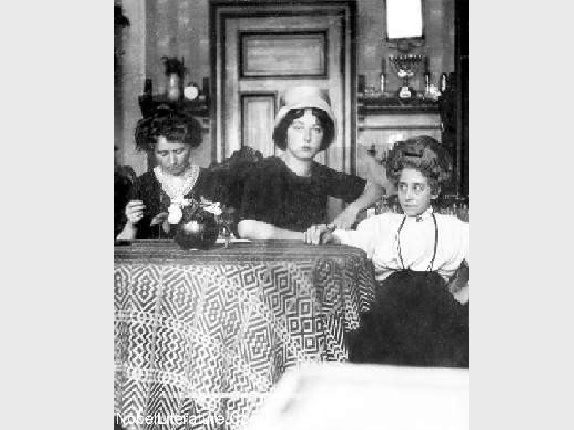

Slide 7
Undset:
Man kan jo bare skrive romaner fra sin samtid.

Slide 8
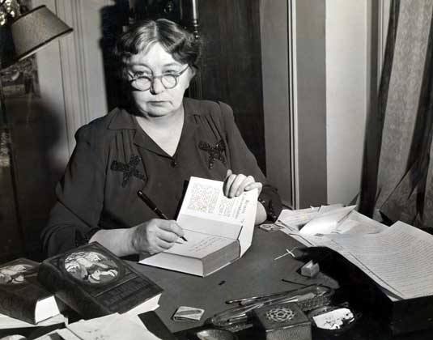
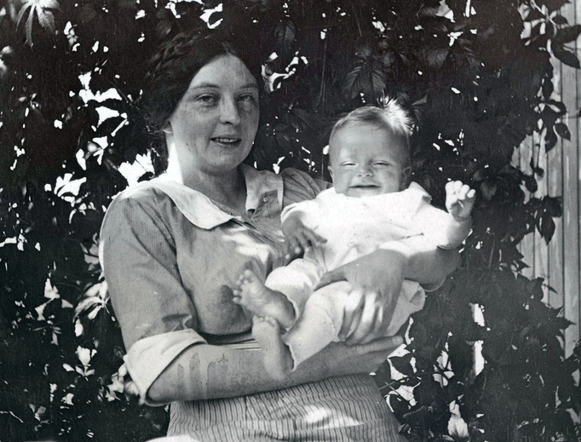
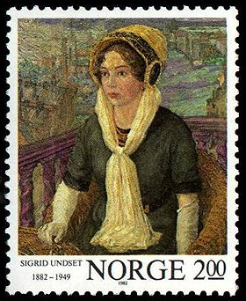
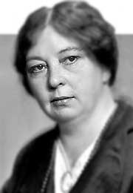

Slide 9
Kristin Lavransdatter 1920 - 22
Kransen
Husfrue
Korset

Slide 10
Olav Audunssøn
I. Olav Audunssøn i Hestviken (1925)
Olav Audunssøn gifter seg
Ingunn Steinfinnsdatter
Olav Audunssøns lykke
II. Olav Audunssøn og hans barn (1927)
1. Veiskilet
2. Ødemarken
3. Vinteren
4. Hevnersønnen

Slide 11
autobiografie
Elleve år 1934
inneholder Sigrid Undsets barndomserindringer fra oppveksten i Kristiania. Her kaller fortelleren seg Ingvild, et navn hun velger for å vise sin kjærlighet til faren, arkeologen Ingvald Undset, som ble syk og døde på den tiden hun skriver om.
Tolv år 1998

Slide 12
Tilbake til fremtiden
New York (Knopf) 1942: Return to the Future
Rio de Janeiro 1942: portugalsky
švédsky 1943
dánsky 1943 v ilegálním tisku
německy ve Švýcarsku 1944
islandsky 1944 (po získání nezávislosti)
francouzsky 1947
turecky 1953
norsky? 1945 X 1949

Slide 13
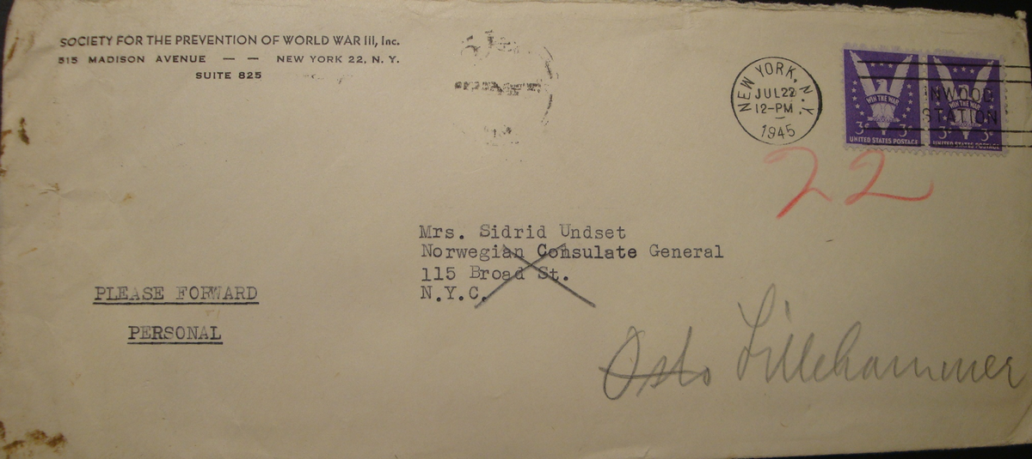

Slide 14
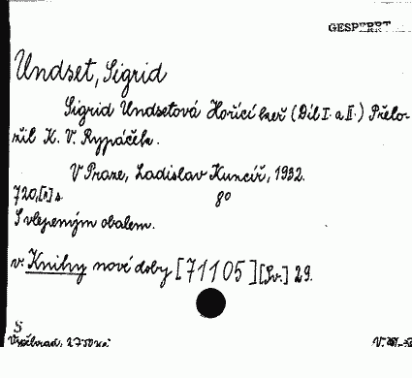
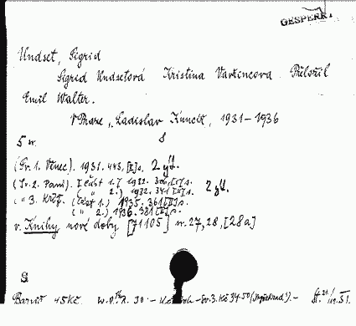

Slide 15
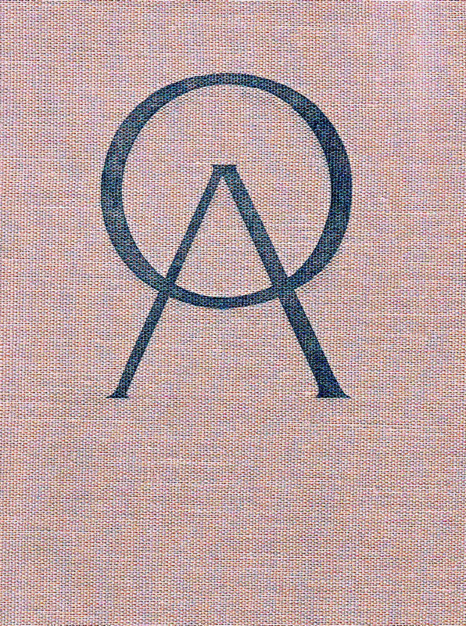
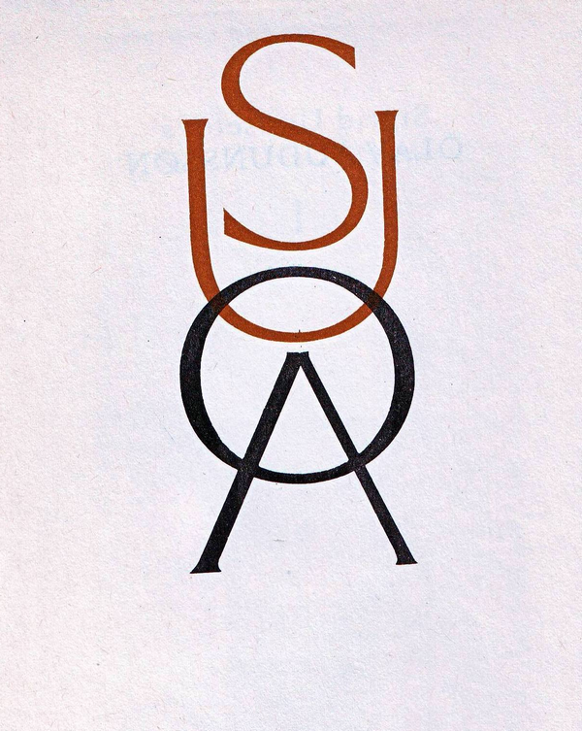

Slide 16
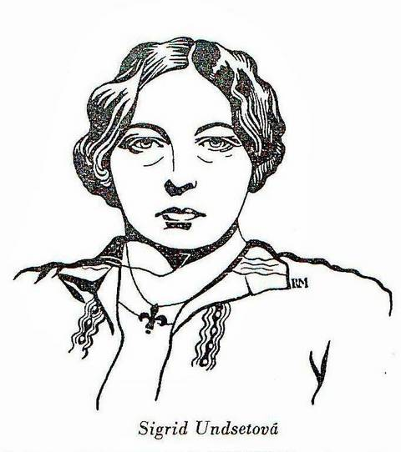

Slide 17
SU
Tsjekkiske oversettelser
1929: Våren (Rypáček/Kuncíř)
1931: Gymnadenia (Rypáček/Kuncíř)
1931: Kransen (Emil Walter/Vyšehrad)
1932: Den braennende busk (Rypáček/Kuncíř)
1932: Simonsen (Walter/A. Synek)
1932: Husfrue (Walter/Kuncíř)
1932: Kransen (Walter/Vyšehrad)
1932: Husfrue (Walter/Vyšehrad)
1933: Jenny (Kosterka/Kuncíř)
1935: Korset (Walter/Vyšehrad)
1935: Olav Audunsson I. – IV. (Kosterka/Vyšehrad)
1936: Korset (Walter/Vyšehrad)
1936: Vaaren (Rypáček/Vyšehrad)
1937: Ida Elisabeth (Rypáček/Vyšehrad)
1939: Den trofaste husfru (Vrtišová/Vyšehrad)
1939: Thjodolf (G. Pallas/Družstvo Máje

Slide 18
1945-1948
1946: Madame Dorthea (Vrtišová/Katolický literární klub)
1946: Vaaren (Rypáček/Vyšehrad)
1946: Ida Elisabeth (Rypáček/Vyšehrad)
1947: Jenny (Kosterka/Vyšehrad)
1947: Den trofaste hustru (Walter/Vyšehrad)
1948: Kristin Lavransdatter (Pollák/Vyšehrad)
1948: Den braennende busk + Gymnadenia (Rypáček/Vyšehrad)

Slide 19
SU 1948-1989
1963: Kristin Lavransdatter (Chvojková-Pallasová/Lidová demokracie)
1972: Jenny (Kosterka/Lidové nakladatelství)
1976: En fremmed, Fru Waage, Gunvold og Emma. In: Byla jsem nevěrná (Vrtišová/Lidové nakladatelství)
1977: Kristin Lavransdatter (Vrtišová/Kejzlar/Lidové nakladatelství)
1982: Olav Audunssøn (Köllnová-Ehrmannová/Vyšehrad)
1987: Fortellingen om Vigaljot og Vigdis (Köllnová/Odeon)
1988: Vaaren (Köllnová-Ehrmannová/Vyšehrad)
1990: Lykkelige dager (Köllnová-Ehrmannová/Vyšehrad) Šťastné dny

