Slide 1
Yery Kim
Myeng wha Kim
Korean class week 6
Notes:
Hello welcome to todays Korean class. And we will begin.

Slide 2
Index
Endings – Sentence Final endings
Past tense marker -Subtle differences
Double past tense marker
4. Today’s word
5. Today’s conversation
6. Korean culture
Notes:
Today we will be learning about the sentence final endings, the subtle difference of the past tense marker and move on to the double

Slide 3
1. Endings - Sentence final endings
Sentence final endings
: The typical examples of sentence-final endings are various speech-level endings. These speech-level endings indicate the speaker’s interpersonal relationship with the addressees or attitude toward them (e.g., social meanings such as intimacy and formality of the situation).
Notes:
(여기까지 약 6분)
So starting with the sentence final ending, we will be learning 4 types of Korean speech levels.
The deferential speech level is the highest among the four, followed by the polite speech level and Inrimate and plain.
Starting from intimate, which are intimate and plain, there are no honorific meanings within those two.
Each speech level has four endings that shows the type of the sentence which is the declarative which shows the statement, ~~~.
We are going to use the stem word for the Korean word ‘eat’ which is 먹다. So if you want to use the word 먹다 in a sentence we could use it by applying one of the above. The first one is deferential, this is used when you want to say it in the most honorific way,,
When the word ends with the consonant you put it with 으십시오 but when it ends with a vowel you use 십시오. And it is the same in every speech level.
Let us apply four of the endings above to the verb stem 먹[muk] “eat.” When saying “(someone) eats,” one needs to use one of the four interrogative endings (-습니까, -어요, -어, and -냐).
Exercise
Intermideate 부터 honnorific 전혀 없

Slide 4
1. Endings - Sentence final endings
: presentation, official meeting, to customers
Situation examples
*말 놓을까요? [mal noh-eul·kka·yo]
*말 편하게 하세요. [mal pyeon·ha·gae ha·se·yo]
: presentation, official meeting, to customers
: official conversation, to someone older than you, to someone new
: to someone close, when you got permission from someone older
: to someone younger
Notes:
2분 30초 가량 소요. 하지만 가장 안중요한 부분임.

Slide 5
1. Endings - Sentence final endings
앉읍시다[an·jeup·ssi·da]
앉아요[an·ja·yo]
앉아[an·ja]
앉자[an·jja]
Notes:
Propositive is the suggestion.
8분 50초. 9분 가량 소요.
Deferential: 앉읍시다[an·jeup·ssi·da]
Polite: 앉아요[an·ja·yo]
Intimate: 앉아[an·ja]
Plain: 앉자[an·jja]

Slide 6
2. Past tense marker 었, 았 - Subtle differences
ends in a bright vowel
Verb stem + (honorific suffix) + Past tense + speech level ending

Slide 7
2. Past tense marker 었, 았 - Subtle differences
Subtle differences

Slide 8
2. Past tense marker 었, 았 - Subtle differences
바지를 입었어요 [ba ji leul i beo sseo yo]
1) “(I) wore a pants”
2) “(I) am wearing a pants” (As a result of the complete action of wearing pants)
Exercise 3. Look at the following sentence and write two corresponding interpretations in English
커피를 마셨어요. [keo pi leul ma syeo sseo yo]
→ (2) 한국어 수업 숙제를 했어요. [han gug eo su eob sug je leul hae sseo yo]
(I) drank coffee/ (I) am drinking coffee
(I) did Korean class assignment./ (I) am doing Korean class assignment

Slide 9
3. Double past tense marker -‘ 었/았었 [-eot / at eot]’
Verb stem + (honorific suffix) + Past tense + speech level ending
Notes:
So as we just learned, to use the markers we have to put it in the order of the verb stem

Slide 10
3. Double past tense marker -‘ 었/았었 [-eot / at eot]’
In Korean they not only present what it happened in the past, also consider whether an action or event is completed.
-았[at] / 었[eot] + -었[eot]
We can change a past sentence into a double past sentence by adding -었 [eot] to the existing past tense marker -았 [at] / 었 [eot], there is only one word different of their form
Notes:
첫 줄 읽고, so by the past tence we check if it has happened in the past. And on that past tense we could say that what happened in the past has been completely finished by the double past tense marker
And the way we can ~~~ 아래 읽기. 았었까지.
so it would turn out as 았었, 었었 in the sentence which is only one word different of their form

Slide 11
3. Double past tense marker -‘ 었/았었 [-eot / at eot]’
Past tense: 가- + 았 + -다 => 갔다
Double past tense: 갔- + 었 + 다 => 갔었다
Polite speech level: 갔었어요
가
=> Bright vowel
Notes:
This is the list which shows how the marker is placed. So firstly, if we look at the Korean word that means go, it is pronounced as 가자. And to make it into a past tense we can put 었 or 았

Slide 12
3. Double past tense marker -‘ 었/았었 [-eot / at eot]’
Past tense:
어제 학교에 갔어요. [eoje haggyo gass-eoyo] “I went to school yesterday”
Double past tense:
어제 학교에 갔었어요. [eoje haggyo gass-eoss-eoyo]
Notes:
This is the list which shows how the marker is placed. So firstly, if we look at the Korean word that means go, it is pronounced as 가자. And to make it into a past tense we can put 었 or 았

Slide 13
3. Double past tense marker -‘ 었/았었 [-eot / at eot]’
Past tense:
친구가 왔어요. [chinguga wass-eoyo] “A friend came”
Double past tense:
친구가 왔었어요. [chinguga wass-eoss-eoyo]
“ A friend came but is no longer here”
Notes:
This is the list which shows how the marker is placed. So firstly, if we look at the Korean word that means go, it is pronounced as 가자. And to make it into a past tense we can put 었 or 았

Slide 14
3. Double past tense marker -‘ 었/았었 [-eot / at eot]’
Past tense:
피아노 가르쳤어요. [pianoleul galeuchyeoss-eoyo] “I taught piano”
Double past tense:
피아노를 가르쳤었어요. [pianoleul galeuchyeoss-eoss-eoyo]
“ I taught piano but finished./ I used to teach piano ”
Notes:
This is the list which shows how the marker is placed. So firstly, if we look at the Korean word that means go, it is pronounced as 가자. And to make it into a past tense we can put 었 or 았

Slide 15
3. Double past tense marker -‘ 었/았었 [-eot / at eot]’
Past tense:
과제가 있었어요. [gwajega iss-eoss-eoyo] “I had an assignment”
Double past tense:
과제가 있었었어요. [gwajega iss-eoss-eoss-eoyo]
“ I had an assignment long before”
Notes:
This is the list which shows how the marker is placed. So firstly, if we look at the Korean word that means go, it is pronounced as 가자. And to make it into a past tense we can put 었 or 았

Slide 16
3. Double past tense marker -‘ 었/았었 [-eot / at eot]’
Past tense:
디저트가 많았어요. [dijeoteuga manh-ass-eoss-eoyo] “There were many deserts”
Double past tense:
디저트가 많았었어요. [dijeoteuga manh-ass-eoss-eoss-eoyo]
“ There were many deserts but not anymore.”
Notes:
This is the list which shows how the marker is placed. So firstly, if we look at the Korean word that means go, it is pronounced as 가자. And to make it into a past tense we can put 었 or 았

Slide 17
3. Double past tense marker -‘ 었/았었 [-eot / at eot]’
Notes:
This is the list which shows how the marker is placed. So firstly, if we look at the Korean word that means go, it is pronounced as 가자. And to make it into a past tense we can put 었 or 았

Slide 18
3. Double past tense marker -‘ 었/았었 [-eot / at eot]’
았[at]
었[eot]
어요 [eo yo]
았[at]
었[eot]
어요 [eo yo]
좁 + 았[at] + 었[eot] + 어요 [eo yo] = 좁았었어요 [job at sseo sseo yo] “ was narrow”
(2) 받 + 았[at] + 었[eot] + 어요 [eo yo]= 받았었어요 [bad at sseo sseo yo] “received (long before)”
Notes:
좁았다는 just explaining if the road was narrow or not. 좁았었어요는

Slide 19
3. Double past tense marker -‘ 었/았었 [-eot / at eot]’
Past tense : 안경이 깨끗했어요. [an gyeong i kkae kkeu tae sseo yo]
Double past tense: 안경이 깨끗했었어요. [an gyeong I kkae kkeu tae sseo sseo yo]

Slide 20
3. Double past tense marker -‘ 었/았었 [-eot / at eot]’
The double past tense marker 았/었 [at/eot] makes the past action or situation more remote than the regular past tense marker 았/었 [at/eot] does
The double past tense marker indicates that the past event is no longer relevant to the present activity or situation. It indicates that the past action or situation is totally complete.
Ex) 보름달이 뜨다
- 보름달이 떴어요 [bo leum dal I tteo sseo yo]
“The full moon came up” or “The full moon is up”
- 보름달이 떴었어요 [bo leum dal i tteo sseo sseo yo] “The full moon was up (back then)”
Notes:
The double past tense marker 았/었 [at/eot] makes the past action or situation more remote than the regular past tense marker 았/었 [at/eot] does
The double past tense marker 았/었 [at/eot] makes the past action or situation more remote than the regular past tense marker 았/었 [at/eot] does. The double past tense marker indicates that the past event is no longer relevant to the present activity or situation. In addition, it indicates that the past action or situation is totally complete. For instance, consider the following sentence.

Slide 21
3. Double past tense marker -‘ 었/았었 [-eot / at eot]’

Slide 22
Today’s word
안경[an gyeong] n. glasses
깨끗하다[kkae kkeu ta da] v. clean
보름달[bo leum dal] n. full moon
뜨다[tteu da] v. rise
냉장고[naeng jang go] n. refrigerator
싸다[ssa da] v. cheap, inexpensive
비싸다[bi ssa da] v. expensive
팔다[pal da] v. sell
또[tto] adv. again, conj. and
군대[gun dae] n. military, army
휴가[hyu ga] n. vacation, holiday
앞[ap] n. front
Notes:
우리 레벨 업 됐지? 하고

Slide 23
Today’s word
카페[ka pe] n. cafe
수다[su da] n. chat
얘기[yae gi] n. story, conversation
때[ttae] n. time, the moment
참[cham] adv. really, truly, very
힘들다[him deul da] v. hard, difficult
인테리어[in te li eo] n. interior (design)
예쁘다[ye ppeu da] v. pretty
디저트[di jeo teu] n. dessert
내일[nae il] n. tomorrow
과제[gwa je] n. assignment

Slide 24
Today’s conversation
민준: 하윤아! 나 몇일 전에 호준이 만났어.
[ha yun a! na myeo chil jeon e ho jun i man na sseo]
“Minjun: Hayun! I met Hojun few days ago.”
하윤: 진짜? 또 군대 휴가 나왔나 보네. 뭐 했어?
[jin jja? tto gun dae hyu ga na wat na bo ne. mwo hae sseo?]
“Hayun: Really? Maybe he was on an army vacation.again. What did you do?”

Slide 25
Today’s conversation
민준: 집 앞 카페 가서 수다 떨었어. 군대 얘기 들으니까 예전 생각나더라. 나 때는 참 힘들었
었는데…
[jib ap ka pe ga seo su da tteol eo sseo. Gun dae yae gi deul eu ni kka ye jeon saeng gag na
deola. na ttae neun cham him deul eo sseot neun de ]
Minjun: I went to a cafe in front of my house and chatted. When I heard about the military, I remembered it before. It was very difficult at that time ...

Slide 26
Today’s conversation
하윤: 요즘 많이 바뀌긴 했어. 그나저나 그 카페 얼마전에 생겼었던 곳 말하는 거야?
[yo jeum manh i ba kkwi gin hae sseo. Geu na jeo na geu ka pe eol ma jeon e saeng gyeo
sseot deon got mal ha neun geo ya?]
Hayun: It has changed a lot lately. By the way, are you talking about the cafe that just started ?

Slide 27
Today’s conversation
민준: 맞아 카페 인테리어도 되게 예쁘고, 디저트도 진짜 맛있었어. 꼭 가봐.
[maj a ka pe in te li eo do doe ge ye ppeu go, di jeo teu do jin jja ma si sseo sseo. kkog ga bwa]
Minjun: Right, the cafe interior was very pretty, and the dessert was also really good. Be sure to go.
하윤: 그렇지 않아 도 내일 과제하러 카페 가려했는데! 고마워.
[geu leo ch i an a do nae il gwa je ha leo ka pe ga lyeo haet neun de! Go ma wo.]
Hayun: I was just thinking about to go to the cafe for an assignment tomorrow! Thanks.

Slide 28
Sentence Drill/ Practice
< Topic: Café & Restaurant >
1. 물 한 잔 주 시겠어요? [mul han jan ju si ge sseo yo?]
: (what) (how many)잔 (action/verb)시겠어요? “Could I have a glass of water?”
2. 냅킨 은 어디 있나요? [naeb kin eun eo di it na yo?]
: (what)은/는 어디 (action/verb)나요? “Where is the napkin?”
3. 오늘 카페 에서 숙제 를 했어요. [o neul ka pe e seo sug je leul hae sseo yo]
: (when), (where)에서 (what)을/를 (action/verb)어요. “I did my homework at the café today”

Slide 29
Sentence Drill/ Practice
4. 메뉴에 아메리카노, 카페 라떼, 마카롱 등 이 있어요. [me nyu e a me li ka no, ka pe la tte, ma ka long deung i i sseo yo]
: (where)에 (what),(what),(what) 등 이 (action/verb)어요. “There are Americano, Cafe Latte, Macarons, etc. on the menu.”
5. 아메리카노 두 잔 이랑 초콜렛 마카롱 하나 주세요. [a me li ka no du jan I lang cho kol let ma ka long ha na ju se yo]
: (what) (how many)잔 이랑 (what)(how many) (action/verb)세요. “(Give me) Two glasses of Americano and one chocolate macaron”

Slide 30
Sentence Drill/ Practice
6. 화장실 이 어디 있는지 알 수 있을까요? [hwa jang sil i eo di it neun ji al su i sseul kka yo?]
: (where)이이/가 어디 (action/verb)는지 (action/verb) 수 있을까요? “Can I know where the toilet is?”
7. 너 는 뭐 주문 할래? [neo neun mwo ju mun hal lae?]
: (who)은/는 뭐 (action/verb)할래? “What do you want to order?”
8. 남은 음식 포장해 주세요. [nam eun eum sig po jang hae ju se yo]
: (what) (action/verb)세요 “Please pack the leftovers.”

Slide 31
Sentence Drill/ Practice
9. 어떤 메뉴가 제일 인기 많나요? [eo tteon me nyu ga je il in gi manh na yo?]
: 어떤 (what)이/가 제일 인기 (action/verb)나요? “Which menu is the most popular?”
10. 피클이랑 김치 더 주시겠어요? [pi keul I lang gim chi deo ju si ge sseo yo?]
: (what)(이)랑 (what) 더 (action/verb) 시겠어요? “Would you please give more pickle and kimchi?”

Slide 32
Korean Culture

Slide 33
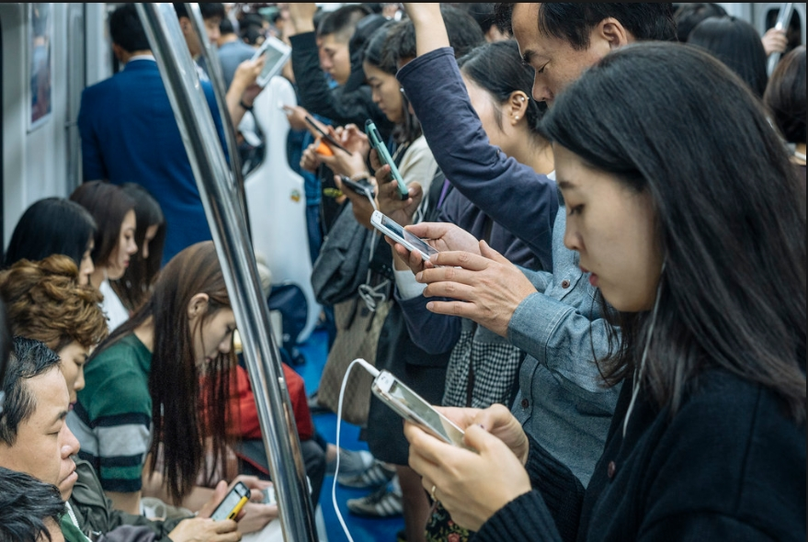
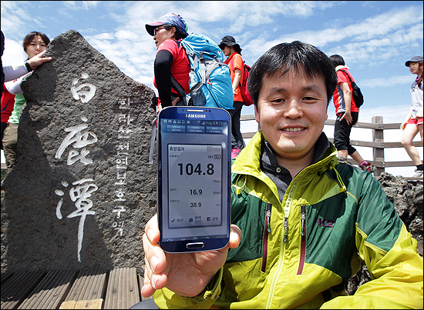
Korean culture – 1. IT powerhouse
5. https://www.youtube.com/watch?v=wr7UtYDG7Jo
Korea, which is called ‘IT ( Information Technology)’ powerhouse, has cell phone signals everywhere
In Korea, phone signals are good everywhere, such as subways, train, countryside, basement, and even mountains
Most places have Wi-Fi installed
Korean Culture
All the people on the subway look at their phone
Even the highest mountain in Korea has a good signal

Slide 34
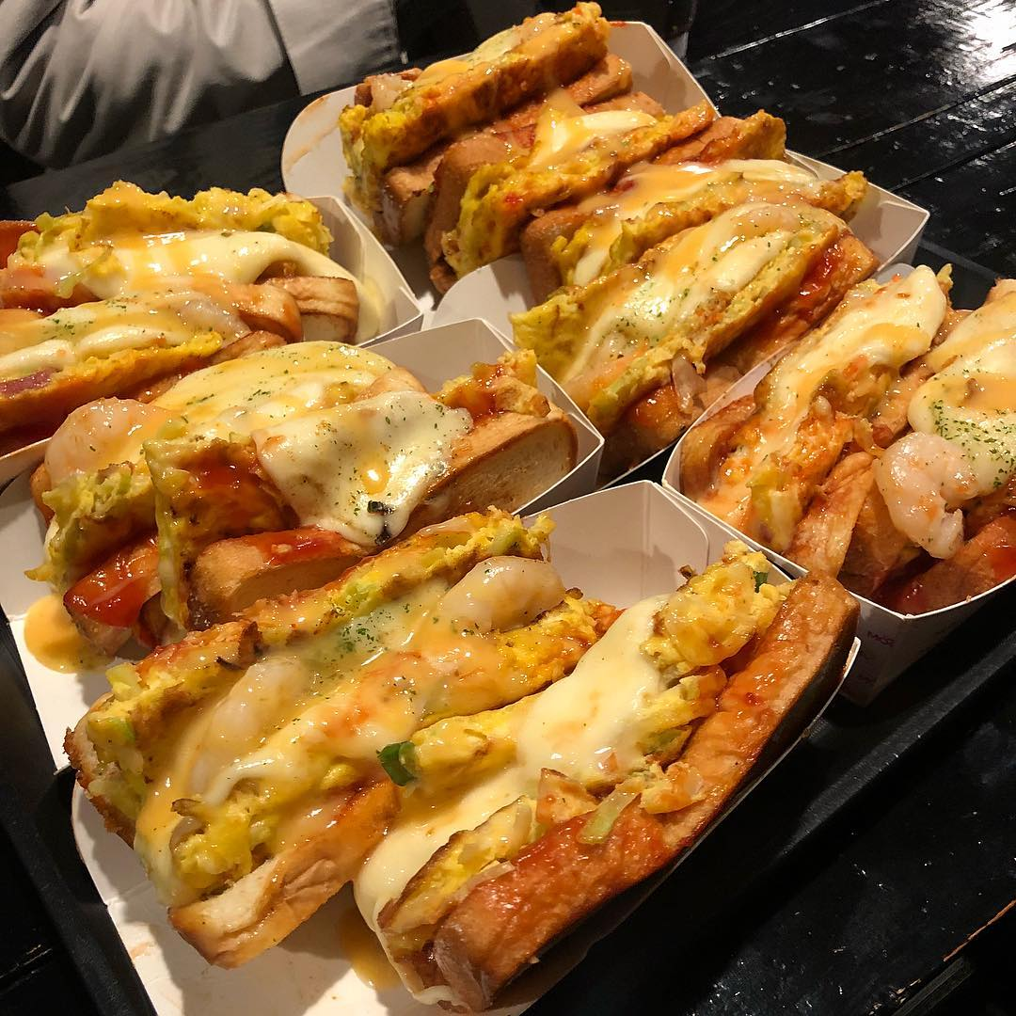
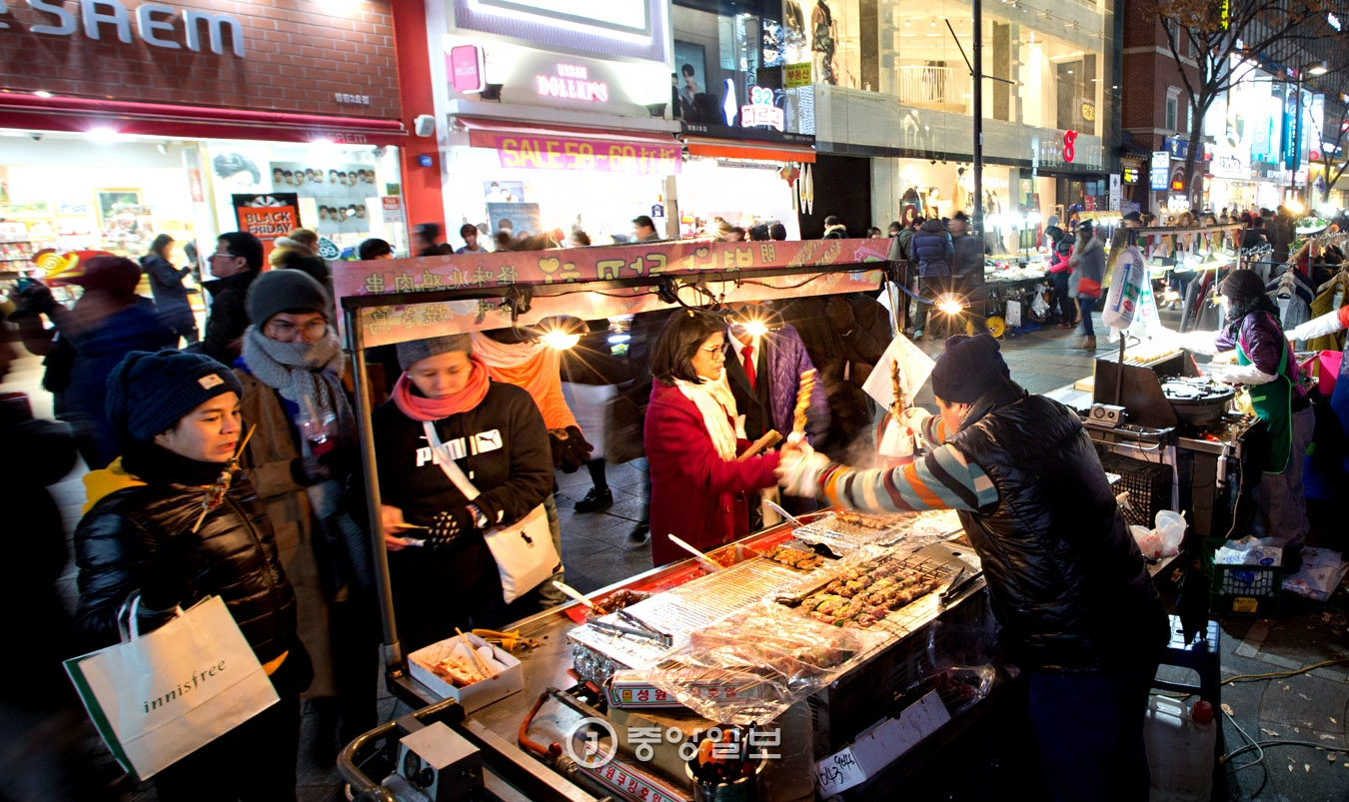
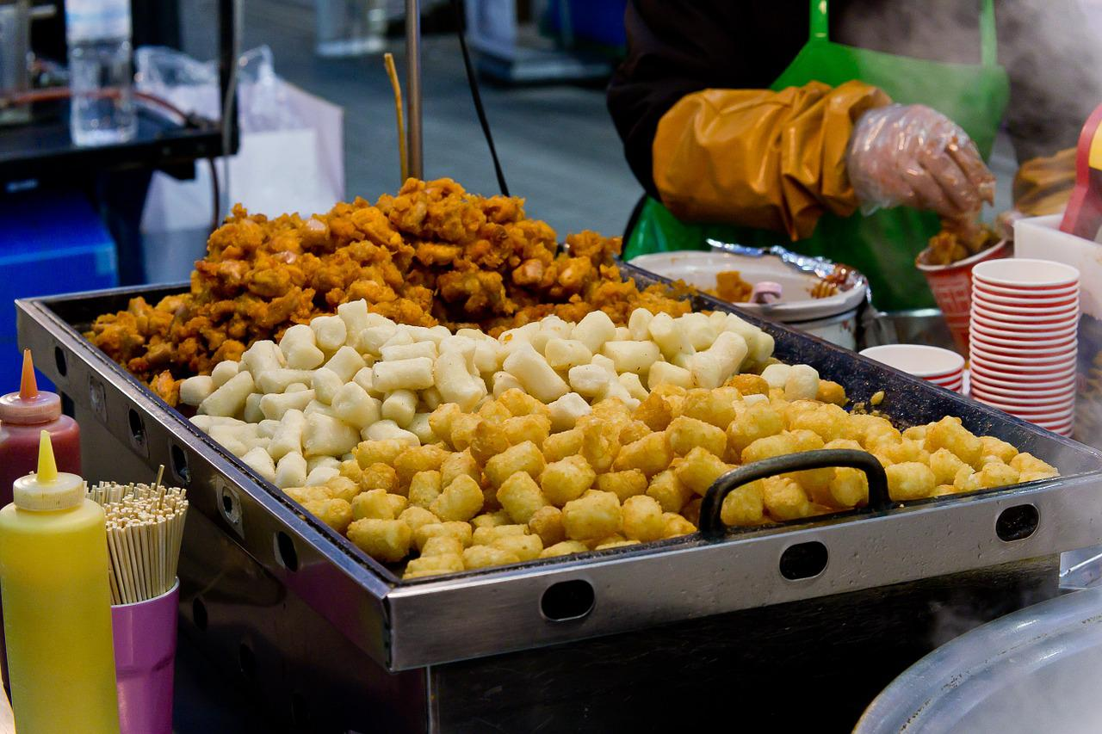
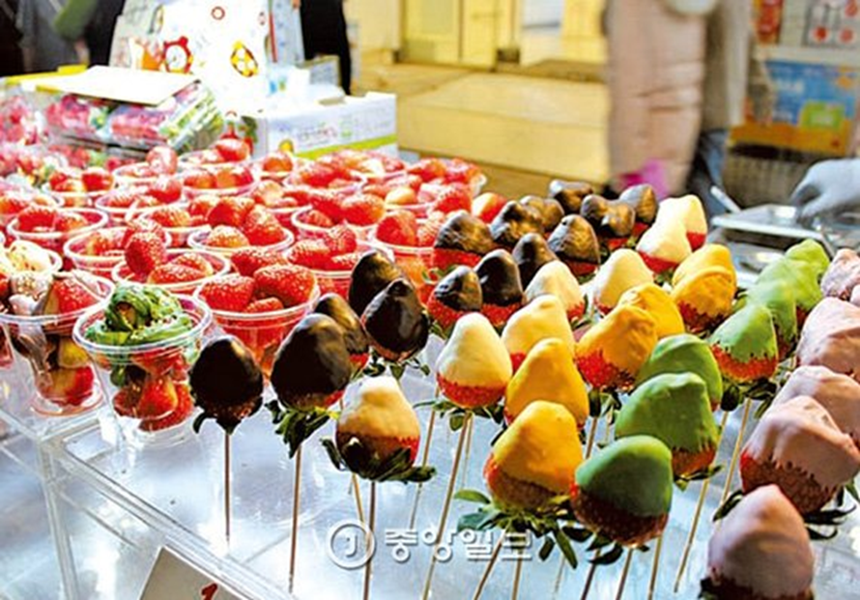
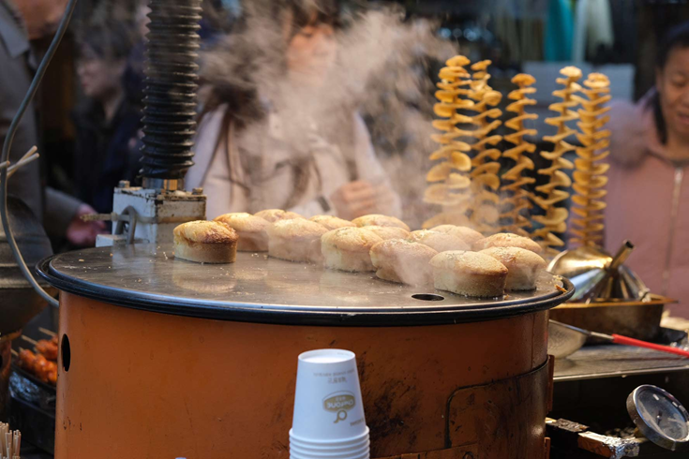
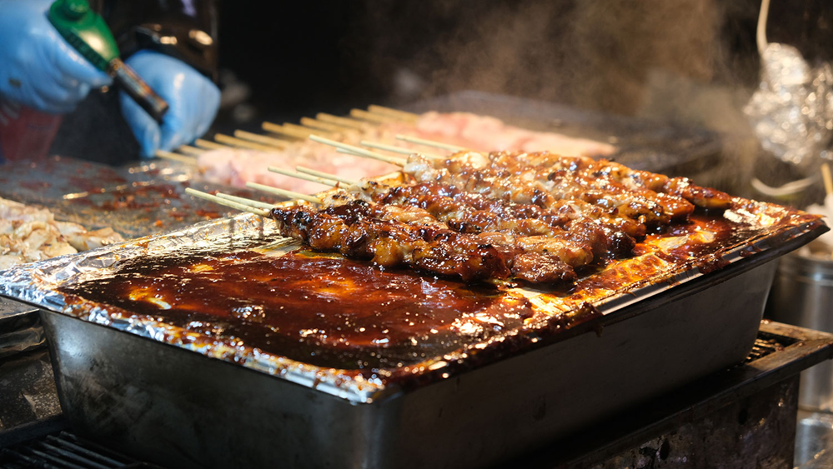
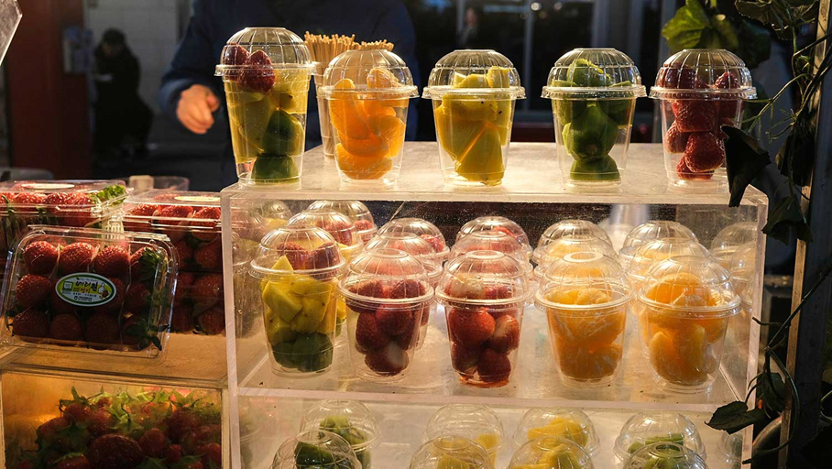
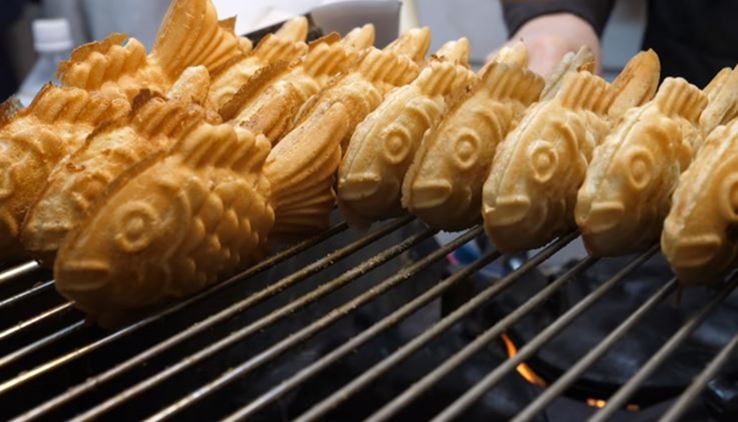
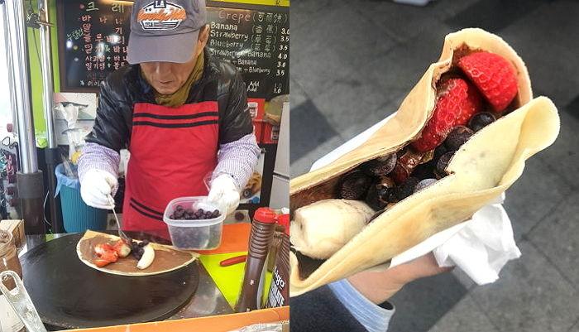
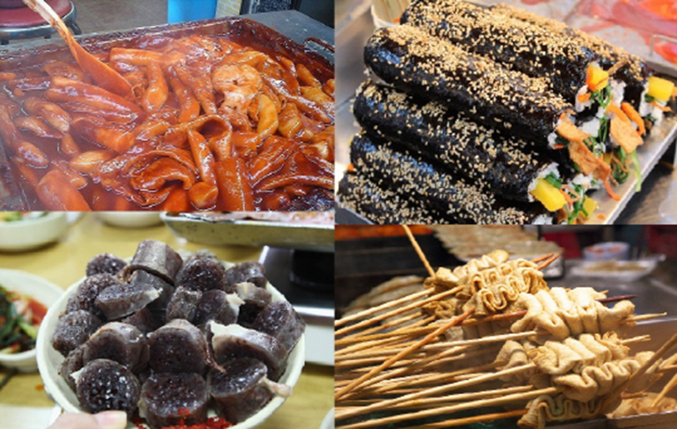
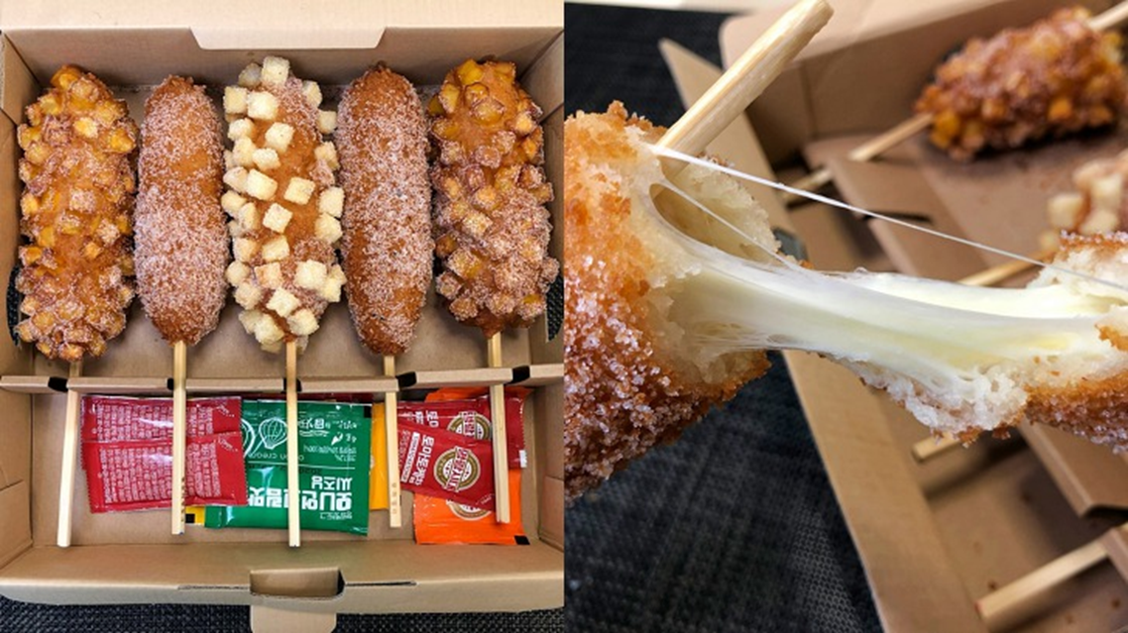
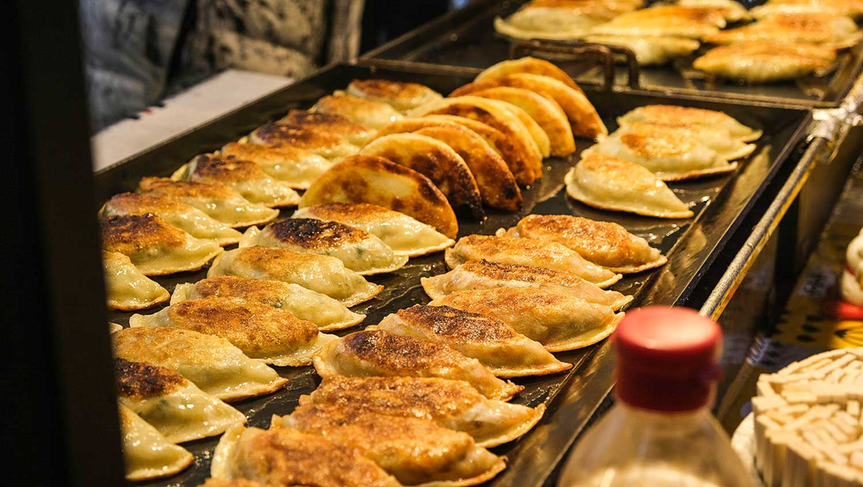
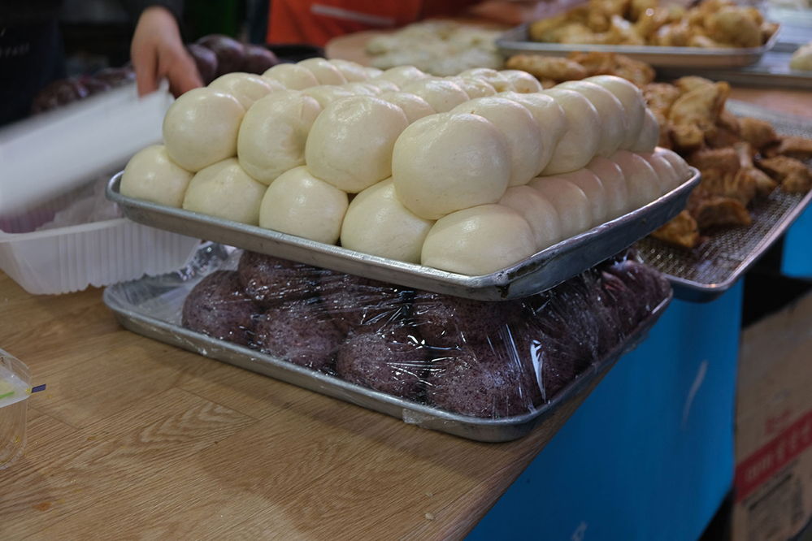
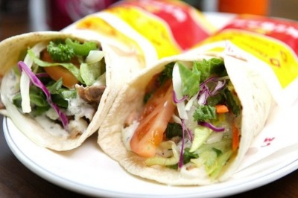
5. https://www.youtube.com/watch?v=wr7UtYDG7Jo
Vs.
Kebob,,
Korean ‘street food’
Most of these foods can be eaten within 20czk – 50czk

Slide 35
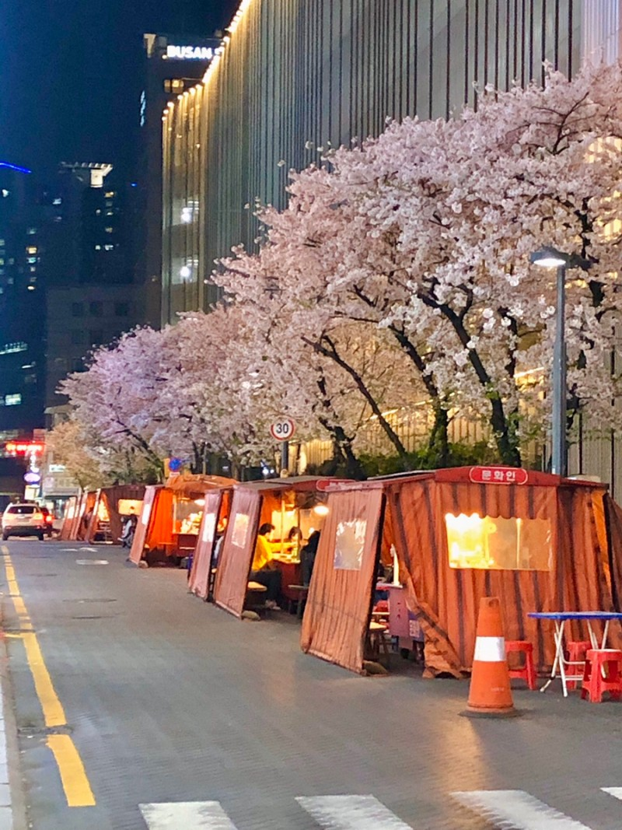
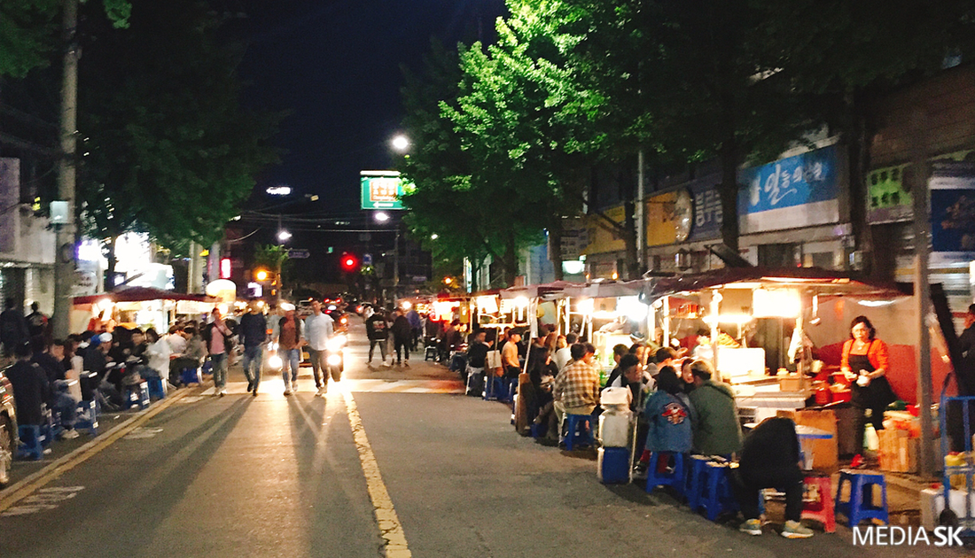
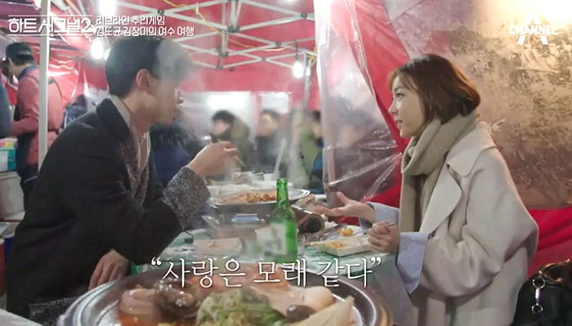
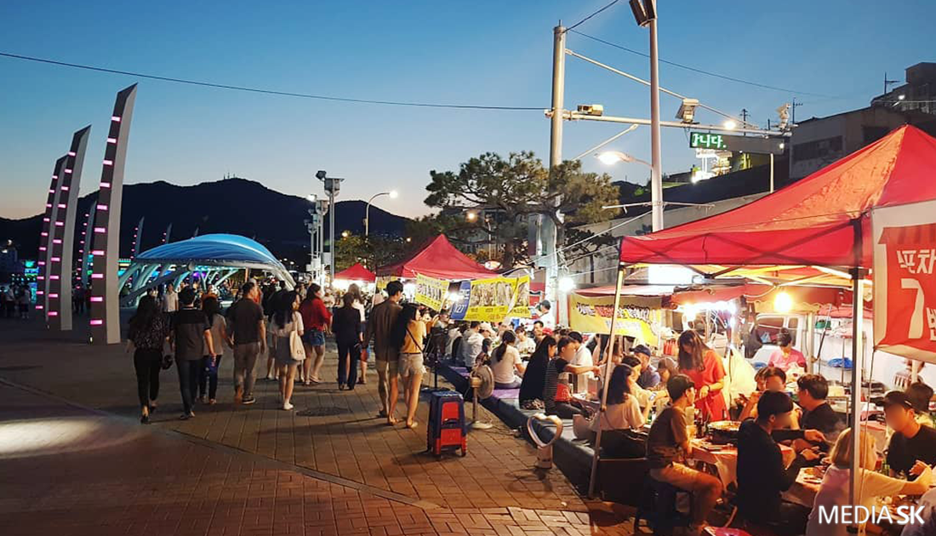
2. Sincere for food
5. https://www.youtube.com/watch?v=wr7UtYDG7Jo
포장마차[pojangmacha]
(snack cart)

Slide 36
2. Sincere for food
Koreans have a special affection for ‘MEAL’ (밥)
5. https://www.youtube.com/watch?v=wr7UtYDG7Jo
There are various expressions using ‘meal’
When you scold someone – 너 밥도 없을 줄 알아
When you trying to approach someone – 밥 한끼 같이 먹을래요?
When you’re thankful to someone- 야 내가 밥 한 번 살게
When you ask how someone doing – 밥은 먹고 사니?
When someone is sick – 밥 잘 챙겨 먹어
When we say goodbye to someone – 나중에 밥 한 번 먹자
Greeting – 밥 먹었어?
When we threat someone – 콩밥 먹고 싶냐?
You can’t eat meal if you keep doing like this
Do you want to have a meal with me?
Hey, I will buy a meal for you
Do you eat well these days?
Don’t skip meals and eat well
Let’s eat a meal later
Did you eat?
Do you want to eat rice with beans?

Slide 37
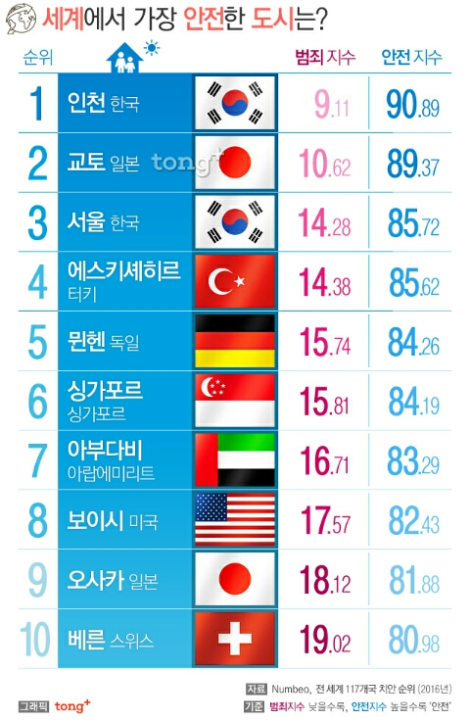
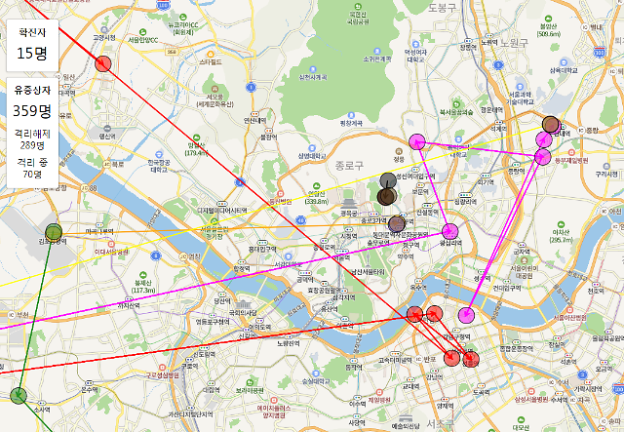
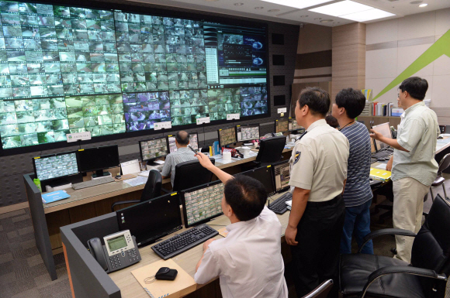
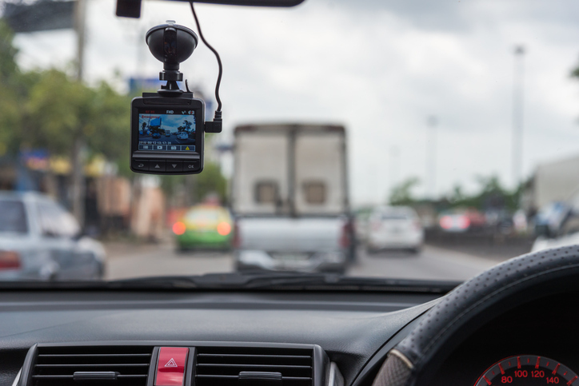
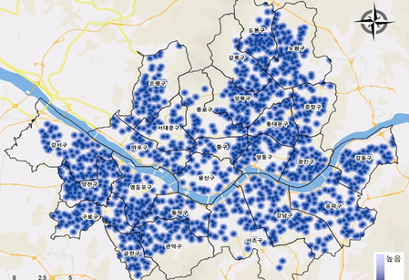
3. A country of good security
5. https://www.youtube.com/watch?v=wr7UtYDG7Jo
South Korea is the most secure country in the world
CCTV is installed everywhere in Seoul, and police officers monitoring the dangerous places through CCTV for 24 hours
Dispatch them immediately if there is a problem

Slide 38
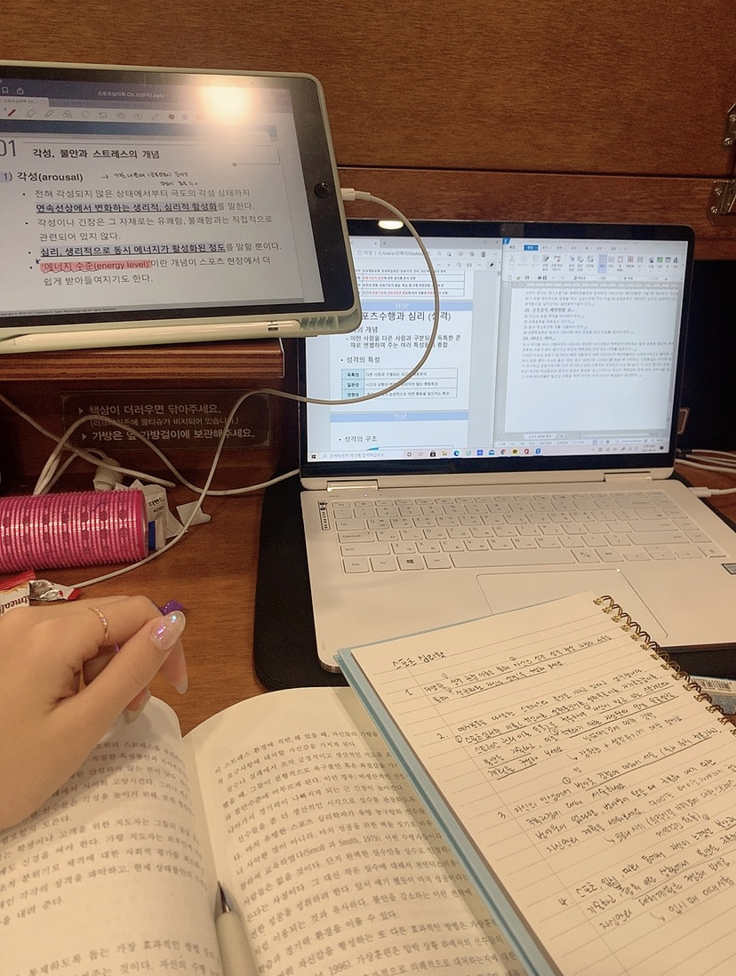
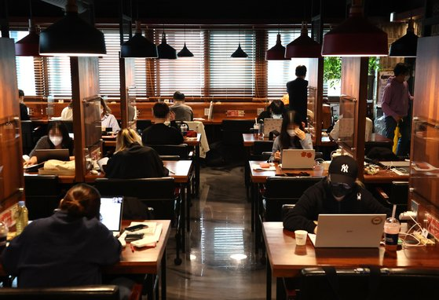
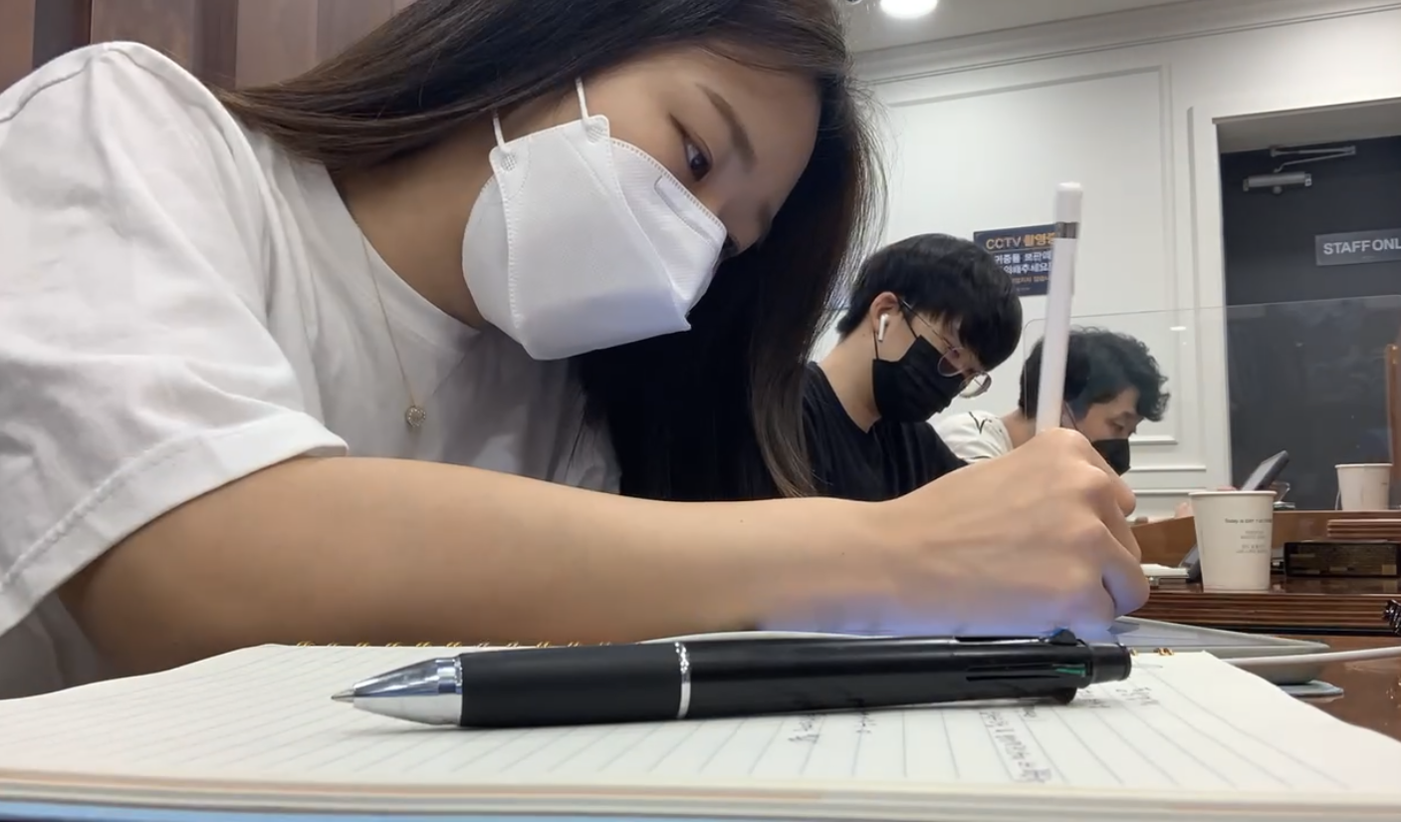
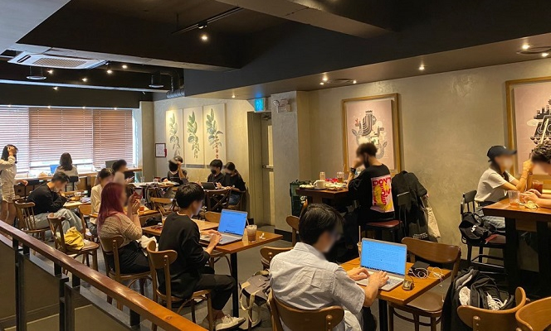
3. A country of good security
Korean’s creed : If it’s not mine, do not touch it
5. https://www.youtube.com/watch?v=wr7UtYDG7Jo
Koreans don’t touch other people’s things that aren’t their own, and in cafes where univ. students study a lot, they can see a lot of expensive electronic devices just placed on the table without their owners
https://www.youtube.com/watch?v=Ne4bfEb20lU

Slide 39
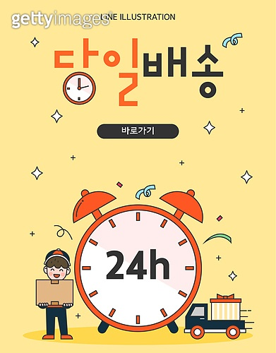
4. Fast country
5. https://www.youtube.com/watch?v=wr7UtYDG7Jo
Everything is fast in Korea
For example, the package arrives on the day, and if you order groceries at night ( 12a.m), it arrives in front of your door at 6 a.m
https://www.youtube.com/watch?v=MB_GN9N8mg4

Slide 40
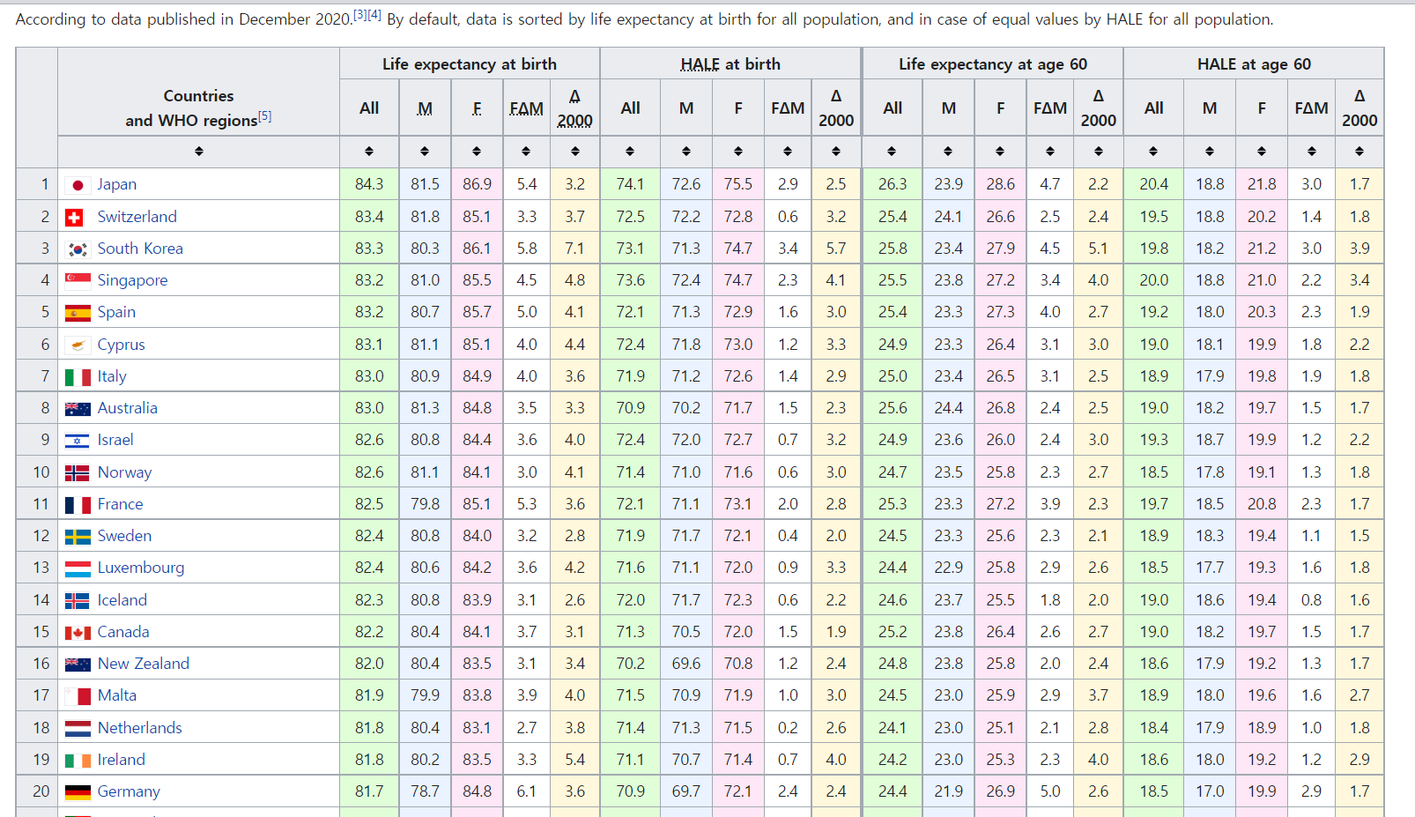
4. Fast and cheap healthcare system
5. https://www.youtube.com/watch?v=wr7UtYDG7Jo
https://www.youtube.com/watch?v=jm73iQudwzY
In some cases, you have to wait a lot to go to the hospital and make a reservation
But, in Korea, you can visit hospitals without a reservation and receive treatment on the same day & even if there is no insurance, foreigners can get treatment in a cheap cost

Slide 41
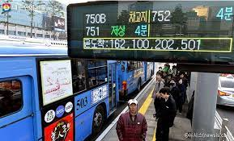
5. Other things
-All stores are open on the weekends and quite many shops are open even on holidays
The public transportation includes buses, subways and taxi arrive on time and can check where they are currently now
Most of public toilets are free
Also water is for free
5. https://www.youtube.com/watch?v=wr7UtYDG7Jo

Slide 42
Today’s K-pop
https://www.youtube.com/watch?v=nF1zZIETE5k
Twice – Alcohol-Free
TWICE "Alcohol-Free" M/V - YouTube

